Slide 1
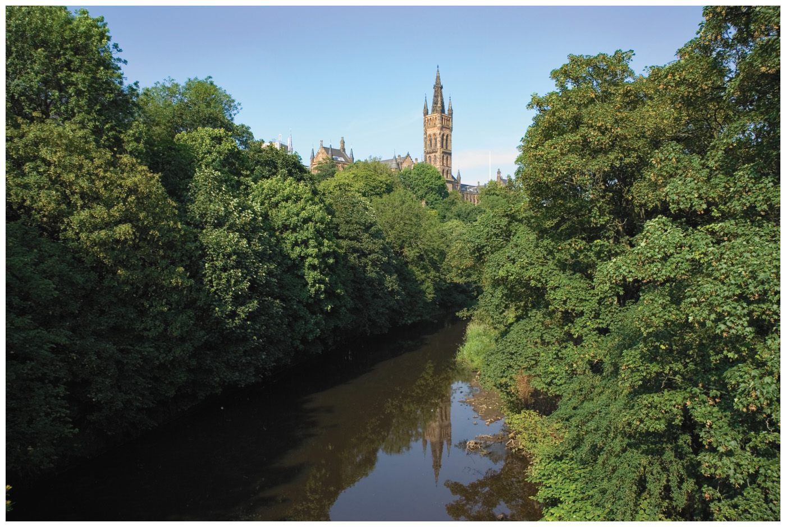
Chapter 5
Alkenes Structure, Nomenclature, and an introduction to Reactivity • Thermodynamics and Kinetics
Paula Yurkanis Bruice
University of California,
Santa Barbara

Slide 2
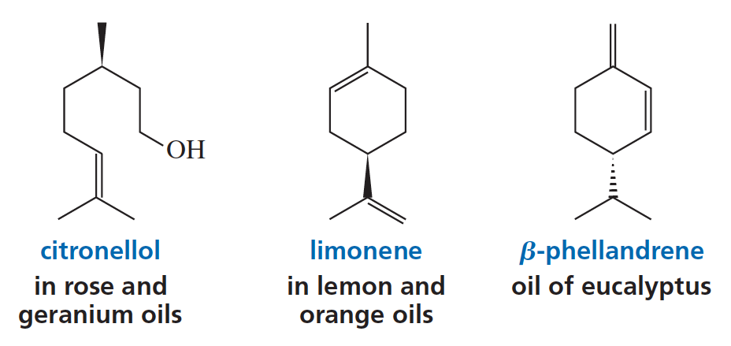



Alkenes

Slide 3
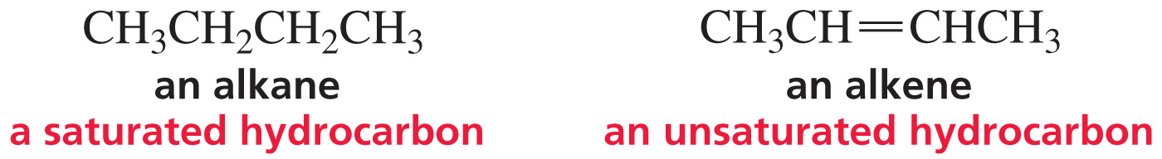
Saturated and
Unsaturated Hydrocarbons
Saturated hydrocarbons have no double bonds.
Unsaturated hydrocarbons have one or more double bonds.

Slide 4
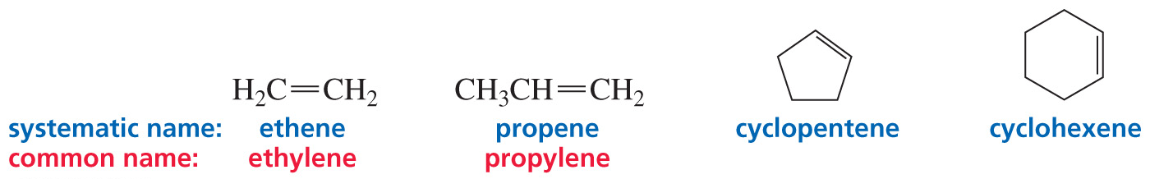
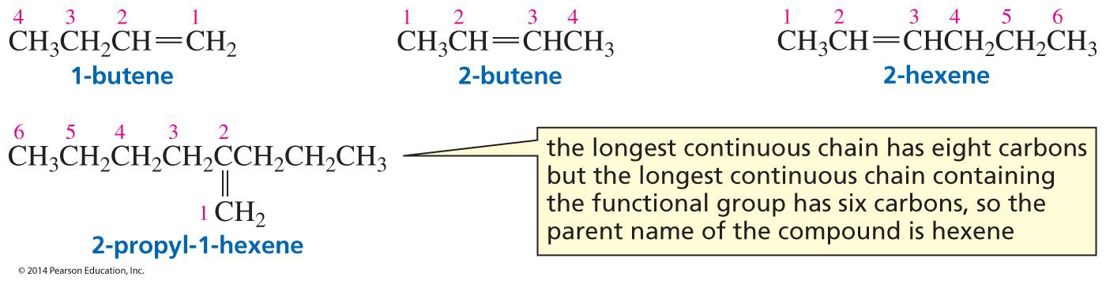
Nomenclature of Alkenes
Replace “ane” of alkane with “ene.”
The functional group gets the lowest possible number.
Notes:
4

Slide 5
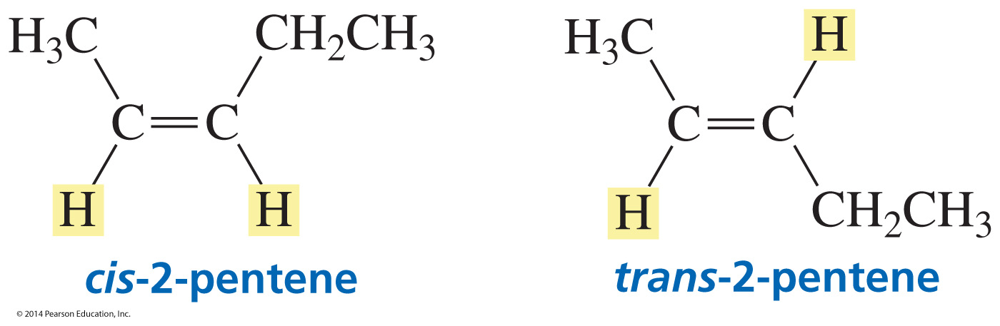
Stereoisomers of an Alkene are named using a cis or trans Prefix

Slide 6
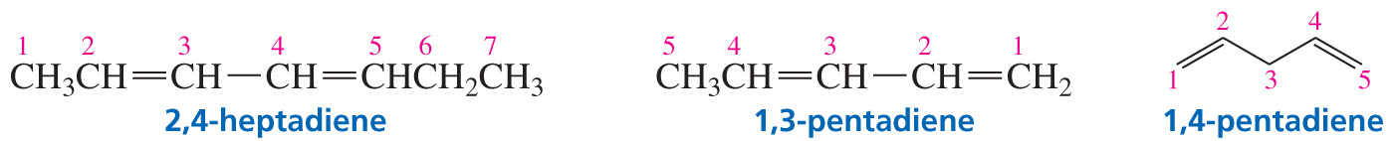
Nomenclature of Dienes
two double bonds = diene

Slide 7
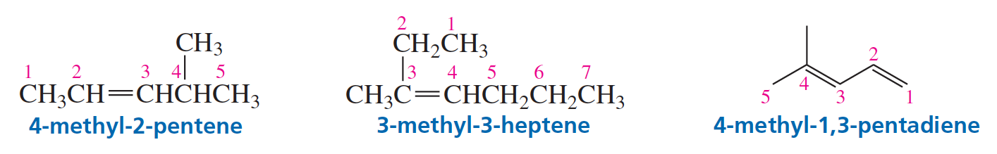
Nomenclature of Alkenes
Number in the direction so that the functional group gets the lowest number.

Slide 8
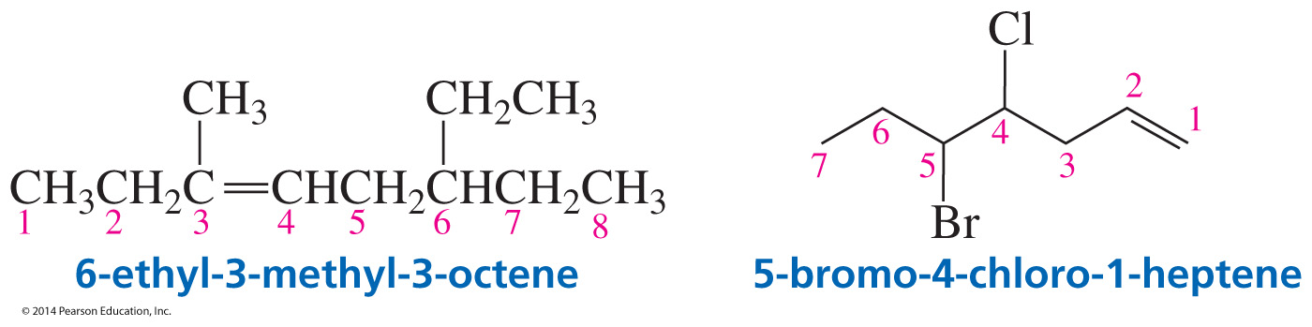
Nomenclature of Alkenes
Substituents are stated in alphabetical order.

Slide 9
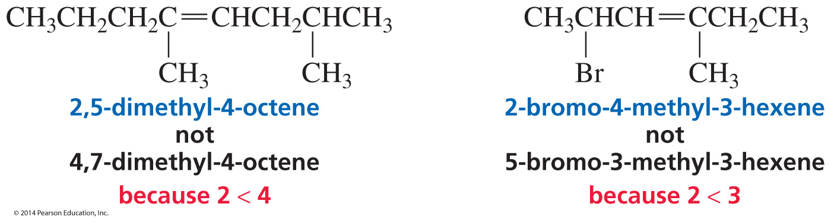
Nomenclature of Alkenes

Slide 10
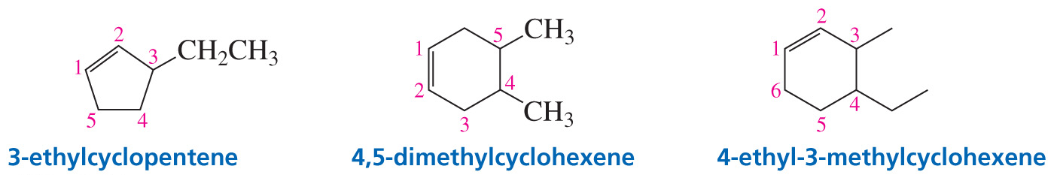
Nomenclature of Cyclic Alkenes
A number is not needed to denote the position of the functional group; it is always between C1 and C2.

Slide 11
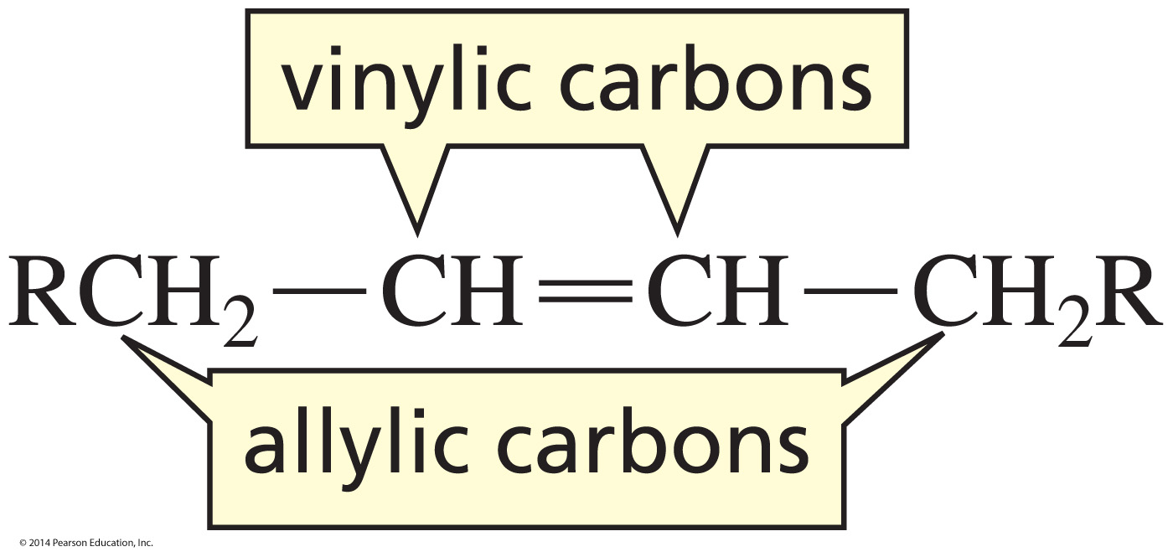
Vinylic and Allylic Carbons
vinylic carbon: the sp² carbon of an alkene
allylic carbon: a carbon adjacent to a vinylic carbon

Slide 12
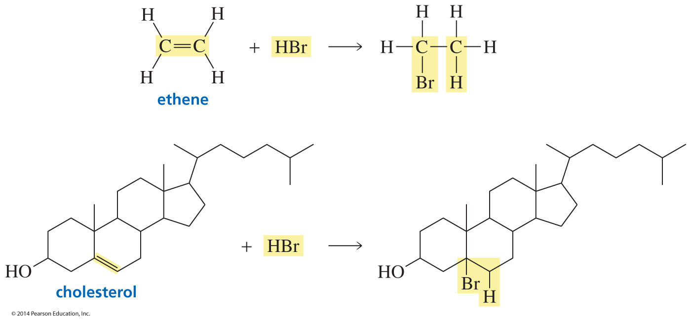
Reactions of Organic Compounds
Organic compounds can be divided into families.
All members of a family react in the same way. The family a compound belongs to, depends on its functional group.
Notes:
12

Slide 13
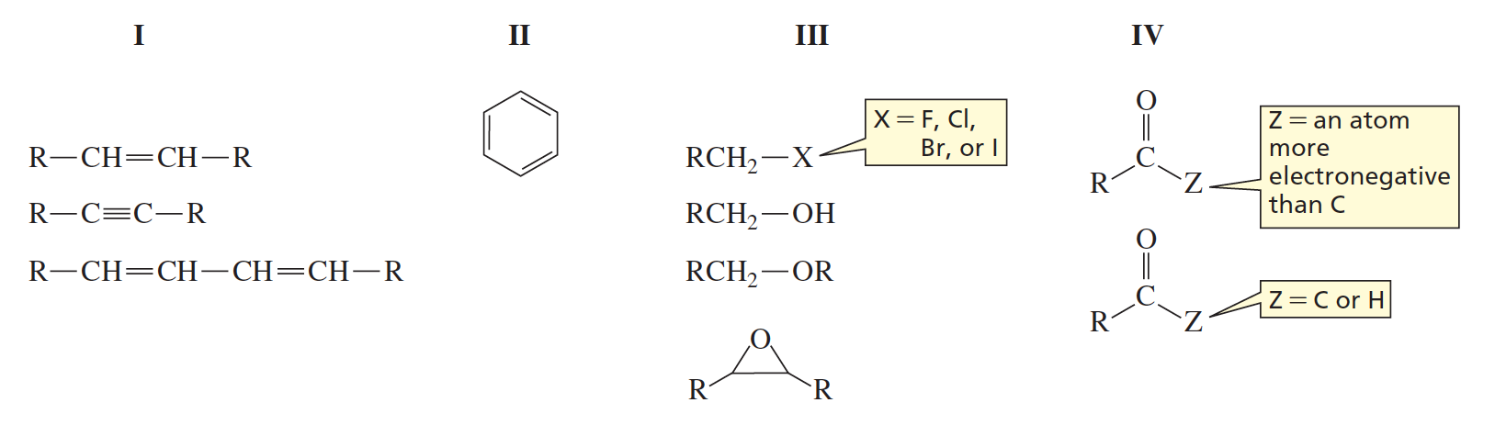
Each family can be put in one
of four Groups
The families in a group react in similar ways.

Slide 14
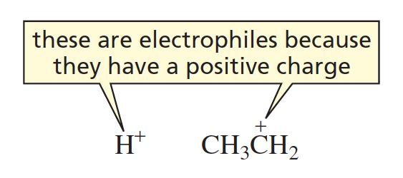
Electrophiles

Slide 15
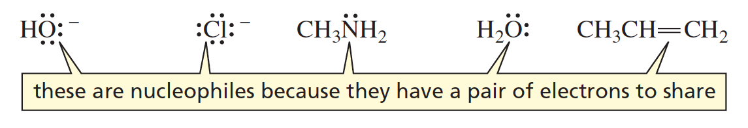
Nucleophiles
A nucleophile has
a negative charge
a lone pair
a double bond

Slide 16
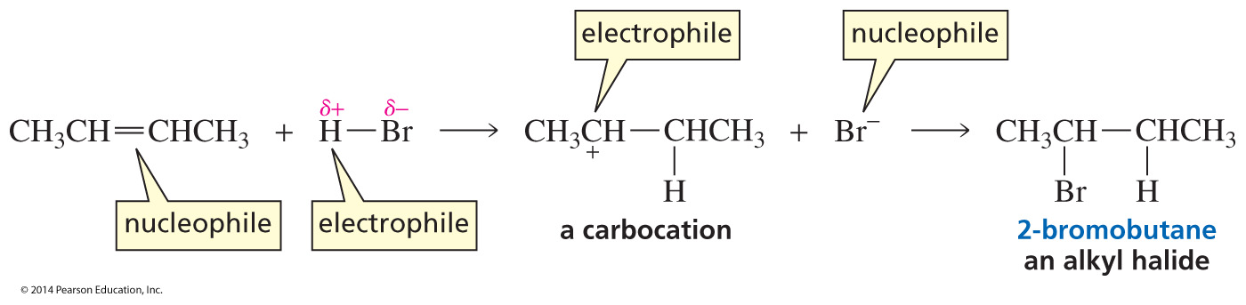
A Nucleophile reacts
with an Electrophile
Your first organic reaction is a two-step reaction.

Slide 17
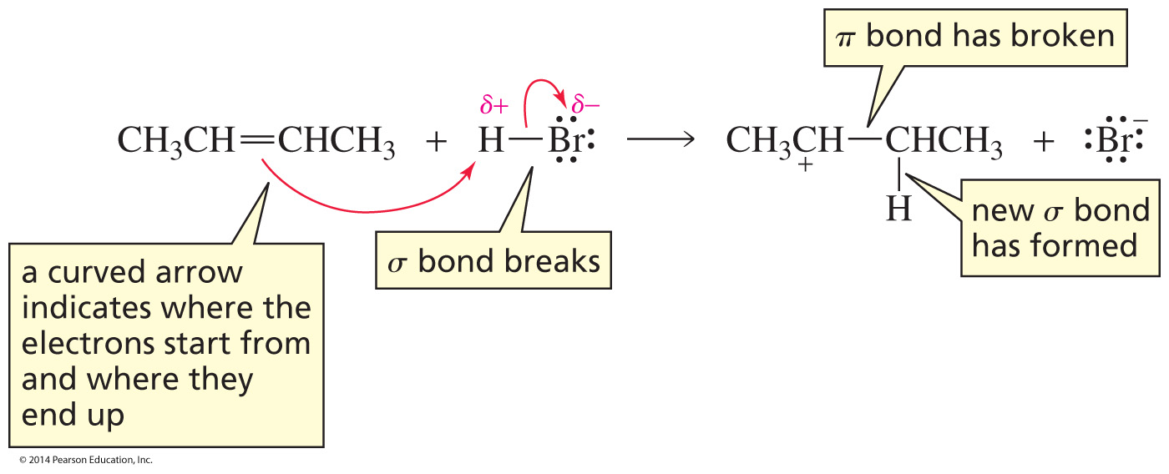
Curved Arrows
first step of the reaction
Curved arrows are used to show the mechanism of a reaction.
The mechanism of a reaction is the step-by-step description of the process by which reactants are converted into products.

Slide 18
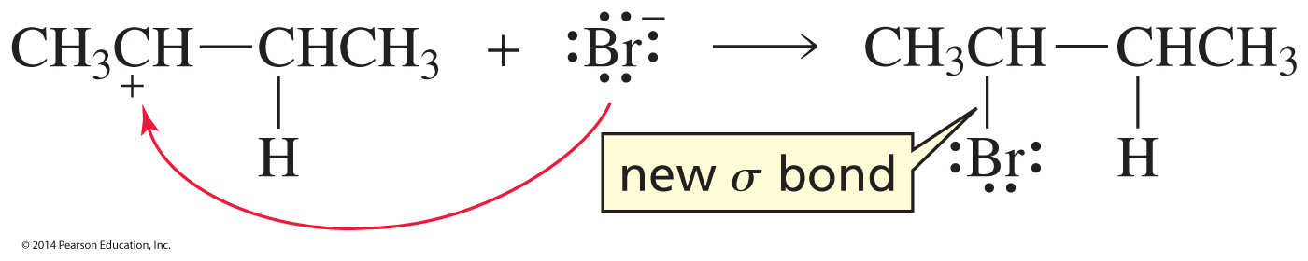
Curved Arrows
second step of the reaction
The curved arrow shows where the electrons start from
and where they end up.

Slide 19
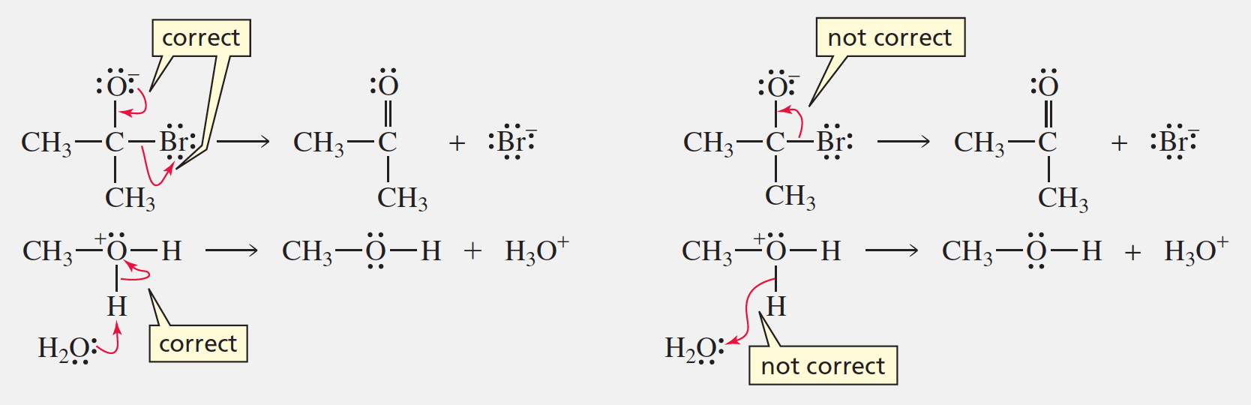
How to draw Curved Arrows

Slide 20
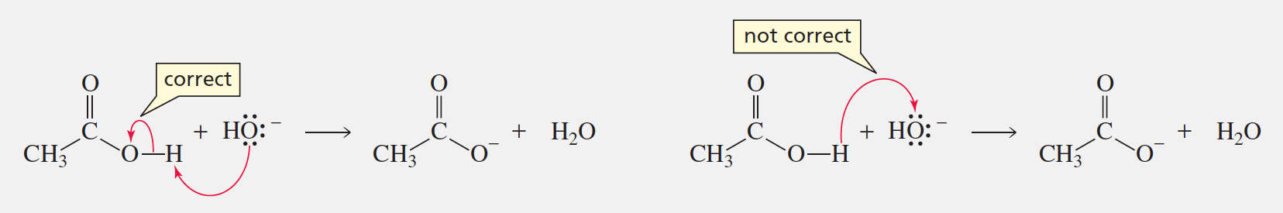
How to draw Curved Arrows

Slide 21
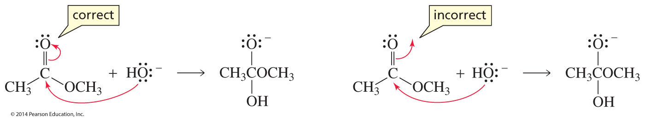
How to draw Curved Arrows

Slide 22
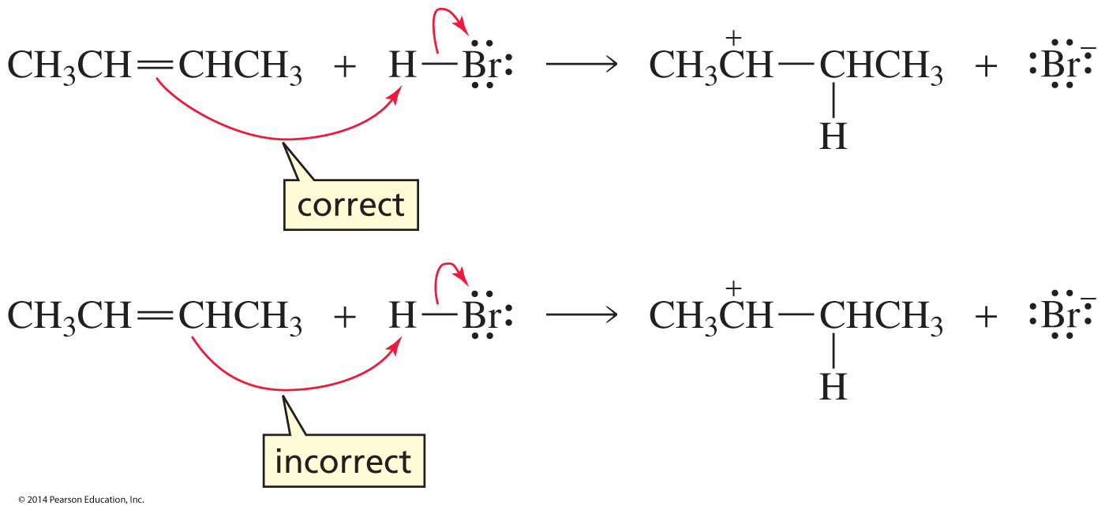
How to draw Curved Arrows

Slide 23
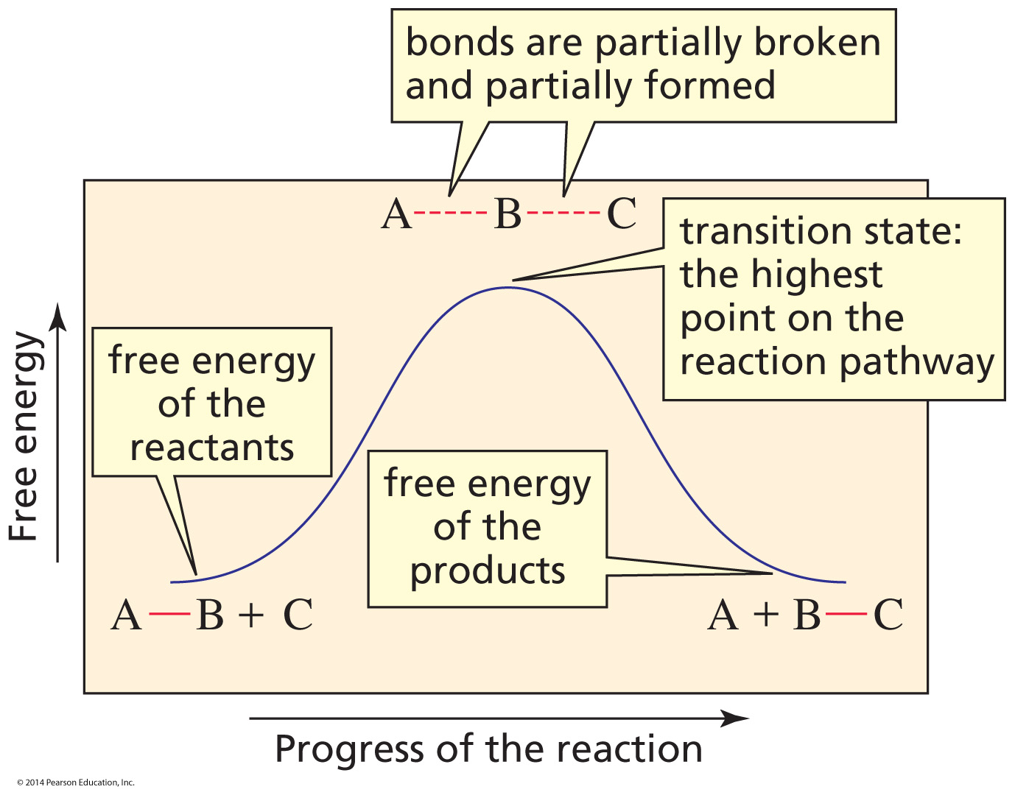
A Reaction Coordinate Diagram
A reaction coordinate diagram shows the energy changes that take place in each step of a reaction.

Slide 24
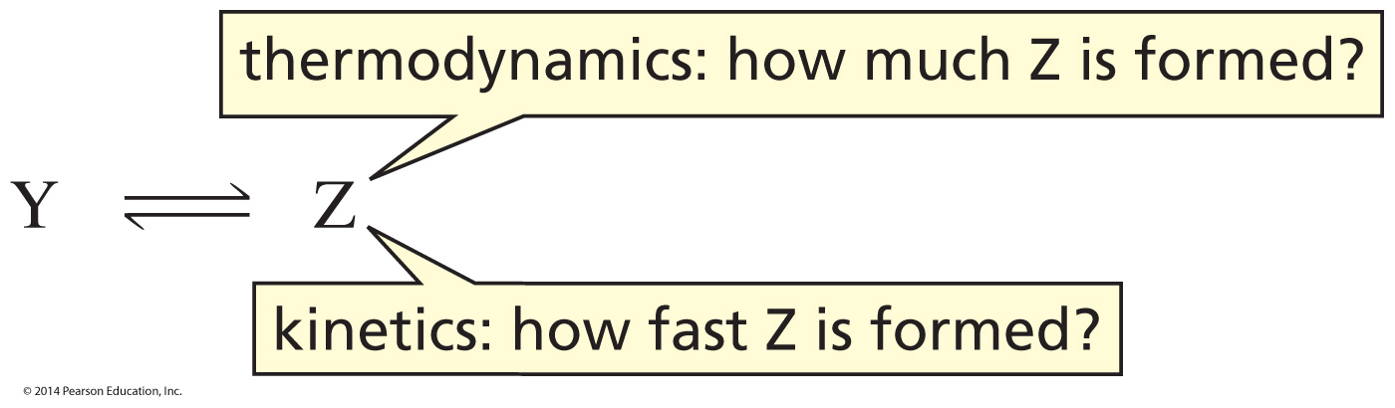
Thermodynamics and Kinetics
influenced by the relative stability of the products
influenced by the rate of product formation

Slide 25
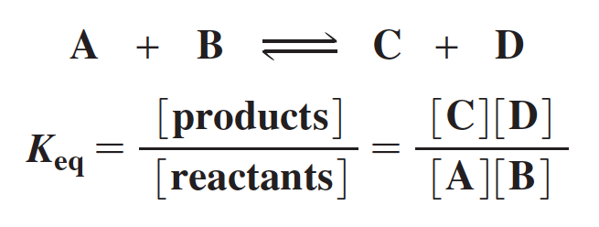
The Equilibrium Constant
The equilibrium constant gives the concentration of reactants and products at equilibrium.

Slide 26
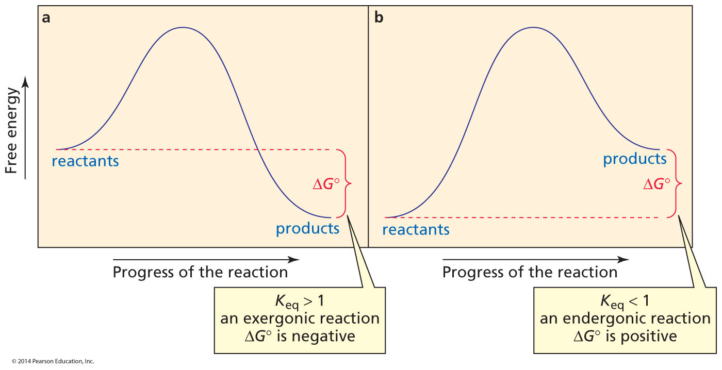
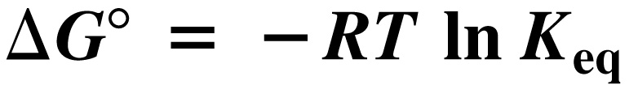
Exergonic and Endergonic Reactions

Slide 27

Gibbs Free-Energy Change (∆G°)
ΔG° = free energy of the products – free energy of the reactants
ΔH° = heat required to break bonds – heat released from forming bonds
ΔS° = freedom of motion of the products – freedom of motion of the reactants

Slide 28
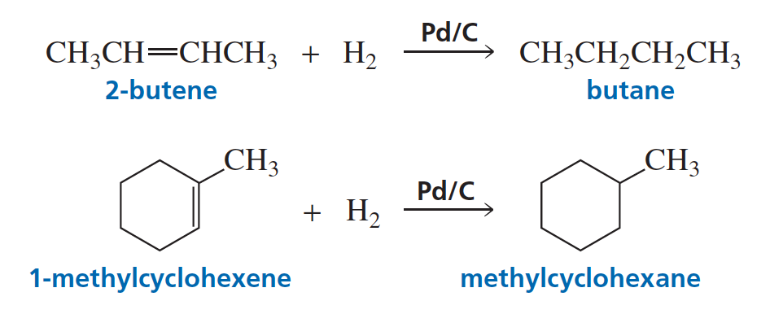
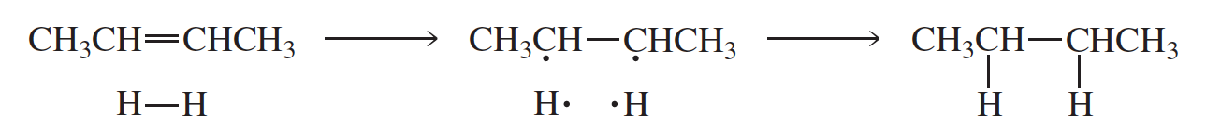
A Reduction Reaction

Slide 29
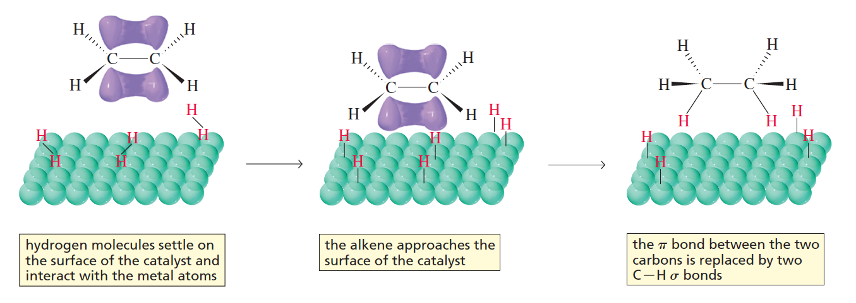
Catalytic Hydrogenation

Slide 30
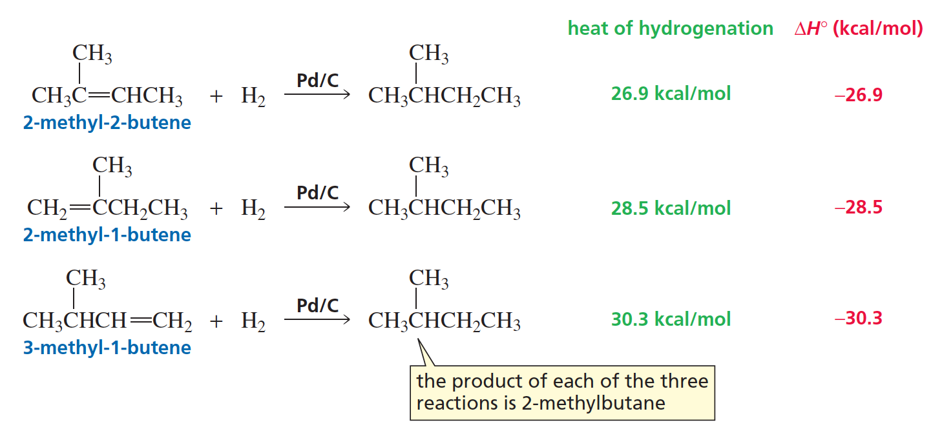
Using ∆H° Values to determine
the Relative Stabilities of Alkenes

Slide 31
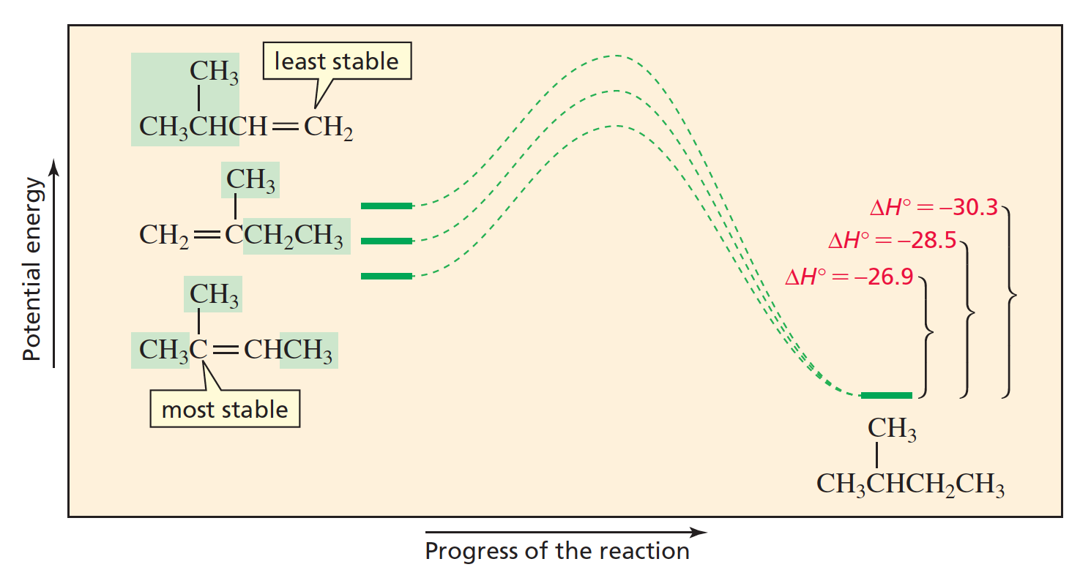
Using ∆H° Values to determine
the Relative Stabilities of Alkenes
The relative energies (stabilities) of three alkenes that can be catalytically hydrogenated to 2-methylbutane. The most stable alkene has the smallest heat of hydrogenation. (Notice that when a reaction coordinate diagram shows ∆H° values, the y-axis is potential energy; when it shows ∆G°values, the y-axis is free energy [Figure 5.2].)

Slide 32
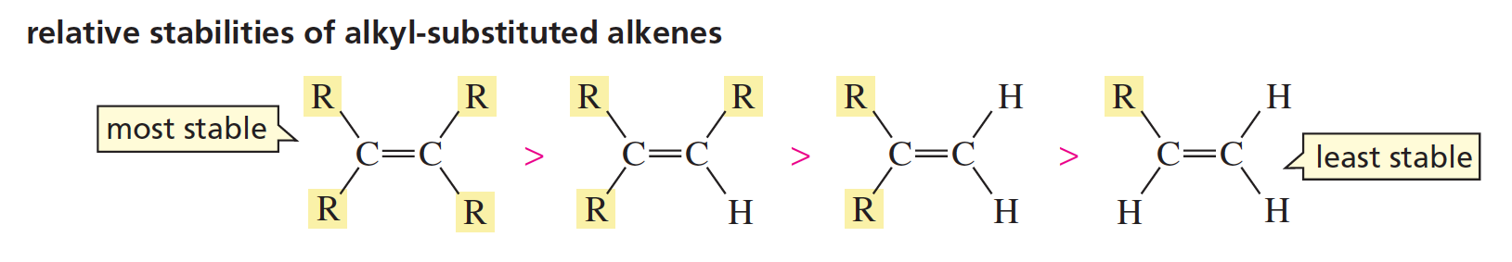
Relative Stabilities of Alkenes

Slide 33
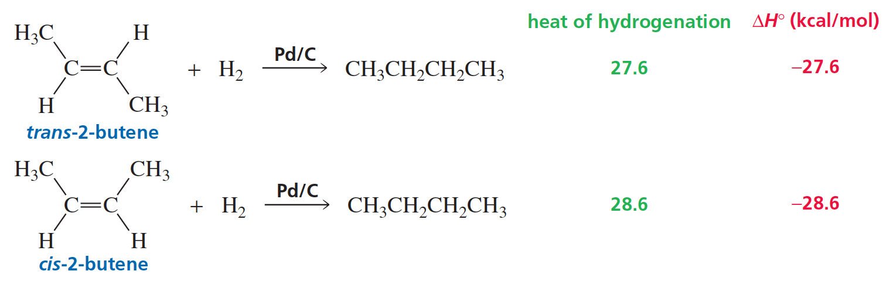
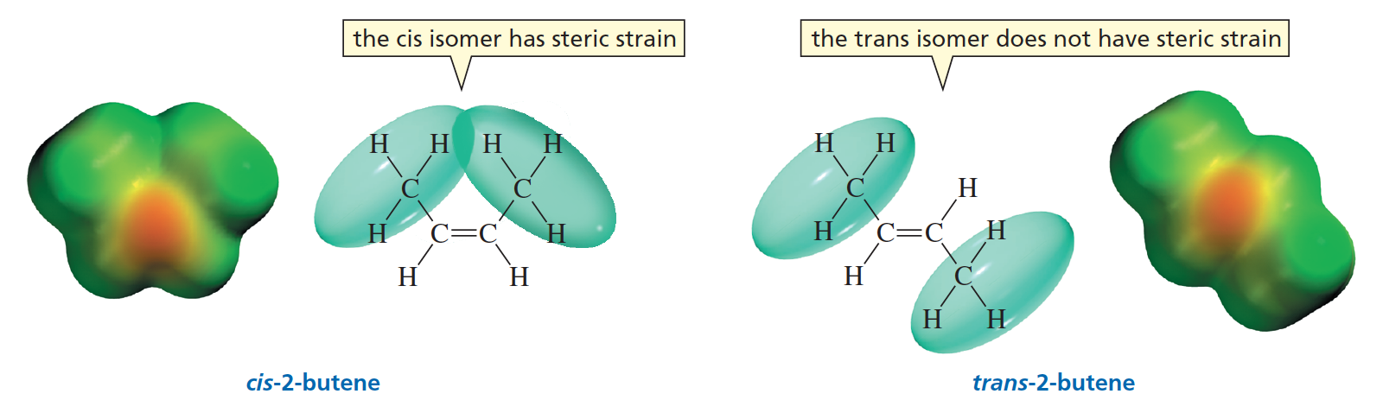
Relative Stabilities of
Cis and Trans Alkenes

Slide 34
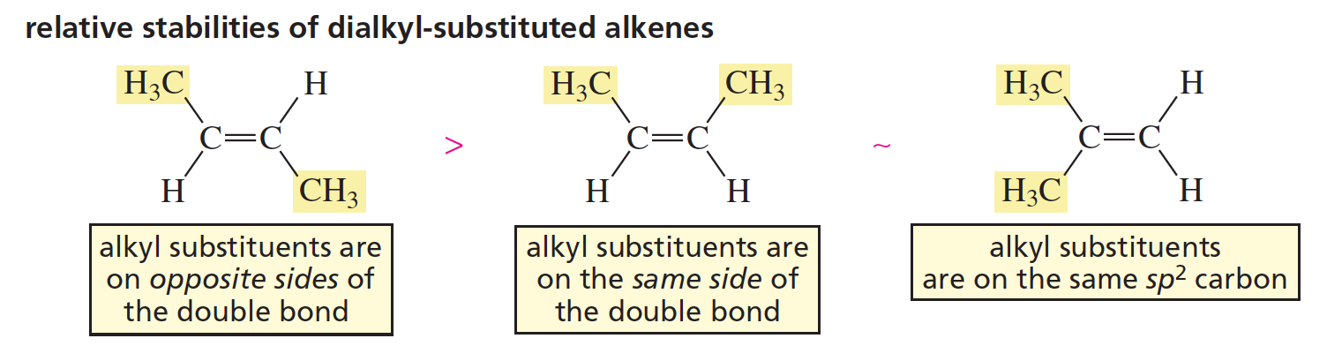
Relative Stabilities of
Dialkyl-Substituted Alkenes

Slide 35
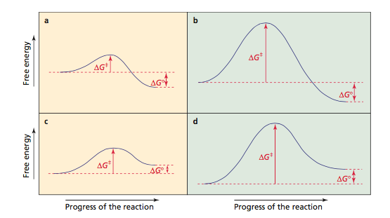
Kinetics: How fast is the
product formed?
∆G‡ = free energy of the transition state - free energy of the reactants
The greater the energy barrier, the slower the reaction.

Slide 36
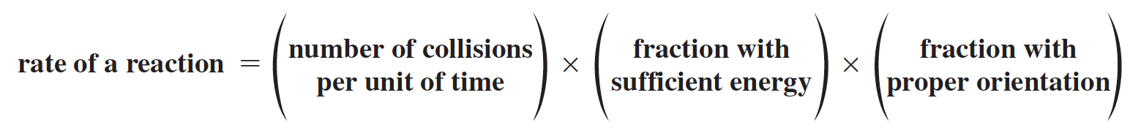
Rate of a Reaction
Increasing the concentration increases the rate.
Increasing the temperature increases the rate.
The rate can also be increased by a catalyst.

Slide 37
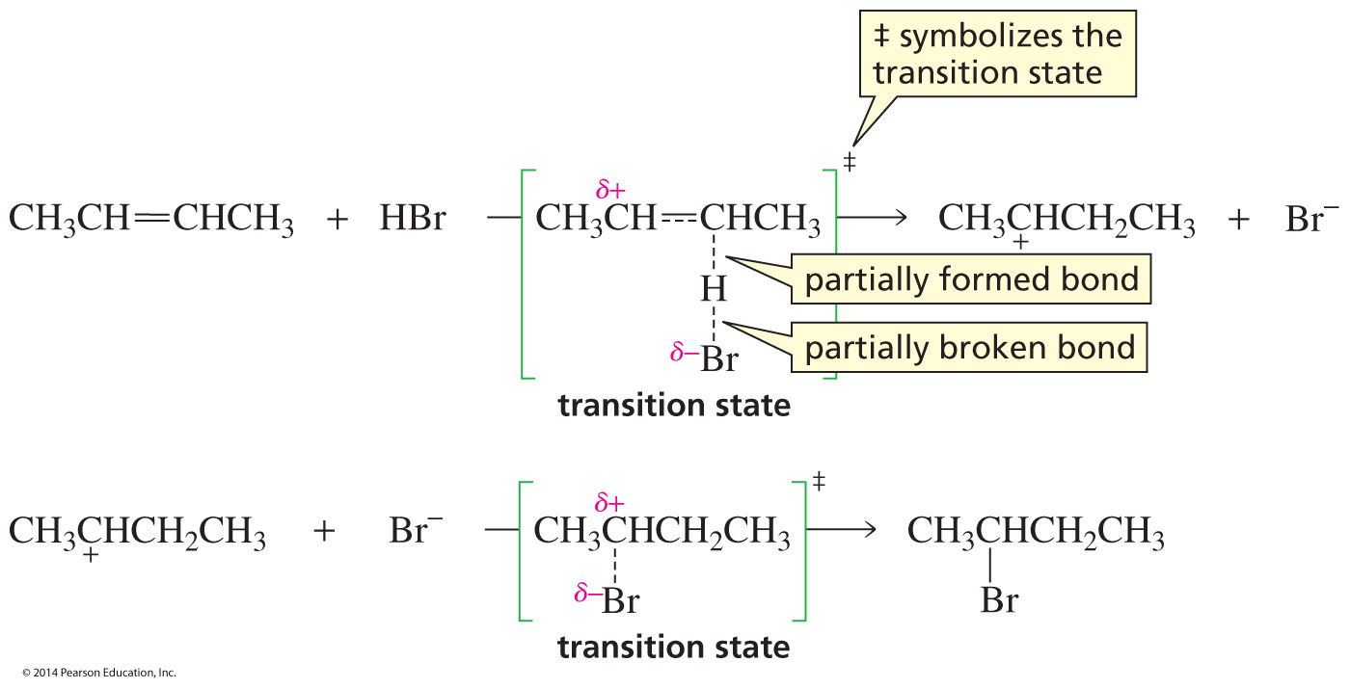
An Electrophilic Addition Reaction
Transition states have partially formed bonds.

Slide 38
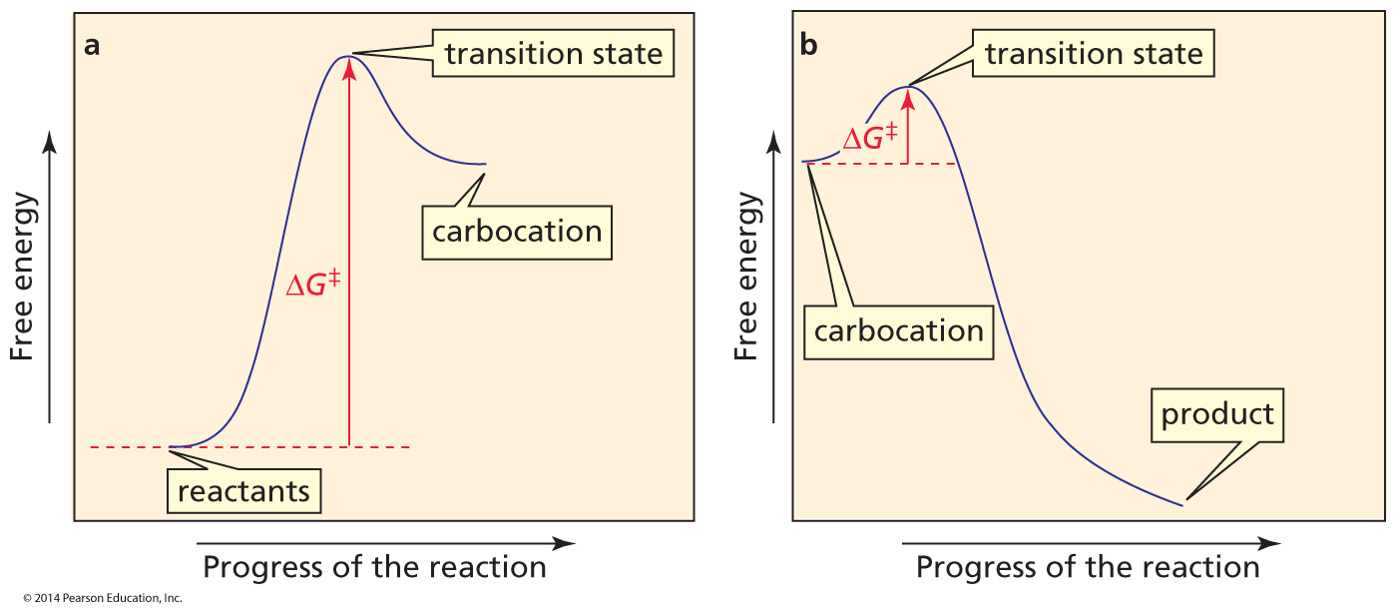
Reaction Coordinate Diagram for each step
of the addition of HBr to 2-Butene

Slide 39
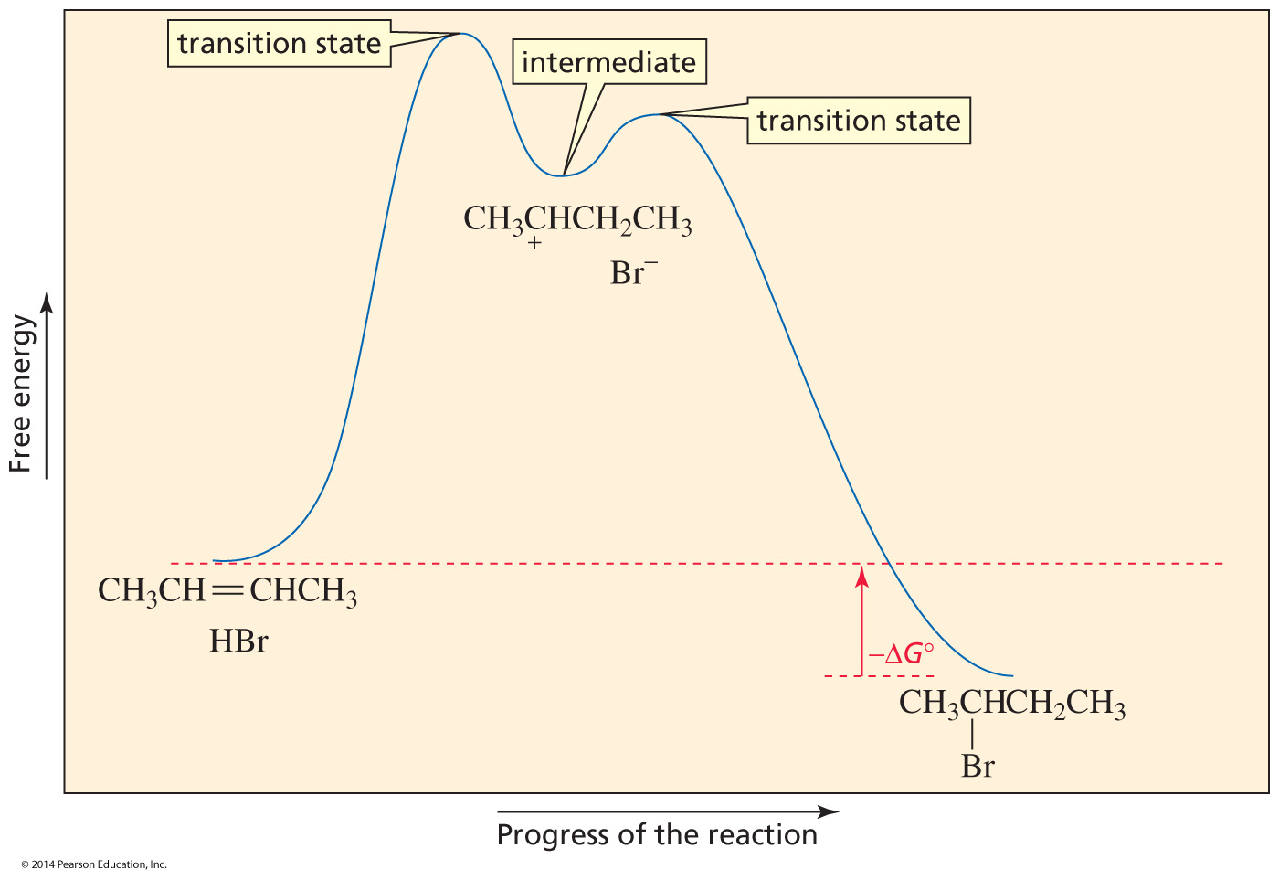
Reaction Coordinate Diagram for the addition of HBr to 2-Butene
The rate-limiting step of the reaction is the step that has its transition state at the highest point of the reaction coordinate diagram.

Slide 40
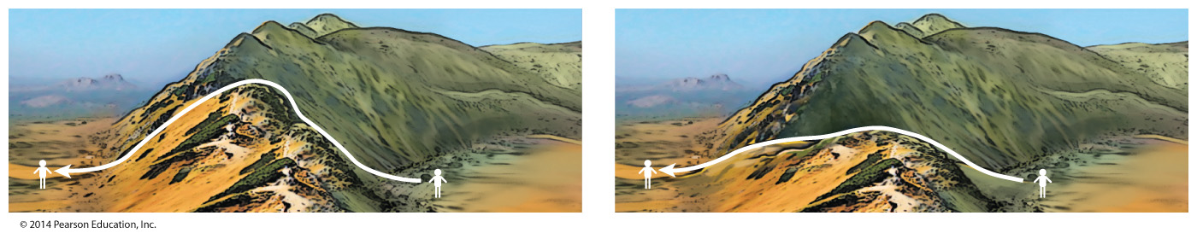
A Catalyst
A catalyst provides a pathway for a reaction with a lower energy barrier.
A catalyst does not change the energy of the starting point (the reactants) or the energy of the end point (the products).

Slide 41
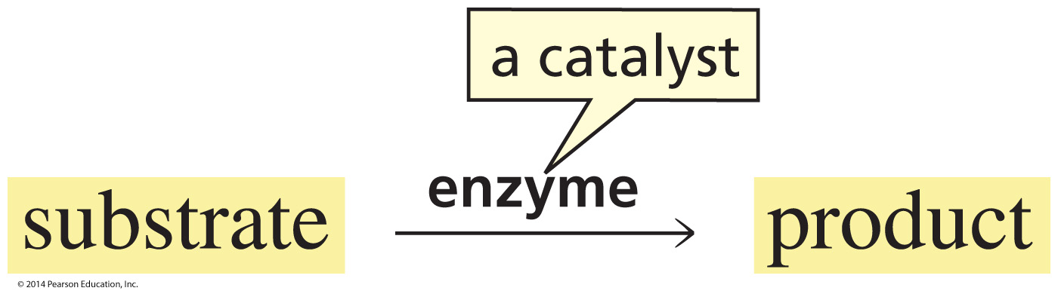
Enzymes
Most biological reactions require a catalyst.
Most biological catalysts are proteins called enzymes.
The reactant of a biological reaction is called a substrate.

Slide 42
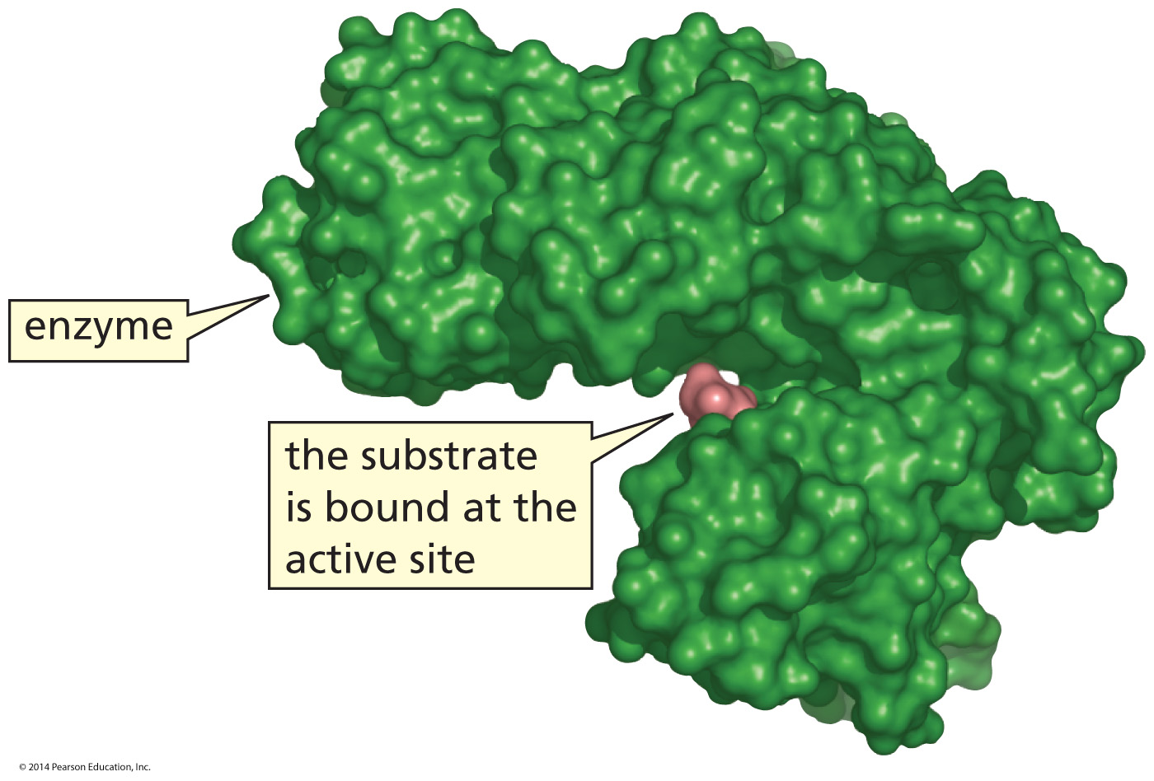
The Active Site of an Enzyme
An enzyme binds its substrate at its active site.

Slide 43
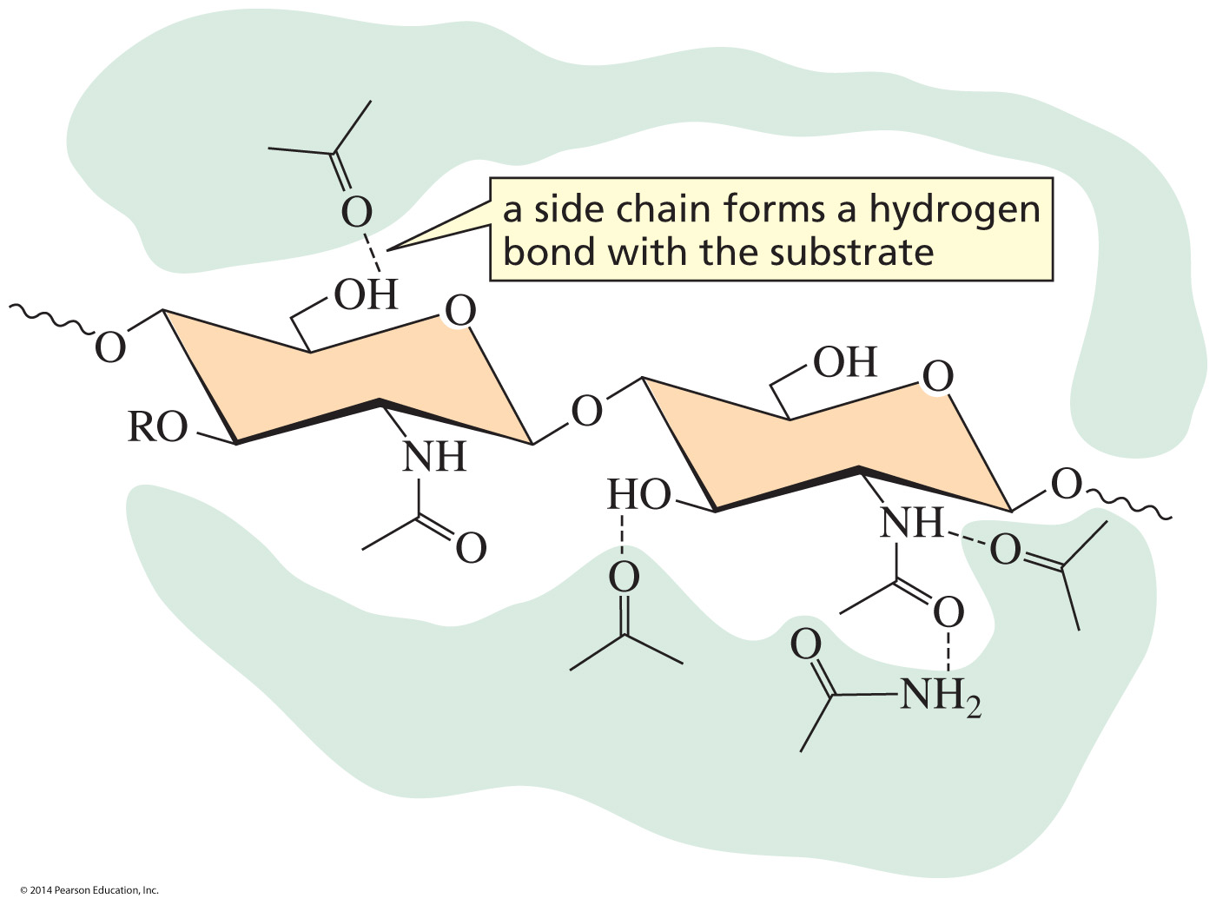
Enzyme Side Chains that
bind the Substrate
Some enzyme side chains bind the substrate.
Some enzyme side chains are acids, bases, and nucleophiles
that catalyze the reaction.

Slide 44
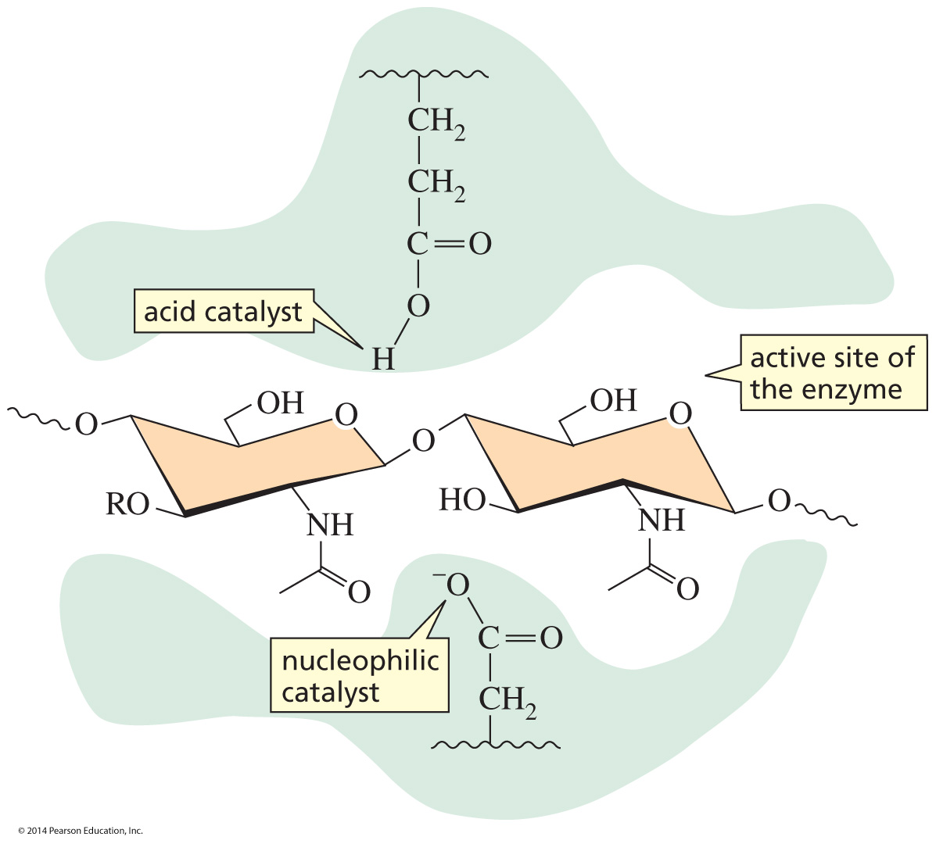
Enzyme Side Chains that
catalyze the Reaction
Some enzyme side chains are acids, bases, and nucleophiles
that catalyze the reaction.

