Slide 1
Chapter Fifteen
Advertising and Public Relations

Slide 2
Advertising and Public Relations
Topic Outline
Advertising
Setting Advertising Objectives
Setting the Advertising Budget
Developing Advertising Strategy
Evaluating Advertising Effectiveness and Return on Advertising Investment
Public Relations
The Role and Impact of Public Relations
Major Public Relations Tools

Slide 3
Advertising
Advertising is any paid form of non-personal presentation and promotion of ideas, goods, or services by an identified sponsor

Slide 4
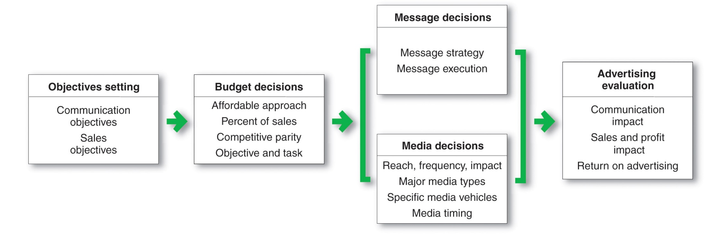
Advertising
Major Advertising Decisions

Slide 5

Advertising
Setting Advertising Objectives
An advertising objective is a specific communication task to be accomplished with a specific target audience during a specific time

Slide 6
Advertising
Setting Advertising Objectives
Informative advertising is used when introducing a new product category; the objective is to build primary demand
Persuasive advertising is important with increased competition to build selective demand
Reminder advertising is important with mature products to help maintain customer relationships and keep customers thinking about the product
Notes:
Note to Instructor
Discussion Question
When would an advertiser use each of these types of objectives?
You can then draw a strong tie to the PLC. This YouTube link is to a classic Pepsi ad, which is practicing persuasive advertising.

Slide 7
Table 15.1 Possible Advertising Objectives

Slide 8
Advertising
Developing Advertising Strategy
Advertising strategy is the strategy by which the company accomplishes its advertising objectives and consists of:
Creating advertising messages
Selecting advertising media

Slide 9


Developing Advertising Strategy
Creating the Advertising Message
Advertisements need to break through the clutter:
Gain attention
Communicate
well
Notes:
Note to Instructor
This Web link is for Microsoft’s new advertising campaign that was launched in 2008. The campaign was unusual as it began with two ads featuring Bill Gates and Jerry Seinfeld. These ran for only a short period of time and were followed immediately by the “I’m a PC” campaign. There is thought that the Gates/Seinfeld spots were to draw attention and create buzz because they were not very strongly received by the public.
Advertisements need to be better planned, more imaginative, more entertaining, and more rewarding to consumers.
Madison & Vine—the intersection of Madison Avenue and Hollywood—represents the merging of advertising and entertainment.

Slide 10
Advertising
Creating the Advertising Message
Advertisements need to be better planned, more imaginative, more entertaining, and more rewarding to consumers
Madison & Vine—the intersection of Madison Avenue and Hollywood—represents the merging of advertising and entertainment

Slide 11
Advertising
Creating the Advertising Message

Slide 12
Advertising
Creating the Advertising Message
Message strategy is the general message that will be communicated to consumers
Identifies consumer benefits

Slide 13
Advertising
Creating the Advertising Message
Creative concept is the idea that will bring the message strategy to life and guide specific appeals to be used in an advertising campaign
Characteristics of the appeals include:
Meaningful
Believable
Distinctive

Slide 14
Advertising
Creating the Advertising Message
Message execution is when the advertiser turns the big idea into an actual ad execution that will capture the target market’s attention and interest.
The creative team must find the best approach, style, tone, words, and format for executing the message.

Slide 15
Advertising
Creating the Advertising Message

Slide 16


Advertising
Creating the Advertising Message
Message execution also includes:
Tone
Positive or negative
Attention-getting words
Format
Illustration
Headline
Copy
Notes:
Note to Instructor
In slideshow view, click on movie icon to launch eTrade video snippet. See accompanying DVD for full video segment.

Slide 17

Advertising
Creating the Advertising Message
Consumer Generated Messages
YouTube videos
Brand Web site contests
Positives
Low expense
New creative ideas
Fresh perspective on brand
Boost consumer involvement
Notes:
Note to Instructor
An example of this is given in the text:
Doritos held a “Crash the Super Bowl Challenge” contest that invited consumers to create their own video ads about the tasty triangular corn chips.
Doritos received 1,080 user-generated videos and posted the top five on the contest Web site, where consumers could view the ads and vote for a winner.
The five finalists received a $10,000 prize and PepsiCo showed the winning ad during the Super Bowl. The campaign was a smashing success.

Slide 18
Advertising
Selecting Advertising Media
Major steps include:
Deciding on reach-frequency-impact
Selecting media vehicles
Deciding on media timing

Slide 19
Advertising
Selecting Advertising Media
Reach is a measure of the percentage of people in the target market who are exposed to the ad campaign during a given period of time
Frequency is a measure of how many times the average person in the target market is exposed to the message
Impact is the qualitative value of a message exposure through a given medium

Slide 20
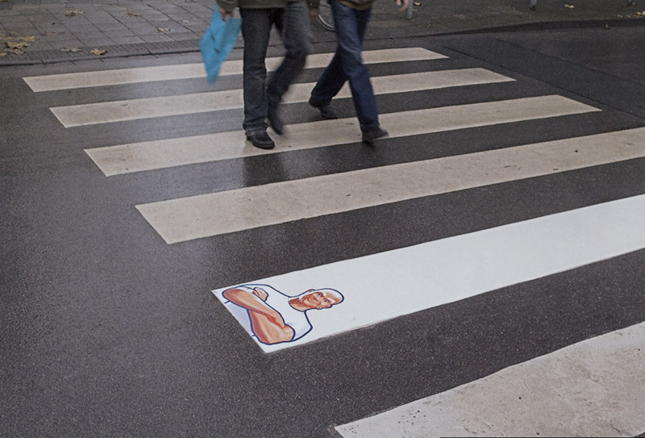
Advertising
Selecting Advertising Media
Selecting media vehicles involves decisions presenting the media effectively and efficiently to the target customer and must consider the
message’s:
Impact
Effectiveness
Cost
Notes:
Note to Instructor
When selecting specific media vehicles, the planner must consider the cost of the media as compared to its effectiveness by evaluating:
Audience quality
Audience engagement
Editorial quality

Slide 21
Advertising
Selecting Advertising Media
Narrowcasting Versus Shotgun Approaches
Narrowcasting focuses the message on selected market segments
Lowers cost
Targets more effectively
Engages customers better
Notes:
Note to Instructor
The text gives the following example:
Tiny billboards attached to shopping carts.
Ads on shopping bags.
Decals on supermarket floors.
Supermarket eggs are stamped with the names of CBS television shows.
At the local laundromat, you load your laundry through a clever Pepto-Bismol ad plastered on the front of the washing machine.
City trash truck sporting an ad for Glad trash bags.
DVD case.
Parking-lot tickets.
Foreheads of college students for temporary advertising tattoos.

Slide 22

Advertising
Selecting Advertising Media
When deciding on media timing, the planner must consider:
Seasonality
Pattern of the advertising
Continuity—scheduling within a given period
Pulsing—scheduling unevenly within a given period

Slide 23
Advertising
Evaluating the Effectiveness and Return on Advertising Investment
Return on advertising investment
The net return on advertising investment
divided by the costs of the advertising
investment

Slide 24
Advertising
Evaluating the Effectiveness and Return on Advertising Investment
Communication effects indicate whether the ad and media are communicating the ad message well and should be tested before or after the ad runs
Sales and profit effects compare past sales and profits with past expenditures or through experiments

Slide 25

Advertising
Developing and Advertising Programs
Other Advertising Considerations
Organizing for advertising
Agency vs. in-house
International advertising decisions
Standardization
Notes:
Note to Instructor
This Web link brings you to the homepage for Advertising Age. Depending on the amount of time the instructor has during this class, it might be interesting to explore the site with the students. At the minimum, students should write down this url, especially if they have an interest in advertising.
For international advertising decisions the most basic issue concerns the degree to which global advertising should be adapted to the unique characteristics of various country markets. Some large advertisers have attempted to support their global brands with highly standardized worldwide advertising, with campaigns that work as well in Bangkok as they do in Baltimore.

Slide 26
Public Relations
Public relations involves building good relations with the company’s various publics by obtaining favorable publicity, building up a good corporate image, and handling or heading off unfavorable rumors, stories, and events
Public relations is used to promote product, people, ideas, and activities

Slide 27

Public Relations
Public relations department functions include:
Press relations or press agency
Product publicity
Public affairs
Lobbying
Investor relations
Development

Slide 28
Public Relations
Press relations or press agency involves the creation and placing of newsworthy information to attract attention to a person, product, or service
Product publicity involves publicizing specific products
Public affairs involves building and maintaining national or local community relations

Slide 29
Public Relations
Lobbying involves building and maintaining relations with legislators and government officials to influence legislation and regulation
Investor relations involves maintaining relationships with shareholders and others in the financial community
Development involves public relations with donors or members of nonprofit organizations to gain financial or volunteer support

Slide 30
Public Relations
The Role and Impact of Public Relations
Lower cost than advertising
Stronger impact on public awareness than advertising

Slide 31
Public Relations
Major Public Relations Tools

Slide 32

All rights reserved. No part of this publication may be reproduced, stored in a retrieval system, or transmitted, in any form or by any means, electronic, mechanical, photocopying, recording, or otherwise, without the prior written permission of the publisher. Printed in the United States of America.
Copyright © 2012 Pearson Education, Inc.
Publishing as Prentice Hall

