Slide 1

Mechatronics System Design Chapter 1: Introduction to Mechatronics System Design
Instructor: Dr. Ahmad Al-Balasie
First Semester - 2019/2020

Slide 2
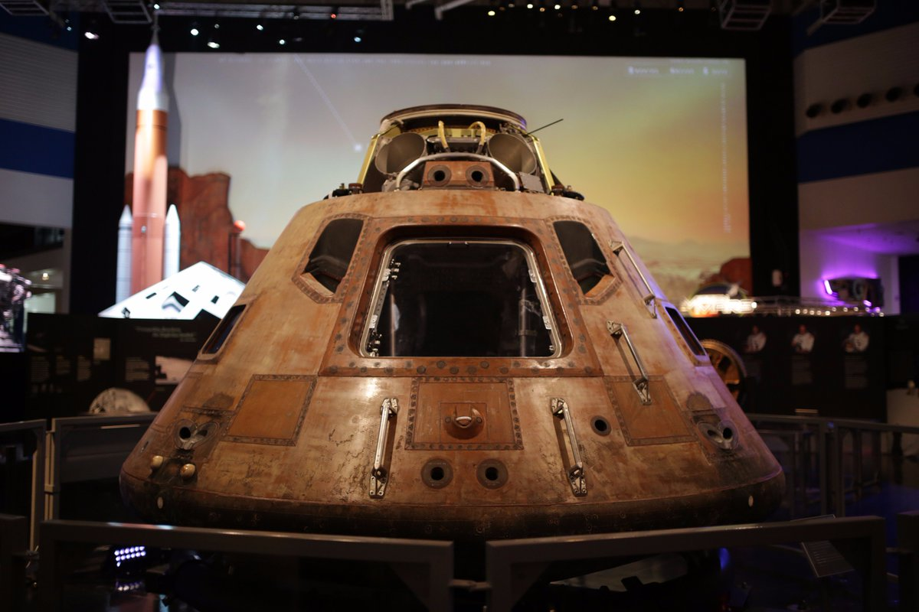
Remember this:
It is always more expensive to improve a bad conceptual design than a bad detailed design, therefore this process is crucial and essential

Slide 3
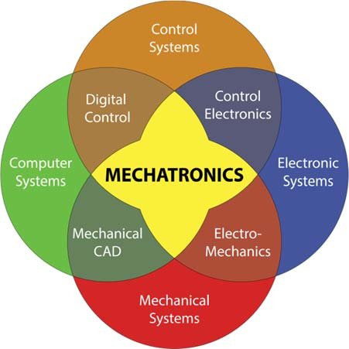
What is Mechatronics?
Mechatronics is a multidisciplinary covers mechanics, electronics, controls, and computer engineering to develop electromechanical products and systems, through an integrated design approach.

Slide 4
Mechatronic Design Concept vs Electro-mechanical Concept
The difference between a Mechatronics System and an Electro-mechanical System is explained by the following two points:
Mechatronics System is designed in an integrated manner by a multi-disciplinary team of engineers who work together.
Electro-mechanical System is created by designing the mechanical and electrical components separately, then combining them together. This is known as “sequential” approach” (Not as Efficient!)

Slide 5
Electro-mechanical Approach
Traditionally, a “sequential” approach has been adopted for the design of mixed systems such as electromechanical systems.
For example :
The mechanical and structural components are designed first.
Electrical and electronic components are selected or developed and interconnected.
Thirdly, a computer is selected and interfaced with the system next, and so on.
The dynamic coupling between various components of a system dictates.
The accurate design of the system should consider the entire system as a whole rather than designing the electrical/electronic aspects and the mechanical aspects separately and sequentially.

Slide 6
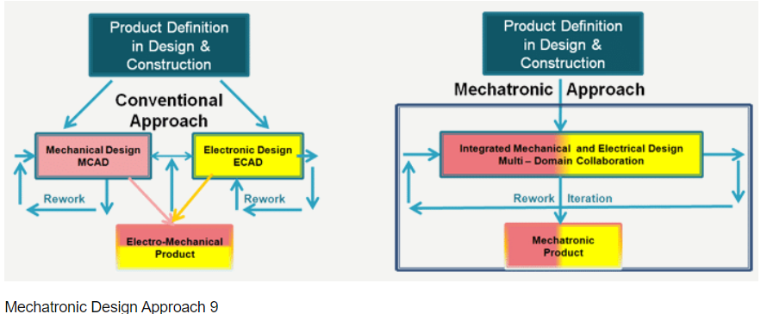
Mechatronic Design Concept vs Electro-mechanical Concept
In an electromechanical system an interaction (or, coupling) exists between electrical dynamics and mechanical dynamics. Specifically, electrical dynamics affect the mechanical dynamics and vice versa.

Slide 7
Problems of Electro-mechanical approach
When independently designed components are interconnected, several problems can arise:
When two independently designed components are interconnected, the original characteristics and operating conditions of the two will change due to loading or dynamic interactions.
Perfect matching of two independently designed and developed components will be practically impossible. As a result a component can be considerably underutilized or overloaded, in the interconnected system, both conditions being inefficient and undesirable performance.
Some of the external variables in the components will become internal and “hidden” due to interconnection, which can result in potential problems that cannot be explicitly monitored through sensing and it can’t be directly controlled.

Slide 8
Problems of Electro-mechanical Approach
By definition, a “better” design is where the design objectives (design specifications) are met more closely.
The “principle of synergy” in Mechatronics means, an integrated and concurrent design should result in a better product than one obtained through an uncoupled or sequential design.
Note that an uncoupled design is where each subsystem is designed separately (and sequentially), while keeping the interactions with the other subsystems constant (i.e., ignoring the dynamic interactions).

Slide 9
Mechatronics System has four main components:
1. Mechanical Skeleton. 3. Actuators
2. Sensors 4. Controllers
Other components are also necessary to integrate the main components. These are:
Signal Conditioning Circuits
Computer Hardware and Software (used in the design process, not necessarily part of the final product.
Interface Devices: Devices that allow humans to interact with the machine, such as: keyboards, push buttons, screens, LCDs ...
Power Sources

Slide 10
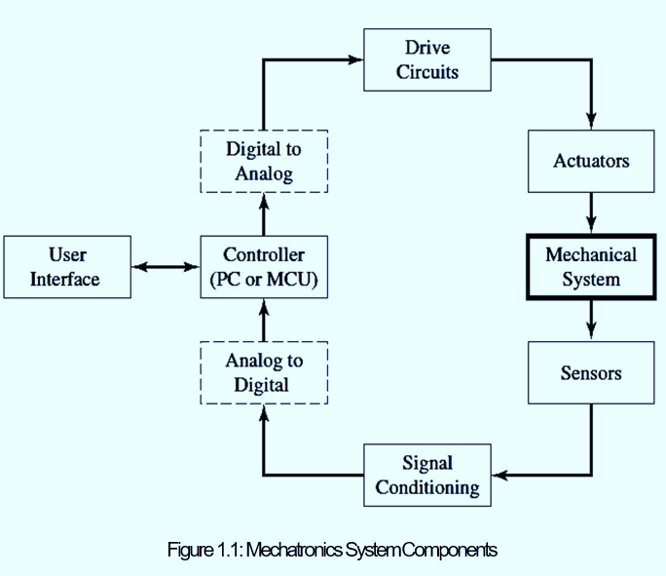
Mechatronics System Components
To be able for better understand the components of a Mechatronics System. Think of the system as a human body, we can make the following analogies:
Mechanical Skeleton: The Skeleton (bones)
Actuators : Muscles and Limbs
Sensors: The five Senses
Controllers: The Brain
Signal Conditioning Devices: Blood and Nerves
Power Sources: Food, Oxygen, and Water

Slide 11
Examples of Mechatronics Systems
Home Appliances (Washing Machines): Many of the home appliances that are in use today are Mechatronics Systems. They are manufactured in large numbers typically require small controllers to be ”embedded” in them.
ABS (anti-lock braking system) and many areas in automotive engineering: An anti-lock braking system on a vehicle is a system that prevents the wheels from ceasing up or stopping to rotate when the brakes are suddenly pressed. Another good example of a Mechatronics System from automotive engineering is the Engine Control Unit (ECU).
Elevators and Escalators: Elevators present good examples of Mechatronics Systems. They have many sensors to detect the position and speed of the elevator car, as well as any calls registered by the passengers. It has many actuators, the most important of which is the main hoist motor. Safety is also important in these systems as they carry humans beings.

Slide 12
Examples of Mechatronics Systems
4. Mobile Robots and Manipulator Arms: Robots are widely used today in all aspects of life. Robots are generally used for applications that are inaccessible (difficult locations to get to due to height or space), dull (repetitive and tedious tasks), or dangerous (hazardous environments).
5. Sorting and Packaging Systems in production lines: Mechatronics Systems are effectively the basis of modern factory automation.
6. Computer Numerical Control (CNC) production machines: CNC machines are critical in modern manufacturing systems. They allow the user to produce a product directly from a computer model of the piece.

Slide 13
Examples of Mechatronics Systems
7. Aeroplanes and Helicopters: These are complex examples of Mechatronics Systems that incorporate hundreds or even thousands of smaller sub-mechatronics systems.
8. Packing Machines.
9. Robots for painting windows and doors.

Slide 14
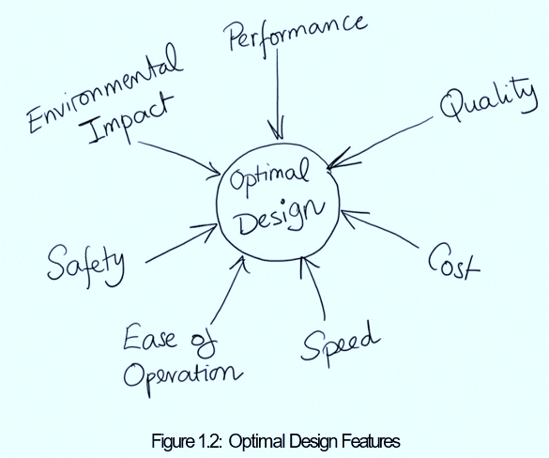
What makes a design ”good”?
An optimal design depends on several factors, the importance of each of these factors depends on the required features of the designed system. These factors are explained in Figure 1.2:

Slide 15
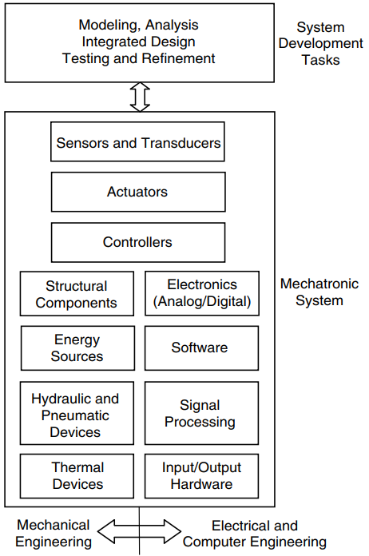
Modeling and Design
Remember, you can never come up with a complete functional design at the first attempt. The design procedure is an iterative approach that takes time.
First, based on the purpose of the machine, the required performance specifications and past knowledge that you have, you will come up with an initial model.
The intial model should be created using computer tools such as CATIA or SolidWorks, and simulation should be used to predict the behavior of your machine.
This model that you created and the required design objectives should give you a complete initial design of your machine (prototype).

Slide 16
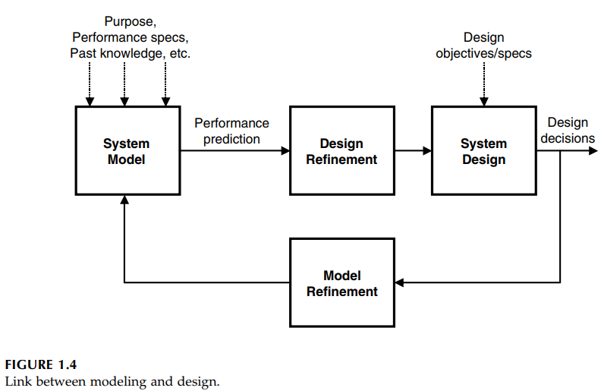
Modeling and Design
Now it is time for some decision making; is your design optimal?
If yes, then the design procedure is done. However, if you are not satisfied with your design, you should go back to the virtual model and do model refinements. Then, these model refinements are translated to design refinements on your prototype Figure 1.3 clearly explains this iterative approach.

Slide 17
The Four Questions that should be asked when designing a Mechatronics System
When designing a Mechatronics System, it is important to consider the following four questions:
Is system dynamics important?
What type of components to select for each of the four main components for the Mechatronics System?
What is the ”size” of each component?
Resolution, Accuracy, and Precision?

Slide 18
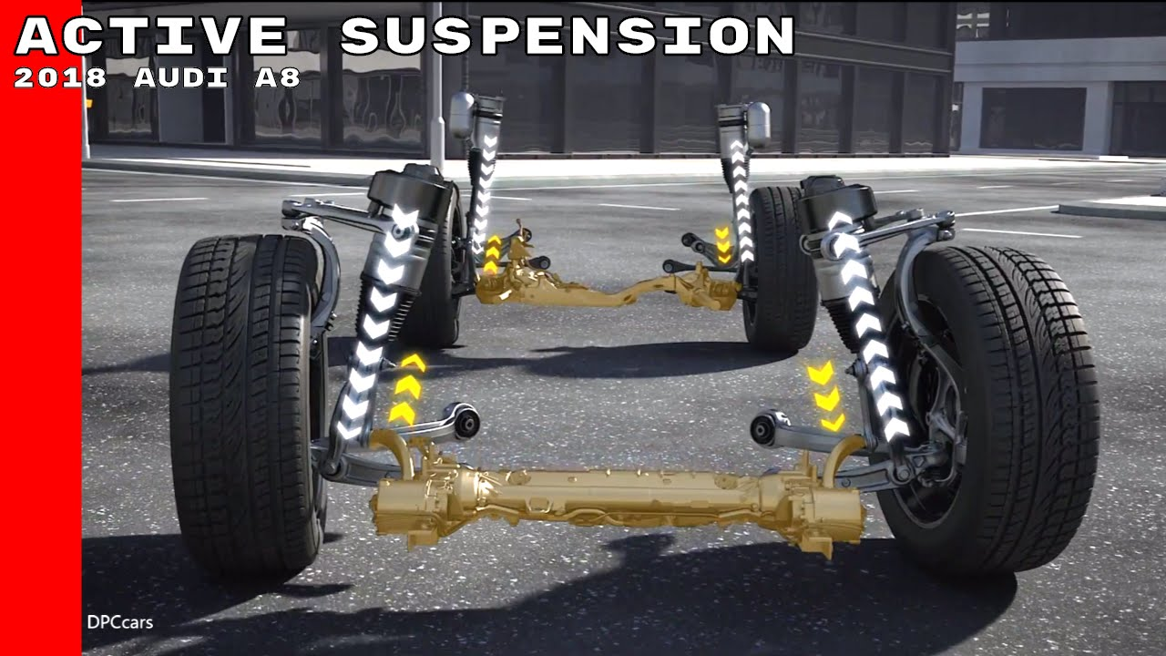
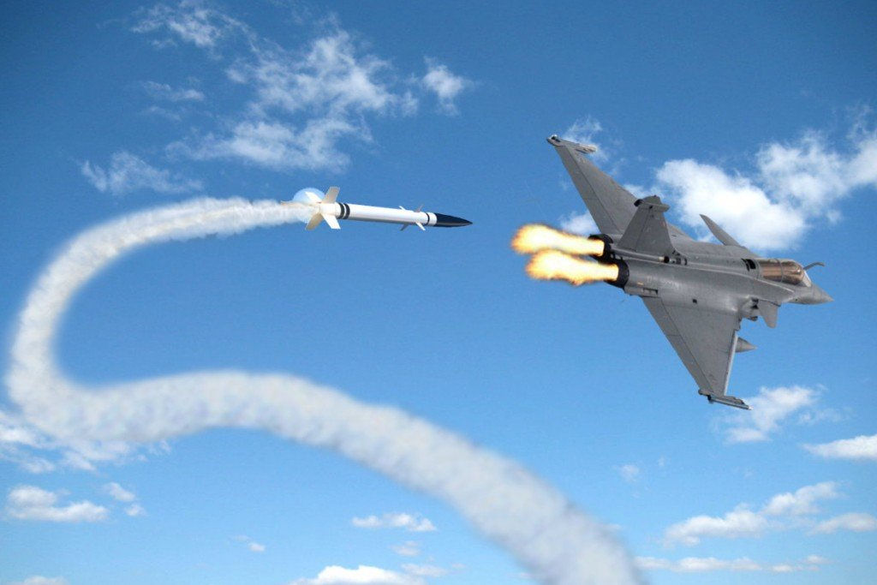
Is system dynamics important?
If the speed/position of response of a system is critical to its stability and time response specifications (overshoot, rise time, settling time,...). Then the system dynamics is important and has to be considered in the design. In this case, a dynamic model has to be developed for the whole system (including the plant, controller, actuator, and sensor). The model is then used to design a suitable controller.
The following list includes examples of systems for which system dynamics is critical:
Quad-rotor
Heat-seeking missile
Vehicle active suspension system

Slide 19

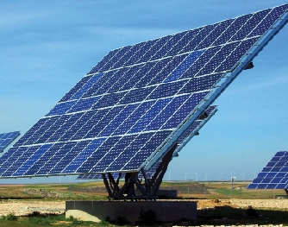
Is system dynamics important?
The following systems the dynamics is not critical:
Iris scanning system for identification purposes.
Controlling actuators through PLC or traditional control.

Slide 20
What type of components to select for each of the four main components for the Mechatronics System?
The designer of the system will have to make a decision regarding the components of the Mechatronics System, as follows:
Control Algorithm: On-Off, PI, PD, PID, lead-lag compensator, fuzzy logic controller, neural, genetic, digital ...
Physical Controller: This is the physical controller within which the control algorithm will be implemented. Examples: PLC, PC/Laptop, Microcontrollers, relays, and older types of analogue computers and logic gates.
Actuators: The actuator executes the instructions of the controller to realize changes in the plant.

Slide 21
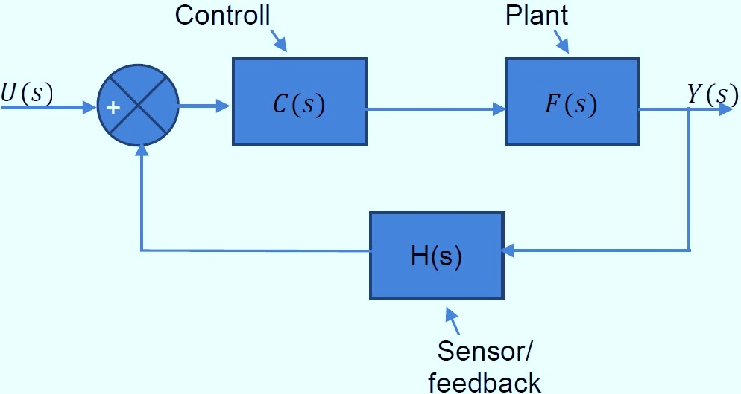
What type of components to select for each of the four main components for the Mechatronics System?
Sensor/Transducer/Feedback Drivers: The sensors are the eyes and ears of the Mechatronics System. These sensors measure physical variables from the environment to help the microcontroller make decisions. If system dynamics is important, it is necessary to find the transfer function of the sensor as well, as it forms the H(s) Transfer Function shown in the Figure below.
Figure 1.4: Basic Block Diagram of a Mechatronics System

Slide 22
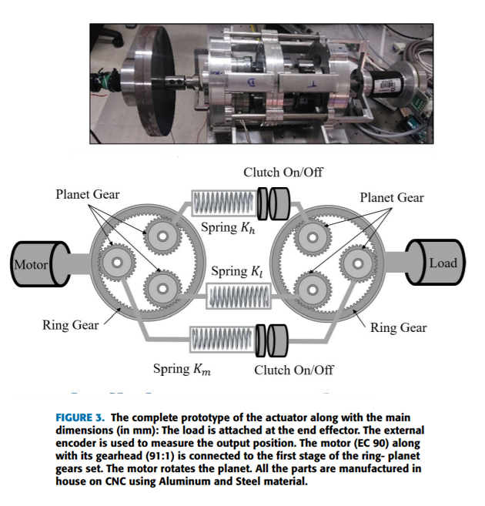
What is the ”size” of each component?
Once the designer has selected the components, he/she has to size them. Calculations have to be carried out to find the necessary size.
This is especially true of the actuator system (motor, Variable Frequency/Speed Drive, Gearbox ... )

Slide 23
Resolution, Accuracy, and Precision?
Once the sensor/feedback has been selected, it is necessary to ensure that it can achieve the required accuracy, resolution, and precision. The user requirements specify the required accuracy, resolution, and precision.
What is the difference between accuracy, resolution, and precision?
Accuracy refers to the closeness of a measured value to a standard or known value. For example, if in lab you obtain a weight measurement of 3.2 kg for a given substance, but the actual or known weight is 10 kg, then your measurement is not accurate. In this case, your measurement is not close to the known value.

Slide 24
Resolution, Accuracy, and Precision?
Precision refers to the closeness of two or more measurements to each other. Using the example above, if you weigh a given substance five times, and get 3.2 kg each time, then your measurement is very precise.
Precision is independent of accuracy. You can be very precise but inaccurate, as described above. You can also be accurate but imprecise.
Resolution is the smallest change a sensor/transducer can detect in the quantity that it is measuring.
In some cases, the controller selection and the actuator selection have to be revised or changed in order to achieve these requirements.

Slide 25
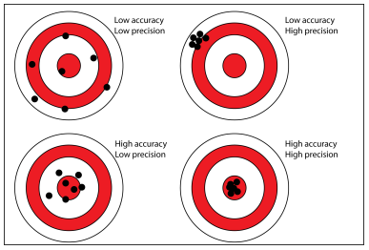
Resolution, Accuracy, and Precision?
The system is shown with multiple inputs U₁, U₂, ... U_{i}; and multiple outputs Y₁, Y₂, ... Y_{i}, to express a general case.
Figure 1.5: Difference between Precision and Accuracy

Slide 26
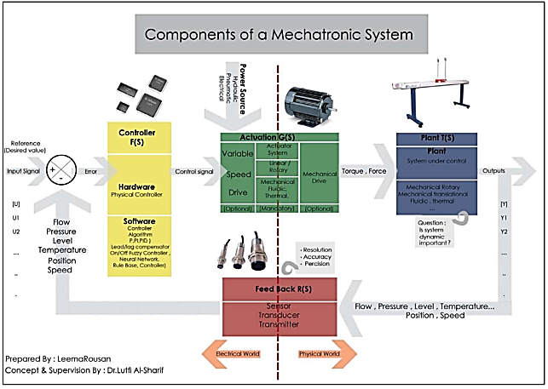
Components of a Mechatronics System

Slide 27
User Requirements Specifications for a Mechatronics System
Size, Capacity, Force, Torque, Stroke: This is the most obvious user requirement. It is related to the size of the system, in relationship to what it can do. For example, a bottle filling system will be able to fill 1000 bottles per hour; or an elevator can carry eight persons; or a printer can print 12 pages per minute.
Safety, Reliability, Maintainability, Availability.
System Dynamics: Rise Time, Settling Time, Overshoot ...
Resolution, Accuracy, Precision: These characteristics are related to both actuators and sensors.
User Friendliness: The system user interface should be user-friendly. It should allow different levels of access. It should also be ”fool proof”.

Slide 28
User Requirements Specifications for a Mechatronics System
Energy Consumption: In some applications, it is important to minimize the amount of energy consumed.
Cost (Capital Cost, Running Cost): It is important to consider all costs associated with the system, throughout the lifetime of the system. This includes capital costs (initial cost of the system) as well as the running cost (energy cost, maintenance cost.
Space, Size, Weight: Sometimes there may be constraints on the size of the system and its weight.

Slide 29
User Requirements Specifications for a Mechatronics System
Environment: It is important to consider the environment in which the system will be operated. For example, ambient temperature, humidity, dust, and foreign particle and fluid ingress. the IP rating selection of the enclosure is thus important (IP: ingress protection, see next section).
Versatility: A versatile system is one that can be used in different ways.

Slide 30
Ingress Protection
Ingress Protection Rating (IP) is a code that defines how an enclosure will prevent foreign particles and fluid from entering.
It is important for a mechatronics system because the controller, the actuator, and the transducer are placed inside enclosures, and we need to ensure that no foreign objects or fluids enter these enclosures depending on the environment in which the system will eventually operate.
The coding consists of two numbers (for example IP21, IP54, IP67 ...).
The first number represents solids and the second number represents liquids. It can be used instead of a number if ingress is not critical or does not matter. See the table on the next page for details.

Slide 31
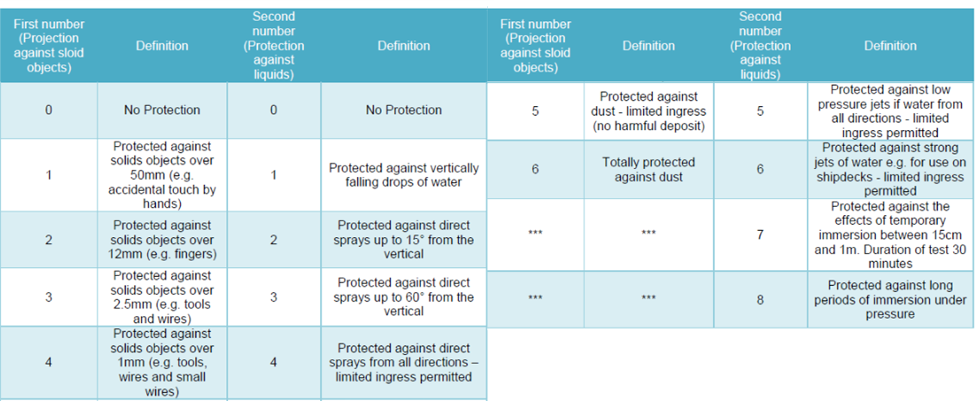
Ingress Protection

