Slide 1
Section 5.5
Heisenberg’s Uncertainty Principle
(1927)
مبدأ عدم التأكد أو عدم التيقن

Slide 2
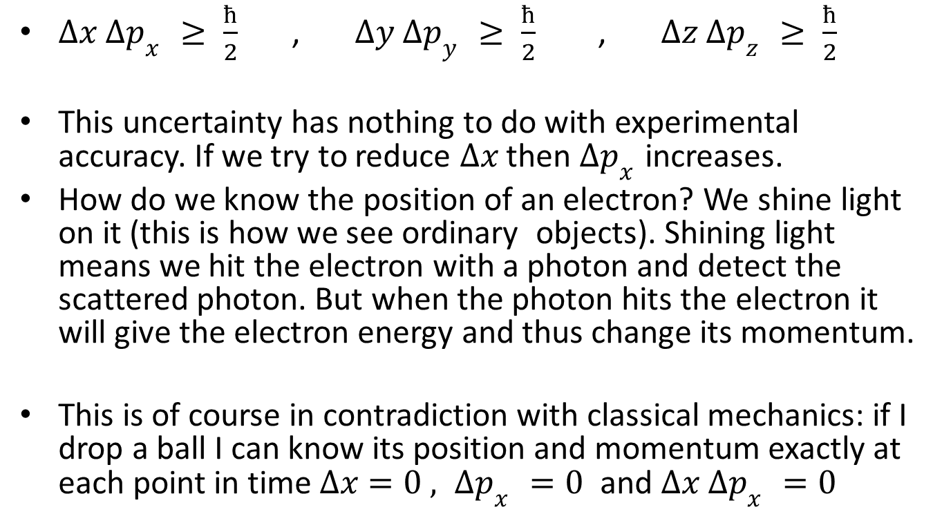
Position-Momentum Uncertainty
$∆x ∆p_{x }≥ \frac{ħ}{2}$ , $∆y ∆p_{y }≥ \frac{ħ}{2}$ , $∆z ∆p_{z }≥ \frac{ħ}{2}$
This uncertainty has nothing to do with experimental accuracy. If we try to reduce $∆x$ then $∆p_{x }$increases.
How do we know the position of an electron? We shine light on it (this is how we see ordinary objects). Shining light means we hit the electron with a photon and detect the scattered photon. But when the photon hits the electron it will give the electron energy and thus change its momentum.
This is of course in contradiction with classical mechanics: if I drop a ball I can know its position and momentum exactly at each point in time $∆x=0 , ∆p_{x }=0$ and $∆x ∆p_{x }=0$

Slide 3
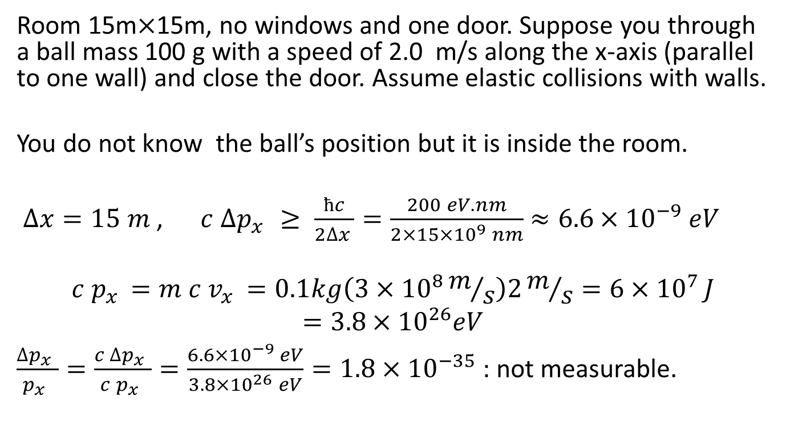
Example 5.8 Why we cannot see the Uncertainty Principle for ordinary objects?
Room 15m$×$15m, no windows and one door. Suppose you through a ball mass 100 g with a speed of 2.0 m/s along the x-axis (parallel to one wall) and close the door. Assume elastic collisions with walls.
You do not know the ball’s position but it is inside the room.
$∆x=15 m$ , $c ∆p_{x }≥ \frac{ħc}{2∆x }=\frac{200 eV.nm}{2×15×{10}^{9} nm}$ $≈6.6×{10}^{−9} eV$
$$c p_{x }=m c v_{x }=0.1kg\left(3×{10}^{8}m/s\right)2m/s=6×{10}^{7 }J$$
$$=3.8×{10}^{26}eV$$
$\frac{∆p_{x }}{p_{x }}=\frac{c ∆p_{x }}{c p_{x }}=\frac{6.6×{10}^{−9} eV}{3.8×{10}^{26} eV}=1.8×{10}^{−35}$ : not measurable.

Slide 4
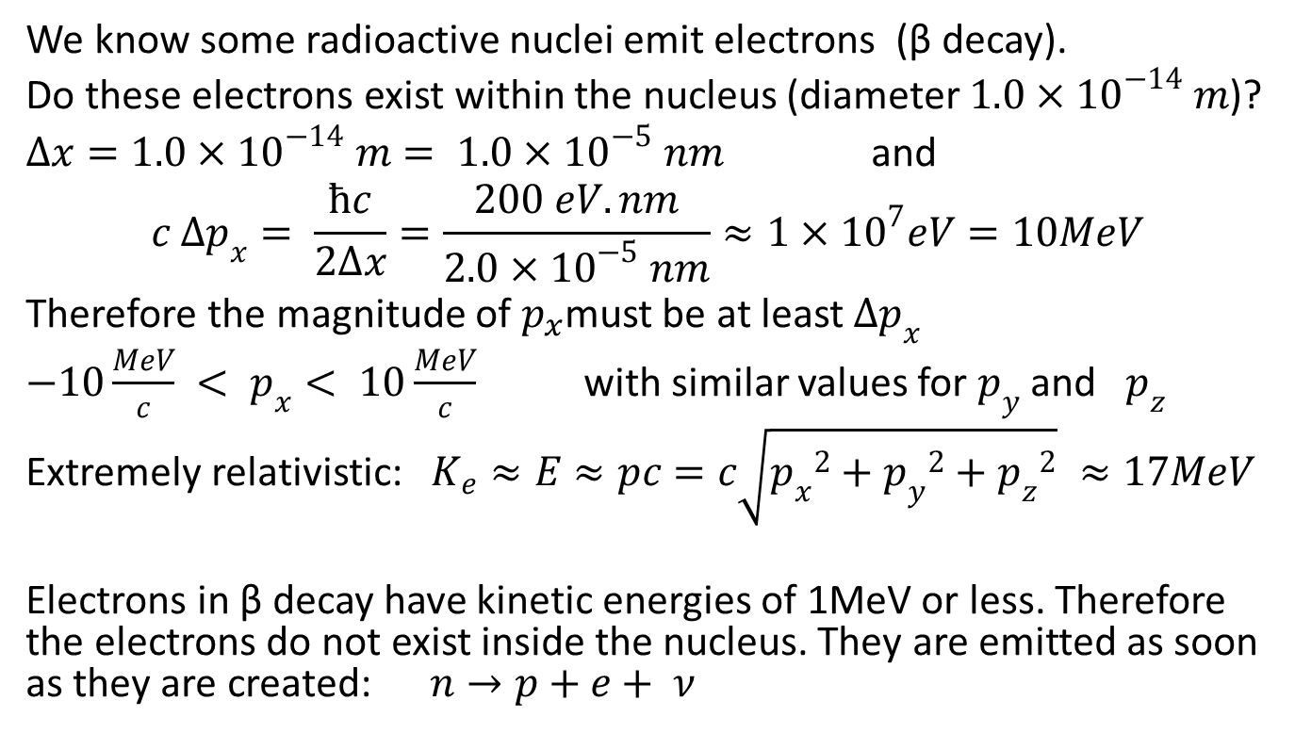
Example 5.9
Do electrons exist inside the nucleus
We know some radioactive nuclei emit electrons (β decay).
Do these electrons exist within the nucleus (diameter $1.0×{10}^{−14} m$)?
$∆x=1.0×{10}^{−14} m= 1.0×{10}^{−5} nm$ and
$$c ∆p_{x}= \frac{ħc}{2∆x}=\frac{200 eV.nm}{2.0×{10}^{−5} nm}≈1×{10}^{7}eV=10MeV$$
Therefore the magnitude of $p_{x}$must be at least $∆p_{x}$
$−10\frac{MeV}{c} < p_{x}< 10\frac{MeV}{c}$ with similar values for $p_{y}$ and $p_{z}$
Extremely relativistic: $K_{e}≈E≈pc=c\sqrt{{p_{x}}^{2}+{p_{y}}^{2}+{p_{z}}^{2}} ≈17MeV$
Electrons in β decay have kinetic energies of 1MeV or less. Therefore the electrons do not exist inside the nucleus. They are emitted as soon as they are created: $n→p+e+ ν$

Slide 5
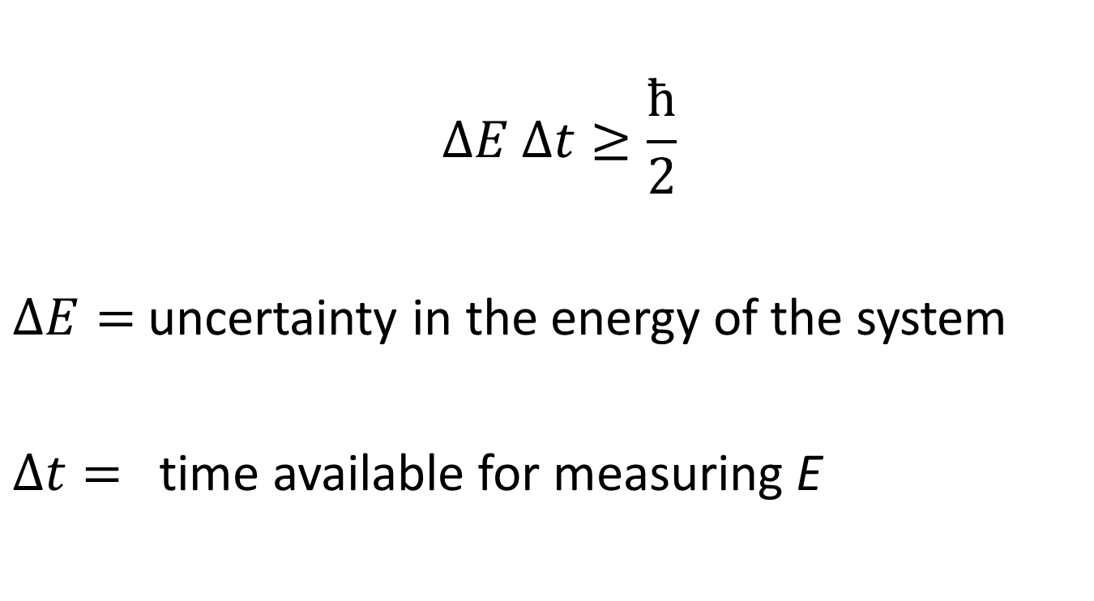
The Energy-Time uncertainty principle
$$∆E ∆t≥\frac{ħ}{2}$$
$∆E=$ uncertainty in the energy of the system
$∆t=$ time available for measuring E

Slide 6
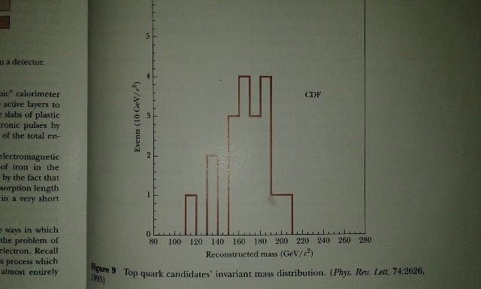
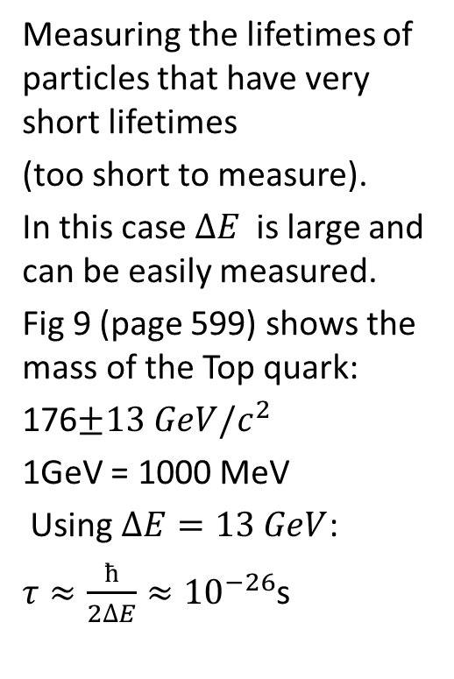
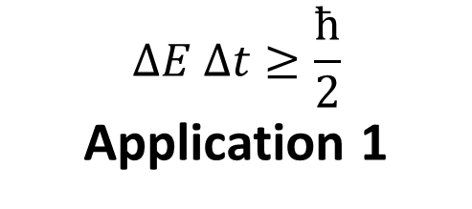
$$∆E ∆t≥\frac{ħ}{2}$$
Application 1
Measuring the lifetimes of particles that have very short lifetimes
(too short to measure).
In this case $∆E$ is large and can be easily measured.
Fig 9 (page 599) shows the mass of the Top quark:
176$±13 GeV/c^{2}$
1GeV = 1000 MeV
Using $∆E=13 GeV$:
$τ≈\frac{ħ}{2∆E}≈{10}^{−26}$s

Slide 7
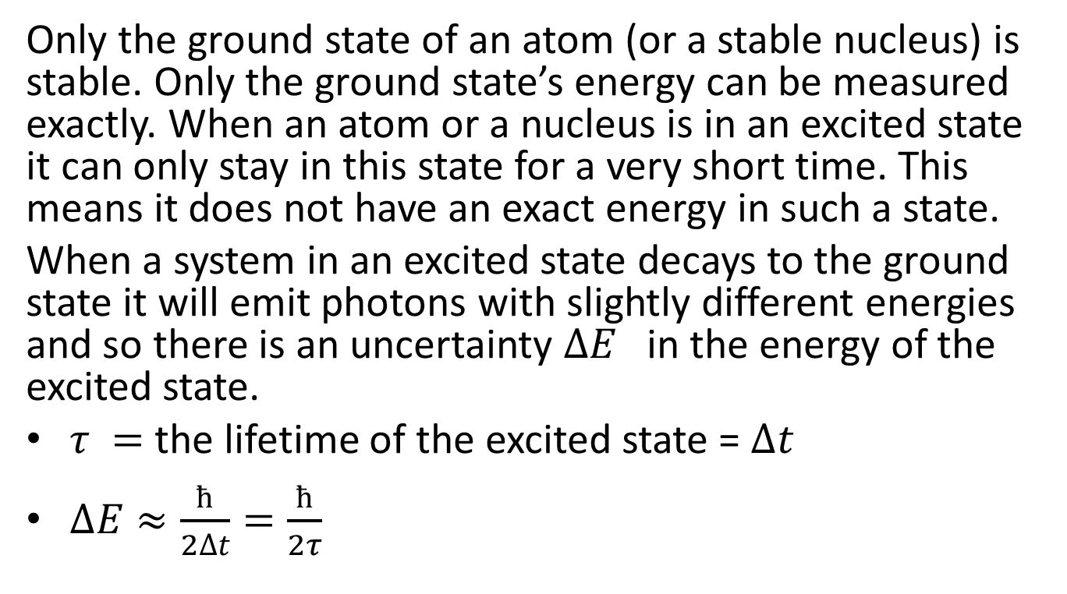

$∆E ∆t≥\frac{ħ}{2}$
Application 2: Width of spectral lines.
Only the ground state of an atom (or a stable nucleus) is stable. Only the ground state’s energy can be measured exactly. When an atom or a nucleus is in an excited state it can only stay in this state for a very short time. This means it does not have an exact energy in such a state.
When a system in an excited state decays to the ground state it will emit photons with slightly different energies and so there is an uncertainty $∆E$ in the energy of the excited state.
$τ =$ the lifetime of the excited state = $∆t$
$∆E≈\frac{ħ}{2∆t}=\frac{ħ}{2τ}$

Slide 8
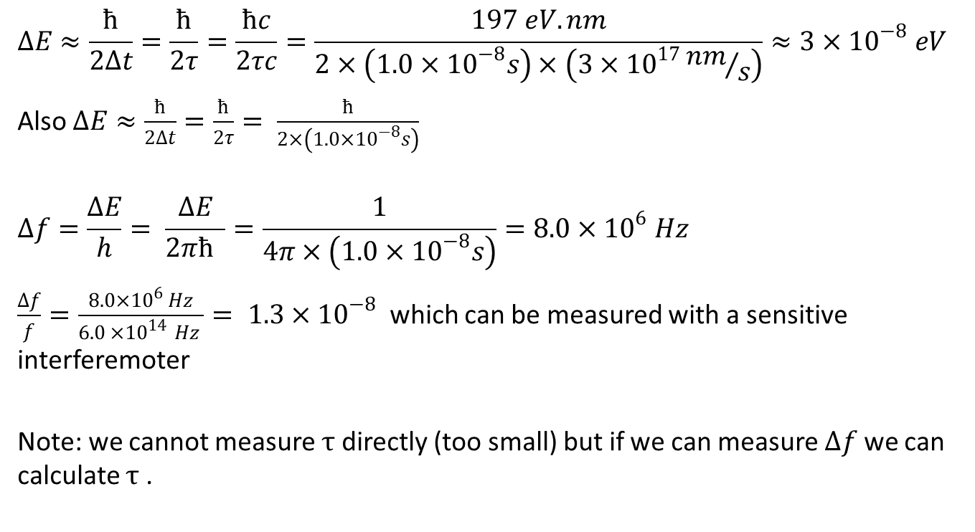
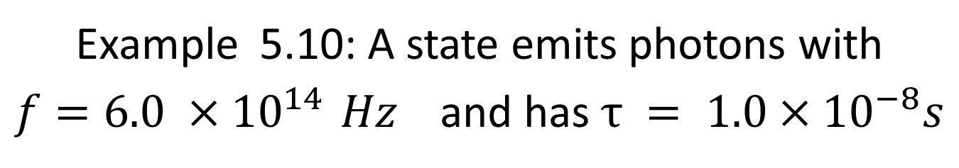
Example 5.10: A state emits photons with $f=6.0 ×{10}^{14 }Hz$ and has $τ = 1.0×{10}^{−8}s$
$$∆E≈\frac{ħ}{2∆t}=\frac{ħ}{2τ}=\frac{ħc}{2τc}=\frac{197 eV.nm}{2×\left(1.0×{10}^{−8}s\right)×\left(3×{10}^{17}{nm}/s\right)}≈3×{10}^{−8} eV$$
Also $∆E≈\frac{ħ}{2∆t}=\frac{ħ}{2τ}= \frac{ħ}{2×\left(1.0×{10}^{−8}s\right)}$
$$∆f=\frac{∆E}{h}= \frac{∆E}{2πħ }=\frac{1}{4π×\left(1.0×{10}^{−8}s\right)}=8.0×{10}^{6} Hz$$
$\frac{∆f}{f}=\frac{8.0×{10}^{6} Hz}{6.0 ×{10}^{14 }Hz }= 1.3×{10}^{−8}$ which can be measured with a sensitive interferemoter
Note: we cannot measure $τ$ directly (too small) but if we can measure $∆f$ we can calculate $τ$.

Slide 9
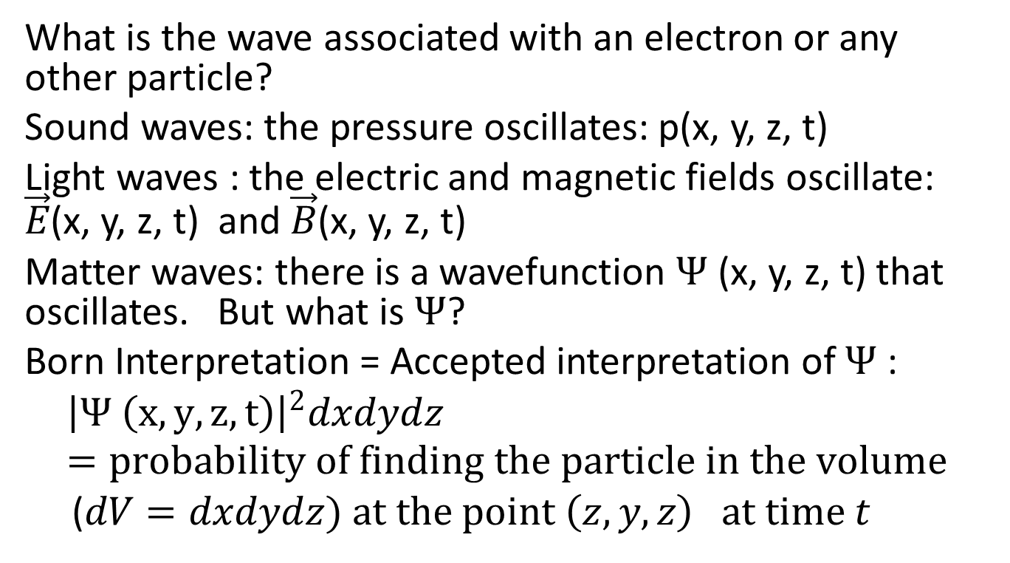
Section 5.6: Wave-particle duality
What is the wave associated with an electron or any other particle?
Sound waves: the pressure oscillates: p(x, y, z, t)
Light waves : the electric and magnetic fields oscillate: $\vec{E}$(x, y, z, t) and $\vec{B}$(x, y, z, t)
Matter waves: there is a wavefunction $Ψ$ (x, y, z, t) that oscillates. But what is $Ψ$?
Born Interpretation = Accepted interpretation of $Ψ$:
$${\left|Ψ \left(x, y, z, t\right)\right|}^{2}dxdydz=probability of finding the particle in the volume$$
($dV=dxdydz) at the point \left(z, y, z\right) at time t$

Slide 10
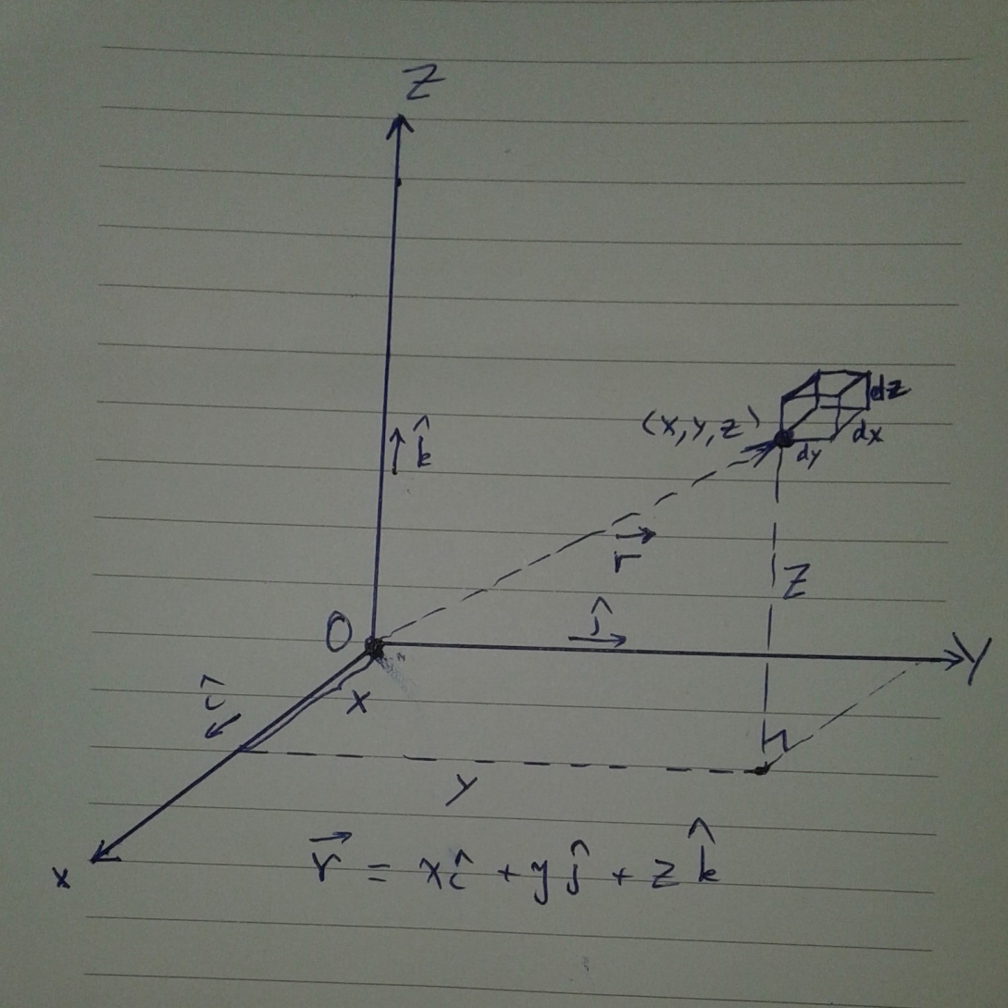
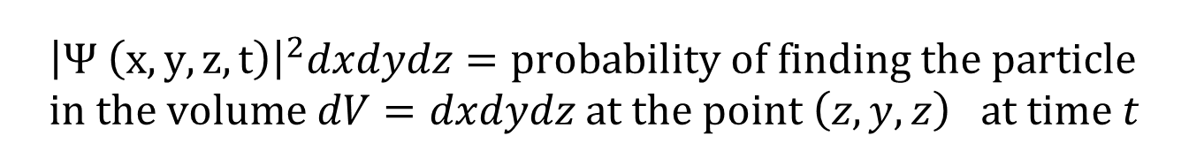
$${\left|Ψ \left(x, y, z, t\right)\right|}^{2}dxdydz=probability of finding the particle \\ in the volume dV=dxdydz at the point \left(z, y, z\right) at time t$$

Slide 11
Two-slit interference (a) Schematic of two-slit interference; (b) light interference pattern;(c) interference pattern with low-intensity light
We can do the same thing with electrons or atoms or even large molecules

