Slide 1
Exp #5 Frame and Tween Animation in Android
SLIDES BY: Tarek Zidan and Mohamad Balawi

Slide 2
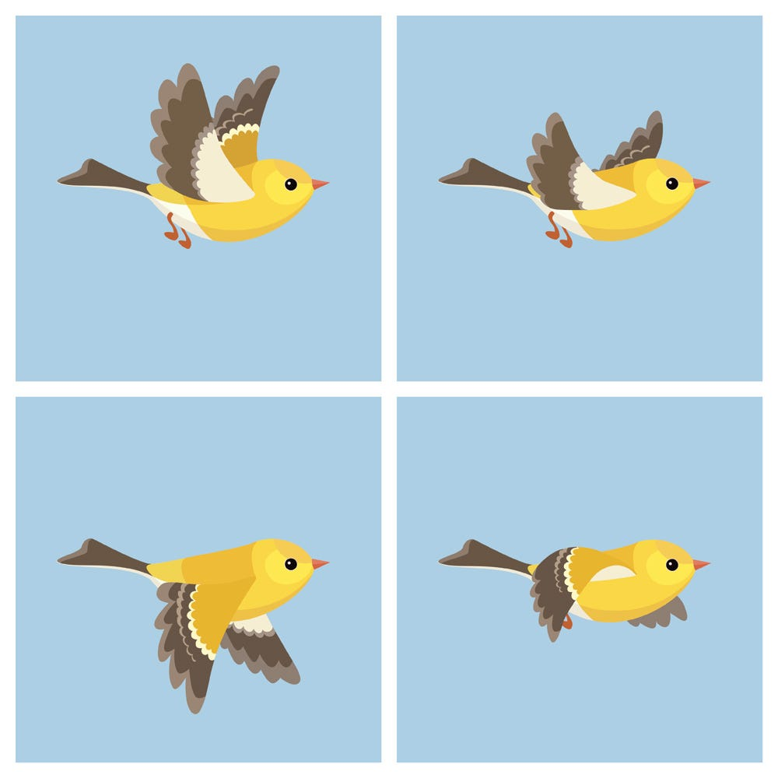

Types of animations in Android
Frame animation
It is a series of frames drawn one after the other at regular. Creates an animation by showing a sequence of images in order with an AnimationDrawable.

Slide 3
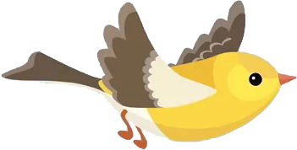
Types of animations in Android
Tween animation
Simple transformations of position, size, and rotation to the content of a View. Animation can be defined in XML as performing transitions such as rotating, fading, moving, and stretching.

Slide 4
Tween animation
AnimationUtils class is used to fetch an animation file from anim folder by using loadAnimation() method of this class which has two arguments (context in which the animation is to be loaded, id of the animation in resources file).
Tween XML attributes:
xmlns:android: Must be defined in the root tag to get the path of the XML file.
android:fromXDelta: Specifies the starting point of translation animation on X-axis.
android:toXDelta: Specifies the ending point of translation animation on X-axis

Slide 5
Tween animation (2)
android:duration: Specifies the duration of the animation in milliseconds.
android:fromXScale: X-axis scale animation starting value (1.0 means no change).
android:toXScale: X-axis scale animation ending value (2.0 means double the size).
android:fromYScale: Y-axis scale animation starting value (0.5 means half the size).
android:toYScale: Y-axis scale animation ending value (1.0 means no change).
android:pivotX: Specifes the X-axis center of rotation/scale.
android:pivotY: Specifes the Y-axis center of rotation/scale.

Slide 6
Tween animation (3)
android:fromXDelta: This attribute is used to define the starting point of translation animation on Xaxis.
android:toXDelta: This attribute is used to define the ending point of translation animation on Xaxis. Values from -100 to 100 ending with "%", indicating a percentage relative to itself. Values from -100 to 100 ending in "%p", indicating a percentage relative to its parent. A float value with no suffix, indicating an absolute value.
Important note: In the Y axis, the negative numbers (-) translate figures upwards while positive numbers (+) translate figures downwards عكس اللي بنعرفه في الرياضيات

Slide 7
Tween animation (4)
The values of these XML attributes can be specified using multiple units:
Values from -100 to 100 ending with "%", indicates a percentage relative to the image itself.
Values from -100 to 100 ending in "%p", indicating a percentage relative to its parent.
A float value with no suffix, indicating an absolute value in pixels relative to the image itself.

Slide 8











Tween animation (5)
On the image on the right, the red border represents the image itself, the purple border represents the parent (e.g. Linear layout),
For example, the green dot location is:
$$X=“0\%p”$$
$$Y=“0\%p”$$
$$X=“100\%p”$$
$$Y=“10\%p”$$
$$X=“100\%”$$
$$Y=“100\%”$$
$$X=“50\%p”$$
$$Y=“100\%p”$$
$$X=“100\%p”$$
$$Y=“100\%p”$$
$$X=“100\%”$$
$$Y=“50\%”$$
$$X=“10\%p”$$
$$Y=“10\%p”$$
$$X=“50\%”$$
$$Y=“0\%”$$
$$X=“50\%”$$
$$Y=“50\%”$$
$$X=“10\%p”$$
$$Y=“0\%p”$$
$$X=“0\%”$$
$$Y=“0\%”$$

Slide 9
Frame animation

Slide 10
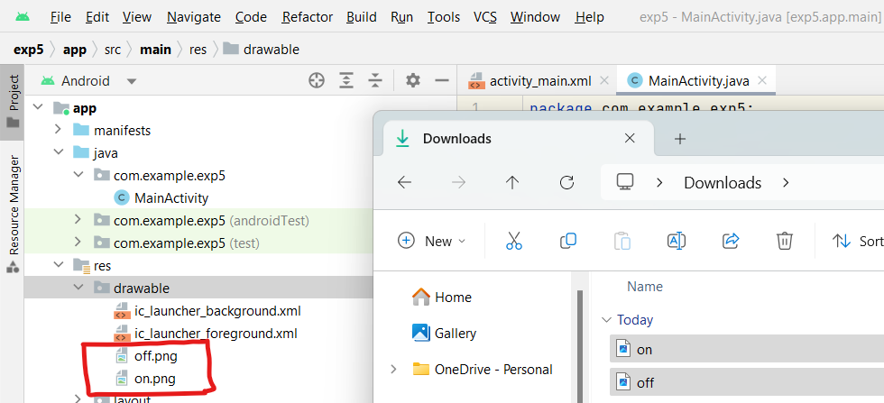
Insert pictures into res/drawable
Just copy-paste the picture into the directory or drag and drop them.

Slide 11
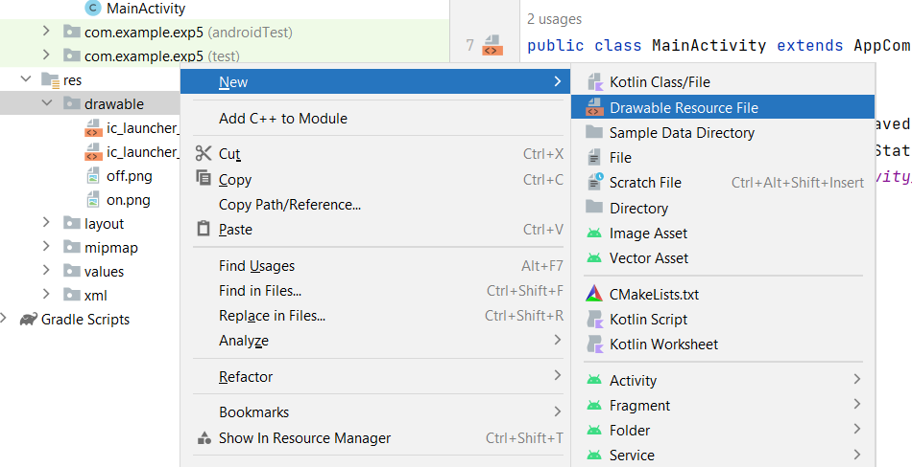
Create animation.xml file for frame animation

Slide 12
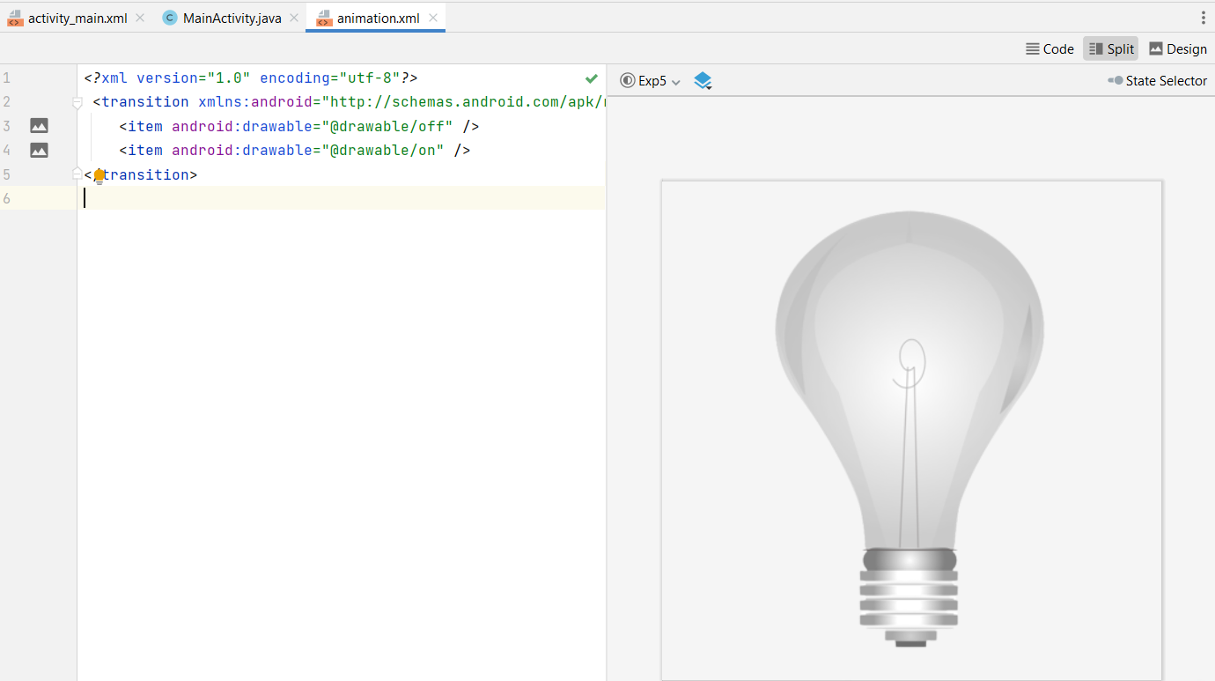
Off picture was in line 3 while on in 4 so the first to appear is off

Slide 13
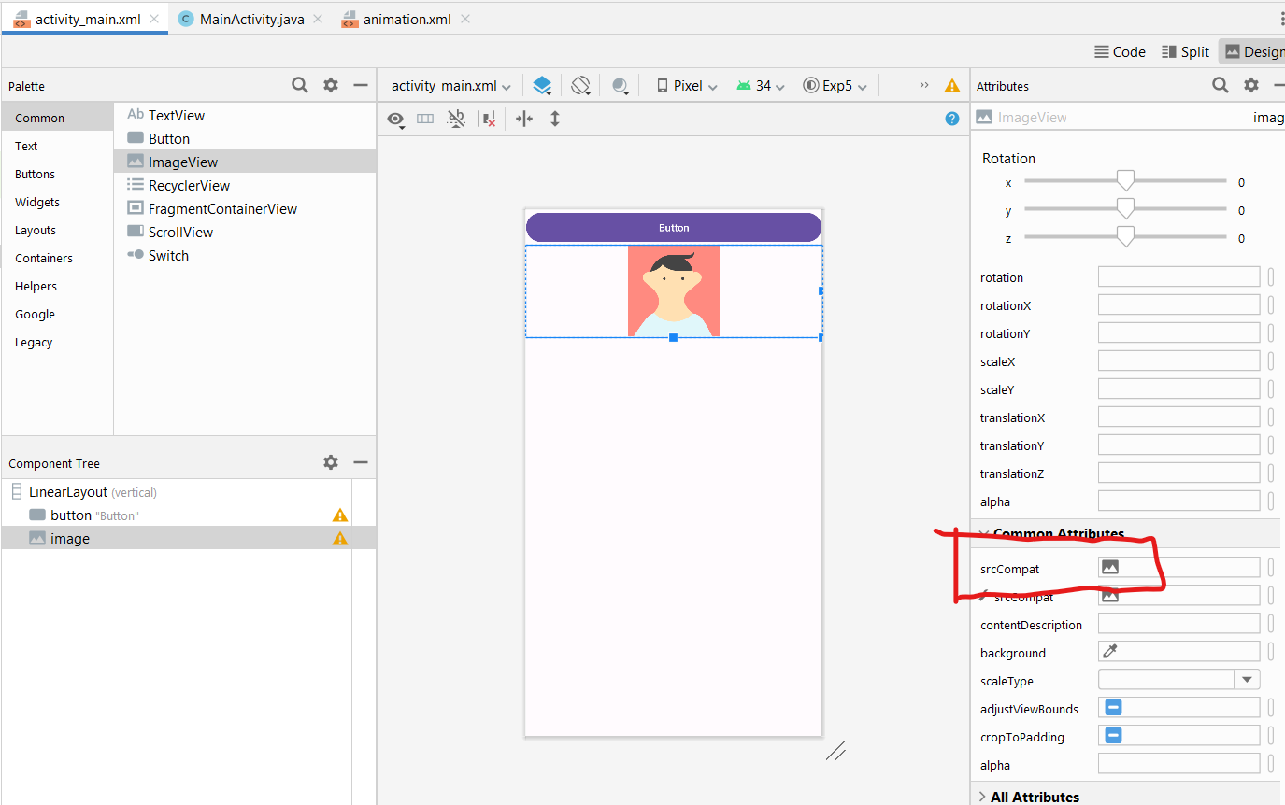
Design
Change the figure from here

Slide 14
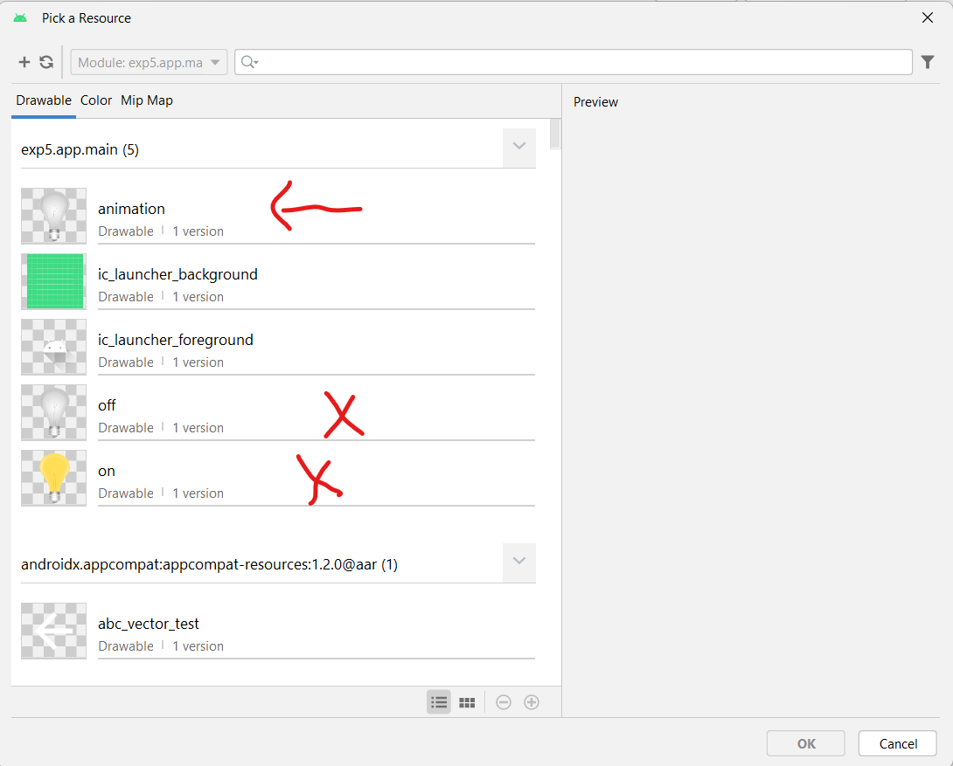
Animation file selection
Choose the animation file, not the figures. If you choose the figures, they will be static and do not change when pressing the button.

Slide 15
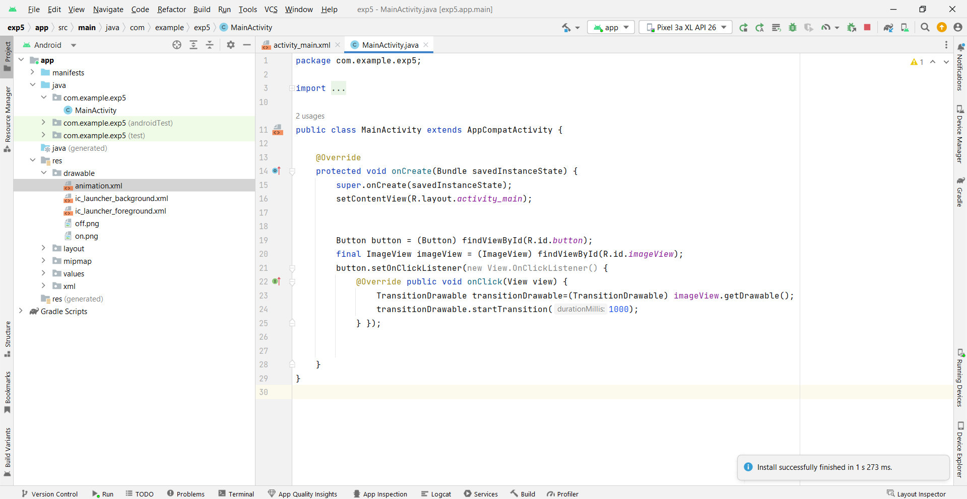
Code (try to change line 24 to: transitionDrawable.reverseTransition(1000);)

Slide 16
Tween animation

Slide 17
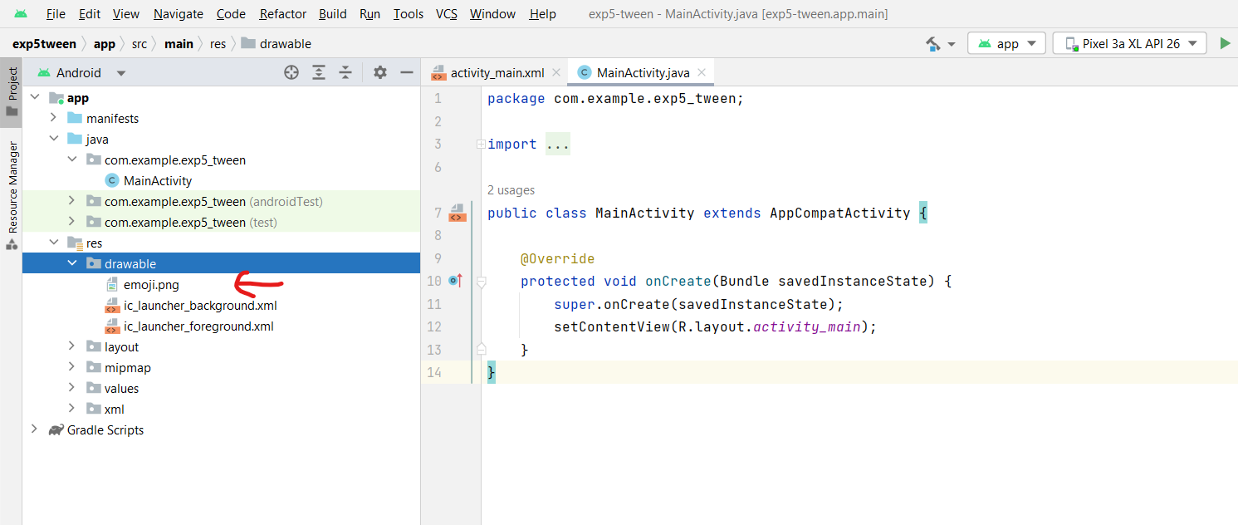
Place the picture in its correct directory

Slide 18
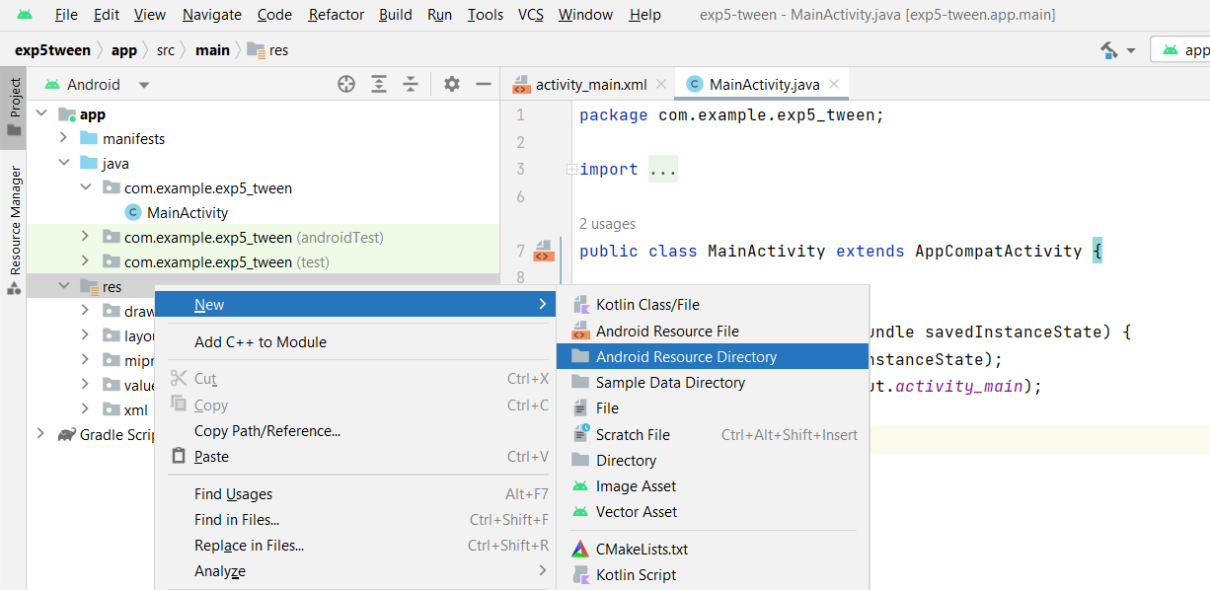
In the res folder create a new Android Resource Directory

Slide 19
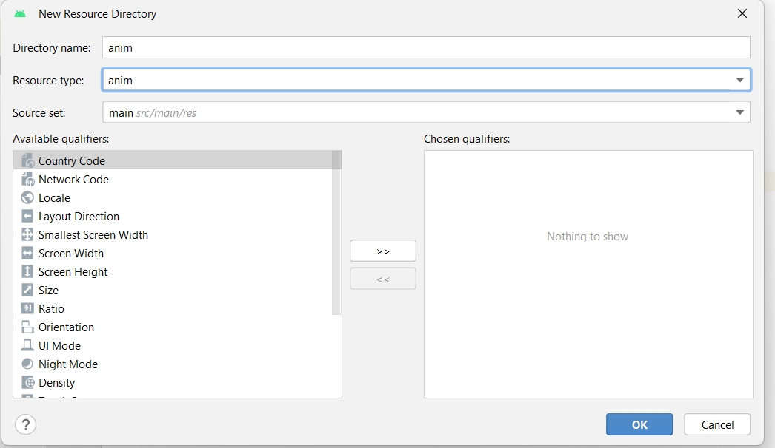
Change the Resource type to anim

Slide 20
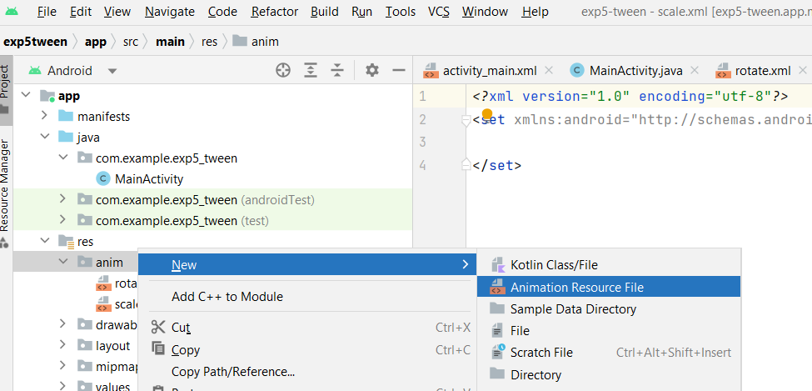
Create three Animation Resource File in the anim directory and call them rotate, scale and translate

Slide 21
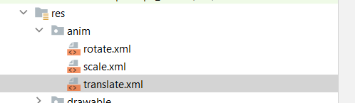
Create three Animation Resource File in the anim directory and call them rotate, scale and translate

Slide 22
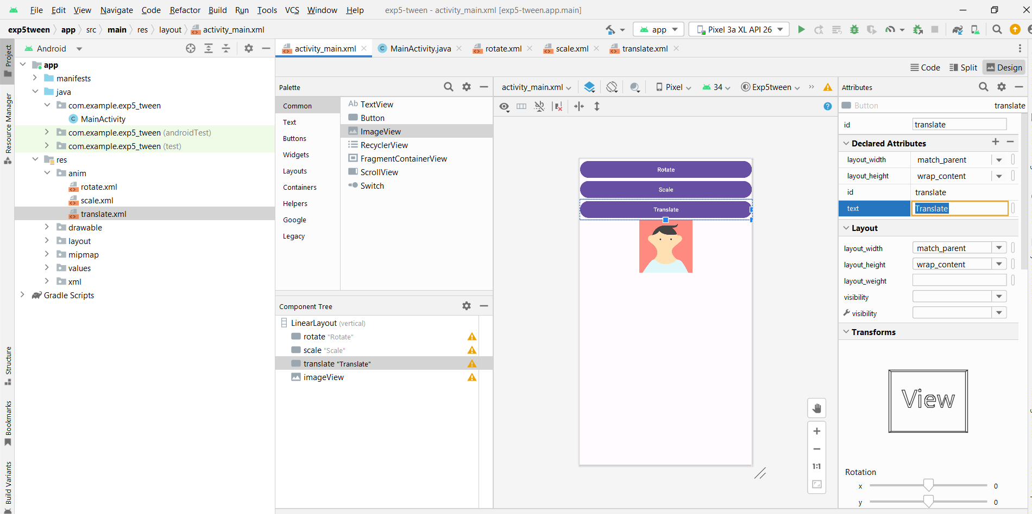
Design

Slide 23
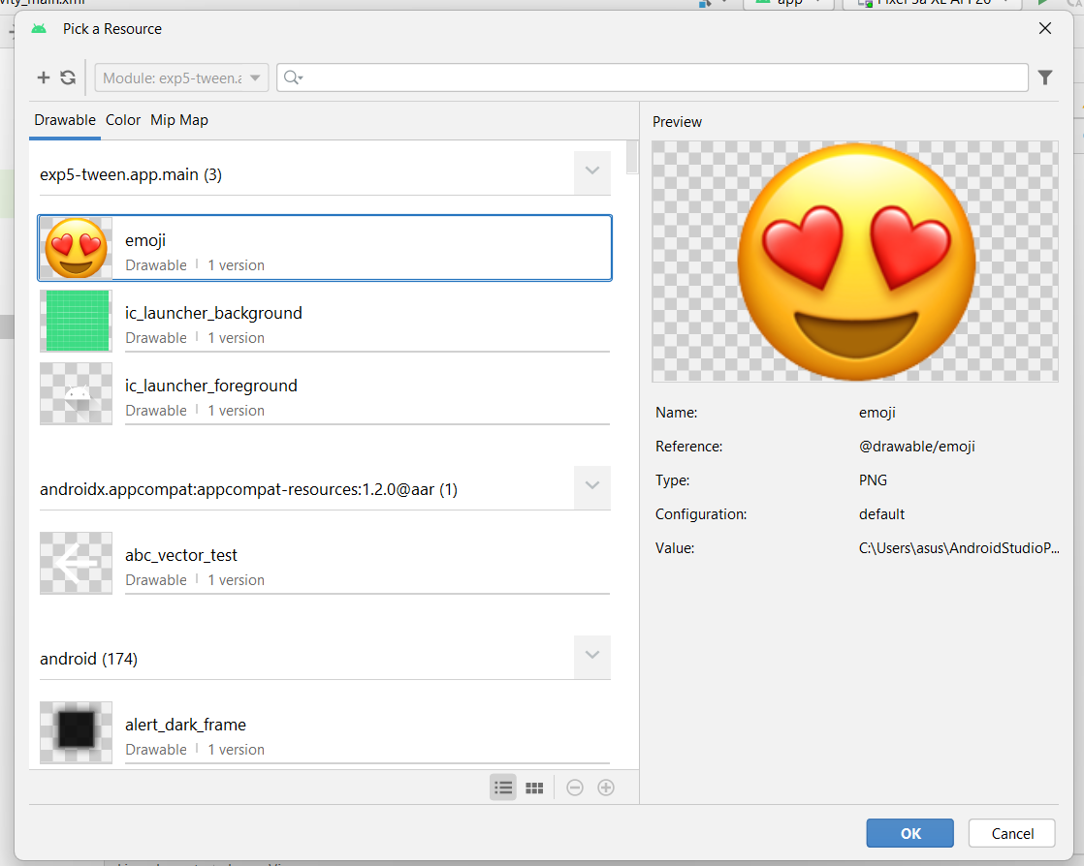
Select the picture for the imageView

Slide 24
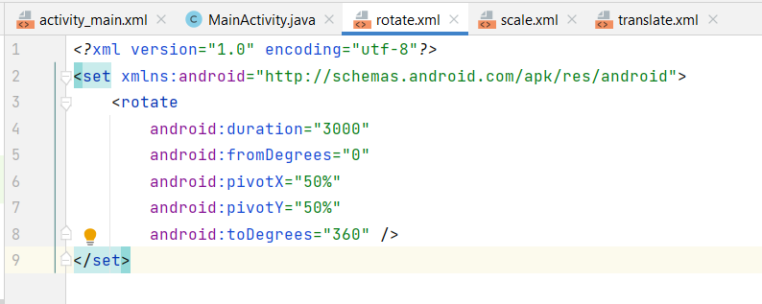
Rotate

Slide 25
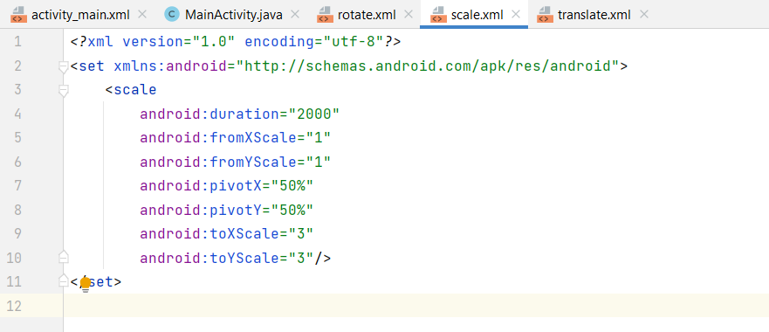
Scale

Slide 26
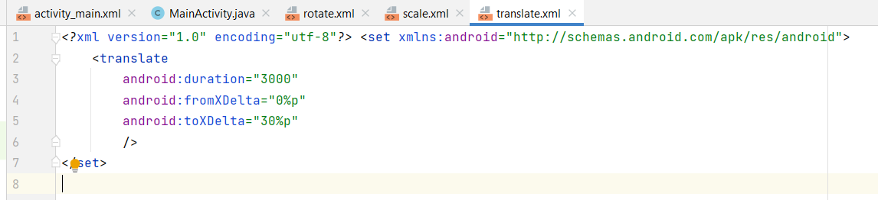
Translate

Slide 27
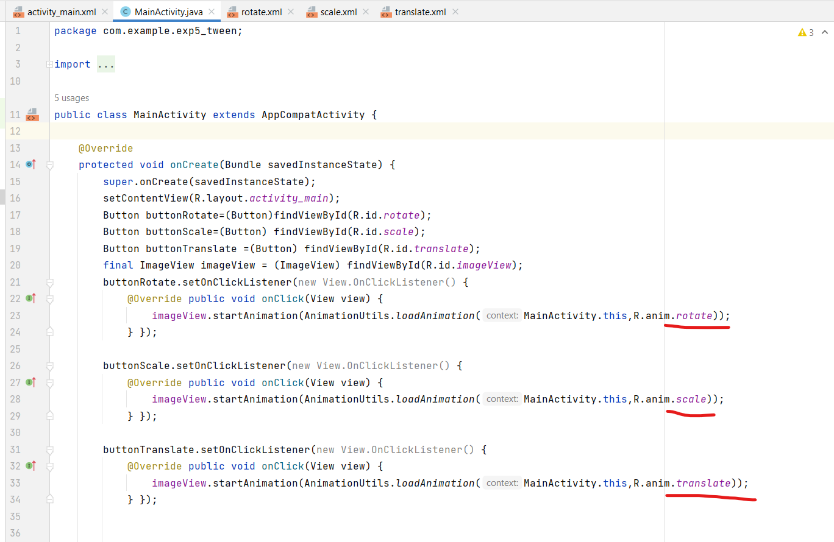
Code (only calls files)

Slide 28
To-Do (1)
Open lab manual
Check pages 66/67: ‘3.3. Try doing the following animations ‘

Slide 29
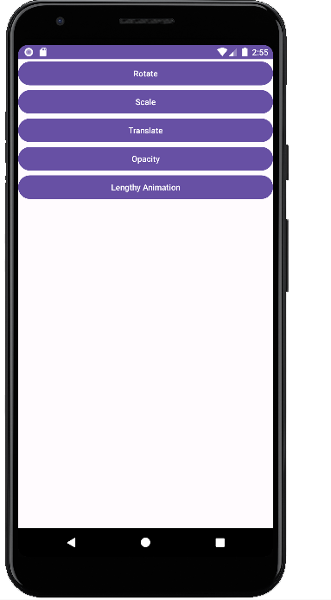
To-Do (2)
Make the bird move like this, and ensure the transitions are 500ms long. (play the slides to see the animation)
Bird figure: https://drive.google.com/file/d/1IDGVR5ABtlhcTYLW4EdPmtuyTCt4kVDK/view?usp=sharing

