Slide 1
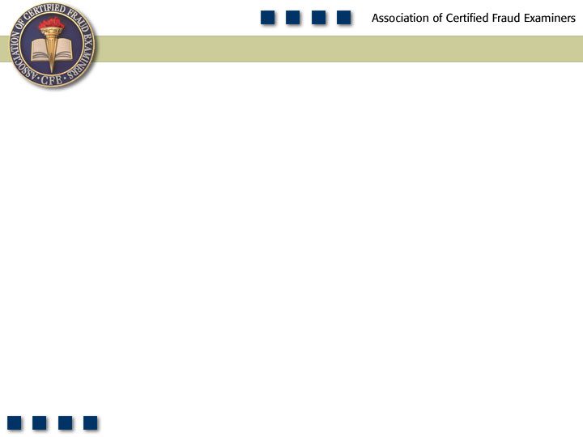
Chapter 1
Introduction to Fraud Examination

Slide 2
Learning Objectives
Define fraud examination and differentiate it from auditing.
Understand the fraud theory approach.
Define occupational fraud.
Define fraud.
Define abuse.
Know the difference between fraud and abuse.
Describe the criminological contributions of Edwin H. Sutherland.
Understand Donald Cressey’s hypothesis.
Give examples of non-shareable problems that contribute to fraud.
Understand how perceived opportunity and rationalization contribute to fraud.
Explain W. Steve Albrecht’s “fraud scale.”
Summarize the conclusions of the Hollinger-Clark study.
Summarize the results of the 2012 Report to the Nations on Occupational Fraud and Abuse.

Slide 3
Discipline of Fraud Examination
Resolving allegations of fraud from tips, complaints, or accounting clues
  Documentary evidence
  Interviewing witnesses
  Writing investigative reports
  Testifying
  Assisting in the detection and prevention of fraud
Forensic accounting vs. fraud examination

Slide 4
Auditing vs. Fraud Examination
Issue Auditing Fraud Examination
Timing Recurring Nonrecurring
Scope General Specific
Objective Opinion Affix blame
Relationship Nonadversarial Adversarial
Methodology Audit techniques Fraud examination
techniques
Presumption Professional Proof
skepticism

Slide 5
Fraud Examination Methodology
Predication
  Totality of circumstances that would lead a reasonable, professionally trained, and prudent individual to believe a fraud has occurred, is occurring, and/or will occur
  Fraud examinations must be based on predication.

Slide 6
Fraud Theory Approach
Analyze available data
Create a hypothesis
Test the hypothesis
Refine and amend the hypothesis

Slide 7
Tools Used in Fraud Examination
Document Analysis
Corroborative Witnesses
T
Target
Co-Conspirators
Neutral Third-Party Witnesses
Observation

Slide 8
Defining Occupational
Fraud and Abuse
The use of one’s occupation for personal enrichment through the deliberate misuse or misapplication of the employing organization’s resources or assets

Slide 9
Elements of Fraud
A material false statement
Knowledge that the statement was false when it was uttered
Reliance on the false statement by the victim
Damages resulting from the victim’s reliance on the false statement

Slide 10
Occupational Fraud and Abuse Research
Edward Sutherland
Donald Cressey
  Cressey’s Hypothesis

Slide 11
Fraud
Triangle
Opportunity
Pressure
Rationalization

Slide 12
2012 Report to the Nations on Occupational Fraud & Abuse
Global survey
Measuring the costs of occupational fraud
  5 percent lost to fraud
  $3.5 trillion worldwide

Slide 13
Position of Perpetrator

Slide 14
Median Loss by Position

Slide 15
Gender of Perpetrator

Slide 16
Median Loss by Gender

Slide 17
Department of Perpetrator

Slide 18
Median Loss by Department

Slide 19
Criminal History of Perpetrator

Slide 20
Median Loss per Number of Employees

Slide 21
Initial Detection of Frauds

Slide 22
Occupational Fraud and Abuse
Corruption
Asset
Misappropriations
Fraudulent
Statements
Conflicts
of Interest
Cash
Financial
Bribery
Inventory &
All Other Assets
Nonfinancial
Illegal
Gratuities
Economic
Extortion

Slide 23
Frequency of Types of Occupational Fraud and Abuse
 | Percent of Casesª | Median Loss
Asset Misappropriation | 86.7% | $120,000
Corruption | 33.4% | $250,000
Financial Statement Fraud | 7.6% | $1,000,000
ªThe sum of percentages listed in this column exceeds 100 percent because some cases involved fraud schemes that fell into more than one category. The same is true for every scheme classification chart in this book that is based on the 2011 Global Fraud Survey.

