Slide 1
An Introduction to Bioethics

Slide 2
Ethics and morality
Ethics is a set of moral principles and a code for behavior that govern an individual’s actions with other individuals and within society.
Morality is what people believe to be right and good, while ethics is a critical reflection about morality.

Slide 3
Law
Laws are societal rules or regulations that are obligatory to observe. And brought about by tension, agitation and conflict by dramatic situations.

Slide 4
Law
Laws protect the welfare and safety of society, resolve conflicts, and are constantly evolving.
Laws have governed the practice of medicine for over one hundred of years.

Slide 5
Ethical Dilemma:
Value conflicts, no clear
consensus as to the “right” thing to do. A conflict between moral obligations that are difficult to reconcile and require moral reasoning.

Slide 6
Ethical Dilemma:
Situations necessitating a choice between two equal (usually undesirable) alternatives.

Slide 7
What is bioethics?
  Bioethics: how scientists and health professionals ought to behave in the biomedical sciences
The attempt to understand and justify the link between values (fundamental principles) and actions

Slide 8
What is bioethics?
Bioethics refers to the moral issues that are usually life-and-death issues! and problems that have arisen as a result of modern medicine and medical research.
Ethical and bioethical principles can be personal, organizational, institutional or worldwide.

Slide 9
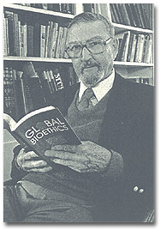
Bioethics
Van Rensselaer Potter
"Biology combined with diverse humanistic knowledge forging (يصقل) a science that sets a system of medical and environmental priorities for acceptable survival.“
Global Bioethics (1988)
-------- 1911 - 2001 --------

Slide 10
Comparing Law bioethics and Ethics
Law, ethics, and bioethics are different but related concepts.
Laws are mandatory to which all citizens must adhere or risk civil or criminal liability.
Ethics relate to morals and help us organize complex information and competing values and interests to formulate consistent and coherent decisions.
Notes:
There are penalties for failing to follow the law. This includes professional practice acts.
Although there are no penalties for not following the principles of ethics, there are consequences to self, organizations and the community at-large.

Slide 11
Current Bioethical Issues
Check the local news paper
Stem cells (state, national, international)
Genetically Engineered Organisms
Knowing your genes
In vitro fertilization – choosing your child's genes and characteristics
Chemicals exposures – human health
Environmental health

Slide 12
Ethical Issues in
Modern Healthcare
In modern healthcare and research, value conflicts arise where often there appears to be no clear consensus as to the “Right thing to do.” These conflicts present problems requiring moral decisions and necessitates a choice between two or more alternatives.
Examples:
Should a parent have a right to refuse immunizations for his or her child?
Does public safety supersede (تلغي) an individual’s right?

Slide 13
Ethical Questions, Cont.
Should children with serious birth defects be kept alive?
Should a woman be allowed an abortion for any reason?
Should terrorists be tortured (يعذب) to gain information possibly saving hundreds of lives?
Should health care workers be required to receive small pox vaccination?
Who should get the finite number of organs for transplantation?
Notes:
Update examples for this slide as current issues arise.
Select questions of your choice for class discussion.

Slide 14
Why do we need bioethics?

Slide 15
Why Employ Ethical Principles?

Slide 16
Respect for the Individual
In our pluralistic society (مجتمعنا التعددي) individuals often misunderstand each other.
Even when they do understand each other, it is possible for them to disagree.
The Healthcare arena, in common with every other segment of society has found it necessary to find ways to create understanding and agreement.

Slide 17
How to Create Understanding and Agreement?
Common ground must be created or found.
A function of Ethics, in our society, is to make agreement possible.
As healthcare professionals and patients meet, they meet as strangers from diverse backgrounds therefore, their ways of looking at and approaching the world are usually quite different.

Slide 18
Creating Harmony is Difficult
In The Healthcare Arena.
Power
Self esteem
Communication
Personality/Attitude
Education Level
Socioeconomic Class
Culture (which constitutes the most
profound difference).
Values
Notes:
I need a note.

Slide 19
How May Harmony Be Achieved?
Through ethical principles/behaviors, because they:
  Provide a unique opportunity for personal fulfillment and self respect.
  Serve to make it possible for professionals to deal with each other on a human level with respect across all disciplines.

Slide 20
Ethical Dilemma:
Deciding People’s Fate
Notes:
Starting at the life boat exercise, the small group activity should take about an hours time. This exercise can be used by itself and can be expanded. At the end of the exercise, some questions and reflections to focus on may be:
How did decision making and consensus building occur within the groups/class. Who is the leader, how did that happen? Are you requiring 100% consensus or majority rule? Have the student who had the minority opinion explain how he/she felt? How and why did the student acquiesce? Examine the individual values of the group as to why they choose the survivors. During the process explore whether students changed their minds, and why?

Slide 21
You are on a sinking ship and there is only ONE lifeboat available. Posted on the side of the lifeboat is a sign which reads, “Maximum
Occupancy” - 7 persons…this boat will sink if over occupied.” Standing on the deck and waiting on board the lifeboat are eight adults and one child.
You must decide who dies. Be prepared to defend your decision.
Notes:
Feel free to add characteristics and situations to the persons on deck. For example, at the end of the discussion, ask if any of the groups had considered:
The seventeen year old was raped.
The girl is 9 months pregnant.
The retired physician was an emergency room physician.
Unbeknownst to the other persons on deck, the professional athlete has AIDS.

Slide 22
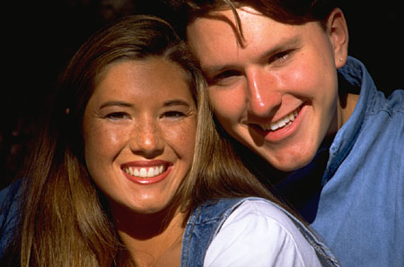
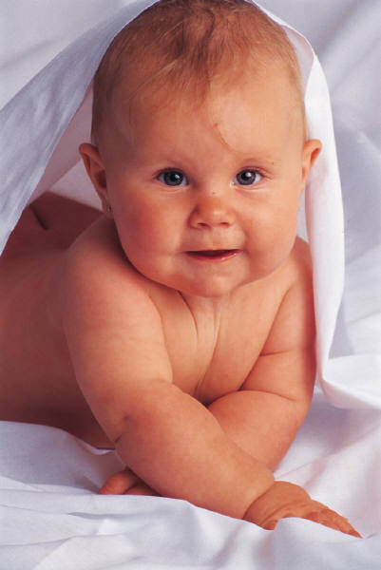

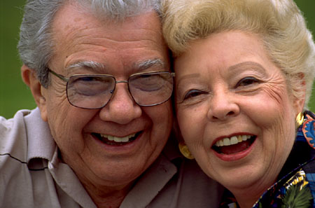
Persons on deck
You
A young mother and her infant son
A 75 year old retired physician
His 68 year old wife
A 17 year old, pregnant girl
(this counts as one person)
A professional athlete (male)
A middle aged school teacher and
Her husband, a banker

Slide 23
Who Boards the Lifeboat? Why?
1.
2.
3.
4.
5.
6.
7.

Slide 24
Who goes down with the ship? Why?
1.
2.

Slide 25
Ethical Questions for Discussion
Should children with serious birth
defects be kept alive?
Should a woman on Medicaid be allowed an abortion for any reason?
Should organs for transplantation be able to be purchased?

Slide 26
Ethical Questions for Discussion
Should people suffering from
a genetic disease, where future misery
is predicted, be allowed to have children?
Should individuals be allowed to use
scarce healthcare resources when death
is inevitable?
Notes:
There are many more ethical questions and dilemmas we have to deal with today and none has an easy answer.

Slide 27
An Example of A
Decision Making Model
(ADPIE)
Assessment
  Gather the facts/collect information from a variety of sources
Diagnosis
  Identify the problem or issue

Slide 28
An Example of A
Decision Making Model
(ADPIE)
Planning
  Explore alternatives and/options.
  Identify the consequences of actions/non-actions.
  Analyze the values and professional issues at stake.
  Select the course of action / make a decision and Justify the decision.

Slide 29
An Example of A
Decision Making Model
(ADPIE)
Implementation
  Carry out the plan.
Evaluation
  Determine how this ethical problem could possibly have been prevented.
  Lessons learned.
  Assessment of outcomes.

Slide 30
Decision Making Model:
(ADPIE)
Diagnose
Assessment
Planning
On-going Evaluation
On-going Implementation
Implementation
On-going Planning
Evaluate
On-going Diagnosis
On-going Assessment
Notes:
Assessment, Diagnosis, Planning, Implementation, Evaluation (ADPIE) Decision Making Model
This model was developed as an on-going evaluation tool. The strategic plan is an ongoing living process. As soon as the organization initiates the assessment process and, therefore, determines the needs of the organization (diagnosis), it is time to move on to the planning phase where the stake holders determine (plan) the strategies to meet the needs of fixing or addressing the problems within the organization (diagnosis). After this phase is completed, it is time to put into action the plans (implement) determined by the organization’s stake holders. It is then imperative to see if the organization has met the goals of the plans and programs that were implemented (evaluate). Upon finishing the evaluation and discovering the success and failures of the implemented plans, (take note already a new organization is emerging), it is time to begin assessing the new organization with it’s new strengths and weaknesses that are a net result of implementing the initial ADPIE process. To do this effectively, it is necessary to initiate the ADPIE process again. At the end of this next ADPIE process, the result will again be a new organization with its new strengths and weaknesses that are a net result of implementing the second ADPIE process. ADPIE then starts again, and so on and so on…. This process is ongoing through out the life of the organization. This helps to prevent inertia, stagnation, and non-growth which is inherent in many organizations who have not put in place an on-going evaluation processes to use as a metric for the on-going outcomes measurements needed for the on-going success of the organization.

Slide 31
Controversies:
Should a mother be legally liable for drinking or doing drugs while pregnant? This of course would cause harm to their unborn child.
Opinion?

Slide 32
Controversies:
Should you be allowed to genetically modify your children before they are born to prevent disease?
What about to change eye color, make them taller, stronger, smarter, better behaved?
Opinion:

Slide 33
Controversies:
Should food and chemical corporations genetically modify food to yield more product, make food more nutritious, or make food taste better? Would you eat this food?
Opinion

Slide 34
Controversies:
Should people be allowed to sell their extra kidney or a portion of their liver to a person in need of a transplant? This is currently illegal
Opinion

