Slide 1
Exp #6
Singleton and Shared Preferences
SLIDES BY: Tarek Zidan and Mohamad Balawi

Slide 2
Notes:
In this experiment we will use Constraint Layout instead of Linear Layout like we always do.
Please watch the following short video about constraint layout:
https://www.youtube.com/watch?v=4N4bCdyGcUc

Slide 3
1. Shared preferences
SharedPreferences is a simple key-value pair storage system.
Allows you to save and retrieve primitive data types (such as boolean, float, int, long, etc.) as well as String type.
It's often used for storing small amounts of app configuration data or user preferences.
Stored as an XML file in the app's directory within the device's file system.
/data/data/<package_name>/shared_prefs/<filename>.xml.

Slide 4
Steps to Store Data:
Get a SharedPreferences reference.
Create an editor to make changes.
Add data using a key-value pair.
Save the changes (This commits the changes, saving them to the shared preferences file, if you forget it then you didn’t save anything)

Slide 5
Steps to Read Data:
Get a SharedPreferences reference.
Retrieve the data using the key.
Ex: String name = sharedPreferences.getString("name", "noValue");
If the key ("name") exists, the value will be returned.
If it doesn’t exist, "noValue" will be returned as the default.

Slide 6
Accessing shared preferences
There are two methods to access shared preferences:
  getPreferences(int mode): gets an instance that is specific to that Activity.
  getSharedPreferences(String name , int mode): gets an instance by its name, this instance can be accessed by multiple activites.
The mode parameter can take several values:
  MODE_PRIVATE Only your app can access the file. (Birthday)
  MODE_WORLD_READABLE All apps can read the file. (Theme)
  MODE_WORLD_WRITABLE All apps can write to the file.

Slide 7
Shared preferences vs SQLite Database
sqlite database
Shared preferences
Offers structured, relational data storage suitable for larger datasets and complex querying.
Returns cursor object
Slower because it has DB overhead
Suitable for large data
Suitable for structured data retrieval
provides simpler key-value pair storage primarily for lightweight, primitive data, like user preferences or small configurations.
Returns primitive data types (and String)
Faster than SQLite for small files
Not suitable for large data
Not suitable for structured data retrieval

Slide 8
2. Singleton
The Singleton Design Pattern is a creational design pattern that ensures a class has only one instance and provides a global access point to that instance. It is commonly used in scenarios where exactly one object is needed to coordinate actions across the system.
Even if we instantiate the class multiple times at multiple locations in our code, we will always get the same object.
Difference between Singleton and regular Java class (How to achieve Singleton):
  Private constructor. (Because it won’t be used to take instances)
  Private static instance of the same class.
  A public static method to get the one and only instance of the class; the method is usually called getInstance().

Slide 9
getInstance() method
  In the Singleton class: when we first time call the getInstance() method
  1- It creates an object of the class with the name single_instance and returns it to the variable. Since single_instance is static, it is changed from null to some object.
  2- Next time, if we try to call the getInstance() method since single_instance is not null, it is returned to the variable instead of instantiating the Singleton class again. This part is done by if condition.

Slide 10
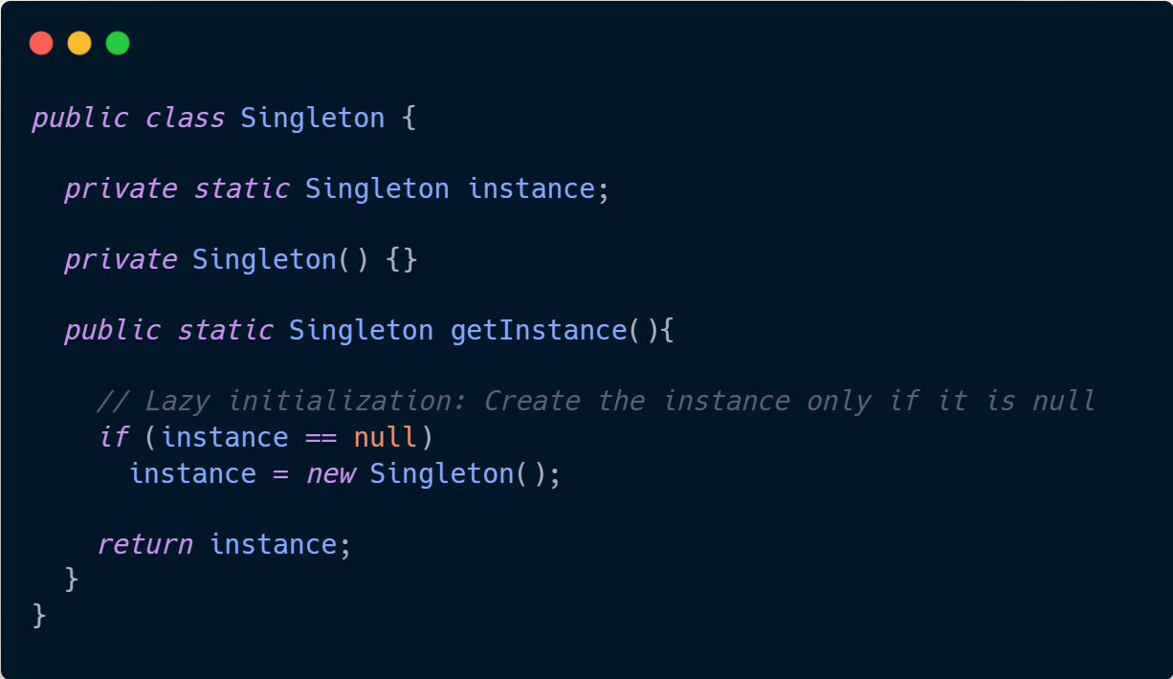
Singleton Implemntation
Q) What is visible to external classes?
A) Only getInstance().

Slide 11
What problem does Singleton solve?
Global Access Point: They provide a single, centralized access point to an instance, ensuring that all code accessing that instance goes through a defined interface, which can be crucial for managing resources or controlling access to shared services.
Examples:
  Loggers.
  Database connection.
  Hardware access.
  Configuration manager.

Slide 12
MainActivity Design

Slide 13
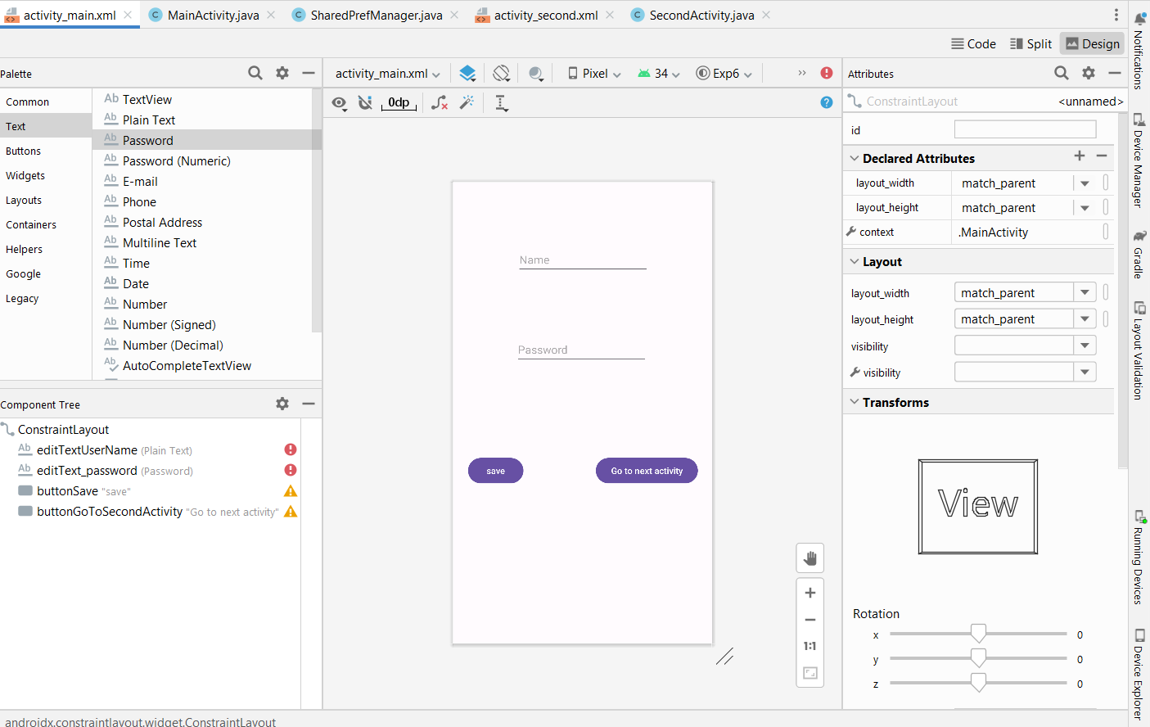

Slide 14
MainActivity Code

Slide 15
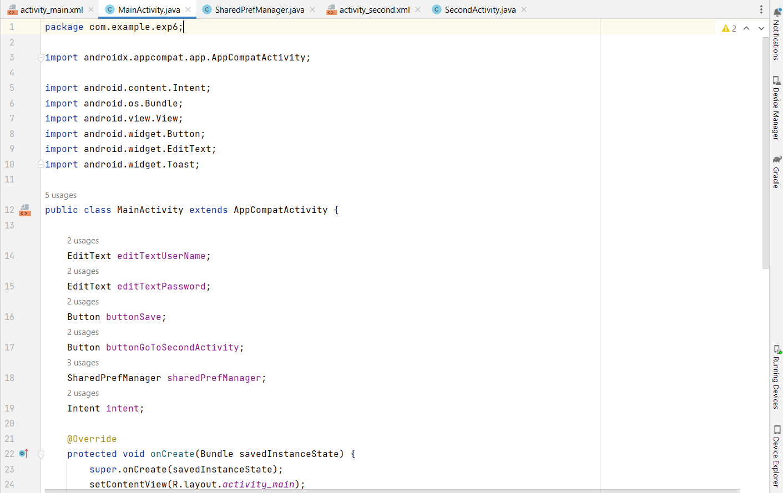

Slide 16
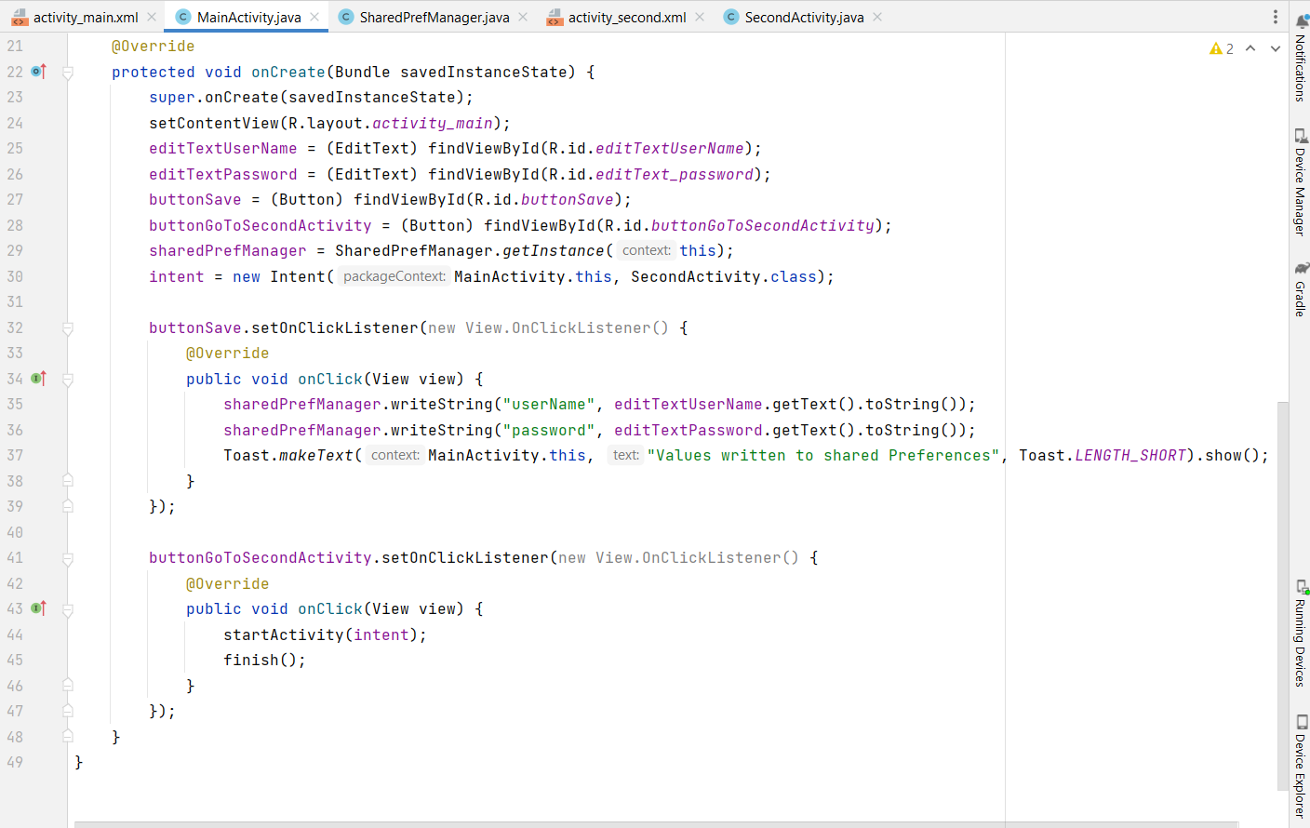

Slide 17
SecondActivity Design

Slide 18
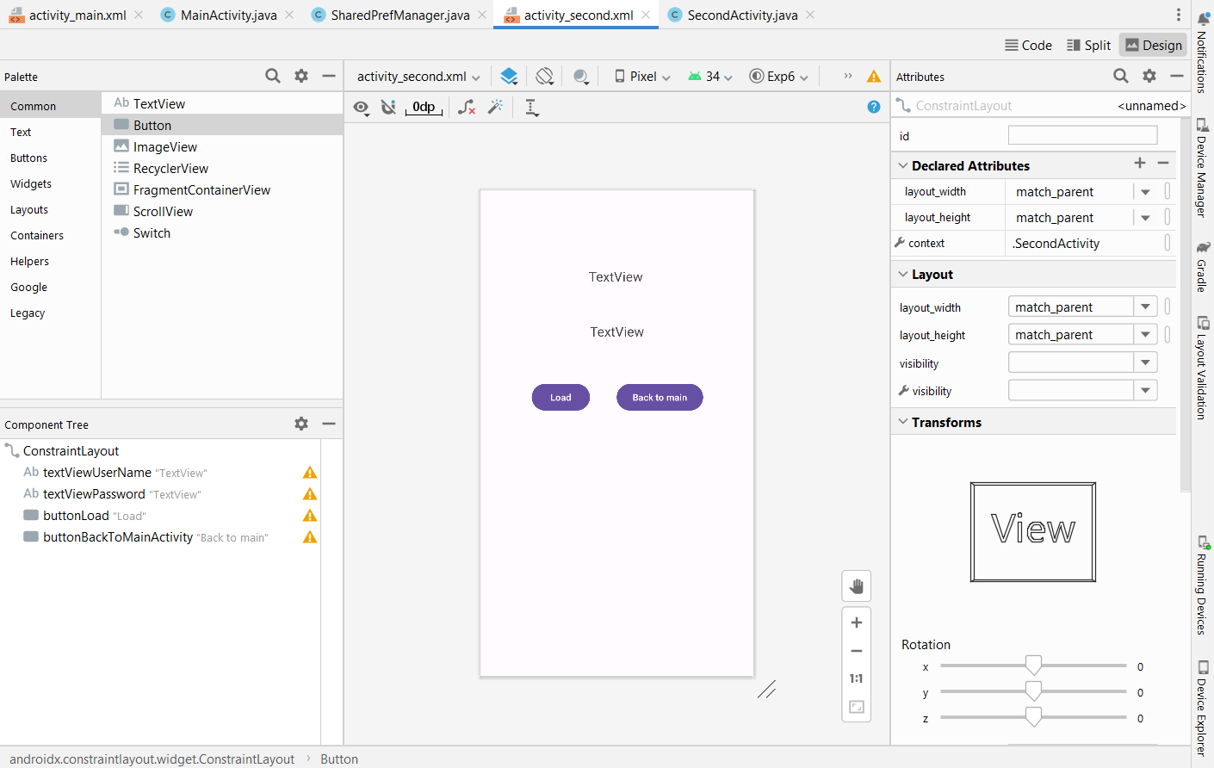

Slide 19
SecondActivity Code

Slide 20
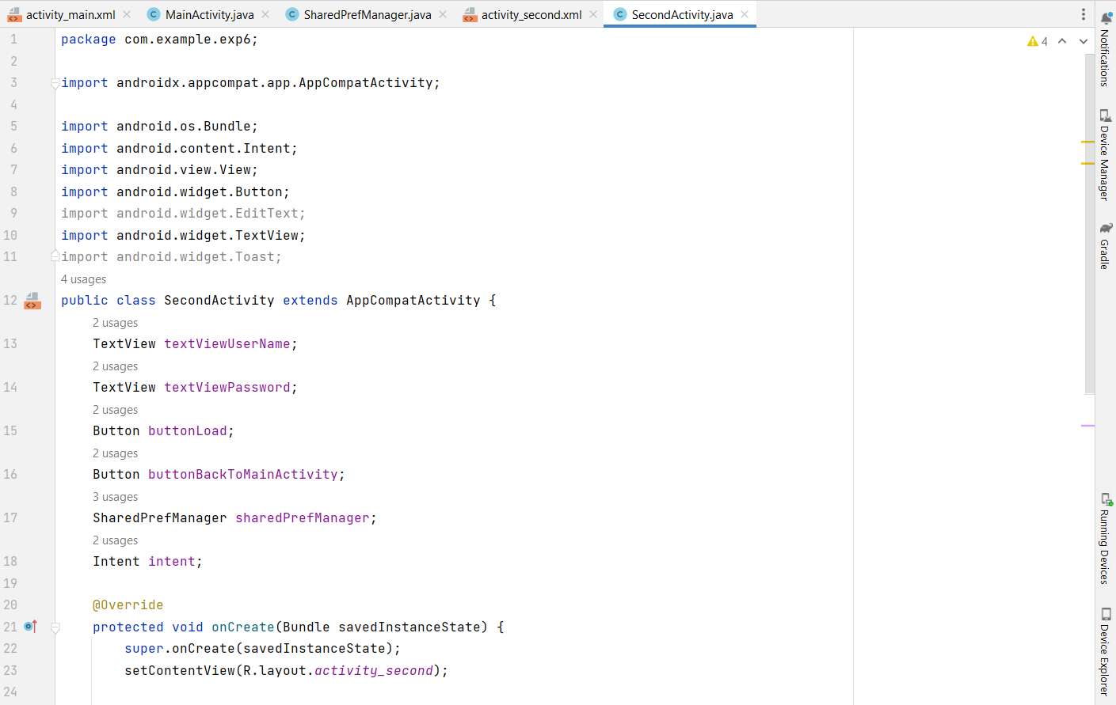

Slide 21
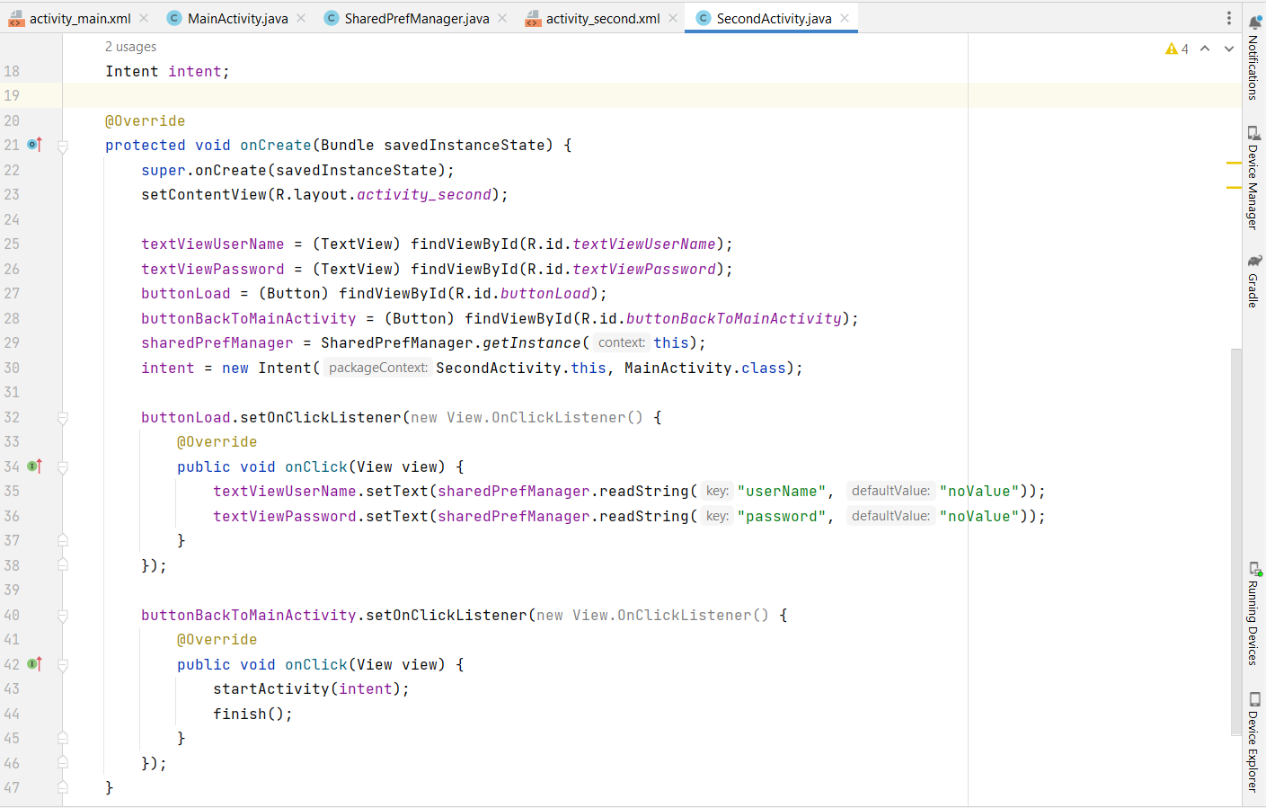

Slide 22
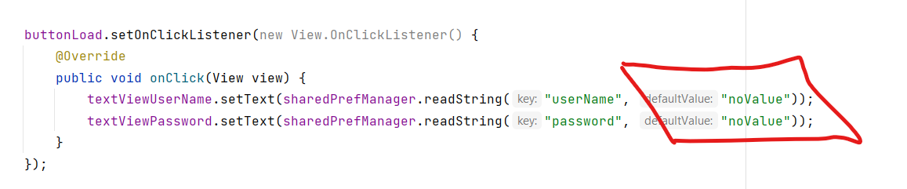
Important Note
The two lines are retrieving stored values from SharedPreferences using key-value pairs.
Key: A string used to identify the value (e.g., "userName" or "password").
Default Value: A value that will be shown if the key doesn't exist or hasn't been assigned any value.
In this case, "noValue" is used as the default value.
textViewUserName.setText(...): This sets the TextView to show the saved username. If no username is found, it will display "noValue".
textViewPassword.setText(...): Similarly, this sets the TextView to display the password. If no password is found, "noValue" will be shown.

Slide 23
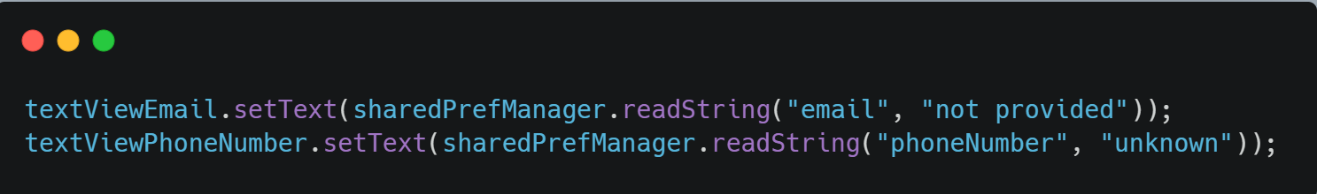
Another example
Assume the following data is saved:
"email": student@example.com
"phoneNumber": not savedResult
On the Screen:
Email: student@example.com
Phone Number: unknown

Slide 24
SharedPrefManager Java class

Slide 25
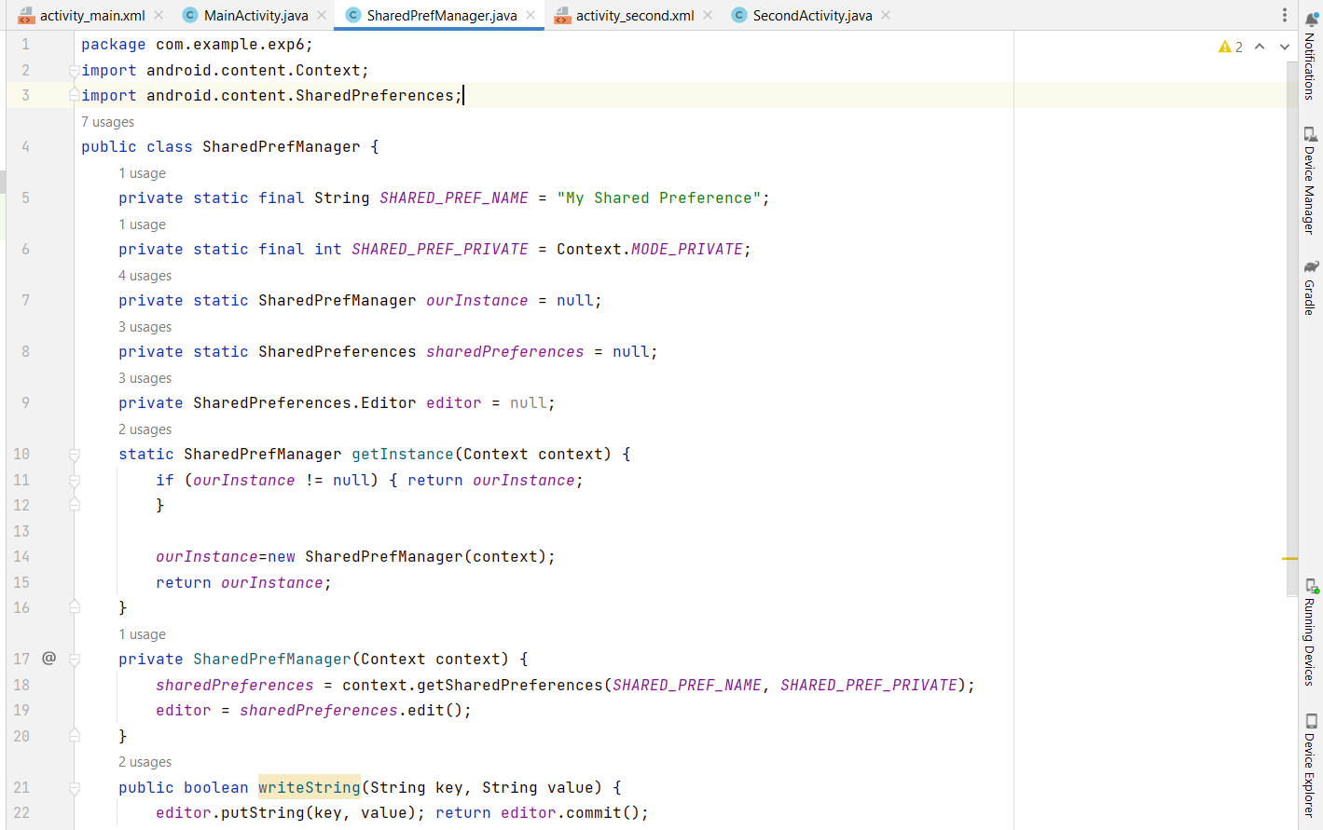

Slide 26
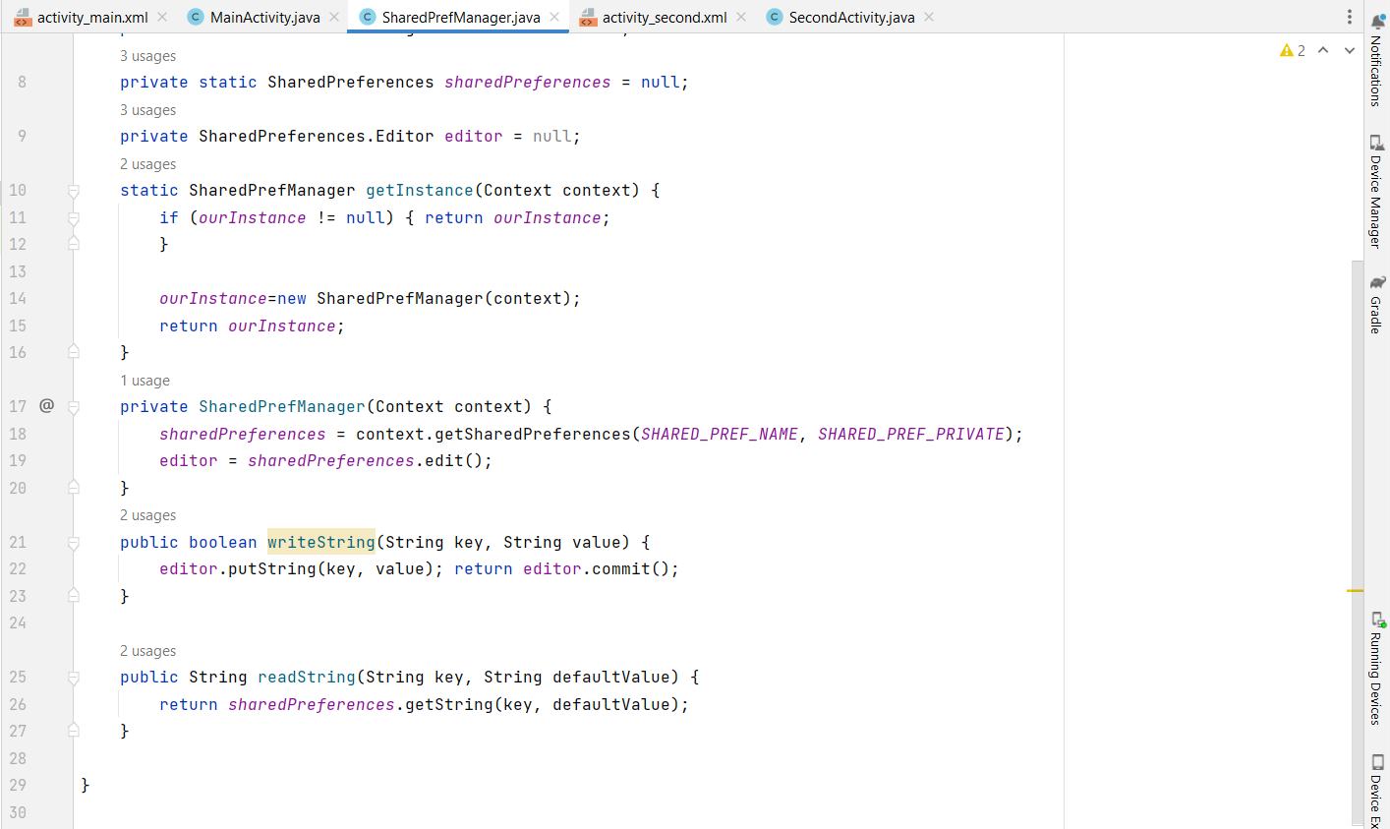

Slide 27
To-Do: Apply Dark Mode using SharedPreferences
Steps:
Create a CheckBox in your layout to allow users to enable or disable dark mode.
Use SharedPreferences to:
  Save the user's preference (whether dark mode is enabled or not).
  Retrieve and apply the saved preference when the app starts.
Search online for resources or tutorials on how to implement dark mode in an Android application.
Write code to: Save the CheckBox state (checked or unchecked) in SharedPreferences.

Slide 28
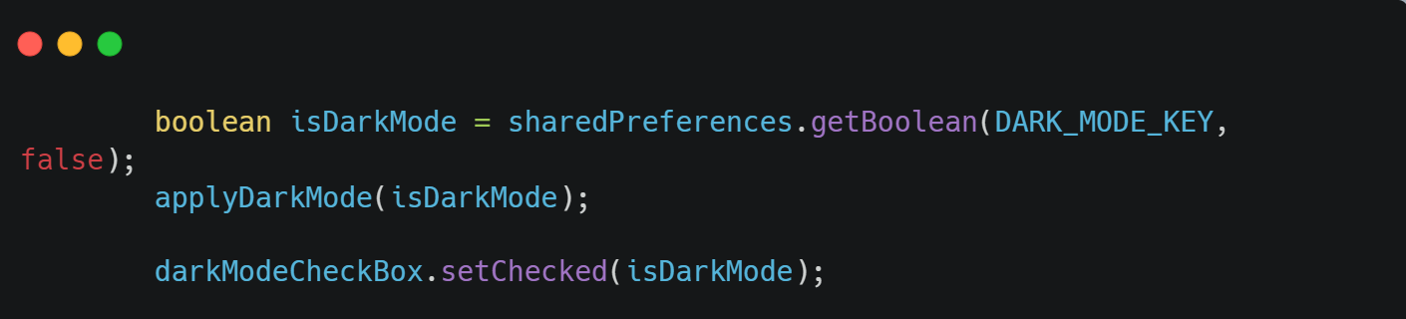
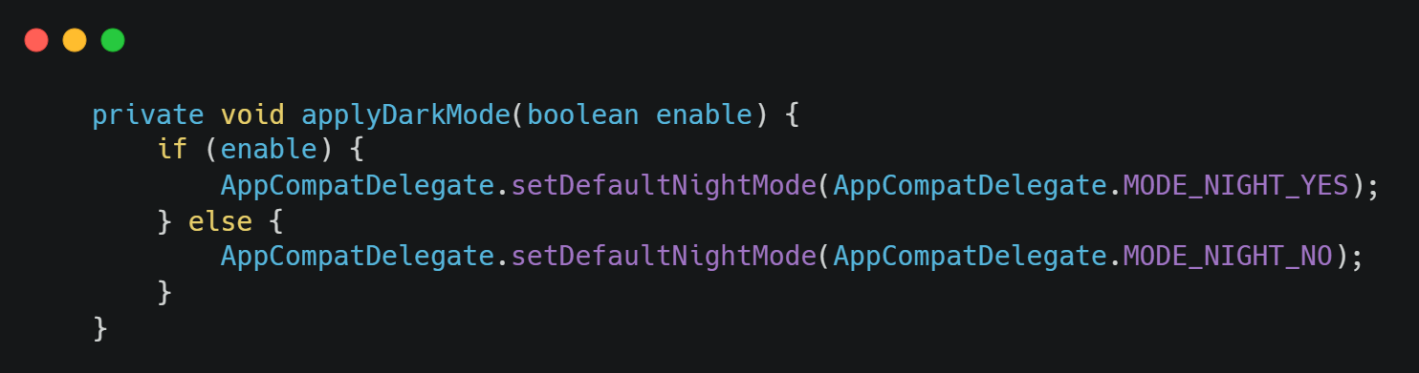
Hint Code

