Slide 1

Mechatronics System Design
Chapter 2: Dynamic Models and Analogies
Instructor: Dr. Ahmad Al-Balasie
First Semester - 2021/2022

Slide 2
Dynamic Models and Analogies
    Design, development, modification, and control of a mechatronic system require an understanding and a suitable “representation” of the system; specifically, a “model” of the system is required.
    Any model is an idealization of the actual system.
    Properties established and results derived are associated with the mode . In this manner the component models can be conveniently integrated to obtain the overall model.
    In particular, analytical models may be developed for mechanical, electrical, fluid, and thermal systems in a rather analogous manner, because some clear analogies are present among these four types of systems.
    In view of the analogy, a unified approach may be adopted in the analysis, design, and control of mechatronic systems.

Slide 3
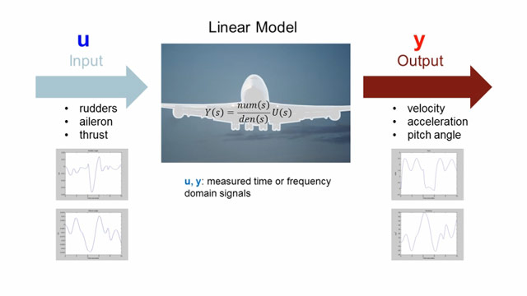
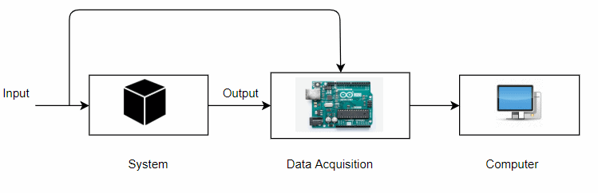
Model Types
    Experimental Model or Model Identification:
    One way to analyze a system is to impose disturbances (inputs) on the system and analyze the reaction (outputs) of the system. This is known as. A model that is developed by exciting the actual system and measuring its response, is called an experimental model.

Slide 4
Model Types
2. Analytical Model :
Another way is to analyze the system using an analytical model of the system. In effect, we represent the system with a model, such as:
state space model
linear graph
transfer function model
frequency-domain model
its analytical model, analytical models are commonly used in practical applications.
Analytical models are very useful in predicting the dynamic behavior (response) of a system when it is subjected to a certain excitation (input). F

Slide 5
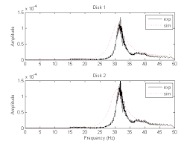
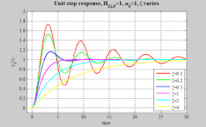
System Response
The response of an analytical model to an imposed disturbance can be expressed in either the time-domain (response value versus time) or in the frequency domain (amplitude and phase versus frequency).
The time-domain response generally involves the solution of a set of differential equations. The frequency domain analysis is done with a set of transfer functions, that is the ratio output/input in the Laplace transform (“s”) form.

Slide 6
Model Development
Development of a suitable analytical model for a large and complex system requires a systematic approach. The main steps are summarized below:
Identify the system of interest by defining its purpose and the system boundary.
Identify or specify the variables of interest. These include inputs (forcing functions or excitations) and outputs (response).
Approximate (or model) various segments (components or processes or phenomena) in the system by ideal elements, which are suitably interconnected.
Draw a free-body diagram for the system with isolated/separated elements, as appropriate.

Slide 7
Model Development
Write constitutive equations (physical laws) for the elements.
Write continuity (or conservation) equations for through variables (equilibrium
of forces at joints; current balance at nodes, fluid flow balance, etc.)
Write compatibility equations for across (potential or path) variables. These
are loop equations for velocities (geometric connectivity), voltage (potential
balance), pressure drop, etc.
Eliminate auxiliary variables that are redundant and not needed to define the
model.
9. Express system boundary conditions and response initial conditions using
system variables.

Slide 8
Analogies
Analogies exist among mechanical, electrical, hydraulic, and thermal systems.
The basic system elements can be divided into two groups: energy-storage elements and energy dissipation elements.
Table 2.1 gives the linear relationships, which describe the behavior of translatory-mechanical, electrical, thermal, and fluid elements. These relationships are known as constitutive relations.

Slide 9
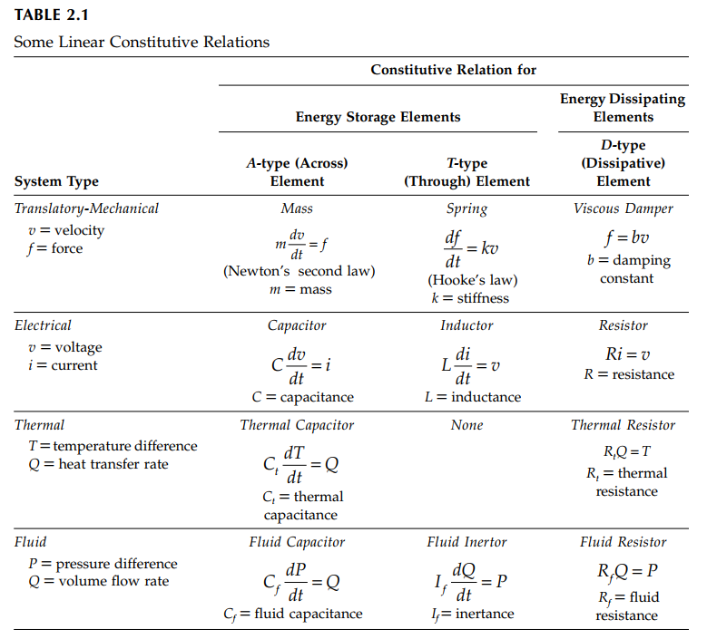

Slide 10
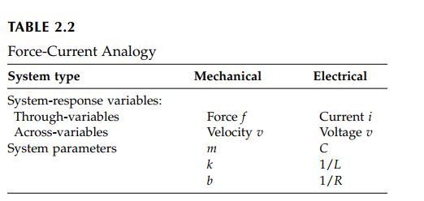

Slide 11
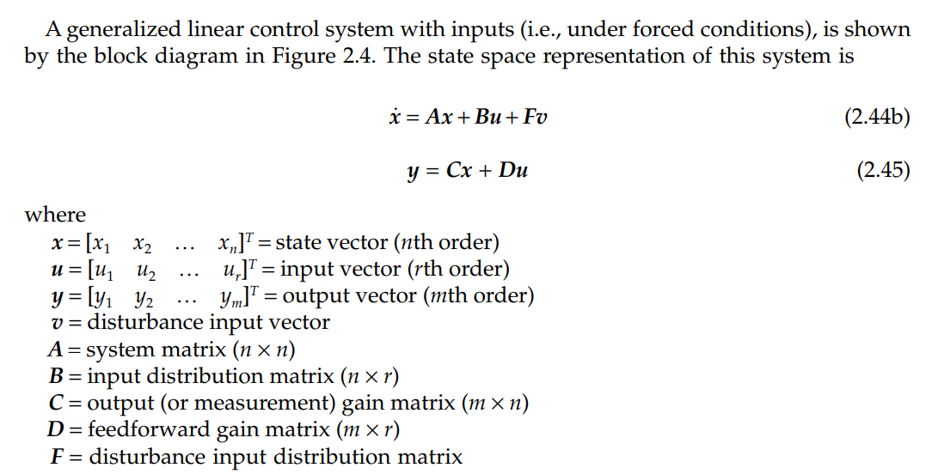
Linear State Space Model

Slide 12
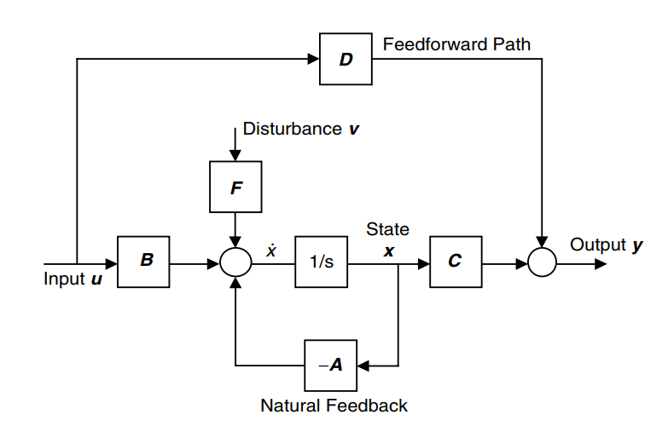
Linear State Space Model

Slide 13
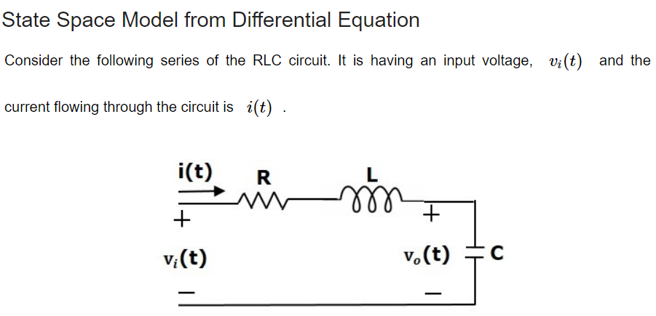

Notes:
The state variable on the case of the capacitor is its voltage.
The state variable on the case of the capacitor is its current.

Slide 14
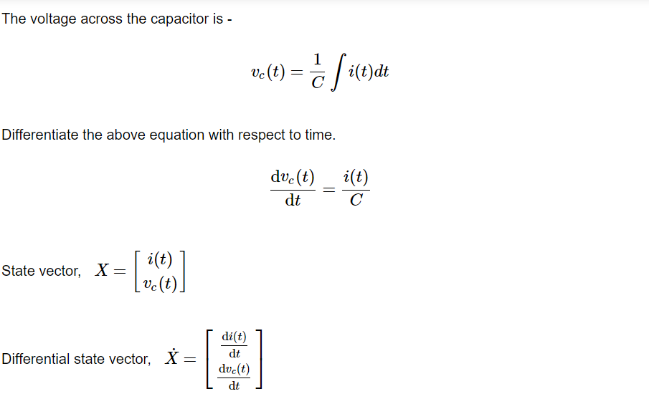

Slide 15
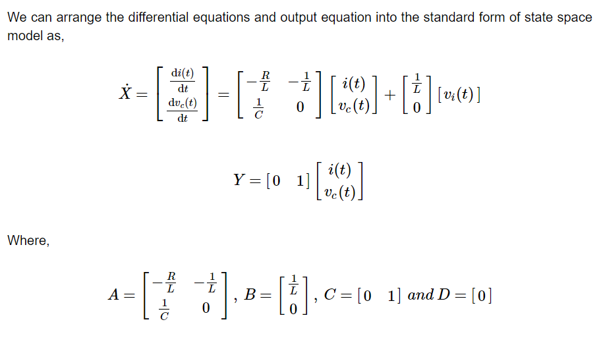

Slide 16
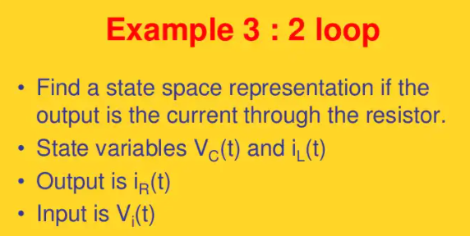

Slide 17
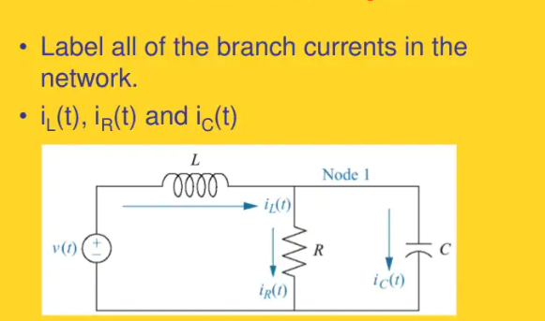
Find State Space Representation

Slide 18
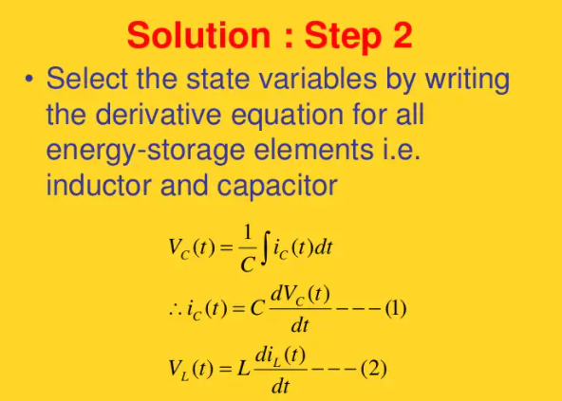

Slide 19
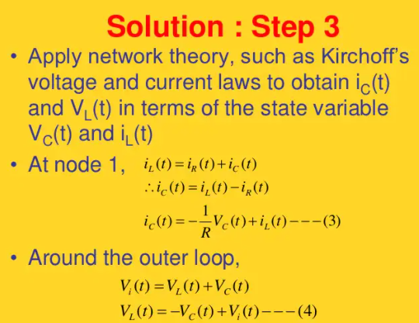

Slide 20
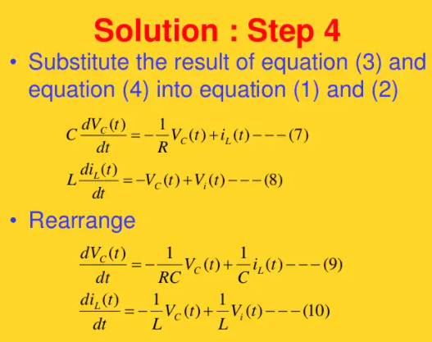

Slide 21
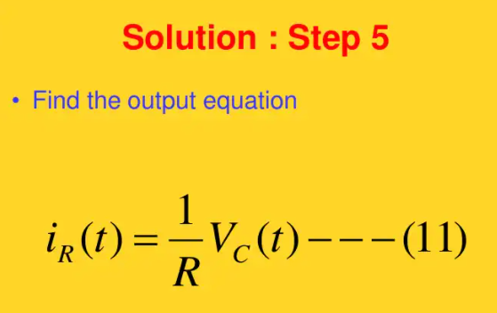

Slide 22
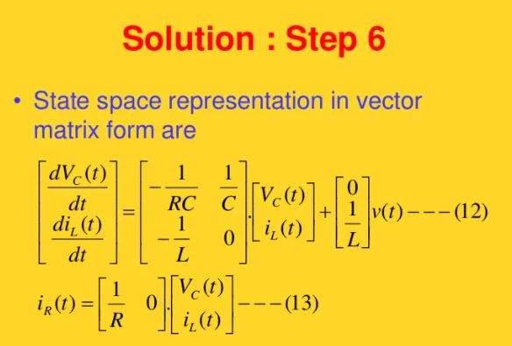

Slide 23
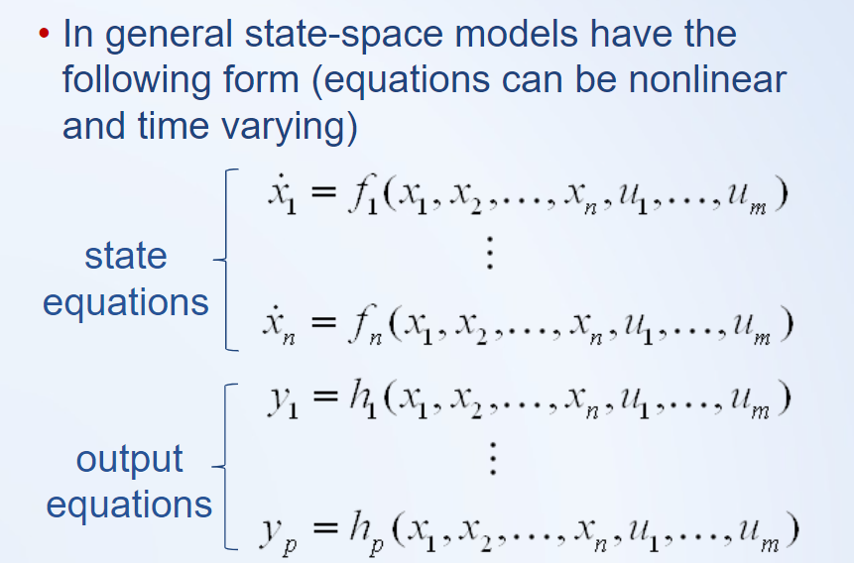
Nonlinear State Space Model

Slide 24
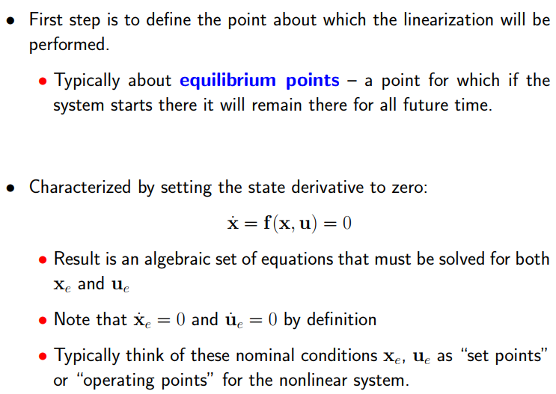
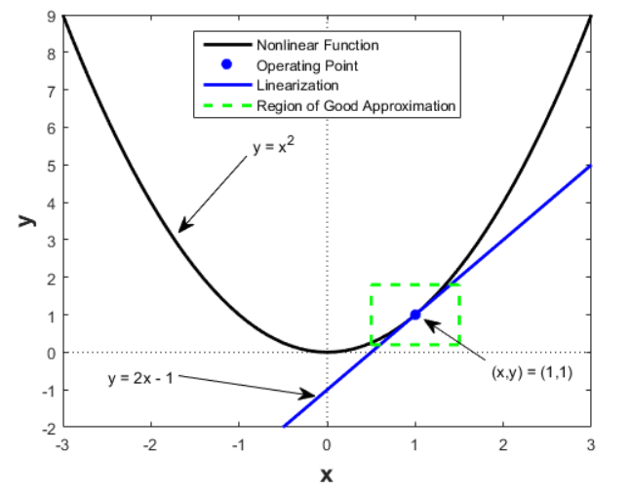
Linearization about operating Point

Slide 25
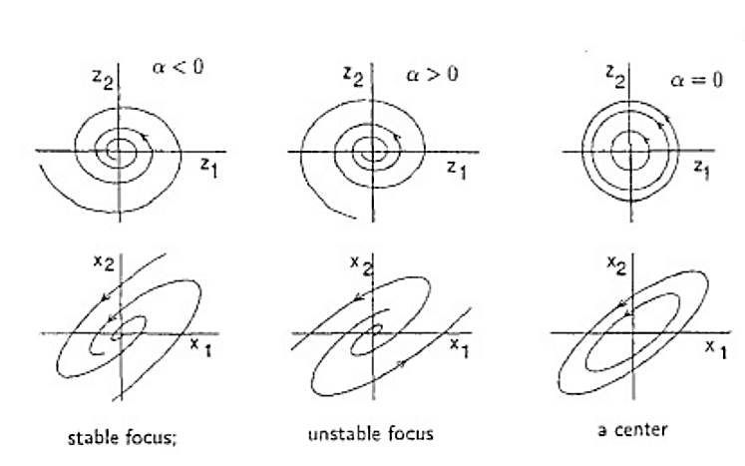
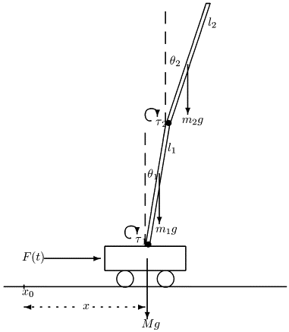
Linearization about operating Point

Slide 26
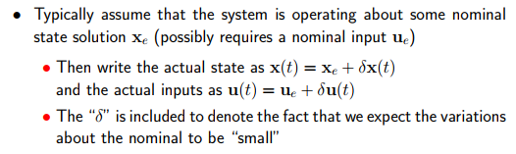
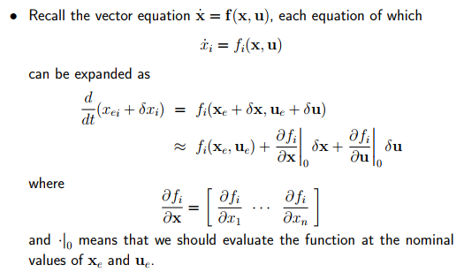

Slide 27
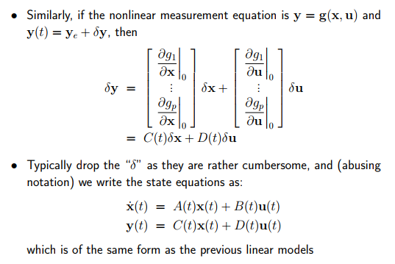

Slide 28

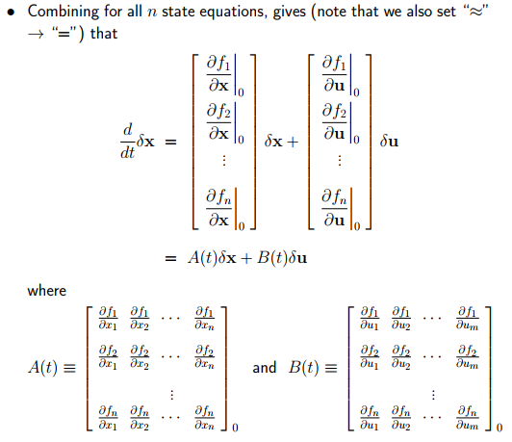

Slide 29
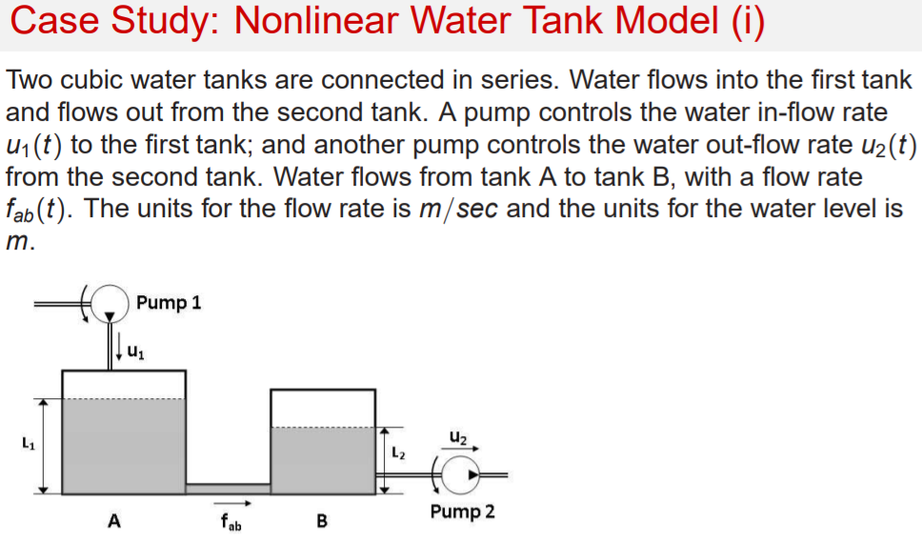

Slide 30
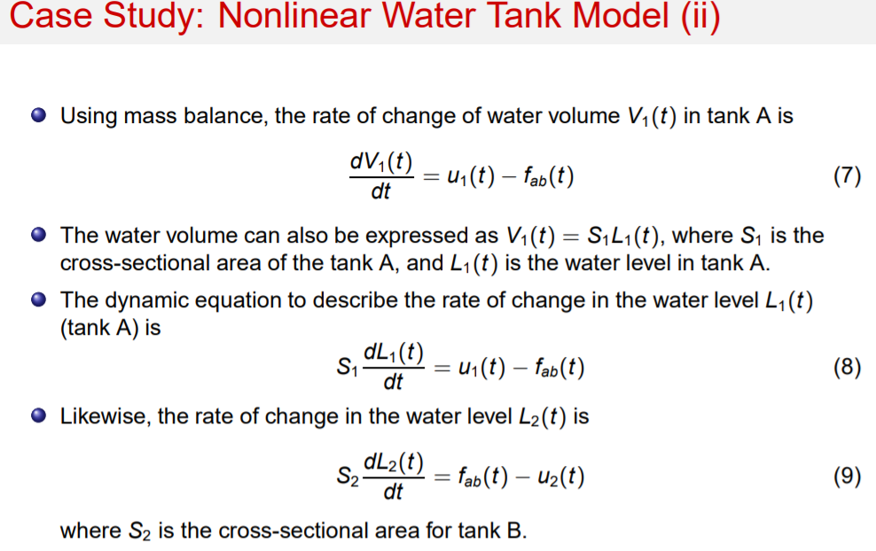

Slide 31
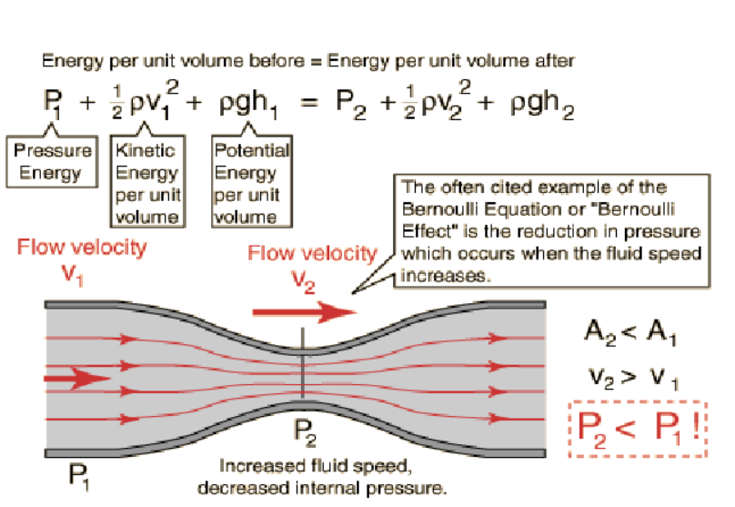

Slide 32
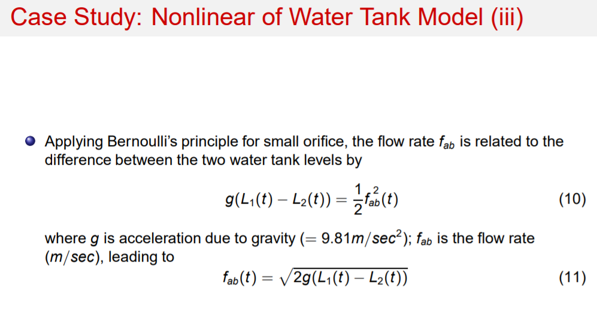

Slide 33
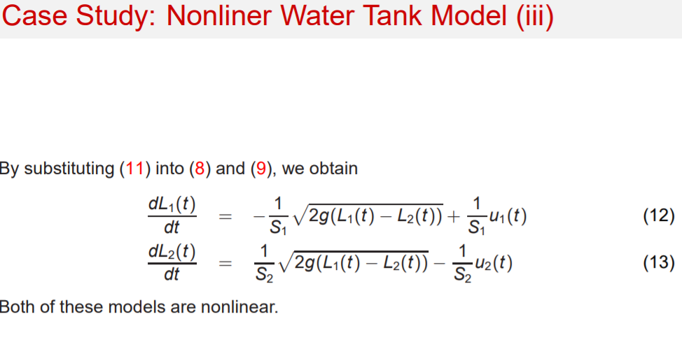

Slide 34
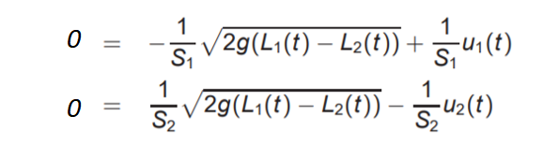
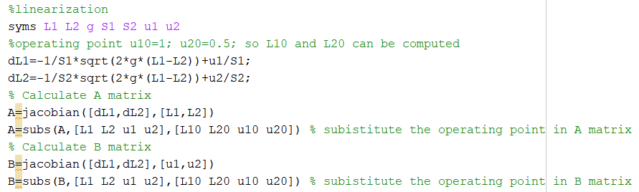
Determine the Operating Point and Compute A and B matrices
Let $u_{1}\left(t\right)$ and $u_{2}\left(t\right)$ are known as constants so we can determine $L_{1}(t)$ and $L_{2}(t)$

Slide 35
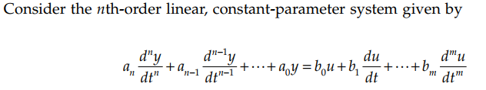
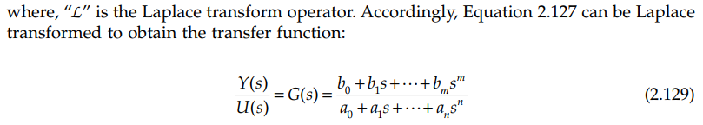
Transfer Functions
The transfer function G(s) of a linear, time-invariant, single-input single-output (SISO) system is given by the ratio of the Laplace-transformed output to the Laplace-transformed input, assuming zero initial conditions.

Slide 36


Transfer Matrix
Consider the state variable representation of a linear, time-invariant system given by the state equations:

Slide 37
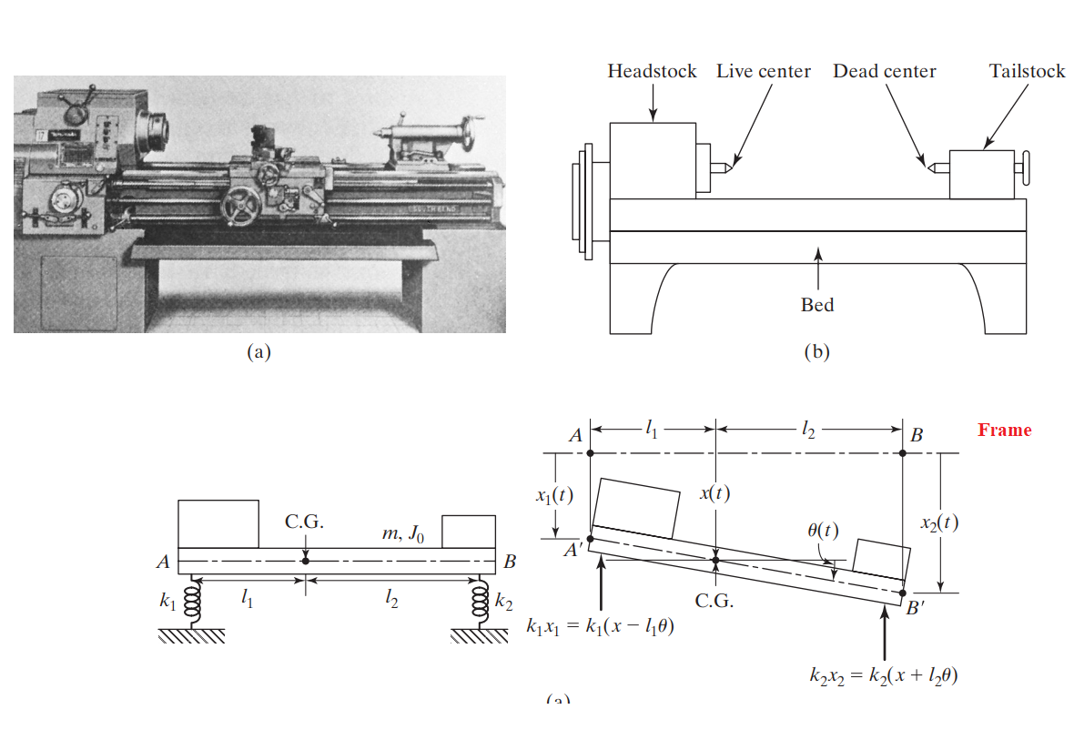

Slide 38
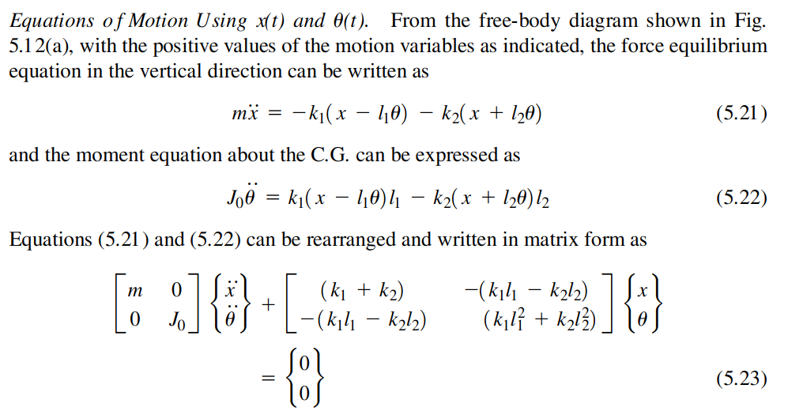

Slide 39
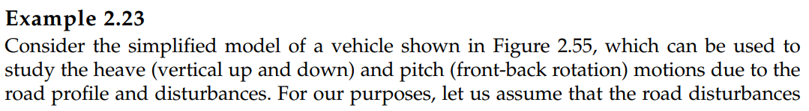
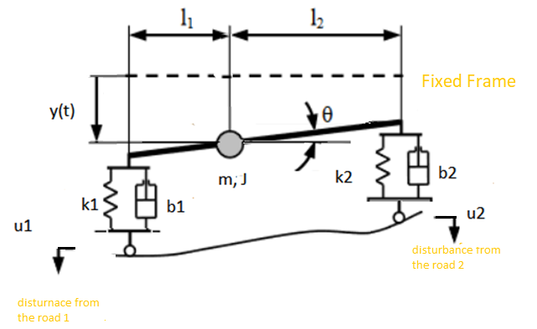
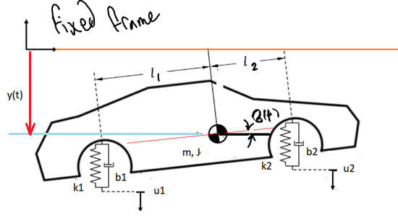

Slide 40
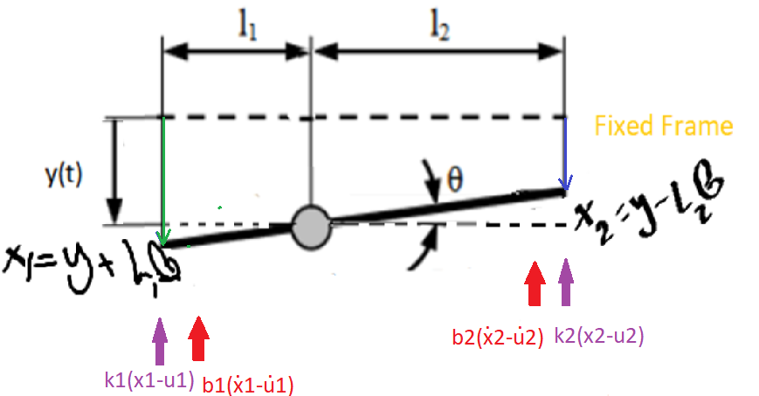

Slide 41
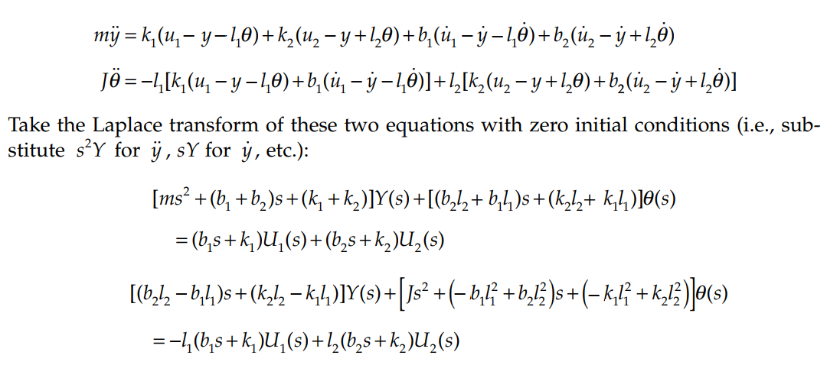

Slide 42
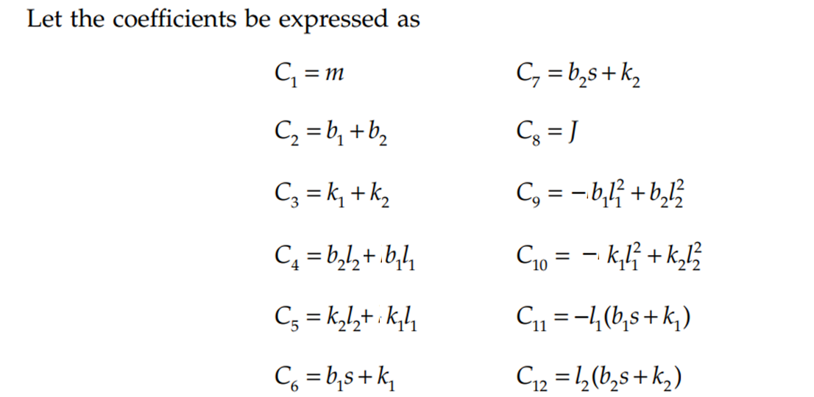

Slide 43
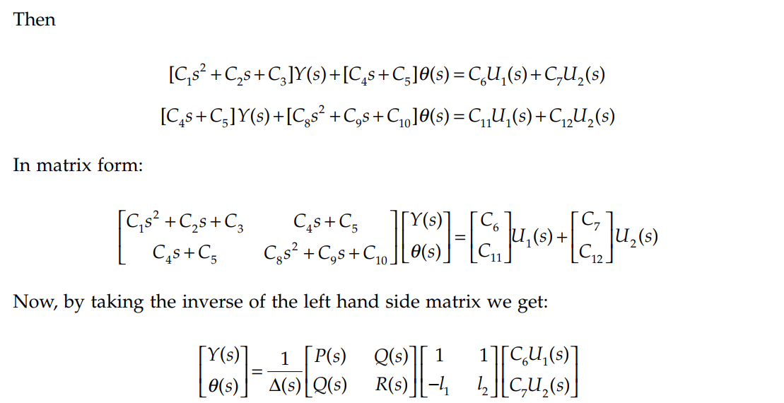

Slide 44
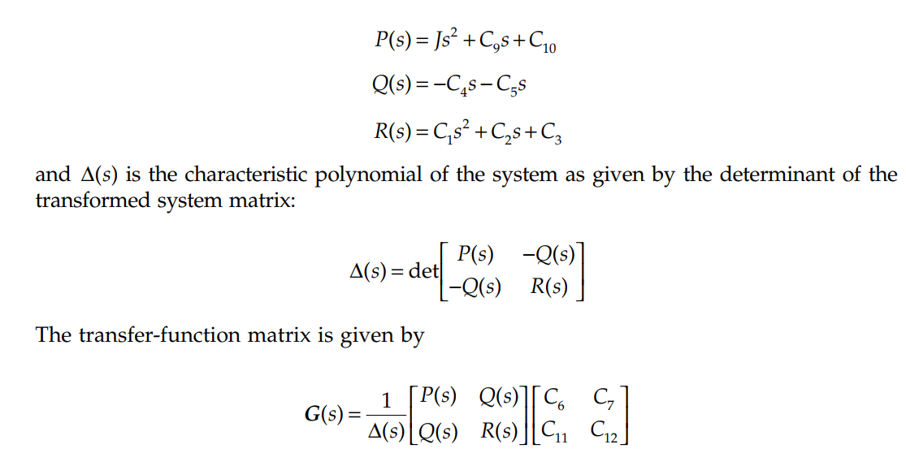

Slide 45
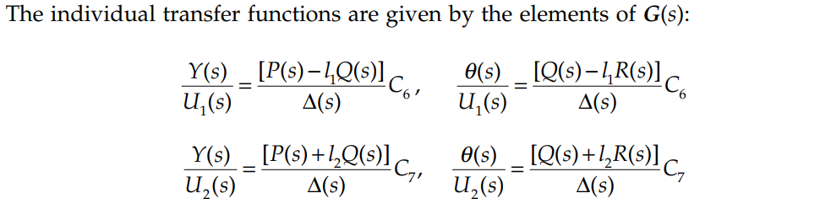

Slide 46
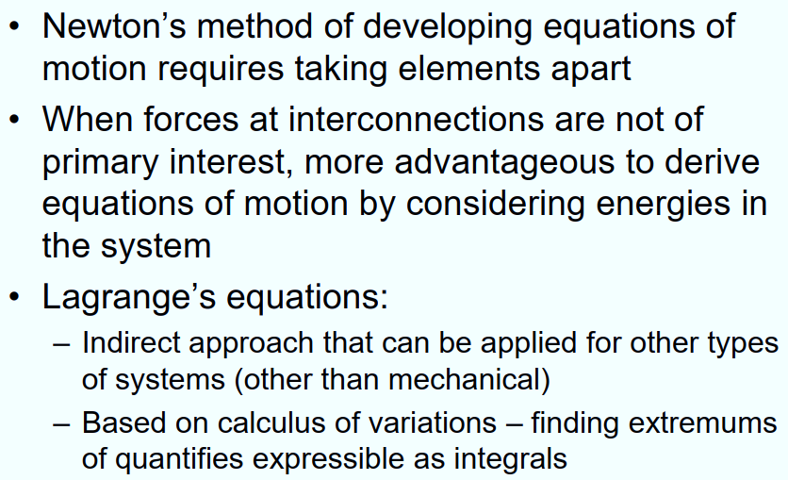
Lagrange’s Equation

Slide 47
Lagrange’s Equation

Slide 48
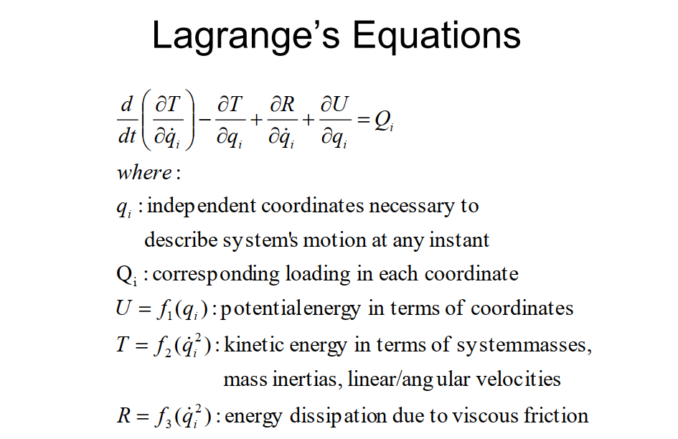

Slide 49
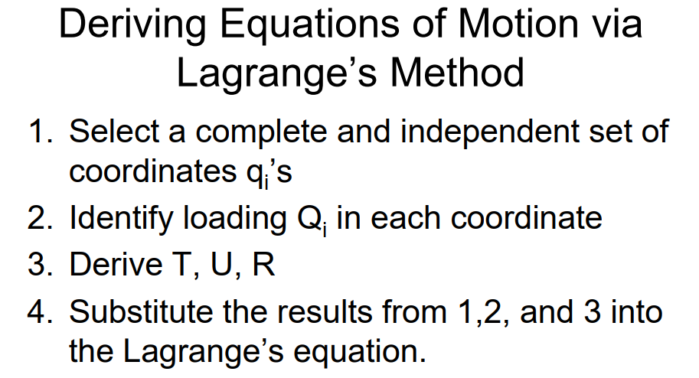

Slide 50


Slide 51


Slide 52
Mechanics
Mechanics consists of three main areas:
    Kinematics: which involves the study of the motion of bodies (position, speed acceleration) in a reference frame without any consideration of the force causing the motion.
    Statics: which involves the study of the equilibrium of bodies under the effect of several forces.
    Dynamics: which involves the study of the motion of bodies under the effect of several forces.

Slide 53

Translational and Rotational Systems
Table 2.1 below shows a comparison of number of quantities between the two systems. This table is useful in two aspects:
It provides a clear description of the analogies between the translational and rotational systems.
Any equation that applies to the translational system (that we are familiar with) can be translated into the rotational system just by replacing the suitable variables as shown in the table.

Slide 54

Translational and Rotational Systems
The equation F = ma is equivalent to the equation $T = Iα$. Some other notes on Table 2.1 are:
There is no clear equivalent of the potential energy of the translational system (P E = mgh) in the rotational system.
The time derivative of the acceleration in the rectilinear translation system is called the jerk, and it is an important quantity in passenger transport systems, such as elevators and trains. It is considered to be an indicator of passenger comfort.
The second time derivative of the acceleration is called the jounce, and this quantity is not important in practice. Although this quantity has equivalent in the rotational system, which is not used in practice.

Slide 55
Mechanisms for Motion Transmission
Actuators provide purely rotary or purely linear motion. In general, it is not practical to place the actuator exactly at the location where the motion of a tool is needed. Therefore, a motion transmission mechanism is needed.
Motion transmission mechanisms perform two different roles:
Transmit motion from actuator to tool when the actuator can’t be designed into the same location as the tool with the desired motion type.
Increase or reduce the torque and the speed between input and output shafts while maintaining the power conservation between input and output.

Slide 56




Mechanisms for Motion Transmission
The most common motion transmission mechanisms fit into one of three main categories:
Rotary-to-Rotary motion transmission mechanisms (gears, belts and pulleys).
Rotary-to-Translational motion transmission mechanisms (lead-screw, rack-pinion, belt-pulley).
Cyclic motion transmission mechanisms (linkages and cams).

Slide 57


Rotary-to-Rotary Motion Transmission Mechanisms
Gears: When a gearbox is fitted between the motor and the load, it has an effect on the torque, speed and inertia. In general, a gearbox is used to match the drive to the load.
Most gearboxes are used as reduction gearboxes (i.e. to reduce the rotational speed). Thus the speed will be reduced and the torque will be increased.
This is very useful in practice; the rotational speed of most motors is too high to directly drive the load, and the torque is too low. The gearbox matches the drive to the load.
A step-down gearbox reduces the rotational speed from the drive and increases the torque. We shall refer to the gearbox reduction ratio as $r_{g}$. We shall refer to the drive side shaft as the high speed shaft (HSS), and the load side shaft of the gearbox as the low speed shaft (LSS).
In an ideal world, the efficiency of the gearbox would be 100% and hence no loss of power will result from the conversion. Under such a scenario:

Slide 58




Rotary-to-Rotary Motion Transmission Mechanisms
$$=\frac{r_{0}}{r_{i}}=\frac{N_{o}}{N_{i}}$$
showing the increase in the output torque.
In reality, the efficiency will not be 100%. Denoting the forward efficiency of the gearbox as $η_{f}$, we can rewrite the equations above with the effect of the efficiency as follows: (Note that the efficiency does not affect the speed relationships, it will only affect the torque and power)

Slide 59


Rotary-to-Rotary Motion Transmission Mechanisms
The relationship between the speeds remain unchanged:
The equations above show clearly how the efficiency affects the value of the low speed shaft torque but not the low speed shaft speed.

Slide 60

Table Shows the Forward Efficiency Range for the Gears.

Slide 61

Rotary-to-Rotary Motion Transmission Mechanisms
The reason for using the forward efficiency above is that in certain gearboxes, the forward and reverse efficiencies are unequal.
The terms ’forward’ and ’reverse’ refer to the direction of flow of the power. The power is flowing the forward direction if it is flowing from the high speed shaft to the low speed shaft; on the other hand, the power is considered to be flowing in reverse if it is flowing from the low speed shaft to the high speed shaft.
The gearing will also have an effect on the inertia when it is referred to the high speed shaft. The inertia, when referred from the low speed shaft to the high speed shaft, is divided by the square of the gearbox ratio $r_{g}$. When an inertia is referred from the high speed shaft to the low speed shaft, it is multiplied by the square of the gearbox ratio $r_{g}$.

Slide 62


Rotary-to-Rotary Motion Transmission Mechanisms
The reason for using the square of the gearing ratio (rather than just the gearing ratio) can be understood by looking at the principle of conservation of energy. Let us assume that we have a flywheel on the low speed shaft with an inertia of $I_{LSS}$ rotating at a speed of $ω_{LSS}$ and we want to find its equivalent inertia at the HSS. We have a gearing ratio of $r_{g}$ between the two shafts. Then the kinetic energy must be the same whether the flywheel is fitted on the LSS or the HSS. So:
The practical implication of this result is that if we wish to add more inertia to a system, it is better to fit the extra flywheel to the high speed shaft as it will appear much larger when referred to the low speed shaft. For this reason, flywheels are always used in practice fitted to the HSS (the motor shaft).

Slide 63




Rotary-to-Rotary Motion Transmission Mechanisms
The gear ratio of a belt-pulley mechanism is the ratio between the input and the output diameters. Assuming no slip between the belt and pulleys on both shafts, the linear displacement along the belt and both pulleys should be equal to: $r_{1}$
The inertia and torque reflection between the HSS and the LSS has the same relationship as the gear mechanisms.
$$=\frac{N_{2}}{N_{1}}$$

Slide 64


Rotary-to-Translational Motion Transmission Mechanism
The rotary-to-translational motion transmission mechanisms convert rotary motion to linear translational motion. This means that the torque at the input is converted to a force at the output. It should be noted that all the mechanisms discussed here are back drivable, which means that they also make the conversion in the reverse direction.
I. Lead Screw Mechanism:
Lead-screw is the most widely used precision motion conversion mechanism which transfers rotary motion to linear motion.
In a screw and nut pair, typically we turn the nut and it advances linearly on the stationary screw.

Slide 65


I. Lead Screw Mechanism
The lead-screw is used as a motion conversion mechanism, the nut is not allowed to rotate about the screw, instead the screw is rotated. Since the screw is only allowed to rotate, the nut moves translationally along the screw.
The tool is usually connected to the nut. Hence, the rotary motion of the motor connected to the screw is converted to the translational motion of the nut and the tool.
Lead screws, power screws, and ball screws are rather synonymous. Lead screw and nut units are used in numerous applications including positioning tables, machine tools, gantry and bridge systems, automated manipulators, and valve actuators.

Slide 66
I. Lead Screw Mechanism
The lead-screw is used as a motion conversion mechanism, the nut is not allowed to rotate about the screw, instead the screw is rotated. Since the screw is only allowed to rotate, the nut moves translationally along the screw.
The tool is usually connected to the nut. Hence, the rotary motion of the motor connected to the screw is converted to the translational motion of the nut and the tool.
Lead screws, power screws, and ball screws are rather synonymous. Lead screw and nut units are used in numerous applications including positioning tables, machine tools, gantry and bridge systems, automated manipulators, and valve actuators.

Slide 67


I. Lead Screw Mechanism
$T_{R}:$ this is the net torque after deducting the inertia torque (due to inertia of the motor rotor and the lead screw) and the frictional torque of the bearings, from the motor (magnetic) torque.
F: the net force available from the nut to drive the load in the axial direction
Suppose the screw rotation by θ and the rectilinear motion of the nut by x.

Slide 68

I. Lead Screw Mechanism

Slide 69




Slide 70



Slide 71



I. Lead Screw Mechanism
The kinematic motion conversion factor, or effective gear ratio, of a lead screw is characterized by its pitch $(p) [rev=in]$or $[rev=mm]$.
L =n * p where L: lead screw, p: pitch distance, n: screw thread type (single, double,…)
For a lead screw having a pitch p, the rotational displacement $∆θ$in units of [rad] and the linear displacement $∆x$are related by:
The effective gear ratio may be defined as:

Slide 72




II. Rack-and-Pinion Mechanism
It is similar to a gear mechanism where one of the gears is linear. The pinion is the small gear and the rack is translational component.
The effective gear ratio is calculated based on the assumption that there is no slip between the gears,
Hence the effective gear ratio
r

Slide 73


II. Rack-and-Pinion Mechanism
The previous equation is used if $∆θ$is in [rad] or $ω$ is in [rad/s]. However if $∆θ$ is in [rev] or $ω$ is in [rev/s], then the effective gear ratio is:
The same mass and force reflection relations we developed for lead screws apply for the rack-pinion mechanism. The only difference is the effective gear ratio.

Slide 74

Pulley and Belt
Belt and pulley mechanisms are used both as rotary-to-rotary and rotary-to-linear motion conversion mechanisms depending on the output point of interest. If the load is connected to the belt and used to obtain linear motion, then it acts as a rotary-to-linear motion conversion device.
The relations we developed for the rack-and-pinion mechanism identically apply here.

Slide 75


General Equations for Geared Hoisting Systems
Derive the mathematical model for the geared hoisting applications if the dynamical parameters for the system are known

Slide 76



Slide 77


Slide 78


Slide 79





Slide 80


Slide 81


Slide 82


Slide 83


Slide 84


Slide 85


Slide 86



Example
Calculate the system’s mass moment about the rotating shaft of the motor.
Calculate the required torque to control the end effector if the required speed is 30 rpm while the time for the motion is 1 second if the bang-bang profile is used.
Note: the system parameters are:
Pulley A has a pitch diameter of ($d_{A}$) = 4.992 cm with teeth number ($N_{A})$of 32 teeth.
Pulley B has a pitch diameter of ($d_{B}$) = 1.56 cm with teeth number ($N_{B})$of 10 teeth.
The mass moment of inertia which is calculated about point A by using the CATIA software is $I_{A }=0.0027kg.m^{2}$.

Slide 87

HSS
LSS

