Slide 1
Introduction & Review of Key Terms

Slide 2
Outline
The introduction will provide the students with a quick review of
The cell
Energy
Digestive System

Slide 3
Definitions
Nutrition
Food, vitamins, and minerals that are ingested and assimilated into the body
Metabolism
Process of using food molecules as energy sources and as building blocks for our own molecules
Catabolism
Breaks food molecules down, releasing their stored energy; oxygen used in catabolism
Anabolism
Builds food molecules into complex substances
3
COPYRIGHT © 2016 BY ELSEVIER INC. ALL RIGHTS RESERVED.

Slide 4
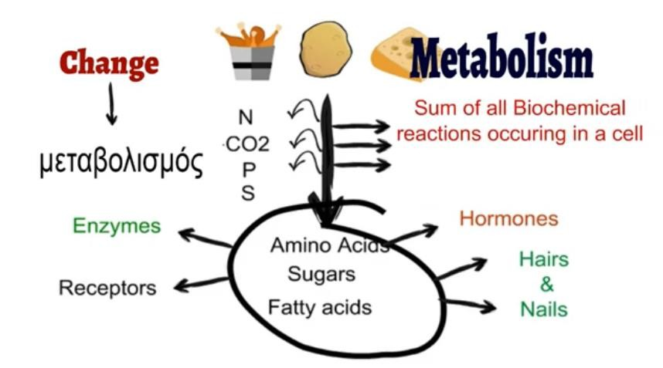
Photo credit: Sajid Sheikh, https://www.youtube.com/watch?v=HrYRMknYHrk&t=190s
Notes:
Metabolism: Sum of all of the biochemical reactions occurring in the cell

Slide 5
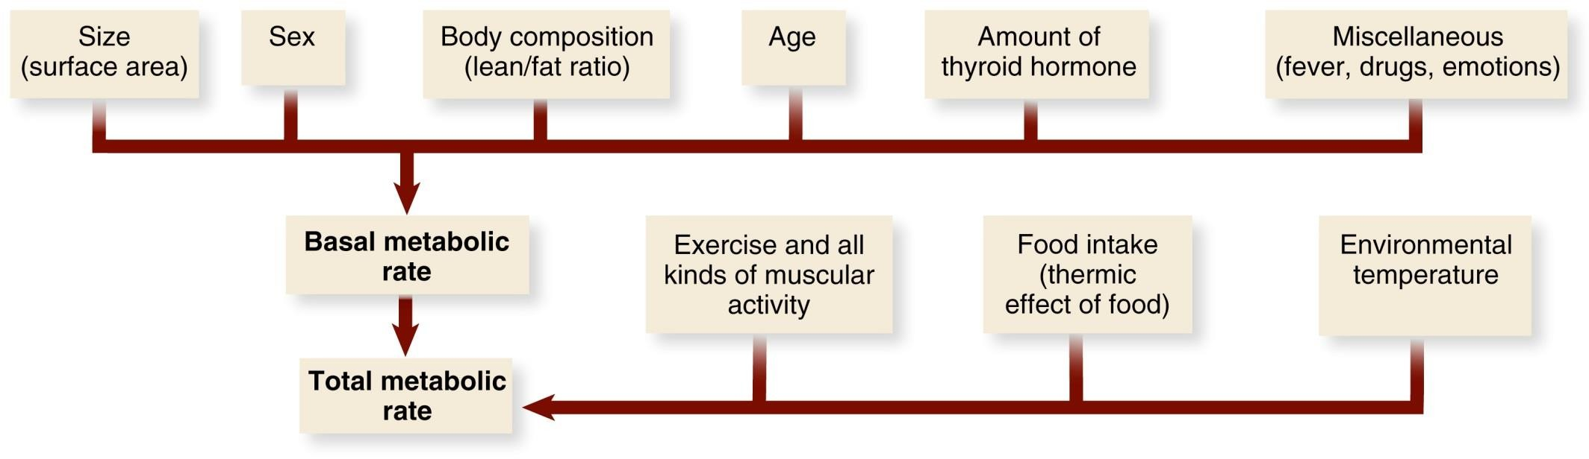
Basal and Total Metabolic Rates
7
COPYRIGHT © 2016 BY ELSEVIER INC. ALL RIGHTS RESERVED.

Slide 6
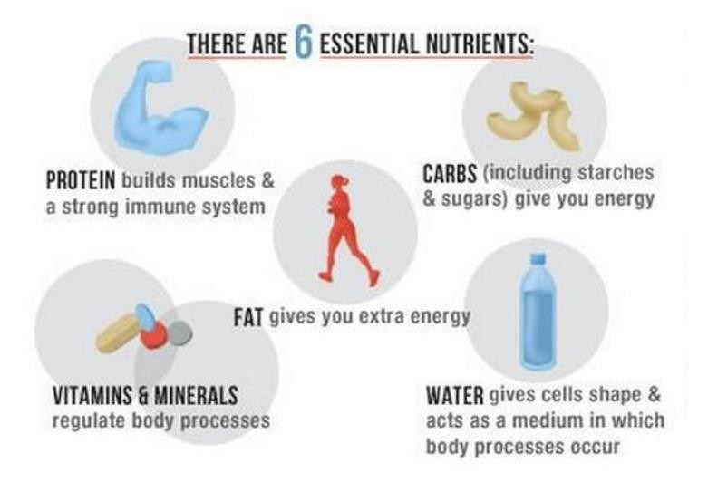
Introduction
To use those nutrients, the food must be broken down (digested) mechanically and chemically

Slide 7
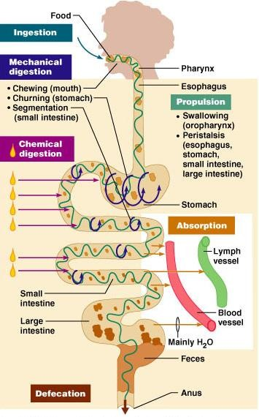
Introduction: The Digestive System

Slide 8
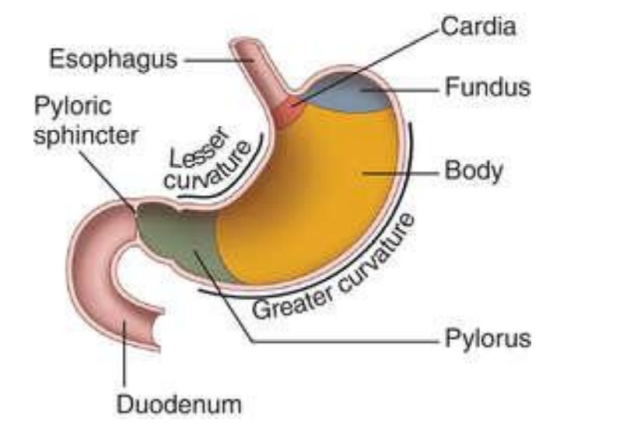
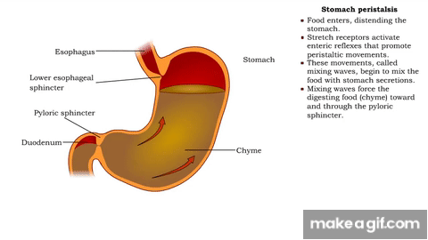
Introduction: The Digestive System
The pylorus grinds and mixes the food with the gastric juices and form chyme

Slide 9
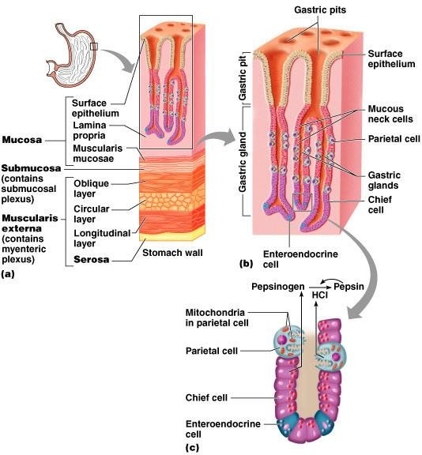
Microscopic Anatomy of the Stomach
Figure 23.15
Notes:
specialized endocrine cells located in the lining of the stomach that secrete hormones in response to stimuli like food, which regulate digestion, metabolism, and gut function. Key gastric EECs include G cells, which produce gastrin, and enterochromaffin-like (ECL) cells, which secrete histamine.
Stomach enteroendocrine cells, known as G cells release gastrin, and stimulate gastric acid secretion.
histamine's main function is to stimulate the secretion of gastric acid by acting on parietal cells via H2 receptors. It is produced by enterochromaffin-like (ECL) cells in response to gastrin and acts as a final chemical mediator for acid production

Slide 10
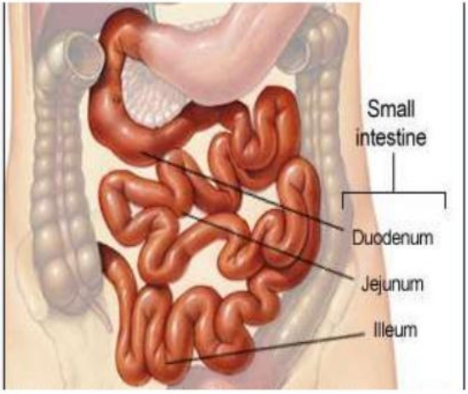
The Small Intestines
The main site for digestion and absorption

Slide 11
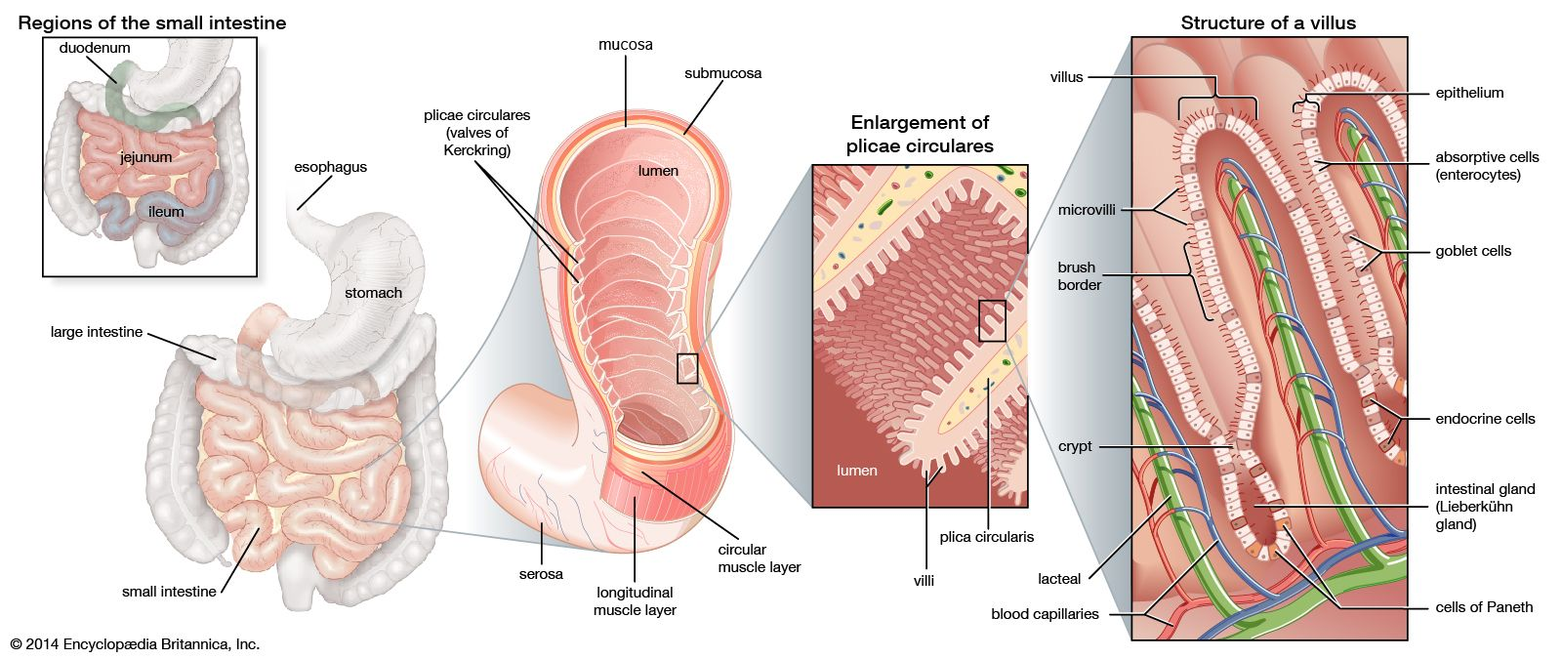
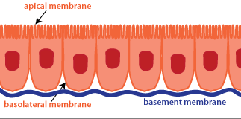
Microscopic Anatomy of the Small Intestines
Notes:
Epithelium
Single layer of cells lining the villus.
Provides a barrier and facilitates absorption and secretion.
2. Absorptive cells (Enterocytes)
Main epithelial cells with microvilli (brush border).
Absorb nutrients (sugars, amino acids, lipids, vitamins, minerals).
Contain enzymes in the brush border for final digestion steps.
3. Goblet cells
Secrete mucus.
Lubricates the intestinal surface and protects against mechanical damage and pathogens.
4. Endocrine cells (Enteroendocrine cells)
Secrete hormones (e.g., secretin, cholecystokinin, GIP, motilin).
Regulate digestion, motility, and secretion of other digestive glands.
5. Intestinal gland (Crypt of Lieberkühn)
Invaginations between villi.
Contain stem cells for continuous renewal of the epithelium.
Secrete intestinal juices and enzymes.
6. Cells of Paneth (found at the base of crypts)
Secrete antimicrobial substances (defensins, lysozyme).
Important in innate immunity and maintaining gut microbiota balance.
7. Crypt
Contains stem cells that regenerate villus epithelium every few days.
Produces new enterocytes, goblet cells, and endocrine cells.
8. Brush border (on enterocytes)
Formed by microvilli.
Increases surface area for absorption.
Contains digestive enzymes (e.g., disaccharidases, peptidases).
9. Microvilli
Tiny projections on enterocytes.
Further increase absorptive surface area.
10. Lacteal (lymphatic capillary inside villus)
Absorbs dietary fats (chylomicrons).
Transports them into the lymphatic system.
11. Blood capillaries
Absorb amino acids, monosaccharides, water-soluble vitamins, and minerals.
Transport them via the hepatic portal vein to the liver.

Slide 12
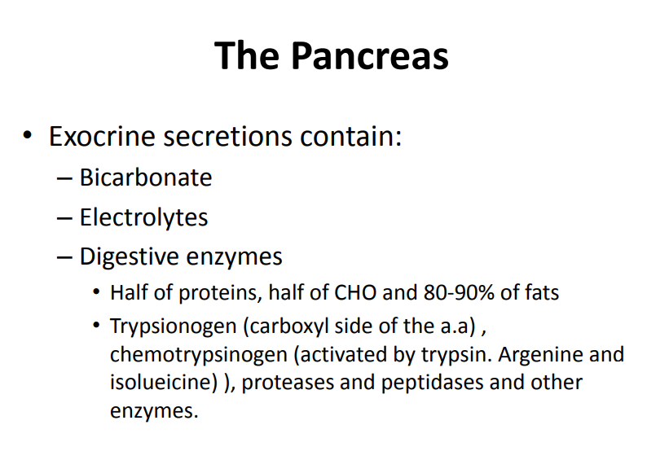
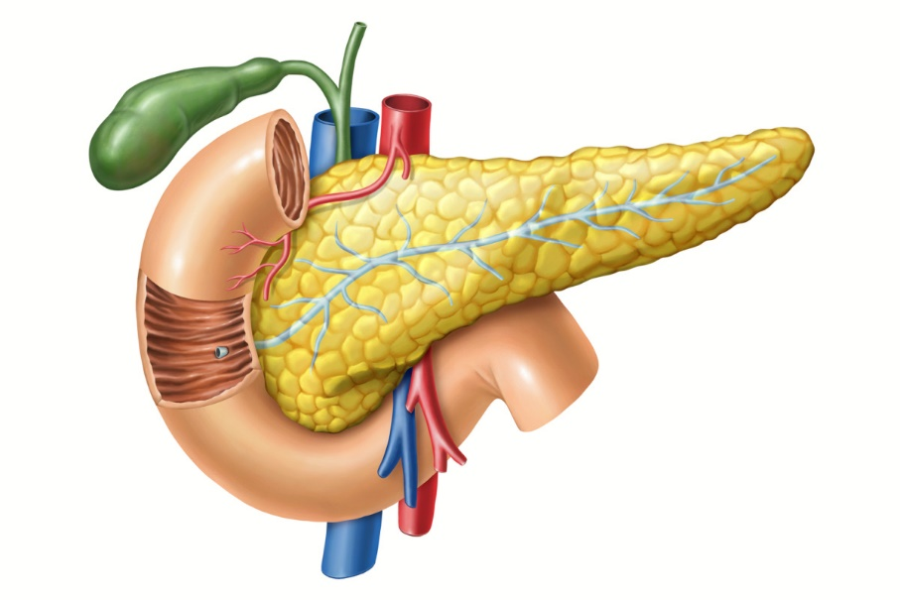

Slide 13
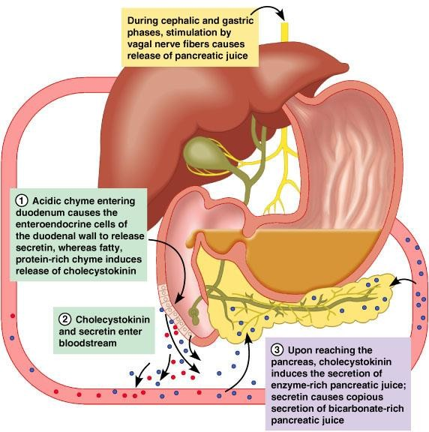
Regulation of Pancreatic Secretion
CCK + Secretin
Pancreatic Juice
Figure 23.28

Slide 14


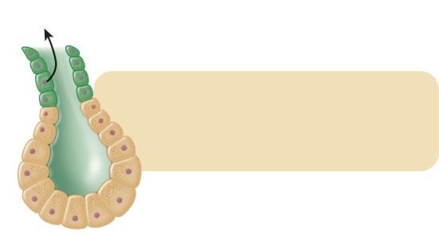
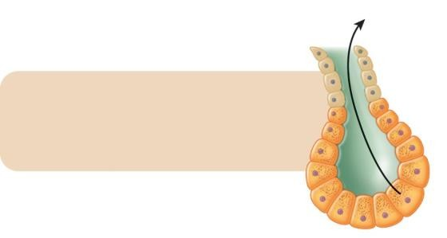
Acid in duodenal lumen
Fat (especially) and protein products in duodenal lumen
Secretin release from duodenal mucosa
CCK release from duodenal mucosa
(Secretin carried
by blood)
Neutralizes
(CCK carried
by blood)
Digests
Pancreatic duct
cells
Pancreatic acinar
cells
Secretion of aqueous NaHCO₃ solution into duodenal lumen
Secretion of pancreatic digestive enzymes into duodenal lumen
(a) Control of pancreatic aqueous
NaHCO₃ s–ecretion
(b) Control of pancreatic digestive
enzyme secretion

Slide 15
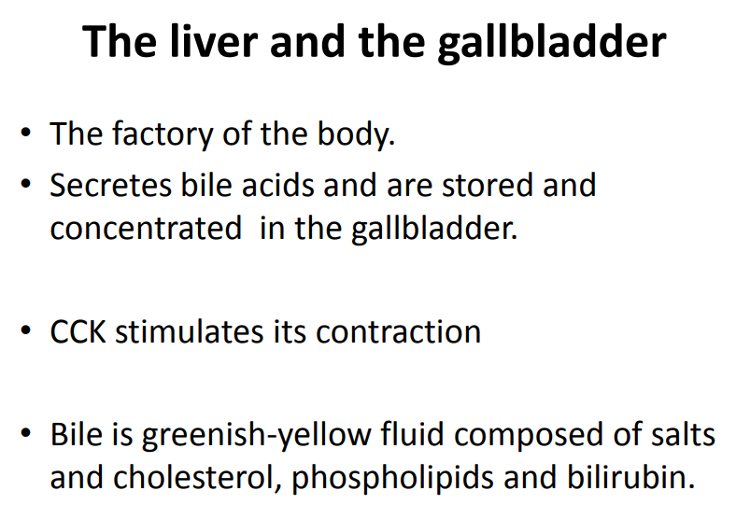

Slide 16
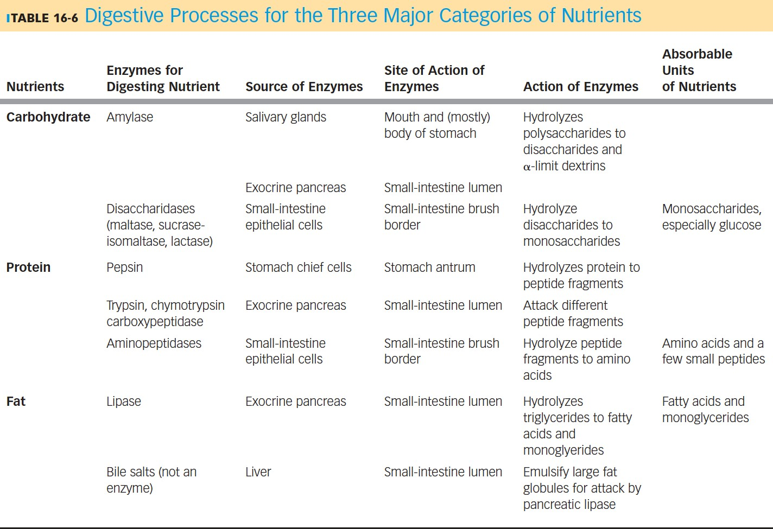

Slide 17
Introduction: The Cell
Cells : the basic living, structural, and functional units of the human body.
They vary greatly in size, chemical composition, and function, but each one is a remarkable miniaturization of human life.
Cells move, grow, ingest “food,” excrete wastes, react to their environment, and reproduce.
While specialization among cells is necessary for life, cells, in general, have certain basic
similarities.

Slide 18
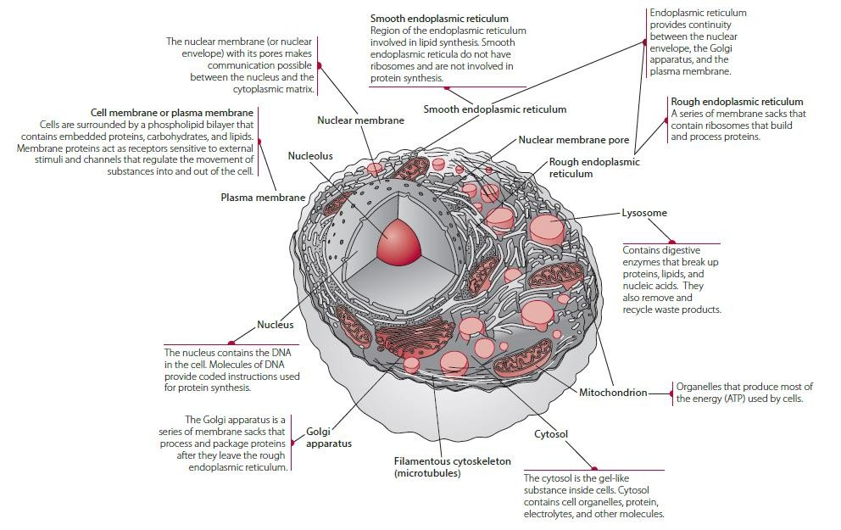

Slide 19
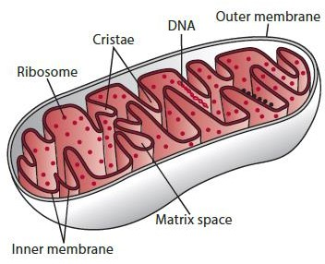
Introduction: The Mitochondria
The mitochondria are the primary sites of oxygen use in cells and are responsible for most of the metabolic energy (ATP) produced in cells.
The mitochondrion consists of a matrix or interior space surrounded by a double membrane
The inner membrane has many invaginations, called the cristae, which increase its surface area, and has all the components of the electron transport chain embedded within it.

Slide 20
Introduction: The Mitochondria
The electron transport (respiratory) chain is central to the process of oxidative
phosphorylation, the mechanism by which most cellular ATP is produced.
The components of the electron transport chain (ETC) carry electrons and hydrogens during the catalytic oxidation of nutrients by enzymes in the mitochondrial matrix.
The function of the electron transport chain is to couple the energy released by nutrient oxidation to the formation of ATP. The chain components are precisely positioned within the inner mitochondrial membrane

Slide 21
Biological Energy
The cell obtains this energy from small molecules transformed (oxidized) to provide heat and chemical energy.
The small molecules that are constantly required are supplied by the nutrients in food.
Adenosine triphosphate (ATP), the major storage form of molecular energy in the cell. The living body has requirements for this energy, including:
Physical exertion
Biosynthetic (anabolic) systems by which substances can be formed from simpler precursors
Active transport systems by which compounds or ions can be moved across membranes
against a concentration gradient
The transfer of genetic information.

Slide 22
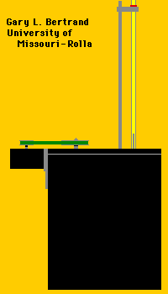
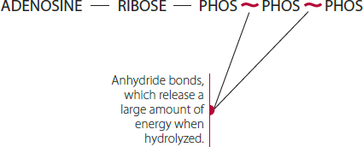
Biological Energy
Energy cannot be created or destroyed; it can only be transformed.
Burning a molecule of glucose outside the body liberates heat, along
with CO2 and H2O as products of combustion, as shown:
C6H12O6 + 16O2 → 6CO2 + 16H2O +heat
The metabolism of glucose within the cell is nearly identical. The difference is that in metabolic oxidation a significant portion of the released energy is salvaged as chemical energy in the form of new, high-energy bonds.
http://web.mst.edu/~gbert/animation.html

Slide 23
Biological Energy
Units of Energy
The unit of energy used is the calorie, abbreviated cal.
In the expression of the higher caloric values encountered in nutrition, the unit kilocalories (kcal) is often used:
1kcal = 1,000 cal.
The international scientific community and many scientific journals use another unit of energy, called the joule (J) or the kilojoule (kJ)
Calories can easily be converted to joules by the factor 4.18:
1 cal = 4.18 J
1 kcal = 4.18 kJ

Slide 24
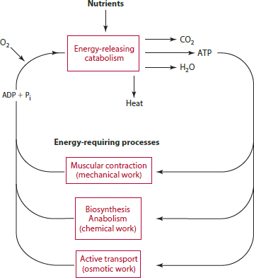
Biological Energy
Some reactions require energy, and others yield energy.
The coupling of these reactions makes it possible for a pathway to continue.
The oxidation of glucose in the glycolysis pathway demonstrates the importance of coupled reactions in metabolism.
An example is the release of a Pi group from creatine phosphate; this Pi joins with ADP forming ATP.
Creatine phosphate serves as a ready reservoir to renew ATP levels quickly, particularly in muscle.

