Slide 1
Beckman oral motor protocol
Ruba Siam 1170005
Enaya bakri 1171841
Sabrena bazar 1171620

Slide 2

Debra Beckman has worked in the field of communicative disorders since 1975, specializing in motor speech disorders. She has worked in a variety of settings, including schools, hospitals, universities, trauma centers, home-bound, foster homes, group homes.

Slide 3
Beckman Oral Mortor Protocol What is Oral Motor Intervention?
Oral Motor Intervention works the striated muscle- this improves range of motion and/or strength. It uses interventions that move the muscle group through a full range of activation.
The oral musculature is unique in that it is accessible from both sides of the muscle.
A note about oral hypersensitivity: ~Make sure that hydration is good, even borderline dehydration will increase sensitivity.
Patients may also be Hyper-vigilant: just too aware of anything new or different in their mouths. They will require more time to acclimate to the interventions.

Slide 4
What do we do?
Slow, deep pressure
Slow stretch
Provide postural support
Children, especially, may not be able to tolerate pressure and movement at first. Start with pressure to the area, once this is accepted then add movement.

Slide 5
Why Slow, Deep Pressure?
In the muscles of the face and the masseter muscle there is an Upper Limit at which increased stimulation does NOT increase muscle contraction. This is why oral motor stimulation has diminishing returns
Deep pressure and slow movements produce the greatest benefit.

Slide 6
What is the Purpose?
-Increase strength of muscles
-Increase range of motion
-Increase awareness of the muscle groups

Slide 7
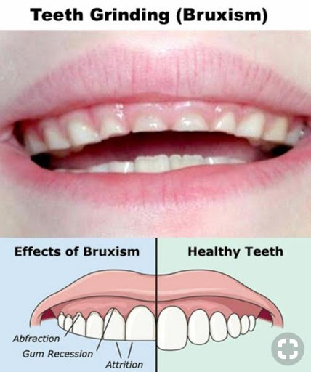
Issues such as
1-tooth grinding
2- excessive drooling
3-hyper/hyposensitivity
(gagging and tooth
brushing difficulty)
4- infants with failure to thrive (FTT)

Slide 8

Beckman oral motor
Oral motor examination

Slide 9
Beckman oral motor manual

Slide 10
Techniques

Slide 11
Beckman oral probe
https://www.youtube.com/watch?v=oLvbisYfhqM

Slide 12
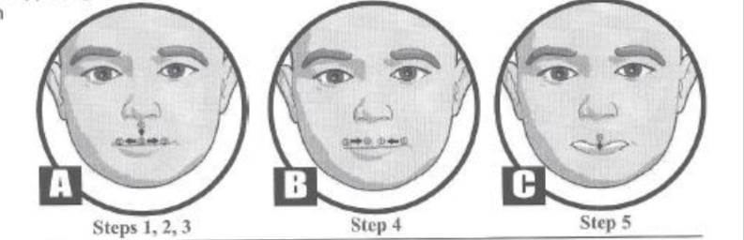
Upper lip stretch
https://www.youtube.com/watch?v=vwr0a553lI0

Slide 13
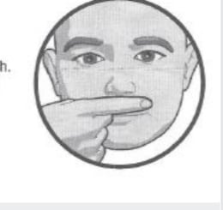
Side to side upper lip stretch
https://youtu.be/CXT8QSyw8O4

Slide 14
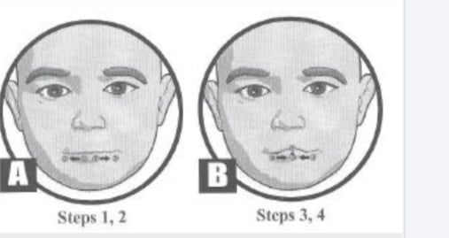
Lower lip sretch
https://www.youtube.com/watch?v=genNPZS5lmQ

Slide 15
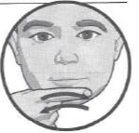
Side to side lower lip stretch
https://www.youtube.com/watch?v=SKqZ1q3nnGE

Slide 16
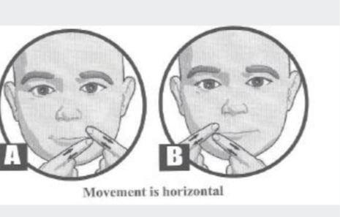
Corner lip stretch
https://youtu.be/Xd7oqReFg4E

Slide 17
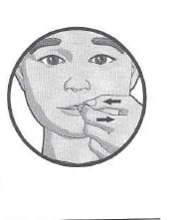
Horizontal lip stretch

Slide 18
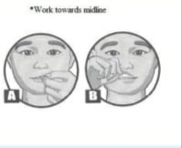
Lip curl stretch

Slide 19
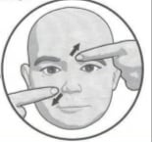
Diagonal nasal bridge stretch
https://www.youtube.com/watch?v=w6gkVzLXfYk&t=6s

Slide 20
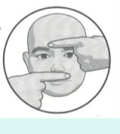
Z stretch for the nasal bridge

Slide 21
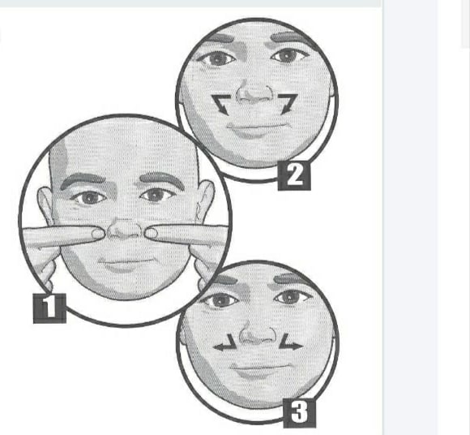
C stretch
https://www.youtube.com/watch?v=tYu1XMdzFZM

Slide 22
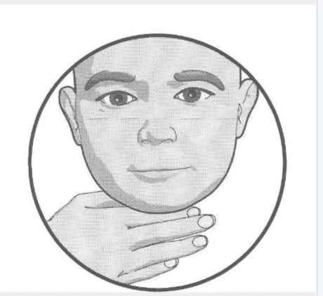
Pressure to the base at the tongue
https://www.youtube.com/watch?v=e90k8Ne51xg

Slide 23
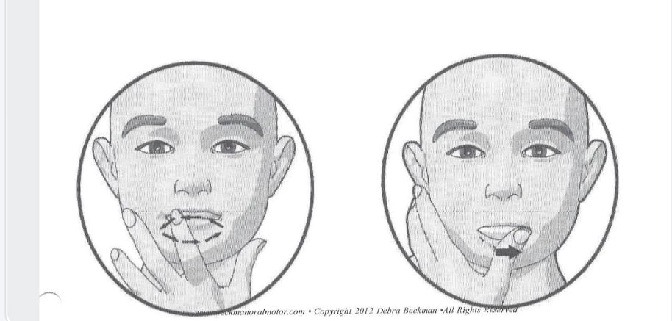
Gum massage

Slide 24
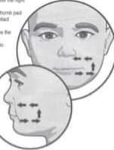
Upper cheek stretch

Slide 25
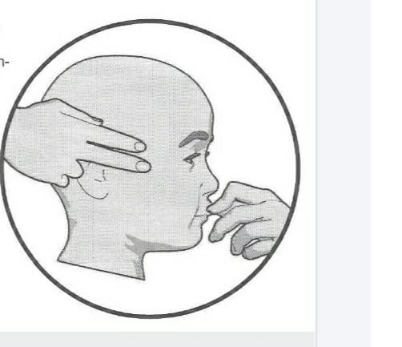
Upper postterier cheek stretch

Slide 26
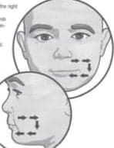
Lower cheek stretch

Slide 27
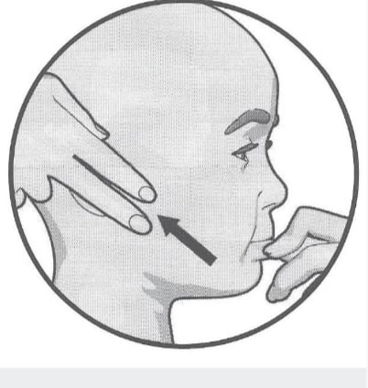
Lower posterior cheek stretch

Slide 28
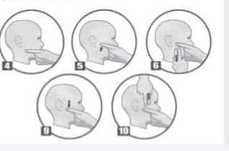
Massater cheek stretch

