Slide 1


Slide 2
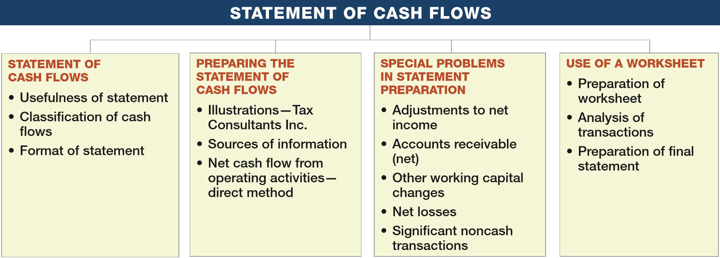
PREVIEW OF CHAPTER 23
Intermediate Accounting
16th Edition
Kieso ● Weygandt ● Warfield

Slide 3
LEARNING OBJECTIVES
23
Statement of Cash Flows
After studying this chapter, you should be able to:
Describe the usefulness and format of the statement of cash flows.
Prepare a statement of cash flows.
Contrast the direct and indirect methods of calculating net cash flow from operating activities.
Discuss special problems in preparing a statement of cash flows.
Explain the use of a worksheet in preparing a statement of cash flows.
LO 1

Slide 4
STATEMENT OF CASH FLOWS
Primary purpose:
To provide information about a company’s cash receipts and cash payments during a period.
Secondary objective:
To provide cash-basis information about the company’s operating, investing, and financing activities.
LO 1

Slide 5
STATEMENT OF CASH FLOWS
Usefulness of the Statement of Cash Flows
Provides information to help assess:
  Entity’s ability to generate future cash flows.
  Entity’s ability to pay dividends and meet obligations.
  Reasons for difference between net income and net cash flow from operating activities.
  Cash and noncash investing and financing transactions.
LO 1

Slide 6
STATEMENT OF CASH FLOWS
Classification of Cash Flows
Operating Activities
Investing Activities
Financing Activities
Income Statement Items
Changes in Investments and Long-Term Asset Items
Changes in Long-Term Liabilities and Stockholders’ Equity
LO 1

Slide 7
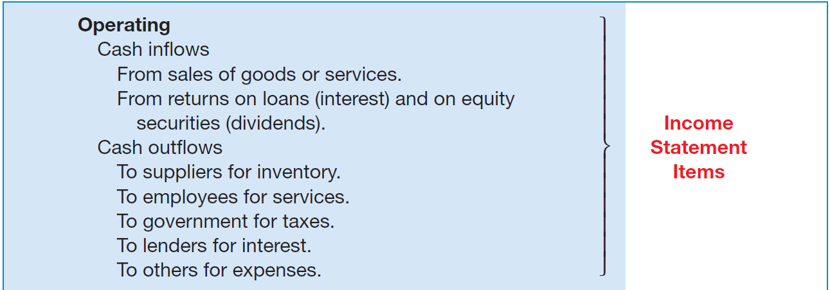
Classification of Cash Flows
ILLUSTRATION 23-1 Classification of Typical Cash Inflows and Outflows
LO 1

Slide 8
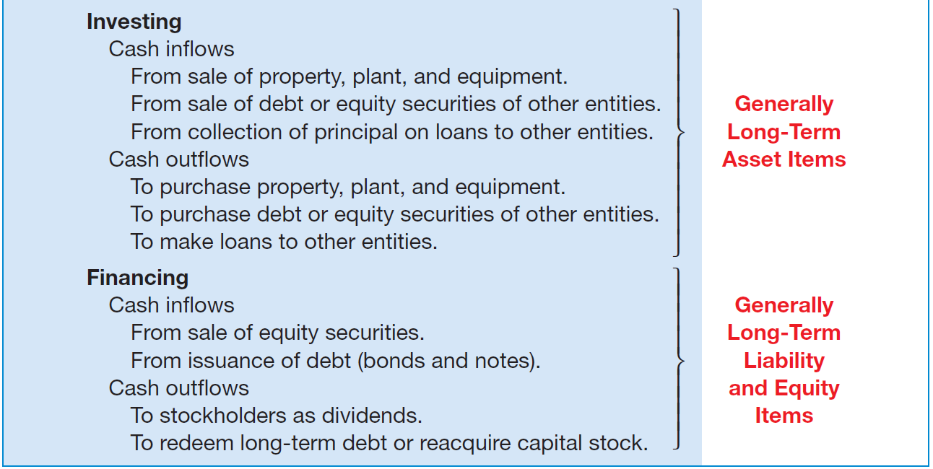
Classification of Cash Flows
ILLUSTRATION 23-1
Classification of Typical Cash Inflows and Outflows
LO 1

Slide 9
Classification of Cash Flows
The basis recommended by the FASB for the statement of cash flows is actually “cash and cash equivalents.” Cash equivalents are short-term, highly liquid investments that are both:
  Readily convertible to known amounts of cash, and
  So near their maturity that they present insignificant risk of changes in interest rates.
  Generally, only investments with original maturities of three months or less qualify under this definition.
LO 1

Slide 10
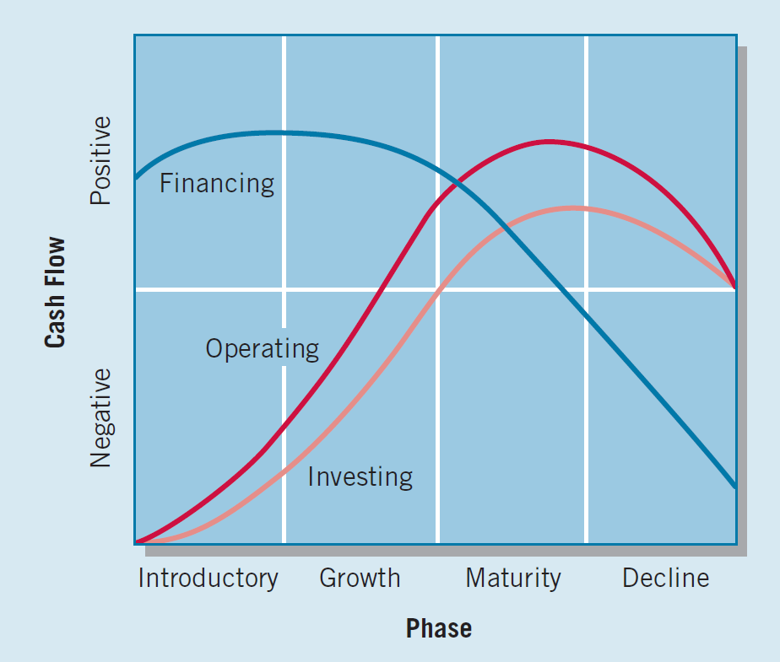
Classification of Cash Flows
Company Product Life Cycle
LO 1

Slide 11
STATEMENT OF CASH FLOWS
Format of the Statement of Cash Flows
Presentation:
  Operating activities.
  Investing activities.
  Financing activities.
Direct Method
Indirect Method
Report inflows and outflows from investing and financing activities separately.
LO 1

Slide 12
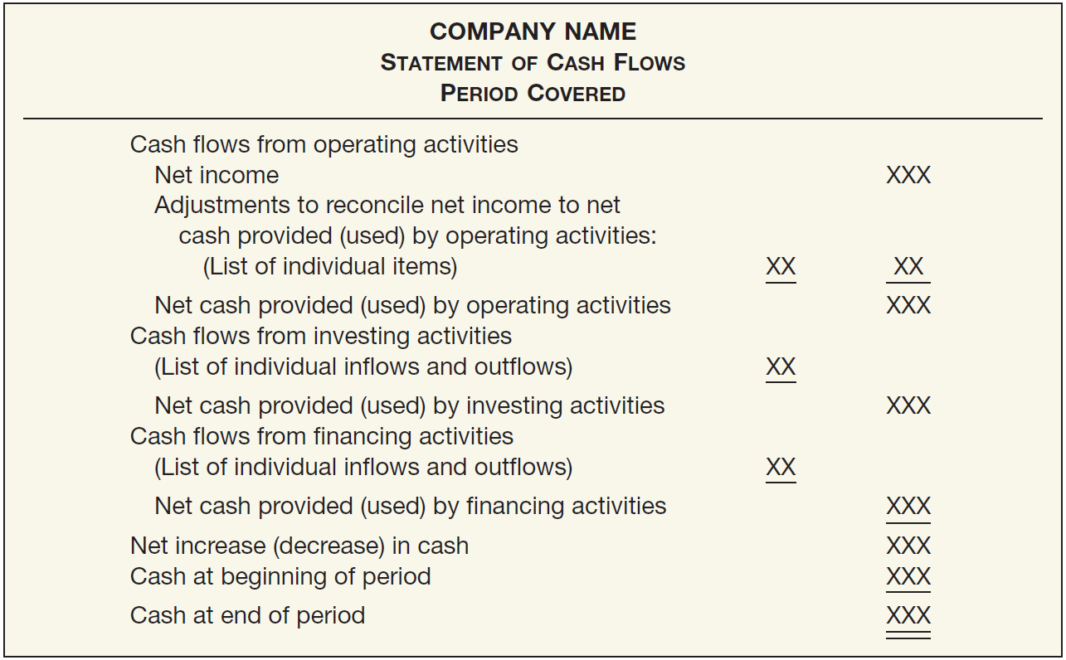
ILLUSTRATION 23-2
Format of the Statement of Cash Flows
LO 1

Slide 13
LEARNING OBJECTIVES
23
Statement of Cash Flows
After studying this chapter, you should be able to:
Describe the usefulness and format of the statement of cash flows.
Prepare a statement of cash flows.
Contrast the direct and indirect methods of calculating net cash flow from operating activities.
Discuss special problems in preparing a statement of cash flows.
Explain the use of a worksheet in preparing a statement of cash flows.
LO 2

Slide 14
PREPARATION OF STATEMENT OF CASH FLOWS
Three Sources of Information:
  Comparative balance sheets.
  Current income statement data.
  Selected transaction data.
Three Major Steps:
Step 1. Determine change in cash.
Step 2. Determine net cash flow from operating activities.
Step 3. Determine net cash flows from investing and financing activities.
LO 2

Slide 15
Illustrations—Tax Consultants Inc.
Illustration: Tax Consultants Inc. started on January 1, 2016, when it issued 60,000 shares of $1 par value common stock for $60,000 cash. The company rented its office space, furniture, and equipment, and performed tax consulting services throughout the first year.
The comparative balance sheets at the beginning and end of the year 2016 appear in Illustration 23-3. Illustration 23-4 shows the income statement and additional information for Tax Consultants.
LO 2

Slide 16
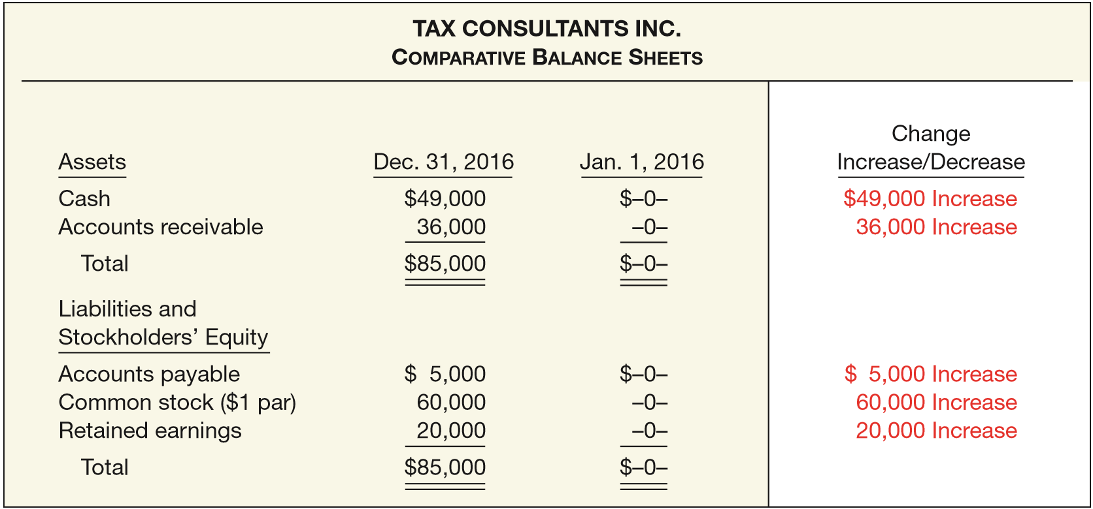
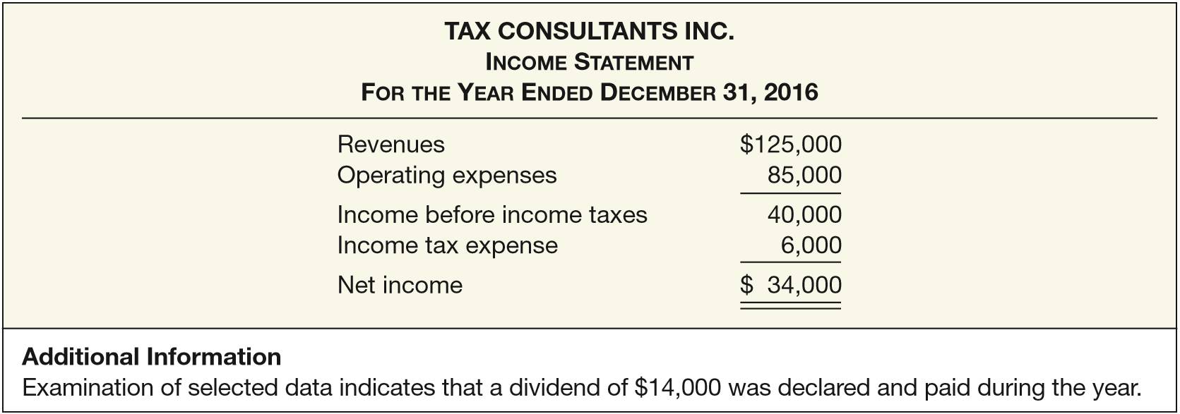
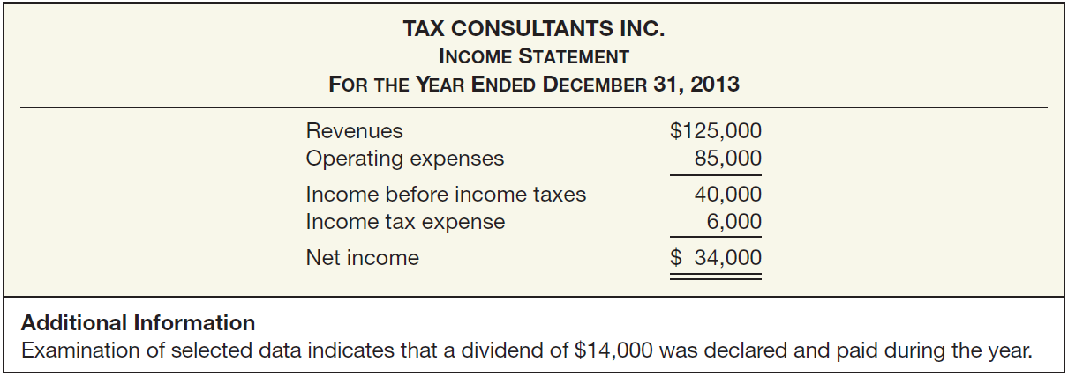
ILLUSTRATION 23-3
Comparative Balance Sheets, Tax Consultants Inc., Year 1
ILLUSTRATION 23-4
Income Statement, Tax Consultants Inc., Year 1

Slide 17
Illustrations—Tax Consultants Inc.
Step 1: Determine the Change in Cash
ILLUSTRATION 23-3
Comparative Balance Sheets, Tax Consultants Inc., Year 1
LO 2

Slide 18
Illustrations—Tax Consultants Inc.
Step 2: Determine the Net Cash Flow from Operating Activities
Company must determine revenues and expenses on a cash basis.
Eliminate the effects of income statement transactions that do not result in an increase or decrease in cash.
Convert net income to net cash flow from operating activities through either a direct method or an indirect method.
LO 2

Slide 19
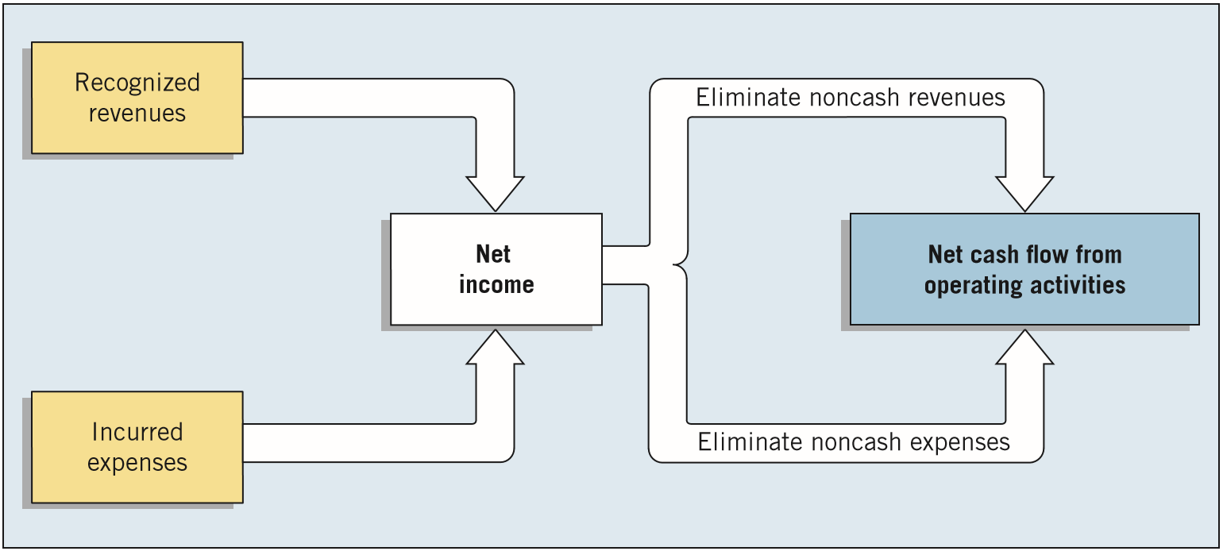
Illustrations—Tax Consultants Inc.
Step 2: Determine the Net Cash Flow from Operating Activities
ILLUSTRATION 23-5
Net Income versus Net Cash Flow from Operating Activities
LO 2

Slide 20
Illustrations—Tax Consultants Inc.
Increase in Accounts Receivable—Indirect Method
Accounts receivable increased by $36,000 (from $0 to $36,000) during the year.
ILLUSTRATION 23-6
Accounts Receivable
1/1/16 Balance 0
Receipts from customers 89,000
Revenues 125,000
12/31/16 Balance 36,000
When the Accounts Receivable balance increases, cash receipts are lower than revenue earned under the accrual basis.
LO 2

Slide 21
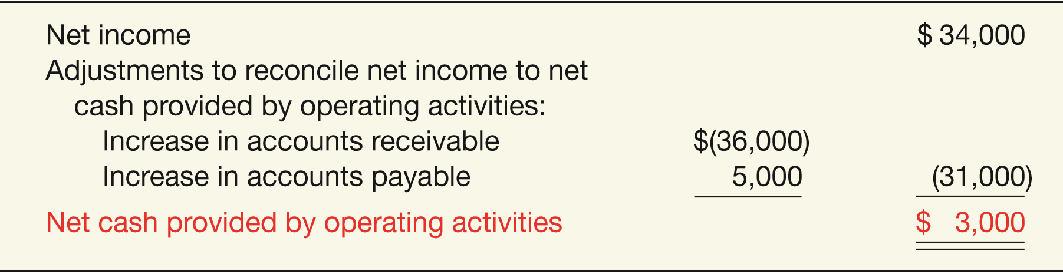
Illustrations—Tax Consultants Inc.
Increase in Accounts Receivable—Indirect Method
ILLUSTRATION 23-6
Accounts Receivable
1/1/16 Balance 0
Receipts from customers 89,000
Revenues 125,000
12/31/16 Balance 36,000
The increase in accounts receivable is subtracted from net income to arrive at net cash provided by operating activities.
ILLUSTRATION 23-7
LO 2

Slide 22
Illustrations—Tax Consultants Inc.
Increase in Accounts Payable—Indirect Method
Accounts payable increased by $5,000 during the year.
When accounts payable increase during the year, expenses on an accrual basis exceed those on a cash basis.
ILLUSTRATION 23-7
LO 2

Slide 23
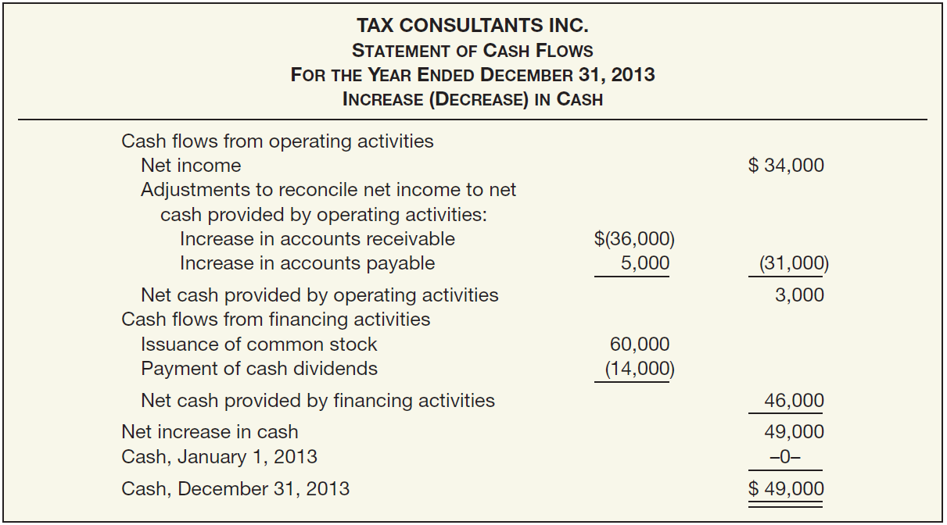




Tax Consultants Inc.
ILLUSTRATION 23-3
Step 3: Determine Net Cash Flows from Investing and Financing Activities
ILLUSTRATION 23-8

Slide 24
Tax Consultants Inc.
ILLUSTRATION 23-3
Step 3: Determine Net Cash Flows from Investing and Financing Activities
ILLUSTRATION 23-8

Slide 25
Tax Consultants Inc.
ILLUSTRATION 23-3
Step 3: Determine Net Cash Flows from Investing and Financing Activities
ILLUSTRATION 23-8

Slide 26
Tax Consultants Inc.
ILLUSTRATION 23-3
Step 3: Determine Net Cash Flows from Investing and Financing Activities
ILLUSTRATION 23-8

Slide 27
Tax Consultants Inc.
ILLUSTRATION 23-3
Step 3: Determine Net Cash Flows from Investing and Financing Activities
ILLUSTRATION 23-8

Slide 28
Illustrations—Tax Consultants Inc.
Statement of Cash Flows—2016
ILLUSTRATION 23-8
LO 2

Slide 29
Operating Activities — Indirect Method
Illustration: Norman Company’s financial statements for the year ended December 31, 2017, contained the following condensed information.
LO 2

Slide 30
Operating Activities — Indirect Method
Prepare the operating activities section of the statement of cash flows using the indirect method (Step 2).
LO 2

Slide 31
Operating Activities — Direct Method
Norman Company’s financial statements for the year ended December 31, 2017, contained the following condensed information.
Assume accounts payable relates to operating expenses.
LO 2

Slide 32
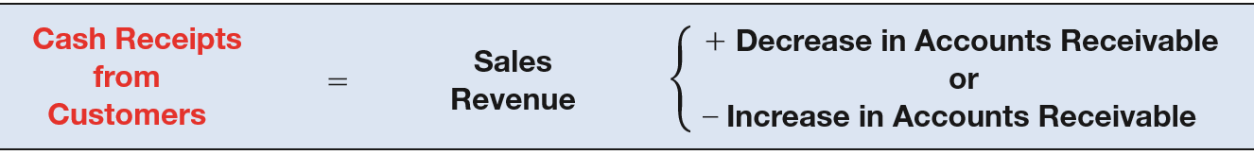
Operating Activities — Direct Method
Prepare the operating activities section of the statement of cash flows using the Direct method (Step 2).
ILLUSTRATION 23-22
Accounts Receivable
1/1/17 Balance 59,000
Receipts from customers 862,000
Revenues 840,000
12/31/17 Balance 37,000
LO 2

Slide 33
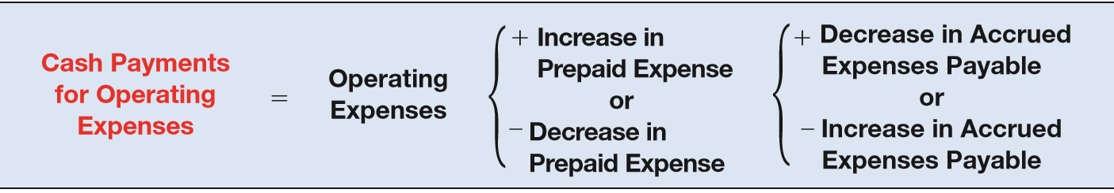
Operating Activities — Direct Method
Prepare the operating activities section of the statement of cash flows using the Direct method (Step 2).
ILLUSTRATION 23-24
Accounts Payable
Payments for operating
expenses 609,000
1/1/17 Balance 31,000
Operating expenses 624,000
12/31/17 Balance 46,000
LO 2

Slide 34
Operating Activities — Direct Method
Prepare the operating activities section of the statement of cash flows using the Direct method (Step 2).
ILLUSTRATION 23-24
Income Tax Payable
1/1/17 Balance 8,500
Payments for income tax 44,500
Income tax expense 40,000
12/31/17 Balance 4,000
LO 2

Slide 35
Operating Activities — Direct Method
Prepare the operating activities section of the statement of cash flows using the Direct method (Step 2).
LO 2

Slide 36
Step 3: Determine Net Cash Flow from Investing and Financing Activities
Illustration: (a) Plant assets that had cost $25,000 6 years before and were being depreciated on a straight-line basis over 10 years with no estimated scrap value were sold for $5,300.
LO 2

Slide 37
Investing and Financing Activities
O
I
F

Slide 38
Investing and Financing Activities
(b): During the year, 10,000 shares of common stock with a stated value of $10 a share were issued for $33 a share.
LO 2

Slide 39
Investing and Financing Activities
O
I
F

Slide 40
Investing and Financing Activities
(d): The company sustained a net loss for the year of $50,000. Depreciation amounted to $22,000, and a gain of $9,000 was realized on the sale of land for $39,000 cash.
LO 2

Slide 41
Investing and Financing Activities
O
I
F

Slide 42
Investing and Financing Activities
(h): During the year, treasury stock costing $47,000 was purchased.
LO 2

Slide 43
Investing and Financing Activities
O
I
F

Slide 44
Sources of Information for the Statement of Cash Flows
Comparative balance sheets.
An analysis of the Retained Earnings account.
Includes all changes that have passed through cash or have resulted in an increase or decrease in cash.
Write-downs, amortization charges, and similar “book” entries, such as depreciation, because they have no effect on cash.
LO 2

Slide 45
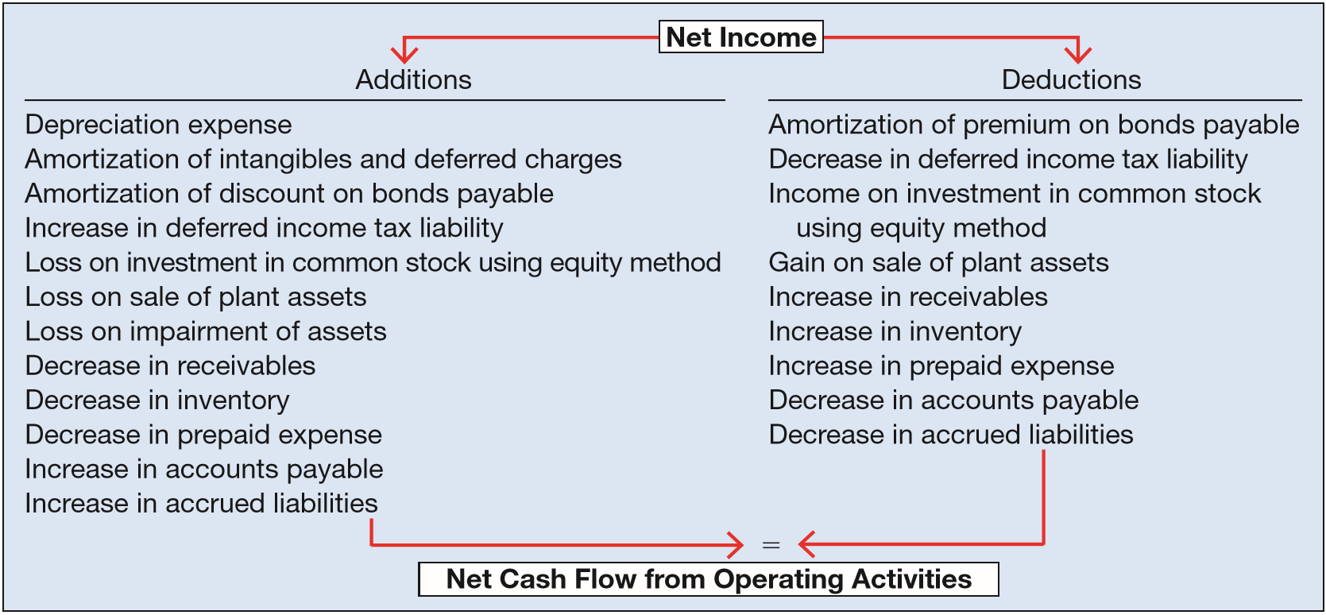
Indirect Method—Additional Adjustments
Adjustments Needed to Determine Net Cash Flow from Operating Activities.
ILLUSTRATION 23-17
LO 2

Slide 46
LEARNING OBJECTIVES
23
Statement of Cash Flows
After studying this chapter, you should be able to:
Describe the usefulness and format of the statement of cash flows.
Prepare a statement of cash flows.
Contrast the direct and indirect methods of calculating net cash flow from operating activities.
Discuss special problems in preparing a statement of cash flows.
Explain the use of a worksheet in preparing a statement of cash flows.
LO 3

Slide 47
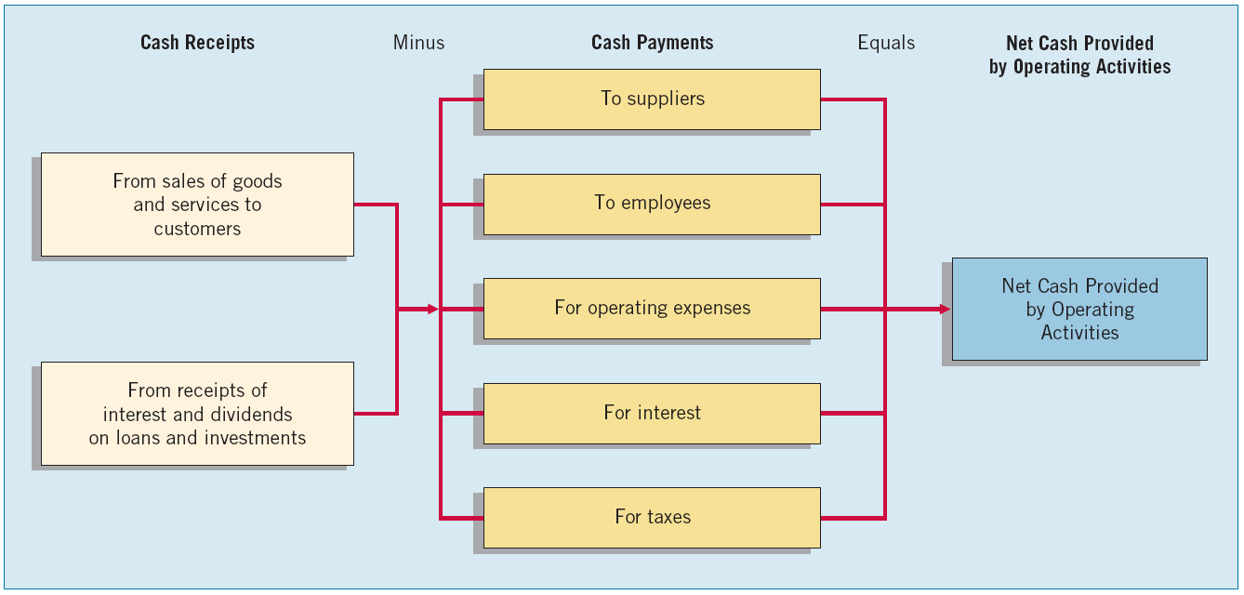
Net Cash Flow from Operating Activities—Direct Method
Companies adjust each item in the income statement from the accrual basis to the cash basis.
ILLUSTRATION 23-21
LO 3

Slide 48
Net Cash Flow from Operating Activities—Direct Method
Special Rules Applying to Direct and Indirect Methods
Companies that use the direct method are required, at a minimum, to report separately:
Receipts
Cash collected from customers (including lessees, licensees, etc.).
Interest and dividends received.
Other operating cash receipts, if any.
LO 3

Slide 49
Net Cash Flow from Operating Activities—Direct Method
Special Rules Applying to Direct and Indirect Methods
Companies that use the direct method are required, at a minimum, to report separately:
Payments
Cash paid to employees and suppliers of goods or services (including suppliers of insurance, advertising, etc.).
Interest paid.
Income taxes paid.
Other operating cash payments, if any.
LO 3

Slide 50
LEARNING OBJECTIVES
23
Statement of Cash Flows
After studying this chapter, you should be able to:
Describe the usefulness and format of the statement of cash flows.
Prepare a statement of cash flows.
Contrast the direct and indirect methods of calculating net cash flow from operating activities.
Discuss special problems in preparing a statement of cash flows.
Explain the use of a worksheet in preparing a statement of cash flows.
LO 4

Slide 51
SPECIAL PROBLEMS IN STATEMENT PREPARATION
Adjustments to Net Income
Depreciation and Amortization
  Amortization of limited-life intangible assets.
  Amortization of bond discount or premium.
Postretirement Benefit Costs
  Company must adjust net income by the difference between cash paid and the expense reported.
LO 4

Slide 52
Adjustments to Net Income
Changes in Deferred Income Taxes
  Affect net income but have no effect on cash.
Equity Method of Accounting
  Net increase in the investment account does not affect cash flows.
  Company must deduct the net increase from net income to arrive at net cash flow from operating activities.
LO 4

Slide 53
Adjustments to Net Income
Losses and Gains
  A loss is added to net income to compute net cash flow from operating activities because the loss is a noncash charge in the income statement.
  Company reports a gain in the statement of cash flows as part of the cash proceeds from the sale of equipment under investing activities, thus it deducts the gain from net income to avoid double-counting—once as part of net income and again as part of the cash proceeds from the sale.
LO 4

Slide 54
Adjustments to Net Income
Stock Options
  Cash is not affected by recording the expense.
  The company must increase net income by the amount of compensation expense from stock options in computing net cash flow from operating activities.
LO 4

Slide 55
Adjustments to Net Income
Unusual and Infrequent Items
  Companies should report either as investing activities or as financing activities cash flows from unusual and infrequent transactions and other events whose effects are included in net income but which are not related to operations.
LO 4

Slide 56
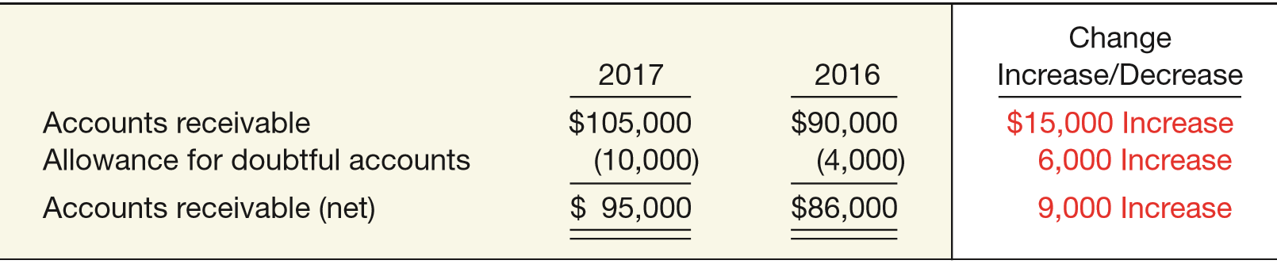
SPECIAL PROBLEMS
Accounts Receivable (Net)
Indirect Method
  Because an increase in Allowance for Doubtful Accounts results from a charge to bad debt expense, a company should add back an increase in Allowance for Doubtful Accounts to net income to arrive at net cash flow from operating activities.
ILLUSTRATION 23-28
Accounts Receivable Balances, Redmark Co.
LO 4

Slide 57
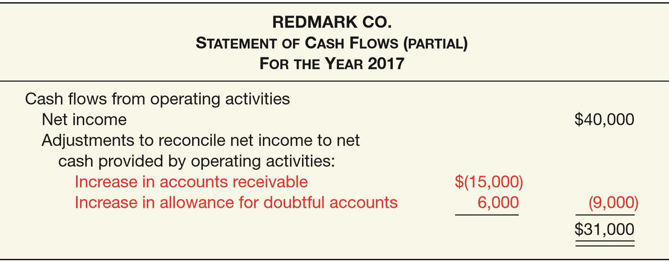

Accounts Receivable (Net)
Indirect Method
  One method of presenting this information in the statement of cash flows:
REDMARK CO.
Statement of Cash Flows (Partial)
For The Year 2014
ILLUSTRATION 23-29
Presentation of Allowance for Doubtful Accounts— Indirect Method
LO 4

Slide 58
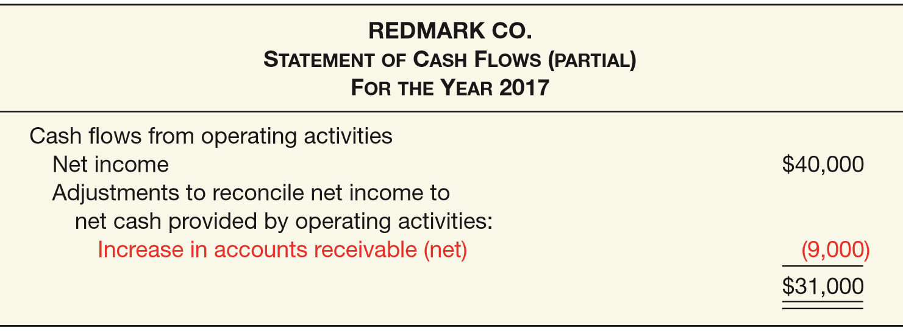
Accounts Receivable (Net)
Indirect Method
  Alternate method (net approach) of presenting this information in the statement of cash flows:
ILLUSTRATION 23-30
Net Approach to Allowance for Doubtful Accounts— Indirect Method
LO 4

Slide 59
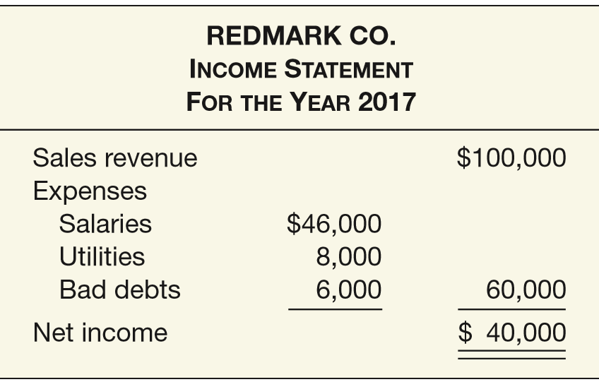
Accounts Receivable (Net)
Direct Method
  Company should not net Allowance for Doubtful Accounts against Accounts Receivable.
REDMARK CO.
Income Statement
For The Year 2014
ILLUSTRATION 23-31
Income Statement, Redmark Co.
LO 4

Slide 60
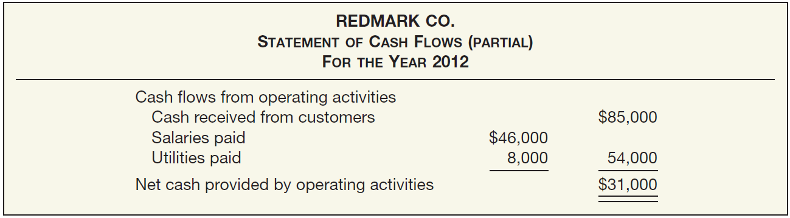

Accounts Receivable (Net)
Direct Method
ILLUSTRATION 23-31
  Company should not net Allowance for Doubtful Accounts against Accounts Receivable.
ILLUSTRATION 23-32
Cash sales should be reported at $85,000 ($100,000 - 9,000 - 6,000).
Increase in Accounts Receivable
LO 4

Slide 61
SPECIAL PROBLEMS
Other Working Capital Changes
  Some changes in working capital, although they affect cash, do not affect net income.
    Purchase of short-term available-for-sale securities.
    Issuance of a short-term nontrade note payable for cash.
    Cash dividend payable.
LO 4

Slide 62
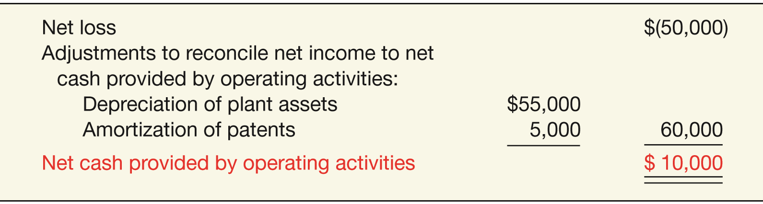
SPECIAL PROBLEMS
Net Losses
  Illustration: If the net loss is $50,000 and the total amount of charges to add back is $60,000, then net cash provided by operating activities is $10,000.
ILLUSTRATION 23-33
Computation of Net Cash Flow from Operating
Activities—Cash Inflow
LO 4

Slide 63
SPECIAL PROBLEMS
Significant Noncash Transactions
Common noncash transactions that a company should report or disclose:
  Acquisition of assets by assuming liabilities (including capital lease obligations) or by issuing equity securities.
  Exchanges of nonmonetary assets.
  Refinancing of long-term debt.
  Conversion of debt or preferred stock to common stock.
  Issuance of equity securities to retire debt.
LO 4

Slide 64
LEARNING OBJECTIVES
23
Statement of Cash Flows
After studying this chapter, you should be able to:
Describe the usefulness and format of the statement of cash flows.
Prepare a statement of cash flows.
Contrast the direct and indirect methods of calculating net cash flow from operating activities.
Discuss special problems in preparing a statement of cash flows.
Explain the use of a worksheet in preparing a statement of cash flows.
LO 5

Slide 65
USE OF A WORKSHEET
A worksheet involves the following steps.
Step 1. Enter the balance sheet accounts and their beginning and ending balances in the balance sheet accounts section.
Step 2. Enter the data that explain the changes in the balance sheet accounts and their effects on the statement of cash flows in the reconciling columns of the worksheet.
Step 3. Enter the increase or decrease in cash on the cash line and at the bottom of the worksheet. This entry should enable the totals of the reconciling columns to be in agreement.
LO 5

Slide 66

RELEVANT FACTS - Similarities
  Both GAAP and IFRS require that companies prepare a statement of cash flows.
  Both IFRS and GAAP require that the statement of cash flows should have three major sections—operating, investing, and financing—along with changes in cash and cash equivalents.
  Similar to GAAP, the cash flow statement can be prepared using either the indirect or direct method under IFRS. For both IFRS and GAAP, most companies use the indirect method for reporting net cash flow from operating activities.
  The definition of cash equivalents used in IFRS is similar to that used in GAAP.
LO 6 Compare the statement of cash flows under GAAP and IFRS.

Slide 67
RELEVANT FACTS - Differences
  A major difference in the definition of cash and cash equivalents is that in certain situations, bank overdrafts are considered part of cash and cash equivalents under IFRS(which is not the case in GAAP). Under GAAP, bank overdrafts are classified as financing activities.
  IFRS requires that non-cash investing and financing activities be excluded from the statement of cash flows. Instead, these non-cash activities should be reported elsewhere. This requirement is interpreted to mean that non-cash investing and financing activities should be disclosed in the notes to the financial statements instead of in the financial statements. Under GAAP, companies may present this information in the cash flow statement.
LO 6

Slide 68
RELEVANT FACTS - Differences
  One area where there can be substantive differences between IFRS and GAAP relates to the classification of interest, dividends, and taxes. IFRS provides more alternatives for disclosing these items, while GAAP requires that except for dividends paid (which are classified as a financing activity), these items are all reported as operating activities.
LO 6

Slide 69
ON THE HORIZON
  Presently, the IASB and the FASB are involved in a joint project on the presentation and organization of information in the financial statements. With respect to the cash flow statement specifically, the notion of cash equivalents will probably not be retained. The definition of cash in the existing literature would be retained, and the statement of cash flows would present information on changes in cash only. In addition, the IASB and FASB favor presentation of operating cash flows using the direct method only. This approach is generally opposed by the preparer community.
LO 6

Slide 70
IFRS SELF-TEST QUESTION
Which of the following is true regarding the statement of cash flows under IFRS?
  The statement of cash flows has two major sections—operating and nonoperating.
  The statement of cash flows has two major sections—financing and investing.
  The statement of cash flows has three major sections—operating, investing, and financing.
  The statement of cash flows has three major sections—operating, non-operating, and financing.
LO 6

Slide 71
IFRS SELF-TEST QUESTION
In the case of a bank overdraft:
  GAAP typically includes the amount in cash and cash equivalents.
  IFRS typically includes the amount in cash equivalents but not in cash.
  GAAP typically treats the overdraft as a liability, and reports the amount in the financing section of the statement of cash flows.
  IFRS typically treats the overdraft as a liability, and reports the amount in the investing section of the statement of cash flows.
LO 6

Slide 72
IFRS SELF-TEST QUESTION
For purposes of the statement of cash flows, under IFRS interest paid is treated as:
  an operating activity in all cases.
  an investing or operating activity, depending on use of the borrowed funds.
  either a financing or investing activity.
  either an operating or financing activity, but treated consistently from period to period.
LO 6

Slide 73
COPYRIGHT
“Copyright © 2016 John Wiley & Sons, Inc. All rights reserved. Reproduction or translation of this work beyond that permitted in Section 117 of the 1976 United States Copyright Act without the express written permission of the copyright owner is unlawful. Request for further information should be addressed to the Permissions Department, John Wiley & Sons, Inc. The purchaser may make back-up copies for his/her own use only and not for distribution or resale. The Publisher assumes no responsibility for errors, omissions, or damages, caused by the use of these programs or from the use of the information contained herein.”

