Slide 1
Chapter 21
Electrochemistry:
Chemical Change and Electrical Work
Copyright ©The McGraw-Hill Companies, Inc. Permission required for reproduction or display.
Notes:
‹#›

Slide 2
Electrochemistry: Chemical Change and Electrical Work
21.1 Redox Reactions and Electrochemical Cells
21.2 Voltaic Cells: Using Spontaneous Reactions to Generate
Electrical Energy
21.3 Cell Potential: Output of a Voltaic Cell
21.4 Free Energy and Electrical Work
21.5 Electrochemical Processes in Batteries
21.6 Corrosion: A Case of Environmental Electrochemistry
21.7 Electrolytic Cells: Using Electrical Energy to Drive
Nonspontaneous Reactions
Notes:
‹#›

Slide 3
Key Points About Redox Reactions
Oxidation (electron loss) always accompanies reduction (electron gain).
The oxidizing agent is reduced, and the reducing agent is oxidized.
The number of electrons gained by the oxidizing agent always equals the number lost by the reducing agent.
Notes:
‹#›

Slide 4
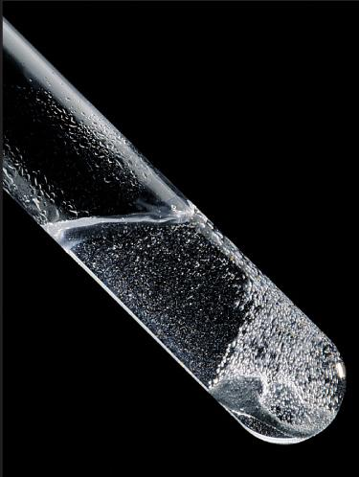
Figure 21.1
A summary of redox terminology.
Zn(s) + 2H+(aq) Zn2+(aq) + H2(g)
OXIDATION
One reactant loses electrons.
Zn loses electrons.
Reducing agent is oxidized.
Zn is the reducing agent and becomes oxidized.
Oxidation number increases.
The oxidation number of Zn increases from 0 to +2.
REDUCTION
Other reactant gains electrons.
Hydrogen ion gains electrons.
Oxidizing agent is reduced.
Hydrogen ion is the oxidizing agent and becomes reduced.
Oxidation number decreases.
The oxidation number of H decreases from +1 to 0.
Notes:
‹#›

Slide 5
Half-Reaction Method for Balancing Redox Reactions
Summary: This method divides the overall redox reaction into oxidation and reduction half-reactions.
Each reaction is balanced for mass (atoms) and charge.
One or both are multiplied by some integer to make the number of electrons gained and lost equal.
The half-reactions are then recombined to give the balanced redox equation.
Advantages:
The separation of half-reactions reflects actual physical separations
in electrochemical cells.
The half-reactions are easier to balance especially if they involve
acid or base.
It is usually not necessary to assign oxidation numbers to those
species not undergoing change.
Notes:
‹#›

Slide 6
Balancing Redox Reactions in Acidic Solution
Cr₂O₇²⁻(aq) + I⁻(aq) Cr³⁺(aq) + I₂(s)
1. Divide the reaction into half-reactions -
Determine the O.N.s for the species undergoing redox.
+6
-1
+3
0
Cr₂O₇²⁻(aq) + I⁻(aq) Cr³⁺(aq) + I₂(s)
Cr₂O₇²⁻ Cr³⁺
Cr is going from +6 to +3
I ⁻ I₂
I is going from -1 to 0
2. Balance atoms and charges in each half-reaction -
14H⁺(aq) +
Cr₂O₇²⁻ Cr³⁺
2
+ 7H₂O(l)
net: +12
net: +6
Add 6e⁻ to reactants.
6e⁻ +
14H⁺(aq) +
Cr₂O₇²⁻ Cr³⁺
2
+ 7H₂O(l)
Notes:
‹#›

Slide 7
Balancing Redox Reactions in Acidic Solution
continued
6e⁻ +
14H⁺(aq) +
Cr₂O₇²⁻ Cr³⁺
2
+ 7H₂O(l)
2
I ⁻ I₂
+ 2e⁻
Cr (+6) is the oxidizing agent and I (-1) is the reducing agent.
3. Multiply each half-reaction by an integer, if necessary -
2
I ⁻ I₂
+ 2e⁻
x 3
4. Add the half-reactions together -
6e⁻ +
14H⁺ +
Cr₂O₇²⁻ Cr³⁺
2
+ 7H₂O(l)
6
I ⁻ I₂
3
+ 6e⁻
14H⁺(aq) +
Cr₂O₇²⁻(aq) + 6I⁻(aq) 2Cr³⁺(aq) + 3I₂(s)
+ 7H₂O(l)
5. Do a final check on atoms and charges.
Notes:
‹#›

Slide 8
Balancing Redox Reactions in Basic Solution
Balance the reaction in acid and then add OH⁻ so as to neutralize the H⁺ ions.
14H⁺(aq) +
Cr₂O₇²⁻(aq) + 6 I⁻(aq) 2Cr³⁺(aq) + 3I₂(s)
+ 7H₂O(l)
+ 14OH⁻(aq)
+ 14OH⁻(aq)
14H₂O +
Cr₂O₇²⁻ + 6 I⁻ 2Cr³⁺ + 3I₂
+ 7H₂O + 14OH⁻
Reconcile the number of water molecules.
7H₂O +
Cr₂O₇²⁻ + 6 I⁻ 2Cr³⁺ + 3I₂
+ 14OH⁻
Do a final check on atoms and charges.
Notes:
‹#›

Slide 9
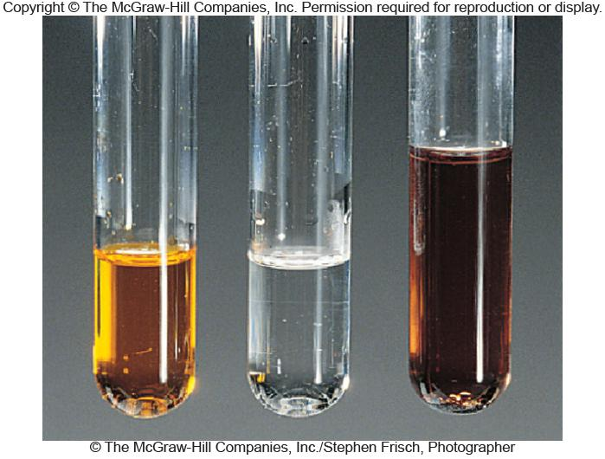
Figure 21.2
The redox reaction between dichromate ion and iodide ion.
Cr³⁺ + I₂
Notes:
‹#›

Slide 10
Sample Problem 21.1
Balancing Redox Reactions by the Half-Reaction Method
PROBLEM:
Permanganate ion is a strong oxidizing agent, and its deep purple color makes it useful as an indicator in redox titrations. It reacts in basic solution with the oxalate ion to form carbonate ion and solid manganese dioxide. Balance the skeleton ionic equation for the reaction between NaMnO₄ and Na₂C₂O₄ in basic solution:
MnO₄⁻(aq) + C₂O₄²⁻(aq) MnO₂(s) + CO₃²⁻(aq)
PLAN:
Proceed in acidic solution and then neutralize with base.
SOLUTION:
MnO₄⁻ MnO₂
C₂O₄²⁻ CO₃²⁻
+7
+4
+3
+4
MnO₄⁻ MnO₂
C₂O₄²⁻ CO₃²⁻
2
C₂O₄²⁻ 2CO₃²⁻
4H⁺ +
MnO₄⁻ MnO₂
+ 2H₂O
+3e⁻
+ 2H₂O
+ 4H⁺
+2e⁻
Notes:
‹#›

Slide 11
Sample Problem 21.1
Balancing Redox Reactions by the Half-Reaction Method
continued
4H⁺ + MnO₄⁻ +3e⁻ MnO₂+ 2H₂O
C₂O₄²⁻ + 2H₂O 2CO₃²⁻ + 4H⁺ + 2e⁻
4H⁺ + MnO₄⁻ +3e⁻ MnO₂+ 2H₂O
C₂O₄²⁻ + 2H₂O 2CO₃²⁻ + 4H⁺ + 2e⁻
x 2
x 3
8H⁺ + 2MnO₄⁻ +6e⁻ 2MnO₂+ 4H₂O
3C₂O₄²⁻ + 6H₂O 6CO₃²⁻ + 12H⁺ + 6e⁻
8H⁺ + 2MnO₄⁻ +6e⁻ 2MnO₂+ 4H₂O
3C₂O₄²⁻ + 6H₂O 6CO₃²⁻ + 12H⁺ + 6e⁻
2MnO₂⁻(aq) + 3C₂O₄²⁻(aq) + 2H₂O(l) 2MnO₂(s) + 6CO₃²⁻(aq) + 4H⁺(aq)
+ 4OH⁻
+ 4OH⁻
2MnO₂⁻(aq) + 3C₂O₄²⁻(aq) + 4OH⁻(aq) 2MnO₂(s) + 6CO₃²⁻(aq) + 2H₂O(l)
Notes:
‹#›

Slide 12
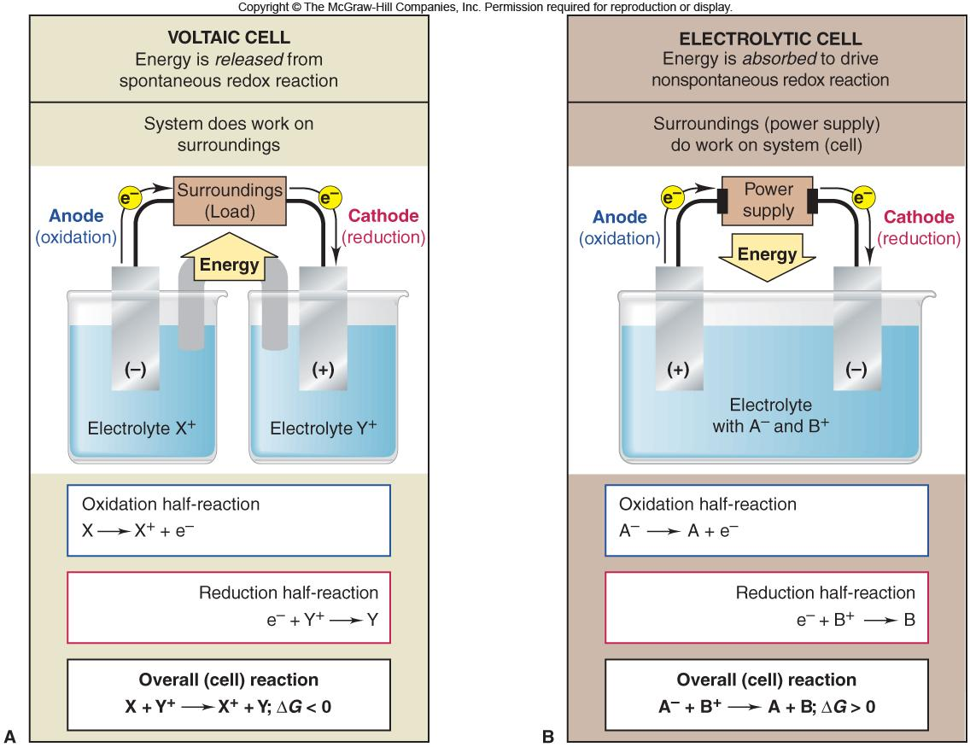
Figure 21.3
General characteristics of voltaic and electrolytic cells.
Notes:
‹#›

Slide 13
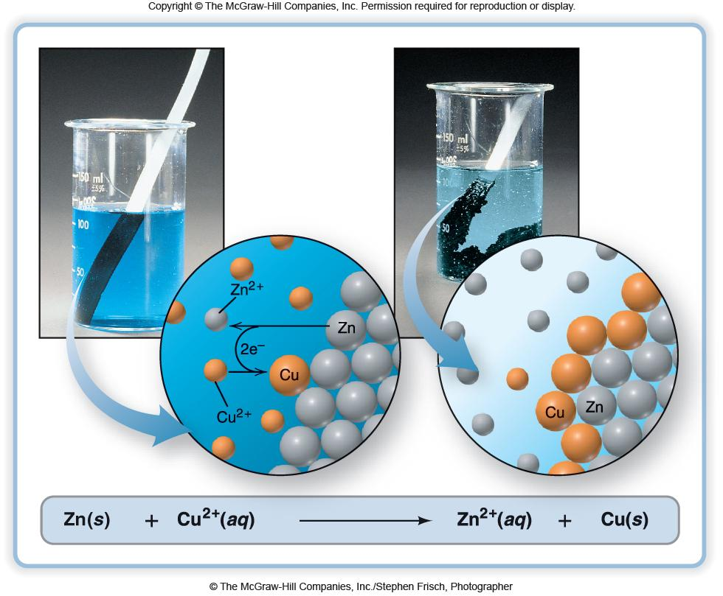
Figure 21.4
The spontaneous reaction between zinc and copper(II) ion.
Notes:
‹#›

Slide 14
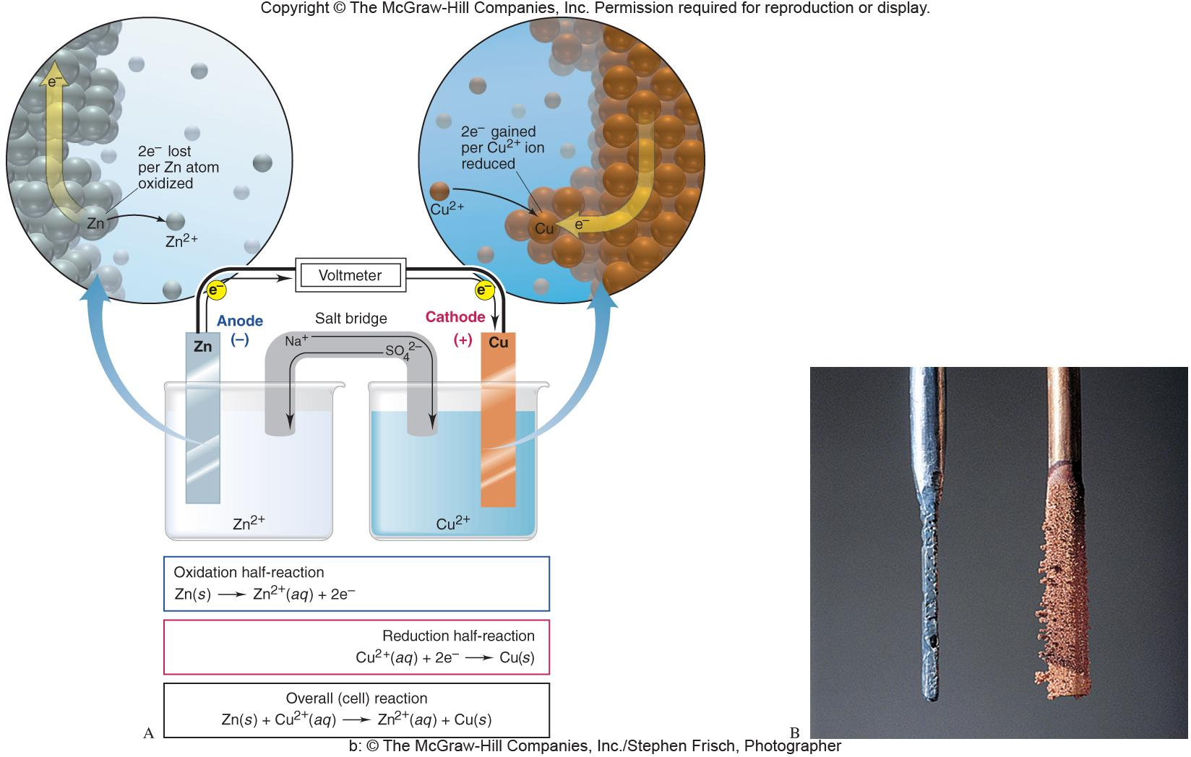
Figure 21.5
A voltaic cell based on the zinc-copper reaction.
Notes:
‹#›

Slide 15
Notation for a Voltaic Cell
Components of anode compartment
(oxidation half-cell)
Components of cathode compartment
(reduction half-cell)
Phase of lower oxidation state
Phase of higher oxidation state
Phase of higher oxidation state
Phase of lower oxidation state
Phase boundary between half-cells
Examples:
Zn(s) | Zn²⁺(aq) || Cu²⁺(aq) | Cu (s)
Zn(s) Zn²⁺(aq) + 2e⁻
Cu²⁺(aq) + 2e⁻ Cu(s)
graphite | I⁻(aq) | I₂(s) || H⁺(aq), MnO₄⁻(aq) | Mn²⁺(aq) | graphite
inert electrodes
Notes:
‹#›

Slide 16
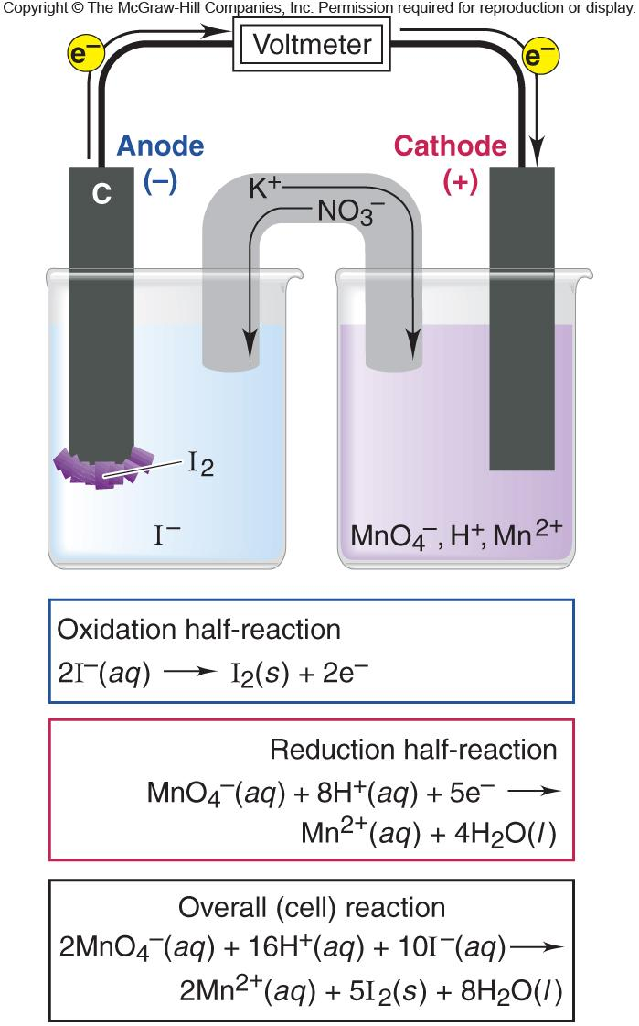
Figure 21.6
A voltaic cell using inactive electrodes.
Notes:
‹#›

Slide 17
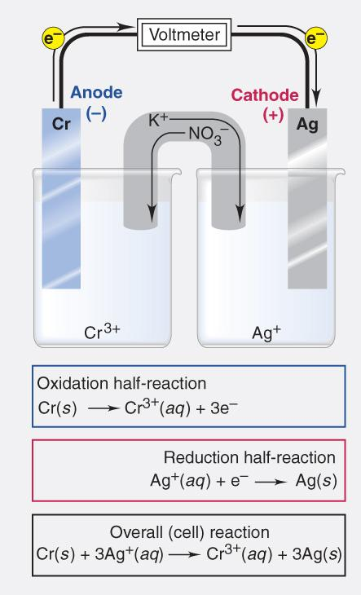
Sample Problem 21.2
Describing a Voltaic Cell with Diagram and Notation
PROBLEM:
Draw a diagram, show balanced equations, and write the notation for a voltaic cell that consists of one half-cell with a Cr bar in a Cr(NO₃)₃ solution, another half-cell with an Ag bar in an AgNO₃ solution, and a KNO₃ salt bridge. Measurement indicates that the Cr electrode is negative relative to the Ag electrode.
PLAN:
Identify the oxidation and reduction reactions and write each half-reaction. Associate the (-)(Cr) pole with the anode (oxidation) and the (+) pole with the cathode (reduction).
SOLUTION:
Cr(s) | Cr³⁺(aq) || Ag⁺(aq) | Ag(s)
Notes:
‹#›

Slide 18
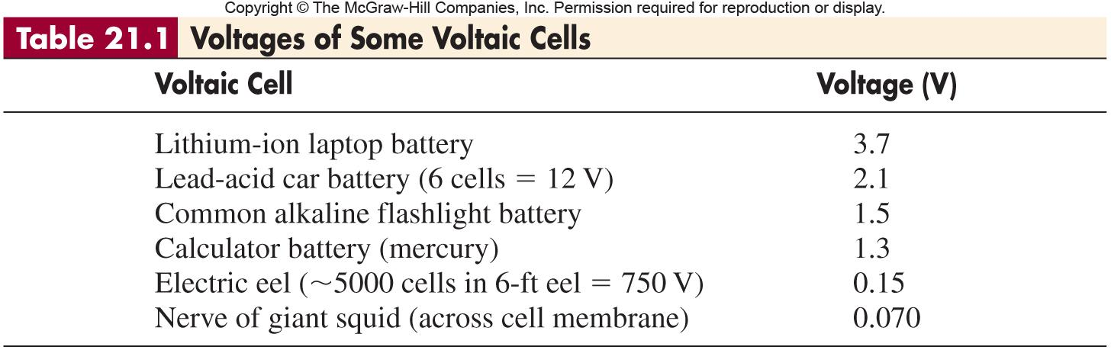
Notes:
‹#›

Slide 19
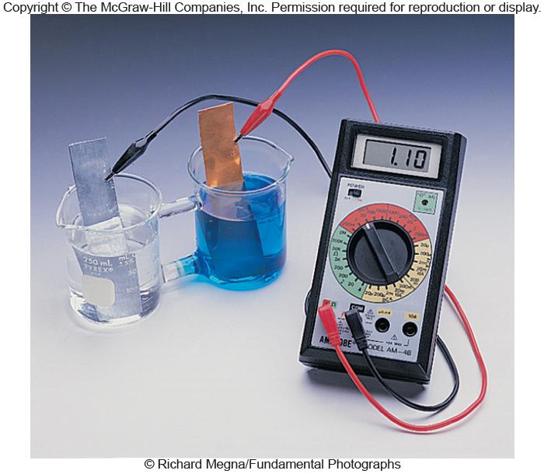
Figure 21.7
Measurement of a standard cell potential.
Notes:
‹#›

Slide 20
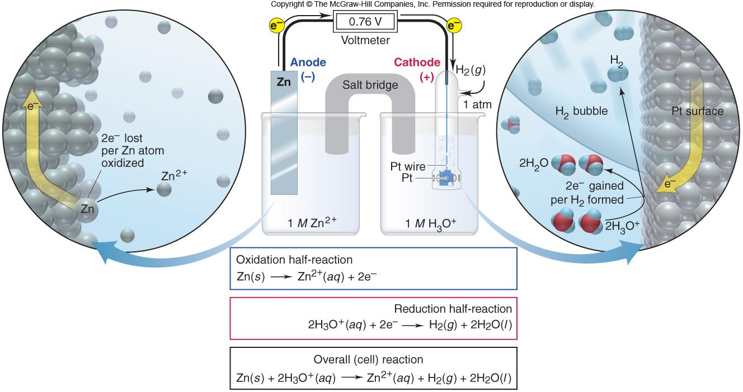
Figure 21.8
Determining an unknown Eº_{half-cell} with the standard reference (hydrogen) electrode.
Notes:
‹#›

Slide 21
Sample Problem 21.3
Calculating an Unknown Eº_{half-cell} from Eº_{cell}
PROBLEM:
A voltaic cell houses the reaction between aqueous bromine and zinc metal:
Br₂(aq) + Zn(s) Zn²⁺(aq) + 2Br ⁻(aq) Eº_{cell} = 1.83 V
Calculate Eº_{bromine}, given Eº_{zinc} = -0.76 V.
PLAN:
The reaction is spontaneous as written since the Eº_{cell} is (+). Zinc is being oxidized and is the anode. Therefore, the Eº_{bromine} can be found using Eº_{cell} = Eº_{cathode} - Eº_{anode}.
SOLUTION:
Anode: Zn(s) Zn²⁺(aq) + 2e⁻ E = +0.76 V
Eº_{Zn} as Zn²⁺(aq) + 2e⁻ Zn(s) is -0.76 V
Eº_{cell} = Eº_{cathode} - Eº_{anode} = 1.83 = Eº_{bromine} - (-0.76)
Eº_{bromine} = 1.83 + (-0.76) = 1.07 V
Notes:
‹#›

Slide 22
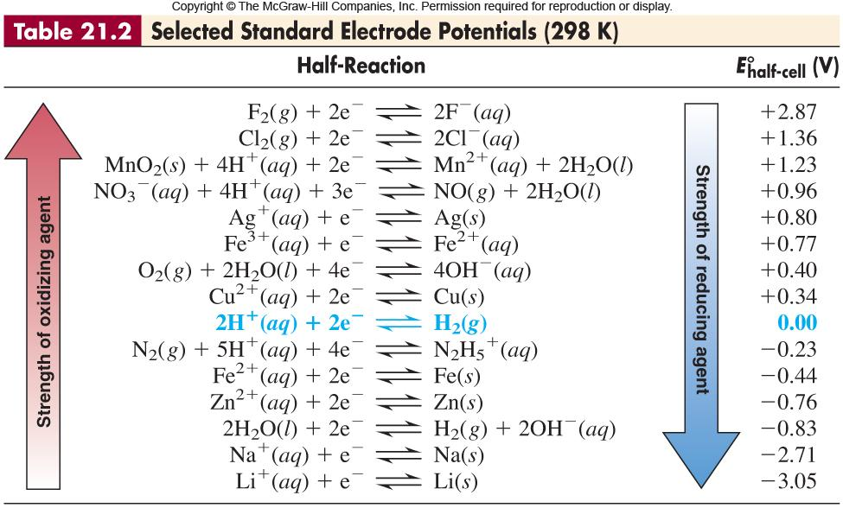
Notes:
‹#›

Slide 23
Writing Spontaneous Redox Reactions
By convention, electrode potentials are written as reductions.
When pairing two half-cells, you must reverse one reduction half-cell to produce an oxidation half-cell. Reverse the sign of the potential.
The reduction half-cell potential and the oxidation half-cell potential are added to obtain the Eº_{cell}.
When writing a spontaneous redox reaction, the left side (reactants) must contain the stronger oxidizing and reducing agents.
Example:
Zn(s) + Cu²⁺(aq) Zn²⁺(aq) + Cu(s)
stronger reducing agent
stronger oxidizing agent
weaker oxidizing agent
weaker reducing agent
Notes:
‹#›

Slide 24
Sample Problem 21.4
Writing Spontaneous Redox Reactions
PROBLEM:
(a) Combine the following three half-reactions into three balanced equations (A, B, and C) for spontaneous reactions, and calculate Eº_{cell} for each.
(1) NO₃⁻(aq) + 4H⁺(aq) + 3e⁻ NO(g) + 2H₂O(l)
Eº = 0.96 V
(2) N₂(g) + 5H⁺(aq) + 4e⁻ N₂H₅⁺(aq)
Eº = -0.23 V
(3) MnO₂(s) + 4H⁺(aq) + 2e⁻ Mn²⁺(aq) + 2H₂O(l)
Eº = 1.23 V
PLAN:
Put the equations together in varying combinations so as to produce (+) Eº_{cell} for each combination. Since the reactions are written as reductions, remember that as you reverse one reaction for an oxidation, reverse the sign of Eº. Balance the number of electrons gained and lost without changing the Eº.
In ranking the strengths, compare the combinations in terms of Eº_{cell}.
Notes:
‹#›

Slide 25
Sample Problem 21.4
Writing Spontaneous Redox Reactions
continued (2 of 3)
SOLUTION:
(1) NO₃⁻(aq) + 4H⁺(aq) + 3e⁻ NO(g) + 2H₂O(l)
Eº = 0.96 V
(a)
Rev
(2) N₂H₅⁺(aq) N₂(g) + 5H⁺(aq) + 4e⁻
Eº = +0.23 V
(1) NO₃⁻(aq) + 4H⁺(aq) + 3e⁻ NO(g) + 2H₂O(l)
x 4
Eº_{cell} = 1.19 V
(2) N₂H₅⁺(aq) N₂(g) + 5H⁺(aq) + 4e⁻
x 3
(A)
4NO₃⁻(aq) + 3N₂H₅⁺(aq) + H⁺(aq) 4NO(g) + 3N₂(g) + 8H₂O(l)
Rev
(1) NO(g) + 2H₂O(l) NO₃⁻(aq) + 4H⁺(aq) + 3e⁻
Eº = -0.96 V
(3) MnO₂(s) + 4H⁺(aq) + 2e⁻ Mn²⁺(aq) + 2H₂O(l)
Eº = 1.23 V
(1) NO(g) + 2H₂O(l) NO₃⁻(aq) + 4H⁺(aq) + 3e⁻
x 2
Eº_{cell} = 0.27 V
(3) MnO₂(s) + 4H⁺(aq) + 2e⁻ Mn²⁺(aq) + 2H₂O(l)
x 3
(B)
2NO(g) + 3MnO₂(s) + 4H⁺(aq) 2NO₃⁻(aq) + 3Mn³⁺(aq) + 2H₂O(l)
Notes:
‹#›

Slide 26
Sample Problem 21.4
Writing Spontaneous Redox Reactions
continued (3 of 3)
Rev
(2) N₂H₅⁺(aq) N₂(g) + 5H⁺(aq) + 4e⁻
E⁰ = +0.23 V
(3) MnO₂(s) + 4H⁺(aq) + 2e⁻ Mn²⁺(aq) + 2H₂O(l)
E⁰ = 1.23 V
(2) N₂H₅⁺(aq) N₂(g) + 5H⁺(aq) + 4e⁻
E⁰_{cell} = 1.46 V
(3) MnO₂(s) + 4H⁺(aq) + 2e⁻ Mn²⁺(aq) + 2H₂O(l)
x 2
(C)
N₂H₅⁺(aq) + 2MnO₂(s) + 3H⁺(aq) N₂(g) + 2Mn²⁺(aq) + 4H₂O(l)
A comparison of the relative strengths of oxidizing and reducing agents produces the overall ranking of
Oxidizing agents: MnO₂ > NO₃⁻ > N₂
Reducing agents: N₂H₅⁺ > NO > Mn²⁺
Notes:
‹#›

Slide 27
Relative Reactivities (Activities) of Metals
1. Metals that can displace H₂ from acid.
2. Metals that cannot displace H₂ from acid.
3. Metals that can displace H₂ from water.
4. Metals that can displace other metals from solution.
Notes:
‹#›

Slide 28
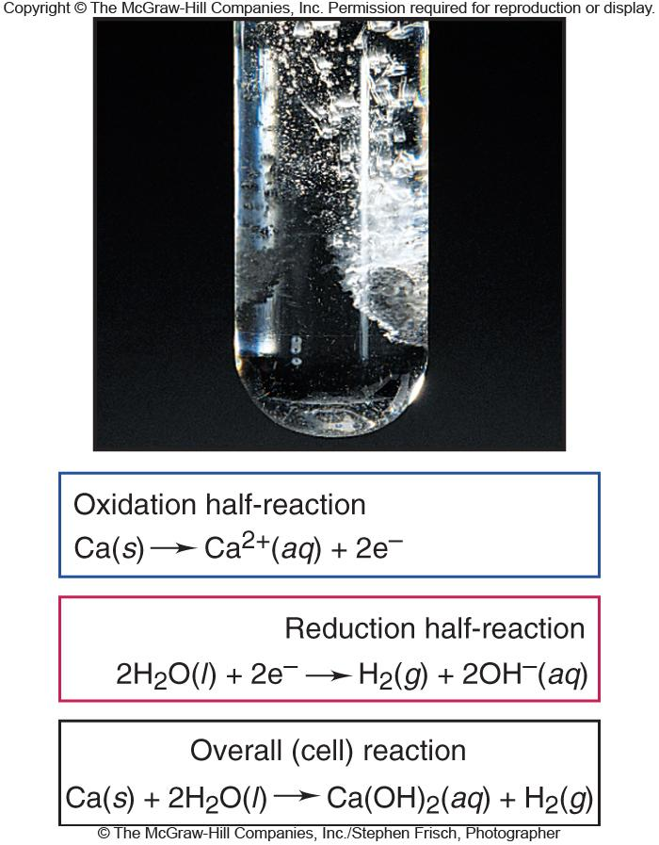
Figure 21.9
The reaction of calcium in water.
Notes:
‹#›

Slide 29
Free Energy and Electrical Work
ΔG α -E_{cell}
ΔG = w_{max} = charge x (-E_{cell})
-w_{max}
-E_{cell} =
charge
ΔG = -nFE_{cell}
charge = nF
In the standard state -
n = mol e⁻
ΔGº = -nFEº_{cell}
F = Faraday constant
ΔGº = - RT ln K
96,485 C
F =
Eº_{cell} = - ( )ln K
mol e⁻
RT
n F
J
1 V = 1
C
9.65 x 10⁴ J
F =
V•mol e⁻
Notes:
‹#›

Slide 30
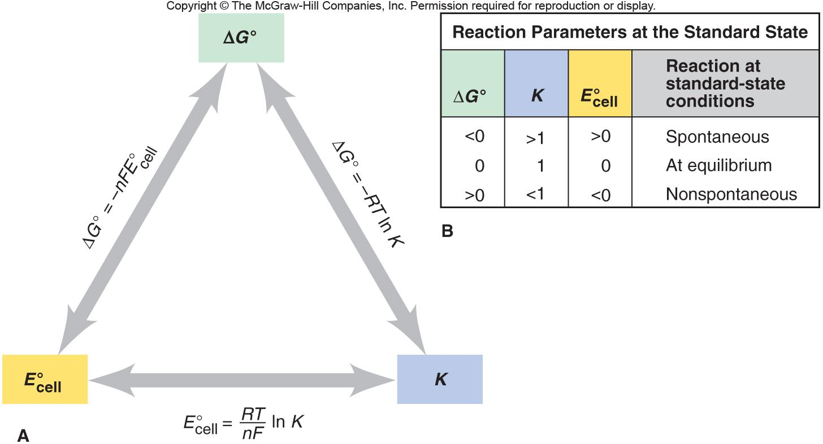
Figure 21.10
The interrelationship of ΔG⁰, E⁰_{cell}, and K.
< 0
> 1
> 0
0
1
0
> 0
< 1
< 0
ΔGº = -RT lnK
Notes:
‹#›

Slide 31
Sample Problem 21.5
Calculating K and ΔGº from Eº_{cell}
PROBLEM:
Lead can displace silver from solution:
Pb(s) + 2Ag⁺(aq) Pb²⁺(aq) + 2Ag(s)
As a consequence, silver is a valuable byproduct in the industrial extraction of lead from its ore. Calculate K and ΔGº at 298.15 K for this reaction.
PLAN:
Break the reaction into half-reactions, find the Eº for each half-reaction and then the Eº_{cell}. Substitute into the equations from previous slide.
SOLUTION:
Pb²⁺(aq) + 2e⁻ Pb(s)
Eº = -0.13 V
Eº = 0.13 V
Ag⁺(aq) + e⁻ Ag(s)
Eº = 0.80 V
Eº = 0.80 V
Pb(s) Pb²⁺(aq) + 2e⁻
Eº_{cell} = 0.93 V
2 x
Ag⁺(aq) + e⁻ Ag(s)
0.0592 V
96.5 kJ
Eº_{cell} =
log K
ΔGº = -nFE⁰_{cell}
= -(2)( )(0.93 V)
n
mol•V
n x Eº_{cell}
(2)(0.93 V)
log K =
=
K = 2.6 x 10³¹
ΔGº = -1.8 x 10² kJ
0.0592 V
0.0592 V
Notes:
‹#›

Slide 32
The Effect of Concentration on Cell Potential
ΔG = ΔGº + RT ln Q
-nF E_{cell} = -nF E_{cell} + RT ln Q
RT
E_{cell} = Eº_{cell} -
ln Q
nF
When Q < 1 and thus [reactant] > [product], ln Q < 0, so E_{cell} > Eº_{cell}.
When Q = 1 and thus [reactant] = [product], ln Q = 0, so E_{cell} = Eº_{cell}.
When Q >1 and thus [reactant] < [product], ln Q > 0, so E_{cell} < Eº_{cell}.
0.0592
E_{cell} = Eº_{cell} -
log Q
n
Notes:
‹#›

Slide 33
Sample Problem 21.6
Using the Nernst Equation to Calculate E_{cell}
PROBLEM:
In a test of a new reference electrode, a chemist constructs a voltaic cell consisting of a Zn/Zn²⁺ half-cell and an H₂/H⁺ half-cell under the following conditions:
[Zn²⁺] = 0.010 M [H⁺] = 2.5 M P = 0.30 atm
H₂
Calculate E_{cell} at 298.15 K.
PLAN:
Find Eº_{cell} and Q in order to use the Nernst equation.
SOLUTION:
Determining Eº_{cell} :
P x [Zn²⁺]
2H⁺(aq) + 2e⁻ H₂(g)
Eº = 0.00 V
Q =
H₂
Zn²⁺(aq) + 2e⁻ Zn(s)
Eº = -0.76 V
[H⁺]²
Zn(s) Zn²⁺(aq) + 2e⁻
Eº = +0.76 V
(0.30)(0.010)
Q =
0.0592 V
(2.5)²
E_{cell} = Eº_{cell} -
log Q
n
Q = 4.8 x 10⁻⁴
0.0592
E_{cell} = 0.76 – log(4.8 x 10⁻⁴) =
0.86 V
2
Notes:
‹#›

Slide 34
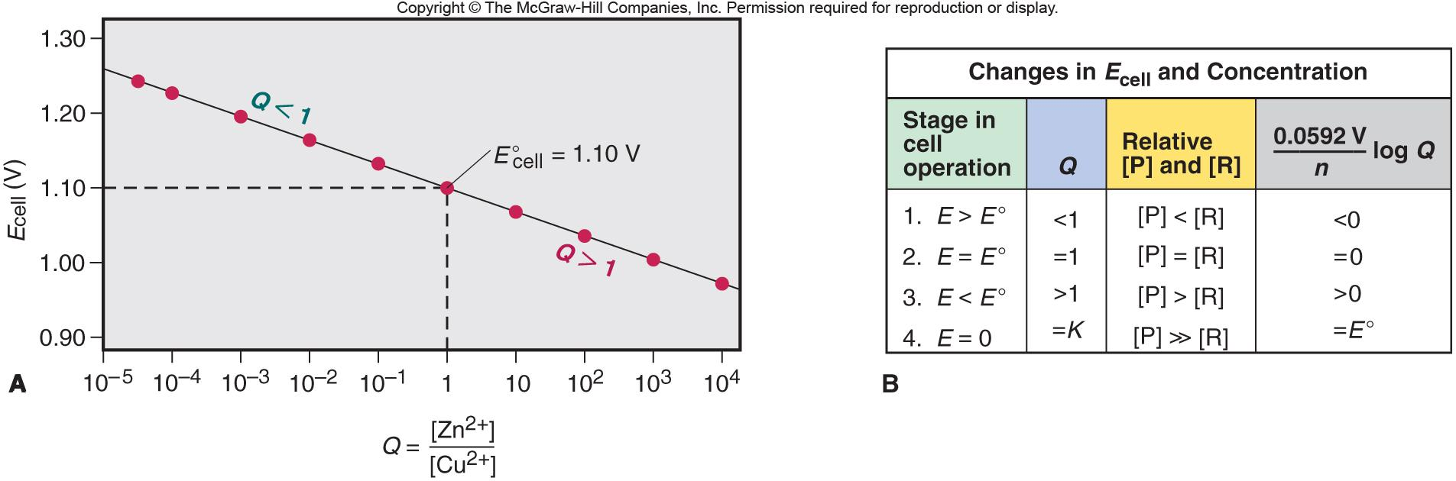
Figure 21.11
The relation between E_{cell} and log Q for the zinc-copper cell.
Notes:
‹#›

Slide 35
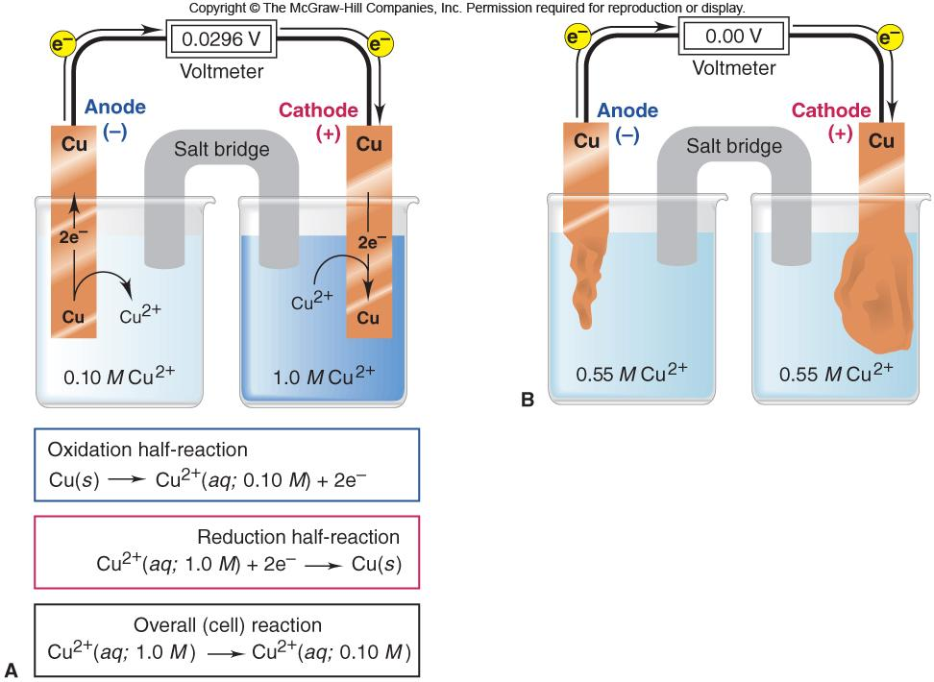
Figure 21.12
A concentration cell based on the Cu/Cu²⁺ half-reaction.
Notes:
‹#›

Slide 36
Sample Problem 21.7
Calculating the Potential of a Concentration Cell
PROBLEM:
A concentration cell consists of two Ag/Ag⁺ half-cells. In half-cell A, electrode A dips into 0.010 M AgNO₃; in half-cell B, electrode B dips into 4.0 x 10⁻⁴ M AgNO₃. What is the cell potential at 298.15 K? Which electrode has a positive charge?
PLAN:
Eº_{cell} will be zero since the half-cell potentials are equal. E_{cell} is calculated from the Nernst equation with half-cell A (higher [Ag⁺]) having Ag⁺ being reduced and plating out, and in half-cell B Ag(s) will be oxidized to Ag⁺.
SOLUTION:
Ag⁺(aq; 0.010 M) [half-cell A] Ag⁺(aq; 4.0 x 10⁻⁴ M) [half-cell B]
0.0592 V
[Ag⁺]_{dilute}
E_{cell} = Eº_{cell} -
log
1
[Ag⁺]_{concentrated}
4.0 x 10⁻²
E_{cell} = 0 V - 0.0592 V log
= 0.0828 V
0.010
Half-cell A is the cathode and has the positive electrode.
Notes:
‹#›

Slide 37
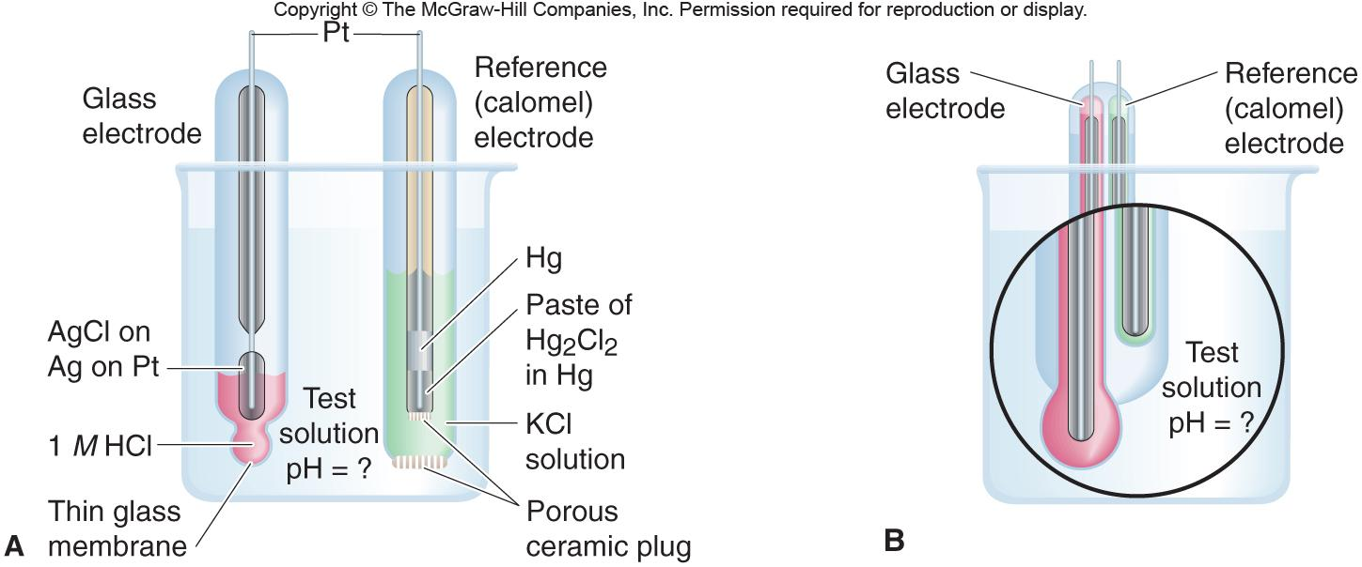
Figure 21.13
The laboratory measurement of pH.
Notes:
‹#›

Slide 38
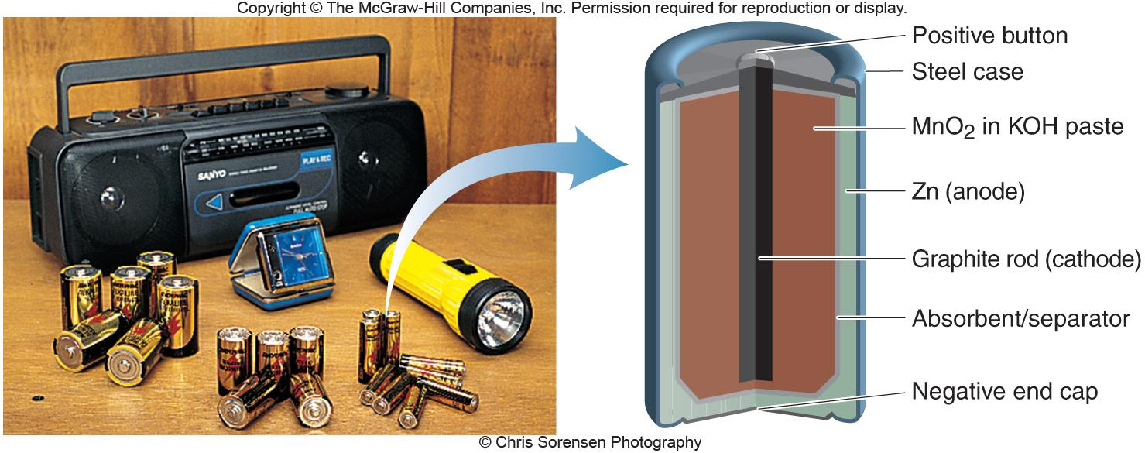
Figure 21.14
Alkaline battery.
Notes:
‹#›

Slide 39
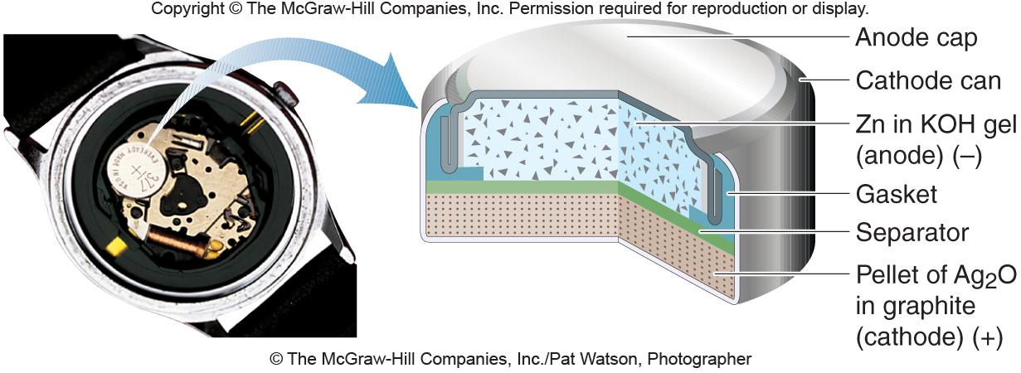
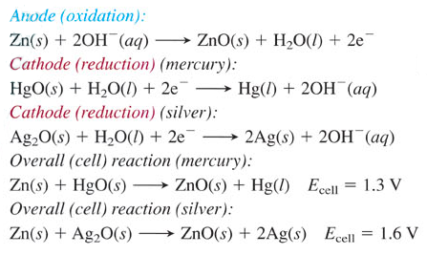
Figure 21.15
Silver button battery.
Notes:
‹#›

Slide 40
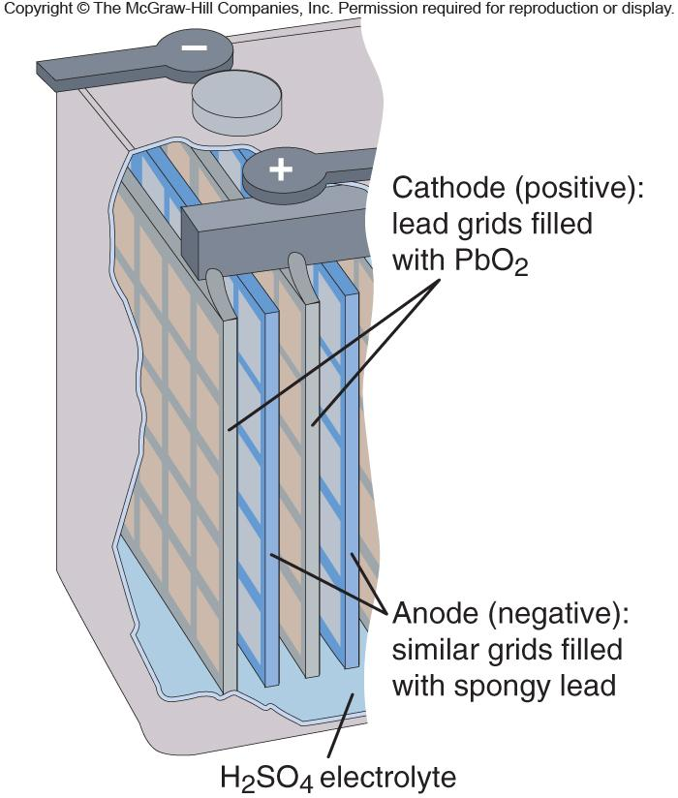
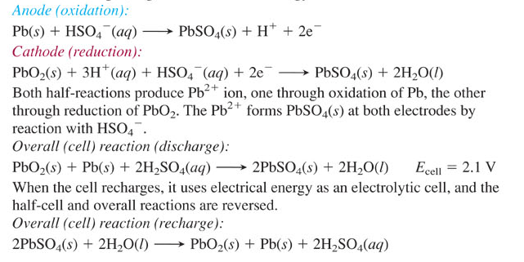
Figure 21.16
Lead-acid battery.
Notes:
‹#›

Slide 41
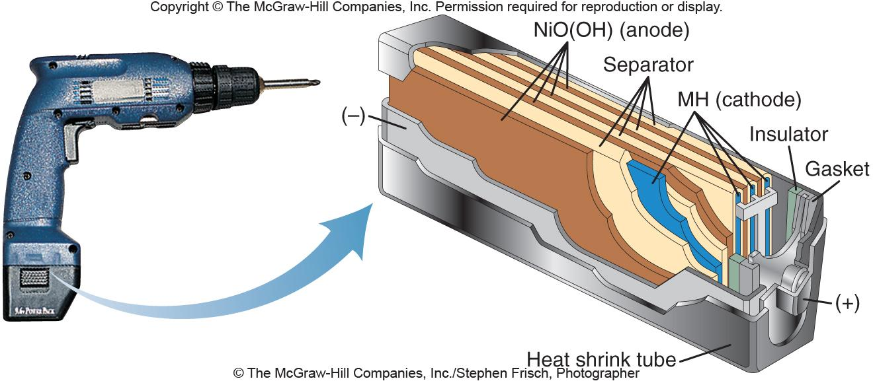
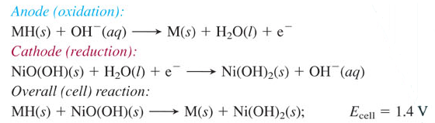
Figure 21.17
Nickel-metal hydride battery.
Notes:
‹#›

Slide 42

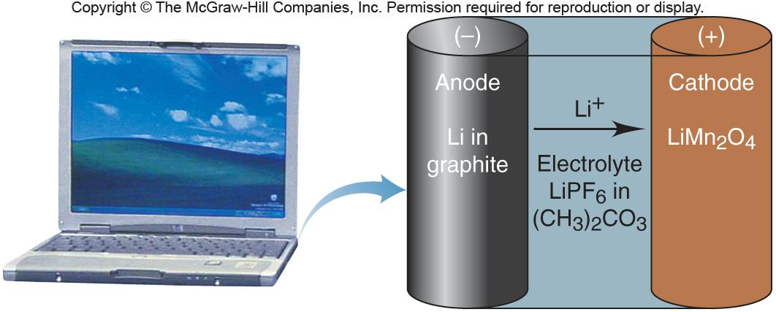
Figure 21.18
Lithium-ion battery.
Notes:
‹#›

Slide 43
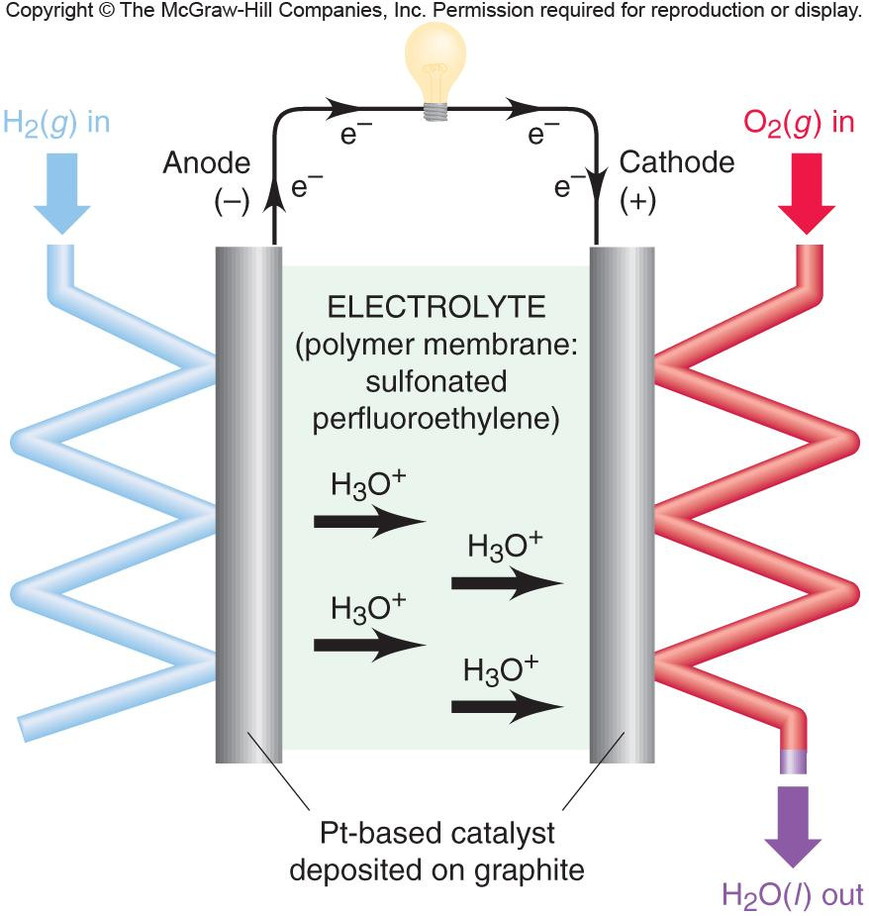
Figure 21.19
Hydrogen fuel cell.
Notes:
‹#›

Slide 44
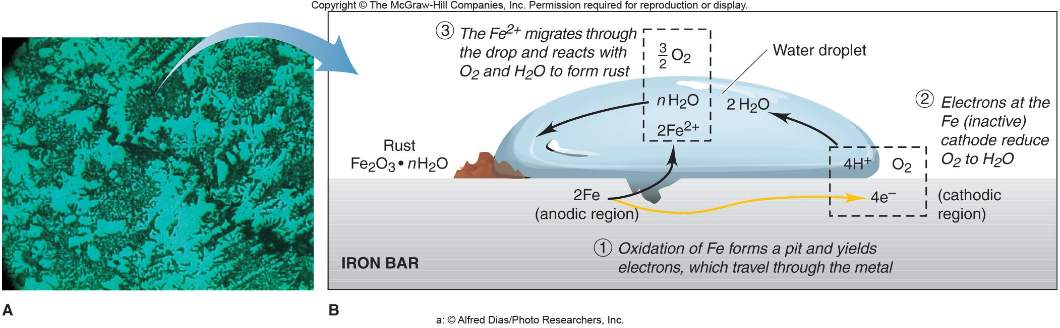
Figure 21.20
The corrosion of iron.
Notes:
‹#›

Slide 45
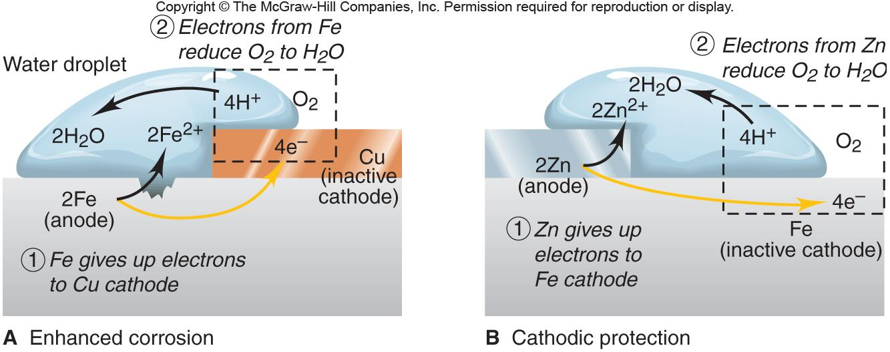
Figure 21.21
The effect of metal-metal contact on the corrosion of iron.
Faster corrosion
Notes:
‹#›

Slide 46
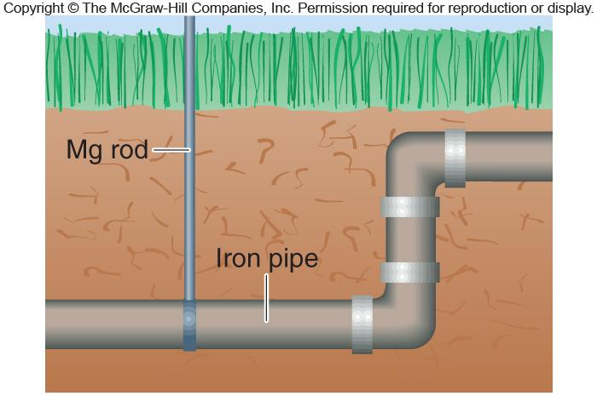
Figure 21.22
The use of sacrificial anodes to prevent iron corrosion.
Notes:
‹#›

Slide 47
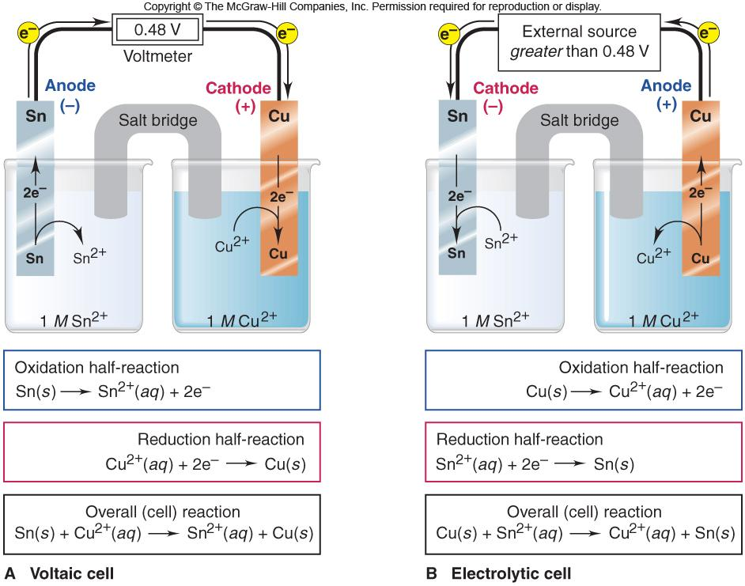
Figure 21.23
The tin-copper reaction as the basis of a voltaic and an electrolytic cell.
Notes:
‹#›

Slide 48
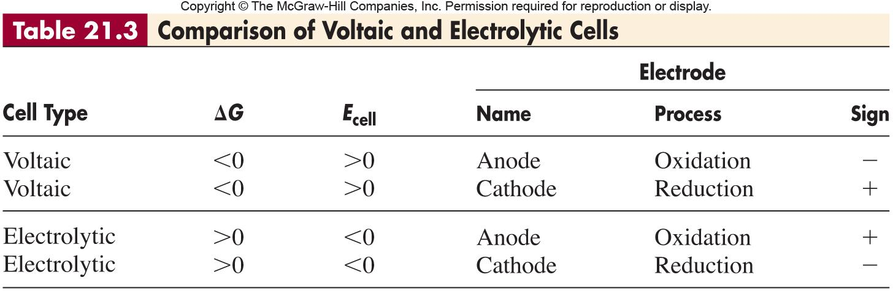
Notes:
‹#›

Slide 49
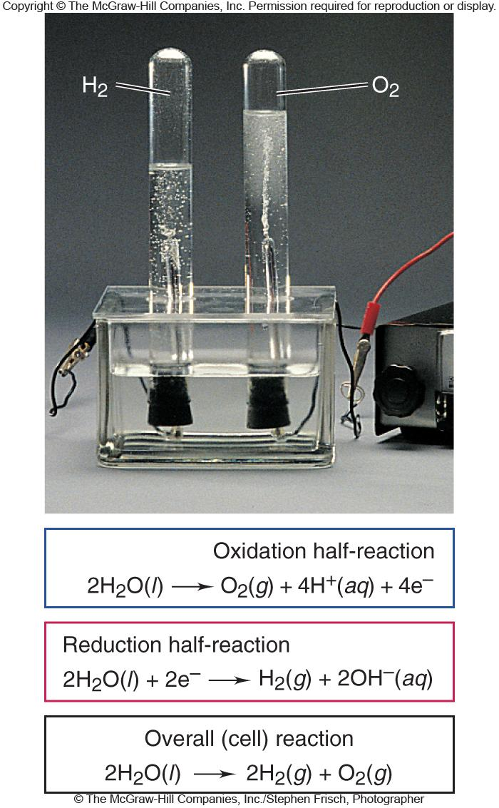
Figure 21.25
The electrolysis of water.
Notes:
‹#›

Slide 50
Sample Problem 21.8
Predicting the Electrolysis Products of Aqueous Ionic Solutions
PROBLEM:
What products form during electrolysis of aqueous solutions of the following salts: (a) KBr; (b) AgNO₃; (c) MgSO₄?
PLAN:
Compare the potentials of the reacting ions with those of water, remembering to consider the 0.4 to 0.6 V overvoltage.
The reduction half-reaction with the less negative potential, and the oxidation half-reaction with the less positive potential will occur at their respective electrodes.
SOLUTION:
(a) K⁺(aq) + e⁻ K(s)
Eº = -2.93 V
2H₂O(l) + 2e⁻ H₂(g) + 2OH⁻(aq)
Eº = -0.42 V
The overvoltage would make the water reduction -0.8 to -1.0 V, but the reduction of K⁺ is still a higher potential so H₂(g) is produced at the cathode.
2Br ⁻(aq) Br₂(l) + 2e⁻
Eº = 1.07 V
2H₂O(l) O₂(g) + 4H⁺(aq) + 4e⁻
Eº = 0.82 V
The overvoltage would give the water half-cell more potential than Br ⁻, so the Br ⁻ will be oxidized. Br₂(l) forms at the anode.
Notes:
‹#›

Slide 51
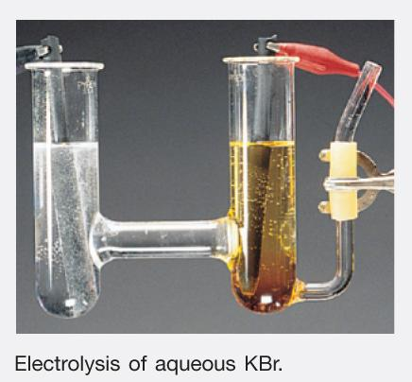
Sample Problem 21.8
Predicting the Electrolysis Products of Aqueous Ionic Solutions
continued
(b) Ag⁺(aq) + e⁻ Ag(s)
Eº = 0.80 V
2H₂O(l) + 2e⁻ H₂(g) + 2OH⁻(aq)
Eº = -0.42 V
Ag⁺ is the cation of an inactive metal and therefore, will be reduced to Ag at the cathode.
Ag⁺(aq) + e⁻ Ag(s)
The N in NO₃⁻ is already in its most oxidized form so water will have to be oxidized to produce O₂ at the anode.
2H₂O(l) O₂(g) + 4H⁺(aq) + 4e⁻
(c) Mg²⁺(aq) + 2e⁻ Mg(s)
Eº = -2.37 V
Mg is an active metal and its cation cannot be reduced in the presence of water. So as in (a) water is reduced and H₂(g) is produced at the cathode.
The S in SO₄²⁻ is in its highest oxidation state; therefore, water must be oxidized and O₂(g) will be produced at the anode.
Notes:
‹#›

Slide 52
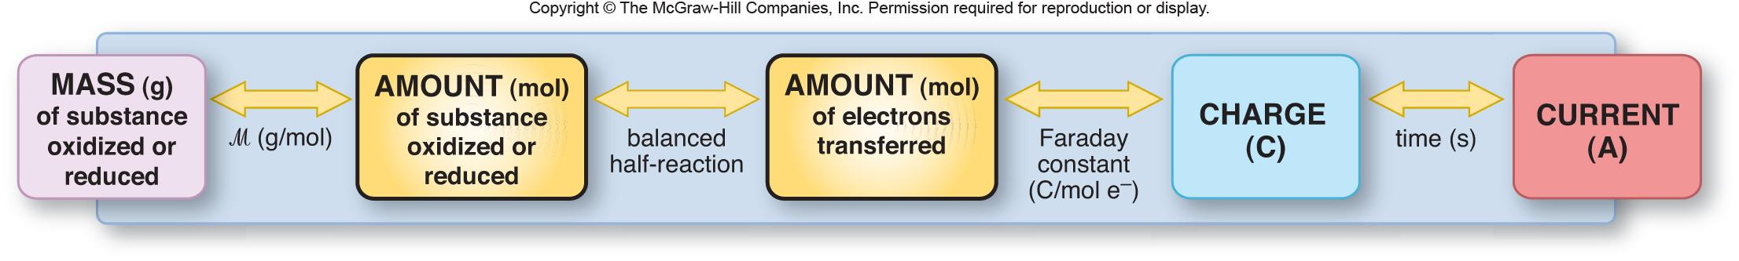
Figure 21.29
A summary diagram for the stoichiometry of electrolysis.
Notes:
‹#›

Slide 53
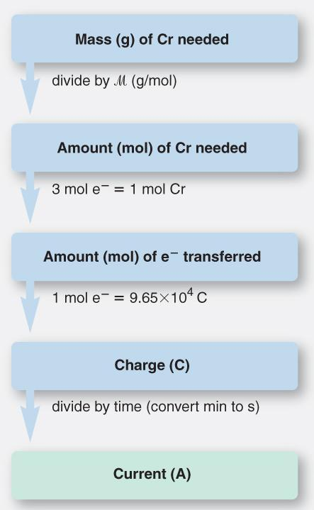
Sample Problem 21.9
Applying the Relationship Among Current, Time, and Amount of Substance
PROBLEM:
A technician is plating a faucet with 0.86 g of chromium from an electrolytic bath containing aqueous Cr₂(SO₄)₃. If 12.5 min is allowed for the plating, what current is needed?
PLAN:
Notes:
‹#›

Slide 54
Sample Problem 21.9
Applying the Relationship Among Current, Time, and Amount of Substance
continued
SOLUTION:
Cr³⁺(aq) + 3e⁻ Cr(s)
mol Cr
3 mol e-
0.86 g
x
x
= 0.050 mol e⁻
52.00 g Cr
1 mol Cr
9.65 x 10⁴ C
0.050 mol e⁻ x = 4.8 x 10³ C
mol e⁻
4.8 x 10³ C
= 6.4 = 6.4 A
1 min
C
x
12.5 min
60 s
s
Notes:
‹#›

