Slide 1
Food Microbiology lecture 3
NUT343
Dr. Emilia Rappocciolo

Slide 2
Microbial spores
Sporulation:
Resproduction: molds and yeast (both sexual and asexual)
Survival: bacteria
Mold spores: molds that form spores by sexual reproduction (zygospores, ascospores) are classified as perfect molds, those who form spores by asexual reproduction (conidia) are classified as imperfect molds.
important molds in food: Aspergillus, Penicillium, Rhizopus, Mucor
Yeast spores:
Ascomycetes (true yeast) sexual ascospores
False yeast: yeast that does not produce spores

Slide 3
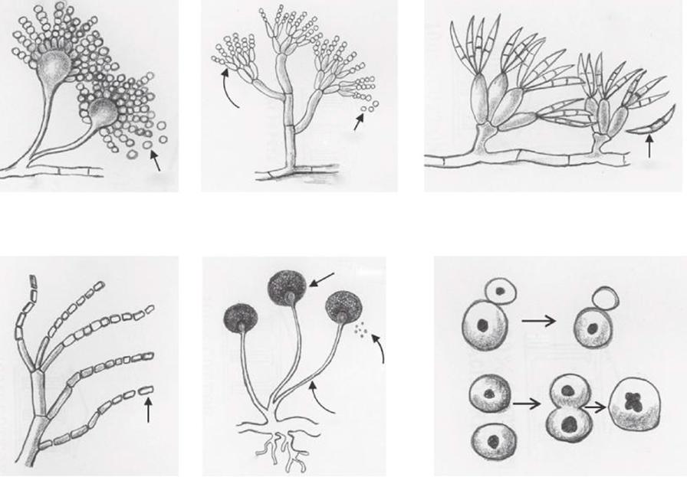
Fungal spores
a
b
c
i
ii
d
e
f
Schematics of spores of molds and yeasts. Conidiophore with condial head and condia
of (a) Aspergillus sp., (b) Penicillium sp., (c) Fusarium sp., (d) arthrospore in Geotrichum sp.,
(e) sporangiophore with sporangium containing sporangiospores of Rhizopus sp., (f) ascospore
formation in yeasts by conjugation of (i) mother–daughter and (ii) two separate cells.

Slide 4
Bacterial spores – endospores
Endospores are a differentiated form of the cell produced to promote survival
Only a few bacterial genera have the ability to form spores: the Gram positive Bacillus, Alicyclobacillus, Clostridium, Sporolactobacillus, and the Gram negative Desulfotomaculum.
Endospores are composed of several layers with the core at the centre. The core contains DNA, a few ribosomes, enzymes, dipicolinic acid, and very little water. The core is surrounded by: inner membrane, germ cell wall, cortex, outer membrane, coat, and in some cases exosporium.
Spores are metabolically inactive and can survive for years.

Slide 5
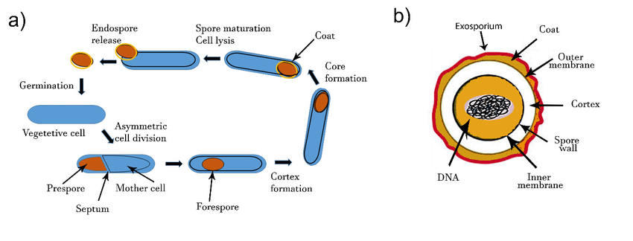
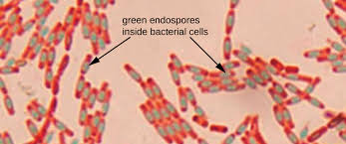

Slide 6
sporulation
Sporulation is triggered by changes in environment. Lack of nutrients, changes in pH or temperature, and overcrowding, are examples of triggers.
The process is complex and genetically controlled. Several genes are required to direct the differentiation of the cell from vegetative cell to endospore.
Before sporulation the DNA is replicated.
The process is long and might take up to 8 hours to be completed.

Slide 7
Dormancy, activation, germination
Dormancy: Metabolic inactivity of the spore, due mostly to the low water content in the core that reduces chemical reactions.
Also low content of ATP.
Spores can become activated by external signals. An activated spore might not germinate if the environmental conditions are not suitable
Germination involves re-hydration of core, excretion of calcium and dipicolinic acid. Initiation of metabolic activity, activation of protein and cortex-lytic enzymes, and release of cortex-lytic products.
After the spore germinates it outgrows. Swelling of the spore due to water and nutrients uptake. Repair and synthesis of RNA, proteins, and materials for cells membrane and wall. Emergence of the vegetative cell.

Slide 8
Spores resistance
Compared with growing cells, spores of Bacillus species in water:
Are resistant to ~40°C and higher temperatures
Can survive multiple cycles of freezing, drying and rehydration with no loss in viability
Are 10- to 50-fold more resistant to UV radiation
Are extremely resistant to acids, bases oxidizing agents, aldehydes.....
Can survive pressures as high as 8,000 atmospheres
Can survive processing/sterilization
Spore resistance is due to many factors:
the spore coats protect against lytic enzyme
spore inner membrane lack of permeability
low core hydration,
specific mechanisms for protecting and repairing spore DNA

Slide 9
Spores resistance
Resistance to freezing and dessication. Mostly due to the presence of Small Acid-soluble Small Proteins (SASP) and dipicolinic acid.
Resistance to high pressure >12,000 atmospheres (1atm~15 pSi). Lower pressure allows spore germination and can be used to kill germinated cells.
Gamma and UV radiation resistance
Chemical resistance: Spore coats provide a barrier. Impermeability of coats inhibits penetration of the chemicals

Slide 10
Spores resistance
Heat resistance
Implications in food industry
Best studied form of resistance
Withstand 100 ºC for several minutes
Dt value is used for quantification: Dt is time in min at temp (t) to kill 90% of population (1 log reduction)
The target of heat is not known- DNA is not damaged, no mutations due to heat, but may be proteins
Main goal of commercial sterility is C. botulinum spores, the most heat resistant
Spores must be reduced by 12D
12D is the time required in a thermal process for a 12 log reduction of the spores

Slide 11
Importance of spores in food
Due to their high resistance spores are important factors to be considered in food processing and preservation.
Spores should be either destroyed or prevented from germinating. Alternatively the spores can be induced to germinate and the vegetative cells destroyed by antimicrobial treatment.
Superdormant spores are a problem as they cannot be easily identified and eliminated.
Often a combination of methods is required to overcome the problem.

Slide 12
Importance of spores in food
In the canning of low-acid foods very high heat treatment is employed to achieve commercial sterility that kills spores of all pathogenic bacteria and most spoilage bacteria (except some thermophilic spoilage bacteria)
To prevent germination of spores, depending on the food type: nitrites (in processed meat), low pH (acid products), low AW, or high salt are used.
Mold spores can be destroyed at relatively low pressure (<58,000 Psi) spores of pathogenic and spoilage bacteria require high pressure (> 100,000 Psi) and high temperature (> 90 °C) to obtain commercial sterility

