Slide 1

Mechatronics System Design Chapter 3: System Identifications
Instructor: Dr. Ahmad Al-Balasie
First Semester - 2021/2022

Slide 2
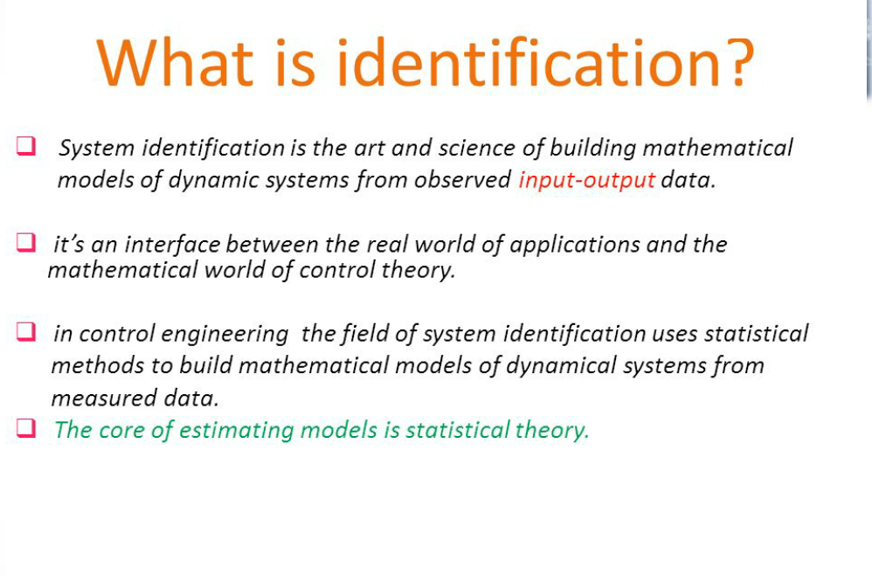

Slide 3
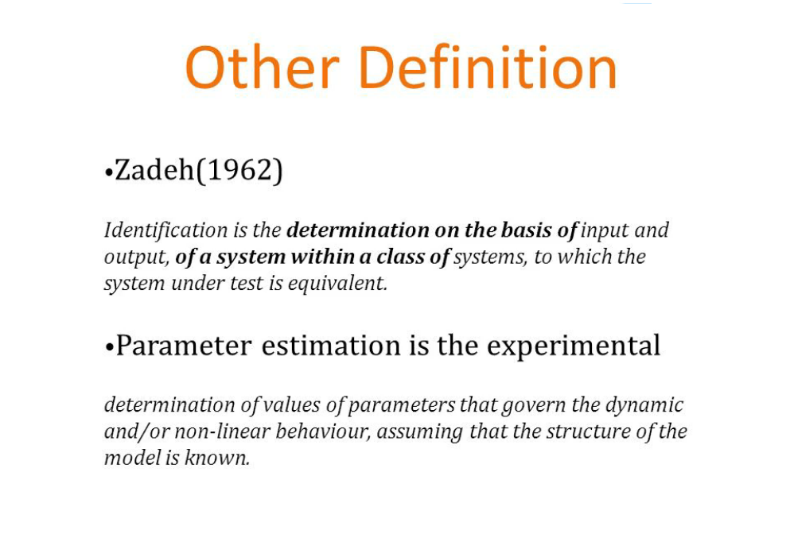

Slide 4
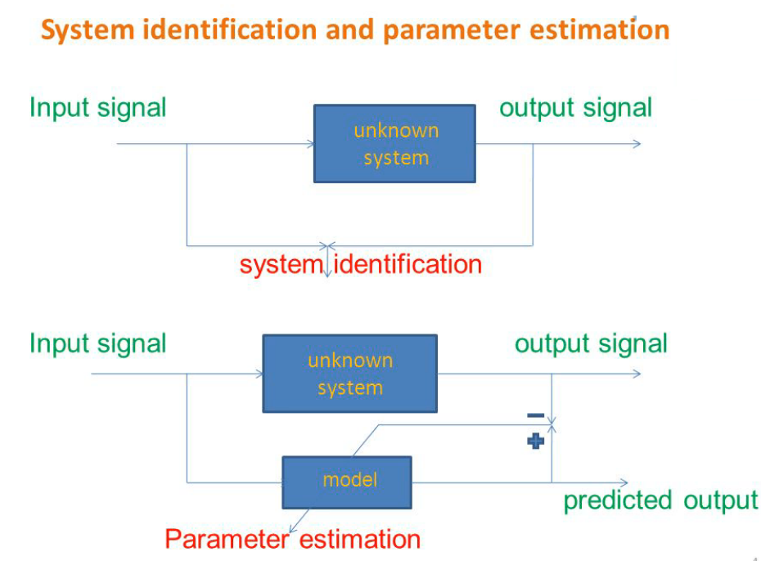

Slide 5
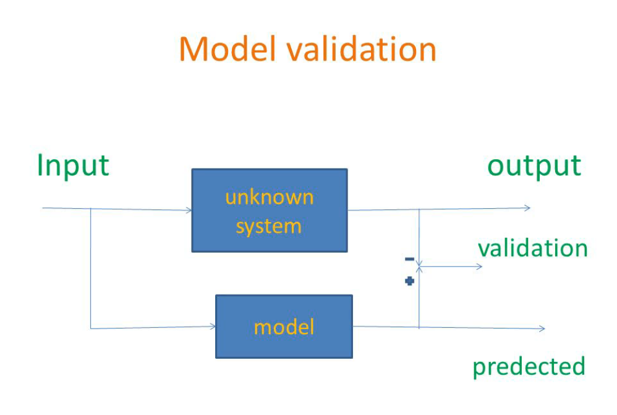

Slide 6
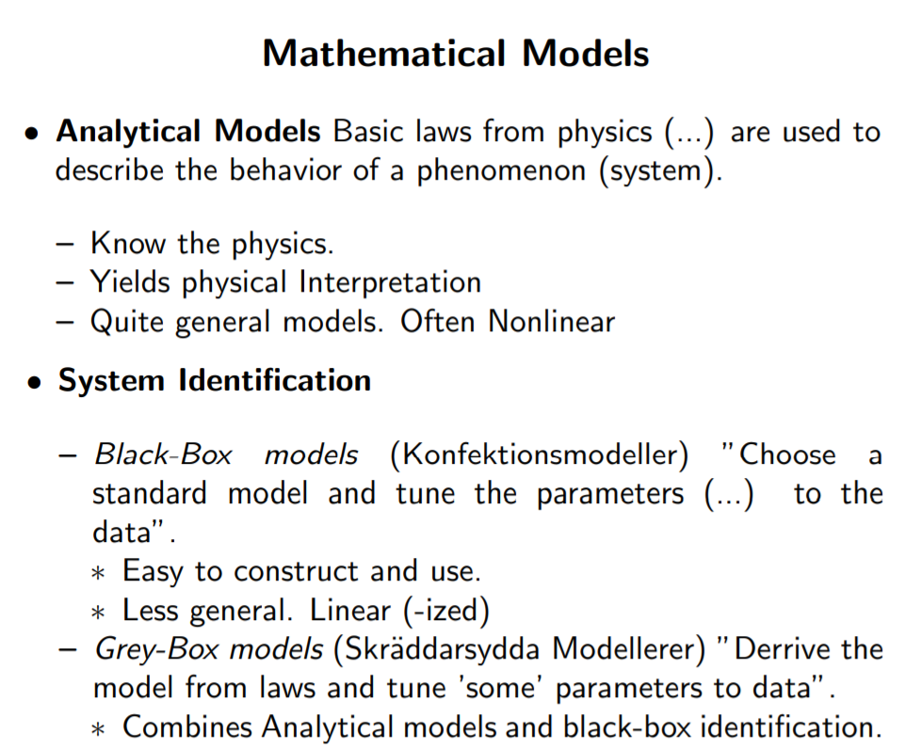

Slide 7
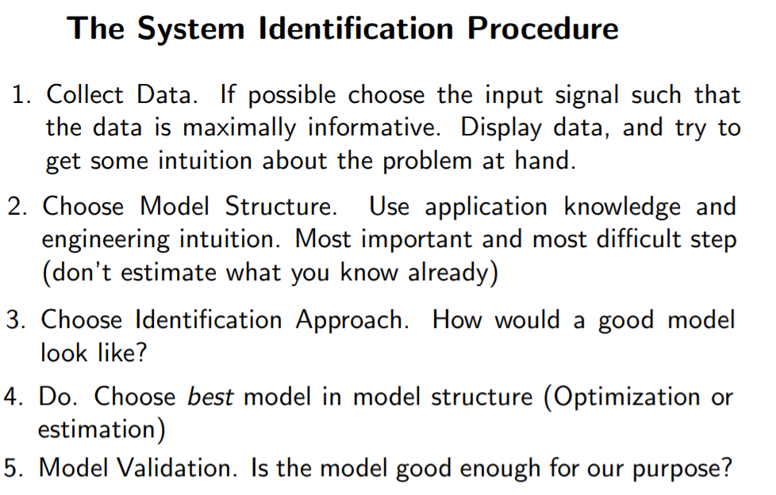

Slide 8
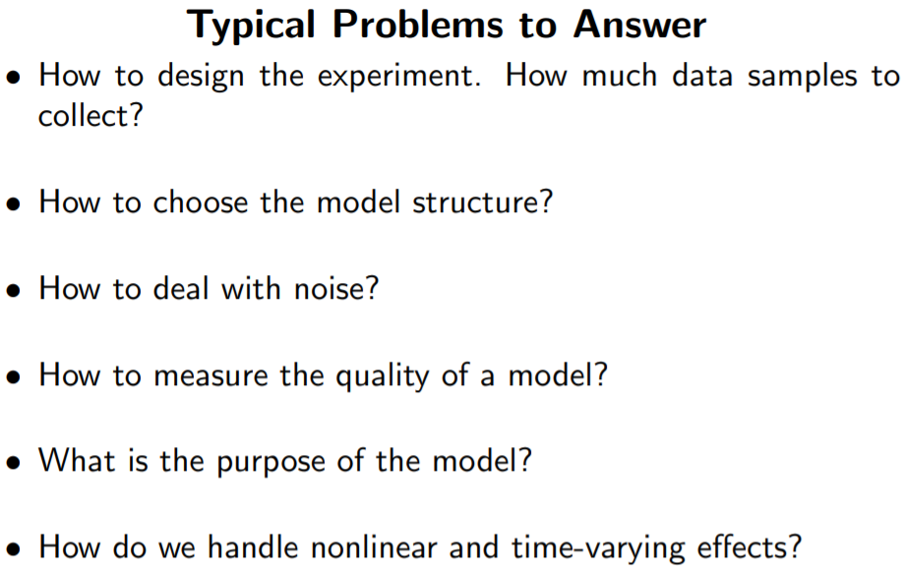

Slide 9
