Slide 1
Introduction to Sociology
Maram Jaghama

Slide 2
Outline
What is society?
Values and beliefs?
What is culture?

Slide 3
What is Society ??

Slide 4
Society Is….
A society is a group of people who share a culture and live more or less together.
Society is the system that connects individuals to one another.

Slide 5
Social Institutions
Institutions are the principal social structures that organize, direct, & execute the essential tasks of living.
Some institutions are: Family, Medical, educational, economic, religious, legal & political systems

Slide 6
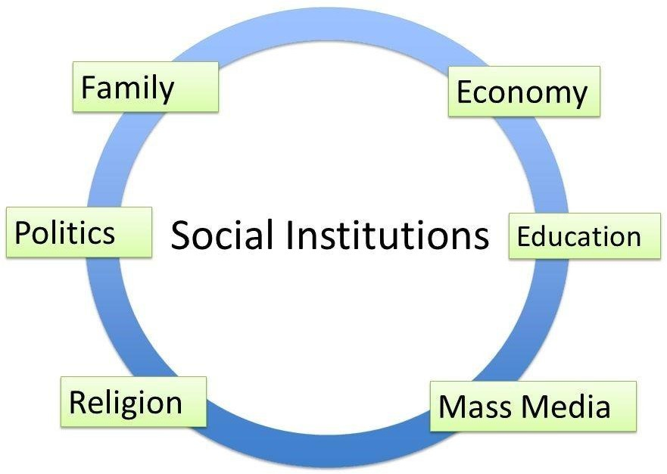
Social Institutions

Slide 8
Values and Beliefs
Values (القيم): are the standards by which
people assess desirability, goodness, & beauty; they are broad principles

Slide 9
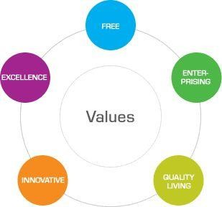

Slide 10
Values and Beliefs
Beliefs ( المعتقدات): specific statements that people hold to be true.
Beliefs are learned through socialization & help shape how we perceive our surroundings & how our personality develops.
Examples:
I believe that all people are basically the same. They want a good life, some relaxation, good job, happy family that they can care for and get care from, a secure life.
I believe that every body is unique. They each have their own desires and goals, feelings and hopes, and fears. And how they react to those fears are also unique.

Slide 11
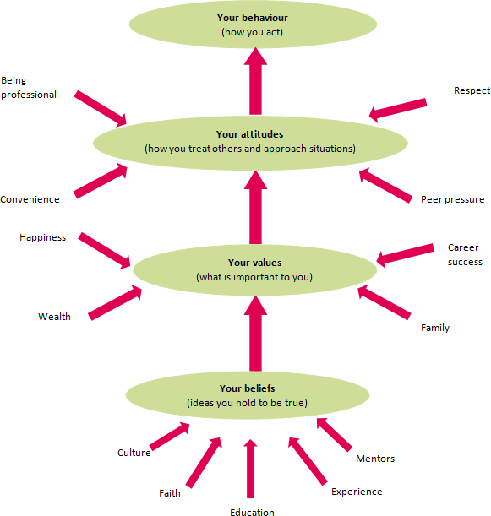
Wrap up: beliefs, values, attitudes & behaviour

Slide 13
What is culture?
Culture is the way of life of individuals.
Culture is defined as the values, beliefs, behavior, and material objects that constitute a people's way of life.

Slide 14
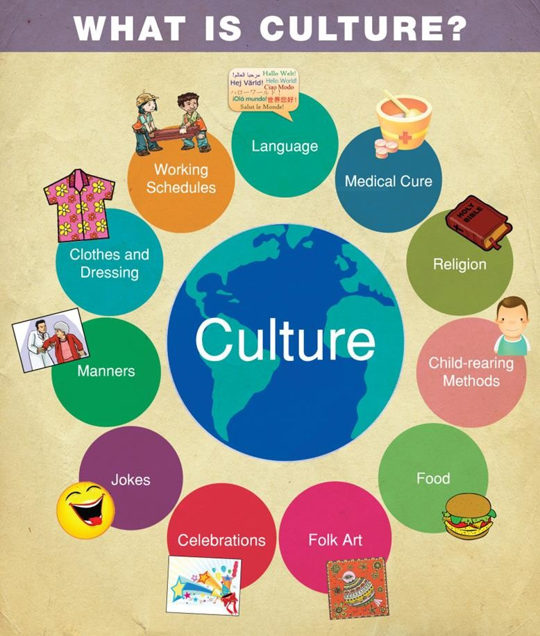

Slide 15
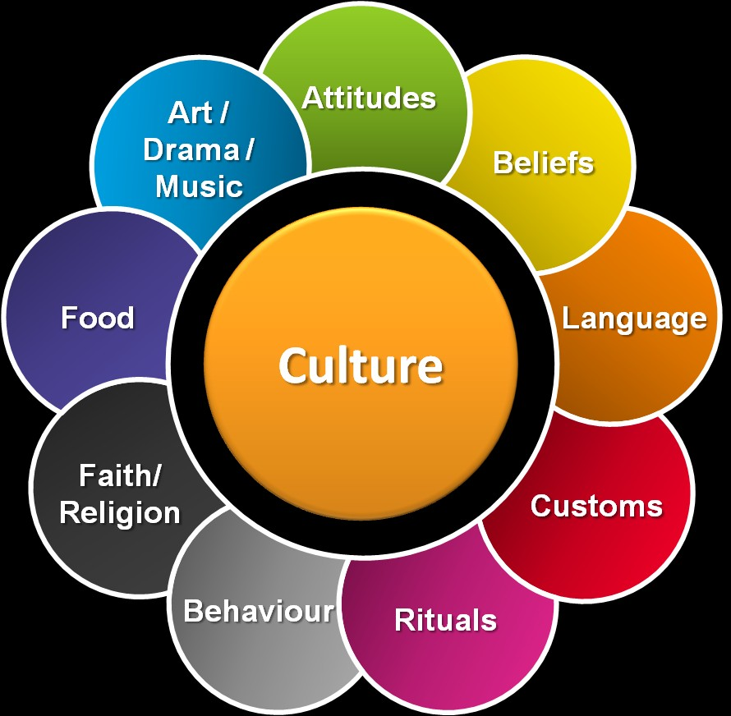
What is culture?

Slide 16
What is culture?
When people travel between societies or even within their own, they can experience culture shock, a personal disorientation that can come from encountering an unfamiliar way of life.

Slide 17
What is culture?
Cultures are reinforced by norms (أعراف)
Norms are fundamental because they provide the
rules of social behavior that reinforce a culture’s values
Norms are rules that guide behavior.

Slide 18
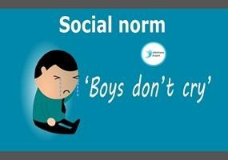

Slide 19
Lets give some examples

