Slide 1
Neuroanatomy & Neurophysiology for Neurogenic Speech and Language Disorders

Slide 2
Central Nervous System
Brain
Spinal Cord

Slide 3
The Human Brain
Composed of 4 lobes
2 paired lobes: Temporal & Parietal
2 Unpaired Lobes; 1 lobe each : frontal & Occipital

Slide 4
Cerebral cortex
Cerebral cortex is the outer layer of the brain (2-4 mm thickness)
Elevated folds in the cerebrum are called gyri (gyrus, singular)
The grooves or valleys are called sulci (salacus, singular)

Slide 5
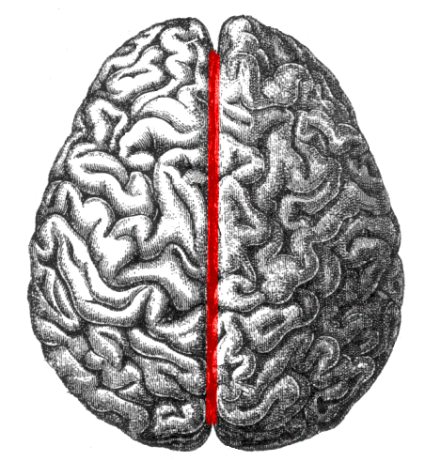
Longitudinal cerebral fissure
Separates left and right hemispheres of the cerebrum

Slide 6
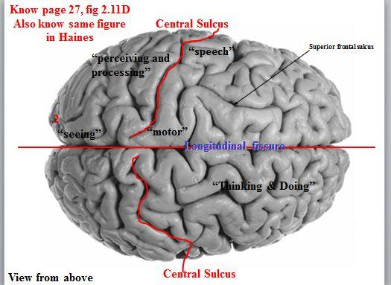
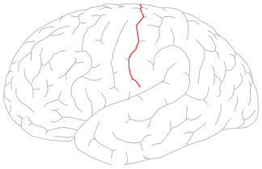
Central Salacus / Fissure of Rolando
Divides the anterior part of the cerebrum from the posterior part

Slide 7
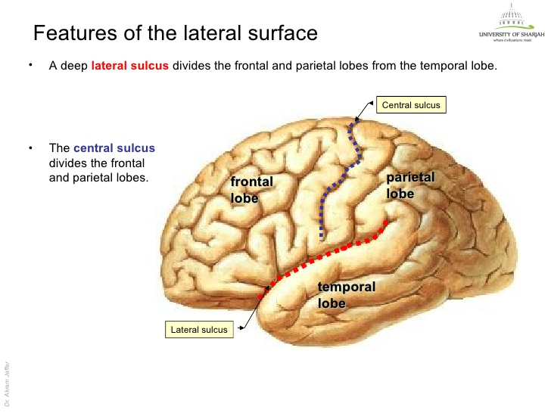
Lateral cerebral fissure / Sylvian Fissure
Separates frontal and temporal
Regions arount it are involved in speech and language

Slide 8
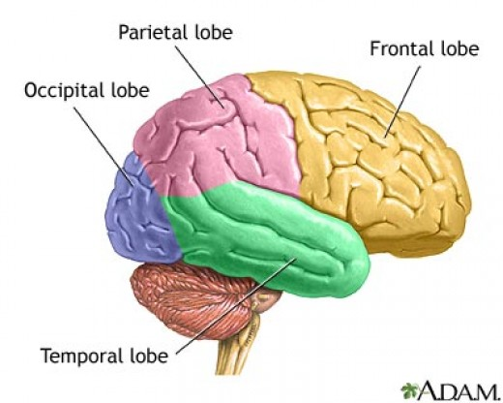
Lobes of the brain

Slide 9
The frontal lobe
It’s all of the cortex that is in front of the central fissure
Above the lateral fissure
It is the largest lobe

Slide 10
Frontal Lobe
Responsible for:
Voluntary movements of skeletal muscles including speech
Cognitive functions
Involved in storing complex memories

Slide 11
Primary Motor Cortex
It’s located in the frontal lobe (anterior to the central fissure)
Controls voluntary movements of skeletal muscles on the opposite side of the body
The precentral gyrus is a major portion of the primary motor cortex and it controls movements of arms, hands, fingers, face, lips, legs, and feet
The primary motor cortex (the motor strip) controls movements through a neural pathway called PYRAMIDAL system. Neural impulses are modified by another system called the extra-pyramidal system.

Slide 12
The premotor area & Supplementary motor area
Located anterior to the primary motor cortex.
Specialize in controlling fine and complex motor skills.

Slide 13
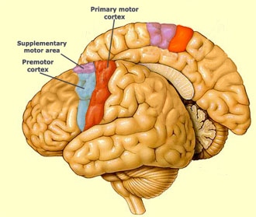
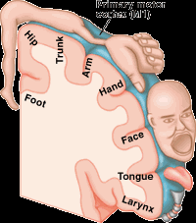
The Primary motor cortex

Slide 14
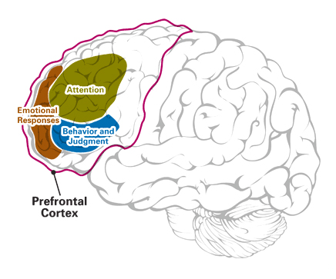
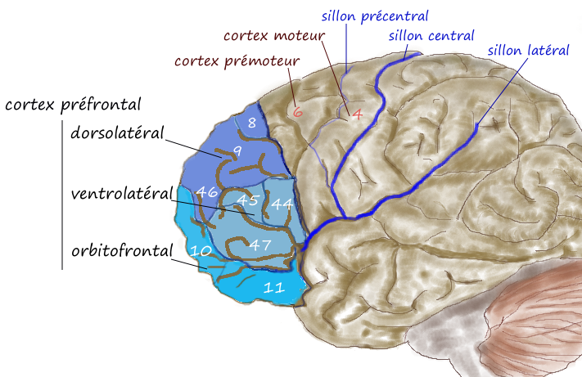
The prefrontal cortex of the frontal lobe
The frontal lobe except primary motor cortex/ premotor cortex/ supplementary motor cortex.
Controls intellectual abilities/reasoning/decision making/planning/ social responsibility and foresight

Slide 15
Broca’s area
Broca’s area is present in the frontal lobe in the inferior frontal gyrus
Broca’s area → Low, left, posterior frontal lobe on the inferior frontal gyrus at the junction of the central and lateral fissures
P.49 fig2-17
Broca’s area is also called: Motor speech area because it controls motor movements involved in the production of speech.

Slide 16
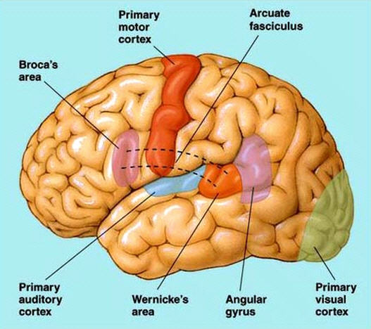
Broca’s area

Slide 17
The temporal lobe
Lies beneath the temporal bone
It is the lower one-third part of the brain
Starts from the lateral fissure and ends at an imaginary point with the occipital lobe
3 important gyri:
Superior temporal gyrus
Middle temporal gyrus
Inferior temporal gyrus
It is the sight of auditory reception and interpretation and auditory-visual associate. It is the sight of receptive language functions

Slide 18
The temporal lobe
Handles complex memories
Contains the primary auditory cortex which is also known as Heschl’s gyrus and is present at the border of superior temporal gyrus and the lateral fissure (found in both hemispheres but it’s larger in the left tempral lobe than the right which suggests left dominance of receptive language functions.

Slide 19
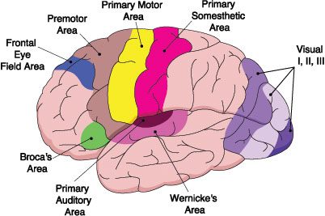
Temporal lobe

Slide 20
Wernick’s area
Posterior to the primary auditory cortex lies Wernick’s area and it is the posterior two-thirds of the superior temporal gyrus in the left hemisphere.
Wernick’s area in the left hemisphere is 7 times larger than in the right
Wernick’s area is connected to broca’s area through the arcuate fasciculus.

Slide 21
The occipital lobe
Posterior inferior portion of the brain
Responsible for translation of vision the the visual cortex
The visual cortex in each hemisphere receives visual information from the contralateral visual fields of each eye. (At the level of the optic chiasm, neural cross over takes place).

Slide 22
The Parietal Lobe
Lies posterior to central fissure and above the lateral fissure
Contains the sensory cortex
Enables body touch and sensation and spatial orientation and understanding of selective attention.
Damage to the right parietal lobe leads to left neglect; a condition in which the patient is unaware of objects and persons on the left side.

Slide 23
The Parietal lobe
Two important gyri for speech and language
Supramarginal gyrus
Lies above the lateral fissure in the inferior portion of the parietal lobe. Damage to the supramarginal gyrus causes agraphia (writing problems) or conduction aphaisa
Angular gyrus
Lies posterior to the supramarginal gyrus
Damage to the angular gyrus causes naming/reading/writing difficulties (a type of aphasia called transcortical sensory aphasia)

Slide 24
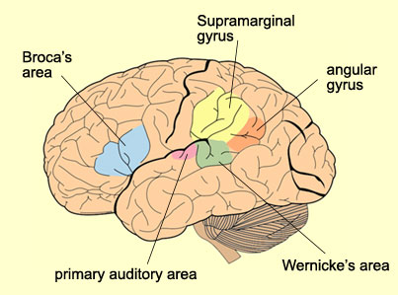
Parietal lobe

Slide 25
Peripheral Nervous System PNS
It is composed of cranial nerves and spinal nerves
PNS is divided into:
Somatic PNS
Autonomic PNS

Slide 26
Somatic PNS
Effector organ: is the voluntary skeletal muscles
Acetylcholine is the neurotransmitter
Heavily myalinated nerve fibers
Have long axons

Slide 27
Autonomic PNS
Effector organs: smooth/cardiac muscles and involuntary glands
Autonomic PNS is divided into: Sympathetic and parasympathetic divisions
Sympathetic Autonomic PNS: functions in cases of stress and threat.
Parasympathetic Autonomic PNS: operates when we are relaxed (e.g. after a heavy meal). Minimizes energy used, getting rid of feaces and urine.
In autonomic PNS, Pre-ganglion neurons release acetylcholine and post ganglion fibers release norepinephrine

Slide 28
Diencephalon
Between the brainstem and the cerebral cortex
Contains ventricles that are filled w/ CSF
Regions of diencephalon:
Thalamus
Hypothalamus
Epithalamus
subthalamus

Slide 29
Diencephalon Region
Includes:
Thalamus
Hypothalamus
Pituitary gland
Pinal gland
Basal Ganglia
Diencephalon region plays an important role in movement and sensation

Slide 30
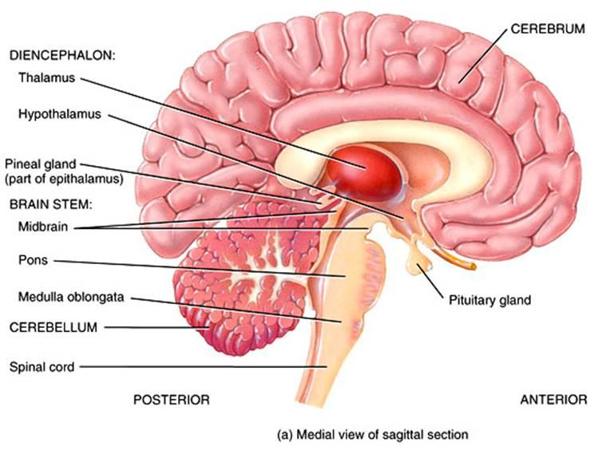
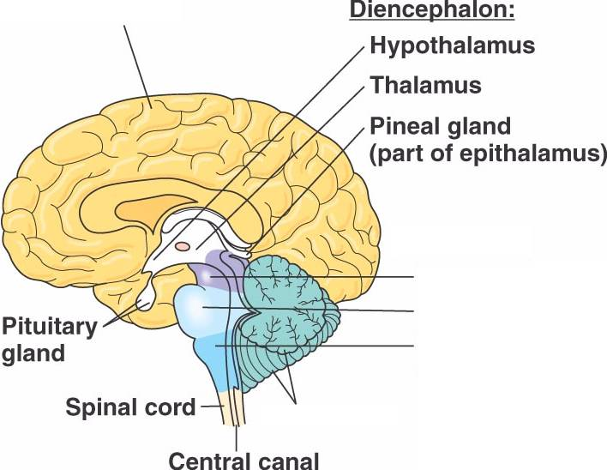
Diencephalon

Slide 31
Thalamus
It’s the largest of the diencephalon
The region where motor information leave the brain.
The region where sensory information enter the brain.
It is a major rely center for movement and sensation
It maintains alertness/ consciousness and attention

Slide 32
Basal Ganglia
Composed of several nuclei that rely and communicate information
The nuclei are:
Caudate Nucleus
Putamen Nucleus
Globus Nucleus
Subthalamus Nucleus
Substentia Nigra
Damage to the basal ganglia affects motor/sensation and voluntary & involuntary movement depending on the site of lesion

Slide 33
Basal Ganglia
Basal ganglia receive input mostly from frontal lobe
Sends info back to higher centers in the brain through the thalamus
Modulates movements because it produces important neurotransmitters → regulating and controlling movement
Damage to basal ganglia leads to movement disorders (i.e. parkinson’s and huntington)
Motor disorders associated with impaired functioning of basal ganglia include dyskinesias (involuntary movements and tremors), hypokensia (restricted range of movement) and bradykinesia(slownness of movement)
Impaired basal ganglia → impaired muscle tone → dysarthria

Slide 34
The brainstem
The brainstem is composed of :
Mid brain
Pons
Medulla Oblongata
The brainstem is the region that connects the spinal cord to the brain
Damage to the brainstem affects sensory/motor info. Transmission/ involuntary breathing/ heart rate

Slide 35
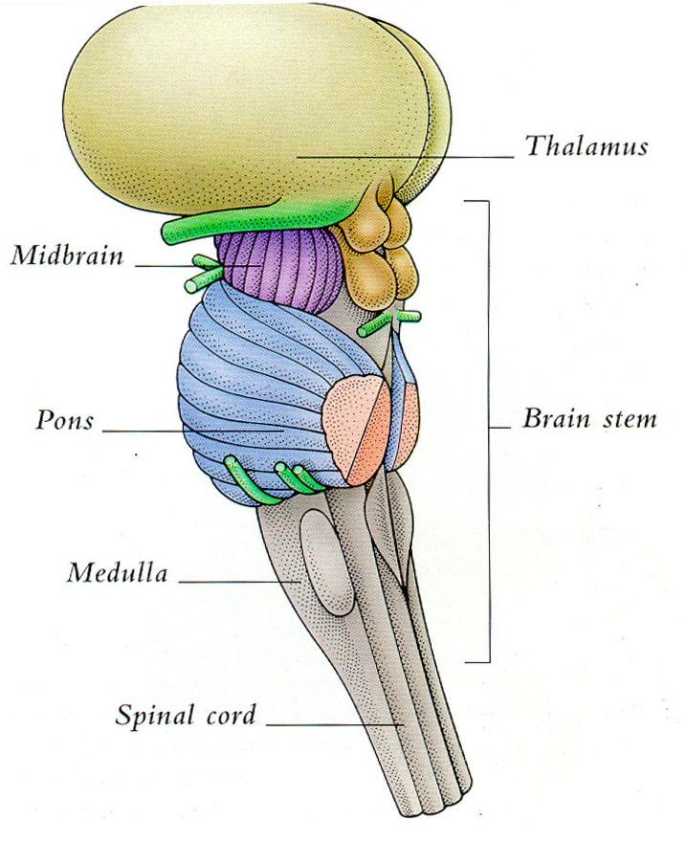
The brainstem

Slide 36
The mid-brain
Lies above the pons
CN III and CN IV originate from the midbrain
CN III and IV connect to muscles that move the eyes.
Midbrain controls many sensory and motor functions, including eye movements, postural reflexes, and coordination of visual and auditory reflexes.

Slide 37
Pons
Contains several nuclei involved in hearing and balance
CN V, CN VI, VII originate from it.
Damage to the Pons → Paralysis of muscles moving the eye horizontally
Lesion of anterior pons leads to quadraplegia (locked-in syndrome)-

Slide 38
Medulla Oblengate
Contains the nuclei of CN VIII → CN XII
Damage to medulla results in vertigo/dizziness, paralysis of the muscles of the throat and the larynx (voice and swallowing), plus a combination of sensory loss of limbs and face.

Slide 39
Meudulla
Also Called Myelencephalon
Passes through the foramen magnum of the skull.
Controls several centers that control autonomic functions such as breathing (affecting speech), blood pressure, and heart rate.

Slide 40
Cerebellum
Has two hemispheres called cerebellar hemispheres)
Has grey matter on the surface and white matter inside.
Coordinates movements that has been initiated somewhere else.
Doesn’t initiate movements itself.
Damage to the cerebellum results in a clumsy movements; a condition called ataxic dysarthria

Slide 41
Spinal Cord
It is divided into white and grey matter.
2 branches of the spinal cord :
Ventral branch → motor
Dorsal root ganglia → sensory

Slide 42
Reflex Arch
Reflex Arch: Rapid, unpredictable, automatic response to a stimulus.
Receptor (picks up the stimulus) → Afferent pathway (Sensory info/sensory fibers) → Dorsal root ganglia → Integrated CNS → efferent pathway (through the ventral root) → Effector

Slide 43
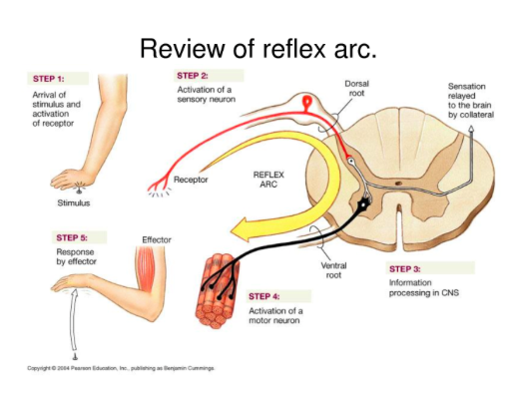
Reflex Arch

Slide 44
Somatic / Autonomic Reflexes
Somatic Reflexes:
Knee Jerk
Flexor reflex
Autonomic Reflexes
Salivary reflex
Pupil’s reflex

Slide 45
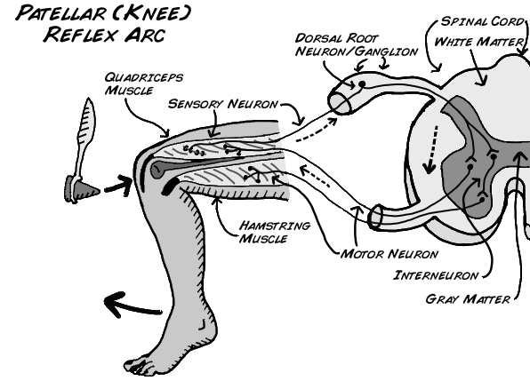
Two neuronal reflexes

Slide 46
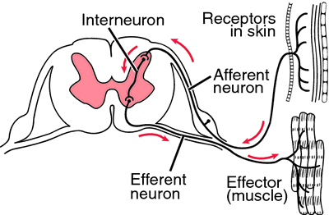
Three neuronal reflexes

Slide 47
Motor Pathways: Motor Tracts
1- Pyramidal Tracts
2- Vestibulospinal Tract
3- Descending Autonomic Tract

Slide 48
Pyramidal Tracts
Corticospinal tract
begins in the cerebral cortex and ends on the spinal cord.
Contracts muscles that are responsible for voluntary movements of trunk and limbs

Slide 49
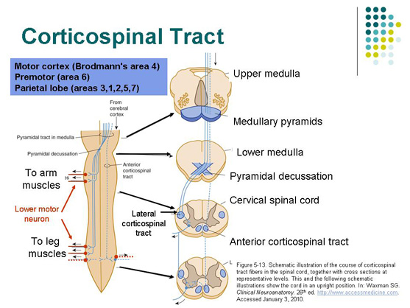
Corticospinal
Decussates at medulla of brainstem and ends in the effector organ

Slide 50
Pyramidal Tracts
(B) Corticobulbar tract:
Begins from the cerebral cortex and ends in the brainstem (medulla)
(Bulbar: medulla)
Functions:
Activates CNS
Controls muscles of head and neck

Slide 51
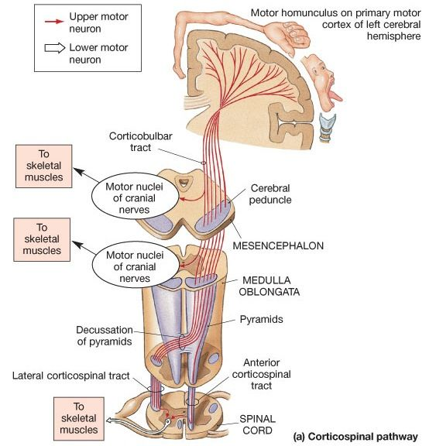
Corticobulbar Tract
Decussates at the medulla and ends at the brainstem

Slide 52
Upper and Lower motor neuron
Upper motor neuron: is the motor cortex
Brainstem and spinal cord : Lower motor neuron
Lesions in the upper motor neuron (motor cortex) causes spasticity; a motor function disorder
Lesions in the lower neuron: decrease in tone, decrease in strength, decrease in reflex and paralysis of muscle

Slide 53
Vestibulospinal Tract
Vestibulo: Brainstem
Begins from the brainstem and ends in the spinal cord
Controls muscles that are responsible for quick movement in response to sudden change in body position.

Slide 54
Descending Autonomic Tract
Begins deep within the brain and ends in motor neurons in the brainstem and spinal cord (Lower motor neurones)
Regulates autonomic functions (i.e. heart rate and blood pressure)

Slide 55
CRANIAL NERVES
I. Olfactory: sense of smell (sensory)
II. Optic: Vision (motor)
III. Occulomotor: Eye movement (motor)
IV. Trochlear: Eye movement (motor)
V. Trigeminal: Face (sensory); jaw (motor)
VI. Abducens: Eye movement (motor)
VII. Facial: Tongue (sensory); Face (motor)
VIII. Vestibular acoustic: Hearing and balance (sensory)

Slide 56
Cranial Nerves
IX. Glossopharyngeal: Tongue and pharynx (sensory); Pharynx only (motor)
X. Vagus: larynx, respiratory, cardiac, and gastrointestinal systems (sensory and motor)
XI. Accessory: Shoulder, arm, and throat movements (motor)
XII. Hypoglossal: Mostly tongue movements (motor)

Slide 57
Spinal nerves
Arise from the spinal cord
31 pairs
8 pairs of cervical nerves
12 pairs of thoracic
5 pairs of lumbar
5 pairs of sacral
Spinal nerves carry sensory and motor info from/to CNS <-> muscles

Slide 58
Spinal Nerves
Not important in language comprehension, formulation, and expression
Important in speech because some spinal nerves control respiration.
Damage to some spinal nerves may impair the function of muscles of breathing

Slide 59
White Matter and the connecting fibers in the CNS
Short connecting fibers in CNS connect adjacent areas while long fibers connect distant areas
Longer fibers are called FASCICULI (Fasciculus)
Connecting fibers in the white matter core of brain are classified into:
Projection fibers
Commissural fibers
Association fibers

Slide 60
Projection Fibers
They transmit sensory info to the brain and motor info to muscles and glands
They connect cortical structures at the top <-> brainstem and spinal cord at lower levels
As they move toward upper regions of the brain, they fan out in a structure called corona radiata
Efferent projection fibers pass through the thalamus and basal ganglia

Slide 61
Association Fibers
May be short or long
Connect areas within the same hemisphere
They are intrahemispheric in their connections
Shorter association fibers connect adjacent areas
Longer association fibers (fasciculi) connect more distant areas within the same hemisphere
Example of association fibers important for speech and language is the superior longitudinal fibers (ARCUATE FASICULUS)

Slide 62
Arcuate Fasciculus
Connects the inferior part of the frontal → posterior superior part of the temporal lobe
Connect the motor speech area broca’s area (frontal lobe) with sensory speech area Wernick’s area
Important for language acquisition/verbal memory/language production

Slide 63
Commissural Fibers
Connect corresponding areas of the two hemispheres
They are interhemispheric in their connection
The corpus callosum is the most important of commissural fibers
Damage to the corpus callosum results in disconnecting the hemispheres resulting in movement, reading, and naming problems knows as disconnection syndromes

Slide 64
Association fiber tracts
Shorter tracts: connect regions within the same lobe and they are also called association fibers
Longer tracts: connect regions from separate lobes and they are called fasciculi
Example on longer tract fibers is the arcuate fasciculus

Slide 65
The corpus collosum and the split brain contraversy
In some severe cases of epilepsy the corpus collosum is cut in a surgery called commisurotomy to prevent the spread of seizures from one hemisphere to the other.
Right brain → intuitive / holistic/ spatial and perceptual skills
Left brain → logical / analytic / verbal

Slide 66
The ventricles
System of interconnected cavities deep within the brain
the ventricles are filled with the cerebrospinal fluid CSF
There 4 ventricles
Two lateral ventricles (one in each hemisphere)
3rd ventricle
4th ventricle

Slide 67
The ventricles
The lateral ventricles are the largest of all ventricles. They lie just below the corpus collosum
Ventricles contain the choroid plexus: a vascular membrane that produces the CSF
CSF circulates through the CNS and :
Cushions the brain
Regulates intracranial pressure
Nourishes neural tissues
Removes wastes
When the movement of CSF through the ventricles is blocked or it’s absorption is impaired, the result is a condition called hydrocephalus (associated with MR)

Slide 68
The protective layers of the brain
The brain is protected by a layer of tissue called the meninges
The meninges is composed of 3 layers covering the brain and spinal cord:
Dura mater
Arachnoid mater
Pia mater

Slide 69
Meninges
Dura mater is tough and thick membrane with one side adhering to the skull. It is composed of connective tissue protecting from external shock.
Arachnoid mater, semitransparent/ non-vascular/ delicate/ web-like. The CSF fills the Arachnoid mater
Pia mater thin/ delicate transparent membrane that adheres to the brain serfuce closely following surface sulci and gyri. It covers blood vessels. Pia mater is highly vascular

