Slide 1
Documents
The IR Index refers to documents.
Our assumptions were:
We know what a document is.
We can “machine-read” each document.
This can be complex in reality.
1

Slide 2
Parsing a document
We need to deal with format and language of each document.
What format is it in? pdf, word, excel, html, tex, ppt,txt, etc.
What language is it in? Can you detect a language? Arabic/Urdu?
What character set is in use?
Each of these is a classification problem of its own.
Alternative: use heuristics
2

Slide 3
Format/Language: Complications
A single index usually contains terms of several languages.
Sometimes a document or its components contain multiple languages/formats.
French email with Spanish pdf attachment, Arabic mixing English
MSA + Dialects
Which language is that: Language Detection
3

Slide 4
Language Detection
May be easy for language classes: Latin vs Arabic
Less so within script: English/French/Dutch or even Dutch/Deutch: Arabic/Farsi/Urdu; MSA/Dialect
Many docs have multiple languages
Real issue:
Spellcheck: select language with min errors!
Look for distinguishing stop words
Look for unique letters: umlauts, چ پ ض
4

Slide 5
Format/Language: Complications
What is the document unit for indexing?
A file?
An email?
An email with 5 attachments?
A group of files (ppt or latex in HTML)?
Upshot: Answering the question “what is a document?” is not trivial and requires some design decisions.
Also: XML
5

Slide 6
Definitions
Word – A delimited string of characters as it appears in the text: Computer, Computational, علوم، علمي، علمية.
Term – A “normalized” word (case, morphology, spelling etc); an equivalence class of words (Comput, علم).
Token – An instance of a word or term occurring in a document.
Type – The same as a term in most cases: an equivalence class of tokens.
6

Slide 7
Normalization
Need to “normalize” terms in indexed text as well as query terms into the same form. [Reduces types, more work!]
Example: We want to match U.S.A. and USA
We implicitly define equivalence classes of terms.
Alternatively: do asymmetric expansion
window → window, windows
windows → Windows, windows
Windows (no expansion)
More powerful, but less efficient
Why don’t you want to put window, Window, windows, and Windows in the same equivalence class? What about Grace and grace? Resume and Resu’me
7

Slide 8
Normalization: Other languages
Normalization and language detection interact.
PETER WILL NICHT MIT. → MIT = mit
He got his PhD from MIT. → MIT ≠ mit
8

Slide 9

Recall: Inverted index construction
Input:
Output:
Each token is a candidate for a postings entry.
What are valid tokens to emit?
9

Slide 10
Exercises
In June, the dog likes to chase the cat in the barn. – How many
word tokens? How many word types? Why tokenization is difficult
– even in English. Tokenize: Mr. O’Neill thinks that the boys’
stories about Chile’s capital aren’t amusing.
Compare TokenTo Type Ration (TTR) for Arabic and English!
With and without normalization! (which)
10

Slide 11
Tokenization problems: One word or two? (or several)
Hewlett-Packard
State-of-the-art
co-education
the hold-him-back-and-drag-him-away maneuver
data base
San Francisco
Los Angeles-based company
cheap San Francisco-Los Angeles fares
York University vs. New York University
11

Slide 12
Numbers
3/20/91
20/3/91
Mar 20, 1991
B-52
100.2.86.144
(800) 234-2333
800.234.2333
Older IR systems may not index numbers . . .
. . . but generally it’s a useful feature.
12

Slide 13
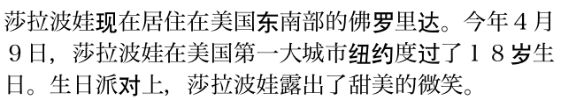
Chinese: No whitespace
13

Slide 14

Ambiguous segmentation in Chinese
The two characters can be treated as one word meaning ‘monk’ or as a sequence of two words meaning ‘and’ and ‘still’.
14

Slide 15
Other cases of “no whitespace”
Compounds in Dutch, German, Swedish
Computerlinguistik → Computer + Linguistik
Lebensversicherungsgesellschaftsangestellter =
Employee of Life Insurance Company
→ leben + versicherung + gesellschaft + angestellter
Many other languages with segmentation difficulties: Finnish, Urdu, . . . What about Arabic:
طرقت الباب حتى كلمتني فلما كلمتني كلمتني
طرقت الباب حتى كل متني فلما كل متني كلمتني
قالت ايا اسماعيل صبرا فقلت ايا اسماعيل صبري
قالت أيا إسماعيل صبرا فقلت أيا أسما عيل صبري
15

Slide 16
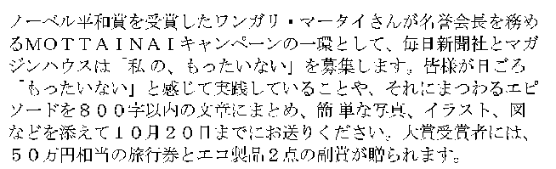
Japanese
4 different “alphabets”: Chinese characters, hiragana syllabary for inflectional endings and functional words, katakana syllabary for transcription of foreign words and other uses, and latin. No spaces (as in Chinese). End user can express query entirely in hiragana!
16

Slide 17
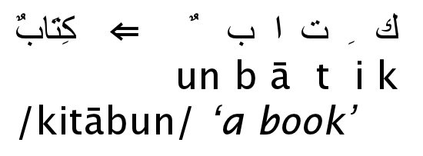
Arabic script
17

Slide 18
Arabic script: Bidirectionality
← → ← → ← START
‘Algeria achieved its independence in 1962 after 132 years of French occupation.’
Bidirectionality is not a problem if text is coded in Unicode.
18

Slide 19
Accents and diacritics
Accents: résumé vs. resume (simple omission of accent)
Umlauts: Universität vs. Universitaet (substitution with special letter sequence “ae”);
Most important criterion: How are users likely to write their queries for these words?
Even in languages that standardly have accents, users often do not type them. (Polish? Arabic?)
19

Slide 20
Case folding
Reduce all letters to lower case
Possible exceptions: capitalized words in mid-sentence
MIT vs. Mit??
Fed vs. fed
It’s often best to lowercase everything since users will use lowercase regardless of correct capitalization.
20

Slide 21
Stop words
stop words = extremely common words which would appear to be of little value in helping select documents matching a user need
Examples: a, an, and, are, as, at, be, by, for, from, has, he, in, is, it, its, of, on, that, the, to, was, were, will, with: How many?
من، الى، هو، هي، هم، How Many??
Stop word elimination used to be standard in older IR systems.
But you need stop words for phrase queries, e.g. “King of Denmark”، بعد الظهر وقبل العشاء -من عمان إلى دمشق
Most web search engines index stop words.
21

Slide 22
More equivalence classing
Soundex:(phonetic equivalence based on sounds: س، ص ق،ك، ذ، ظ and more , Muller = Mueller)
Thesauri: (semantic equivalence, car = automobile), حافلة، باص كمبيوتر، حاسوب، سيف، حسام
Variations in pronunciations (if from sound): قال-آل-جال Qal-Aal, Gal:
22

Slide 23
Lemmatization
Reduce inflectional/variant forms to base form
Example: am, are, is → be
Example: car, cars, car’s, cars’ → car; NOT Care, though
Example: the boy’s cars are different colors → the boy car be different color
Lemmatization implies doing “proper” reduction to dictionary headword form (the lemma).
الجذور بالعربية: السيارة تحركت بنفسها:← سيارة حرك نفس
Inflectional morphology (cutting → cut حملوا← حمل) vs. derivational morphology (destruction → destroy صيام ← صام )
23

Slide 24
Stemming التجذيع
Definition of stemming: Crude heuristic process that chops off the ends of words in the hope of achieving what “principled” lemmatization attempts to do with a lot of linguistic knowledge.
Language dependent
Often inflectional and derivational
Example for derivational: automate, automatic, automation all reduce to automat
Stems need not be spelling correct: comput: computing, computer, computation, computational, computationally,
ات: سياتي، سياتون، اتي، اتون، اتاك، اتاكم،
24

Slide 25
Porter algorithm
Most common algorithm for stemming English
Results suggest that it is at least as good as other stemming options
Conventions + 5 phases of reductions
Phases are applied sequentially
Each phase consists of a set of commands.
Sample command: Delete final ement if what remains is longer than 1 character
replacement → replac
cement → cement
Sample convention: Of the rules in a compound command, select the one that applies to the longest suffix.
25

Slide 26
Porter stemmer: A few rules
Rule
SSES → SS
IES → I
SS → SS
S →
Example
caresses → caress
ponies → poni
caress → caress
cats → cat
26

Slide 27
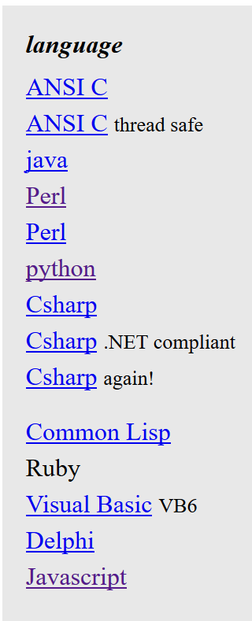
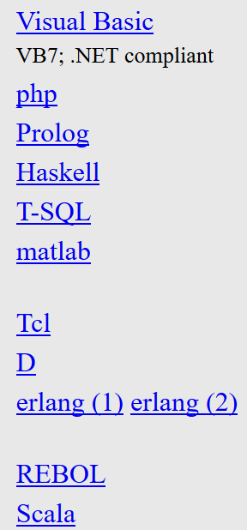
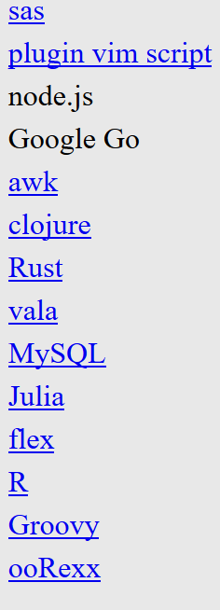
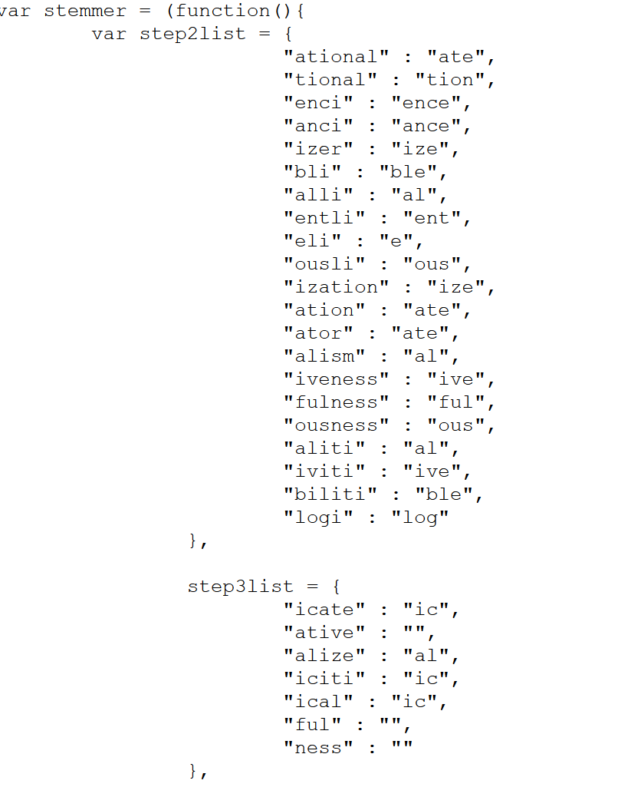
Porter stemmer: Implementations
Here is a link to implementations in many languages
https://tartarus.org/martin/PorterStemmer/
27

Slide 28
Three stemmers: A comparison
Sample text: Such an analysis can reveal features that are not easil visible from the variations in the individual genes and
can lead to a picture of expression that is more
biologically transparent and accessible to interpretation
Porter stemmer: such an analysi can reveal featur that ar not easili visibl from the variat in the individu gene and can lead to
pictur of express that is more biolog transpar and
access to interpret
Lovins stemmer: such an analys can reve featur that ar not eas vis from th vari in th individu gen and can lead to a pictur of
expres that is mor biolog transpar and acces to
interpres
Paice stemmer: such an analys can rev feat that are not easy vis from
the vary in the individ gen and can lead to a pict of
express that is mor biolog transp and access to interpret
28

Slide 29
Khoja Stemmer and light stemmers
Khoja Stemmer:
root-based stemmers
an algorithm that removes prefixes and suffixes, all the time checking that it's not removing part of the root and then matches the remaining word against the patterns of the same length to extract the root.
uses two dictionaries, one to match remaining letters against Arabic patterns, and the second is to confirm the correctness of the root.
Too much work and too many errors!
29

Slide 30
Khoja Stemmer and light stemmers
Light10 Stemmer:
Is one of the light stemmer approach
Strips off initial ‘و’
And definite articles ( ال ، وال ، بال ، كال، فال، لل )
And suffixes ( ها ، ان ، ون ، ين ، يه ، ية ، ه ، ة ، ي)
It was designed to strip off strings that were frequently found as prefixes or suffixes.
30

Slide 31
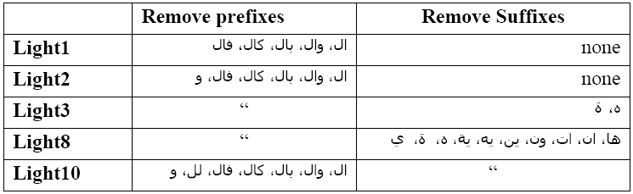

Slide 33
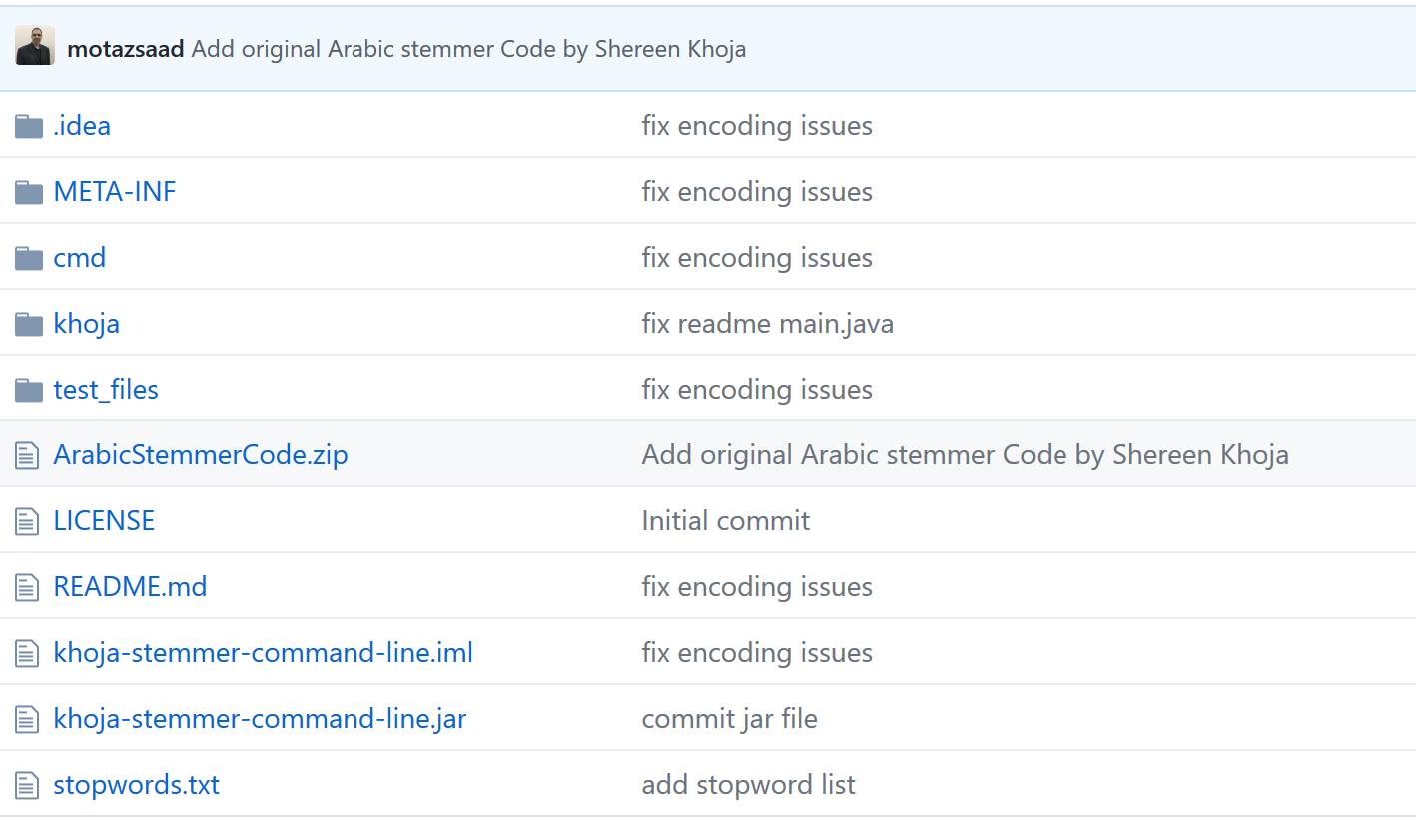
Khoja Stemmer Implemenattions:
Khoja Stemmer:
https://github.com/motazsaad/khoja-stemmer-command-line
33

Slide 34
Does stemming improve effectiveness?
In general, stemming increases effectiveness for some queries, and decreases effectiveness for others.
Queries where stemming is likely to help: [tartan sweaters], [sightseeing tour san francisco] (equivalence classes: {sweater,sweaters}, {tour,tours})
Porter Stemmer equivalence class oper contains all of operate operating operates operation operative operatives operational. What about Opera?
Queries where stemming hurts: [operational AND research], [operating AND system], [operative AND dentistry]
34

Slide 35
Exercise: What does Google do?
Stop words
Normalization
Tokenization
Lowercasing
Stemming
Non-latin alphabets
Umlauts
Compounds
Numbers
35

Slide 36
Normalization/Stemming and the Index?
Normalization generally improves recall but may hurt precision.
Stemming is a form of Normalization (equivalence class building)
Normalization reduces the vocabulary BUT
Increases the postings per TYPE (Term).
What about the overall postings number?
If document is stemmed the query needs to be stemmed as well
So stemming delays query answering at query issuing time
But not by much!
36

Slide 37
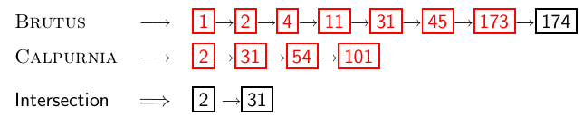
Skip Pointers: Recall basic intersection algorithm
Linear in the length of the postings lists.
Imagine worst case: Brutus and Calpurnia had only docID 175 in common! Need to traverse all of the 2 lists
Reach end of at least one in all cases
Do we know where 11 is stored? NO! 4 pointer tells that!
Can we do better?
Yes, if we can move faster.
37

Slide 38
Skip pointers
Skip pointers allow us to skip postings that will not figure in the search results. Meaning move several steps not one!
This makes intersecting postings lists more efficient.
Some postings lists contain several million entries [e.g. stop words]– so efficiency can be an issue even if basic intersection is linear.
The skip idea: use skips to move faster towards the end:
Skip next N elements!
Where do we put skip pointers?
How do we make sure intersection results are correct?
How much space is needed?
38

Slide 39
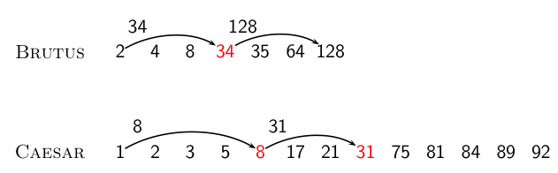
Basic idea
Element 2 for Brutus has 2 pointers: the regular and the skip! Same for 34.
For Caesar: 1, 8, 31 have two pointers,
One memory pointer for each skip is added!
When moving: try skip first: if too far, go back and move linearly!
Brutus at 2, use Skip at Caesar which takes you to 8>2: go back to linear to find 2!!!
Brutus at 35, use Skip at Caesar which takes you to 31 in two steps then to 75.
39

Slide 40
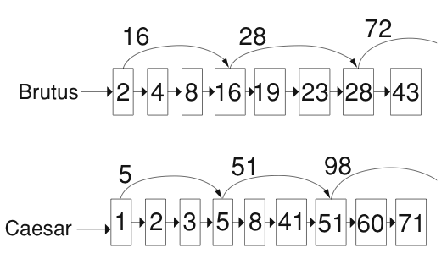
Skip lists: Larger example
40

Slide 41
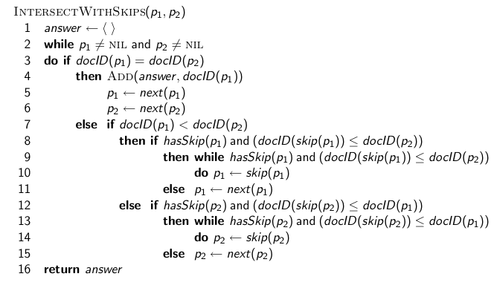
Intersection with skip pointers
41

Slide 42
Where do we place skips?
No skip is 1 skip!
Too large a skip means have to come back to normal!
Tradeoff: number of items skipped vs. frequency skip can be taken
More skips: (smaller steps) Each skip pointer skips only a few items, but we can frequently use it.
Fewer skips: (smaller steps) Each skip pointer skips many items, but we can not use it very often.
42

Slide 43

Where do we place skips? (cont)
Simple heuristic: for postings list of length P, use evenly-spaced skip pointers (100 postings, 10 skips 10 each).
This ignores the distribution of query terms.
Easy if the index is static; harder in a dynamic environment because of updates.
How much do skip pointers help?
They used to help a lot.
With today’s fast CPUs and larger cache, they don’t help that much anymore.
43

Slide 44
Phrase queries
We want to answer a query such as [stanford university] – or جامعة بيرزيت as a phrase.
Thus The inventor Stanford Ovshinsky never went to university رئيس بلدية بيرزيت خريج حامعة القدس should not be a match.
The concept of phrase query has proven easily understood by users.
About 10% of web queries are phrase queries.
Consequence for inverted index: it no longer suffices to store docIDs in postings lists.
Two ways of extending the inverted index:
biword index (N-Gram index)
positional index
44

Slide 45
Biword indexes
Index every consecutive pair of terms in the text as a phrase.
For example, Friends, Romans, Countrymen would generate two biwords: “friends romans” and “romans countrymen”
Each of these biwords is now a vocabulary term.
Two-word phrases can now easily be answered.
45

Slide 46
Longer phrase queries
A long phrase like “stanford university palo alto” can be represented as the Boolean query “STANFORD UNIVERSITY” AND “UNIVERSITY PALO” AND “PALO ALTO”
Not enough: We need to do post-filtering of hits to identify subset that actually contains the 4-word phrase.
Or use 4-gram phrases: too many of them!!!
46

Slide 47
Extended biwords
Parse each document and perform part-of-speech (POS) tagging
Bucket the terms into (say) nouns (N) and articles/prepositions (X)
Now deem any string of terms of the form NX*N to be an extended biword
Examples: catcher in the rye
N X X N
king of Denmark
N X N
Include extended biwords in the term vocabulary
Queries are processed accordingly
47

Slide 48
Issues with biword indexes
Why are bi-word indexes rarely used?
False positives, [any article will give a match:extended]
Index blowup due to very large term vocabulary
48

Slide 49
Positional indexes
Positional indexes are a more efficient alternative to biword indexes.
Postings lists in a nonpositional index: each posting is just a docID
Postings lists in a positional index: each posting is a docID and a list of positions
49

Slide 50
Positional indexes:
Example: Doc: 1,2,3,4,5,6,7 of length: >231,>255,>434, .....
Query: “to₁ be₂ or₃ not₄ to₅ be₆” Concentrate on “to be”
TO, 993427: ‹ 1: ‹7, 18, 33, 72, 86, 231›;
2: ‹1, 17, 74, 222, 255›;
4: ‹8, 16, 190, 429, 433›;
5: ‹363, 367›;
7: ‹13, 23, 191›; . . . ›
BE, 178239: ‹ 1: ‹17, 25›;
4: ‹17, 191, 291, 430, 434›;
5: ‹14, 19, 101›; . . . ›
Document1: has „be to“ but not „to be“
Document 4 is a match [candidate, don‘t have or not]!
50

Slide 51
Proximity search
We just saw how to use a positional index for phrase searches.
We can also use it for proximity search.
For example: employment /4 place
Find all documents that contain EMPLOYMENT and PLACE within 4 words of each other.
“Employment agencies that place healthcare workers are seeing growth“ is a hit.
“Employment agencies that have learned to adapt now place healthcare workers” is not a hit.
51

Slide 52
Proximity search
Use the positional index
Simplest algorithm: look at cross-product of positions of (i) EMPLOYMENT in document and (ii) PLACE in document
Very inefficient for frequent words, especially stop words
Note that we want to return the actual matching positions, not just a list of documents.
This is important for dynamic summaries etc.
52

Slide 53
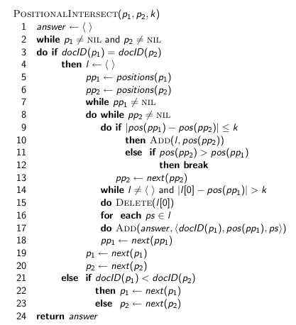
“Proximity” intersection
53

Slide 54
Combination scheme
Biword indexes and positional indexes can be profitably combined.
Many biwords are extremely frequent: Michael Jackson, Jesse Jackson الوطن العربي، القضية الفلسطينية، الشرق الاوسطetc
For these biwords, increased speed compared to positional postings intersection is substantial: Bi-word index them
Combination scheme: Include frequent biwords as vocabulary terms in the index. Do all other phrases by positional intersection.
E.g. Index for n-grams with high frequency for n<4. How high?
54

Slide 55
“Positional” queries on Google
For web search engines, positional queries are much more expensive than regular Boolean queries.
Let’s look at the example of phrase queries.
Why are they more expensive than regular Boolean queries?
Can you demonstrate on Google that phrase queries are more expensive than Boolean queries?
Google search operators/Yandex [Proximity: No/Yes]
https://www.indeed.com/career-advice/finding-a-job/google-search-operators
55

