Slide 1
Functional Voice Disorders

Slide 2
Functional Voice Disorders
Voice disorder that does not have any organic or neurological causes.
The mechanisms of respiration, phonation, and resonance appear physically capable of normal voicing function, but they lack the proper functional balance.
Causes:
1- Excessive Muscle Tension.
2- Psychogenic origins.

Slide 3
Excessive Muscle Tension Disorders:
1- Muscle tension dysphonia (MTD):
Persistent dysphonia that results from excessive laryngeal tension and related musculoskeletal tension and associated hyper-functional true and/or false vocal fold vibratory pattern.
Occurrence of vocal dysfunction in the absence of laryngeal structural abnormalities.
MTD patients often present with:
1- Elevation of the larynx in the neck.
2- Pain in the neck, jaw, and shoulders.
Auditory- perceptual features of MTD can include: strained or effortful voice quality, aberrant pitch, breathiness, and vocal fatigue.

Slide 4
Categories of MTD:
1- Primary MTD: occurs in the absence of current organic, psychogenic or neurological pathologies, represent 40% of the dysphonias seen in clinics.
2- Secondary MTD: originate as a compensatory response to current or recent organic, psychogenic, or neurological pathology.
Factors contributing to the development of MTD:
1- Deviant body posture and misuse of neck and shoulder muscles.
2- High stress levels.
3- Excessive voice use and persistently loud voice use.
4- laryngopharyngeal reflux disease.
Therapy of MTD focuses on muscles relaxation, and larynx positioning.

Slide 5
Differences between MTD and Adductor Spasmodic Dysphonia
MTD maintain hyperadduction across all tasks.
In Spasmodic Dysphonia demonstrate intermittent hyperadduction.
MTD no difference of voice severity between connected speech and sustained vowels.
In Spasmodic Dysphonia voice severity is worse for connected speech than for sustained vowels.
MTD no difference of voice severity in connected speech regardless of
voiced or voiceless utterances.
In Spasmodic Dysphonia voice severity is worse for voiced
utterances.

Slide 6
2- Ventricular Dysphonia/Plicae Ventricularis:
The pathological interference of false vocal folds during phonation.
Phonation using the false vocal folds vibration rather than the true vocal folds vibration.
Two Types:
1- Compensatory: as a reaction to true VF disease (e.g. paralysis,surgery).
2- Non-compensatory: there is no disease, and the vocal folds are capable of vibration. The causes are either habitual, psycho-emotional, or idiopathic.
Voice features:
low pitch, monotone, and hoarse and breathy.
Diplophonia (double voice) : result from the vibration of both true and false vocal folds.
Laryngostroboscopy is used.
Beside facilitating techniques used for voice therapy,medical intervention is impotant.

Slide 7
Benign pathologies resulting from Excessive muscle tension disorders:
1- Vocal Fold Nodules:
The most common benign lesions of VF in children and adults.
Caused by continuous abuse of the larynx and misuse of voice.
Localized at the superficial layer of lamina propria.
Patients usually report that they need to clear their throat continuously and that their voice deteriorates with continuous voicing.
Generally bilateral, whitish protuberances on the glottal margin of each VF.
Located at the anterior middle-third junction(junction of first-third and middle-third).
Voice characteristics: low pitch, breathiness, and hoarseness.
Treatment: voice therapy, or surgical removal in advanced cases.

Slide 8
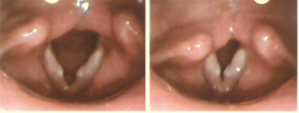
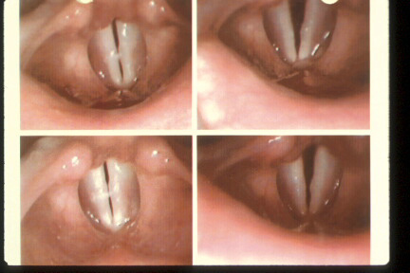
vocal fold nodules
Before Treatment
Following Treatment
3 months
voice therapy

Slide 9
2- Vocal Fold Polyps:
Localized abnormality of the superficial layer of lamina propria, usually at the same site where nodules occur.
Usually unilateral, and could be whitish or reddish.
They result from single vocal event, for example: screaming for much of an evening, (Unlike nodules which result from continuous misuse).
Excessive Vocalization (screaming)→ hemorrhagic irritation → formation of polyp.
Treatment: Voice therapy or surgical intervention.

Slide 10
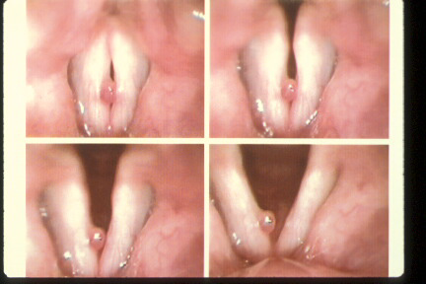
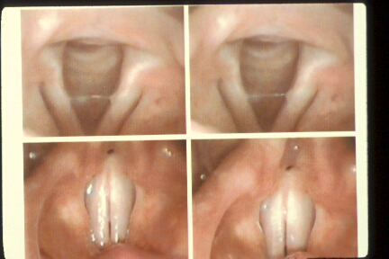
Vocal Fold Polyps
Before Treatment
Following Treatment
6 months
voice therapy
surgery

Slide 11
3- Reinke’s Edema:
Chronic diffuse swelling of the superficial lamina propria of the VF.
Usually bilateral, but can be more pronounced on one side.
Strongly associated with smoking, frequently with hyper-function, and occasionally with laryngopharyngeal reflux.
Usually affects the anterior two-thirds of the glottal margin.
Treatment: voice therapy, and medical- surgical intervention in advanced cases.

Slide 12
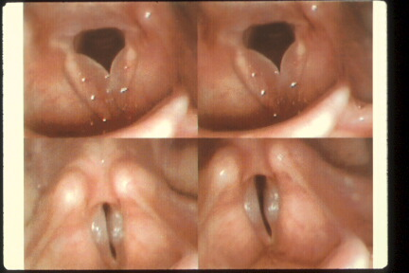
Reinke’s Edema

Slide 13
4- Laryngitis:
Considered as the most frequent cause of dysphonia.
Comorbid conditions include: Upper Airway Inflammatory conditions such as acute pharyngitis, acute bronchitis, pneumonia, and upper respiratory illness.
Traumatic Laryngitis: swelling of the VF as a result of excessive and strained vocalizations.
Acute Laryngitis: the peak during the traumatic vocal behavior, with the VF much increased in size and mass.
Chronic Laryngitis: serious vocal problems if the speaker attempts to speak above the laryngitis.
- Treatment: Voice rest for several days.

Slide 14
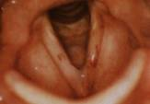
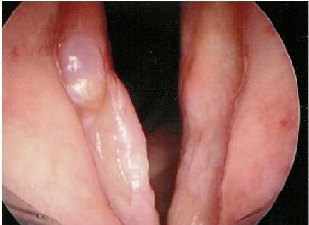
Laryngitis

Slide 15
Voice characteristics with excessive muscle tension disorders:
1- Diplophonia:
Means “double voice”, produced with two distinct frequencies occurring simultaneously.
Often heard in patients with mass lesion, vocal fold paralysis, vocal fold scarring, muscle tension dysphonia, or other inflammatory conditions.
Treatment: eliminate the source of the second voice either by voice therapy or surgical removal of mass (if present).

Slide 16
2- Phonation breaks:
Temporary loss of voice that may occur for only part of a word, a whole word, a phrase, or a sentence.
The individual is phonating with no apparent difficulty when suddenly a complete cessation of voice occurs.
Usually happens after a prolonged hyper-function.
Treatment : Voice therapy, e.g. eliminating the inappropriate vocal behaviors.

Slide 17
3- Pitch breaks:
There are two types of pitch breaks:
1- Developmental phenomenon seen primarily in boys experiencing marked pubertal growth of the larynx.
2- Caused by prolonged vocal hyper-function, particularly while speaking at an inappropriate (usually too low) pitch level.
- Treatment: little temporary voice rest and voice therapy approaches.

Slide 18
Psychogenic voice disorders
The emotional and psychological state of the individual can affect voice production.
Types of psychogenic voice disorders:
1- Puperphonia.
2- Functional Aphonia.
3- Functional Dysphonia.
4- Somatization Dysphonia.
- In such cases, appropriate psychological or psychiatric referrals are required as needed.

Slide 19
1- Puperphonia:
Inappropriate use of high- pitched voice beyond pubertal age in males.
Often seen during age of puberty, when the male laryngeal mechanism has undergone significant change in size and function as a result of hormonal changes.
Also called: falsetto, mutational falsetto, juvenile voice, and incomplete voice mutation.
Treatment: voice therapy, may need psychological referral.

Slide 20
2- Functional Aphonia:
The patient speaks in whisper but with the same rhythm and prosody of normal speech.
Laryngoendoscopic examination is needed to visualize the VF, and rule out organic involvement such as VF paralysis.
When the aphonic patient says ‘ah’, the VF remain too far apart, causing an open position for a whisper production.
The onset could be gradual or sudden, caused by laryngeal pathology, or under hard emotional situations.
Treatment: Voice therapy, may need psychological referral.

Slide 21
3- Functional Dysphonia:
Abnormal voice that has no organic or structural causes.
Possible causes include:
1- Incorrect balance between initiating the airstream with the beginning of phonation (too small or too large breath).
2- Inappropriate VF approximating (too tight or too lax).
3- Inappropriate pitch level for age and gender.
4- Inappropriate head or jaw positions.
- Treatment: Voice therapy, may need psychological referral.

Slide 22
4- Somatization Dysphonia(Briquet’s Dyphonia):
It is a conversion disorder (Functional Neurological Symptom Disorder).
Greater in women than men with a ratio of 10:1.
Symptoms often begin in later adolescence and extend into young adulthood.
voice evaluation may typically reveal an elevated voice pitch, or increased hoarseness with a reduced signal-to-noise ratio.
Associated symptoms: laryngeal pain, neck and shoulder pain with stiffness, shortness in breath, depression, and extreme vocal fatigue.
Treatment: voice therapy accompanied with psychiatric intervention.

Slide 23
Organic Voice Disorders

Slide 24
Congenital abnormalities
Laryngomalacia
Accounts for 75% of all congenital anomalies of the larynx
Symptoms are evident at birth or within the first few hours or days of life
resulting in collapse of the supraglottic structures during inspiration, leading to airway obstruction. It is thought to represent a delay of maturation of the supporting structures of the larynx. Laryngomalacia is the most common cause of congenital stridor

Slide 25
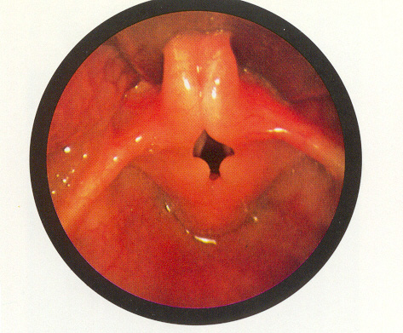
Cont.
The epiglottis is small and curled on itself (omega-shaped). Approximation of the posterior edges of the epiglottis contributes to the inspiratory obstruction.

Slide 26
Cont.
Laryngomalacia may affect the epiglottis, the arytenoid cartilages, or both. When the epiglottis is involved, it is often elongated, and the walls fold in on themselves.
the cartilage is floppy and prolapse over the larynx during inspiration.
This inspiratory obstruction causes an inspiratory noise, high-pitched sounds.
Infants with laryngomalacia have a higher incidence of gastroesophageal reflux, presumably a result of the more negative intrathoracic pressures necessary to overcome the inspiratory obstruction.

Slide 27
Cont.
enlargement and swelling of the arytenoid cartilages and of the epiglottis may be secondary to reflux.
It is common for children to outgrow laryngomalacia by 18-24 months
5% may need surgical intervention.

Slide 28
Acid Reflux Disease
GERD (gatroesophageal reflux disease), the passage of gastric juices from stomach into esophagus
May lead to esophagitis, ulceration, dysphagia, or Barret’s Metaplasia (precancerous conditions).
If these contents move superiorly through upper esophageal sphincter it is said to be called (LPRD)-laryngopharyngeal reflux disease.

Slide 29
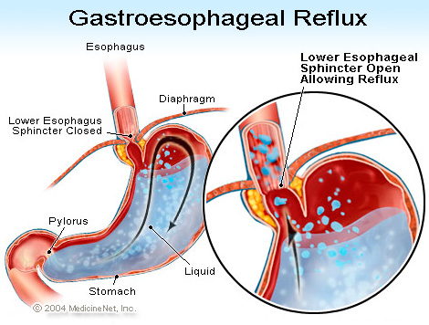

Slide 30
Cont.
Typical symptoms include morning hoarseness, sour taste in mouth with bad breath
Frequent throat clearing and coughing
Severe symptoms occurring when the head is lower than the abdominal area (shoe tying…)
Posterior glottal redness, contact ulcers, pharyngeal irritation

Slide 31
Treatment
Reflux treatment : behavioral, pharmacological, and surgical , or all together
Behavioral, elevating head of the bed; remaining upright for at least 60 min. after meals, avoiding spicy foods, not exercising after eating, cutting down on caffeine, alcohol, avoid drinking excessive quantities of water right before bed – can raise the level of acid in stomach.
Avoiding activities that compress the abdomen, , wearing looser clothing around the waist, and eliminating smoking
Anti-reflux therapy
If we suspect GERD, refer the patient to an ENT for reflux management

Slide 32
Contact ulcers (Granulomas)
Small ulcerations develop on the medial aspect of the vocal processes of the arytenoid cartilages due to irritation.
Treatment involves resting the voice by talking as little as possible for at least 6 weeks so that the ulcers can heal. To avoid recurrences, people who develop contact ulcers need voice therapy to learn how to use the voice properly.
Granulated tissue forms over these ulcers as a protective mechanism, contact ulcer granulomas.
Related to : hard glottal attack along with throat clearing or coughing, LPRD, endotracheal intubation.
Surgical removal may be necessary (granulomas). Voice therapy is often recommended to avoid recurrence.

Slide 33
SYMPTOMS
Typical symptoms, deterioration of voice after prolonged vocalization (vocal fatigue)
Pain in the laryngeal area
Hoarseness or roughness
Throat clearing

Slide 34
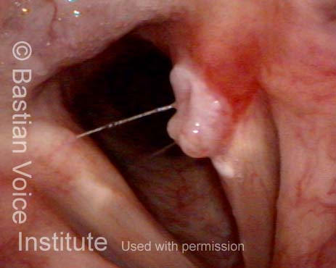

Slide 35
Cysts
Usually unilateral, on the vocal folds or the ventricular folds
Inner margin, superior or inferior surface
Requires surgical excision rather than voice therapy
physician may recommend voice therapy pre-surgically to clear the surgical field (reduce swelling and irritation) or post-surgically to address any residual hoarseness.
Vocal fold cysts are fluid-filled growths.
Vocal quality may include hoarseness, breathiness
Often caused by abnormal blockage of the ductal system of laryngeal mucus glands
Can be congenital or acquired
Soft and pliable

Slide 36
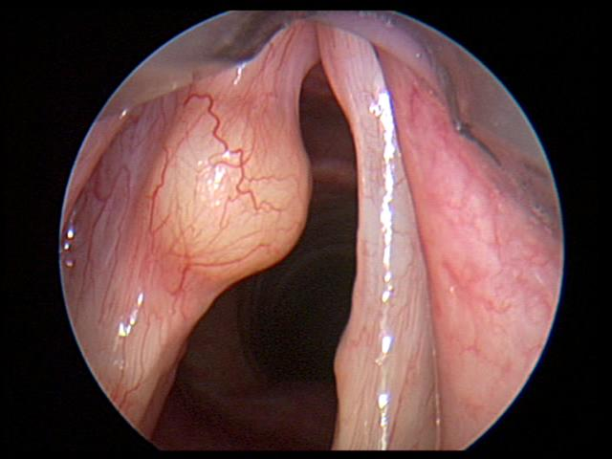
Cont.
there are no clear factors that are documented to cause cysts.
Vocal cysts generally more deeply within the vocal cord rather than on its surface. Though most cysts are acquired through phonotrauma.

Slide 37
Endocrine Changes
Hypofunction of pituitary gland, retarded laryngeal growth; prevent normal development of progesterone by ovaries, and testosterone by testes, no secondary sexual characteristics (no voice change)
Tumor of pituitary gland “precocious puberty as well as acromegaly”
Hypothyroidism, increase VF mass (lower pitch)
Menopause, excessive secretion of androgenic hormones, thicker VF (lower pitch)
Hormonal therapy

Slide 38
Hyperkeratosis
A pinkish, rough lesion, a nonmalignant growth that my be the precursor of malignant tissue change
They are reactive to continued tissue irritation – must be watched closely
May appear under tongue, on VF
LPRD, smoking, environmental pollutants, alcohol use, and other inhaled drugs

Slide 39
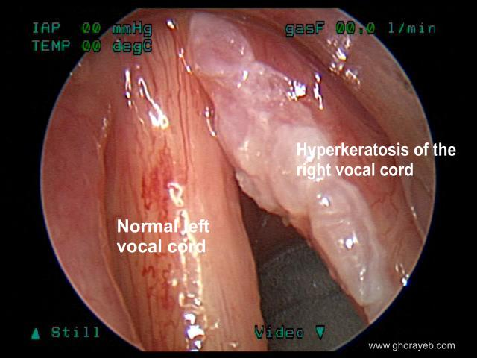
Cont.

Slide 40
Cont.
Usually, surgery will be conducted to confirm the diagnosis with a small biopsy and to remove lesion from the vocal fold cover.
voice therapy is used to ensure that voice conservation strategies and vocal hygiene are in place and to
assist in recovery of voice quality and
assist in modifying the behaviors that contributed to the causes.

Slide 41
Infectious Laryngitis
Upper respiratory tract infection (URI), fever, headache, runny nose, sore throat and coughing
Most are viral in origin, sometimes bacterial infections (ANTIBIOTIC)
Inflammation of VF, irritation, swelling
Hoarse voice
Voice rest 2-3 days, hydration, reduce physical activity

Slide 42
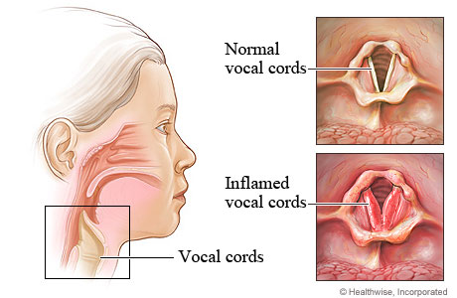
Cont.

Slide 43
Leukoplakia
Whitish-colored patches on the surface membrane of mucosal tissue and often extend beneath the surface into subepithelial space
Benign, but precanceroun lesions, must be followed closely
Most commonly under tongue and on the VF.
Primary etiology, continuous irritation of membranes (heavy smoking, LPRD)
Lower voice pitch, hoarseness, may cause diplophonia, breathiness (if on the glottal margins), reduced loudness
Medical-surgical treatment.
Voice enhancement therapy.

Slide 44
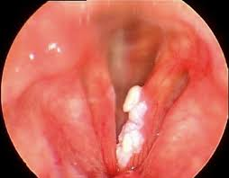
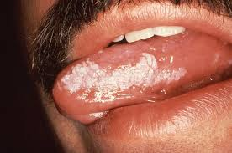

Slide 45
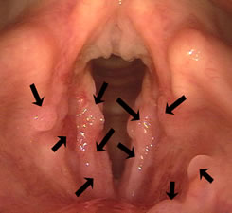
Recurrent Respiratory Papillomatosis
Juvenile onset recurrent respiratory papillomatosis (JORRP) is the most common cause of pediatric hoarseness
Papillomas are wart like growths.
viral in origin(HPV)
The majority of papillomas
occur in children <6 years.

Slide 46
Cont.
may cause significant airway obstruction or voice change.
Treatment is usually surgical.
Interferon treatment appears to slow the rate of growth without curing the disease.
Although some antiviral agents also may slow the rate of regrowth of lesions, they are not curative. Eventually.
In 3-5% of patients, respiratory papillomas may undergo malignant degeneration to squamous cell carcinoma, and the prognosis for patients with these cancers is quite poor.

Slide 47
Pubertal changes
At about nine years old, before the onset of puberty, the larynges of boys and girls are of the same size with same voice pitch.
Pubertal growth changes in girls begin around 9, with onset of puberty, continue over 4-5 years.
In boys, puberty begins around 11-12, continue 4-5 years
Noticeable laryngeal growth and dramatic change in vocal F0 occur in the last year of puberty
By age of 17, full adult development
Voice pitch of males and females drop
boys may experience temporary dysphonia and pitch breaks

Slide 48
Sulcus vocalis
a groove of mucosa along the surface of the vocal fold.
Congenital or acquired
Unknown etiology
Vocal abuse and LPRD (acquired)
Usually bilaterally symmetrical
The furrow may be confined to the superficial layer of mucosa or penetrate into vocal muscle
Some degree of dysphonia , bowing of VF, thyroarytenoid atrophy, presbylaryngis (thinning of VF), paralysis

Slide 49
Cont.
Strained vocal quality, difficulty in speaking loudly
hoarseness, vocal fatigue, voice weakness, and increased effort
May experience periods of aphonia
A defect in the medial surface of the true vocal fold along the sulcus may produce a glottic gap.
Surgical repair usually.
The overall effect is usually a higher fundamental frequency with harsher voice quality.

Slide 50
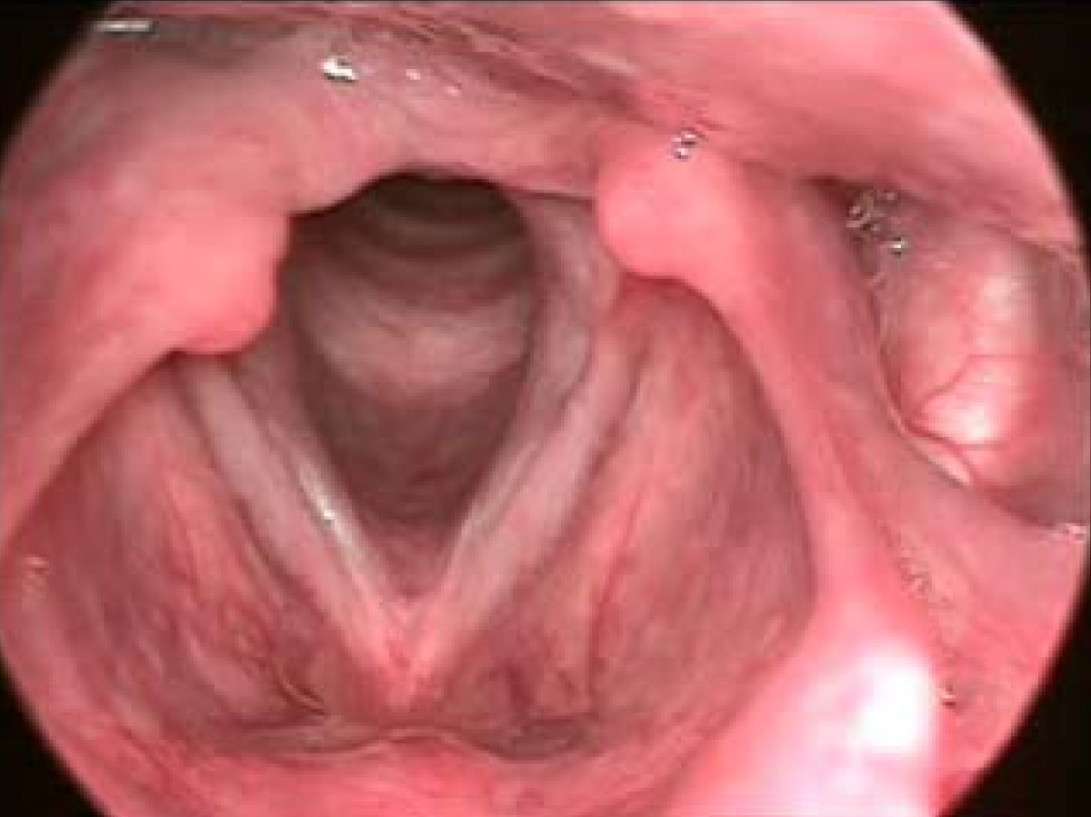

Slide 51
Webbing
Laryngeal web growing across the glottis between the two vocal folds inhibits normal fold vibration
High-pitched voice, rough
Congenital or acquired
A congenital web, glottal membrane failing to separate in embryonic development
Depending on the size of the web, the baby will produce stridor, shortness of breath
Requires immediate surgery
Acquired, because the two VF are so close at the anterior commissure, any surface irritation due to prolonged infection or trauma may cause the inner margins to grow together

Slide 52
Cont.
Webbing grows across the glottis ant-post. Fashion , stops about one-third of the distance from anterior commissure, distance becomes too great
bilateral surgery of the folds.
papilloma or nodules maybe followed by a web
Treatment is by surgery.
Voice enhancement therapy.

Slide 53
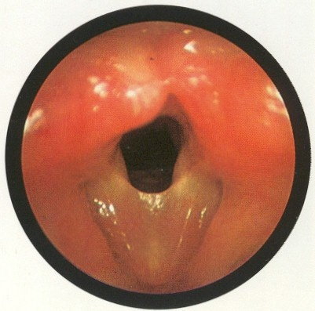

Slide 54
Laryngeal Cancer
Cancer or carcinoma in the vocal tract is a life threatening disease
Lip and intraoral cancers rarely contribute to changes in voice, only on articulation
The American Cancer Society estimated 52,000 new cases of head and neck cancer in 2011
Head and neck cancers are among the 5 most common cancers
Related to smoking (particularly pipe smoking), chronic infections, herpes, repeated trauma to the irritated site, leukoplakia
Often patients first experience chronic lesions in the mouth or on the tongue that do not seem to heal

Slide 55
Cont.
The most serious vocal tract malignancies are those that involve the larynx (airway position)
Laryngeal cancers 6% of all malignancies diagnosed annually in USA
Laryngeal cancers are classified into:
Supraglottal, e.g., false or aryepiglottic folds, epiglottis, arytenoid cartilages, and walls of hypopharynx.
2. Glottal, from the anterior commissure to the vocal process ends of arytenoids
3. subglottal, cricoid cartilage, and trachea

Slide 56
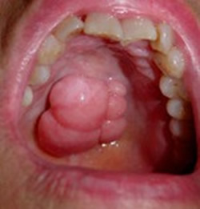
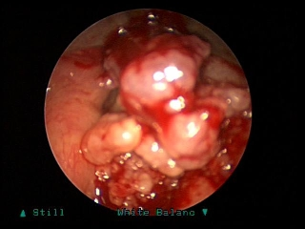
TREATMENT
Treatment combines radiation therapy and surgery fro small to moderate lesions
Extensive cancer requires a hemilaryngectomy, supraglottal laryngectomy or total laryngectomy
Those need rehabilitation after laryngectomy

Slide 57
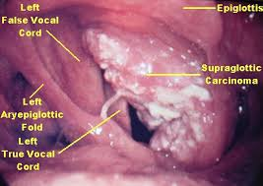
Cont.

Slide 58
Neurogenic Voice Disorders

Slide 59
VOCAL FOLD PARALYSIS
Damage to cranial nerve X
Unilateral VFP
Etiology: neoplastic (compression of the vagus nerve), trauma ( surgical and nonsurgical), secondary to medical disease, idiopathic
The paralyzed VF is fixed in the paramedian position, neither fully abducted nor adducted

Slide 60
UVFP voice characters
Breathy, hoarse vocal quality; reduced phonation time
Decreased loudness and monoloudness
Pitch breaks, diplophonia
Secondary muscle tension contribute to hoarseness
The most common form of VF paralysis, Disease or trauma to RLN on one side
In many cases, strengthening VF muscles result in very good voice quality
Behavioral therapy, digital manipulation, head positioning

Slide 61
VOCAL FOLD PARALYSIS INTERVENTION
The surgical options, vocal fold medialization , and vocal fold innervation
Medialization, injection laryngoplasty (collagen, Teflon, Autologous fat..)
Effective to improve voice quality, can’t prevent VF atrophy.
Reinnervation: ANSA CEVICALIS to RLN anastomosis
VAGUS NERVE to RLN anastomosis and free grafting

Slide 62
BLVFP
Usually as a result of lesions at the nuclei of origin in the medulla- tumors at the base of skull or trauma, hydrocephalus
May be of the abductory or adductory type; both are life threatening
In bilateral adductor paralysis, neither VF capable of moving to midline, phonation is impossible, aspiration risk

Slide 63
Cont.
Abductor paralysis, VF remain at midline,
serious respiratory problems
- need tracheostomy
Muscle reinnervation,
surgical procedures to open
the posterior glottis airway

Slide 64
Spasmodic Dysphonia (SD)
A rare voice disorder results from laryngeal dystonia
Dystonia is a neurological dysfunction of motor movements, either more generalized to major body movements or seen in focal disorders such as in eyelids,in the neck or in larynx (Spasmodic Dysphonia)
A hyperkinetic movement disorder
Starined voice, hyperadduction of true VF and false VF with supraglottic constriction of aryepiglottic folds and contraction of lower pharynx

Slide 65
Cont.
The site of lesion is the brain is not definitely known, supranuclear movement disorder
The total laryngeal and lower pharyngeal airway appears to close down
Hirano and Bless (1993), SD presentation can be heterogeneous, ranging from spasmodic hyperfunction to hypofunction, to irregular twitching of true VF- vocal tremors

Slide 66
Cont.
The most common type of SD, tight laryngeal adduction – Adductor SD
Abductor SD, patients exhibit normal to dysphonic voices that are suddenly interrupted by temporary abduction of VF, resulting in fleeting aphonia (momentary)
The abductor type disorder is a much rarer form of SD

Slide 67
Cont.
Schweinfurth and colleagues (2002), to identify the risk factors
The majority of patients were females 79%
A higher incidence of childhood viral illness was found in the patients with SD (65%)
Tanner and colleagues (2012)
A personal history of cervical dystonia, sinus throat illnesses, mumps, rubella
A family history of voice disorders, meningitis and vocal tremors

Slide 68
Voice Therapy for (SD)
Poor outcome of traditional voice therapy
Few techniques, Yawn-sigh relaxation, laryngeal massage
Voice therapy coupled with surgery or BTX-A injections offers the best therapeutic management of SD

Slide 69
RECURRENT LARYNGEAL NERVE SECTIONING
Injection of Lidocaine into RLN to produce a temporary unilateral adductor paralysis
Better airflow, ease of phonation, and voice quality
If there is marked improvement, the decision may be made to cut the RLN permanently
The result is an easily produced but breathy voice, similar to the sound produced by a patient with unilateral adductor paralysis
Argument over the long-term effectiveness of RLN sectioning – regeneration of the severed RLN-tight voice back

Slide 70
Botulinum Toxin Type a (BTX-A) Injections
The gold standard for treating SD, injection of BTX-A in one or both VF or interarytenoid muscles or a combination .
BTX-A, commonly known as Botox. It blocks nerve signals that tell your muscles to contract. The effect is that it temporarily weakens or paralyzes the muscle.
It is a toxin produced by the bacteria Clostridium botulinum. That prevents nerves from functioning normally (a neurotoxin). It prevents nerves from releasing a chemical called acetylcholine, which is essential for the nerves to communicate with muscle cells. This toxin therefore prevents muscles from receiving nerve stimulation.

Slide 71
ESSENTIAL VOICE TREMOR
In half of the cases, it is an autosomal dominant inherited trait, so a family history of essential tremors is considered to be a risk factor for the development of the disease.
It is a neurogenic disorder that affects the CNS.
The tremor may appear present in tongue, velar, pharyngeal and laryngeal structures, producing a vocal tremor movement
Other patients may show similar tremulous movements in the hands, arms, neck, and face
Familial tremor is common 50% of all cases, beginning in early adulthood
Another form of essential tremor is related to aging

Slide 72
Cont.
Essential voice tremor appears to exist independently of other neurogenic conditions
Vocal tremors co-exist with SD in approximately 30% of the cases
the diagnosis of essential tremor is best made by eliminating contextual speech, ask the patient to sustain the vowels in isolation
Vocal tremors is perceived as during sustained phonation and more if elongated

Slide 73
Treatment
BTX-A injection into the thyroarytenoid muscle may reduce the tremor
Referral to a counseling neurologist – medication control
Some behavioral techniques aim to reduce intensity levels, elevate the pitch a little bit, shorten vowel duration while speaking

Slide 74
Parkinson’s Disease(PD)
Usually with reduced loudness, breathy voice, monotony of pitch, intermittent and rapid rushes of speech and reduced articulatory contacts.
Significant respiratory difficulties as possibly contributing to PD patient’s voice symptoms.
Lee Silverman Voice treatment(LSVT/LOUD), the main goal for this program is to increase vocal fold adduction, and respiratory effort, so increase loudness, vocal quality and subsequently intelligibility.
DAF may be useful, reduction in speech rate, increased loudness, reduced phonetic errors and increased acoustic distinctiveness.
Masking noise.

Slide 75
CEREBROVASCULAR ACCIDENT (CVA)
Or stroke is the third leading cause of death in USA, behind heart disease and cancer.
Swallowing problems – aspiration ,impairred communication.
Depending on the nature and site of lesion.
Vocal fold paralysis as a direct result of stroke is very rare- most commonly brainstem strokes.
Voice quality is characterized as either spastic or flaccid, strained voice quality, hypernasality, breathy voice quality, diminished loudness and air wastage.

Slide 76
TRAUMATIC BRAIN INJURY (TBI)
External forces acting on the head
Mostly by motor vehicle accidents, falls, assaults , and explosion injuries
Can cause focal or diffuse lesions
May affect the mechanism or respiration, articulation…….

