Slide 1
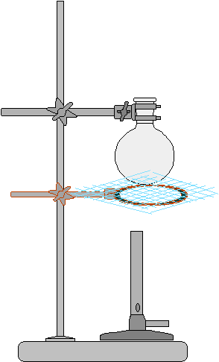
Slide #1 Simple Distillation
This is a step by step representation of the simple distillation set-up:
Hold your round bottomed flask by the clamp.
Let the flask sit on the wire gauze ( on the ring).
The bunsen burner should be placed in a proper position, just below the flask.
Do not light the Bunsen burner yet.

Slide 2
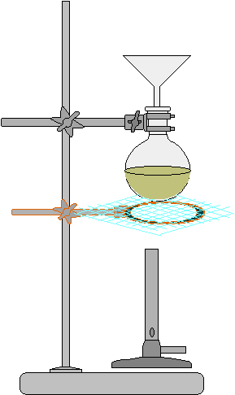
Slide#2
Use a glass funnel to transfer the impure liquid into the round bottomed flask

Slide 3
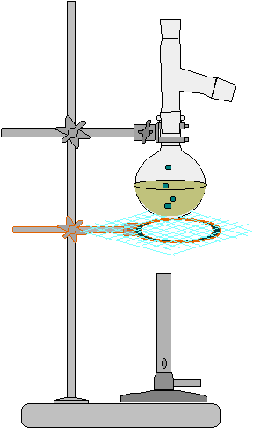
Slide #3
Still Head
After delivering the liquid, remove the funnel.
Add few boiling chips to prevent bumping.
Apply a thin layer of grease on ground glass parts the still head.
Attach the still head by inserting within the neck of the round bottomed flask.

Slide 4
Slide#4
-
Thermometer
Adapter
Attach the thermometer adapter.
Fix it on the top of the still head.

Slide 5
Slide #5
-
Insert the thermometer through the adapter.
Make sure that the thermometer bulb is just below the lower end of the still head side arm.

Slide 6
Slide#6
-
Bring a stand and a clamp near your set-up.
Hold the condenser by the clamp and adjust the height of the condenser.
Carefully move the stand (and the condenser) so that the side arm of the still head slips into the condenser.
Condenser

Slide 7
Slide #7
-
Apply a thin layer of grease to the male joint of the condenser.
Attach a receiver adapter to that end of the condenser. Use a plastic clamp.
Attach the lower rubber tube to the water tap.
Receiver
Adapter

Slide 8
Slide #8
-
Bring a third stand near your set-up.
Place a conical flask (or a graduated Cylinder) under the tip of the receiving adapter.
The flask may be placed within a cooling bath if needed.

Slide 9
Slide# 9
-
Open the water tap allowing the water to run through the condenser from below.
Check your set-up( Instructor).
Light the bunsen burner to start your distillation.

Slide 10
Slide # 10
-
Make sure that the boiling is smooth-
No bumping.
Adjust the flame if necessary.
Record the temperature and volume of distillate.

