Slide 1
Starch
Chapter 13

Slide 2
Starch
In humans, during digestion:
  Starch yields glucose which provides energy to the body.
In plants, as in people, starch provides energy;
During germination (plant begins to grow)
  Starch undergoes enzymatic hydrolysis to yield glucose which provides energy for the growing plant.
This chapter focuses on purified starch

Slide 3
Storage of Starch in Plants
Starch is stored in the:
  Seeds
  Roots (the underground part of a plant)
  Tubers (a thick underground stem)

Slide 4
Most Common Sources of Starch
Cereal grains such as: wheat, rice, and other grains.
Legumes such as: beans
Roots and Tubers such as: potatoes, sweet potatoes, arrowroot (West Indian herbaceous plant from which a starch is prepared) and Cassava (A tropical plant marketed as tapioca)

Slide 5
Sources of Starch
Wheat
Rice
Corn
Roots and Tubers
Legumes

Slide 6
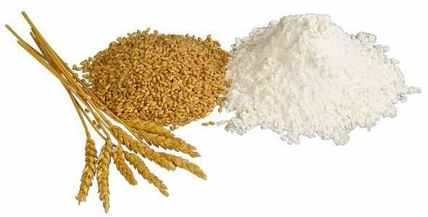
Wheat

Slide 7
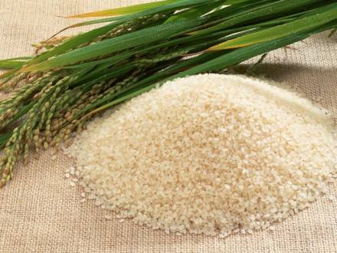
Rice

Slide 8
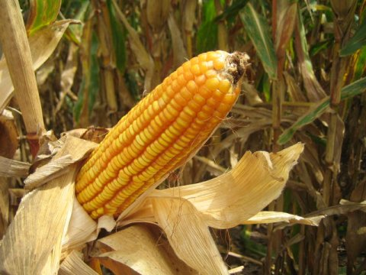
Corn

Slide 9
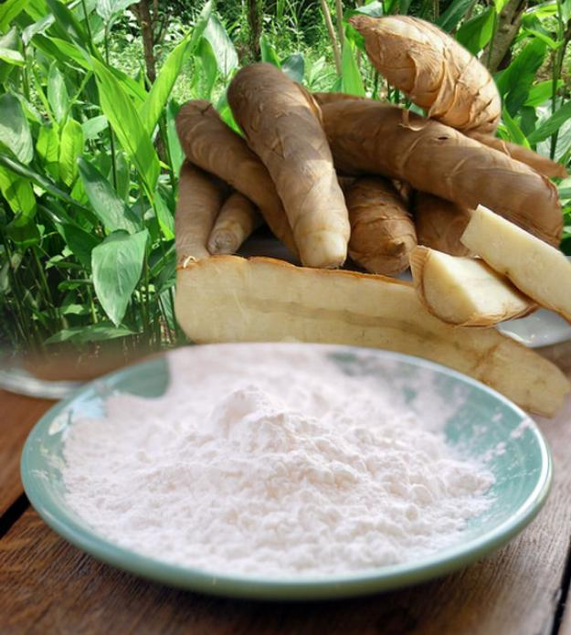
Arrowroot
A West Indian plant from which a starch is prepared.

Slide 10
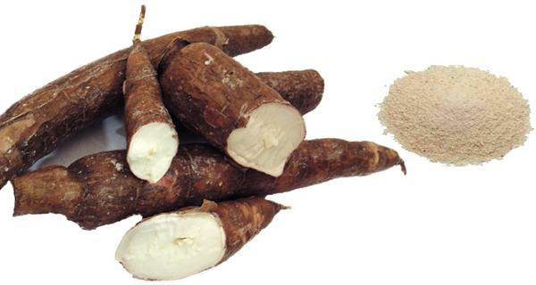
Cassava
Cassava is a long tuberous starchy root that is an essential ingredient in many Latin American and Caribbean cuisines.

Slide 11
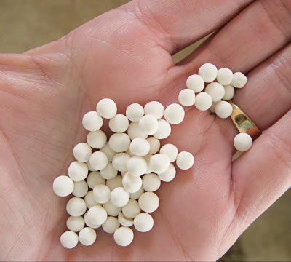
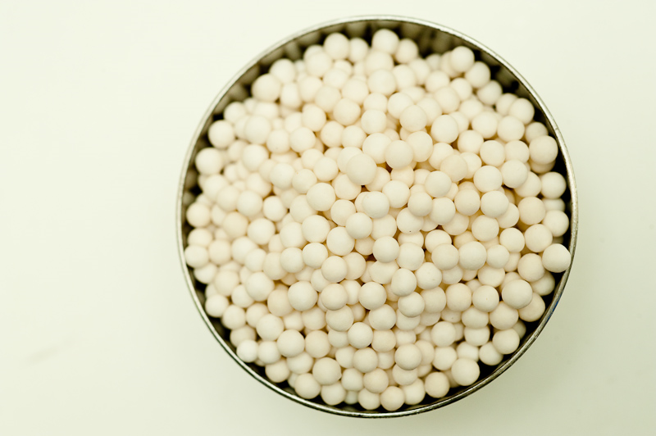
Cassava Tapioca Pearls

Slide 12
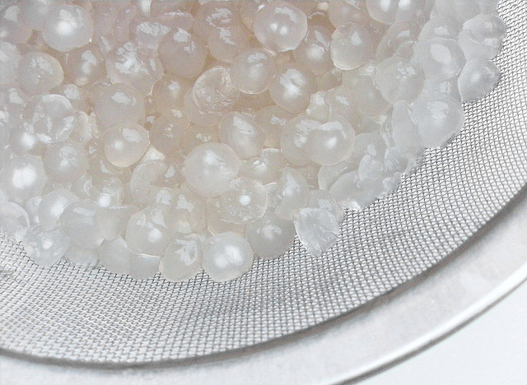
Cooked Tapioca Pearls

Slide 13
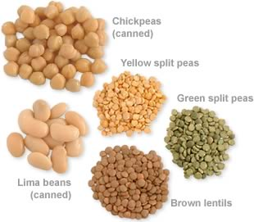
Legumes

Slide 14
Composition of Starch
Starch is composed of:
  Hundreds or thousands of glucose molecules joined together.
Starch molecules are of two fractions:
  Amylose
  Amylopectin

Slide 15
Composition of Starch
Amylose:
  Chain like molecule sometimes called the linear fraction.
  This fraction causes the gelling in cooked starch mixtures.
Genetic manipulation led to high amylose corn called high-amylo-corn or amylo-maize

Slide 16
Composition of Starch
Amylopectin:
  Highly branched, bushy type.
  This fraction causes thickening of cooked starch mixtures.
Starch granules are:
  Tightly packed units that contain the starch molecules;
  Microscopic in size.

Slide 17
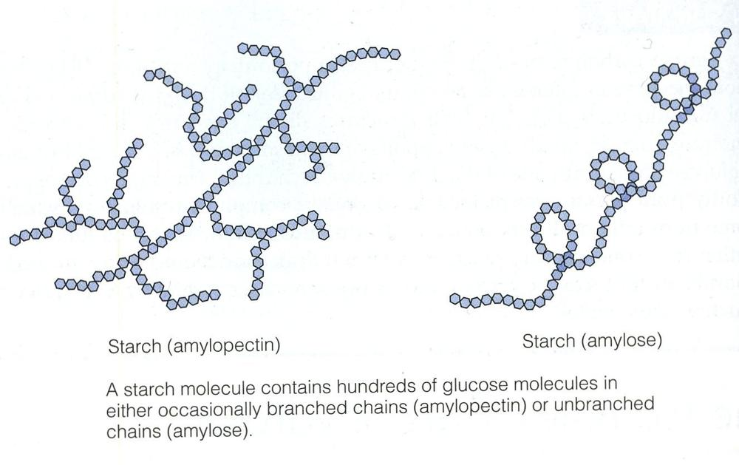

Slide 18
Kinds of Starch
1. Native starch:
  Is derived from all natural plants
  Is composed of varied amounts of amylose and amylopectin
  Behave differently in food preparation
2. Improved Native starch
  Is obtained through natural plant breeding
  Without
    Chemical modification
    Physical modification

Slide 19
Kinds of Starch Cont’d.
3. Modified starch:
  Is exposed to chemical or physical modification
    In order to achieve the desired texture and flavor in the finished products.
    Used in the food industry

Slide 20
Kinds of Starch Cont’d.
4. Resistant starch: which cannot be digested by humans, there are 4 classes of resistant starch:
  RS1: found in seeds, legumes and unprocessed whole grains (e.g. fiber)
  RS2: found in uncooked potatoes, green bananas and high amylose corn
  RS3: this one is formed when starch containing foods are cooked and then cooled
  All above 3 are natural

Slide 21
Kinds of Starch Cont’d.
RS4 is:
  Chemically modified starch (for example by oxidation and esterification) and
or
  Physically modified starch (by heating)
RS4 is not found in nature
All types of resistant starch are useful in foods to increase the dietary fiber without changing the quality of the product.

Slide 22
Effect of Cooking on Starch
Starch + water (liquids) + heat = gelatinization
Gelatinization
  Thickening of the mixture
  Is irreversible

Slide 23
Effect of Cooking on Starch Cont’d.
2. Gel Formation:
  Top layer of a gelatinized starch
  This process takes place on cooling of the cooked starch-liquid mixture,
  This process is gradual and goes on for several hours as the mixture cools.

Slide 24
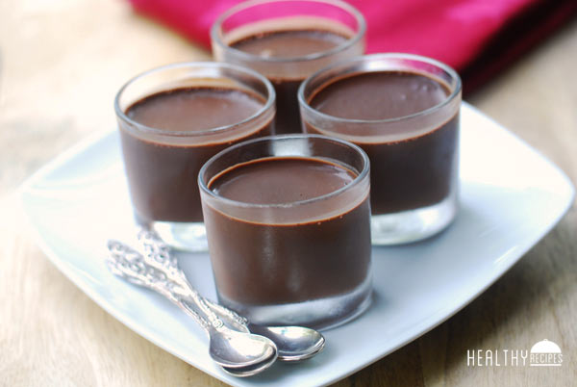
Top Layer Gel Formation

Slide 25
Effect of Cooking on Starch Cont’d.
3. Retrogradation:
  After gel formation and during aging,
  The amylose molecules come closer together (they aggregate, or pull together more tightly)
    Gel shrinks and water is pushed out of the gel.
    This process of weeping, called syneresis which happens as the starch mixture ages.

Slide 26
Effect of Dry Heat on Starch
When starch is exposed to dry heat,
  It becomes more soluble with a decreased thickening power.
  Color and flavor change because of non-enzymatic browning that takes place.
This method is used in making gravy which should have a relatively thin consistency.

Slide 27
Factors that Affect Starch Mixtures
Temperature
Length of heating time
Agitation
Acidity
Amount of sugar

Slide 28
Factors that Affect Starch Mixtures
1 & 2 Temperature and length of heating time:
  Starch mixtures can be prepared quickly by:
    Boiling while constantly stirring and
    Then Simmering for 1 minute after it boils;
    Extended simmering may result in decreased thickness.

Slide 29
Factors that Affect Starch Mixtures Cont’d.
2. Agitation:
  Stirring is necessary at the early stage of cooking to:
  Prevent Lump Formation and
  Get a smooth product.
  Stirring too intensely (fast) or too long may decrease thickness.
  So stirring should be minimized, just enough to avoid lumps.

Slide 30
Factors that Affect Starch Mixtures Cont’d.
3. Acidity:
  A high degree of acidity
  Decreases the thickening power of starch,
So an acidic liquid such as lemon juice for example should be added after cooking the starch mixture.

Slide 31
Factors that Affect Starch Mixtures Cont’d.
4. Sugar content
  Too much sugar
    Decreases the thickness of the paste,
So if the recipe calls for a large amount of sugar,
  Add part of it before cooking and part after the paste has thickened.

Slide 32
Starch Cookery
To avoid lump formation:
  1. Disperse starch in melted fat to make a roux
  Or
  2. Mix starch with cold liquid to make a slurry
  Or
  3. Blend starch with sugar to make puddings

Slide 33
Starch Cookery
Roux
  Is a mixture of starch and liquid
  Is used in making sauces and gravies
  Can be:
    Brown or blond
    White

Slide 34
Brown Roux
Is a mixture of equal parts, by weight, of:
  Flour and
  Fat
    Cooked together until a dark color and nutty aroma develop.
Brown roux enhances the flavor of sauces and gravies.
Brown roux:
  Will have less thickening power compared to white roux

Slide 35
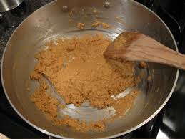
Brown Roux

Slide 36
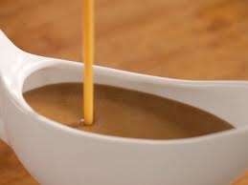
Gravy
How to make gravy
2 Tbsp. of dripping or other fat.
2 Tbsps. of flour.
Stir over heat to brown the flour, stirring constantly.
Add 2 c of stock and stir.
Continue stirring over heat until the flour has thickened and the gravy is smooth.
Season the gravy with salt and pepper and herbs.

Slide 37
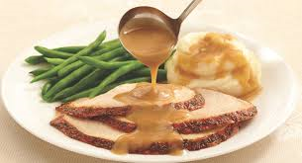
Gravy on Meat and Mashed Potatoes

Slide 38
Roux Preparation
Depending on the product, either starch or flour is used for making the roux.
e.g.
For brown gravy flour is used.
For stir fried vegetables it is better to use corn starch because it makes a glossy sauce.

Slide 39
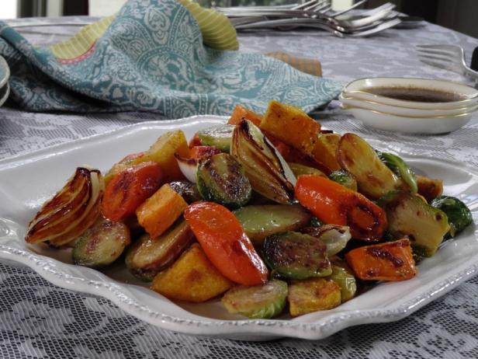
Stir fried Vegetables with a Glossy Sauce

Slide 40
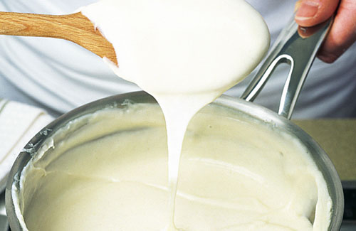
White Sauce
Basic recipe for white sauce
Thin white sauce used for cream soups:
1 c liquids (usually milk)
1 Tbsp flour.
1/2Tbsp fat.
1/4tsp salt.
Few grains (fg) white pepper.

Slide 41
Starch Cookery
Slurry
  Mix the starch with cold liquid to form a slurry which has the consistency of thick cream,
  Then the slurry is added to the hot liquid while stirring

Slide 42
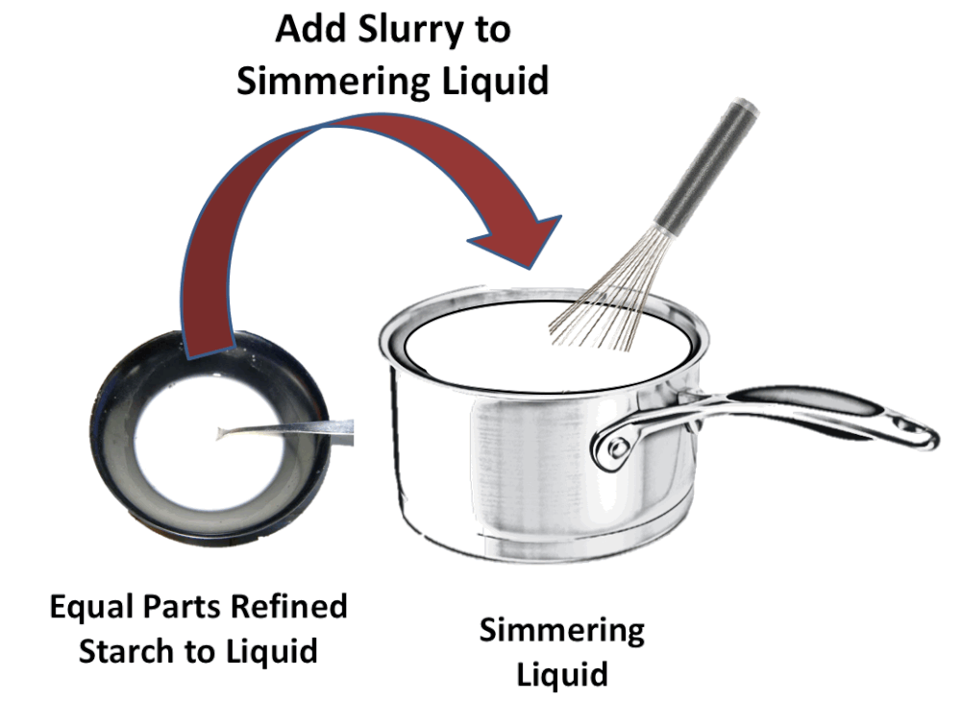

Slide 43
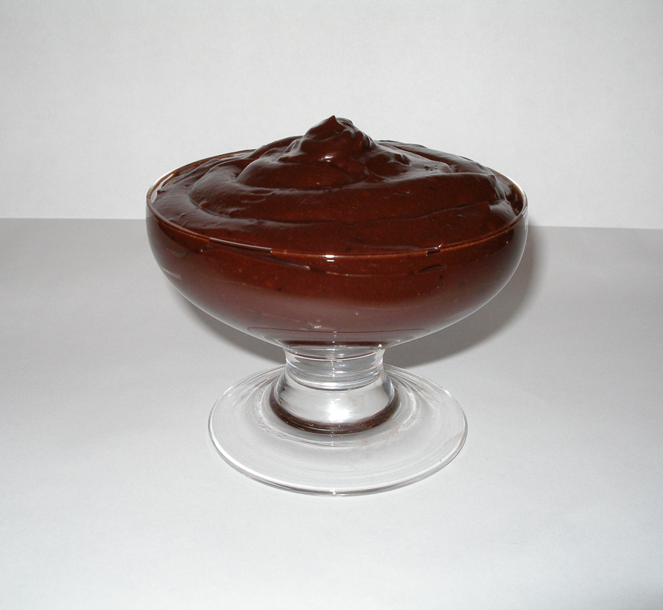
Pudding
Basic recipe for cornstarch pudding
1 c milk
1.5 Tbsp. cornstarch [2Tbsp if no eggs]
2 Tbsp sugar.
Pinch of salt.
1 tsp vanilla.
½ egg or 1 yolk (which you can do without).
Of course many flavors can be used such as: like cocoa, caramelized sugar, nuts, shredded coconuts etc.

