Slide 1



Slide 2
Outline
Social interaction
Social relationship
Social status
Social rules
Social institutions

Slide 3
Social organization
The pattern of individual & group relations.
The term "organization“ = technical arrangement of parts in a whole
The term "social“ = the fact that individual & group relations are the outcomes of social processes

Slide 4



Slide 5

Social Interaction
The ways in which people respond to one another
May simply mean what people do when they are in the presence of one another.
How we interact with people is shaped by our perception of their position relative to our own

Slide 6
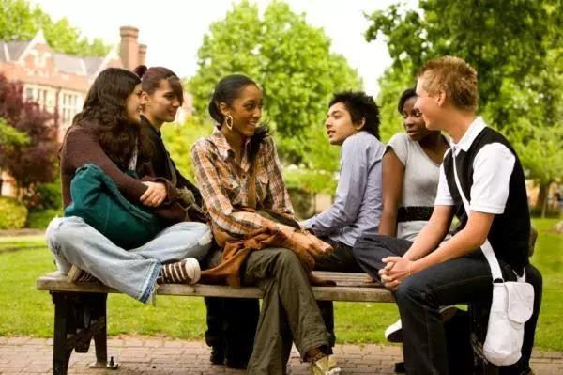
Social Interaction
One way of social interaction in everyday life is by Symbolic Interaction.
Symbolic Interaction focuses on social interaction as the most significant part of life in society.
In Symbolic Interaction we are interested in symbols people use to define
their worlds.

Slide 7
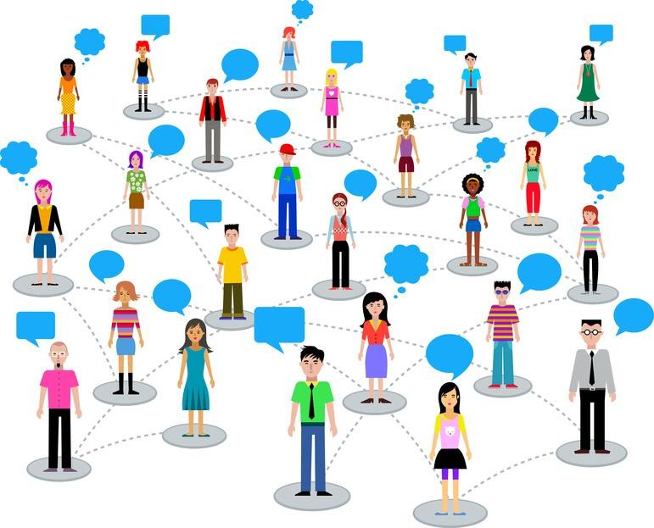
Social Interaction
3 concepts are used to explain the symbolic basis & nature of social interaction; these are:
stereotypes in every day life
personal space
Touching

Slide 8
Social Interaction
Stereotypes in Everyday Life: are the assumptions we have about people;
Stereotyping occurs when a person ascribes the collective characteristics associated with a particular group to every member of that group, discounting individual characteristics.

Slide 9
How we can avoid stereotyping

Slide 10
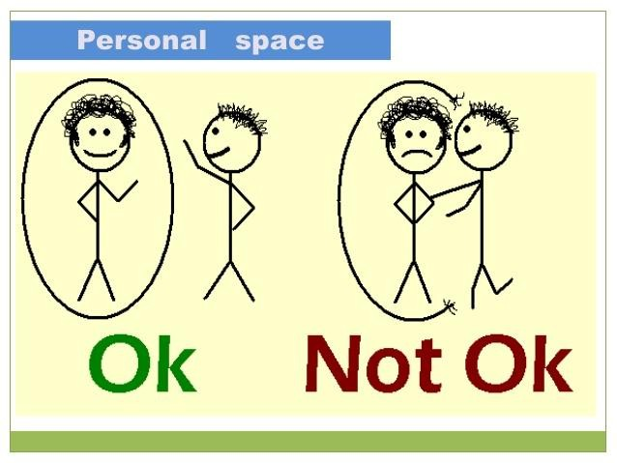
Social Interaction
Personal space: Individuals have, & maintain.
An important sense of personal space in social interaction
Every person has thus personal space
Our personal spaces are open to only those whom we are intimate with
such as children, parents, close friends and spouses.

Slide 11

Social Interaction
Touching: Each society has rules about touching in social interaction.
Frequency of touching & the meaning people attach to it vary between & within cultures.
In impersonal social interactions, higher status individuals are more likely to touch those of lower status; e.g. teacher his/ her students; a boss his secretary, etc.

Slide 12


What is the Most Common Type
of Social Interaction?
When you play a role – you are interacting with others
Some interactions stabilize the social structure
Some interactions promote change.
There are five (5) types of interaction that takes place in society

Slide 13

(1)Exchange
Interacting in an effort to receive a reward or return for actions.
Most common form of interaction
Example: Working, dating, family life, friendship, politics.
Reciprocity: you do something – other person owes you. Basis for Exchange.
Example: a “Thank You” from your parents when
you wash the dishes.

Slide 14
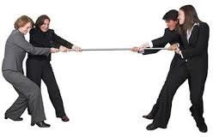
(2) Competition
When two or more people oppose each other to achieve a goal only one can have.
Example: College applications, Football Games,
Positive: Rules of accepted proper conduct are followed.
Negative: Can lead to stress, lack of cooperation, inequality and conflict

Slide 15
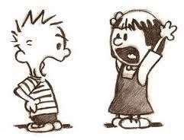
(3) Conflict
Competition is about achieving a goal –
but with Conflict, the emphasis is on defeating the opponent.
Four major sources of Conflict:
wars, disagreements, legal disputes, Sometimes competition becomes conflict

Slide 16

(4) Cooperation
Two or more people work together to achieve a goal that benefits more than one person.
Example: Employees of a company work together to increase sales.

Slide 17
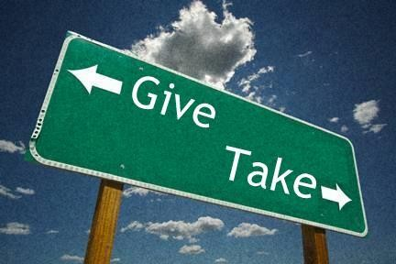
(5) Accommodation
State of balance between cooperation & conflict
Give a little, take a little.
Example: compromise, truce, mediation, arbitration
Accommodation is for situations where you don't care as strongly about the issue as the other person, if prolonging the conflict is not worth your time, or if you think you might be wrong. This option is about keeping the peace, not putting in more effort than the issue is worth

Slide 18
Social relationship

