Slide 1
Intervention for articulation and phonology in children
Chapter 3
Hiba Jawarish

Slide 2
Articulation | Phonology
Model emphasizes the motor component of speech | orientation stresses the linguistic aspect of speech production.
approaches focus on the incorrect production of individual phonemes, | approaches concentrate on rule-based errors that affect multiple speech sounds that follow a predictable pattern.
Articulation disorders can be classified as functional or organic in nature.
Phonetic approaches | Phonological : linguistic rules approaches

Slide 3
Articulation disorders can be classified as functional or organic in nature.
Functional: when no known pathology is causing the errors. Children with functional articulation disorders demonstrate speech production errors in the absence of any identifiable etiology. These children present with adequate hearing acuity and intellectual abilities and with no signs of significant structural abnormalities or neurological dysfunction.
Organic: disorders result from known physical causes, such as cleft palate, neurological dysfunction, or hearing impairment. Some children may demonstrate both functional and organic deficits.rf5555555555555555r4

Slide 4
TREATMENT APPROACHES:
1) traditional approach : Van Riper :
This phonetic approach to intervention is also known as the sensory-perceptual or motor based approach .
It relies on sensory training (i.e., auditory discrimination or “ear-training”) either before or concurrently with speech production training.
The typical sequence for training in the traditional approach involves :
(1) speech sound discrimination training including identification, isolation, and bombardment of specific target sounds
(2) achieving phonetic placement of the articulators for the sound
(3) producing the sound in isolation;
(4) producing the sound in nonsense syllables;

Slide 5
(5) producing the sound in the initial, medial, and final positions of words
(6) producing the sound in phrases and sentences
(7) producing the sound in conversational speech.
It incorporates several teaching strategies, such as imitation, multisensory cues for phonetic placement and production, and successive approximation.

Slide 6
Motor-Kinesthetic (Stinchfield-Hawk & Young, 1938)
This phonetic approach emphasizes development of correct movement patterns and requires the clinician to manipulate the articulators to facilitate sound production.
Assumption: it is possible to establish positive kinesthetic and tactile feedback patterns through direct manipulation of the client’s articulators.As a result of the feedback, the client is helped to recognize and then to produce the movements of speech .
The basic unit of therapy is the isolated sound ,then words and sentences is introduced.
PROMT : Prompts for Restructuring Oral Muscular Phonetic Targets.
It used for children with severe speech motor production difficulties

Slide 7
PROMT : is a multidimensional approach that incorporates three main domains:1) motor-sensory,
2)cognitive-linguistic 3) and social-emotional
Speech production is facilitated through the use of tactile cues that focus on jaw height, labial/facial positioning, and mylohyoid posture for each sound/word.
The program is highly structured, and therapists must be trained/certified through the PROM PT Institute.
Distinctive Features (McReynolds & Bennett, 1972):
is a phonological approach based on the theory that speech sounds can be idefined in terms of articulatory patterns and acoustic properties.
Sounds are usually analyzed according to three basic feature categories: place, manner, and voicing.
The clinician selects a feature for training (e.g., continuancy) and presents syllable or
word pairs that contrast presence with absence of the feature (e.g., /fo/ versus /po/). After
establishing the feature contrast in auditory discrimination activities, the clinician moves
therapy through the traditional speech production hierarchy from isolation/syllables
through conversation

Slide 8
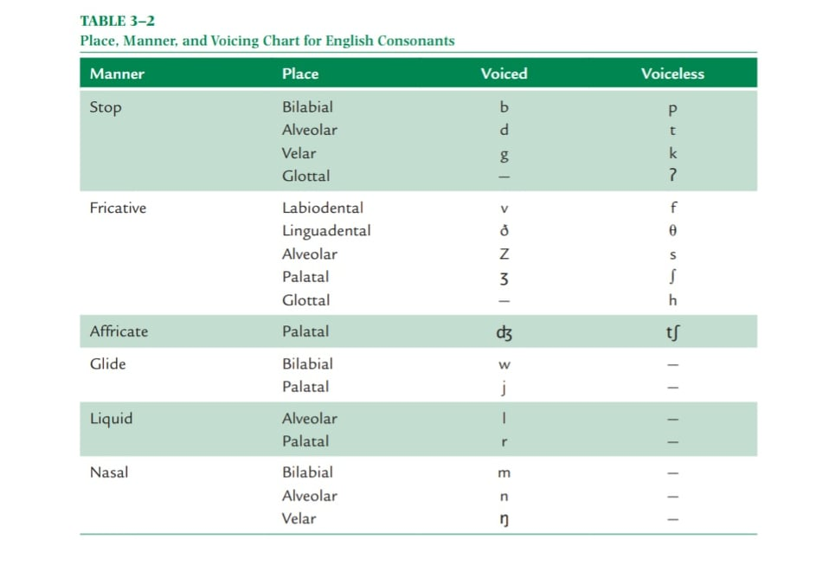
Referrer to page 110 for distinctive features analysis chart

Slide 9
Paired Oppositions—Minimal and Maximal (Weiner, 1981
These phonologically based approaches target phonemic contrasts (errored versus correct) that signal differences in meaning between two words.
This approach emphasizes the use of the child’s communication success or breakdown to teach target sound productions.
Minimal opposition pairs differ in only one feature of sound production (e.g., ban versus pan differ only in voicing) and are generally used with children who demonstrate relatively fewer errors, primarily characterized by sound substitutions.
Maximal opposition word pairs differ in several features (e.g., sad and bad vary in place, manner, and voicing) and are generally used with children who display a larger number of errors that also include omissions and distortions .

Slide 10
Four major steps are commonly used with this approach:
(1) Client is introduced to pairs through pictures or objects.
(2) Client identifies picture/object named by clinician.
(3) Roles are reversed and client must request or label picture/object.
(4) Client is rewarded by clinician’s selection of correct stimulus or is given a chance to repair the communication breakdown caused by inaccurate sound production.

Slide 11
Phonological Processes:
This phonological approach to intervention is based on the strategies used by young, typically developing children between 1½ and 4 years of age to simplify the production of an entire class of adult speech sounds.
Children who persist in using these processes beyond the age of 4 are frequently referred for speech-language services because their speech is now perceived as difficult to understand.
Some children exhibits atypical process or non-developmental process :
1) backing, the substitution of sounds that are more posterior than the usual place of production
(e.g., koe/toe, mackiz/matches, gipper/zipper); (2) initial consonant deletion (e.g., ouse/
house, amp/lamp, ellow/yellow); and (3) glottal replacement, substitution of a glottal stop for
a consonant (e.g., boʔle/bottle, chiʔen/chicken, miʔey/mickey.

Slide 12
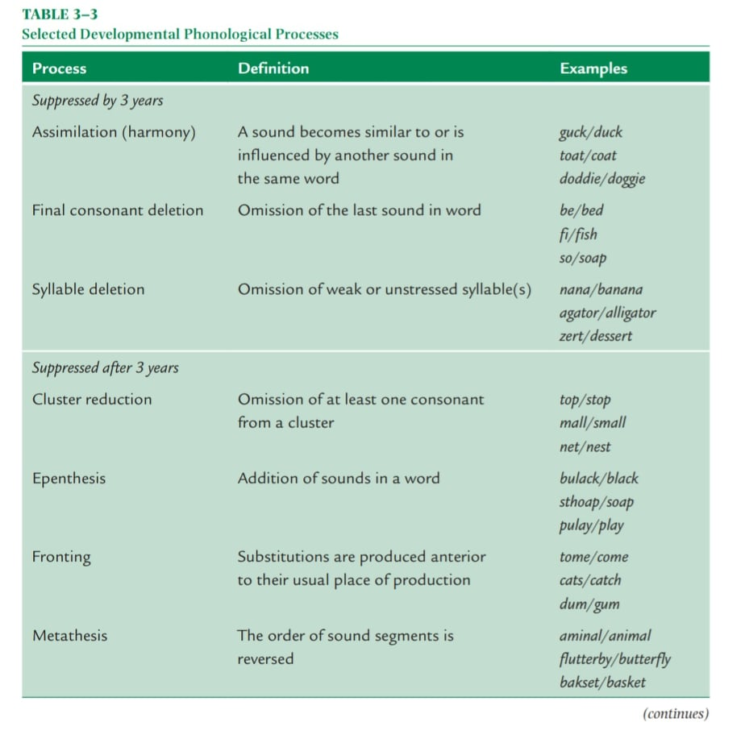
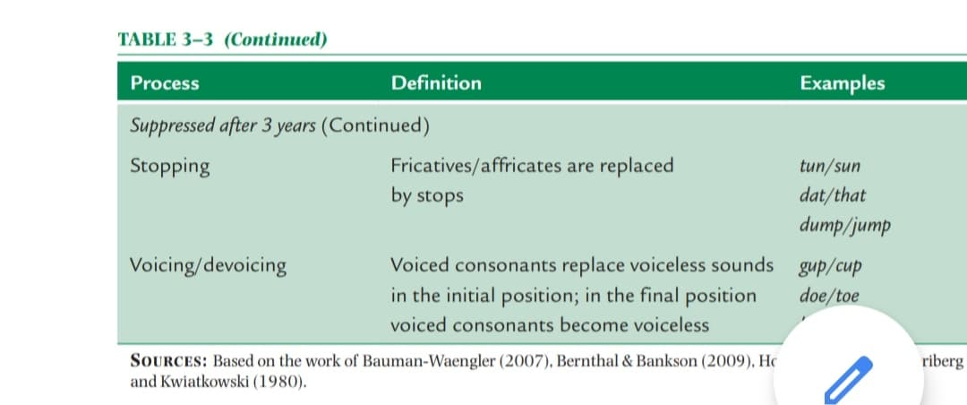

Slide 13
CYCLES APPROACH :
phonological process intervention
intended for children with highly unintelligible speech.
cycles lasting 5–16 weeks.
A typical session sequence includes: (1) auditory bombardment, (2) production training, (3) stimulability probes, and (4) take-home activities for generalization.
After approximately 2 to 6 hours of direct intervention, the child is given time to internalize the pattern while the clinician introduces new targets. Thus, the child’s progression through the program is not based on achieving a criterion level of mastery. Focus on the original target resumes later in the therapy program.
Each cycle is repeated until the target pattern emerges in spontaneous speech.

Slide 14
Core Vocabulary (Dodd, Holm, Crosbie, & McIntosh, 2010)
This approach focuses on functional outcomes in which consistency, as opposed to accuracy,
is targeted. The SLP selects 50 to 70 “functionally powerful” words and targets up to
10 at once. Children learn to produce their best pronunciation of the words consistently,
both in isolation and connected speech. It targets the ability to generate consistent plans
for words; the ability to create a phonological plan is improved by providing detailed, specific
feedback about a limited number of words. This approach relies heavily on systematic
practice in a drill-like format

Slide 15
Metaphon
Developed by Howell and Dean (1994), this approach is more accurately labeled a
“philosophy” rather than a program; it is designed to provide children with explicit information
that will enable them to consciously reflect on the phonemic structure of language.
Heavy emphasis is placed on the child’s awareness/understanding of the detailed aspects
of speech sounds (separately from word meaning) to facilitate accurate sound production.
It utilizes a “word-pair” technique to highlight the salient differences between individual
sounds in similar words (“deep/keep”). The clinician does not provide specific or corrective
feedback regarding the accuracy of the child’s tongue placement or manner of sound
production. Instead, the environment is deliberately structured to give the child repeated
opportunities to distinguish between effective and ineffective communication attempts.

Slide 16
O R A L - M O T O R C O N S I D E R AT I O N S
speech is not an isolated act but the product of a highly complex and synchronized oral-motor system.
Deficits in oral-motor function will affect the neuromuscular control and
organization needed for the production of intelligible speech
These deficits :
hyposensitivity (reduced reactions to sensation);
hypersensitivity (overly strong reactions to sensation);
weakness or incoordination of oral structures, including
the jaw, tongue, lips, or palate

Slide 17
Approach basic rationales:
(1) Speech is founded on earlierdeveloping nonspeech motor patterns such as sucking and chewing
. (2) Reduced muscle tone in the oral-facial area results in limited
strength of speech articulators .
(3) Normal movement and sensation significantly influence motor learning, a Piagetian construct
(4) Speech is a highly complex behavior that is more easily learned when broken into smaller components .
The few controlled studies present correlational rather than causal findings and report no significant connection between nonspeech oral-motor exercises (NSOMEs) and speech sound production.

Slide 18
Factors affecting this approach : (but are not limited to) : 1- age,2- type of disorder,3- severity of impairment,4- number and type of speech error, and individual responsiveness to this treatment approach.5-
children who exhibit the following speech characteristics are potential candidates for such therapy
■■ Weak production of bilabials (/p, b, m/) resulting from decreased lip strength and control
■■ Poor production of sounds requiring tongue elevation (/t, d, n, l/) as a result of decreased
tongue strength and coordination
■■ Poor differential production of midrange vowels (/ɚ, Λ, ɝ/) as a result of inadequate
jaw stabilization
■■ Weak production of plosives, fricatives, and affricates (/p, b, s, z, ∫/) in the presence of
hypernasality as a result of inadequate velar movement

Slide 19
The basic goals of an oral-motor therapy program for improving speech intelligibility
■■ To heighten conscious awareness of the oral mechanism
■■ To normalize (increase or decrease) sensitivity to stimulation of the oral area
■■ To inhibit primitive or abnormal reflex patterns in the oral mechanism, while
Enhancing normal movement patterns
■■ To increase differentiation and stabilization of the oral structures
■■ To refine articulation movements by increasing the strength and range of motion of oral mechanism components

Slide 20
Hierarchy of Oral-Motor Treatment Steps
1. Address postural and positioning issues to ensure adequate balance and alignment of the hip, shoulder, neck, and head. Sample activity: Consult with occupational therapist or physical therapist to determine optimal positioning for conducting effective oral-motor therapy
2. Normalize oral sensitivity (both hypo- and hypersensitivity). Sample activity: Gradually introduce firm, graded pressure along the child’s gums
from front to back, using fingertips or a textured implement. If the child reacts negatively, modify the activity by applying the pressure to an area where touch has been tolerated previously.
3. Increase jaw control to provide a stable base for finely graded movements of the lips and tongue.
Sample activity: Place fingers on the child’s jaw. Use thumb to quickly pull the jaw
down in a firm, gentle manner. Tell the child to try to close his or her mouth while
the clinician guides upward movement with his or her index finger

Slide 21
4. Strengthen lip movement/increase muscle tone. Sample activity: Use the pads of fingers to stroke diagonally from the child’s cheekbones to lips. Tell the child to hold a straw horizontally with lips for at least five seconds. Release and repeat.
5. Improve tongue control for elevation and lateralization.
Sample activity: Place a finger or tongue depressor flat against the child’s tongue
tip. Instruct the child to try to push his or her tongue tip up against pressure.

Slide 22
R E AT M E N T E F F I C A C Y A N D
E V I D E N C E - B A S E D P R A C T I C E
1) Intervention is generally effective in improving correct sound production and increasing speech intelligibility; and (2) No one treatment approach wasdentified as being more effective than any other.
Other factors to consider include the following:
■■ Minimal pair treatment and cycles approach treatment generally result in
Phonological gains.
■■ Computerized instruction is an effective supplement to direct clinical intervention.
■■ Efficacy data are needed to determine the relative effectiveness of specific treatment
procedures as well as their efficiency (i.e., time needed for completion of the therapy
programs).
■■ Clinician and family variables may have an impact on outcomes and should be
Examined in treatment studies (e.g., level of clinical expertise, parental/family
Attitudes and motivation).
■■ Scheduling of treatment (i.e., session frequency and intensity) requires further study
as a potential variable in treatment outcomes (

Slide 23
An evidence-based practice (EBP) approach to treatment comprises three basic elements:
(1) scientific research, (2) clinical expertise, and (3) client/family values.
TA R G E T S E L E C T I O N F O R I N T E RV E N T I O N P R O G R A M M I N G
Two primary approaches are used for choosing initial therapy targets for children with
articulation/phonological disorders: developmental and nondevelopmental.
Developmental :
therapy targets are identified based on the order of acquisition in normally
developing children
Refer to the book for age acquisition table page 117 .

Slide 24
Non developmental :
One strategy is client-specific and bases the selection of therapy objectives on several factors:
1.Target(s) that are most relevant to a child or parent (e.g., a sound in the child’s
name)
2. Target(s) that are most stimulable in a given child’s error repertoire regardless of
developmental sequence.
3.Target(s) that are most visible when produced (e.g., /θ/ versus /g/.
The second non-developmental strategy is based on the degree of perceived deviance associated with a child’s errors.
Articulatory
■■ Omission errors contribute most to unintelligibility, followed by substitutions, and then distortions.
■■ Errors in the initial position of words contribute most to unintelligibility, followed by medial, and then final.
■■ Errors that occur on the most frequent sounds in a language contribute significantly
to unintelligibility.

Slide 25
Phonological
■■ Patterns of initial consonant deletion and glottal replacement of medial consonants tend to contribute significantly to listener perception of unintelligibility
Several strategies can be utilized in the design of a client’s therapy program: vertical, horizontal, and cyclical.
vertical training is that the best route to target mastery is through intense practice on a limited number of targets
horizontal strategy attacks goals broadly. It assumes that simultaneous exposure to a wide variety of targets will facilitate a client’s ability to produce phonemes or sound patterns
Clinicians may choose to combine aspects of the vertical and horizontal strategies into the cycles approach. Recall that instead of attacking therapy targets deeply or broadly, this strategy provides a client with practice on a given target for a predetermined amount of time, and then moves on to another target

Slide 26
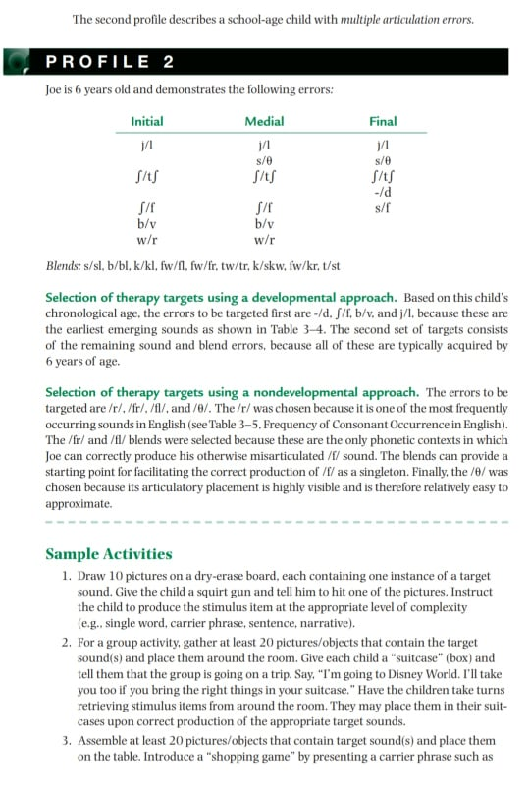

Slide 27
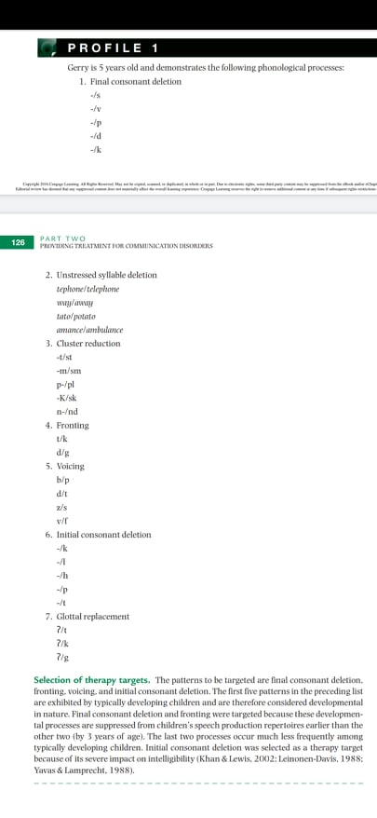
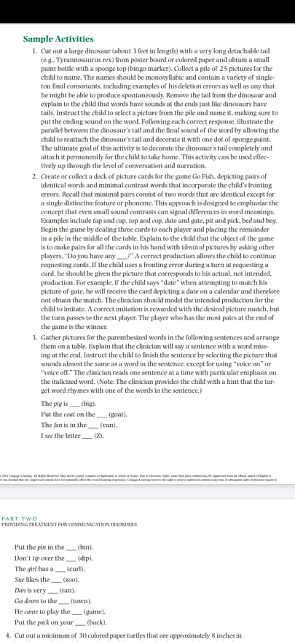

Slide 28
Three pathologies associated with severe articulation problems in children are cleft palate, hearing impairment, and childhood apraxia of speech.
Cleft Palate :
This is a congenital malformation of the palate and/or lip that results from the failure of oral structures to fuse at midline during the first trimester of pregnancy (4 to 12 weeks of gestation). A cleft can be unilateral (one-sided) or bilateral.
Cleft palate affects the speech intelligibly more cleft lip.
Surgical repair of labial clefts is completed at approximately 3 months of age or earlier; palatal repairs generally occur before the child’s second birthday.
Speech therapy may begin before surgical repairs are completed but is primarily provided following surgical intervention.
The most significant speech problem associated with cleft palate is velopharyngeal
incompetence (VPI). VPI is the inability to close off the oral cavity from the nasal cavity
during speech due to inadequate velar movement ,and this result in audible nasal emission .

Slide 29
Following is a profile of the speech sound errors in children with cleft palates:
■■ The most frequent errors occur on fricatives and affricates, followed by plosives.
■■ Distortions and omissions are the most common error types, followed by substitutions.
■■ Singleton fricatives and affricates are most likely to be distorted.
■■ Consonants in blends are most likely to be omitted.
■■ Glottal stops tend to be substituted for plosives.
■■ More misarticulations occur on voiceless consonants than their voiced cognates, especially
in young children.
■■ Most errors occur in the final position, followed by medial and initial positions,
respectively.

Slide 30
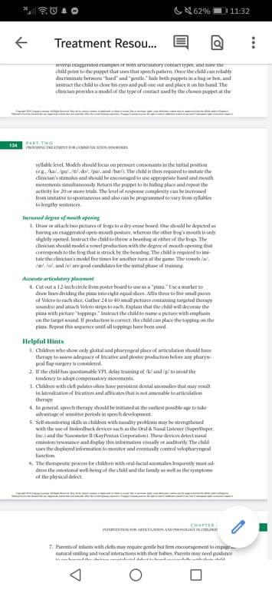
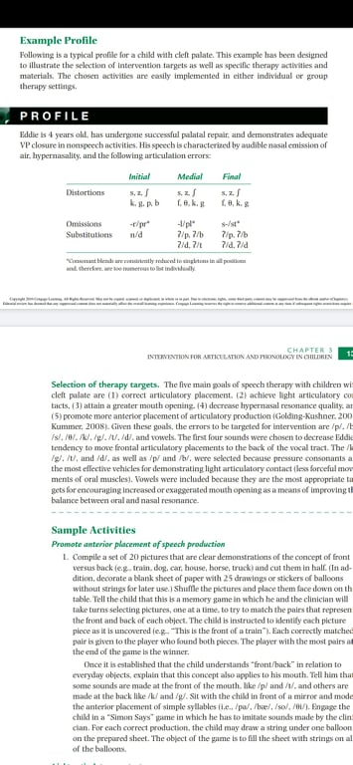

Slide 31
Hearing impairment :
Effects of Hearing Loss on Articulation Development
Degree of Loss : Characteristics
Slight (16–25 dB HL) No noticeable difficulty in relatively quiet listening environments
Mild (26–40 dB HL) Occasional difficulty with voiceless consonants; vowels and voiced
consonants generally intact
Moderate (41–70 dB HL) Some difficulty with sounds characterized by low intensity,
high frequency, or short duration (e.g., final consonant
omission, distortion of fricatives and affricates)
Severe (71–90 dB HL) Significant difficulty in consonant production, with
additional confusion of voiced/voiceless consonants and omission
of consonants in blends
Profound (91 dB HL) Global speech production impairment with the addition of
neutralization or greater (schwa), substitution, addition, and
nasalization of vowels as well as the omission of initial consonants

Slide 32
Speech intelligibility is also significantly affected by several other factors, including age of onset, configuration of hearing loss, age of identification, and degree of linguistic complexity , important factors include the age at which appropriate amplification is fitted, the type and amount of habilitation
Common errors of hearing impaired children :
Omission of final consonants
■■ Substitution of voiced consonants for voiceless
■■ Substitution of stops for nasals, fricatives, and affricates
■■ Omission of consonants in blends
■■ Omission of initial consonants
■■ Substitution of schwa for other vowels (neutralization)
■■ Insertion of schwa into words or added to the ends of words
■■ Substitution of vowels for other vowels
■■ Nasalization of vowels

Slide 33
There are three basic approaches to instruction for children with hearing impairment: oral, manual, and total communication
Oral programs emphasize spoken language as the primary mode of communication through the use of strategies such as speech reading, amplification, auditory training, and explicit speech-language instruction.
Auditory-verbal therapy aims to improve the spoken language abilities of a child with hearing impairment to the level of a child with typical hearing by developing his or her listening skills independent of other cues such as speech reading and gestures.
Manual programs focus on the earliest possible acquisition of a linguistic system, generally via American Sign Language (ASL), finger spelling, and/or manually coded English systems
Refer to the book for profile case study

Slide 34
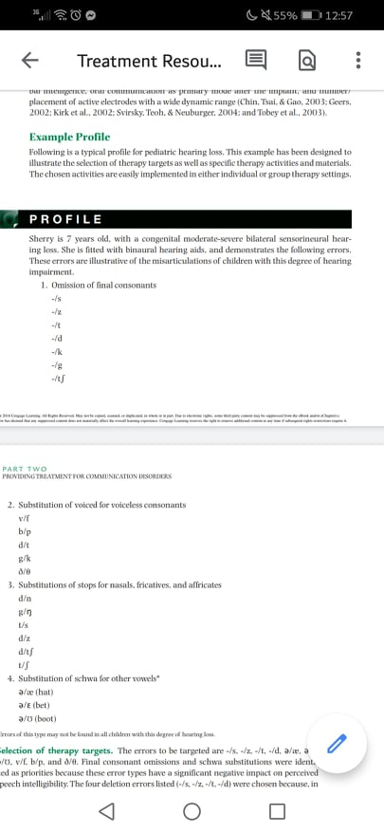
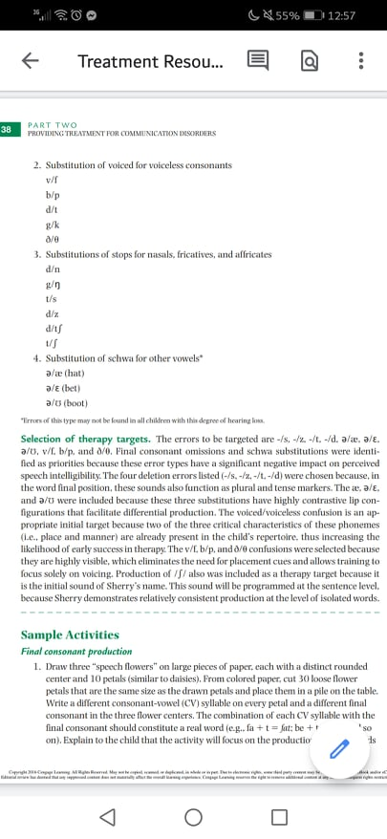

Slide 35
Childhood Apraxia of Speech
Childhood apraxia of speech (CAS) :is a speech-motor planning disorder characterized
by a reduced ability to volitionally sequence movements of the articulators for speech in the absence of paralysis, incoordination, or weakness of the oral musculature (dysarthria).
] CAS is thought to result from neurologic dysfunction
Three characteristics have been identified as hallmark indicators of CAS:
(1) Vowel errors or distortions may be present,
(2) speech production errors are highly inconsistent
(3) prosodic disturbances are evident, particularly in the appropriate use of stress patterns

Slide 36
Following is a list of additional speech production characteristics that have been associated in the literature with CAS:
■■ Repertoire of phonemes is extremely restricted.
■■ A reduced ability to imitate sounds modeled by others, especially at the multisyllabic
level is present.
■■ Omission errors predominate; substitution, distortion, addition, prolongation, and
metathetic errors (transposition of sounds) also occur.
■■ A higher percentage of errors in sounds requiring complex oral movements
(e.g., fricatives,
affricates, consonant clusters) is present.
■■ Struggling or groping movements of the oral musculature are present.
■■ The number of errors increases as the length and complexity of utterances increase.

Slide 37
In general, these children demonstrate receptive language abilities that are significantly superior to their speech production skills and may exhibit an accompanying oral apraxia
Children with CAS can be highly unintelligible; at the most severe levels, these children may be categorized as nonverbal, meaning the near absence of oral expressive output.
CAS does not respond easily to traditional articulation technique
Therapy approaches:
Integral stimulation: utilizes a hierarchical cueing procedure that begins with a high level of support characterized by production of slowly spoken
simple utterances simultaneously by both client and clinician accompanied by visual and
tactile cues. The simultaneous production is gradually faded, and cues are provided until
they are no longer needed. The client then produces delayed repetitions of increasingly
complex stimulus items

Slide 38
Dynamic temporal and tactile cueing (DTTC) is a variation
of the integral stimulation approach and is described by Strand, Stoeckel, and Baas (2006)
and S. Brienza (personal communication). It retains the same hierarchical structure as just
described, but also allows the SLP to use tactile prompts/cues to facilitate correct jaw and
lip positions for the initial articulatory configuration. Proprioceptive processing is maximized
by having the child maintain the postures for several seconds. Also, DTTC incorporates
production of simple consonant-vowel-consonant (CVC) target words, which are
slowed down by elongation of the vowel to provide more time to achieve correct phonetic
placement. In addition, some approaches target prosodic variables

Slide 39
basic factors to be considered in developing treatment programming for this population includes the following:
1. Progress in therapy is slow and marked by poor retention and poor generalization of
therapy targets across treatment sessions.
2. Although repeated practice is an integral component of therapy for all types of
Articulation disorders, it is important to provide intensive, systematic drill for children
with CAS in order for them to master the necessary speech-motor patterns.
3. Based on the first two factors, sessions that are shorter and more frequent may be
helpful in facilitating generalization and avoiding speech-system fatigue.
4. Children with CAS have great difficulty learning articulatory patterns through
Auditory input alone.

Slide 40
Refer to the book 143 for profile case study
Refer to appendix 3-A for phonetic placement instructions.

