Slide 1
Internal control and coso framework
Chapter 11

Slide 2
Chapter 11 Learning Objectives
11-1 Describe the three primary objectives of effective internal control.
11-2 Contrast management’s responsibilities for maintaining internal control with the auditor’s responsibilities for evaluating and reporting on internal control.
11-3 Explain the five components of the COSO internal control framework.
11-4 Explain how general controls and application controls reduce information technology risks.
11-5 Identify types of information technology systems and their impact on internal controls.

Slide 3
OBJECTIVE 11-1
Describe the three primary objectives of effective internal control.

Slide 4
Internal control objectives
Main objectives of a system of internal control:
  Reliability of Reporting
  Efficiency and Effectiveness of Operations
  Compliance with Laws and Regulations
A system of internal control consists of policies and procedures designed to provide management with reasonable assurance that the company achieves its objectives and goals.
Notes:
A good system of internal control helps a company to operate more efficiently while complying with laws and improving the reliability of reporting by preventing or detecting misstatements due to error or fraud.

Slide 5
OBJECTIVE 11-2
Contrast management’s responsibilities for maintaining internal control with the auditor’s responsibilities for evaluating and reporting on internal control.

Slide 6
Management and auditor responsibilities for internal control
Management’s Responsibilities for Establishing Internal Control—Management must establish and maintain the entity’s internal controls.
Internal control systems are designed with two concepts in mind:
  Reasonable Assurance—Management designs a system that provides reasonable assurance considering the costs involved.
  Inherent Limitations—
    No system of internal controls can be completely effective
    Effectiveness depends on the competency and dependability of the employees
    Collusion is still possible
Notes:
Management is responsible for implementing a company’s internal control system—designing the best system within the constraints of cost for the company.

Slide 7
Management and auditor responsibilities for internal control (cont.)
Management’s Section 404 Reporting Responsibilities—Section 404 of Sarbanes-Oxley requires management of all public companies to issue an internal control report that includes the following:
  Statement of responsibility
  An assessment of the effectiveness of internal control over financial reporting as of the end of the fiscal year
Management must also identify the framework used for the evaluation.
  Often COSO's 2013 Internal Control-Integrated Framework.
Notes:
Sarbanes-Oxley requires reporting on internal controls by both management and by the auditor.

Slide 8
Management and auditor responsibilities for internal control (cont.)
Management’s assessment of internal control over financial reporting consists of two key aspects:
  Management must evaluate the design of internal control.
  Management must test the operating effectiveness of the controls.
The SEC requires management to include its report on internal control in its annual Form 10-K report filed with the SEC.
An example of management’s report on internal control that complies with Section 404 requirements is shown in Figure 11-1.

Slide 10
Management and auditor responsibilities for internal control (cont.)
Auditor Responsibilities for Understanding Internal Control—
Must obtain an understanding of internal control relevant to the audit.
Auditors are primarily concerned about:
  Controls over the reliability of financial reporting
  Controls over classes of transactions
Auditor Responsibilities for Reporting on Internal Control—Section 404(b) of Sarbanes-Oxley requires that the auditor report on the effectiveness of internal control over financial reporting.
Notes:
The auditor must understand the client’s internal control system to conduct an effective audit. They must also report on the effectiveness of the client’s internal controls over financial reporting for public companies.

Slide 11
OBJECTIVE 11-3
Explain the five components of the
COSO internal control framework.

Slide 12
Coso components of internal control
COSO’s Internal Control—Integrated Framework
Developed in 1992 and updated in 2013
The COSO Framework describes five components of internal control:
  Control environment 4. Information and communication
  Risk assessment 5. Monitoring
  Control activities
Notes:
COSO’s internal control framework has been used for years. It is based on five components of an effective internal control system.

Slide 13
Coso components of internal control (cont.)
The updated COSO framework includes a total of 17 broad principles that provide guidance to support all three internal control objectives:
reporting,
operations, and
compliance.
As illustrated in Figure 11-2, COSO represents the direct relationship between the three internal control objectives, the five components of internal control, and the organizational structure in the form of a cube.

Slide 14
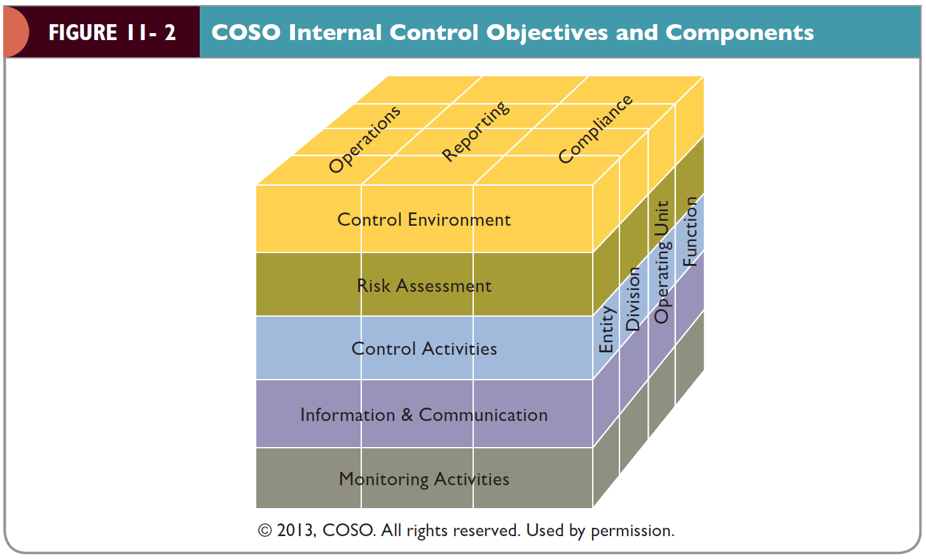

Slide 15
Coso components of internal control (cont.)
The Control Environment—Consists of the actions, policies, and procedures that reflect the overall attitudes of top management, directors, and owners of an entity about internal control and its importance to the entity.
The control environment has five underlying principles:
  Integrity and ethical values
  Board of director or audit committee participation
  Organizational structure
  Commitment to competence
  Accountability
The control environment is an umbrella over the other four components of internal control, as illustrated in Figure 11-3.
Notes:
The control environment is the “tone at the top” which is projected by management to the employees.

Slide 17
Coso components of internal control (cont.)
Risk Assessment—A process for identifying and analyzing risks that may prevent the organization from achieving its objectives.
  Involves management’s identification and analysis of risks relevant to the preparation of financial statements in conformity with appropriate accounting standards.
There are four underlying principles related to risk assessment:
  Have clear objectives
  Determine how risks should be managed
  Consider potential for fraud
  Monitor changes

Slide 18
Coso components of internal control (cont.)
Control Activities—The policies and procedures that help ensure that necessary actions are taken to address the risks to the achievement of the entity’s objectives.
There are three underlying principles related to control activities:
  Develop control activities that mitigate risks to an acceptable level
  Develop general controls over technology
  Establish appropriate policies, procedures, and expectations

Slide 19
Coso components of internal control (cont.)
Control Activities (cont.)—Control activities generally fall into the following five types:
  Adequate separation of duties
  Proper authorization of transactions and activities
  Adequate documents and records
  Physical control over assets and records
  Independent checks on performance
Notes:
Control activities affect all areas of the organization.

Slide 20
Coso components of internal control (cont.)
Control Activities (cont.)
1. Adequate Separation of Duties—There are four general guidelines for adequate separation of duties to prevent both fraud and errors:
  Separation of the custody of assets from accounting
  Separation of the authorization of transactions from the custody of related assets
  Separation of operational responsibility from record-keeping responsibility
  Separation of IT duties from the user departments
Notes:
The most important control activity is separation of duties. It prevents any one employee from having control over any transaction.

Slide 21
Coso components of internal control (cont.)
Control Activities (cont.)
2. Proper Authorization of Transactions and Activities—This is composed of both general authorization that management establishes through policies and procedures and specific authorization that applies to individual transactions.
3. Adequate Documents and Records—Proper design of documents and records include:
  Prenumbered consecutively
  Prepared at the time a transaction takes place
  Designed for multiple use
  Constructed to encourage correct preparation

Slide 22
Coso components of internal control (cont.)
Control Activities (cont.)
4. Physical Control Over Assets and Records—To maintain internal control, assets and records must be protected.
5. Independent Checks on Performance—Careful and continuous review of the first four control activities. This is often called independent checks or internal verification. Personnel responsible for verification must be independent of those originally responsible for preparing the data.

Slide 23
Coso components of internal control (cont.)
Information and Communication—The entity’s information and communication system’s purpose is to initiate, record, process, and report the entity’s transactions and maintain accountability for related assets.
Monitoring—Involves ongoing or periodic assessment of the quality of internal control by management. In larger companies, the internal audit department is essential for this function.
The COSO components of internal control and underlying principles are shown in Table 11-1.

Slide 25
OBJECTIVE 11-4
Explain how general controls and application controls reduce information technology risks.

Slide 26
internal controls specific to information technology
Technology can strengthen a company’s system of internal control, but it also provides challenges.
IT controls address the risks related to technology. There are two categories:
  General Controls—Controls that apply to all aspects of the IT function
  Application Controls—Controls that operate at the process level and apply to processing transactions
Figure 11-4 shows relationship between general and application controls.
The categories of general and application controls are shown in Table 11-2.
Notes:
Technology plays a big role in a company’s internal controls. As IT systems become more complex, the potential for improved controls exists, along with the potential for challenges that must be addressed.

Slide 29
internal controls specific to information technology (cont.)
General Controls—There are six categories of IT general controls:
  Administration of the IT Function—Oversight by the board of directors or senior management is necessary for effective IT controls
  Separation of IT Duties—Data control should be separated into the following categories:
    IT management
    Systems development
    Operations
    Data control
Separation of IT duties is illustrated in Figure 11-5.
Notes:
Separation of duties is also important within the IT function.

Slide 31
internal controls specific to information technology (cont.)
General Controls (cont.)
  Systems Development—This includes:
    Purchasing or developing software that meets the organization’s needs
    Testing all new software to ensure that it is compatible with existing software, which may be done as pilot testing or parallel testing
  Physical and Online Security—Often called cybersecurity
    Physical Controls—Controls over computer equipment including hardware, software, and backup data files
    Online Access Controls—Includes proper user IDs and passwords

Slide 32
internal controls specific to information technology (cont.)
General Controls (cont.)
  Backup and Contingency Planning—IT must have backup and contingency plans because IT systems are subject to power failures, fire, excessive heat or humidity, and even sabotage.
  Hardware Controls—These controls are built into computer equipment by the manufacturer to detect and report equipment failure.
Notes:
Technology presents challenges when systems go down for whatever reason. Companies must have contingency plans for such possibilities.

Slide 33
internal controls specific to information technology (cont.)
Application Controls—Designed for each software application.
Controls may be manual or automated and include the following:
  Input controls
  Processing controls
  Output controls
Batch input controls are shown in Table 11-3.
Processing controls are shown in Table 11-4.

Slide 36
OBJECTIVE 11-5
Identify types of information technology systems and their impact on internal controls.

Slide 37
Impact of It infrastructure on internal control
IT infrastructure can impact the effectiveness of internal controls.
Local area networks (LANs) connect equipment within a small cluster of buildings.
Wide area networks (WANs) connect equipment in larger, even worldwide geographic areas.
Database management systems enable companies to share information across several platforms.
Enterprise resource planning (ERP) systems integrate many areas of the company into one accounting information system.
Companies use firewalls, encryption techniques, and digital signatures to increase security over IT systems.
IT services are often outsourced to service centers, including application service providers (ASPs) and cloud computing environments.

Slide 38
