Slide 1
Cellular Response to Stress, Injury & Death

Slide 2
Question???
True or false?
If a cell does not make adaptive changes as a result of stress, it will die.

Slide 3
Answer
True
Rationale: Adaptive changes allow the cell to survive and maintain some degree of function. If the cell makes no changes or makes maladaptive changes as a result of stress, the cell will not survive.

Slide 4
Cells adapt to changes in their environment and in their work demands by changing their size, number, and characteristics.
These adaptive changes are consistent with the needs of the cell and occur in response to an appropriate stimulus. The changes are usually reversed after the stimulus has been withdrawn.

Slide 5
Introduction
When confronted with a decrease in work demands or adverse environmental conditions, cells atrophy, or reduce in size .
When confronted with an increase in work demands they undergo hypertrophy, an increase in size.
An increase in the number of cells in an organ or tissue is called hyperplasia.

Slide 6
Introduction
Metaplasia occurs in response to chronic irritation and represents the substitution of cells of a type that are better able to survive under circumstances in which a more fragile cell type might succumb.
Dysplasia is characterized by deranged cell growth of a specific tissue that results in cells that vary in size, shape, and appearance. It is often a precursor of cancer.

Slide 7
Introduction
Under some circumstances, cells may accumulate abnormal amounts of various substances.
If the accumulation reflects a correctable systemic disorder, such as the hyperbilirubinemia that causes jaundice, the accumulation is reversible.
If the disorder cannot be corrected, as often occurs in many inborn errors of metabolism, the cells become overloaded, causing cell injury and death.

Slide 8
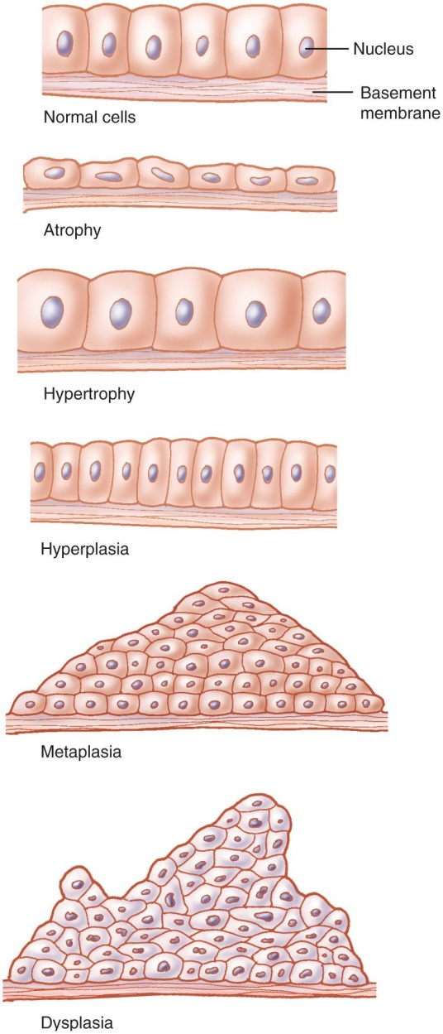
Cellular Adaptation

Slide 9
Which types of cell and tissue adaptations occurred in this case?
A woman broke her left leg; 3 weeks later, you find:
  The left leg is smaller than the right leg.
  The circumference of the right calf has increased by 2 cm.

Slide 10
Risks
Cell injury can be caused by a number of agents, including physical agents, chemicals, biologic agents, and nutritional factors.

Slide 11
Physical Agents
Among the physical agents that generate cell injury are mechanical forces that produce tissue trauma, extremes of temperature, and electrical forces.
Ionizing radiation can directly break chemical bonds, whereas nonionizing radiation exerts its harmful effects by causing vibration and rotation of atoms and molecules.

Slide 12
Chemical Agents
Chemical agents can block enzymatic pathways, cause coagulation of tissues, or disrupt the osmotic or ionic balance of the cell.

Slide 13
Biologic Agents
Biologic agents differ from other injurious agents in that they are able to replicate and continue to produce injury.
Among the nutritional factors that contribute to cell injury are excesses and deficiencies of total energy, as well as individual nutrients.

Slide 14
Injurious Agents
Injurious agents exert their effects largely through generation of reactive oxygen species (ROS) and free radicals, promotion of cell hypoxia, or impaired regulation of intracellular calcium levels.
Free radicals are an important cause of cell injury in hypoxia and after exposure to radiation and certain chemical agents.

Slide 15
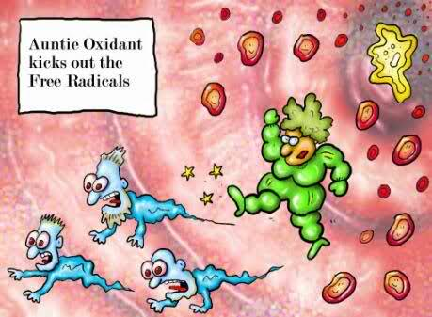
Free Radicals

Slide 16
Free Radicals
Lack of oxygen, which underlies the pathogenesis of cell injury in hypoxia and ischemic, can result from inadequate oxygen in the air, cardiopulmonary disease, cardiorespiratory disease, anemia, or the inability of the cells to use oxygen.
Increased intracellular calcium activates a number of enzymes with potentially damaging effects.

Slide 17
Death
Injurious agents may produce sublethal and reversible cellular damage or may lead to irreversible cell injury and death.
Cell death can involve two mechanisms: apoptosis or necrosis.
Apoptosis involves controlled cell destruction and is the means by which the body removes and replaces cells that have been produced in excess, developed improperly, have genetic damage, or are worn out.
Necrosis refers to cell death that is characterized by cell swelling, rupture of the cell membrane, and inflammation.

Slide 18
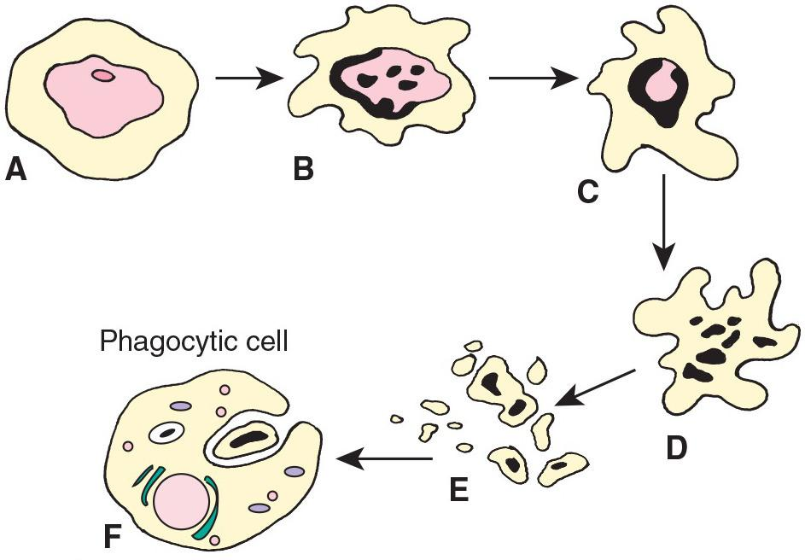
Apoptosis or Programmed Cell Death

Slide 19
Question?
True or false?
Necrotic tissue may be reversed using high concentrations of oxygen.

Slide 20
Answer
False
Rationale: Necrotic tissue is already dead, so it cannot be restored to functional tissue.

Slide 21
Gangrene
Dry gangrene: lack of arterial blood supply but venous flow can carry fluid out of tissue.
  Dry, shrinks, skin wrinkles, dark brown/black.
Wet gangrene: lack of venous flow lets fluid accumulate in tissue.
  Cold, swollen, pulseless, moist, black, odor.
Gas gangrene: Clostridium infection.
  Hydrogen sulfide bubbles in muscle.

Slide 22
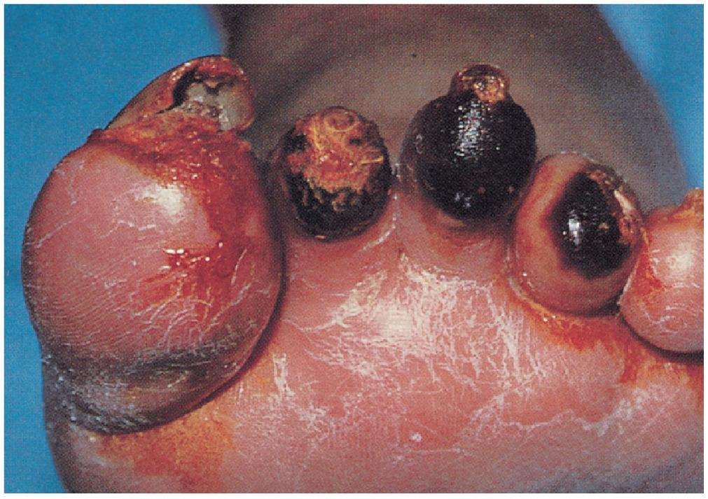
Gangrene

Slide 23
Question?
Which type of gangrene results in crepitus (bubbles that can be felt under the skin)?
  Dry
  Wet
  Gas
  All of the above

Slide 24
Answer
C. Gas
Rationale: The only type of gangrene that causes crepitus is gas gangrene. The bubbles are the result of gas produced by the Clostridium infection.

Slide 25
Gerontologic Considerations
A number of body functions decline with age, including muscle strength, cardiac reserve, vital capacity, nerve conduction time, and glomerular filtration rate.
At the cellular level, oxidative phosphorylation by the mitochondria is reduced, as is the synthesis of nucleic acids and transcription factors, cell receptors, and structural and enzymatic proteins.

Slide 26
Question?
How does hypoxia cause cell damage?
  Directly damages DNA
  Diminishes ATP production
  Forms free radicals
  Increases intracellular calcium

Slide 27
Answer
B. Diminishes ATP production
Rationale: Oxygen is a key reactant for the majority of ATP production. With less oxygen, less ATP is produced, and the cell cannot function at the same level. If hypoxia is severe or prolonged, the cell will die.

Slide 28
Scenario
Two boys suffered hypoxia.
One was at a normal body temperature.
The other one was very cold.
Questions:
Which one will have a lower intracellular pH?
Which one will have more cell swelling?
Why?

