Slide 1
Basic Principles in Pharmacology

Slide 2
Pharmacology
Pharmacology: is the study of drugs, their uses and how they affect organisms
  Pharmacokinetics: describes what the body does to a drug.
  Pharmacodynamics: describes what the drug does to the body.
Notes:
Why should nurses learn pharmacology?
Preadministration assesment
Dosage and administration
Promotig therapeutic effects
Minimizing side effects ex hypoglycemia

Slide 3
A drug: any chemical that can affect living processes.

Slide 4
Properties of an ideal drug
Effective
Safe
Selective

Slide 5
Additional properties of an ideal drug
Reversible action
Predictability
Ease of administration
Freedom from drug interaction
Low cost
Chemical stability
Notes:
Maximum benefit minimum harm،

Slide 6
Most Drugs Have Three Names
Chemical
  Complicated, describes the chemical and physical properties of the drug
Generic
  Describes the active ingredient
Trade
  Assigned by the company marketing the drug
  Example:
  The chemical name for diazepam: 7-chloro-1, 3-dihydro-1-methyl-5- phenyl-2H-1, 4-benzodiazepin-2-one
  Trade name: Valium

Slide 7
Most Drugs Have Three Names
Example
  Chemical name: P-Isobutylhydratropic Acid
  Generic name: Ibuprofen
  Trade names: Trufen, Advil, Motrin…

Slide 8
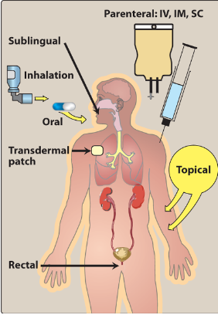
Routes of Drug Administration
Enteral
  Oral
  Sublingual
Parenteral
  Intravenous (IV)
  Intramuscular (IM)
  Subcutaneous (SC)
Other routes
  Inhalation
  Intrathecal/Intraventricular
  Topical
  Transdermal
  Rectal
Harvey, R. A. et al. Lippincott's Illustrated Reviews

Slide 9
Routes of Administration
Determined by
  Properties of the drug
    Water or lipid solubility
    Ionization
  Therapeutic objective
    Rapid onset
    Prolonged effect
    Local effect

Slide 10
Enteral Route
Oral administration:
  Advantages
    Easily self-administered
    Low risk of systemic infections (compared to parenteral)
    Easier to manage toxicity
  Disadvantages
    Inactivation of drugs due to first pass effect or stomach acidity
  Enteric coated to protect the stomach (e.g. Aspirin)
    to protect the drug from stomach acidity
  Extended release to control how fast the drug is released from the pill to the body

Slide 11
Enteral route
Sublingual: Drug diffuses into the capillary network to the systemic circulation
  Advantages
    Rapid absorption
    Convenience
    Low incidence of infection
    Bypass GI
    Bypass first pass effect

Slide 12
Parenteral route
Direct administration of the drug across body barriers into the systemic circulation
  Used for: 1. Drugs with poor GI absorption (e.g. Heparin)
  2. Drugs unstable in GI (e.g. Insulin)
  3. Unconscious patients
  4. Rapid onset of action
  5. High bioavailability
  Advantage: no first pass metabolism
  Disadvantages: Risk of infection
  Can be irreversible
Notes:
Which dose is higher IV or oral?

Slide 13
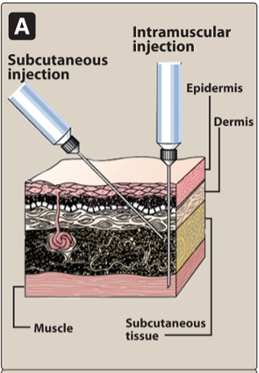
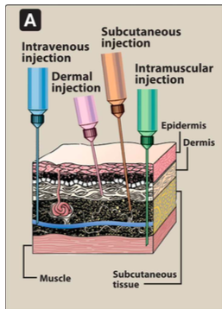
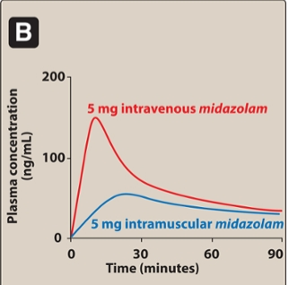
Parenteral Routes
Intravenous (IV)
  Bolus: Immediate delivery of full amount
  Infusion: Delivery over a longer time
Intramuscular
  Aqueous solution (Rapid absorption)
  Depot preparation in nonaqueous
  vehicle (Sustained dose)
Subcutaneous
  Less risk of hemolysis
  May provide sustained slow effect

Slide 14
Additional Routes
Inhalation
  Oral or nasal
  Rapid delivery across the large surface area of mucous membranes
Intrathecal/intraventricular
  Direct injection into the cerebrospinal fluid
  Rapid delivery
  To avoid the blood brain barrier
Topical: application
  Skin, for local effect.
Transdermal:
  Sustained delivery of drugs (e.g. nicotine patches)
Rectal
  Avoids first pass metabolism
  Rapid delivery
  Used when oral administration is not possible (antiemetics)

Slide 15
Pharmacology
Pharmacology: is the study of drugs, their uses and how they affect organisms
  Pharmacokinetics: describes what the body does to a drug.
  Pharmacodynamics: describes what the drug does to the body.

Slide 16
Pharmacokinetics

Slide 17
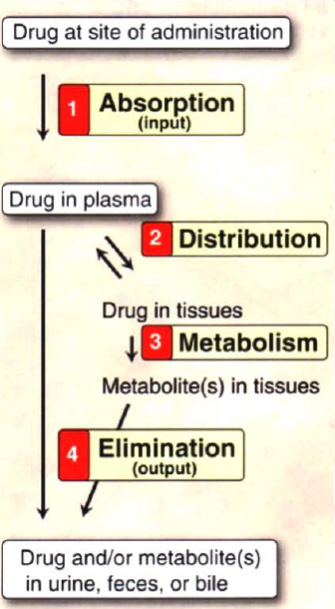
Pharmacokinetics
ADME
  Absorption
  Distribution
  Metabolism
  Elimination
Harvey, R. A. et al. Lippincott's Illustrated Reviews

Slide 18
ADME
Absorption: The drug absorption from the site of administration which permits the entry of the therapeutic agent into the plasma
Distribution: Reversible process, the drug leaves the bloodstream and distributes into the interstitial and intracellular fluids
Metabolism: Biotransformation of the drug into metabolites by the liver or other tissues
Elimination: The drug and its metabolites are eliminated into urine, bile or feces

Slide 19
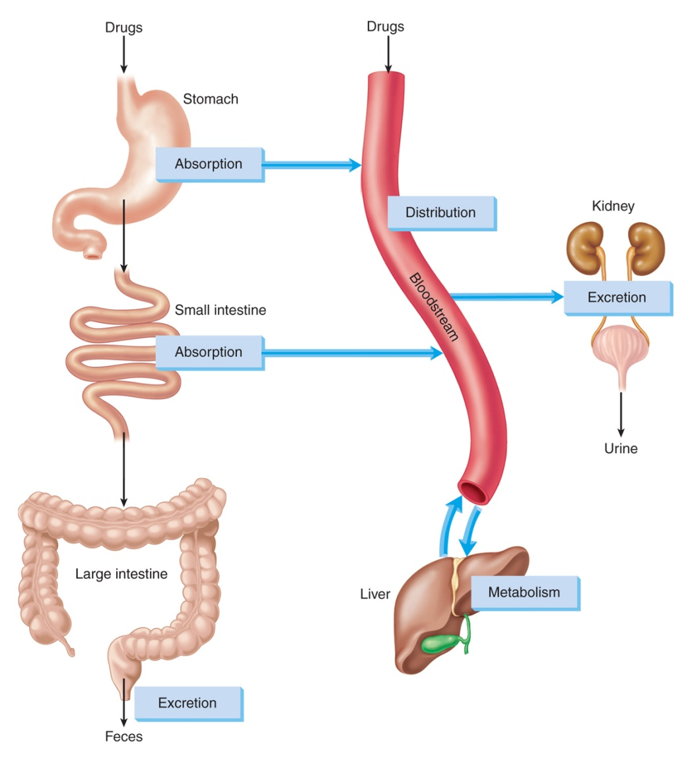
ADME
Adams et al. Pharmacology for Nurses: A Pathophysiologic Approach

Slide 20
Factors Affecting Drug Absorption
Route of administration
Drug formulation
Drug dosage
Digestive motility
Digestive tract enzymes
Blood flow at administration site
Degree of ionization of drug
pH of surrounding environment
Drug-drug interactions
Food-drug interactions
Dietary supplement/herbal product–drug interactions
Notes:
20

Slide 21
Bioavailability: The fraction of administered drug that reaches the systemic circulation.
Example 100 mg of a drug were administered orally, 70 mg of the drug were absorbed unchanged.
  The bioavailability of this drug is 0.7 or 70%
For IV drug the bioavailability is presumed to be 100%

Slide 22
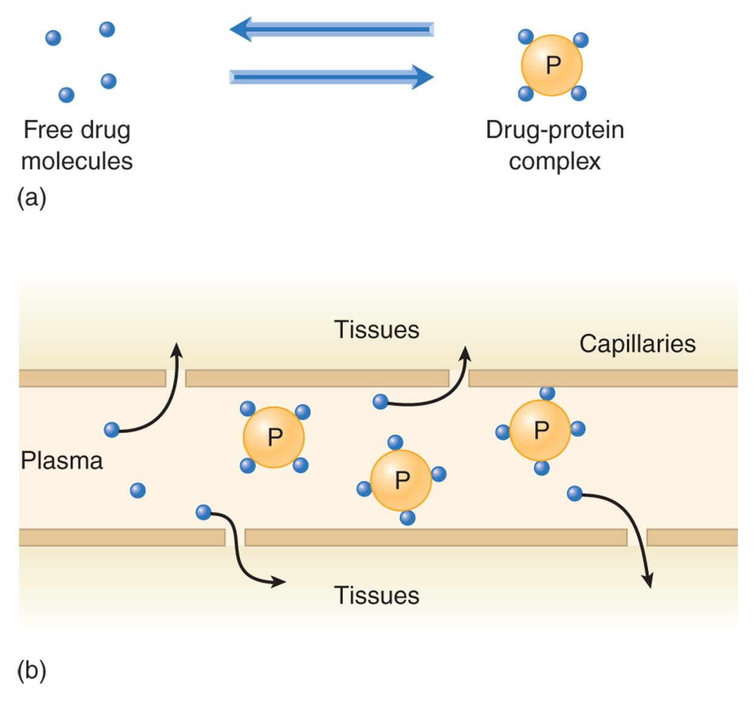
Drug Distribution
Adams et al. Pharmacology for Nurses: A Pathophysiologic Approach

Slide 23
Metabolism (Biotransformation)
Changes drug so it can be excreted
Involves biochemical reactions
Liver—primary site
Notes:
23

Slide 24
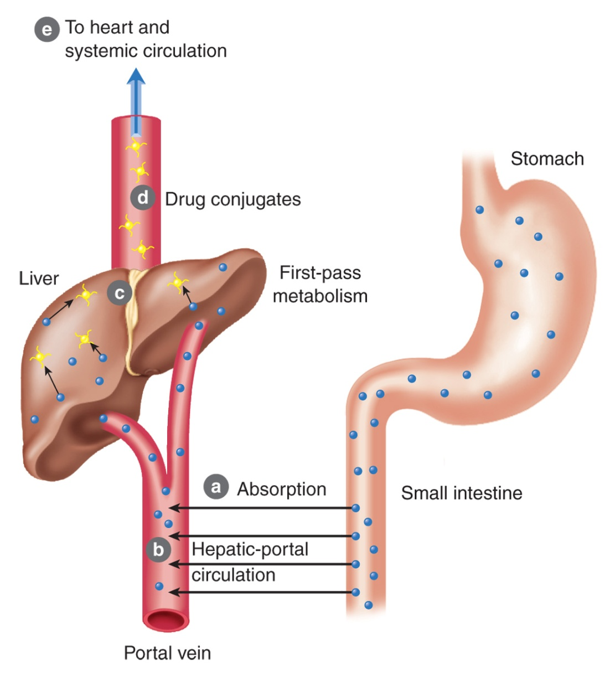
First-Pass Effect (oral drugs)
Drug absorbed
Drug enters hepatic circulation, goes to liver
Drug is metabolized to inactive form
Drug conjugates and leaves liver
Drug is distributed to general circulation
Adams et al. Pharmacology for Nurses: A Pathophysiologic Approach
Notes:
24

Slide 25
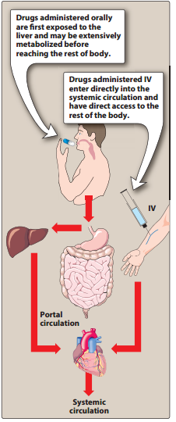

Slide 26
Excretion
Primary Site of Excretion of Drugs Is Kidneys
Ionized and water-soluble drugs are filtered
Secretion mechanism is less active in infants and older adults
Notes:
26

Slide 27
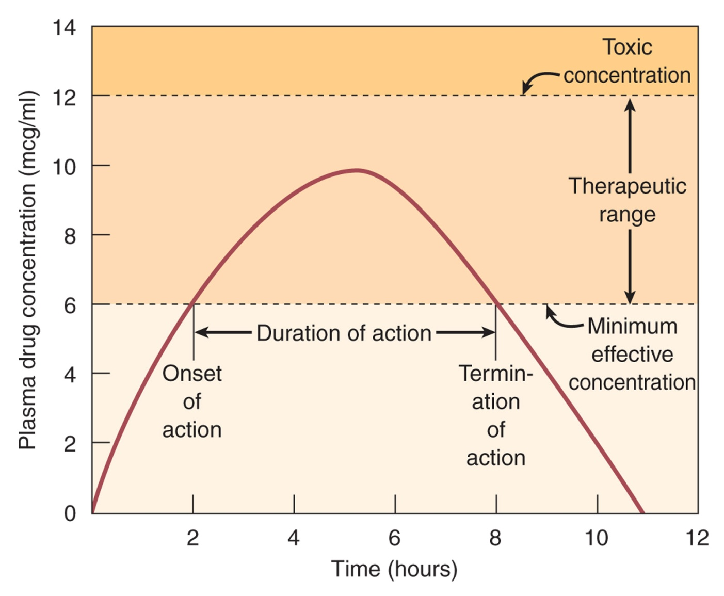
Adams et al. Pharmacology for Nurses: A Pathophysiologic Approach

Slide 28
Plasma Half-Life (t_{1/2}) of Drugs
Length of time needed to decrease drug plasma concentration by one half
The greater the half-life, the longer it takes to excrete
Determines frequency and dosages
Notes:
28

Slide 29
Pharmacodynamics

Slide 30
Pharmacodynamics
Pharmacodynamics: The action of a drug on the body and the influence of drug concentration on the magnitude of response
Most drugs cause their effects by interacting with Receptors (drug target)
Receptors are present on the cell surface or within the cell

Slide 31
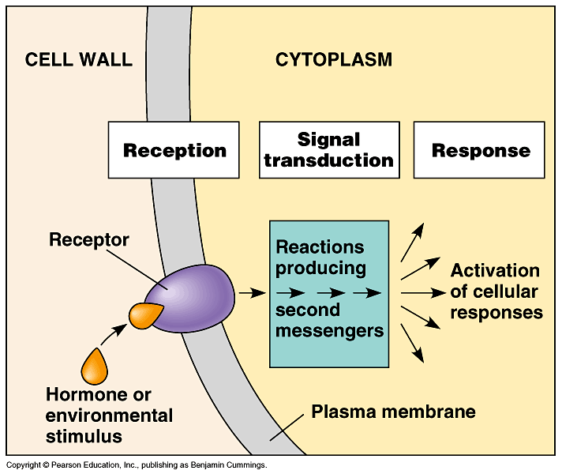

Slide 32
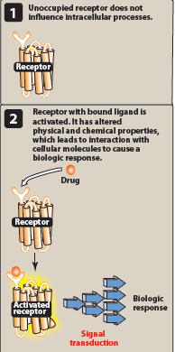
Signal transduction
The process by which the drug receptor complex initiates alterations in biochemical or molecular activity of a cell
Harvey, R. A. et al. Lippincott's Illustrated Reviews

Slide 33
Agonist: An agent that binds to a receptor and causes a biological response
Antagonist: An agent (drug) that decreases or opposes the actions of another drug or endogenous ligand
An antagonists binds to a receptor and blocks its physiologic response
(e.g. Antihistamine, used for allergy)

Slide 34
Agonist: An agent that binds to a receptor and cause a biological response
Agonist: mimics the action of the original endogenous ligand on the receptor
(e.g. Norepinephrine on β-1 receptor of the heart)

Slide 35
The magnitude of the drug effect depends on:
  The concentration of the drug at the receptor site which depends on:
      The dose of the drug administered
      The rate of the drug’s ADME

Slide 36
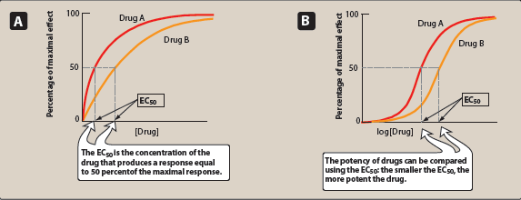
Dose Response curves
Potency: A measure of the amount of a drug needed to produce an effect of a given magnitude
Harvey, R. A. et al. Lippincott's Illustrated Reviews

Slide 37
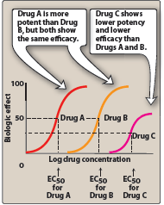
Efficacy: The ability of a drug to produce a response when it interacts with a receptor
EC50: The drug concentration that shows 50% of maximal response
Harvey, R. A. et al. Lippincott's Illustrated Reviews

Slide 38
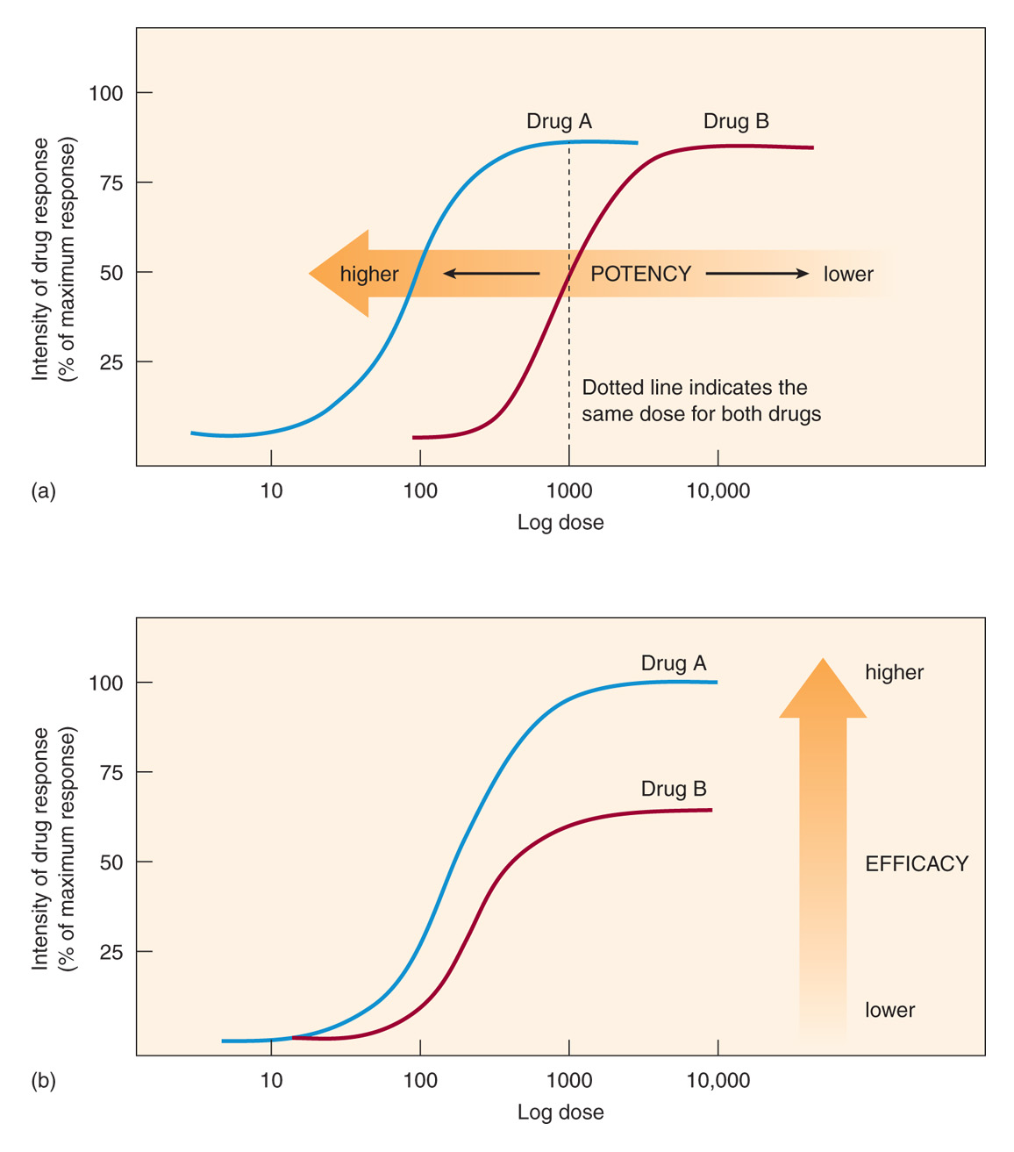
Adams et al. Pharmacology for Nurses: A Pathophysiologic Approach

Slide 39
Therapeutic index of a drug: the ratio of the dose that produces toxicity to the dose that produces a clinically desired or effective response in 50% of the population
Therapeutic index=
  TD50: the drug dose the produces a toxic effect in 50% of the population
  ED50: the drug dose the produces a therapeutic effect in 50% of the population
TD50
ED50

Slide 40
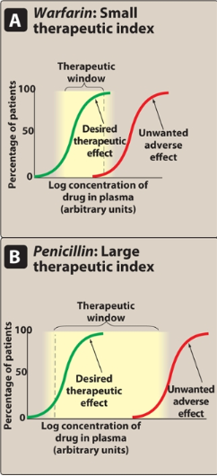
Therapeutic index is a measure of drug safety
A narrow therapeutic index drug
  (e.g. warfarin, digoxin)
A large therapeutic index drug
  more safe to use
  (e.g. penicillin)
Harvey, R. A. et al. Lippincott's Illustrated Reviews

