Slide 1
Interfacing Circuits
Measurement of resistance
Voltage dividers
Wheatstone Bridge
Temperature compensation for strain gauges
AC bridges
Measurement of capacitance
Measurement of impedance
Amplifier Transistor
Diodes
Regulators
BJT
MOSFET

Slide 2
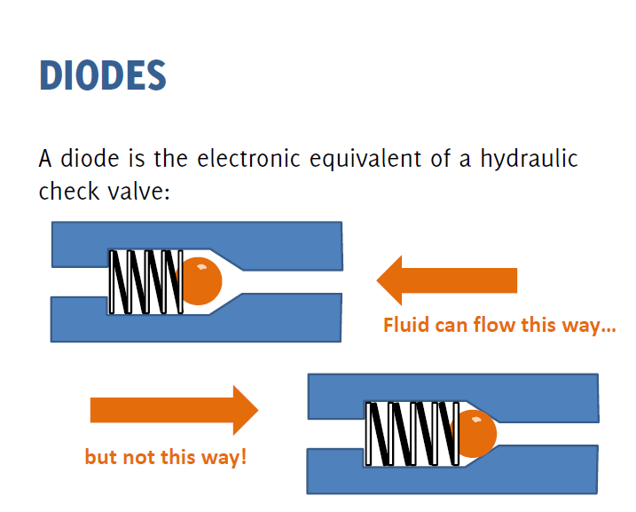

Slide 3
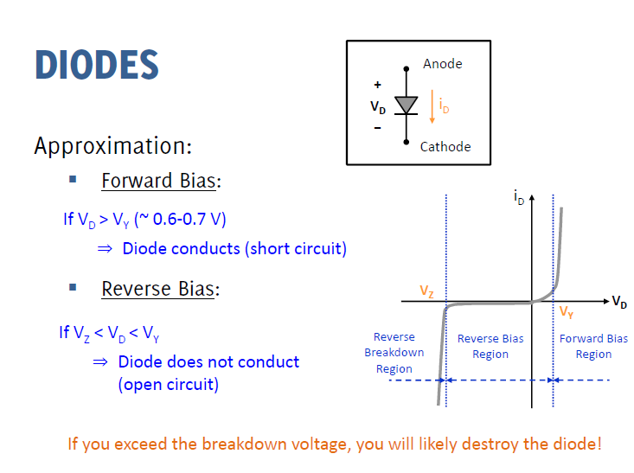

Slide 4
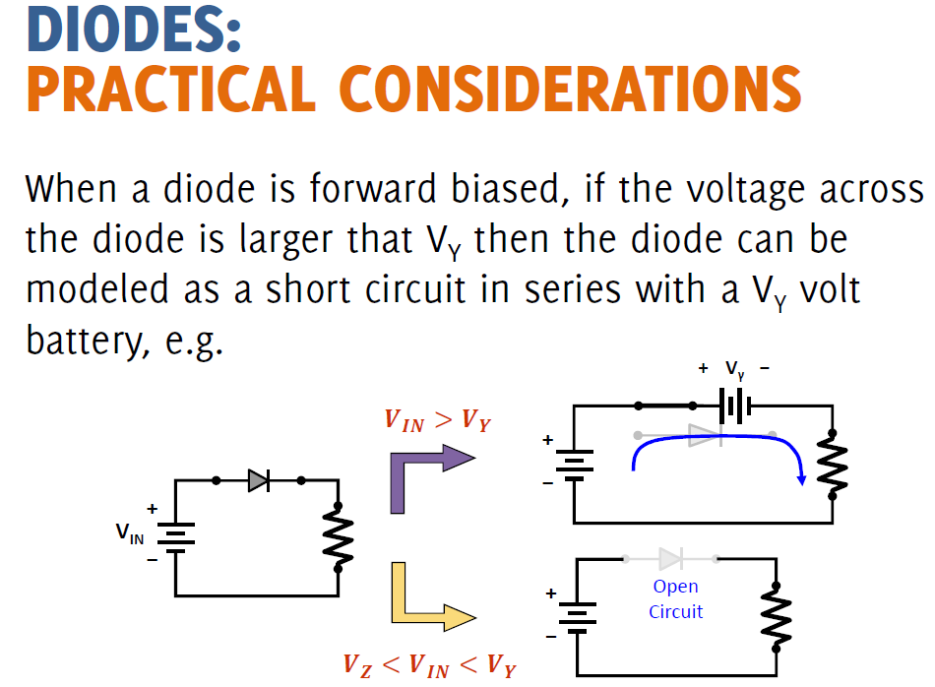

Slide 5
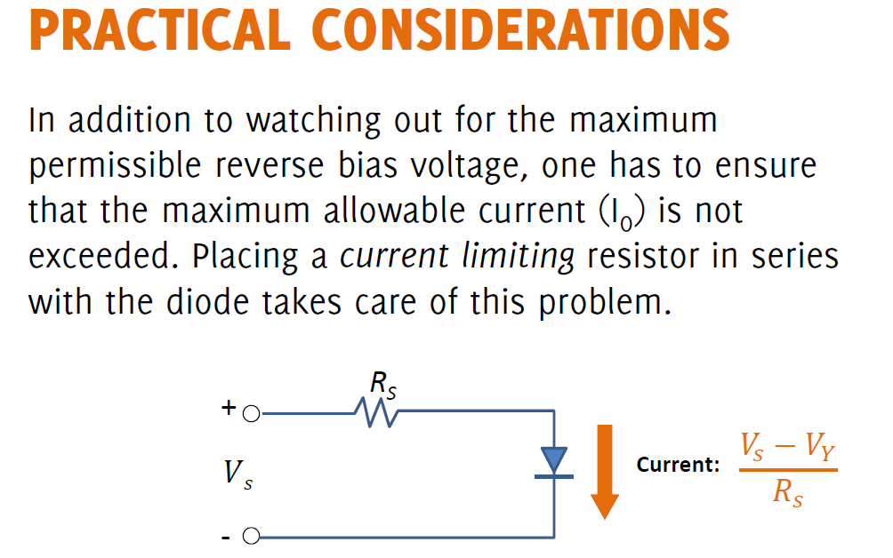

Slide 6
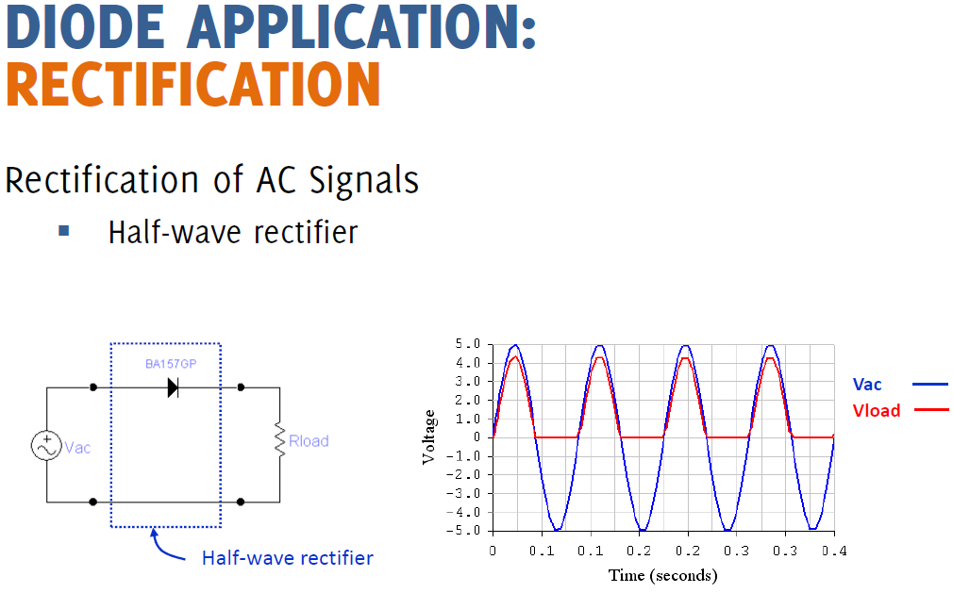

Slide 7
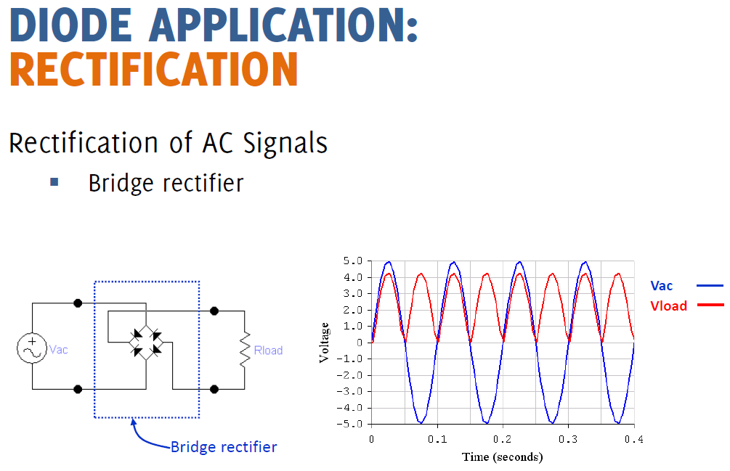

Slide 8
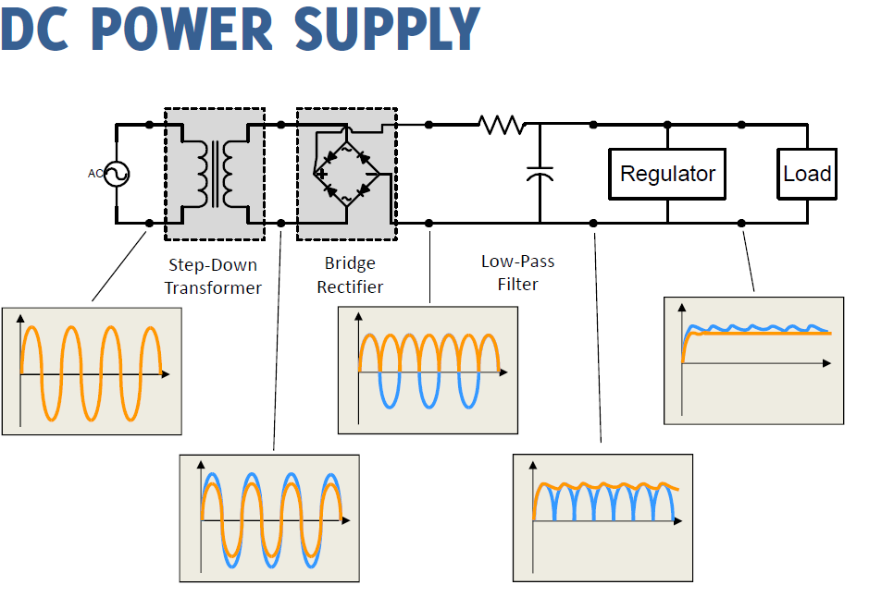

Slide 9
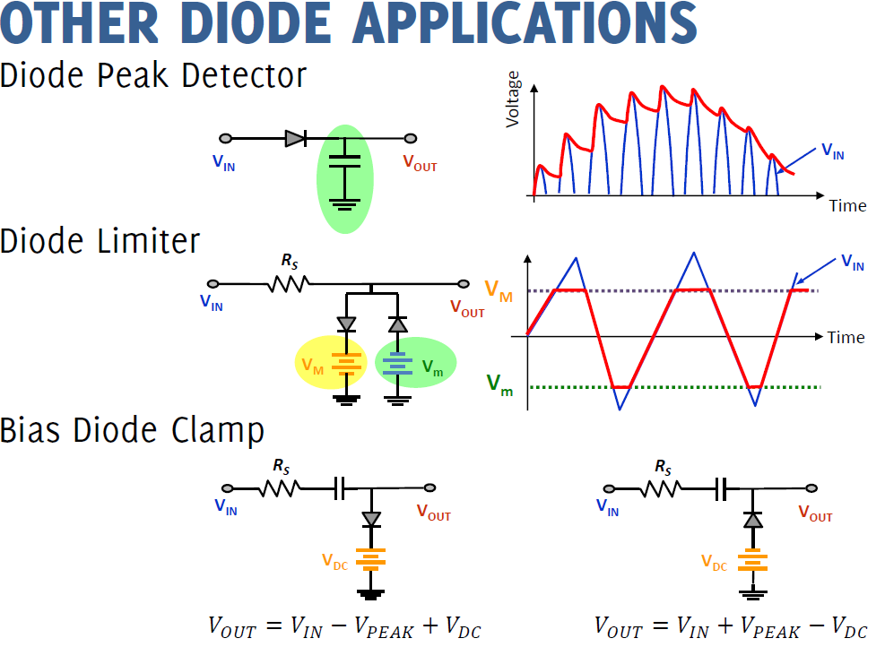

Slide 10
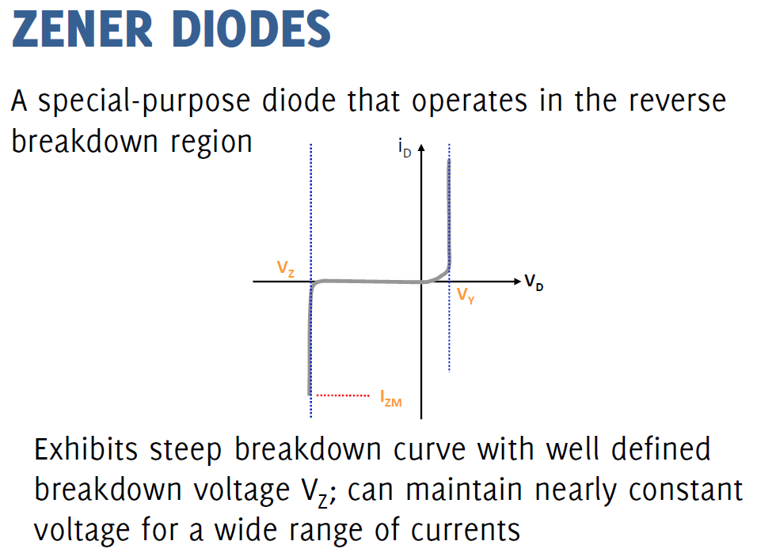

Slide 11
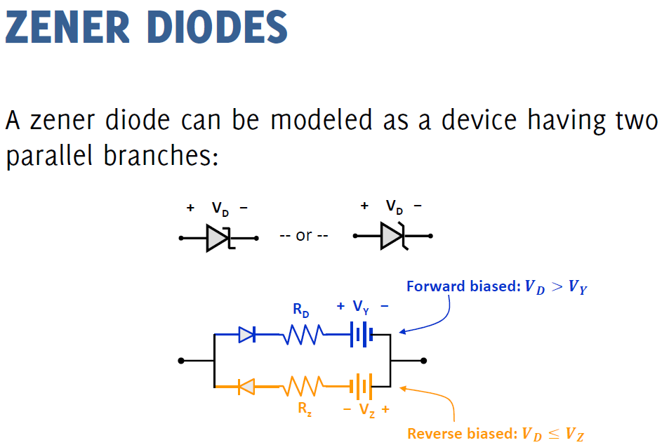

Slide 12
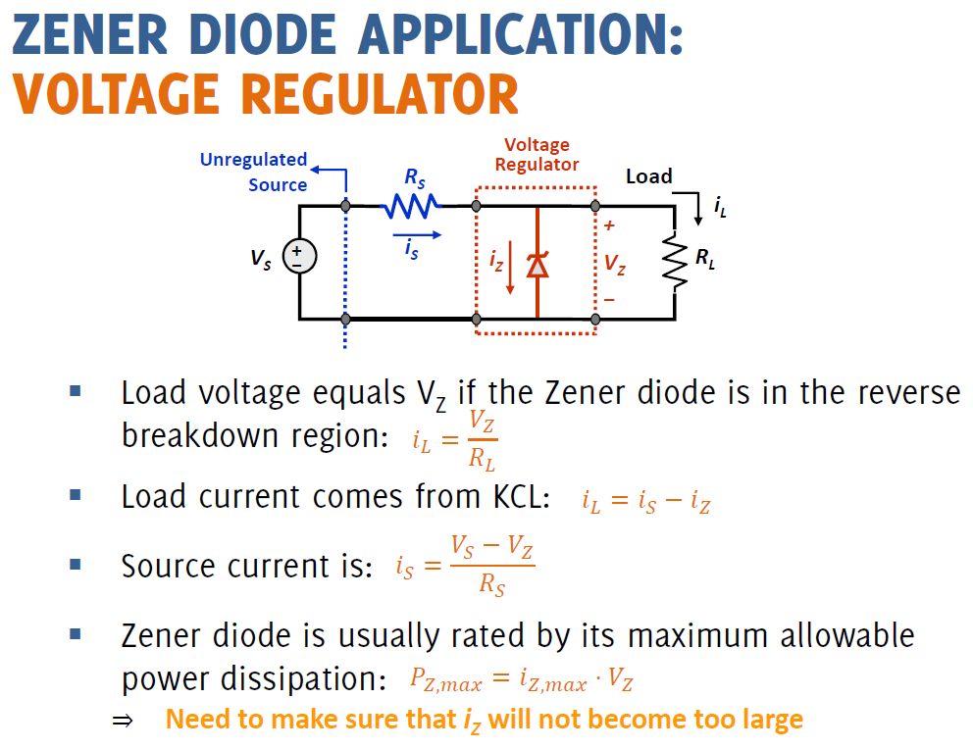

Slide 13
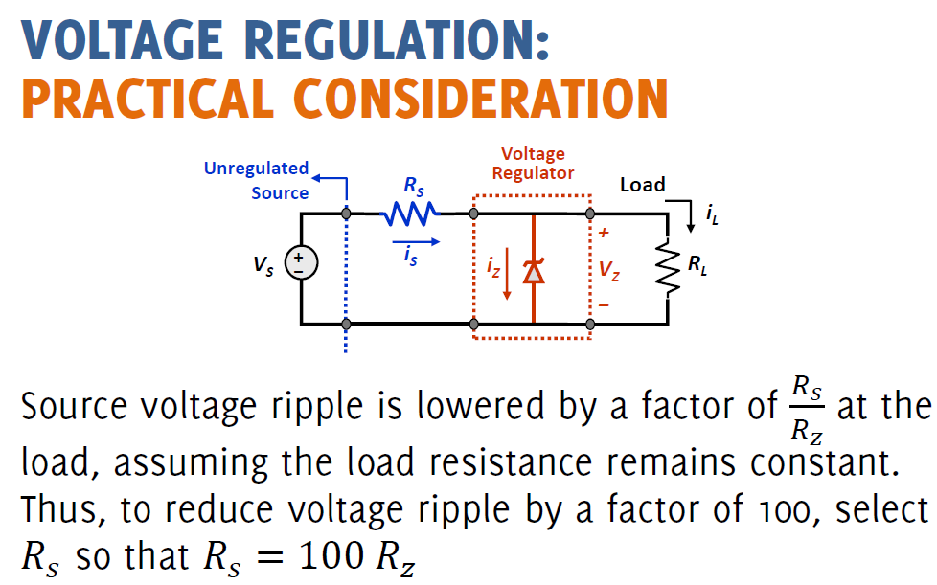

Slide 14
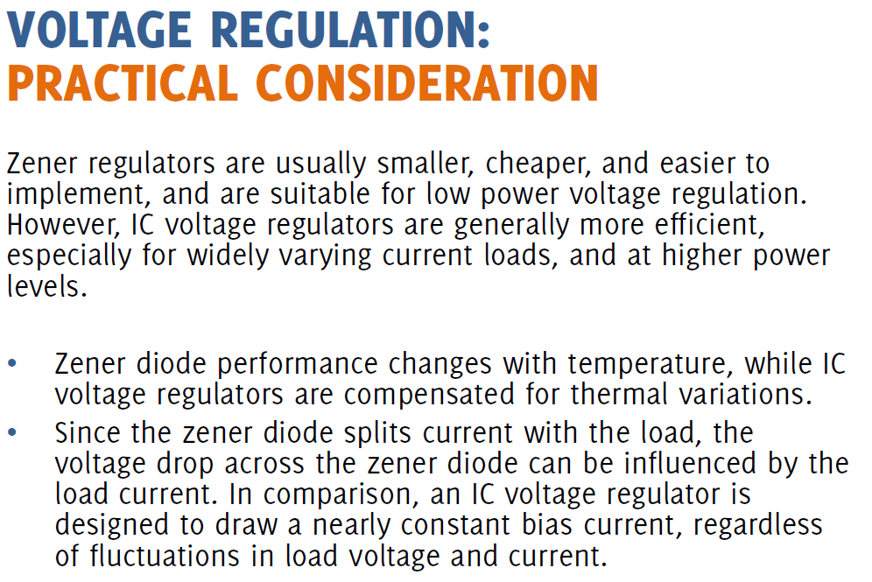

Slide 15
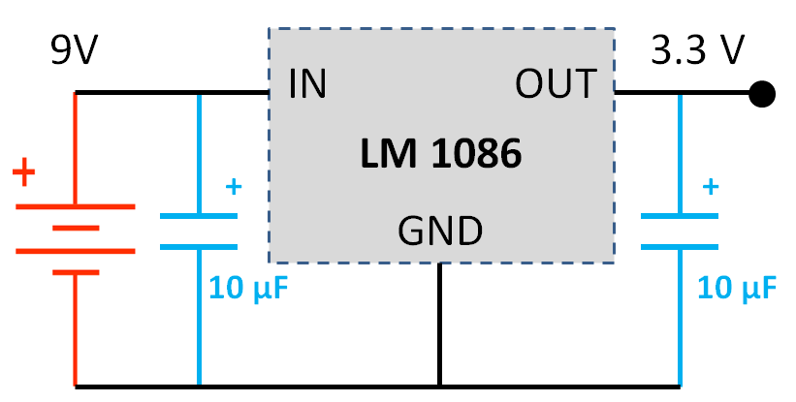
Voltage Regulator

Slide 16
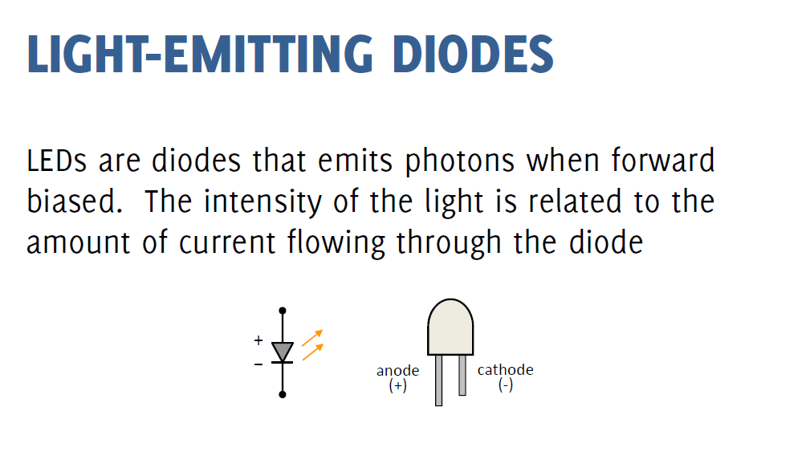

Slide 17
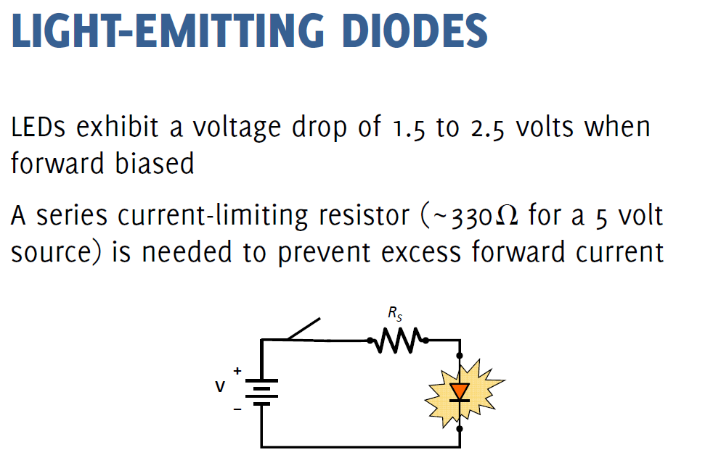

Slide 18
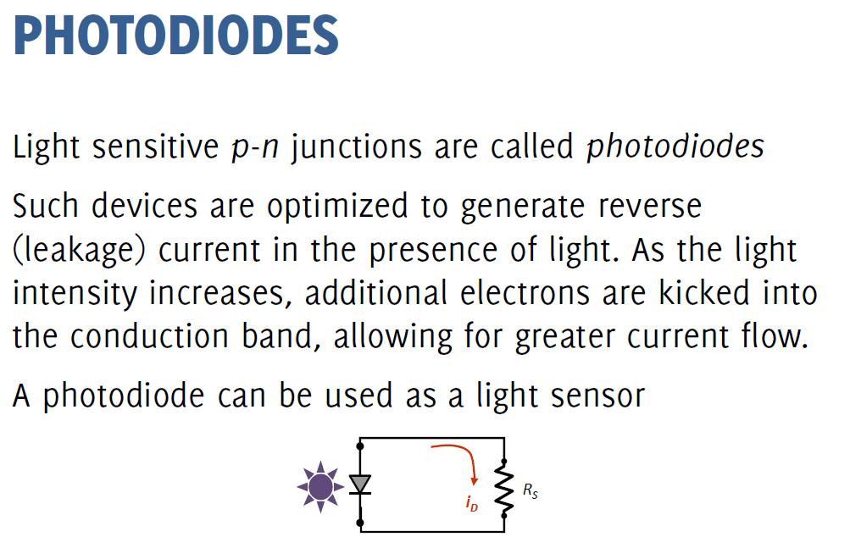

Slide 19
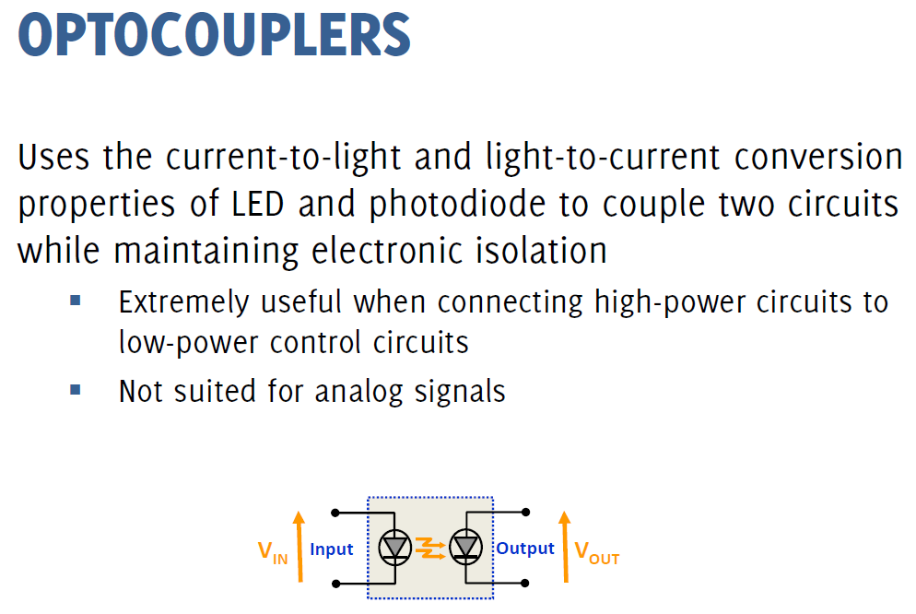

Slide 20
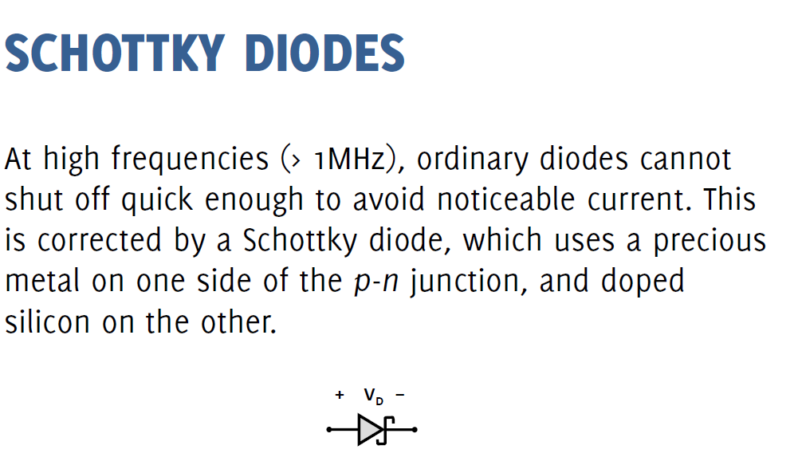

Slide 21
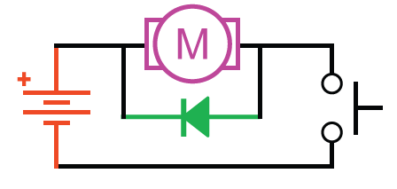
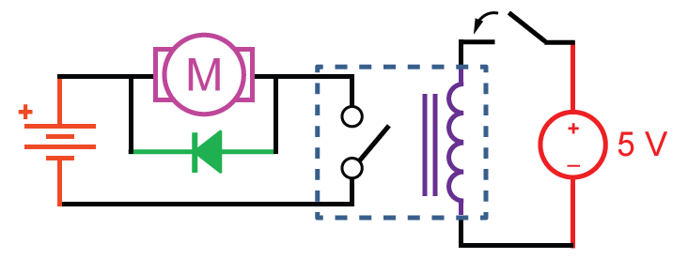
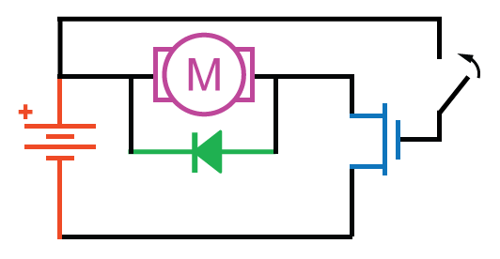
Switches
Relay Motor drive
Pushbottom Motor drive
MOSLFET Motor drive
Notes:
Pushbottom Motor drive

Slide 22
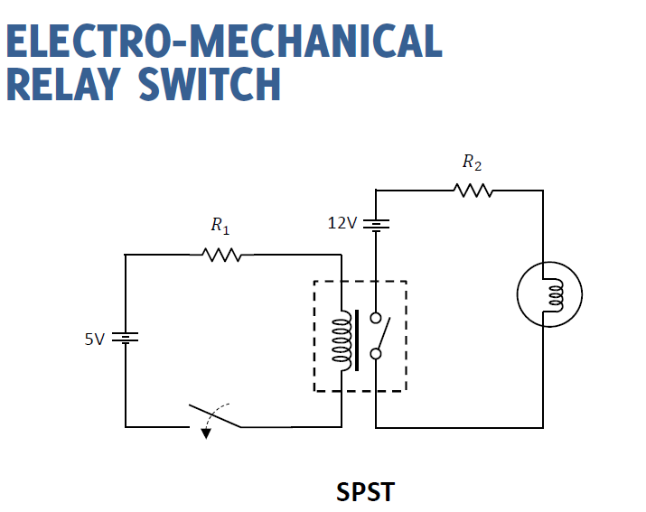

Slide 23
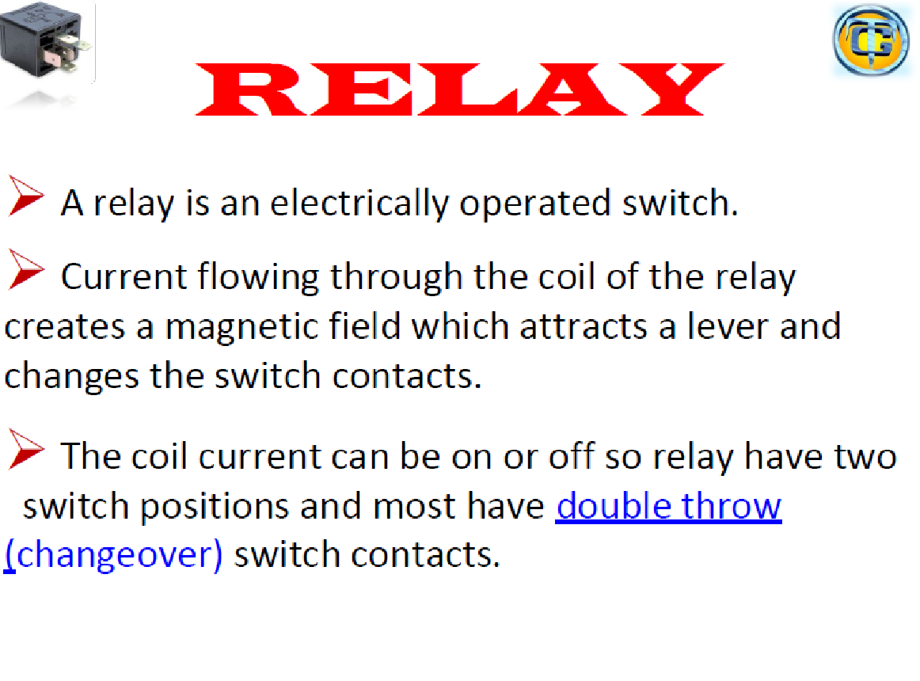

Slide 24
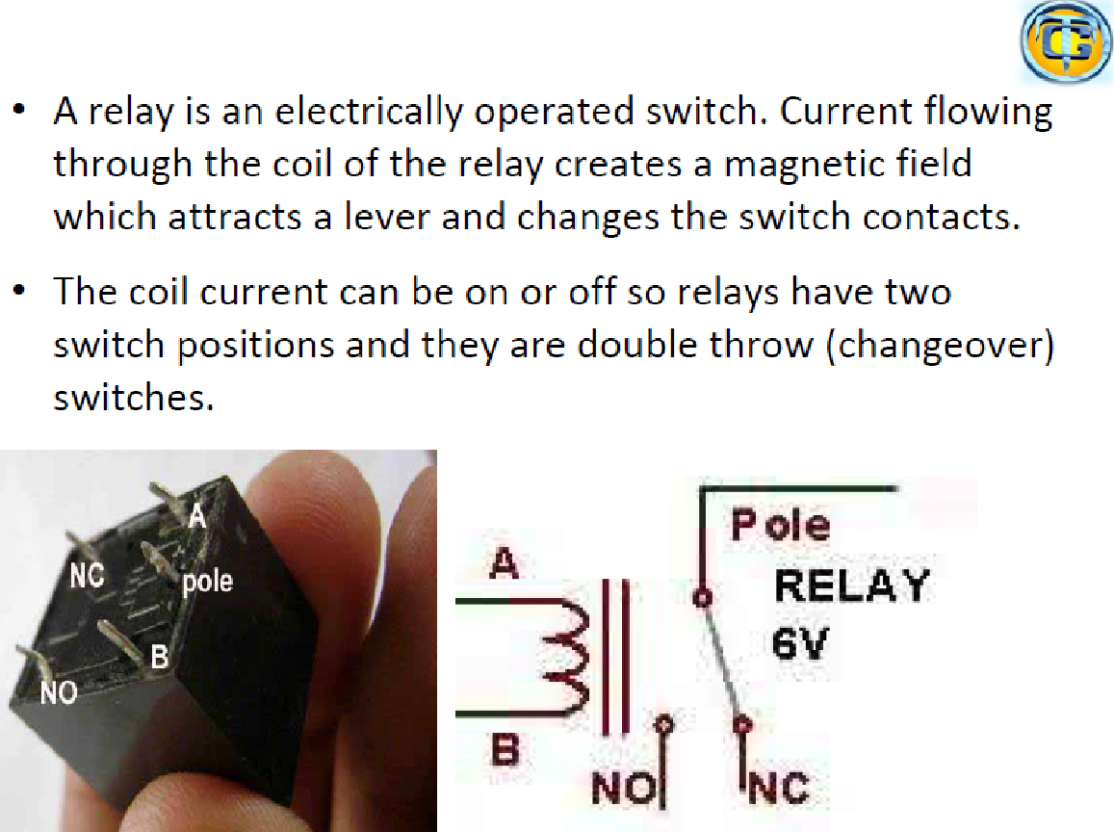

Slide 25
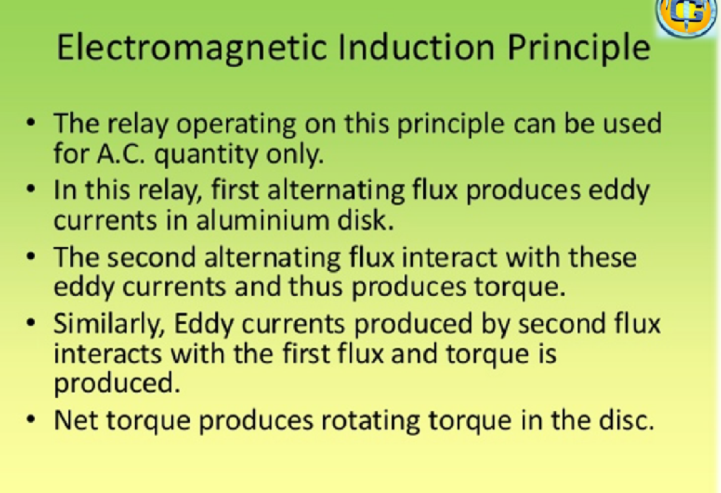

Slide 26
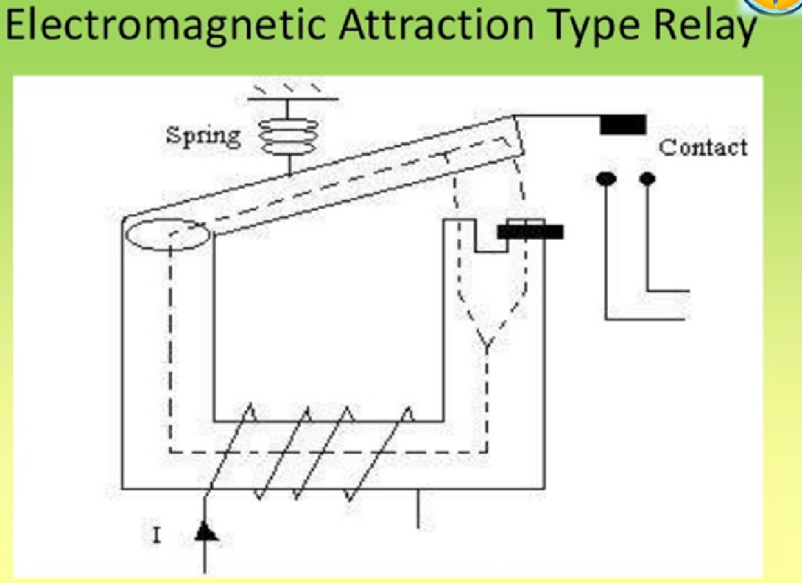

Slide 28
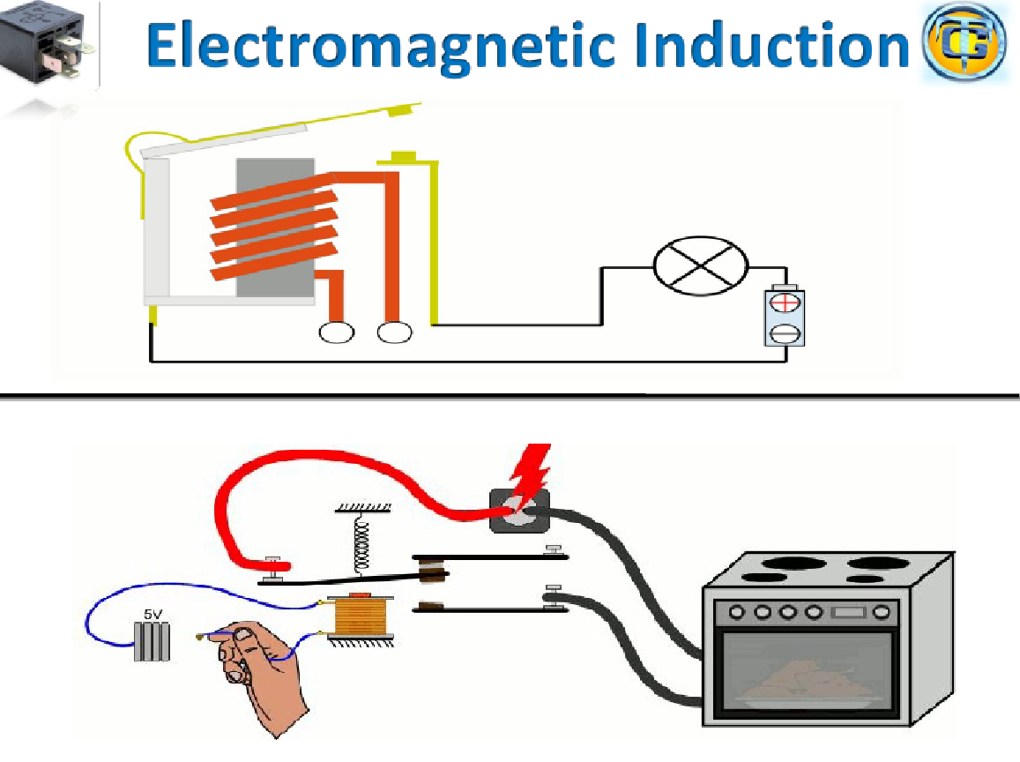

Slide 29
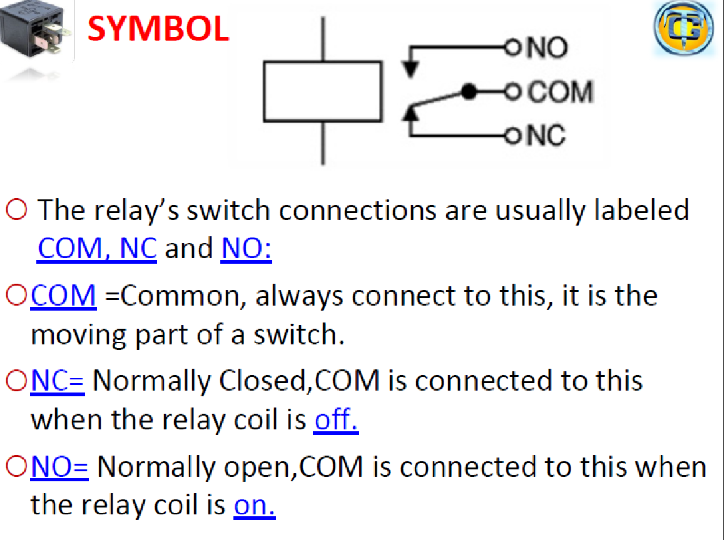

Slide 30
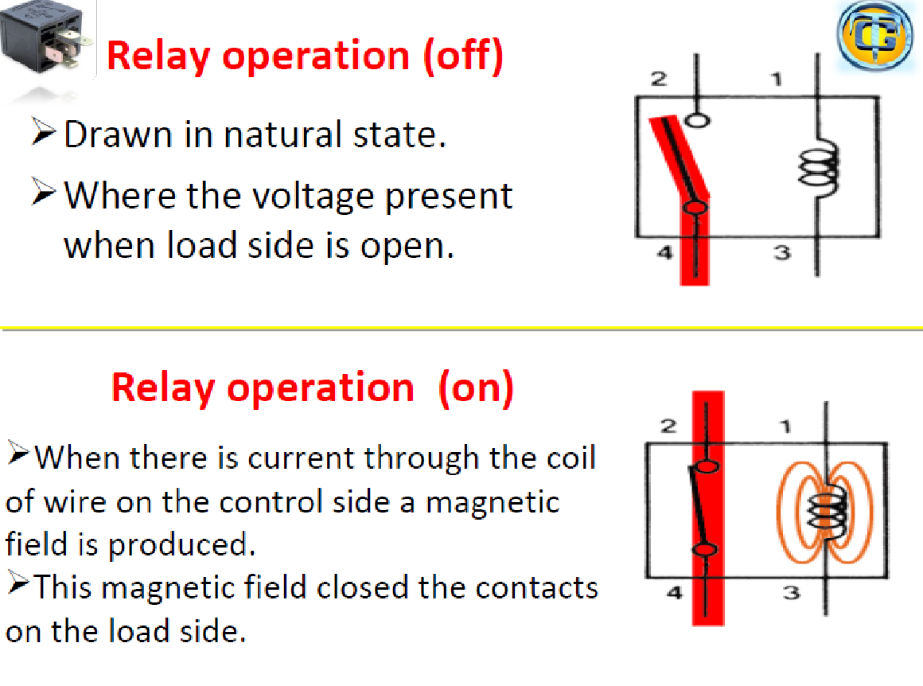

Slide 31
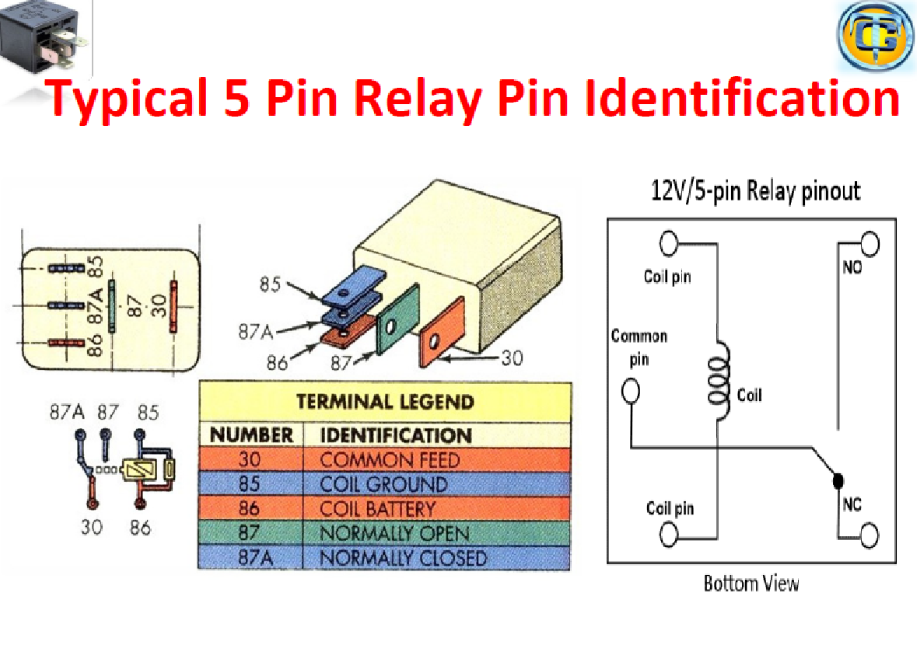

Slide 32
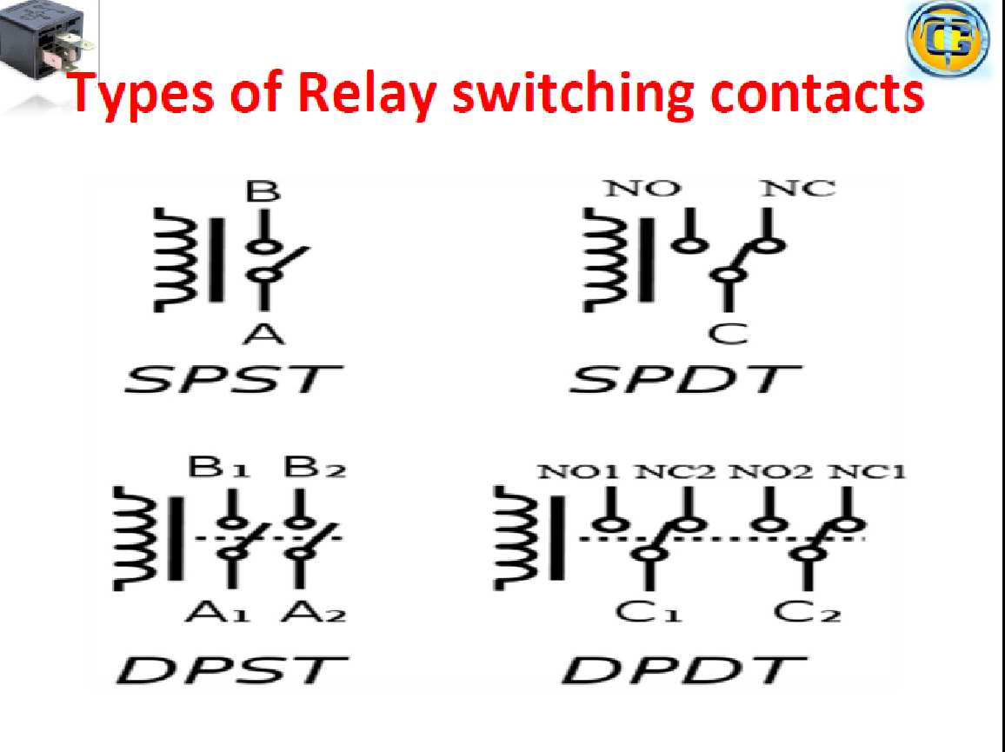

Slide 33
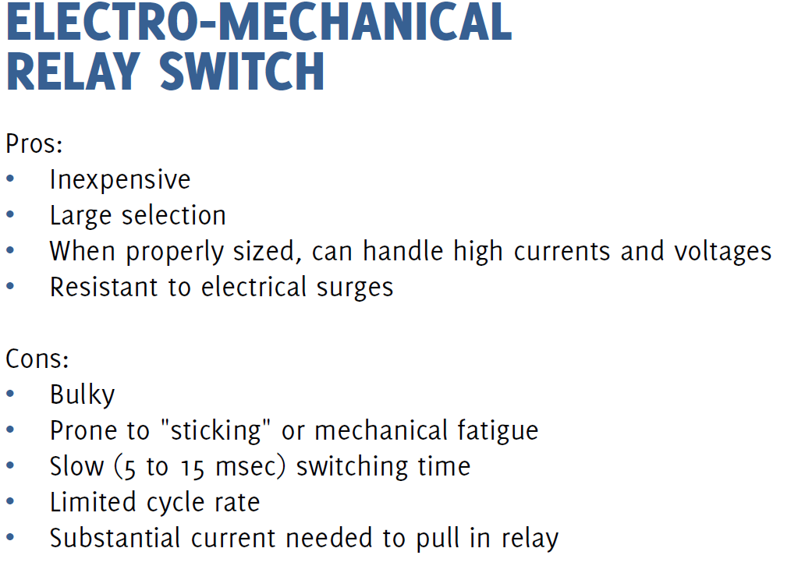

Slide 34
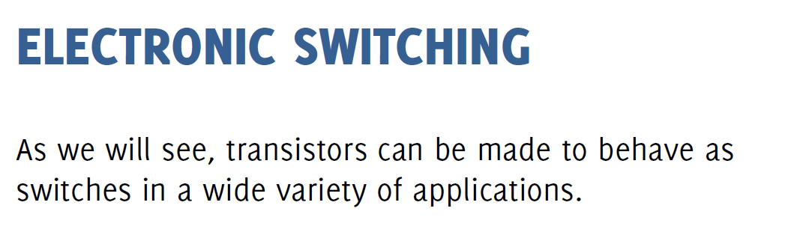

Slide 35
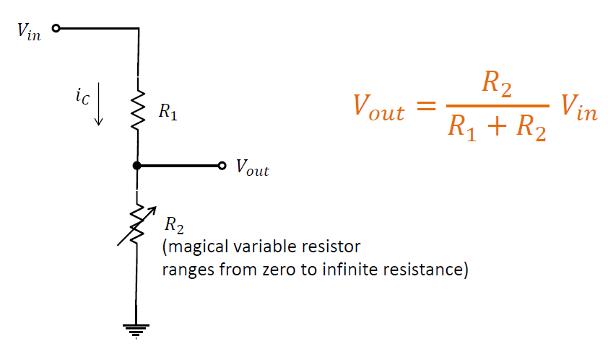

Slide 36
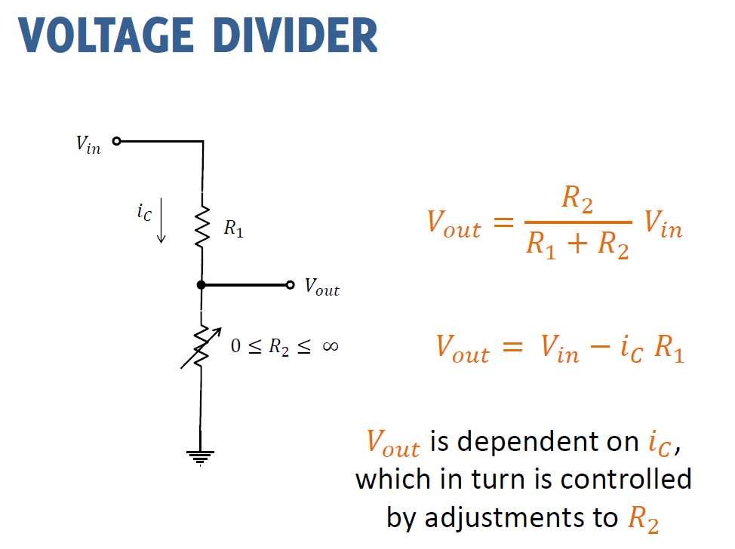

Slide 37
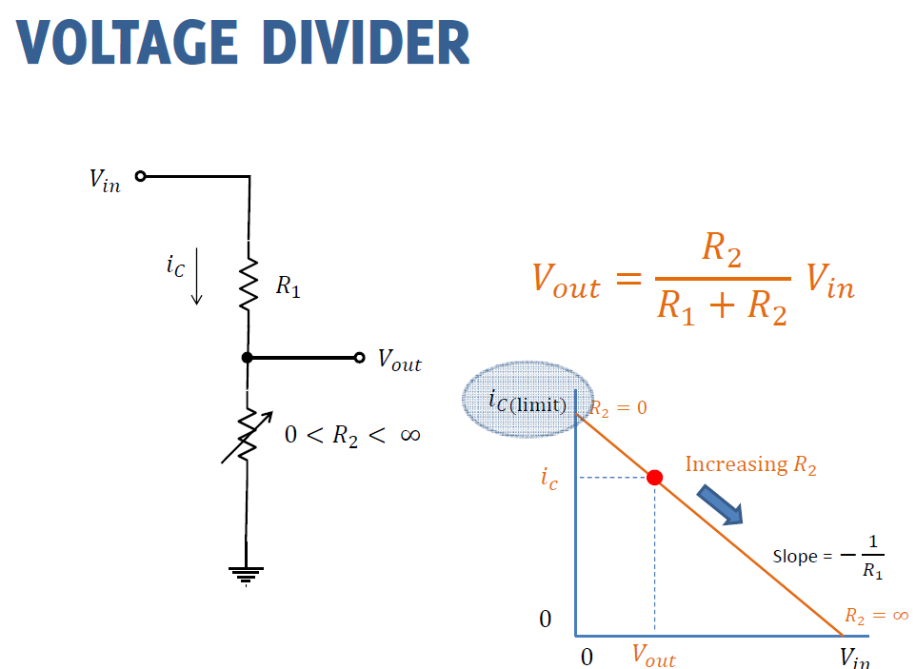

Slide 38
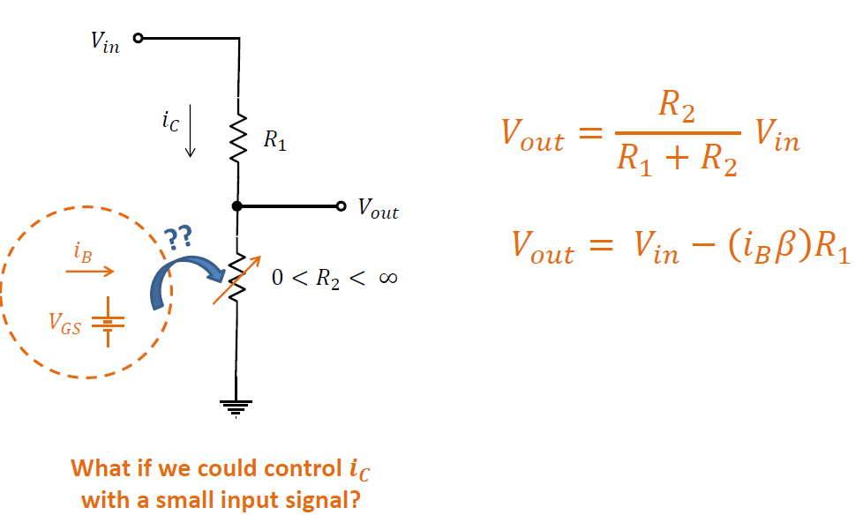

Slide 39
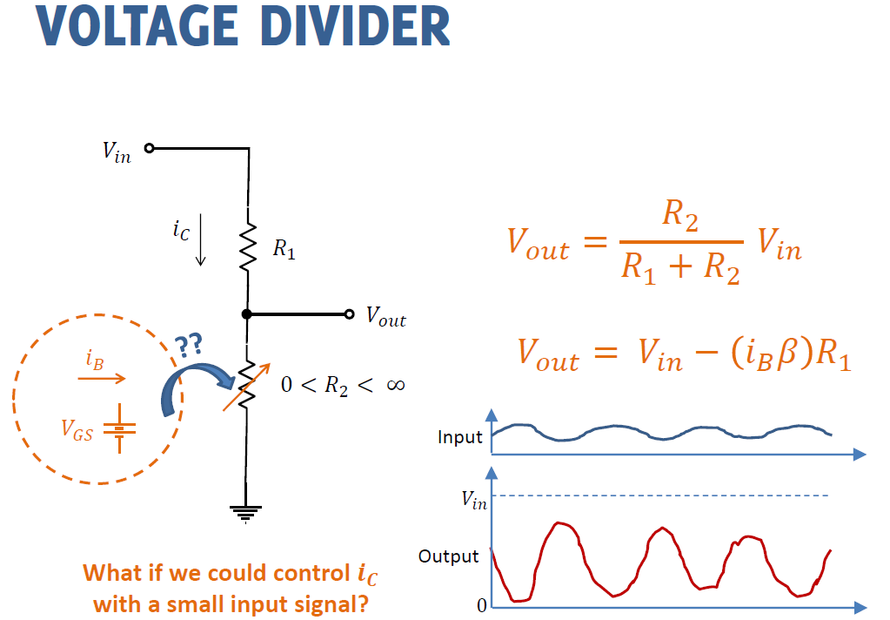

Slide 40
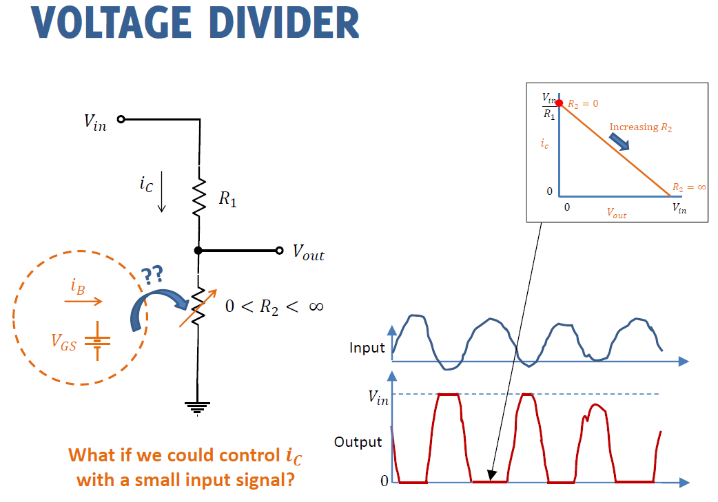

Slide 41
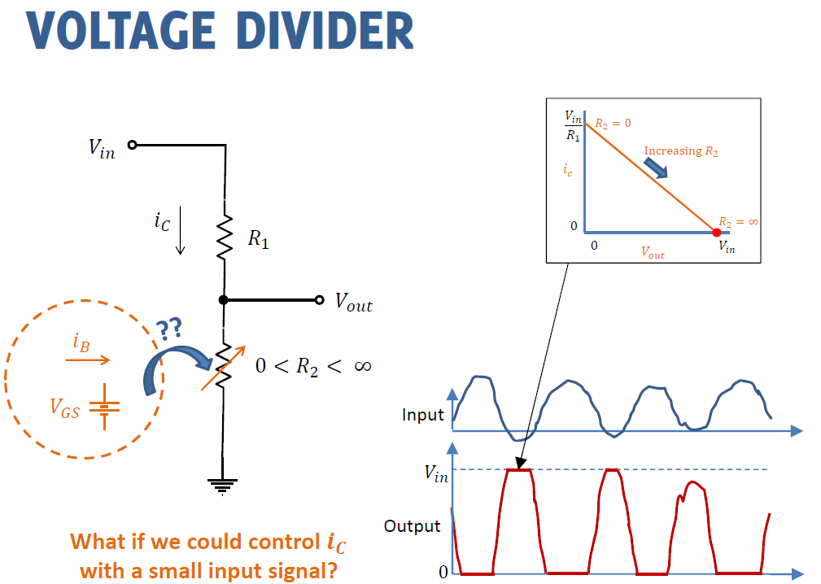

Slide 42
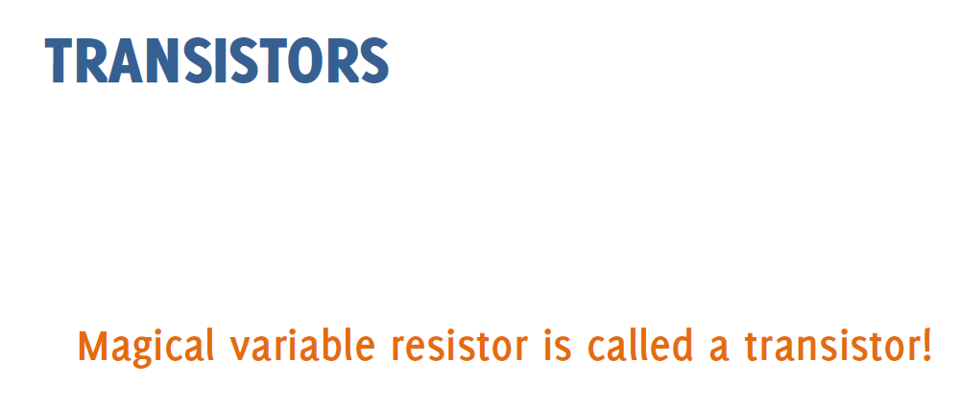

Slide 43
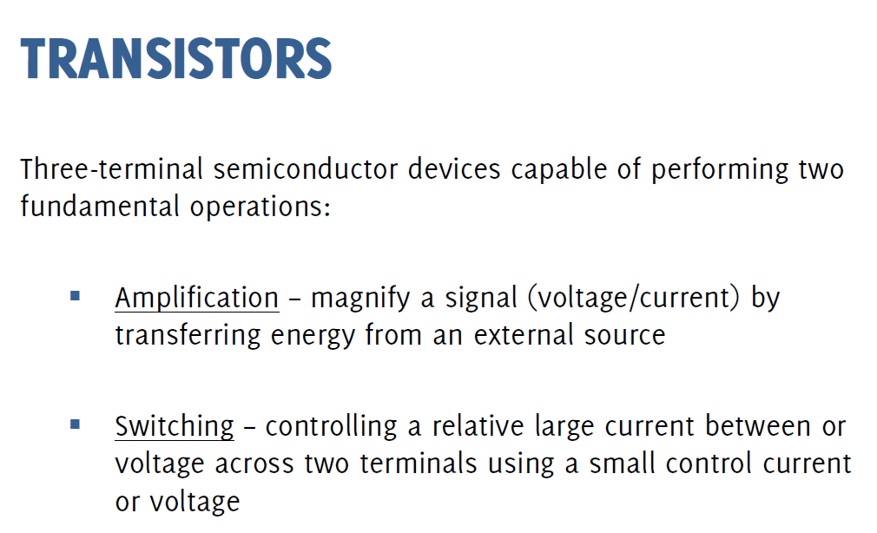

Slide 44
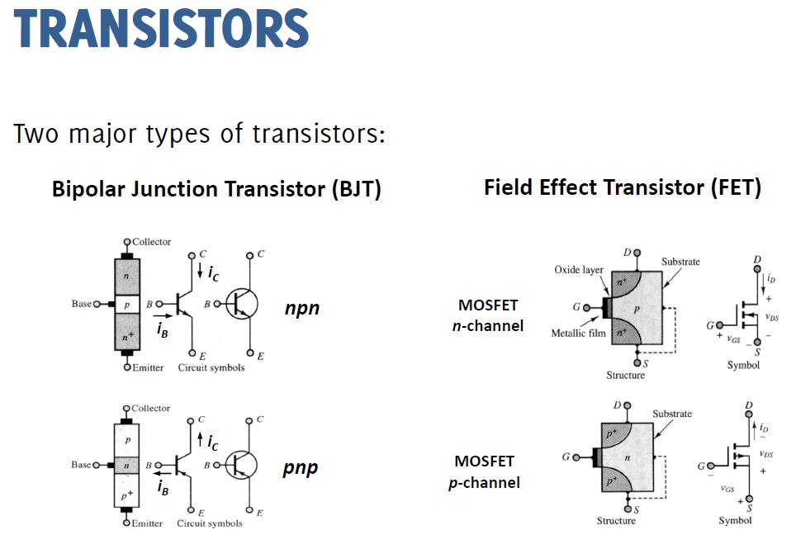

Slide 45
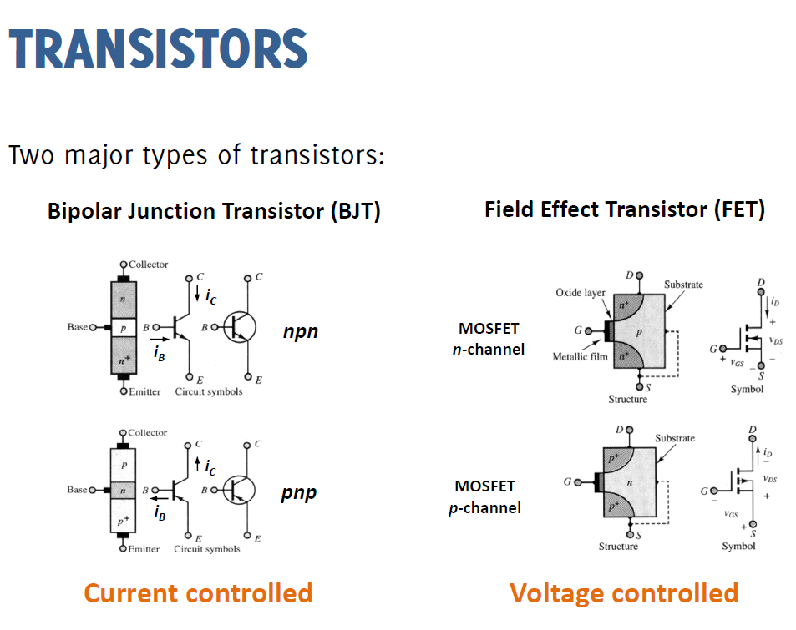

Slide 46
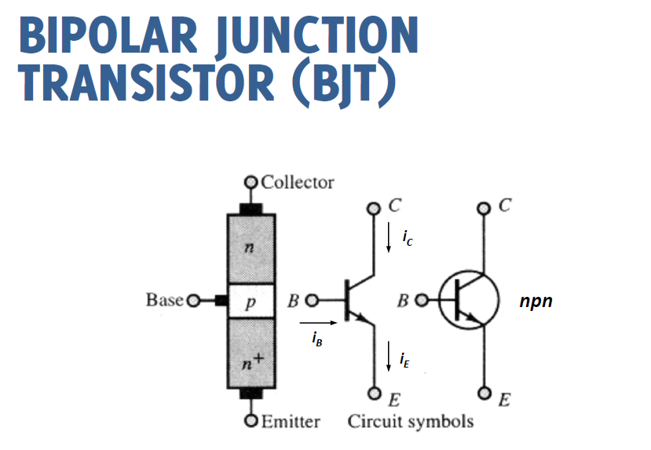

Slide 47
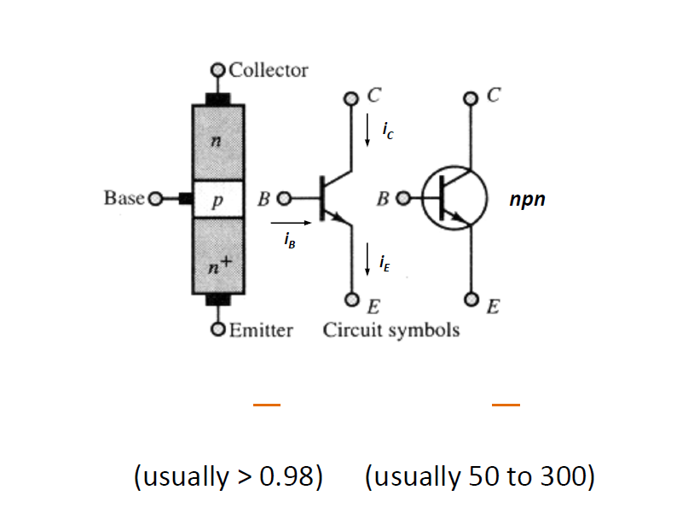

Slide 48
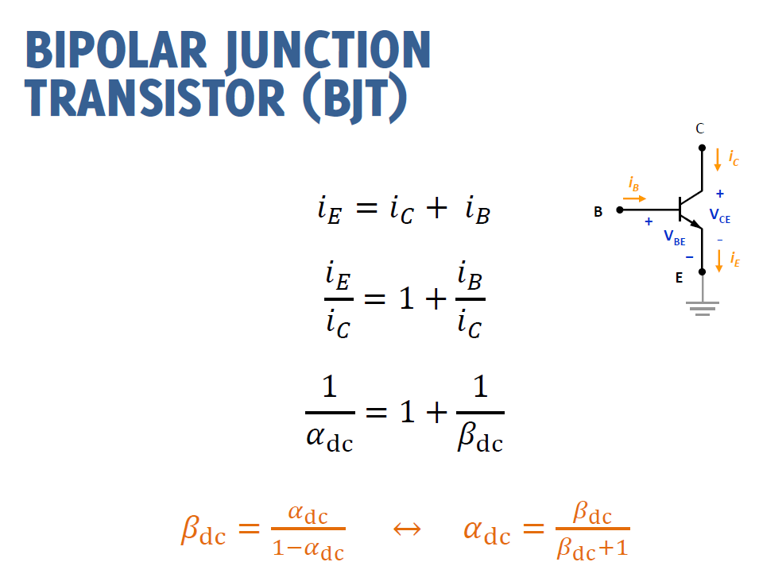

Slide 49
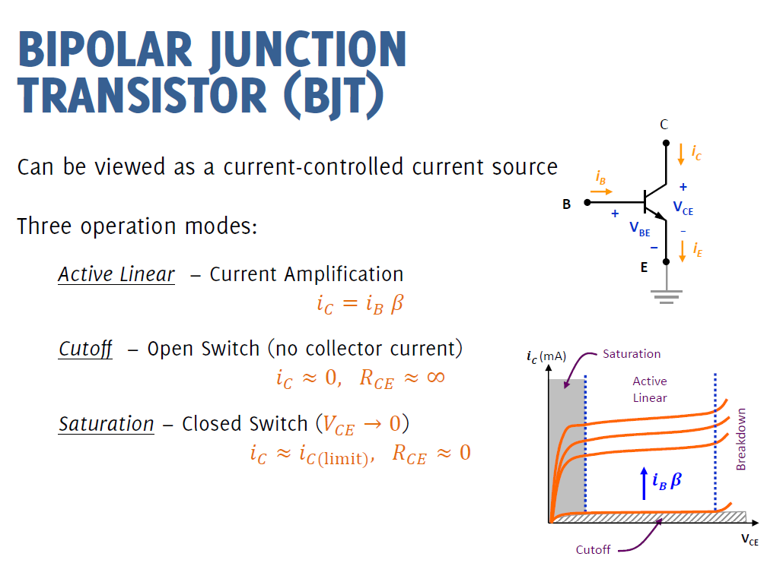

Slide 50
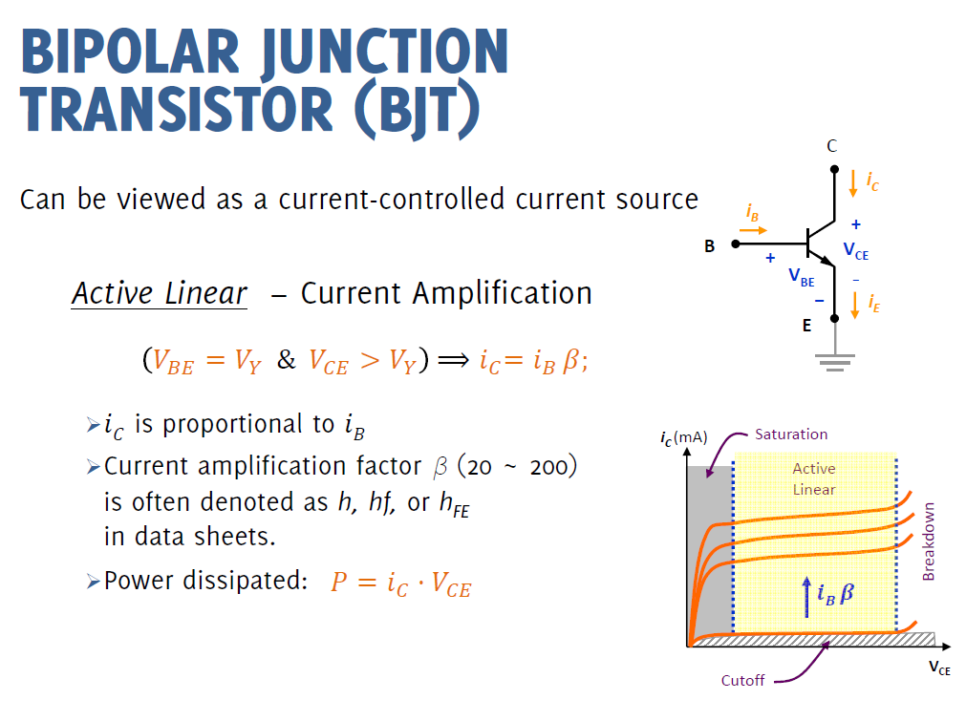

Slide 51


Slide 52


Slide 53


Slide 54


Slide 55


Slide 56


Slide 57


Slide 58


Slide 59


Slide 60


Slide 61


Slide 62


Slide 63


Slide 64


Slide 65


Slide 66


Slide 67


Slide 68


Slide 69


Slide 70


Slide 71


Slide 72


Slide 73


Slide 74


Slide 75


Slide 76


Slide 77


Slide 78


Slide 79



Slide 80


Slide 81


Slide 82


Slide 83



Slide 84


Slide 85


Slide 86


Slide 87


https://howtomechatronics.com/tutorials/arduino/arduino-dc-motor-control-tutorial-l298n-pwm-h-bridge/

Slide 88

L298N IC H-bridge
Input1 | Input2 | Spinning Direction
Low(0) | Low(0) | Motor OFF
High(1) | Low(0) | Forward
Low(0) | High(1) | Backward
High(1) | High(1) | Motor OFF
https://lastminuteengineers.com/l298n-dc-stepper-driver-arduino-tutorial/

Slide 89


After defining the pins, in the loop section, we start with reading the joystick X and Y axis values. The joystick is actually made of two potentiometers which are connected to the analog inputs of the Arduino and they have values from 0 to 1023. When the joystick stays in its center position the value of both potentiometers, or axes is around 512.
int xAxis = analogRead(A0); // Read Joysticks X-axis
int yAxis = analogRead(A1); // Read Joysticks Y-axis

Slide 90
Speed Control of Robot backward
We will add a little tolerance and consider the values from 470 to 550 as center. So if we move the Y axis of joystick backward and the value goes below 470 we will set the two motors rotation direction to backward using the four input pins. Then, we will convert the declining values from 470 to 0 into increasing PWM values from 0 to 255 which is actually the speed of the motor.
// Y-axis used for forward and backward control
if (yAxis < 470) {
// Set Motor A backward
digitalWrite(in1, HIGH);
digitalWrite(in2, LOW);
// Set Motor B backward
digitalWrite(in3, HIGH);
digitalWrite(in4, LOW);
// Convert the declining Y-axis readings for going backward from 470 to 0 into 0 to 255 value for the PWM signal for increasing the motor speed
motorSpeedA = map(yAxis, 470, 0, 0, 255);
motorSpeedB = map(yAxis, 470, 0, 0, 255);
}

Slide 91
Speed control Forward
// X-axis used for left and right control
if (xAxis < 470) {
// Convert the declining X-axis readings from 470 to 0 into increasing 0 to 255 value
int xMapped = map(xAxis, 470, 0, 0, 255);
// Move to left - decrease left motor speed, increase right motor speed
motorSpeedA = motorSpeedA - xMapped;
motorSpeedB = motorSpeedB + xMapped;
// Confine the range from 0 to 255
if (motorSpeedA < 0) {
motorSpeedA = 0;
}
if (motorSpeedB > 255) {
motorSpeedB = 255;
}
}
Similar, if we move the Y axis of the joystick forward and the value goes above 550 we will set the motors to move forward and convert the readings from 550 to 1023 into PWM values from 0 to 255. If the joystick stays in its center the motors speed will be zero.

Slide 92

Speed Control right/left
// X-axis used for left and right control
if (xAxis < 470) {
// Convert the declining X-axis readings from 470 to 0 into increasing 0 to 255 value
int xMapped = map(xAxis, 470, 0, 0, 255);
// Move to left - decrease left motor speed, increase right motor speed
motorSpeedA = motorSpeedA - xMapped;
motorSpeedB = motorSpeedB + xMapped;
// Confine the range from 0 to 255
if (motorSpeedA < 0) {
motorSpeedA = 0;
}
if (motorSpeedB > 255) {
motorSpeedB = 255;
}
}
if (xAxis > 550) {
// Convert the increasing X-axis readings from 550 to 1023 into 0 to 255 value
int xMapped = map(xAxis, 550, 1023, 0, 255);
// Move right - decrease right motor speed, increase left motor speed
motorSpeedA = motorSpeedA + xMapped;
motorSpeedB = motorSpeedB - xMapped;
// Confine the range from 0 to 255
if (motorSpeedA > 255) {
motorSpeedA = 255;
}
if (motorSpeedB < 0) {
motorSpeedB = 0;
}
}
So again, first we need to convert the X axis readings into speed values from 0 to 255. For moving left, we use this value to decrease the left motor speed and increase the right motor speed. Here, because of the arithmetic functions we use two additional “if” statements to confine the range of the motor speed from 0 to 255.

Slide 93
References
[1] J. C. Whitaker, 1996, The Electronics Handbook, CRC Press
[2] P. Elgar, 1998, Sensors for Measurement and Control, Addison Wesley Longman, Essex, UK.
[3] R. Pallas-Areny and J. G. Webster, 1991, Sensors and Signal Conditioning, Wiley, New York

