Slide 1
Cancer Chemotherapy and Immunopharmacology

Slide 2
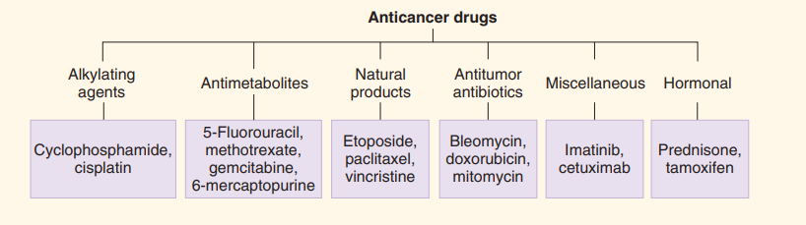

Slide 3
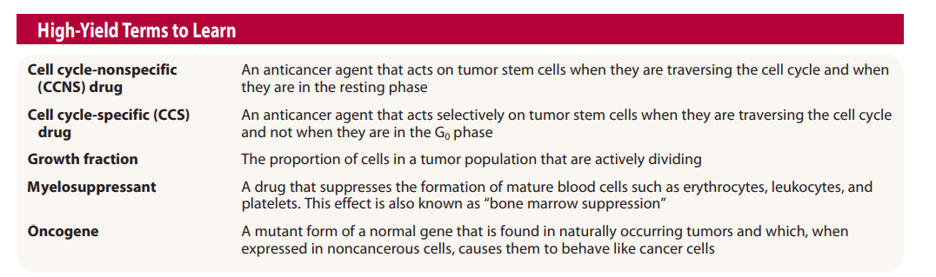

Slide 4
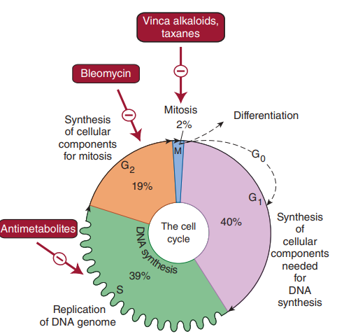

Slide 5
Resistance to Anticancer Drugs
1.Increased DNA repair—An increased rate of DNA repair in tumor cells can be responsible for resistance and is particularly important for alkylating agents and cisplatin.
2. Formation of trapping agents—Some tumor cells increase their production of thiol trapping agents (eg, glutathione), which interact with anticancer drugs that form reactive electrophilic species.
3. Changes in target enzymes—Changes in the drug sensitivity of a target enzyme, dihydrofolate reductase, and increased synthesis of the enzyme are mechanisms of resistance of tumor cells to methotrexate.

Slide 6
4.Decreased activation of prodrugs—Resistance to the purine antimetabolites (mercaptopurine, thioguanine) and the pyrimidine antimetabolites (cytarabine, fluorouracil) can result from a decrease in the activity of the tumor cell enzymes needed to convert these prodrugs to their cytotoxic metabolites.
5. Inactivation of anticancer drugs—Increased activity of enzymes capable of inactivating anticancer drugs is a mechanism of tumor cell resistance to most of the purine and pyrimidine antimetabolites.
6. Decreased drug accumulation—This form of multidrug resistance involves the increased expression of a normal gene (MDR1) for a cell surface glycoprotein (P-glycoprotein). This transport molecule is involved in the accelerated efflux of many anticancer drugs in resistant cells.

Slide 7
Primary induction chemotherapy—Drug therapy is administered as the primary treatment for many hematologic cancers and for advanced solid tumors for which no alternative treatment exists. Although primary induction can be curative in a small number of patients who present with advanced metastatic disease (eg, lymphoma, acute myelogenous leukemia, germ cell cancer, choriocarcinoma, and several childhood cancers), in many cases the goals of therapy are palliation of cancer symptoms, improved quality of life, and increased time to tumor progression.
Neoadjuvant chemotherapy—The use of chemotherapy in patients who present with localized cancer for which alternative local therapy, such as surgery, exist is known as neoadjuvant chemotherapy. The goal is to render the local therapy more effective.
Adjuvant chemotherapy—In the treatment of many solid tumors, chemotherapy serves as an important adjuvant to local treatment procedures such as surgery or radiation. The goal is to reduce the risk of local and systemic recurrence and to improve disease-free and overall survival.

Slide 8
Principles of Combination Therapy Chemotherapy with combinations of anticancer drugs usually increases log-kill markedly, and in some cases synergistic effects are achieved. Combinations are often cytotoxic to a heterogeneous population of cancer cells and may prevent development of resistant clones.
The following principles are important for selecting appropriate drugs to use in combination chemotherapy:
(1) Each drug should be active when used alone against the particular cancer.
(2) The drugs should have different mechanisms of action.
(3) Cross-resistance between drugs should be minimal.
(4) The drugs should have different toxic effects

Slide 9
Rescue Therapy Toxic effects of anticancer drugs can sometimes be alleviated by rescue strategy. For example, high doses of methotrexate may be given for 36–48 h and terminated before severe toxicity occurs to cells of the gastrointestinal tract and bone marrow. Leucovorin, a form of tetrahydrofolate that is accumulated more readily by normal than by neoplastic cells, is then administered. This results in rescue of the normal cells because leucovorin bypasses the dihydrofolate reductase step in folic acid synthesis.
Mercaptoethane sulfonate (mesna) “traps” acrolein released from cyclophosphamide and thus reduces the incidence of hemorrhagic cystitis. Dexrazoxane inhibits free radical formation and affords protection against the cardiac toxicity of anthracyclines (eg, doxorubicin).

Slide 10
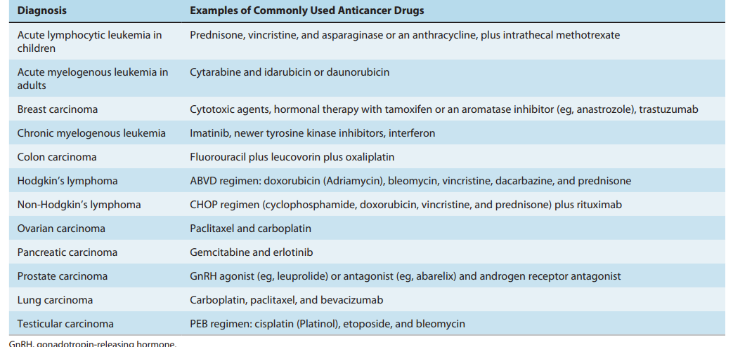

Slide 11
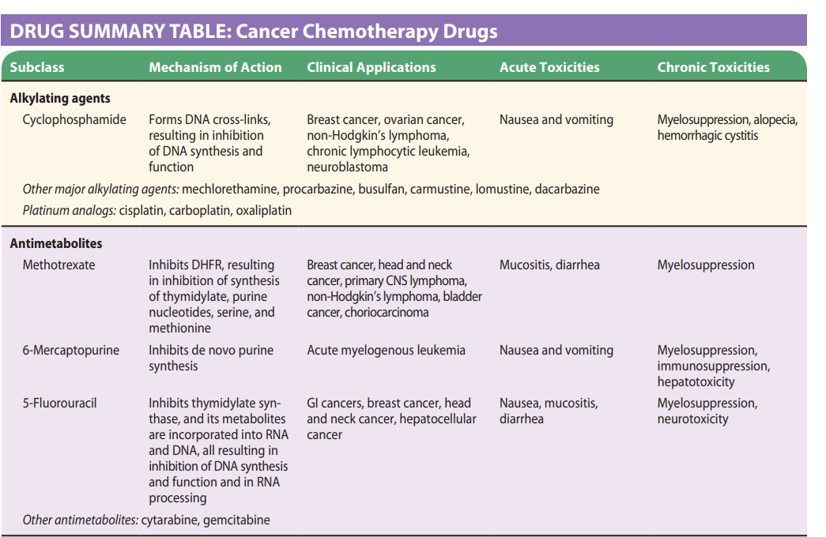

Slide 12
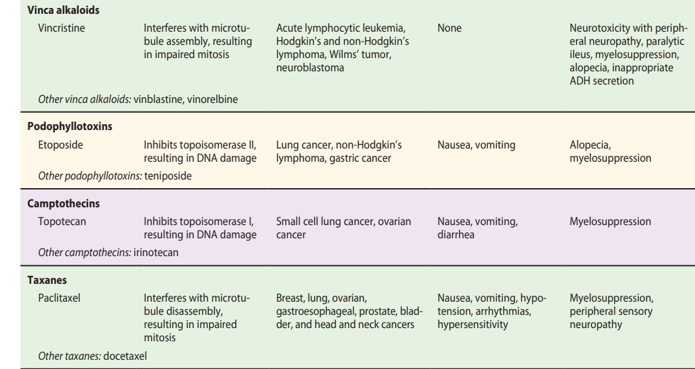

Slide 13
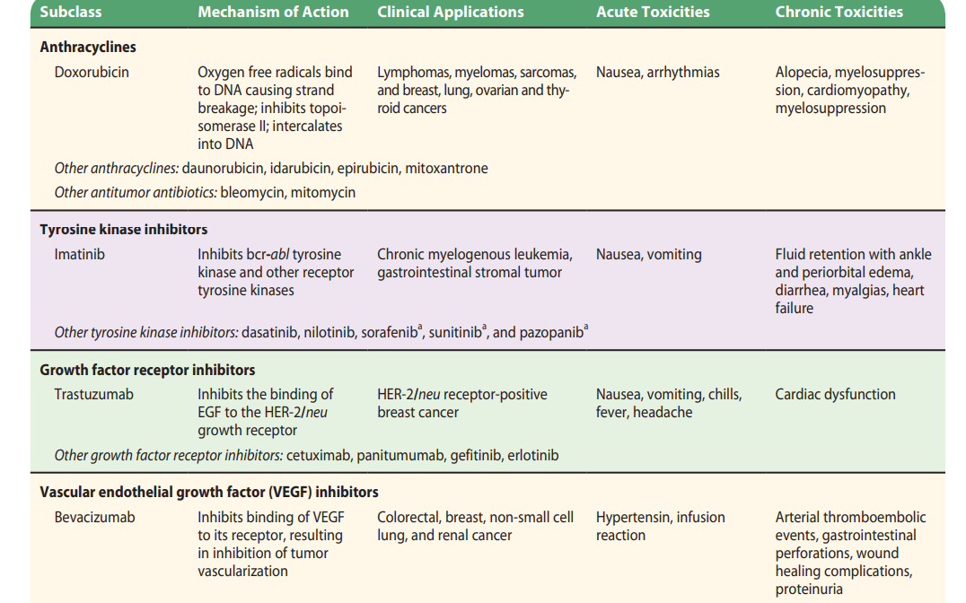

Slide 14
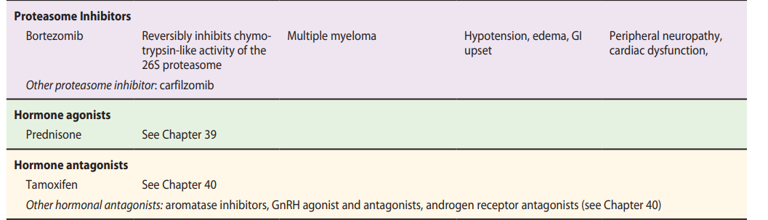

Slide 15
Tamoxifen, a selective estrogen receptor modulator blocks the binding of estrogen to receptors of estrogen-sensitive cancer cells in breast tissue. The drug is used in receptor-positive breast carcinoma and has been shown to have a preventive effect in women at high risk for breast cancer. Because it has agonist activity in the endometrium, tamoxifen increases the risk of endometrial hyperplasia and neoplasia. Other adverse effects include nausea and vomiting, hot flushes, vaginal bleeding, and venous thrombosis.
Anastrozole and letrozole inhibit aromatase, the enzyme that catalyzes the conversion of androstenedione (an androgenic precursor) to estrone (an estrogenic hormone). Both drugs are used in advanced breast cancer. Toxicity includes nausea, diarrhea, hot flushes, bone and back pain, dyspnea, and peripheral edema.
Gonadotropin-Releasing Hormone (GnRH) Analogs Leuprolide, goserelin, and nafarelin are GnRH agonists, effective in prostatic carcinoma. When administered in constant doses so as to maintain stable blood levels, they inhibit release of pituitary luteinizing hormone (LH) and follicle-stimulating hormone (FSH). Leuprolide may cause bone pain, gynecomastia, hematuria, impotence, and testicular atrophy

Slide 16
Asparaginase Asparaginase is an enzyme that depletes serum asparagine; it is used in the treatment of T-cell auxotrophic cancers (leukemia and lymphomas) that require exogenous asparagine for growth. Asparaginase is given intravenously and may cause severe hypersensitivity reactions, acute pancreatitis, and bleeding.
Rituximab is a monoclonal antibody that binds to a surface protein in non-Hodgkin’s lymphoma cells and induces complement-mediated lysis, Rituximab is associated with hypersensitivity reactions and myelosuppression.

Slide 17
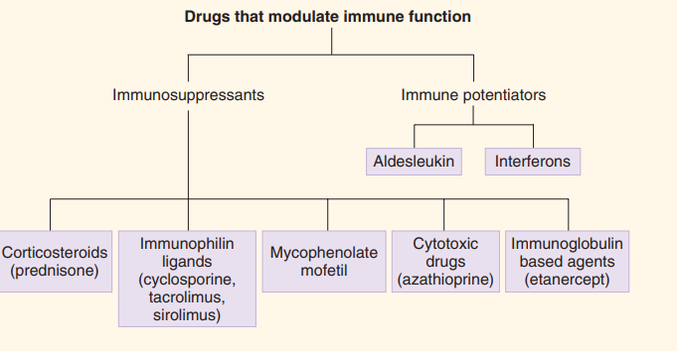
Immunopharmacology

Slide 18
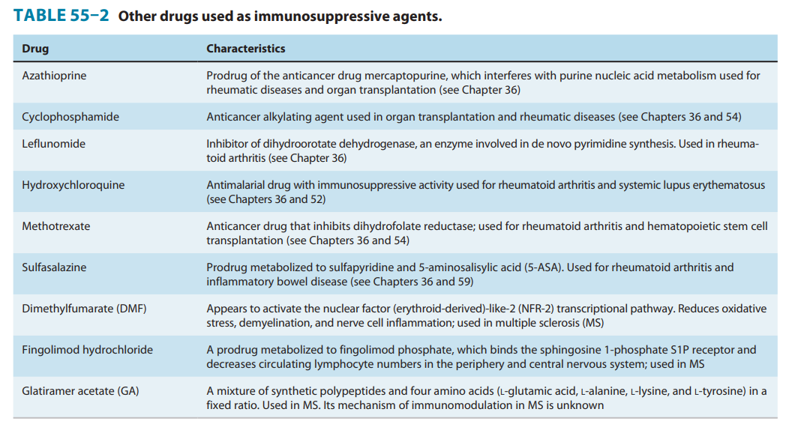

Slide 19
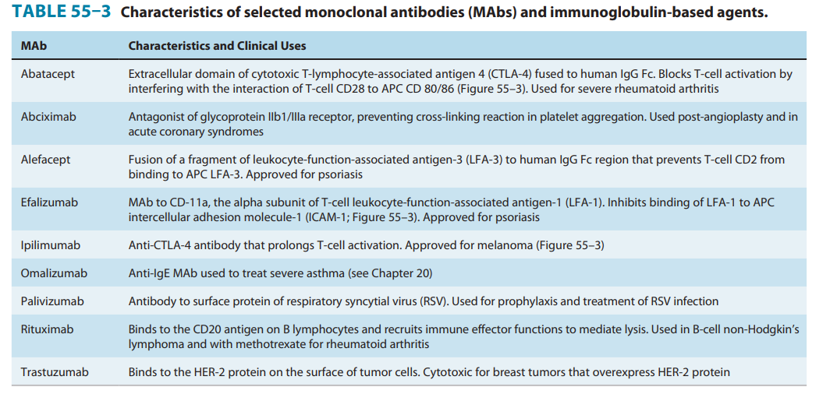

Slide 20
Azathioprine, sold under the brand name Imuran, among others, is an immunosuppressive medication.It is used for the treatment of rheumatoid arthritis, granulomatosis with polyangiitis, Crohn's disease, ulcerative colitis,
Because azathioprine suppresses the bone marrow, patients can develop anaemia ,and cause hepatotoxicity.

Slide 21
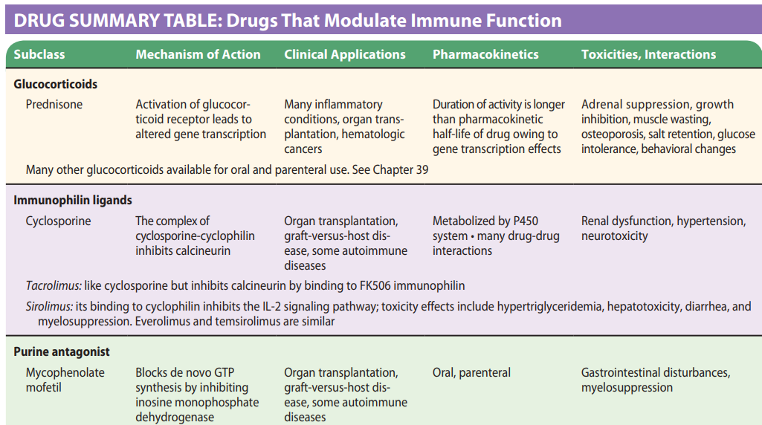

Slide 22
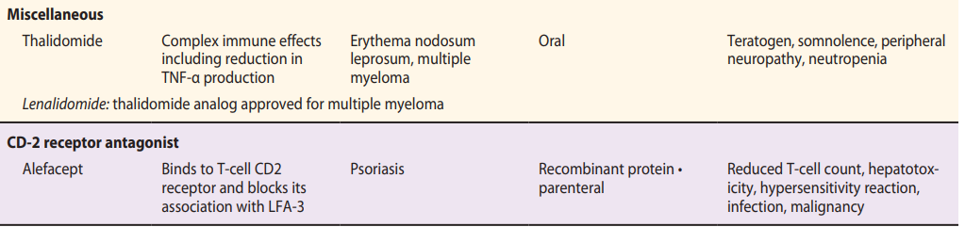

Slide 23
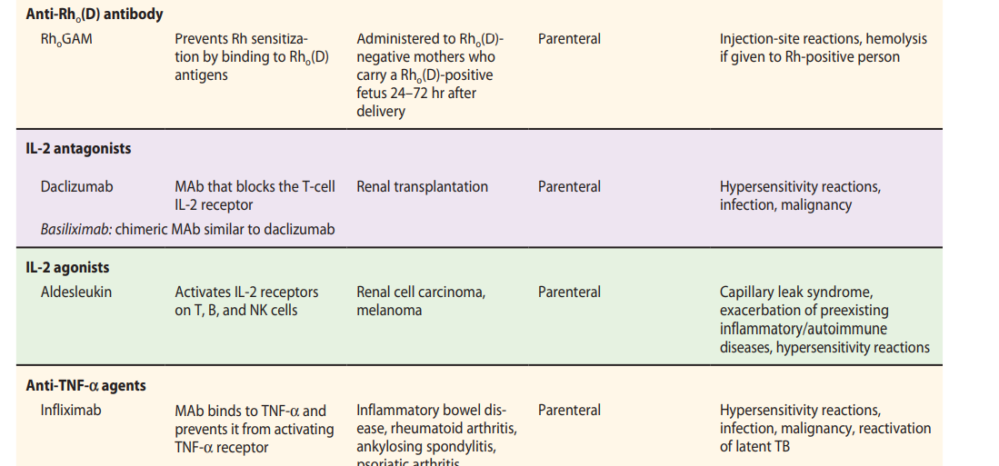

Slide 24
