Slide 1
Artificial Intelligence
ENCS 3340
Adversarial Search & Games

Slide 2
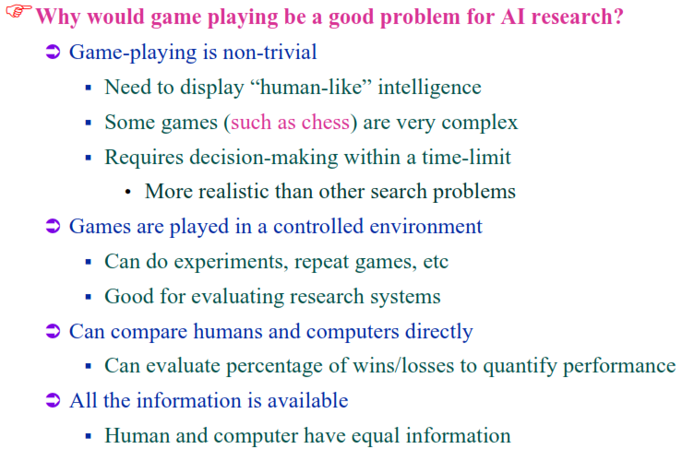
Game Playing and AI

Slide 3
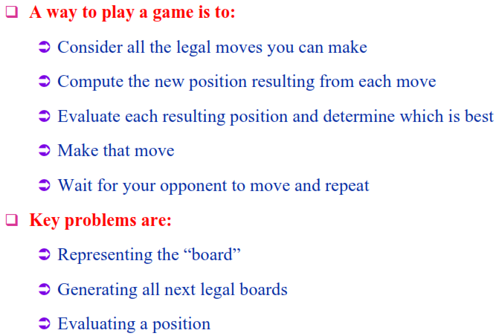
How Does a Computer Play a Game?

Slide 4
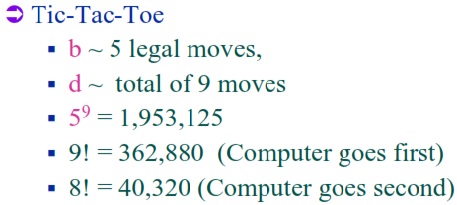
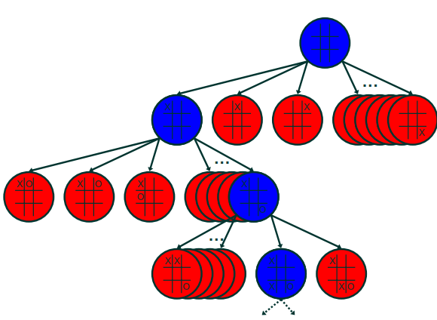
Tic-Tac-Toe Game (X-O)

Slide 5
Game Playing: Adversarial Search
Introduction
Adversarial: involving two people or two sides who oppose each other
Different kinds of games:
 | Deterministic | Chance
Perfect Information | Chess, Checkers Go, Othello | Backgammon, Monopoly
Imperfect Information | Battleship | Bridge, Poker, Scrabble,
  Games with perfect information. No randomness is involved.
  Games with imperfect information. Random factors are part of the game.

Slide 6
Games as Adversarial Search
many games can be formulated as search problems
Zero sum: my win is your loss, my loss is your win!
the zero-sum utility function leads to an adversarial situation
  in order for one agent to win, the other necessarily has to lose
factors complicating the search task
  potentially huge search spaces
  elements of chance
  multi-person games, teams
  time limits
  imprecise rules

Slide 7
Difficulties with Games
games can be very hard search problems
  yet reasonably easy to formalize
  finding the optimal solution may be impractical
    a solution that beats the opponent is “good enough”
  unforgiving
    a solution that is “not good enough” not only leads to higher costs, but to a loss to the opponent
example: chess
  size of the search space
    branching factor around 35
    about 50 moves per player
    about 35¹⁰⁰ or 10¹⁵⁴ nodes
      about 10⁴⁰ distinct nodes (size of the search graph)

Slide 8
Single-Person Game
conventional search problem
  identify a sequence of moves that leads to a winning state
  examples: Solitaire, dragons and dungeons, Rubik’s cube
  little attention in AI
some games can be quite challenging
  some versions of solitaire
  a heuristic for Rubik’s cube was found by the Absolver program

Slide 9
Searching in a two player game
  Traditional (single agent) search methods only consider how close the agent is to the goal state (e.g. best first search).
  In two player games, decisions of both agents have to be taken into account: a decision made by one agent will affect the resulting search space that the other agent would need to explore.
  Question: Do we have randomness here since the decision made by the opponent is NOT known in advance?
  ☺ No. Not if all the moves or choices that the opponent can make are finite and can be known in advance.

Slide 10
Searching in a two player game: Strategies
  Your Strategy for a move: you use the best strategy you can think of: depends on how “smart” you are
  What about opponent strategy?
  We don’t know exactly: could be a NOVICE, could be a MASTER
  Which is safer:
    To assume that the opponent is a novice and may make dumb moves?
    To assume that the opponent is very smart?
  Which is safer in a war:
    To assume your opponent is weak
    To assume your opponent is very strong?
  We assume that the opponent is as smart as possible, or as smart as we can think
  The opponent uses my own strategy for search (but in reverse):
    If I try to maximize MY future choices in XO he tries to minimize MY chances.
    If I try to minimize HIS future choices in XO he tries to maximize HIS chances.
    I am MAX, he is MIN

Slide 11
Two Player Games: Evaluation Functions
  What an evaluation function could be: an assessment of my chances to win:
    Chess: # of my figures - # of opponent figures (maybe weighted)
    Tic_tac_Toe: number of open chances for me – number of opponent’s chances
    General: Something that is good for me when higher and good for oppnent when lower: recall: I am MAX and he is MIN and we have ONLY ONE Evaluation Function!
  Evaluation function is supposed to give an impression of how close MAX is to the goal: the higher the closer:
    do you agree that the above have this property?

Slide 12
Two Player Games: Evaluation Functions
  The deeper you go: the more steps you imagine searching, the more accurate your evaluation function gets (getting closer to goal).
  So it is good to do the computation (of evaluation function) at the deepest possible level and then see how to act now to reach there: but that is costly and time consuming
  We need a compromise! Look ahead at a limited depth!: modest computation, modest knowledge about position:
  Can be better, can be worse: a COMPROMISE!
X | O |  | X | O | O
 |  |  |  |  | O
 |  |  | X |  | X

Slide 13
Searching in a two player game
To formalize a two player game as a search problem an agent can be called MAX and the opponent can be called MIN.
Problem Formulation:
Initial state: board configurations and the player to move.
Successor function: list of pairs (move, state) specifying legal moves and their resulting states. (moves + initial state = game tree)
A terminal test: decide if the game has finished.
A utility function: produces a numerical value for (only) the terminal states. Example: In chess, outcome = win/loss/draw, with values +1, -1, 0 respectively.
Players need search tree to determine next move.

Slide 14
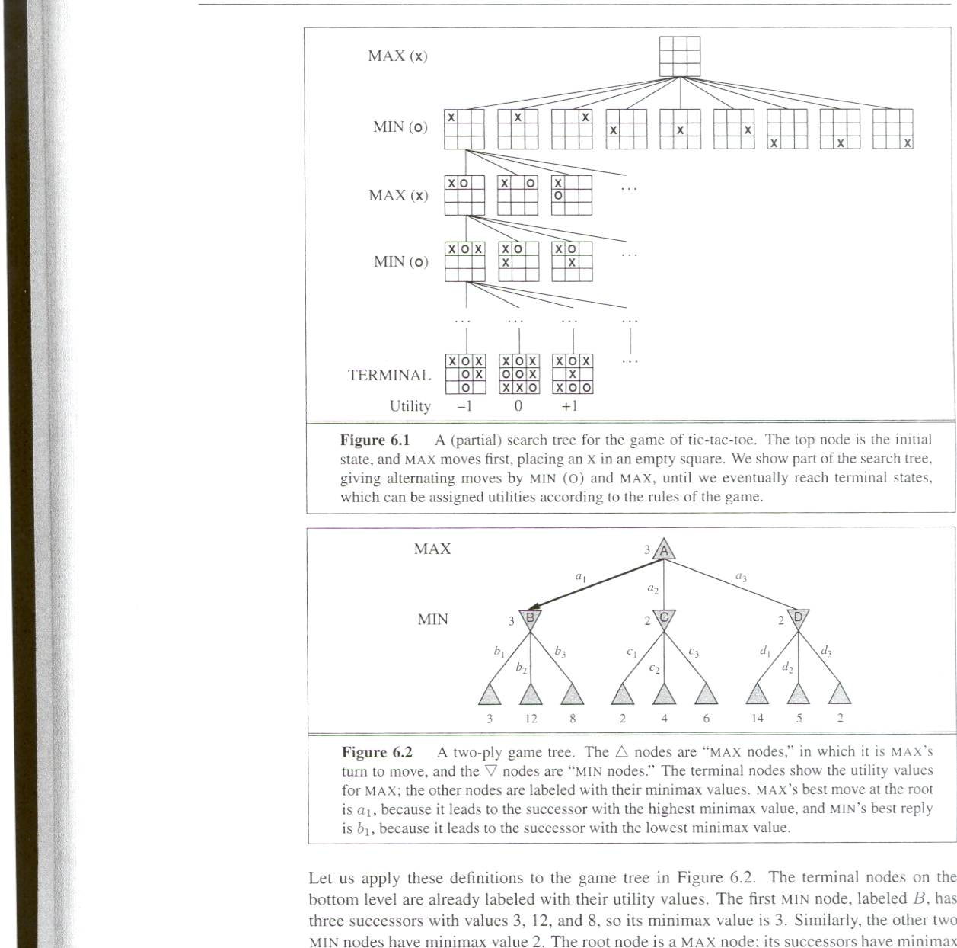
Partial game tree for Tic-Tac-Toe
Root node represents the current board configuration; player must decide the best single move to make next
Each level of search nodes in the tree corresponds to all possible board configurations for a particular player MAX or MIN.
If it is my turn to move, then the root is labeled a "MAX" node; otherwise it is labeled a "MIN" node, indicating opponent's turn.
Utility values found at the end can be returned back to their parent nodes.
Idea: MAX chooses the board with the max utility value, MIN the minimum.

Slide 15
MiniMax (MinMax, MM) Algorithm
An algorithm to search trees representing two-player zero-sum (my gain your loss) games.
Goal: minimizing the possible loss for a worst case (maximum loss) scenario.
Or maximize the minimum gain. Guaranteed: no matter what: how opponent plays: worst case scenario: gain can be MORE, never less
Result: one move (one level down) then the process starts again.
For this one move you may explore as many nodes as you have time for!
MIN works in opposite direction to MAX
Then work is repeated

Slide 16
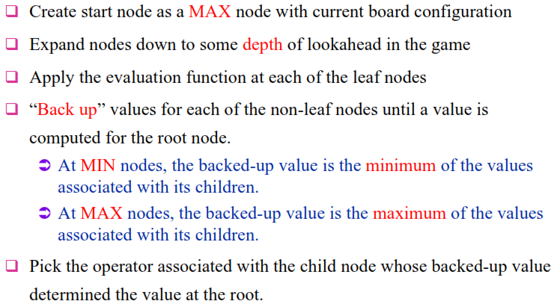
MiniMax Algorithm

Slide 17
MiniMax Example
Max
Min
Max
Min
Min
4
7
9
6
9
8
8
5
6
7
5
2
3
2
5
4
9
3
    terminal nodes: values calculated from the utility function

Slide 18
MiniMax Example
4
7
6
2
6
3
4
5
1
2
5
4
1
2
6
3
4
3
Min
4
7
9
6
9
8
8
5
6
7
5
2
3
2
5
4
9
3
    other nodes: values calculated via minimax algorithm

Slide 19
MiniMax Example
7
6
5
5
6
4
Max
4
7
6
2
6
3
4
5
1
2
5
4
1
2
6
3
4
3
Min
4
7
9
6
9
8
8
5
6
7
5
2
3
2
5
4
9
3

Slide 20
MiniMax Example
5
3
4
Min
7
6
5
5
6
4
Max
4
7
6
2
6
3
4
5
1
2
5
4
1
2
6
3
4
3
Min
4
7
9
6
9
8
8
5
6
7
5
2
3
2
5
4
9
3

Slide 21
MiniMax Example
5
Max
5
3
4
Min
7
6
5
5
6
4
Max
4
7
6
2
6
3
4
5
1
2
5
4
1
2
6
3
4
3
Min
4
7
9
6
9
8
8
5
6
7
5
2
3
2
5
4
9
3

Slide 22
MiniMax Example
5
Max
5
3
4
Min
7
6
5
5
6
4
Max
4
7
6
2
6
3
4
5
1
2
5
4
1
2
6
3
4
3
Min
4
7
9
6
9
8
8
5
6
7
5
2
3
2
5
4
9
3
    moves by Max and countermoves by Min
    Question: can I gain less than 5 if I take a move?

Slide 23
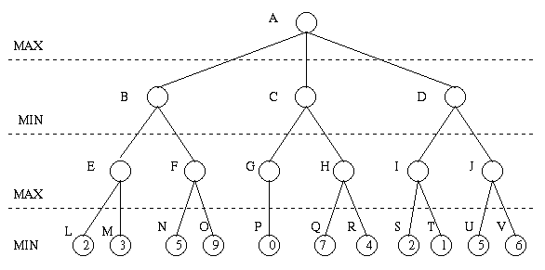
Minimax Algorithm
Payoff for Max

Slide 24
Minimax Algorithm (cont’d)
3
9
0
7
2
6
Payoff for Max

Slide 25
Minimax Algorithm (cont’d)
3
0
2
3
9
0
7
2
6
Payoff for Max

Slide 26
Minimax Algorithm (cont’d)
3
3
0
2
3
9
0
7
2
6
Payoff for Max

Slide 27
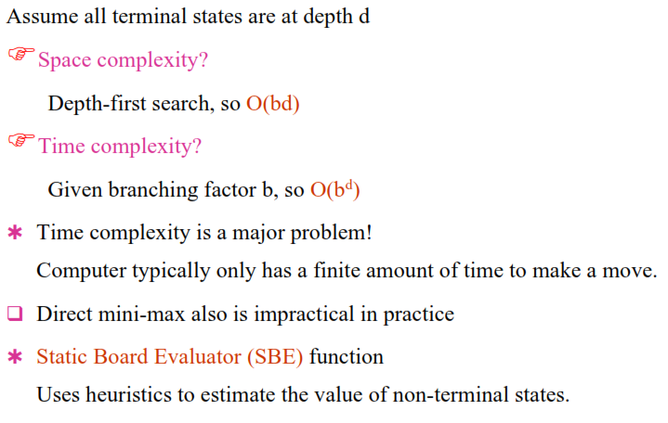
MiniMax Properties

Slide 28
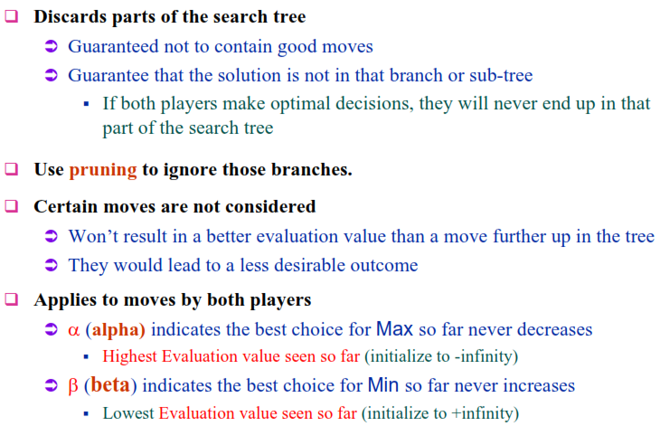
Pruning

Slide 29
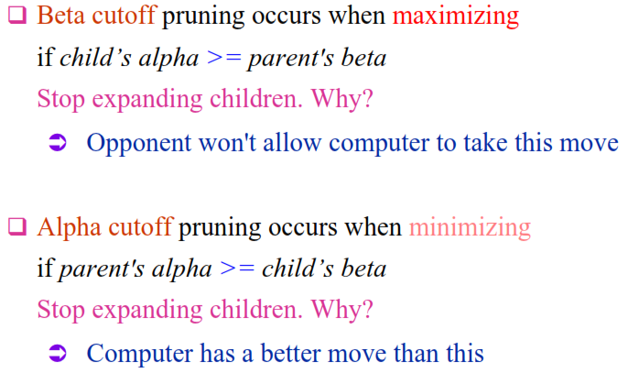
Alpha-Beta Pruning

Slide 30
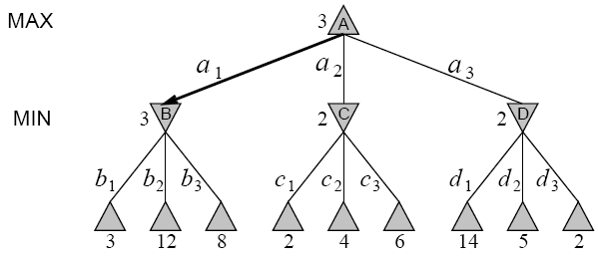
α-β Pruning Example

Slide 31
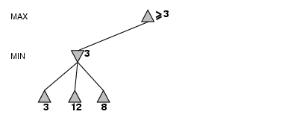
α-β Pruning Example

Slide 32
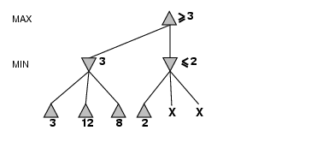
α-β Pruning Example (cont’d)

Slide 33
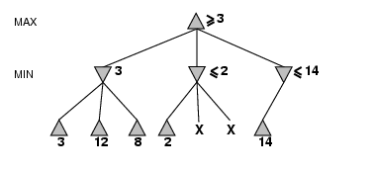
α-β Pruning Example (cont’d)

Slide 34
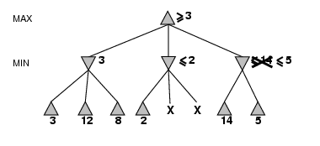
α-β Pruning Example (cont’d)

Slide 35
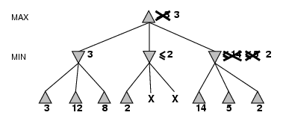
α-β Pruning Example (cont’d)

Slide 36
Alpha-Beta Pruning (αβ prune)
Rules of Thumb
  α is the best ( highest) found so far along the path for Max
  β is the best (lowest) found so far along the path for Min
  Search below a MIN node may be alpha-pruned if the its β ≤ α of some MAX ancestor
  Search below a MAX node may be beta-pruned if the its α≥ β of some MIN ancestor.

Slide 37
Consider this Example
5
5
Max
Min
7
6
5
3
1
7
6
5
4

Slide 38
Alpha-Beta Example 1
[-∞, +∞]
5
Max
[-∞, +∞]
Min
α best choice for Max ?
β best choice for Min ?
  we assume a depth-first, left-to-right search as basic strategy
  the range of the possible values for each node are indicated
    initially [-∞, +∞]
    from Max’s or Min’s perspective
    these local values reflect the values of the sub-trees in that node;
    the global values α and β are the best overall choices so far for Max or Min

Slide 39
Alpha-Beta Example 2
[-∞, +∞]
5
Max
[-∞, 7]
Min
7
α best choice for Max ?
β best choice for Min 7
  Min obtains the first value from a successor node

Slide 40
Alpha-Beta Example 3
[-∞, +∞]
5
Max
[-∞, 6]
Min
7
6
α best choice for Max ?
β best choice for Min 6
  Min obtains the second value from a successor node

Slide 41
Alpha-Beta Example 4
[5, +∞]
5
Max
5
Min
7
6
5
α best choice for Max 5
β best choice for Min 5
  Min obtains the third value from a successor node
  this is the last value from this sub-tree, and the exact value is known
  Max now has a value for its first successor node, but hopes that something better might still come

Slide 42
Alpha-Beta Example 5
[5, +∞]
5
Max
5
[-∞, 3]
Min
7
6
5
3
α best choice for Max 5
β best choice for Min 3
  Min continues with the next sub-tree, and gets a better value
  Max has a better choice from its perspective, however, and will not consider a move in the sub-tree currently explored by Min
    initially [-∞, +∞]

Slide 43
Alpha-Beta Example 6
[5, +∞]
5
Max
5
[-∞, 3]
Min
7
6
5
3
α best choice for Max 5
β best choice for Min 3
  Min knows that Max won’t consider a move to this sub-tree, and abandons it
  this is a case of pruning, indicated by

Slide 44
Alpha-Beta Example 7
[5, +∞]
5
Max
5
[-∞, 3]
[-∞, 6]
Min
7
6
5
3
6
α best choice for Max 5
β best choice for Min 3
  Min explores the next sub-tree, and finds a value that is worse than the other nodes at this level
  if Min is not able to find something lower, then Max will choose this branch, so Min must explore more successor nodes

Slide 45
Alpha-Beta Example 8
[5, +∞]
5
Max
5
[-∞, 3]
[-∞, 5]
Min
7
6
5
3
6
5
α best choice for Max 5
β best choice for Min 3
  Min is lucky, and finds a value that is the same as the current worst value at this level
  Max can choose this branch, or the other branch with the same value

Slide 46
Alpha-Beta Example 9
5
5
Max
5
[-∞, 3]
[-∞, 5]
Min
7
6
5
3
6
5
α best choice for Max 5
β best choice for Min 3
  Min could continue searching this sub-tree to see if there is a value that is less than the current worst alternative in order to give Max as few choices as possible
    this depends on the specific implementation
  Max knows the best value for its sub-tree

Slide 47
Alpha-Beta Example Overview
5
5
Max
5
<= 3
<=5
Min
7
6
5
3
6
4
6
5
4
α best choice for Max 5
β best choice for Min 7 -> 6 -> 5 -> 3
  some branches can be pruned because they would never be considered
    after looking at one branch, Max already knows that they will not be of interest since Min would choose a value that is less than what Max already has at its disposal

Slide 48
Properties of Alpha-Beta Pruning
in the ideal case, the best successor node is examined first
  results in O(b^{d/2}) nodes to be searched instead of O(b^{d})
  alpha-beta can look ahead twice as far as minimax
  in practice, simple ordering functions are quite useful
assumes an idealized tree model
  uniform branching factor, path length
  random distribution of leaf evaluation values
transpositions tables can be used to store permutations
  sequences of moves that lead to the same position
requires additional information for good players
  game-specific background knowledge
  empirical data

Slide 49
Alpha-Beta Pruning Example
  Search below a MIN node may be alpha-pruned if the beta value is <= to the alpha value of some MAX ancestor.
  2. Search below a MAX node may be beta-pruned if the alpha value is >= to the beta value of some MIN ancestor.

Slide 50
Alpha-Beta Pruning Example
  Search below a MIN node may be alpha-pruned if the beta value is <= to the alpha value of some MAX ancestor.
  2. Search below a MAX node may be beta-pruned if the alpha value is >= to the beta value of some MIN ancestor.
3
3
3

Slide 51
Alpha-Beta Pruning Example
  Search below a MIN node may be alpha-pruned if the beta value is <= to the alpha value of some MAX ancestor.
  2. Search below a MAX node may be beta-pruned if the alpha value is >= to the beta value of some MIN ancestor.
3
3
3
5
β

Slide 52
Alpha-Beta Pruning Example
  Search below a MIN node may be alpha-pruned if the beta value is <= to the alpha value of some MAX ancestor.
  2. Search below a MAX node may be beta-pruned if the alpha value is >= to the beta value of some MIN ancestor.
3
3
0
α
3
5
0
β

Slide 53
Alpha-Beta Pruning Example
  Search below a MIN node may be alpha-pruned if the beta value is <= to the alpha value of some MAX ancestor.
  2. Search below a MAX node may be beta-pruned if the alpha value is >= to the beta value of some MIN ancestor.
3
3
0
2
α
α
3
5
0
2
β

Slide 54
α-β Search Algorithm
If terminal state, compute e(n) and return the result.
Otherwise, if the level is a minimizing level,
    Until no more children or
      search on a child
      If
    Return min
Otherwise, the level is a maximizing level:
    Until no more children or
      search on a child.
      If
    Return
pruning
pruning
See page 170 R&N

Slide 55
Imperfect Decisions
Complete search is impractical for most games
Alternative: search the tree only to a certain depth
  requires a cutoff-test to determine where to stop (e.g. # of levels)
    replaces the terminal test
    the nodes at that level effectively become terminal leave nodes
  uses a heuristics-based evaluation function to estimate the expected utility of the game from those leave nodes [not win/lose/draw but measure of closeness to the goal.

Slide 56
Evaluation Function
determines the performance of a game-playing program
must be consistent with the utility function
  values for terminal nodes (or at least their order) must be the same
tradeoff between accuracy and time cost
  without time limits, minimax could be used
should reflect the actual chances of winning
frequently weighted linear functions are used
  E = w₁ f₁ + w₂ f₂ + … + w_{n} f_{n}
  combination of features, weighted by their relevance

Slide 57
Example: Tic-Tac-Toe
simple evaluation function
E(s) = (rx + cx + dx) - (ro + co + do)
(number of rows, columns, and diagonals open for MAX) − (number of rows, columns, and diagonals open for MIN )
1-ply lookahead
  start at the top of the tree
  evaluate all 9 choices for player 1
  pick the maximum E-value
2-ply lookahead
  also looks at the opponents possible move
    assuming that the opponents picks the minimum E-value

Slide 58
Tic-Tac-Toe 1-Ply
E(s0) = Max{E(s11), E(s1n)} = Max{2,3,4} = 4
E(s11)
8
- 5
= 3
E(s12)
8
- 6
= 2
E(s13)
8
- 5
= 3
E(s14)
8
- 6
= 2
E(s15)
8
- 4
= 4
E(s16)
8
- 6
= 2
E(s17)
8
- 5
= 3
E(s18)
8
- 6
= 2
E(s19)
8
- 5
= 3
X
X
X
X
X
X
X
X
X

Slide 59
Tic-Tac-Toe 2-Ply
E(s0) = Max{E(s11), E(s1n)} = Max{2,3,4} = 4
E(s1:1)
8
- 5
= 3
E(s1:2)
8
- 6
= 2
E(s1:3)
8
- 5
= 3
E(s1:4)
8
- 6
= 2
E(s1:5)
8
- 4
= 4
E(s1:6)
8
- 6
= 2
E(s1:7)
8
- 5
= 3
E(s1:8)
8
- 6
= 2
E(s1:9)
8
- 5
= 3
X
X
X
X
X
X
X
X
X
E(s2:41)
5
- 4
= 1
E(s2:42)
6
- 4
= 2
E(s2:43)
5
- 4
= 1
E(s2:44)
6
- 4
= 2
E(s2:45)
6
- 4
= 2
E(s2:46)
5
- 4
= 1
E(s2:47)
6
- 4
= 2
E(s2:48)
5
- 4
= 1
O
O
O
X
X
X
O
X
X
O
X
X
X
O
O
O
E(s2:9)
5
- 6
= -1
E(s2:10)
5
-6
= -1
E(s2:11)
5
- 6
= -1
E(s2:12)
5
- 6
= -1
E(s2:13)
5
- 6
= -1
E(s2:14)
5
- 6
= -1
E(s2:15)
5
-6
= -1
E(s2:16)
5
- 6
= -1
O
X
X
O
X
X
X
X
X
X
O
O
O
O
O
O
E(s21)
6
- 5
= 1
E(s22)
5
- 5
= 0
E(s23)
6
- 5
= 1
E(s24)
4
- 5
= -1
E(s25)
6
- 5
= 1
E(s26)
5
- 5
= 0
E(s27)
6
- 5
= 1
E(s28)
5
- 5
= 0
X
O
X
O
X
X
X
X
X
X
O
O
O
O
O
O

Slide 60
Checkers Case Study (how to play: Link below) https://www.youtube.com/watch?v=yFrAN-LFZRU
initial board configuration
  Black single on 20
  single on 21
  king on 31
  Red single on 23
  king on 22
  evaluation function
  E(s) = (5 x₁ + x₂) - (5r₁ + r₂)
    where
    x₁ = black king advantage,
    x₂ = black single advantage,
    r₁ = red king advantage,
    r₂ = red single advantage
₁
₂
₃
₄
₅
₆
₇
₈
₉
₁₀
₁₁
₁₂
₁₃
₁₄
₁₅
₁₆
₁₇
₁₈
₁₉
₂₀
₂₁
₂₂
₂₃
₂₄
₂₅
₂₆
₂₇
₂₈
₂₉
₃₀
₃₁
₃₂

Slide 61
Checkers MiniMax Example
₁
₂
₃
₄
1
₅
₆
₇
₈
₉
₁₀
₁₁
₁₂
20 -> 16
31 -> 27
₁₃
₁₄
₁₅
₁₆
21 -> 17
31 -> 26
MAX
₁₇
₁₈
₁₉
₂₀
₂₁
₂₂
₂₃
₂₄
1
0
-8
-8
₂₅
₂₆
₂₇
₂₈
₂₉
₃₀
₃₁
₃₂
MIN
23 -> 30
23 -> 32
22 -> 31
22 -> 26
22 -> 13
22 -> 17
22 -> 18
22 -> 25
23 -> 26
23 -> 27
6
1
1
6
1
2
0
-4
-8
-8
MAX
16 -> 11
16 -> 11
31 -> 27
31 -> 27
31 -> 24
20 -> 16
21 -> 14
31 -> 27
31 -> 27
20 -> 16
31 -> 27
21 -> 17
21 -> 17
16 -> 11
20 -> 16
21 -> 17
31 -> 26
20 -> 16
6
1
1
1
1
1
1
1
1
1
1
6
1
1
1
1
2
0
0
0
-4
-4
-8
-8
-8
-8

Slide 62
Checkers Alpha-Beta Example
₁
₂
₃
₄
1
₅
₆
₇
₈
₁₂
₉
₁₀
₁₁
α 1
β 6
MAX
31 -> 27
₁₃
₁₄
₁₅
₁₆
₂₀
20 -> 16
₁₇
₁₈
₁₉
21 -> 17
31 -> 26
₂₁
₂₂
₂₃
₂₄
₂₈
₂₅
₂₆
₂₇
₂₉
₃₀
₃₁
₃₂
1
0
-4
-8
MIN
23 -> 30
23 -> 32
22 -> 31
22 -> 26
22 -> 18
22 -> 17
22 -> 18
22 -> 25
23 -> 26
23 -> 27
6
1
1
6
1
2
0
-4
-8
-8
MAX
16 -> 11
31 -> 27
31 -> 27
16 -> 11
31 -> 27
31 -> 24
20 -> 16
21 -> 17
21 -> 14
16 -> 11
31 -> 27
20 -> 16
31 -> 27
20 -> 16
21 -> 17
20 -> 16
21 -> 17
31 -> 26
6
1
1
1
1
1
1
1
1
1
1
6
1
1
1
1
2
0
0
0
-4
-4
-8
-8
-8
-8

Slide 63
Checkers Alpha-Beta Example
₁
₂
₃
₄
1
₅
₆
₇
₈
₁₂
₉
₁₀
₁₁
α 1
β 1
MAX
31 -> 27
₁₃
₁₄
₁₅
₁₆
₂₀
20 -> 16
₁₇
₁₈
₁₉
21 -> 17
31 -> 26
₂₁
₂₂
₂₃
₂₄
₂₈
₂₅
₂₆
₂₇
₂₉
₃₀
₃₁
₃₂
1
0
-4
-8
MIN
23 -> 30
23 -> 32
22 -> 31
22 -> 26
22 -> 18
22 -> 17
22 -> 18
22 -> 25
23 -> 26
23 -> 27
6
1
1
6
1
2
0
-4
-8
-8
MAX
21 -> 14
16 -> 11
31 -> 27
31 -> 27
16 -> 11
31 -> 27
31 -> 24
20 -> 16
21 -> 17
16 -> 11
31 -> 27
20 -> 16
31 -> 27
20 -> 16
21 -> 17
20 -> 16
21 -> 17
31 -> 26
6
1
1
1
1
1
1
1
1
1
1
6
1
1
1
1
2
0
0
0
-4
-4
-8
-8
-8
-8

Slide 64
Checkers Alpha-Beta Example
₁
₂
₃
₄
α 1
β 1
1
₅
₆
₇
₈
₁₂
₉
₁₀
₁₁
MAX
31 -> 27
₁₃
₁₄
₁₅
₁₆
₂₀
20 -> 16
₁₇
₁₈
₁₉
β− cutoff: no need to
examine further branches
21 -> 17
31 -> 26
₂₁
₂₂
₂₃
₂₄
₂₈
₂₅
₂₆
₂₇
₂₉
₃₀
₃₁
₃₂
1
0
-4
-8
MIN
23 -> 30
23 -> 32
22 -> 31
22 -> 26
22 -> 18
22 -> 17
22 -> 18
22 -> 25
23 -> 26
23 -> 27
6
1
1
6
1
2
0
-4
-8
-8
MAX
21 -> 14
16 -> 11
31 -> 27
31 -> 22
16 -> 11
31 -> 27
31 -> 24
20 -> 16
21 -> 17
16 -> 11
31 -> 27
20 -> 16
31 -> 27
20 -> 16
21 -> 17
20 -> 16
21 -> 17
31 -> 26
6
1
1
1
1
1
1
1
1
1
1
6
1
1
1
1
2
0
0
0
-4
-4
-8
-8
-8
-8

Slide 65
Checkers Alpha-Beta Example
₁
₂
₃
₄
α 1
β 1
1
₅
₆
₇
₈
₁₂
₉
₁₀
₁₁
MAX
31 -> 27
₁₃
₁₄
₁₅
₁₆
₂₀
20 -> 16
₁₇
₁₈
₁₉
21 -> 17
31 -> 26
₂₁
₂₂
₂₃
₂₄
₂₈
₂₅
₂₆
₂₇
₂₉
₃₀
₃₁
₃₂
1
0
-4
-8
MIN
23 -> 30
23 -> 32
22 -> 31
22 -> 26
22 -> 18
22 -> 17
22 -> 18
22 -> 25
23 -> 26
23 -> 27
6
1
1
6
1
2
0
-4
-8
-8
MAX
21 -> 14
16 -> 11
31 -> 27
31 -> 22
16 -> 11
31 -> 27
31 -> 24
20 -> 16
21 -> 17
16 -> 11
31 -> 27
20 -> 16
31 -> 27
20 -> 16
21 -> 17
20 -> 16
21 -> 17
31 -> 26
6
1
1
1
1
1
1
1
1
1
1
6
1
1
1
1
2
0
0
0
-4
-4
-8
-8
-8
-8

Slide 66
Checkers Alpha-Beta Example
₁
₂
₃
₄
α 1
β 1
1
₅
₆
₇
₈
₁₂
₉
₁₀
₁₁
MAX
31 -> 27
₁₃
₁₄
₁₅
₁₆
₂₀
20 -> 16
₁₇
₁₈
₁₉
β− cutoff: no need to
examine further branches
21 -> 17
31 -> 26
₂₁
₂₂
₂₃
₂₄
₂₈
₂₅
₂₆
₂₇
₂₉
₃₀
₃₁
₃₂
1
0
-4
-8
MIN
23 -> 30
23 -> 32
22 -> 31
22 -> 26
22 -> 18
22 -> 17
22 -> 18
22 -> 25
23 -> 26
23 -> 27
6
1
1
6
1
2
0
-4
-8
-8
MAX
21 -> 14
16 -> 11
31 -> 27
31 -> 22
16 -> 11
31 -> 27
31 -> 24
20 -> 16
21 -> 17
16 -> 11
31 -> 27
20 -> 16
31 -> 27
20 -> 16
21 -> 17
20 -> 16
21 -> 17
31 -> 26
6
1
1
1
1
1
1
1
1
1
1
6
1
1
1
1
2
0
0
0
-4
-4
-8
-8
-8
-8

Slide 67
Checkers Alpha-Beta Example
₁
₂
₃
₄
α 1
β 1
1
₅
₆
₇
₈
₁₂
₉
₁₀
₁₁
MAX
31 -> 27
₁₃
₁₄
₁₅
₁₆
₂₀
20 -> 16
₁₇
₁₈
₁₉
21 -> 17
31 -> 26
₂₁
₂₂
₂₃
₂₄
₂₈
₂₅
₂₆
₂₇
₂₉
₃₀
₃₁
₃₂
1
0
-4
-8
MIN
23 -> 30
23 -> 32
22 -> 31
22 -> 26
22 -> 18
22 -> 17
22 -> 18
22 -> 25
23 -> 26
23 -> 27
6
1
1
6
1
2
0
-4
-8
-8
MAX
21 -> 14
16 -> 11
31 -> 27
31 -> 22
16 -> 11
31 -> 27
31 -> 24
20 -> 16
21 -> 17
16 -> 11
31 -> 27
20 -> 16
31 -> 27
20 -> 16
21 -> 17
20 -> 16
21 -> 17
31 -> 26
6
1
1
1
1
1
1
1
1
1
1
6
1
1
1
1
2
0
0
0
-4
-4
-8
-8
-8
-8

Slide 68
Checkers Alpha-Beta Example
₁
₂
₃
₄
α 1
β 0
1
₅
₆
₇
₈
₁₂
₉
₁₀
₁₁
MAX
31 -> 27
₁₃
₁₄
₁₅
₁₆
₂₀
20 -> 16
₁₇
₁₈
₁₉
21 -> 17
31 -> 26
₂₁
₂₂
₂₃
₂₄
₂₈
₂₅
₂₆
₂₇
₂₉
₃₀
₃₁
₃₂
1
0
-4
-8
MIN
23 -> 30
23 -> 32
22 -> 31
22 -> 26
22 -> 13
22 -> 17
22 -> 18
22 -> 25
23 -> 26
23 -> 27
6
1
1
6
1
2
0
-4
-8
-8
MAX
21 -> 14
16 -> 11
31 -> 27
31 -> 22
16 -> 11
31 -> 27
31 -> 24
20 -> 16
21 -> 17
16 -> 11
31 -> 27
20 -> 16
31 -> 27
20 -> 16
21 -> 17
20 -> 16
21 -> 17
31 -> 26
6
1
1
1
1
1
1
1
1
1
1
6
1
1
1
1
2
0
0
0
-4
-4
-8
-8
-8
-8

Slide 69
Checkers Alpha-Beta Example
₁
₂
₃
₄
α 1
β -4
1
₅
₆
₇
₈
₁₂
₉
₁₀
₁₁
MAX
31 -> 27
₁₃
₁₄
₁₅
₁₆
₂₀
20 -> 16
₁₇
₁₈
₁₉
α− cutoff: no need to
examine further branches
21 -> 17
31 -> 26
₂₁
₂₂
₂₃
₂₄
₂₈
₂₅
₂₆
₂₇
₂₉
₃₀
₃₁
₃₂
1
0
-4
-8
MIN
23 -> 30
23 -> 32
22 -> 31
22 -> 26
22 -> 18
22 -> 17
22 -> 18
22 -> 25
23 -> 26
23 -> 27
6
1
1
6
1
2
0
-4
-8
-8
MAX
21 -> 14
16 -> 11
31 -> 27
31 -> 22
16 -> 11
31 -> 27
31 -> 24
20 -> 16
21 -> 17
16 -> 11
31 -> 27
20 -> 16
31 -> 27
20 -> 16
21 -> 17
20 -> 16
21 -> 17
31 -> 26
6
1
1
1
1
1
1
1
1
1
1
6
1
1
1
1
2
0
0
0
-4
-4
-8
-8
-8
-8

Slide 70
Checkers Alpha-Beta Example
₁
₂
₃
₄
α 1
β -8
1
₅
₆
₇
₈
₁₂
₉
₁₀
₁₁
MAX
31 -> 27
₁₃
₁₄
₁₅
₁₆
₂₀
20 -> 16
₁₇
₁₈
₁₉
21 -> 17
31 -> 26
₂₁
₂₂
₂₃
₂₄
₂₈
₂₅
₂₆
₂₇
₂₉
₃₀
₃₁
₃₂
1
0
-4
-8
MIN
23 -> 30
23 -> 32
22 -> 31
22 -> 26
22 -> 18
22 -> 17
22 -> 18
22 -> 25
23 -> 26
23 -> 27
6
1
1
6
1
2
0
-4
-8
-8
MAX
21 -> 14
16 -> 11
31 -> 27
31 -> 22
16 -> 11
31 -> 27
31 -> 24
20 -> 16
21 -> 17
16 -> 11
31 -> 27
20 -> 16
31 -> 27
20 -> 16
21 -> 17
20 -> 16
21 -> 17
31 -> 26
6
1
1
1
1
1
1
1
1
1
1
6
1
1
1
1
2
0
0
0
-4
-4
-8
-8
-8
-8

Slide 71
Search Limits
search must be cut off because of time or space limitations
strategies like depth-limited or iterative deepening search can be used
  don’t take advantage of knowledge about the problem
more refined strategies apply background knowledge
  quiescent search
    cut off only parts of the search space that don’t exhibit big changes in the evaluation function

Slide 72

Horizon Problem
moves may have disastrous consequences in the future, but the consequences are not visible
  the corresponding change in the evaluation function will only become evident at deeper levels
    they are “beyond the horizon”
determining the horizon is an open problem without a general solution
  only some pragmatic approaches restricted to specific games or situation

Slide 73
Games with Chance
in many games, there is a degree of unpredictability through random elements
  throwing dice, card distribution, roulette wheel, …
this requires chance nodes in addition to the Max and Min nodes
  branches indicate possible variations
  each branch indicates the outcome and its likelihood

Slide 74
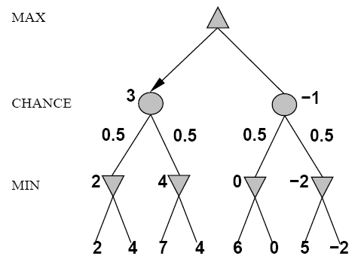
Expected Minimax
Interleave chance nodes
with min/max nodes
Again, the tree is constructed
bottom-up

Slide 75
Decisions with Chance
the utility value of a position depends on the random element
  the definite minimax value must be replaced by an expected value
calculation of expected values
  utility function for terminal nodes
  for all other nodes
    calculate the utility for each chance event
    weigh by the chance that the event occurs
    add up the individual utilities

Slide 76
Multi-player Non-Zero-Sum Games
Similar to minimax:
  Utilities are now tuples
  Each player maximizes their own entry at each node
  Propagate (or back up) nodes from children
  Can give rise to cooperation and competition dynamically…
  Pruning?????
4,3,2
4,3,2
1,5,2
4,3,2
7,4,1
1,5,2
7,7,1
1,2,6
4,3,2
6,1,2
7,4,1
5,1,1
1,5,2
7,7,1
5,4,5

Slide 77
Chapter Summary
many game techniques are derived from search methods
the minimax algorithm determines the best move for a player by calculating the complete game tree
alpha-beta pruning dismisses parts of the search tree that are provably irrelevant
an evaluation function gives an estimate of the utility of a state when a complete search is impractical
chance events can be incorporated into the minimax algorithm by considering the weighted probabilities of chance events

