Slide 1


Slide 2
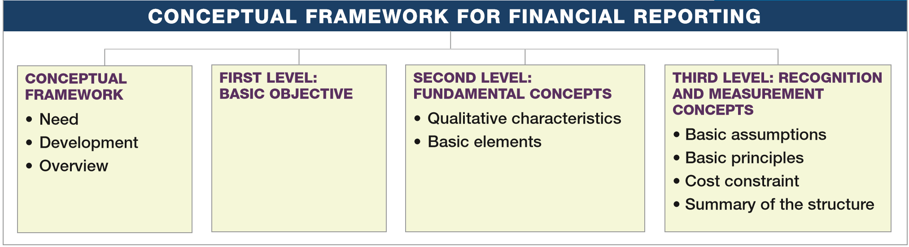
PREVIEW OF CHAPTER 2
Intermediate Accounting
16th Edition
Kieso ● Weygandt ● Warfield

Slide 3
LEARNING OBJECTIVES
2
Conceptual Framework for Financial Reporting
After studying this chapter, you should be able to:
Describe the usefulness of a conceptual framework.
Understand the objective of financial reporting.
Identify the qualitative characteristics of accounting information.
Define the basic elements of financial statements.
Describe the basic assumptions of accounting.
Explain the application of the basic principles of accounting.
Describe the impact that the cost constraint has on reporting accounting information.
LO 1

Slide 4
CONCEPTUAL FRAMEWORK
The Need for a Conceptual Framework
To develop a coherent set of standards and rules.
To solve new and emerging practical problems.
LO 1

Slide 5
CONCEPTUAL FRAMEWORK
Question (true or false):
A conceptual framework underlying financial accounting is important because it can lead to consistent standards and it prescribes the nature, function, and limits of financial accounting and financial statements.
True
LO 1

Slide 6
CONCEPTUAL FRAMEWORK
Question (true or false):
A conceptual framework underlying financial accounting is necessary because future accounting practice problems can be solved by reference to the conceptual framework and a formal standard-setting body will not be necessary.
False
LO 1

Slide 7
WHAT DO THE NUMBERS MEAN? WHAT’S YOUR PRINCIPLE?
WHAT’S YOUR PRINCIPLE
The need for a conceptual framework is highlighted by accounting scandals such as those at Enron and Lehman Brothers. To restore public confidence in the financial reporting process, many have argued that regulators should move toward principles-based rules. They believe that companies exploited the detailed provisions in rules-based pronouncements to manage accounting reports, rather than report the economic substance of transactions. For example, many of the off–balance-sheet arrangements of Enron avoided transparent reporting by barely achieving 3 percent outside equity ownership, a requirement in an obscure accounting rule interpretation. Enron’s financial engineers were able to structure transactions to achieve a desired accounting treatment, even if that accounting treatment did not reflect the transaction’s true nature. Under principles-based rules, hopefully top management’s financial reporting focus will shift from demonstrating compliance with rules to demonstrating that a company has attained the objective of financial reporting.
LO 1

Slide 8
Development of Conceptual Framework
The FASB has issued seven Statements of Financial Accounting Concepts (SFAC) for business enterprises.
SFAC No.1 - Objectives of Financial Reporting (superseded by SFAC No. 8)
SFAC No.2 - Qualitative Characteristics of Accounting Information. (superseded by SFAC No. 8)
SFAC No.3 - Elements of Financial Statements. (superseded by SFAC No. 6)
SFAC No.5 - Recognition and Measurement in Financial Statements.
SFAC No.6 - Elements of Financial Statements (replaces SFAC No. 3).
SFAC No.7 - Using Cash Flow Information and Present Value in Accounting Measurements.
SFAC No.8 - The Objective of General Purpose Financial Reporting and Qualitative Characteristics of Useful Financial Information (replaces SFAC No. 1 and No. 2)
LO 1

Slide 9
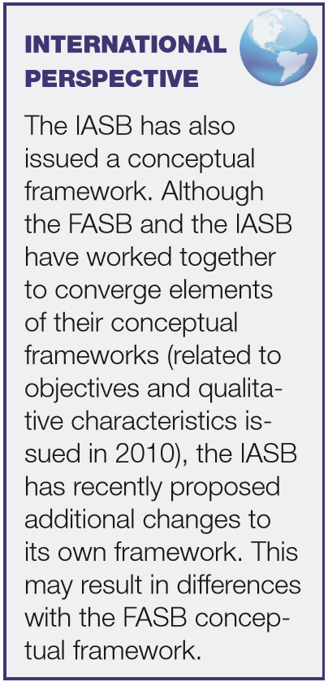
CONCEPTUAL FRAMEWORK
Overview of the Conceptual Framework
First Level = Basic Objectives
Second Level = Qualitative Characteristics and Elements
Third Level = Recognition, Measurement, and Disclosure Concepts.
LO 1

Slide 10

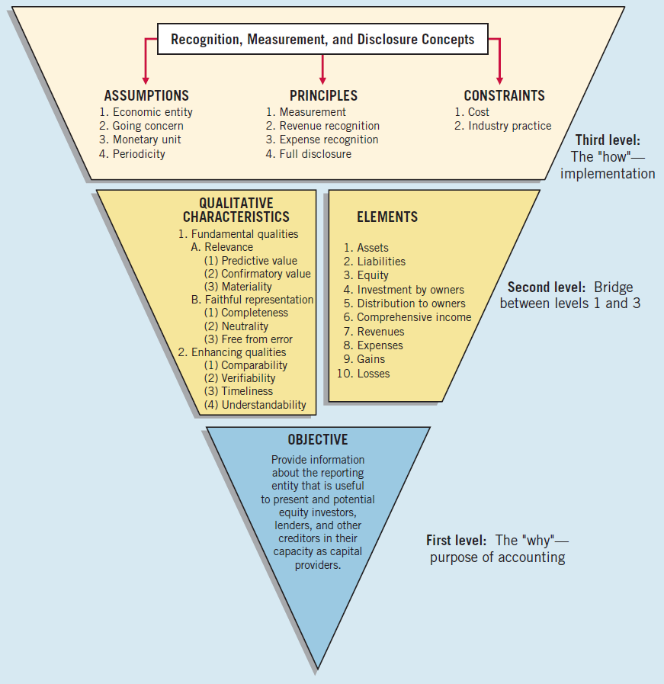
ILLUSTRATION 2-7
Conceptual Framework for Financial Reporting
LO 1

Slide 11
CONCEPTUAL FRAMEWORK
Question
What are the Statements of Financial Accounting Concepts intended to establish?
Generally accepted accounting principles in financial reporting by business enterprises.
The meaning of “Present fairly in accordance with generally accepted accounting principles.”
The objectives and concepts for use in developing standards of financial accounting and reporting.
The hierarchy of sources of generally accepted accounting principles.
LO 1

Slide 12
LEARNING OBJECTIVES
2
Conceptual Framework for Financial Reporting
After studying this chapter, you should be able to:
Describe the usefulness of a conceptual framework.
Understand the objective of financial reporting.
Identify the qualitative characteristics of accounting information.
Define the basic elements of financial statements.
Describe the basic assumptions of accounting.
Explain the application of the basic principles of accounting.
Describe the impact that the cost constraint has on reporting accounting information.
LO 2

Slide 13
FIRST LEVEL: BASIC OBJECTIVES
Objective of financial reporting:
To provide financial information about the reporting entity that is useful to present and potential equity investors, lenders, and other creditors in making decisions about providing resources to the entity.
LO 2

Slide 14
FIRST Level: Basic Objectives
Question
According to the FASB conceptual framework, the objectives of financial reporting for business enterprises are based on?
Generally accepted accounting principles
Reporting on management’s stewardship.
The need for conservatism.
The needs of the users of the information.
LO 2

Slide 15
LEARNING OBJECTIVES
2
Conceptual Framework for Financial Reporting
After studying this chapter, you should be able to:
Describe the usefulness of a conceptual framework.
Understand the objective of financial reporting.
Identify the qualitative characteristics of accounting information.
Define the basic elements of financial statements.
Describe the basic assumptions of accounting.
Explain the application of the basic principles of accounting.
Describe the impact that the cost constraint has on reporting accounting information.
LO 3

Slide 16
SECOND LEVEL: FUNDAMENTAL CONCEPTS
Qualitative Characteristics of Accounting Information
“The FASB identified the qualitative characteristics of accounting information that distinguish better (more useful) information from inferior (less useful) information for decision-making purposes.”
LO 3

Slide 17
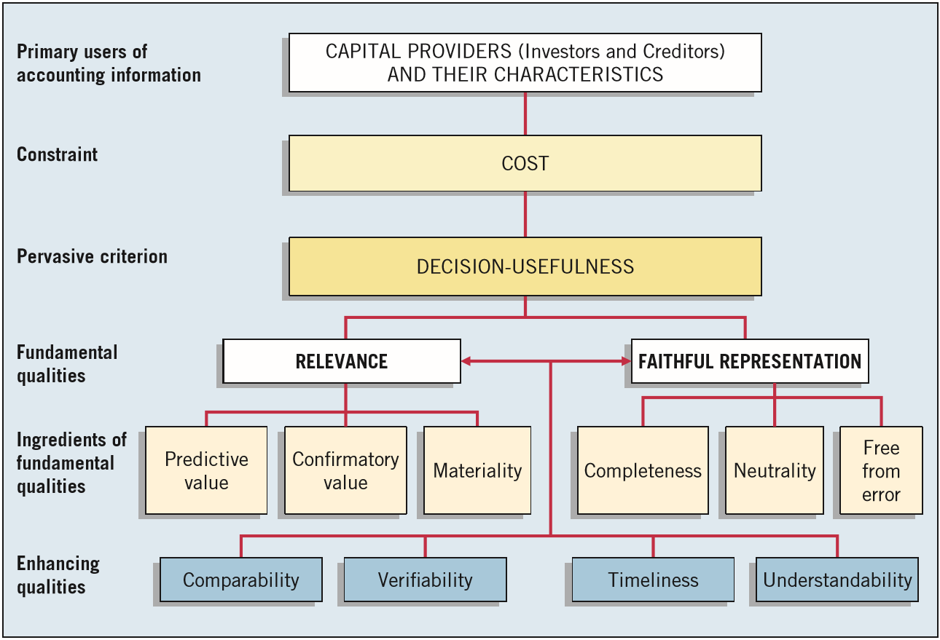
Second Level: Fundamental Concepts
ILLUSTRATION 2-2
Hierarchy of Accounting Qualities
LO 3

Slide 18
Relevance
ILLUSTRATION 2-7
Conceptual Framework for Financial Reporting
LO 3

Slide 19
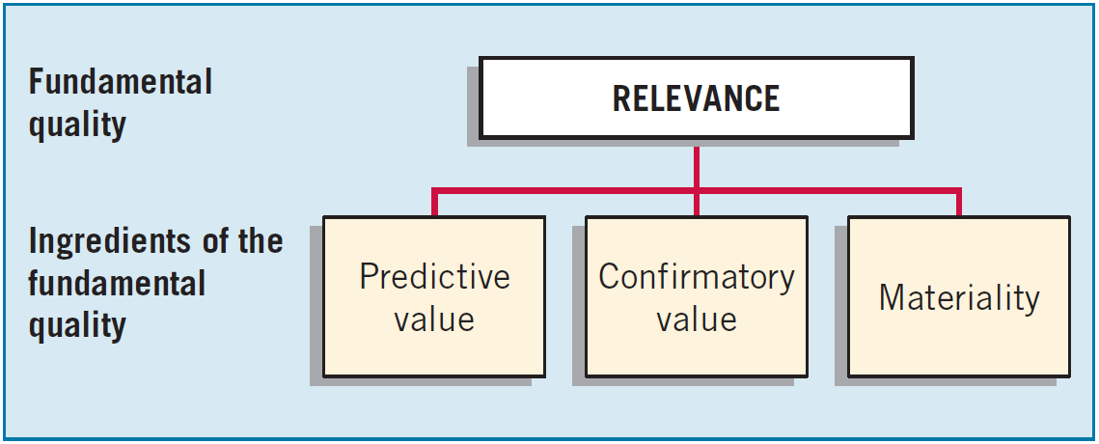
Second Level: Fundamental Concepts
Fundamental Quality—Relevance
To be relevant, accounting information must be capable of making a difference in a decision.
LO 3

Slide 20
Second Level: Fundamental Concepts
Fundamental Quality—Relevance
Financial information has predictive value if it has value as an input to predictive processes used by investors to form their own expectations about the future.
LO 3

Slide 21
Second Level: Fundamental Concepts
Fundamental Quality—Relevance
Relevant information also helps users confirm or correct prior expectations.
LO 3

Slide 22
Second Level: Fundamental Concepts
Fundamental Quality—Relevance
Information is material if omitting it or misstating it could influence decisions that users make on the basis of the reported financial information.
LO 3

Slide 23
WHAT DO THE NUMBERS MEAN? LIVING IN A MATERIAL WORLD
WHAT’S YOUR PRINCIPLE
The need for a conceptual framework is highlighted by accounting scandals such as those at Enron and Lehman Brothers. To restore public confidence in the financial reporting process, many have argued that regulators should move toward principles-based rules. They believe that companies exploited the detailed provisions in rules-based pronouncements to manage accounting reports, rather than report the economic substance of transactions. For example, many of the off–balance-sheet arrangements of Enron avoided transparent reporting by barely achieving 3 percent outside equity ownership, a requirement in an obscure accounting rule interpretation. Enron’s financial engineers were able to structure transactions to achieve a desired accounting treatment, even if that accounting treatment did not reflect the transaction’s true nature. Under principles-based rules, hopefully top management’s financial reporting focus will shift from demonstrating compliance with rules to demonstrating that a company has attained the objective of financial reporting.
LO 3

Slide 24
Faithful Representation
ILLUSTRATION 2-7
Conceptual Framework for Financial Reporting
LO 3

Slide 25
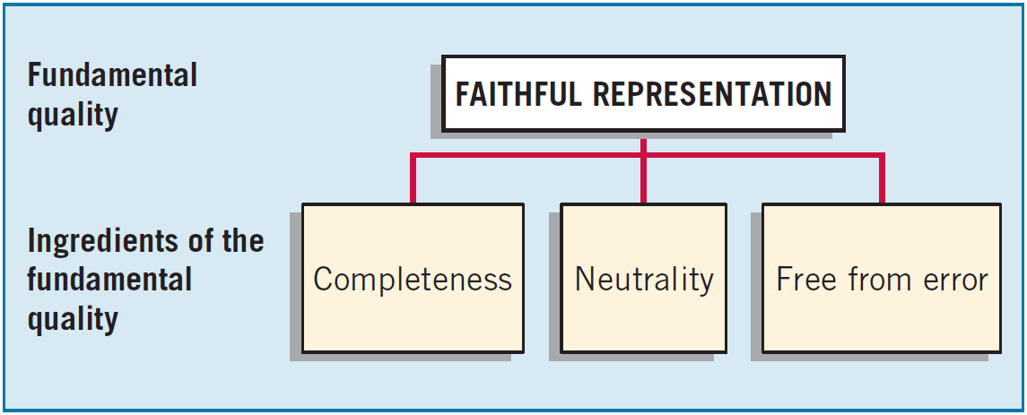
Second Level: Fundamental Concepts
Fundamental Quality—Faithful Representation
Faithful representation means that the numbers and descriptions match what really existed or happened.
LO 3

Slide 26
Second Level: Fundamental Concepts
Fundamental Quality—Faithful Representation
Completeness means that all the information that is necessary for faithful representation is provided.
LO 3

Slide 27
Second Level: Fundamental Concepts
Fundamental Quality—Faithful Representation
Neutrality means that a company cannot select information to favor one set of interested parties over another.
LO 3

Slide 28
Second Level: Fundamental Concepts
Fundamental Quality—Faithful Representation
An information item that is free from error will be a more accurate (faithful) representation of a financial item.
LO 3

Slide 29
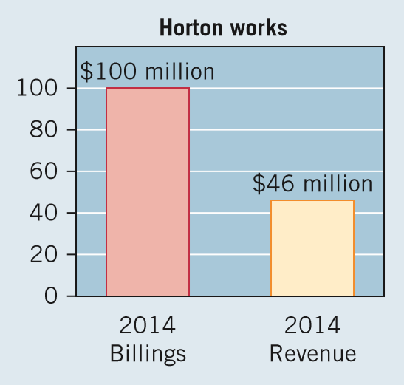
WHAT DO THE NUMBERS MEAN? SHOW ME THE EARNINGS!
WHAT’S YOUR PRINCIPLE
Some young technology companies, in an effort to attract investors who will help them strike it rich, are using unconventional ﬁnancial terms in their ﬁnancial reports. As an example, instead of revenue, these privately held companies use terms such as “bookings,” annual recurring revenues, or other numbers that often exceed actual revenue. Hortonworks Inc. (a software company) is a classic illustration. It forecast in March 2014 that it would have a strong $100 million in
billing by year-end. It turns out the
company was not talking about
revenues but rather a non-GAAP number
that it uses to gauge future business.
This number looked a lot smaller after
Hortonworks went public and reported
ﬁnancial results—just $46 million in
revenues, as shown in the chart.
LO 3

Slide 30
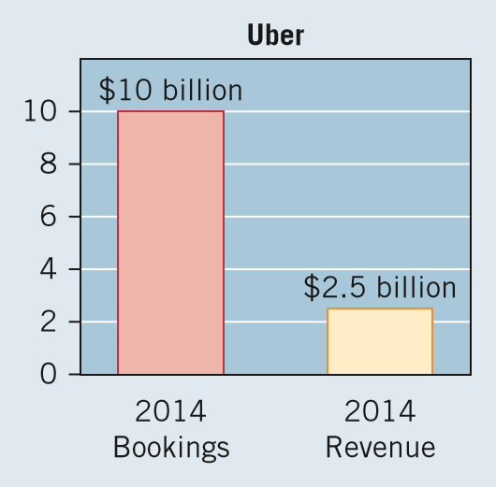
WHAT DO THE NUMBERS MEAN? SHOW ME THE EARNINGS!
WHAT’S YOUR PRINCIPLE
Another example is Uber Technologies (the sometimes controversial ride service). Uber recently noted that it is on target to reach $10 billion in bookings for 2015. Uber deﬁnes bookings as total fares paid by customers. But Uber keeps little of the money from these bookings. As shown in the chart below, Uber gets only 25 cents on each $1 of bookings. If Uber was a public company, it would report the 25 cents as revenues, not the one dollar. The lesson for
investors: Keep an eye on reliable
ﬁnancial measures of performance and
be sure to count expenses and net
income according to GAAP. Using
gross measures such as billings,
recurring revenues, or some nonﬁnancial
and non-GAAP measures to determine
success may be hazardous to your
ﬁnancial health.
Source: Telis Demos, Shira Ovide, and Susan Pulliam, “Tech Startups Play Numbers Game,” Wall Street Journal (June 10, 2015), pp. A1 and A12.

Slide 31
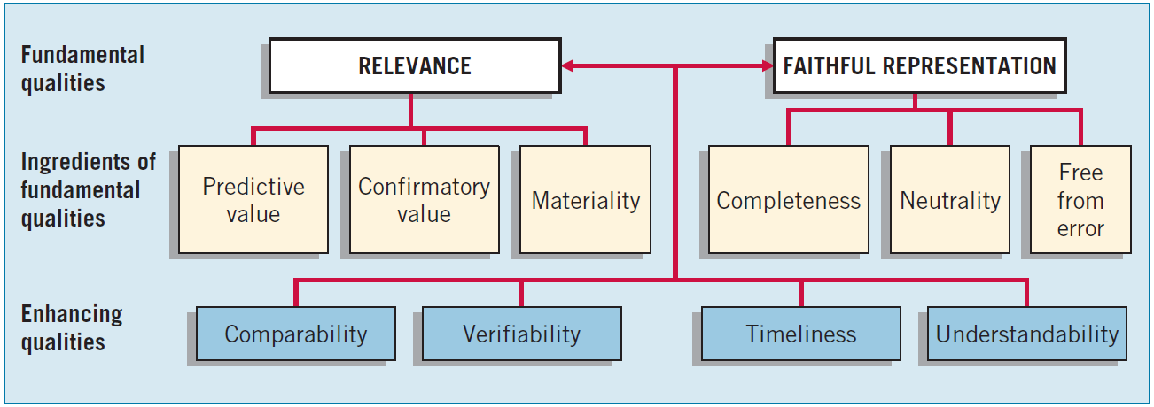
Second Level: Fundamental Concepts
Enhancing Qualities
Information that is measured and reported in a similar manner for different companies is considered comparable.
LO 3

Slide 32
Second Level: Fundamental Concepts
Enhancing Qualities
Verifiability occurs when independent measurers, using the same methods, obtain similar results.
LO 3

Slide 33
Second Level: Fundamental Concepts
Enhancing Qualities
Timeliness means having information available to decision-makers before it loses its capacity to influence decisions.
LO 3

Slide 34
Second Level: Fundamental Concepts
Enhancing Qualities
Understandability is the quality of information that lets reasonably informed users see its significance.
LO 3

Slide 35
Basic Elements
ILLUSTRATION 2-7
Conceptual Framework for Financial Reporting
LO 3

Slide 36
LEARNING OBJECTIVES
2
Conceptual Framework for Financial Reporting
After studying this chapter, you should be able to:
Describe the usefulness of a conceptual framework.
Understand the objective of financial reporting.
Identify the qualitative characteristics of accounting information.
Define the basic elements of financial statements.
Describe the basic assumptions of accounting.
Explain the application of the basic principles of accounting.
Describe the impact that the cost constraint has on reporting accounting information.
LO 4

Slide 37
Second Level: Basic Elements
Concepts Statement No. 6 defines ten interrelated elements that relate to measuring the performance and financial status of a business enterprise.
“Moment in Time”
“Period of Time”
Assets
Liabilities
Equity
Investment by owners
Distribution to owners
Comprehensive income
Revenue
Expenses
Gains
Losses
LO 4

Slide 38
Second Level: Basic Elements
Question
According to the FASB conceptual framework, an entity’s revenue may result from
A decrease in an asset from primary operations.
An increase in an asset from incidental transactions.
An increase in a liability from incidental transactions.
A decrease in a liability from primary operations.
LO 4

Slide 39
LEARNING OBJECTIVES
2
Conceptual Framework for Financial Reporting
After studying this chapter, you should be able to:
Describe the usefulness of a conceptual framework.
Understand the objective of financial reporting.
Identify the qualitative characteristics of accounting information.
Define the basic elements of financial statements.
Describe the basic assumptions of accounting.
Explain the application of the basic principles of accounting.
Describe the impact that the cost constraint has on reporting accounting information.
LO 5

Slide 40
Third Level: Recognition and Measurement
The FASB sets forth most of these concepts in its Statement of Financial Accounting Concepts No. 5, “Recognition and Measurement in Financial Statements of Business Enterprises.”
ILLUSTRATION 2-7
Conceptual Framework for Financial Reporting
LO 5

Slide 41
Third Level: Basic Assumptions
Economic Entity – company keeps its activity separate from its owners and other businesses.
Going Concern - company to last long enough to fulfill objectives and commitments.
Monetary Unit - money is the common denominator.
Periodicity - company can divide its economic activities into time periods.
LO 5

Slide 42
Third Level: Basic Assumptions
Illustration: Identify which basic assumption of accounting is best described in each item below.
The economic activities of KC Corporation are divided into 12-month periods for the purpose of issuing annual reports.
(b) Solectron Corporation, Inc. does not adjust amounts in its financial statements for the effects of inflation.
(c) Walgreen Co. reports current and noncurrent classifications in its balance sheet.
(d) The economic activities of General Electric and its subsidiaries are merged for accounting and reporting purposes.
Periodicity
Monetary
Unit
Going Concern
Economic
Entity
LO 5

Slide 43
WHAT DO THE NUMBERS MEAN? WHOSE COMPANY IS IT?
WHAT’S YOUR PRINCIPLE
The importance of the entity assumption is illustrated by scandals involving W. R. Grace and, more recently, Adelphia. In both cases, senior company employees entered into transactions that blurred the line between the employee’s ﬁnancial interests and those of the company. At Adelphia, among many other self-dealings, the company guaranteed over $2 billion of loans to the founding family. W. R. Grace used company funds to pay for an apartment and chef for the company chairman. As a result of these transactions, these insiders beneﬁtted at the expense of shareholders. Additionally, the ﬁnancial statements failed to disclose the transactions. Such disclosure would have allowed shareholders to sort out the impact of the employee transactions on company results.
LO 5

Slide 44
LEARNING OBJECTIVES
2
Conceptual Framework for Financial Reporting
After studying this chapter, you should be able to:
Describe the usefulness of a conceptual framework.
Understand the objective of financial reporting.
Identify the qualitative characteristics of accounting information.
Define the basic elements of financial statements.
Describe the basic assumptions of accounting.
Explain the application of the basic principles of accounting.
Describe the impact that the cost constraint has on reporting accounting information.
LO 6

Slide 45
Third Level: Basic Principles
Measurement Principle – The most commonly used measurements are based on historical cost and fair value.
Issues:
Historical cost provides a reliable benchmark for measuring historical trends.
Fair value information may be more useful.
Recently the FASB has taken the step of giving companies the option to use fair value as the basis for measurement of financial assets and financial liabilities.
Reporting of fair value information is increasing.
LO 6

Slide 46
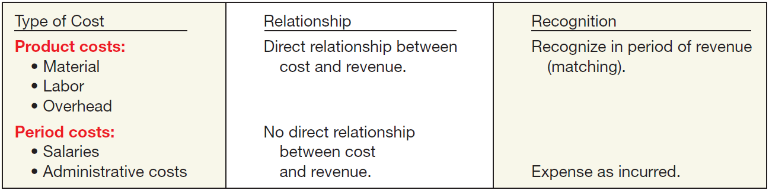
Third Level: Basic Principles
Revenue Recognition - requires that companies recognize revenue in the accounting period in which the performance obligation is satisfied.
Expense Recognition - “Let the expense follow the revenues.”
ILLUSTRATION 2-6 Expense Recognition
LO 6

Slide 47
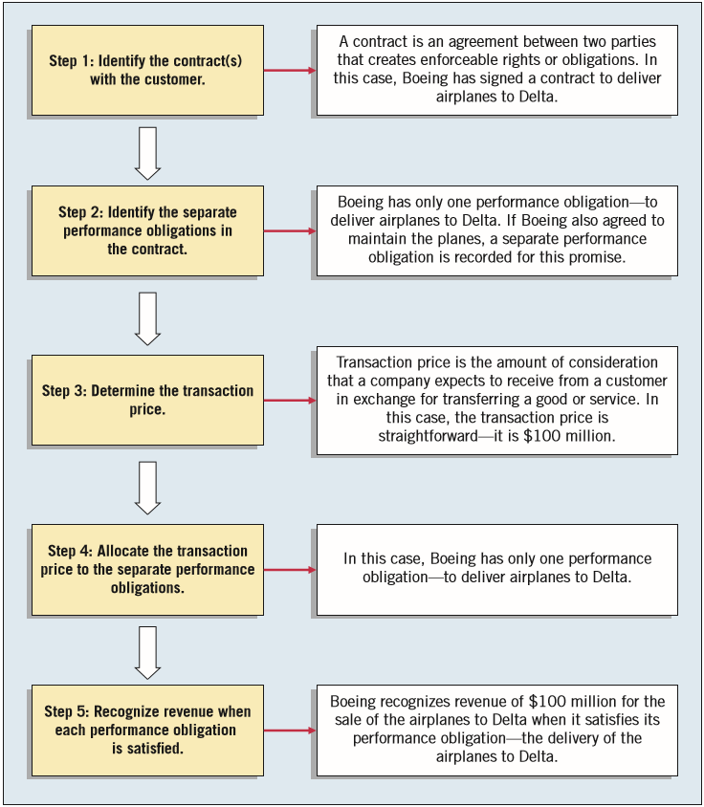
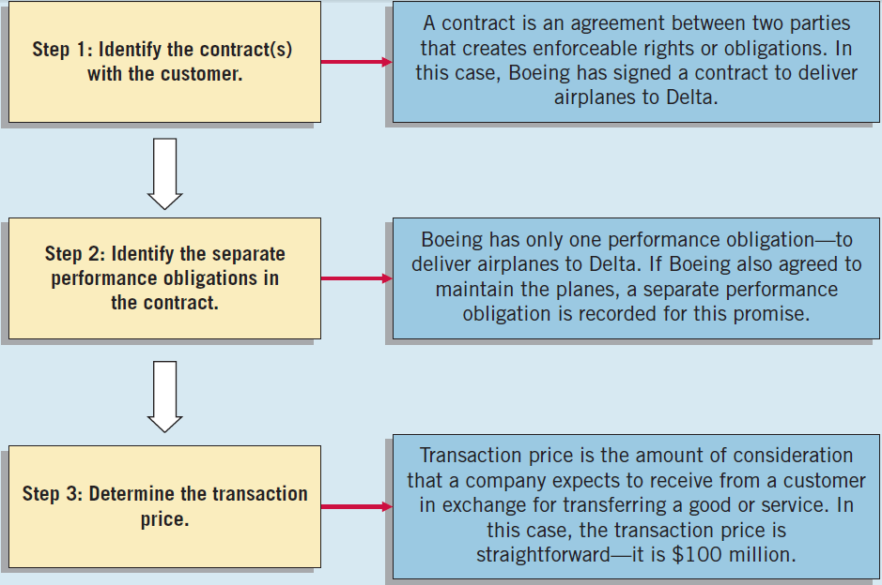
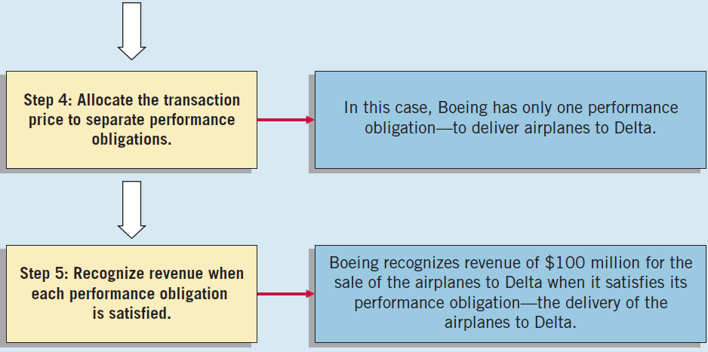
Third Level: Basic Principles
Illustration: Assume the Boeing Corporation signs a contract to sell airplanes to Delta Air Lines for $100 million. To determine when to recognize revenue, use the five steps for revenue recognition shown at right.
ILLUSTRATION 2-5

Slide 48
Third Level: Basic Principles
Full Disclosure – providing information that is of sufficient importance to influence the judgment and decisions of an informed user.
Provided through:
Financial Statements
Notes to the Financial Statements
Supplementary information
LO 6

Slide 49
Third Level: Basic Principles
Illustration: Identify which basic principle of accounting is best described in each item below.
(a) KC Corporation reports revenue in its income statement when it is earned instead of when the cash is collected.
(b) Yahoo, Inc. recognizes depreciation expense for a machine over the 2-year period during which that machine helps the company earn revenue.
(c) Oracle Corporation reports information about pending lawsuits in the notes to its financial statements.
(d) Eastman Kodak Company reports land on its balance sheet at the amount paid to acquire it, even though the estimated fair market value is greater.
Revenue
Recognition
Expense
Recognition
Full
Disclosure
Measurement
LO 6

Slide 50
WHAT DO THE NUMBERS MEAN? DON’T COUNT THESE PLEASE
WHAT’S YOUR PRINCIPLE
Beyond touting nonﬁnancial measures to investors, many companies increasingly promote the performance of their companies through the reporting of various “pro forma” earnings measures. Pro forma measures are standard measures (such as earnings) that companies adjust, usually for unusual or non-recurring items. Such adjustments make the numbers more comparable to numbers reported in periods without these unusual or non-recurring items. However, rather than increasing comparability, it appears that some companies use pro forma reporting to accentuate the positive in their results. Examples include Yahoo! and Cisco, which deﬁne pro forma income after adding back payroll tax expense. Level 8 Systems transformed an operating loss into a pro forma proﬁt by adding back expenses for depreciation and amortization of intangible assets. And taking a more macro look, the following table shows the difference between pro forma (non-GAAP) and GAAP earnings per share for the three main Standard & Poor’s stock indexes for recent year.
continued
LO 6

Slide 51
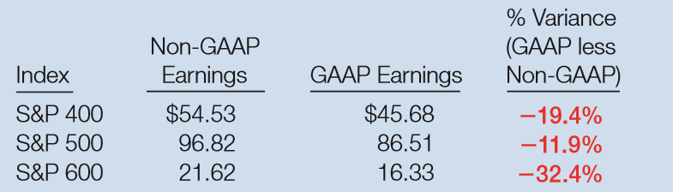
WHAT DO THE NUMBERS MEAN? DON’T COUNT THESE PLEASE
WHAT’S YOUR PRINCIPLE
What this table shows is
that the S&P 600 is
especially biased with a
variance of 32.4%
(non-GAAP higher than
GAAP). Lynn Turner, former chief accountant at the SEC, calls such earnings measures EBS—“Everything but Bad Stuff.” To provide investors a more complete picture of company proﬁtability, not the story preferred by management, the SEC issued Regulation G (REG G). For example, REG G (and related item 10E) requires companies to reconcile non-GAAP ﬁnancial measures to GAAP, thereby giving investors a roadmap to analyze the adjustments that companies make to their GAAP numbers to arrive at pro forma results.
Sources: Adapted from Gretchen Morgenson, “How Did They Value Stocks? Count the Absurd Ways,” The New York Times (March 18, 2001), section 3, p. 1; Regulation G, “Conditions for Use of Non-GAAP Financial Measures,” Release No. 33-8176 (March 28, 2003, updated January, 2010); and J. Adamo, “Even GAAP Is Better Than These Adjustments,” Barron’s (November 4, 2013).
LO 6

Slide 52
LEARNING OBJECTIVES
2
Conceptual Framework for Financial Reporting
After studying this chapter, you should be able to:
Describe the usefulness of a conceptual framework.
Understand the objective of financial reporting.
Identify the qualitative characteristics of accounting information.
Define the basic elements of financial statements.
Describe the basic assumptions of accounting.
Explain the application of the basic principles of accounting.
Describe the impact that the cost constraint has on reporting accounting information.
LO 7

Slide 53
Third Level: Constraints
Cost Constraint – cost of providing information must be weighed against the benefits that can be derived from using it.
Illustration: The following two situations represent applications of the cost constraint.
Rafael Corporation discloses fair value information on its loans because it already gathers this information internally.
Willis Company does not disclose any information in the notes to the financial statements unless the value of the information to users exceeds the expense of gathering it.
LO 7

Slide 54
Summary of the Structure
ILLUSTRATION 2-7
Conceptual Framework for Financial Reporting
LO 7

Slide 55
RELEVANT FACTS
Similarities
In 2010, the IASB and FASB agreed on the objective of financial reporting and a common set of desired qualitative characteristics. These were presented in the Chapter 2 discussion. Note that prior to this agreement, the IASB conceptual framework gave more emphasis to the objective of providing information on management’s performance (stewardship).
The existing conceptual frameworks underlying GAAP and IFRS are very similar. That is, they are organized in a similar manner (objective, elements, qualitative characteristics, etc.). There is no real need to change many aspects of the existing frameworks other than to converge different ways of discussing essentially the same concepts.
LO 8 Compare the conceptual frameworks underlying GAAP and IFRS.

Slide 56
RELEVANT FACTS
Similarities
Both the IASB and FASB have similar measurement principles, based on historical cost and fair value. In 2011, the Boards issued a converged standard fair value measurement so that the definition of fair value, measurement techniques, and disclosures are the same between GAAP and IFRS when fair value is used in financial statements.
LO 8

Slide 57
RELEVANT FACTS
Differences
Although both GAAP and IFRS are increasing the use of fair value to report assets, at this point IFRS has adopted it more broadly. As examples, under IFRS, companies can apply fair value to property, plant, and equipment; natural resources; and in some cases, intangible assets.
GAAP has a concept statement to guide estimation of fair values when market-related data is not available (Statement of Financial Accounting Concepts No. 7, “Using Cash Flow Information and Present Value in Accounting”). The IASB has not issued a similar concept statement; it has issued a fair value standard (IFRS 13) that is converged with GAAP.
LO 8

Slide 58
RELEVANT FACTS
Differences
The monetary unit assumption is part of each framework. However, the unit of measure will vary depending on the currency used in the country in which the company is incorporated (e.g., Chinese yuan, Japanese yen, and British pound). IFRS makes an explicit assumption that financial statements are prepared on an accrual basis.
The economic entity assumption is also part of each framework, although some cultural differences result in differences in its application. For example, in Japan many companies have formed alliances that are so strong that they act similar to related corporate divisions although they are not actually part of the same company.
LO 8

Slide 59
ABOUT THE NUMBERS
Financial Statement Elements
While the conceptual framework that underlies IFRS is very similar to that used to develop GAAP, the elements identified and their definitions under IFRS are different. The IASB elements and their definitions are as follows.
Assets. A resource controlled by the entity as a result of past events and from which future economic benefits are expected to flow to the entity.
Liabilities. A present obligation of the entity arising from past events, the settlement of which is expected to result in an outflow from the entity of resources embodying economic benefits. Liabilities may be legally enforceable via a contract or law, but need not be, i.e., they can arise due to normal business practice or customs.
LO 8

Slide 60
ABOUT THE NUMBERS
Financial Statement Elements
While the conceptual framework that underlies IFRS is very similar to that used to develop GAAP, the elements identified and their definitions under IFRS are different. The IASB elements and their definitions are as follows.
Equity. A residual interest in the assets of the entity after deducting all its liabilities.
Income. Increases in economic benefits that result in increases in equity (other than those related to contributions from shareholders). Income includes both revenues (resulting from ordinary activities) and gains.
Expenses. Decreases in economic benefits that result in decreases in equity (other than those related to distributions to shareholders). Expenses includes losses that are not the result of ordinary activities.
LO 8

Slide 61
Conceptual Framework Work Plan
Moving ahead in its stand-alone conceptual framework project, the IASB has decided that:
The conceptual framework project should focus on elements of financial statements, reporting entity, presentation, and disclosure.
The aim should be to work toward a single discussion paper covering all of the identified areas, rather than separate discussion papers for each area.
LO 8

Slide 62
ON THE HORIZON
The IASB and the FASB face a difficult task in attempting to update, modify, and complete a converged conceptual framework. There are many difficult issues. For example: How do we trade off characteristics such as highly relevant information that is difficult to verify? How do we define control when we are developing a definition of an asset? Is a liability the future sacrifice itself or the obligation to make the sacrifice? Should a single measurement method, such as historical cost or fair value, be used, or does it depend on whether it is an asset or liability that is being measured?
LO 8

Slide 63
IFRS SELF-TEST QUESTION
Which of the following statements about the IASB and FASB conceptual frameworks is not correct?
The IASB conceptual framework does not identify the element comprehensive income.
The existing IASB and FASB conceptual frameworks are organized in similar ways.
The FASB and IASB agree that the objective of financial reporting is to provide useful information to investors and creditors.
IFRS does not allow use of fair value as a measurement basis.
LO 8

Slide 64
IFRS SELF-TEST QUESTION
Which of the following statements is false?
The monetary unit assumption is used under IFRS.
Under IFRS, companies may use fair value for property, plant, and equipment.
The FASB and IASB are working on a joint conceptual framework project.
Under IFRS, there are the same number of financial statement elements as in GAAP.
LO 8

Slide 65
IFRS SELF-TEST QUESTION
The issues that the FASB and IASB must address in developing a common conceptual framework include all of the following except:
Should the characteristic of relevance be traded-off in favor of information that is verifiable?
Should a single measurement method be used?
Should the common framework lead to standards that are principles-based or rules-based?
Should the role of financial reporting focus on internal decision-making as well as providing information to assist users in decision-making?
LO 8

Slide 66
COPYRIGHT
“Copyright © 2016 John Wiley & Sons, Inc. All rights reserved. Reproduction or translation of this work beyond that permitted in Section 117 of the 1976 United States Copyright Act without the express written permission of the copyright owner is unlawful. Request for further information should be addressed to the Permissions Department, John Wiley & Sons, Inc. The purchaser may make back-up copies for his/her own use only and not for distribution or resale. The Publisher assumes no responsibility for errors, omissions, or damages, caused by the use of these programs or from the use of the information contained herein.”

