Slide 1
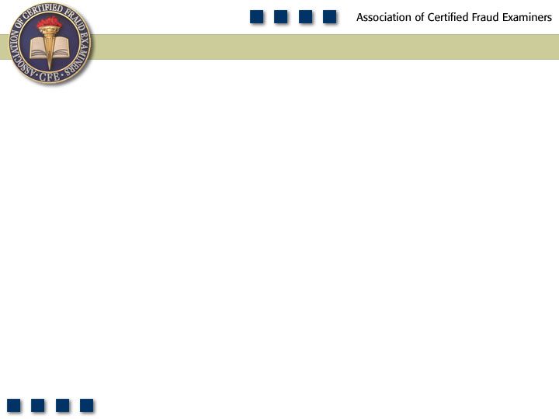
Chapter 2
Skimming

Slide 2
Chapter Objectives
Define skimming.
List and understand the two principal categories of skimming schemes.
Understand how sales skimming is committed and concealed.
Understand schemes involving understated sales.
Understand how cash register manipulations are used to skim currency.
Be familiar with how sales are skimmed during non-business hours.
Understand the techniques discussed for preventing and detecting sales skimming.

Slide 3
Chapter Objectives
List and be able to explain the six methods typically used by fraudsters to conceal receivables skimming.
Understand what “lapping” is and how it is used to hide skimming schemes.
Be familiar with how fraudsters use fraudulent write-offs or discounts to conceal skimming.
Understand the techniques discussed for preventing and detecting receivables skimming.
Be familiar with proactive audit tests that can be used to detect skimming.

Slide 4
Skimming Schemes
Skimming
Sales
Receivables
Refunds &
Other
Unrecorded
Write-off
Schemes
Understated
Lapping
Schemes
Unconcealed

Slide 5
Skimming
Theft of cash from a victim entity prior to its entry in an accounting system
  “Off-book”
No direct audit trail
Its principal advantage is its difficulty of detection.

Slide 6
Asset Misappropriations
2011 Global Fraud Survey
Scheme Type | % of Asset Misappropriation Cases | Median Loss
Cash Misappropriations | 82.1% | $100,000
Non-Cash Misappropriations | 19.9% | $58,000

Slide 7
Frequency of Cash Misappropriations

Slide 8
Median Loss of Cash Misappropriations

Slide 9
Sales Skimming
Employee makes a sale of goods or services, collects the payment, and makes no record of the transaction.
Employee pockets the proceeds of the sale.
Without a record of the sale, there is no audit trail.

Slide 10
Sales Skimming
Cash register manipulation
  “No sale” or other non-cash transaction is recorded.
  Cash registers are rigged so that sales are not recorded on the register tapes.
  No receipt is issued.
After hours sales
  Sales are conducted during non-business hours without the knowledge of the owners.
Skimming by off-site employees
  Independent salespeople
  Employees at remote locations – branches or satellite offices away from the primary business site

Slide 11
Sales Skimming
Poor collection procedures
Understated sales
  Sale is recorded for a lower amount than was collected.
  Price of sales item is reduced.
  Quantity of items sold is reduced.
Theft in the mail room – incoming checks
  Incoming checks are stolen and cashed.
  Customer’s account is not posted.

Slide 12
Preventing and Detecting
Sales Skimming
Maintain a viable oversight presence at any point.
Create a perception of detection.
Install video cameras.
Utilize customers to detect and prevent fraud.
All cash registers should record the log-in and log-out time of each user.
Off-site sales personnel should also be required to maintain activity logs.
Eliminate potential hiding places for stolen money.
Incoming mail should be opened in a clear, open area free from blind spots and with supervisory presence.

Slide 13
Receivables Skimming
More difficult than skimming sales
  There is a record of the sale.
  Collection is expected.
Customers are notified when payment is not received and will most likely complain.
Lapping
Force balancing
Stolen statements
Fraudulent write-offs or discounts
Debiting the wrong account
Document destruction

Slide 14
Receivables Skimming
Lapping
  Crediting one customer’s account with payment received from another customer
  Keeping track of payments becomes complicated.
  Second set of books is sometimes kept.
Force balancing
  Posting to the customer’s account without depositing the check creates an imbalance condition.
  Cash account is overstated so the amount skimmed must be forced in order to balance the account.
Stolen statements
  Employee steals or alters the account statement or produces counterfeit statements.
  May change the customer’s address in order to intercept the statement

Slide 15
Receivables Skimming
Fraudulent write-offs or discounts
  Write off the account as bad debt.
  Post entries to a contra revenue account – “discounts and allowances.”
Debiting the wrong account
  Debit an existing or fictitious A/R.
  Wait for the A/R to age and be written off.
Destroying or altering records of the transaction
  Often a last ditch effort to conceal the fraud
  Makes it more difficult to prove the fraud

Slide 16
Preventing and Detecting Receivables Skimming
Succeed when there is a breakdown in an organization’s controls
  Mandate vacations.
  Mandate supervisory approval.
  Train audit staff.
Proactively search for accounting clues.
Perform trend analysis on aging of customer accounts.
Conduct audit tests.

