Slide 1
Vitamin E
NUTD 337

Slide 2
Vitamin E role
Not well known until recently
  Not just an antioxidant
  Role vary from cell signaling to platelet aggregation
There are eight vitamin E structures
  Tocopherol & Tocotreinol with each having four substrutures labelled as
    α, β, δ, γ

Slide 3
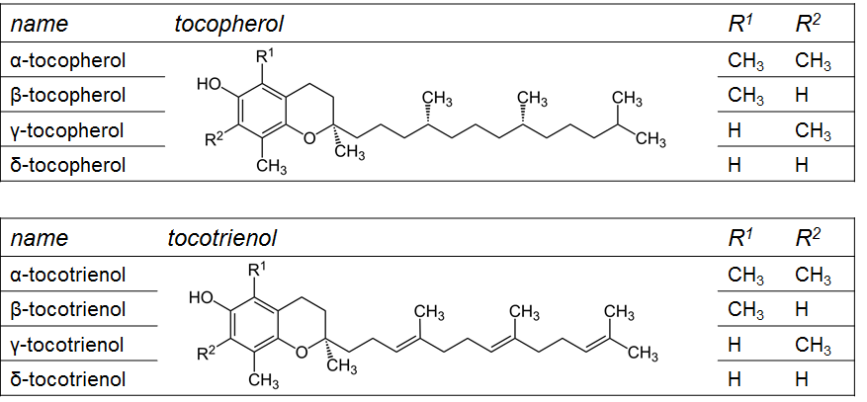
Structures

Slide 4
Food Sources
Best Sources
  Vegetables Oils
  Nuts
  Green leafy vegetables
  Whole grains
  Wheat germ
Low sources
  Fish, meats, dairy, vegetables and fruits

Slide 5
Vitamin E needs
RDA of 15 mg/day
  >14 years till 51+ years old
  AI only 0 t 6 months 4 mg/day
  AI only 7 to 12 months 5 mg/day
  RDA of 6 mg/day for 1 to 3 yrs old
  RDA of 7 mg/day for 4 to 8 years old
  RDA of 11 mg/day for 9 to 13 years old
Upper Limit
  0 to 6 mnths 200 mg/day
  4 to 8 years 300 mg/day
  9 to 13 years old 600 mg/day
  14 to 18 years old 800 mg/day
  > 19 years old 1000 mg/day

Slide 6
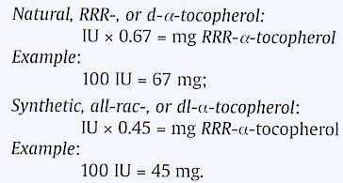
Vitamin E International Unit conversion

Slide 7
Absorption
Vitamin E is found in the diet as vitamin Ester
First the ester is cleaved by lipases
Vitamin E is the incorporated into micelles for absorption in the small intestine
In the small intestine it is incorporated into chylomircons, released into lymphatic criculation and delivered to the liver
Tocopherol transport protein incorporate vitamin E into Lipoproteins and delivered to extrahepatic tissue

Slide 8
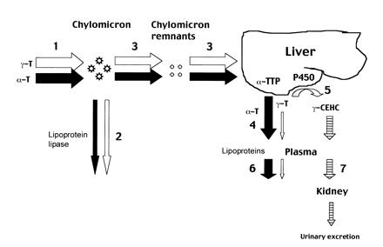
Figure 1. Absorption, transport, and metabolism of a-tocopherol (a -T) and γ-tocopherol (γ -T) in peripheral tissues (eg, muscle and adipose). American Journal of Clinical Nutrition, Vol. 74, No. 6, 714-722, 2001

Slide 9
metabolism
There are two main routes of vitamin E excretion. The major route of excretion is through bile that is then excreted in feces. The second route is in the urine after vitamin E is chain-shortened in a process similar to beta-oxidation to make them more water-soluble
Metabolites
  2,5,7,8-tetramethyl-2-(2´-carboxyethyl)-6-hydroxychroman (α-CEHC)
  2,7,8-trimethyl-2-(2´-carboxyethyl)-6-hydroxychroman (γ-CEHC) derived
  The major route of excretion of absorbed tocopherol is fecal elimination. Excess a-tocopherol and other forms of tocopherols are excreted unchanged in the bile.

Slide 10
Vitamin E functions
Anti oxidant
  Protect cellular membrane and DNA from free radical damage
  Protects LDL cholesterol from free radical damage
    Oxidation of LDL causes it to precipitate and accumulate in arteries causing plagues leading to stroke
  Prevent blood clots by reducing platelet aggregation
  Cellular signalling and gene regulation

Slide 11
Defiency and toxicity
Deficiency rare
  First signs is breakdown of red blood cells
Toxicity
  Low toxicity
  But overdosing may increase blood thinning
  USDA uppler Limit 1000mg/day, EU 300 mg/day

