Slide 1
Chapter 6 Part 2
The particle in a box
(Infinite square well)

Slide 2
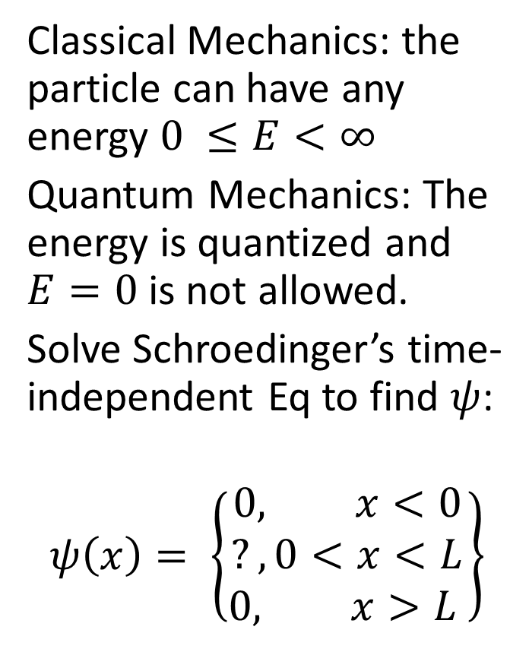
Section 6.4: The particle in a box:
Classical Mechanics: the particle can have any energy $0 ≤E<∞$
Quantum Mechanics: The energy is quantized and $E=0$is not allowed.
Solve Schroedinger’s time-independent Eq to find $ψ$:
$$ψ\left(x\right)= \left\{\begin{matrix}0, x<0 \\ ?, 0<x<L \\ 0, x>L \end{matrix}\right\}$$

Slide 3
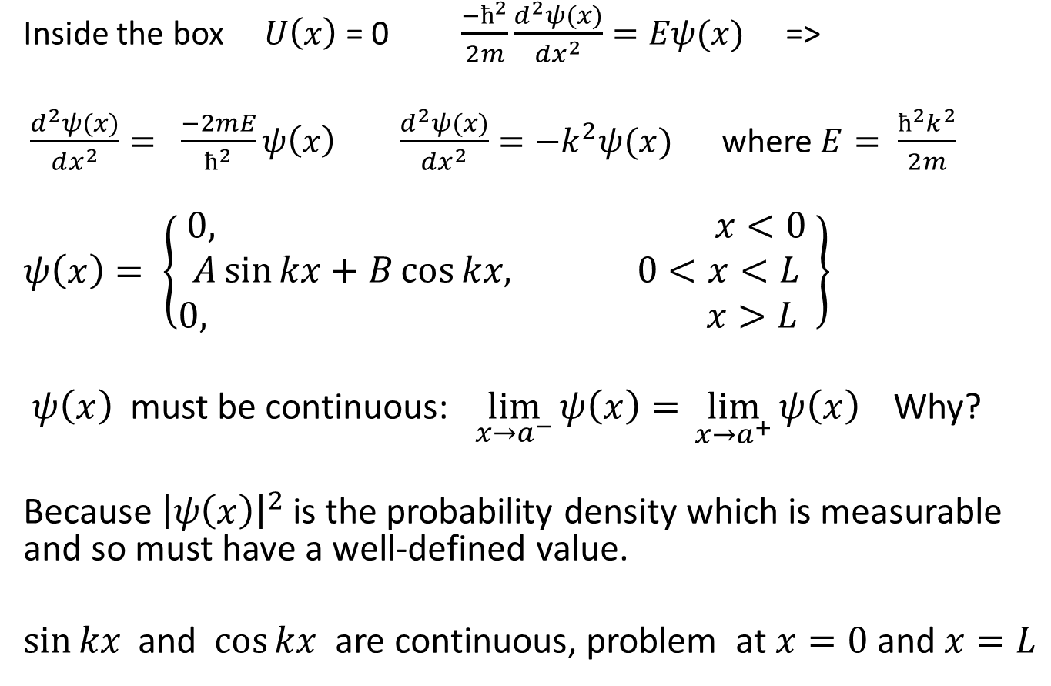

$$\frac{−ħ^{2}}{2m}\frac{d^{2}ψ(x)}{dx^{2}}+ U\left(x\right)ψ\left(x\right)=Eψ(x)$$
Inside the box $U\left(x\right)$ = 0 $\frac{−ħ^{2}}{2m}\frac{d^{2}ψ(x)}{dx^{2}}=Eψ(x)$ =>
$\frac{d^{2}ψ(x)}{dx^{2}}= \frac{−2mE}{ħ^{2}}ψ\left(x\right)$ $\frac{d^{2}ψ(x)}{dx^{2}}=−k^{2}ψ(x)$ where $E= \frac{ħ^{2}k^{2}}{2m}$
$$ψ\left(x\right)= \left\{\begin{matrix}0, x<0 \\ A\sin{kx}+B\cos{kx,} 0<x<L \\ 0, x>L \end{matrix}\right\}$$
$ψ\left(x\right)$ must be continuous: $\lim_{x→a^{−}}{ψ\left(x\right)= }\lim_{x→a^{+}}{ψ\left(x\right) }$ Why?
Because ${\left|ψ\left(x\right)\right|}^{2}$ is the probability density which is measurable and so must have a well-defined value.
$\sin{kx}$ and $\cos{kx}$ are continuous, problem at $x=0$and $x=L$

Slide 4
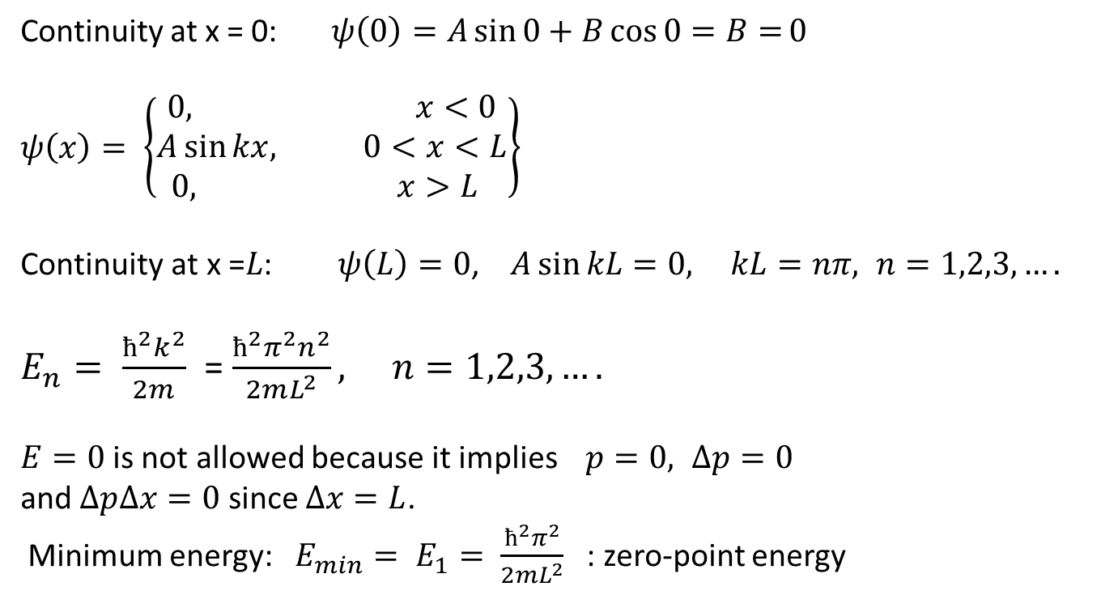
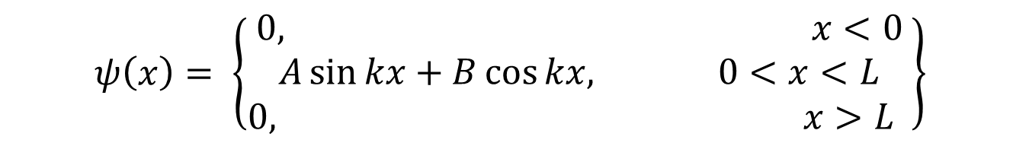
$$ψ\left(x\right)= \left\{\begin{matrix}0, x<0 \\ A\sin{kx}+B\cos{kx,} 0<x<L \\ 0, x>L \end{matrix}\right\}$$
Continuity at x = 0: $ψ\left(0\right)=A\sin{0}+B\cos{0=B=}0$
$$ψ\left(x\right)= \left\{\begin{matrix}0, x<0 \\ A\sin{kx, } 0<x<L \\ 0, x>L \end{matrix}\right\}$$
$\text{Continuity} \text{at} \text{x}\text{ =}L\text{:} ψ\left(L\right)=0$, $A\sin{kL=0, }$ $kL=nπ, n=1,2,3,….$
$E_{n}= \frac{ħ^{2}k^{2}}{2m}$ = $\frac{ħ^{2}π^{2}n^{2}}{2mL^{2}}, n=1,2,3,….$
$E=0$is not allowed because it implies $p=0, ∆p=0$
and $∆p∆x=0$ since $∆x=L$.
Minimum energy: $E_{min}= E_{1}= \frac{ħ^{2}π^{2}}{2mL^{2}}$ : zero-point energy

Slide 5
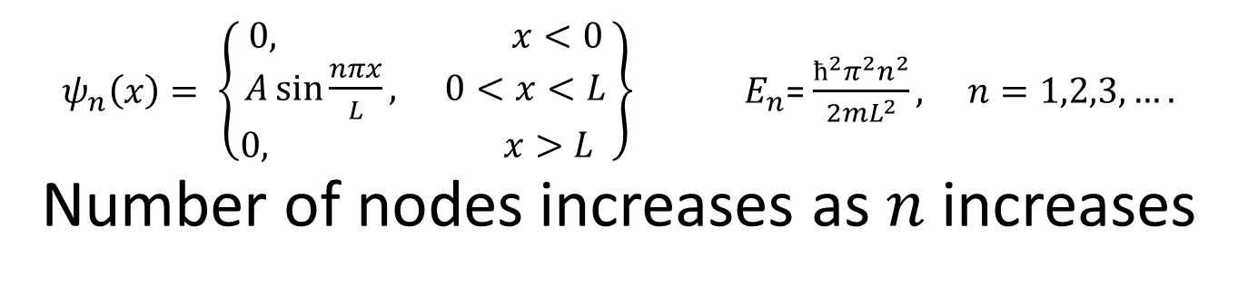
$ψ_{n}\left(x\right)= \left\{\begin{matrix}0, x<0 \\ A\sin{\frac{nπx}{L}, } 0<x<L \\ 0, x>L \end{matrix}\right\}$ $E_{n}$= $\frac{ħ^{2}π^{2}n^{2}}{2mL^{2}}, n=1,2,3,….$
Number of nodes increases as $n$ increases

Slide 7
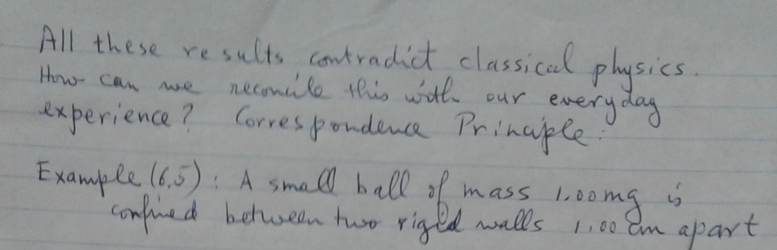
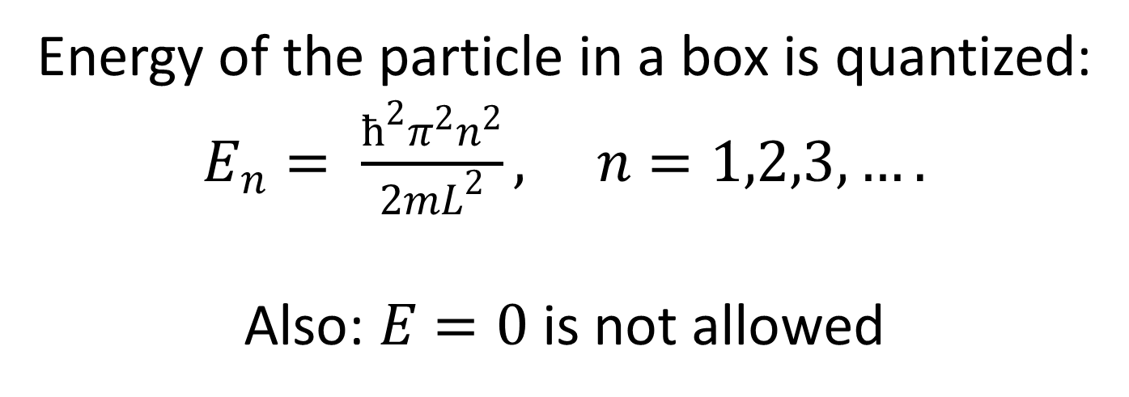
Energy of the particle in a box is quantized:
$E_{n}= \frac{ħ^{2}π^{2}n^{2}}{2mL^{2}}, n=1,2,3,….$
Also: $E=0$is not allowed

Slide 8
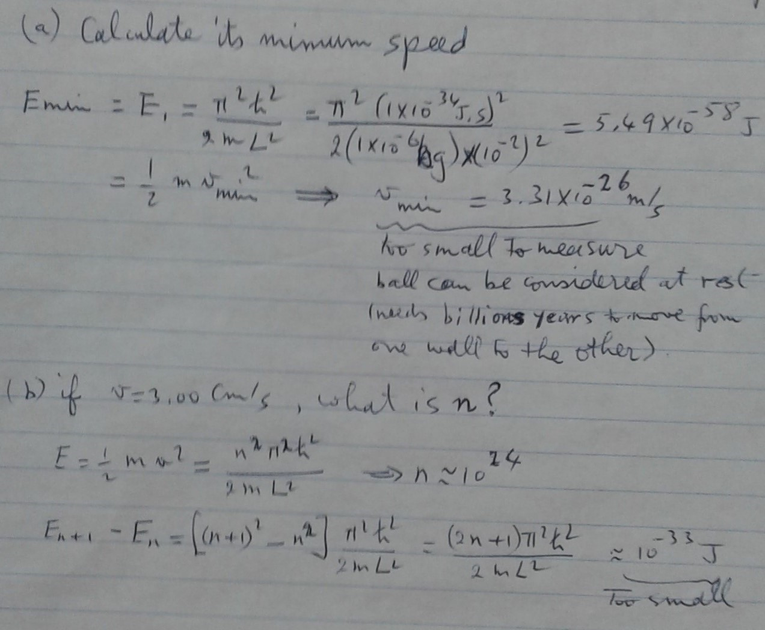

Slide 9
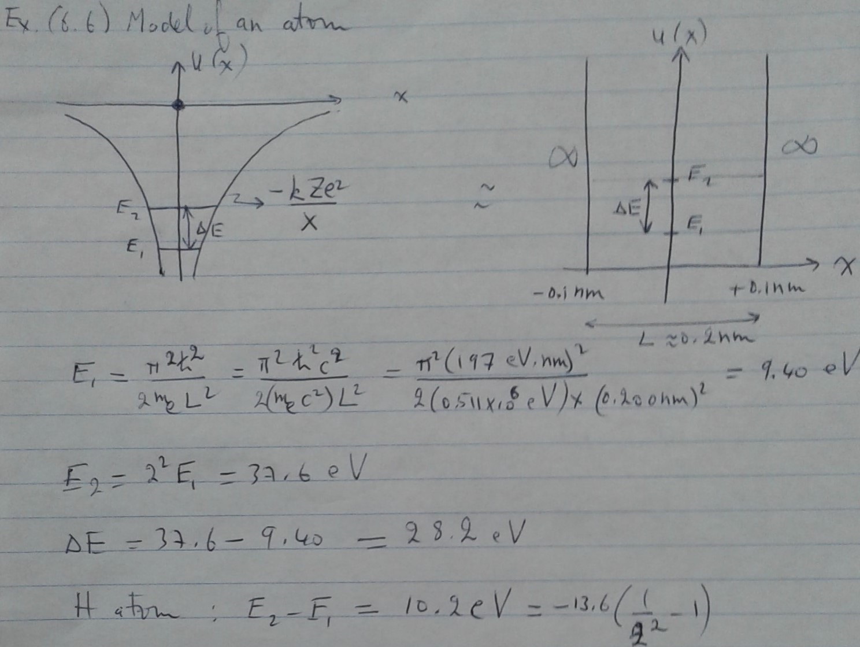

Slide 10
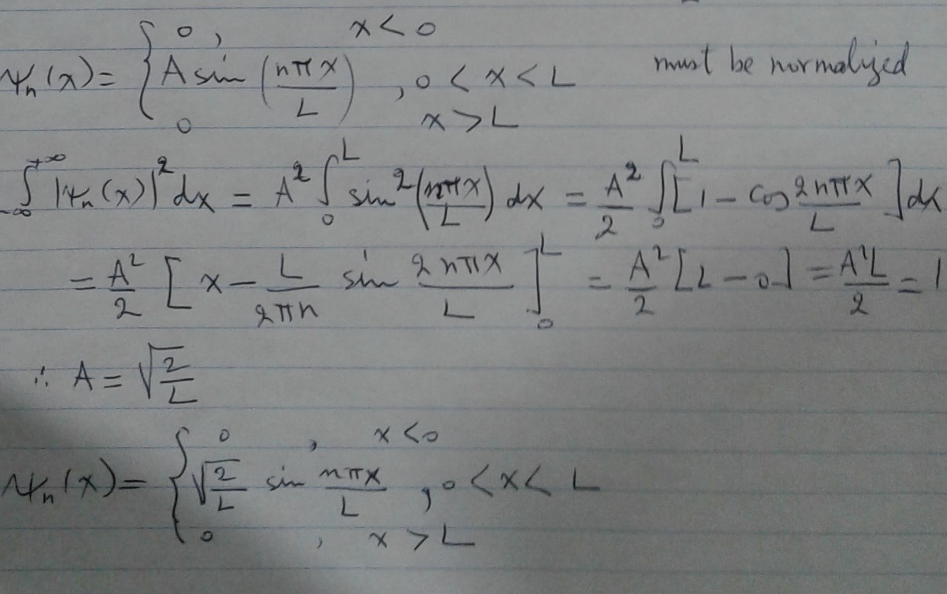

Slide 11
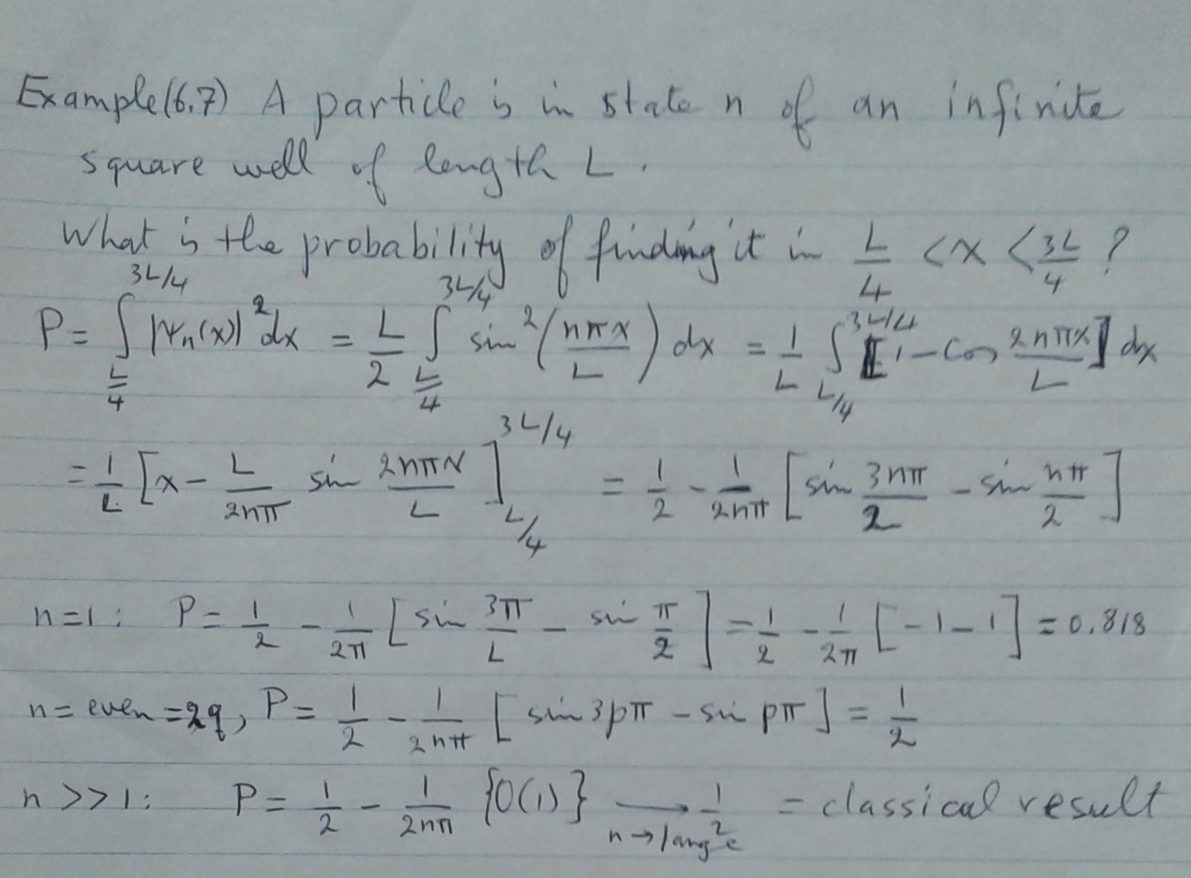

Slide 12
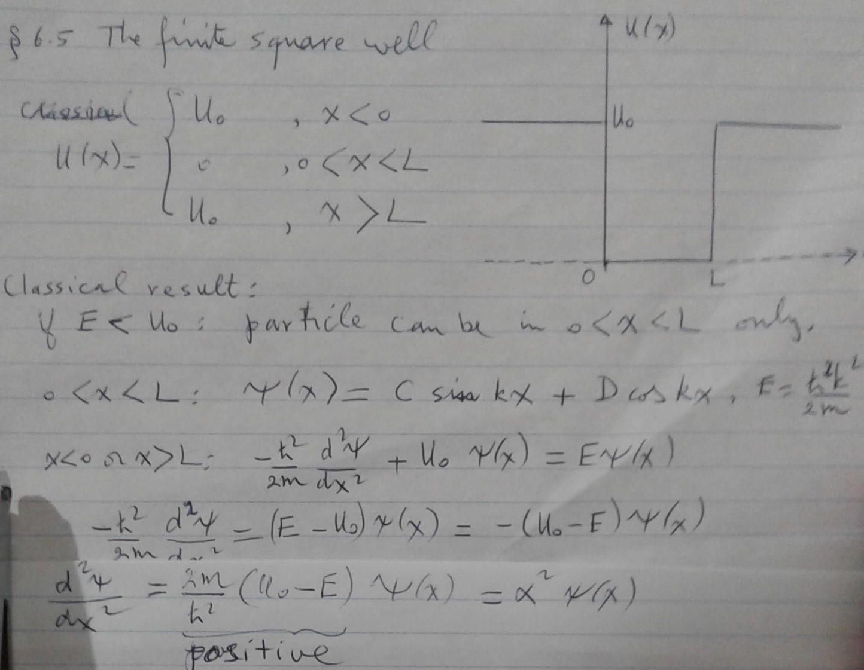

Slide 13
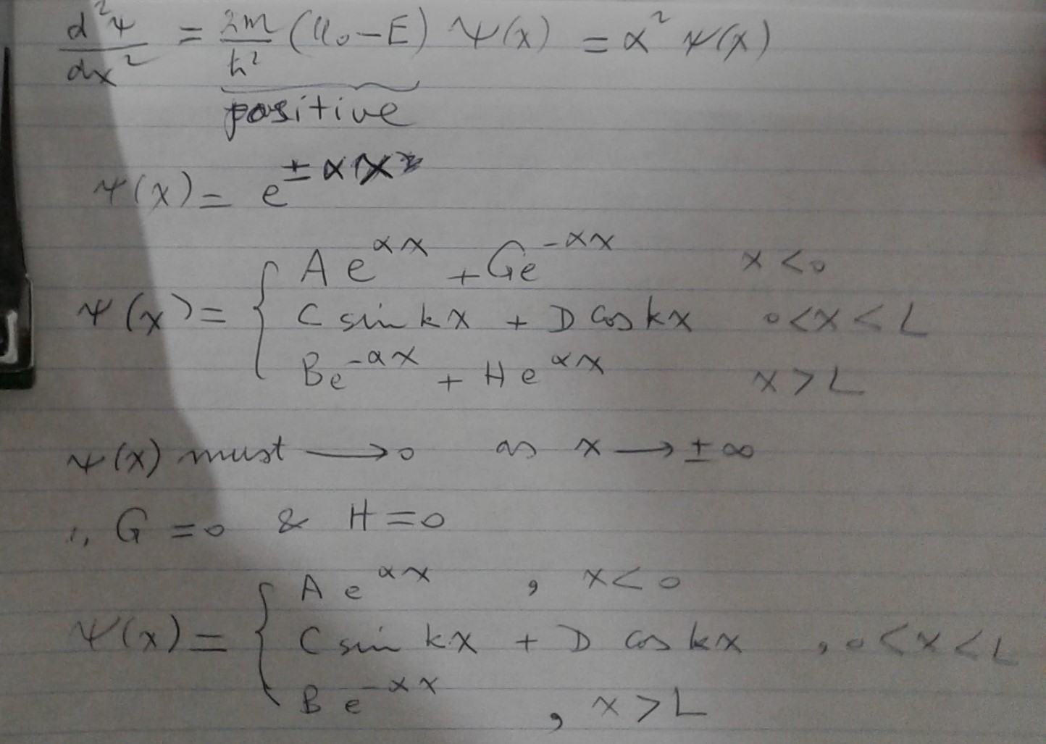

Slide 14
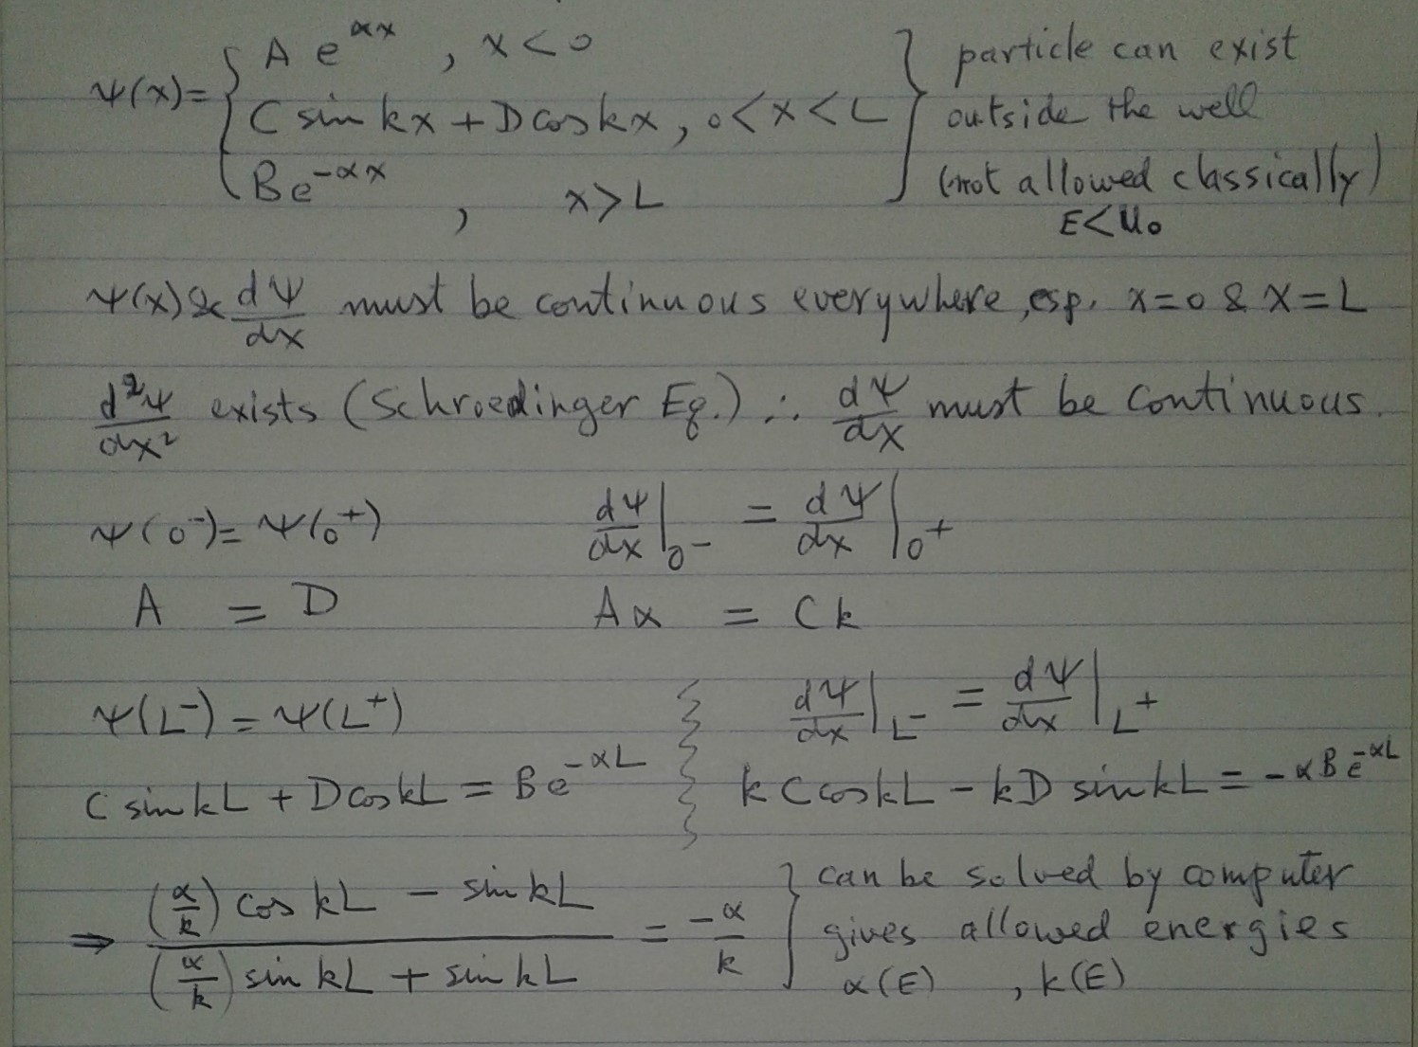
Exact solution for Finite Square Well

Slide 15
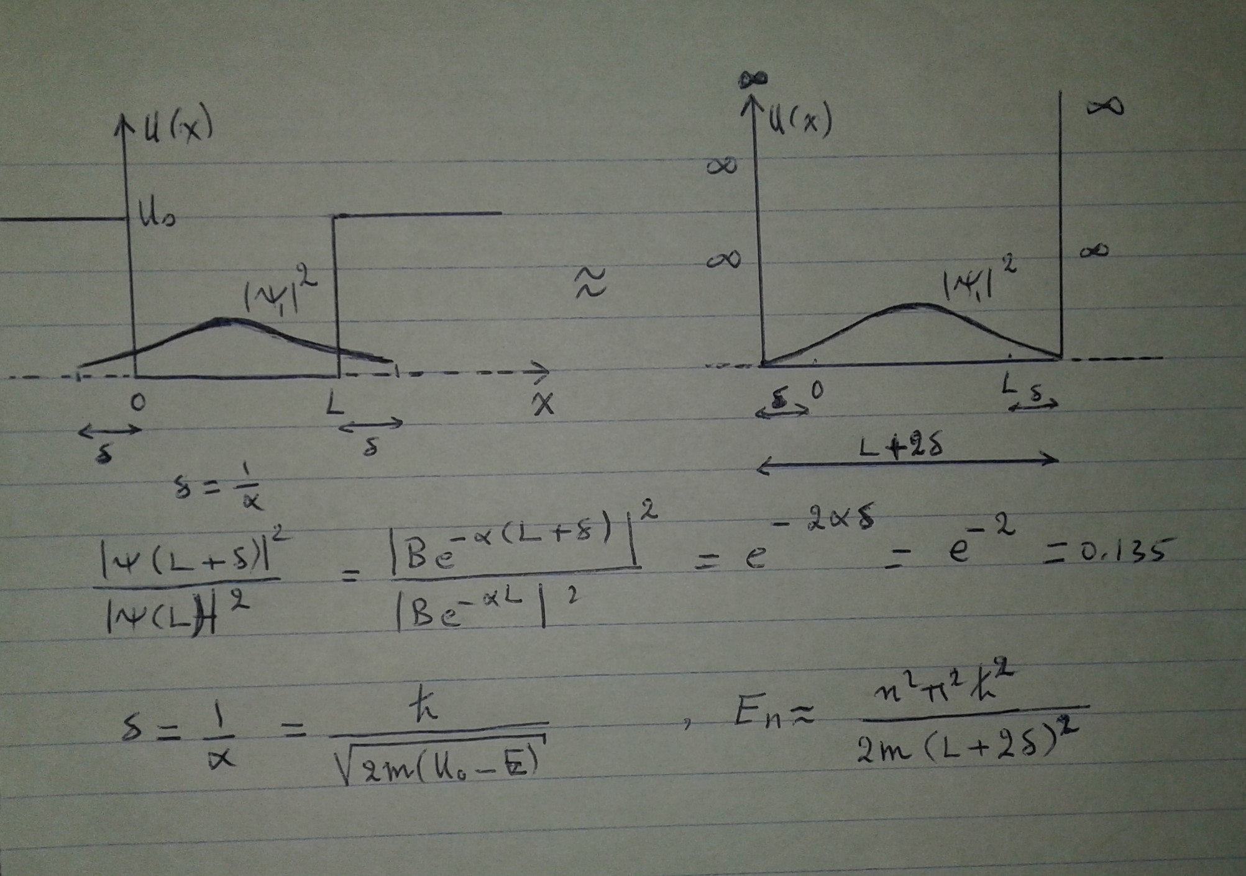
Approximate Treatment of Finite Square Well
Iteration Method

Slide 16
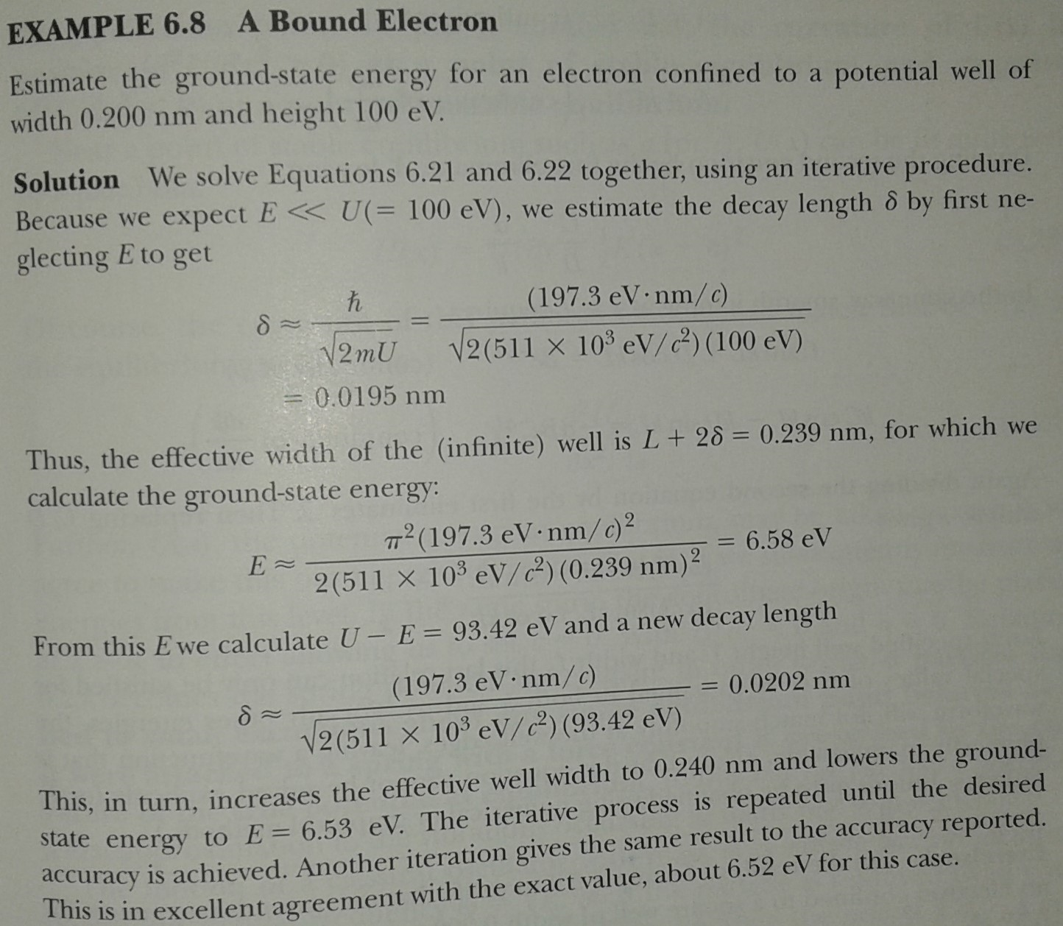

Slide 17
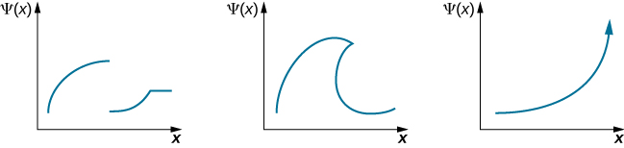
Unacceptable wavefunctions

