Slide 1
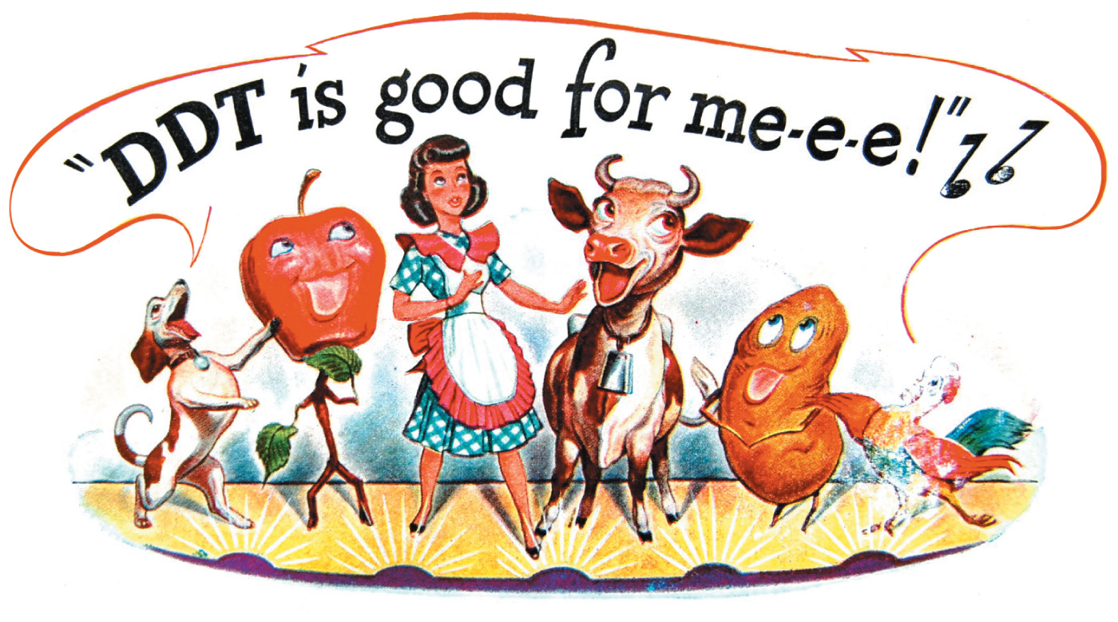
Chapter 8
Substitution and Elimination Reactions of
Alkyl Halides
Paula Yurkanis Bruice
University of California,
Santa Barbara

Slide 2
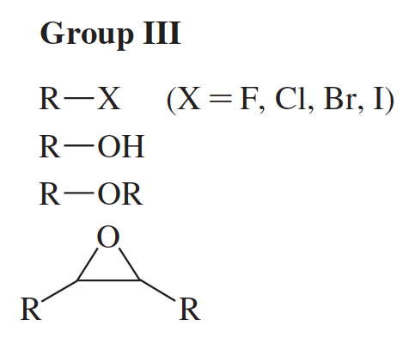
The Families of Group III
Substitution Reactions of Alkyl Halides
alkyl halides:
the first of the families
in Group III

Slide 3
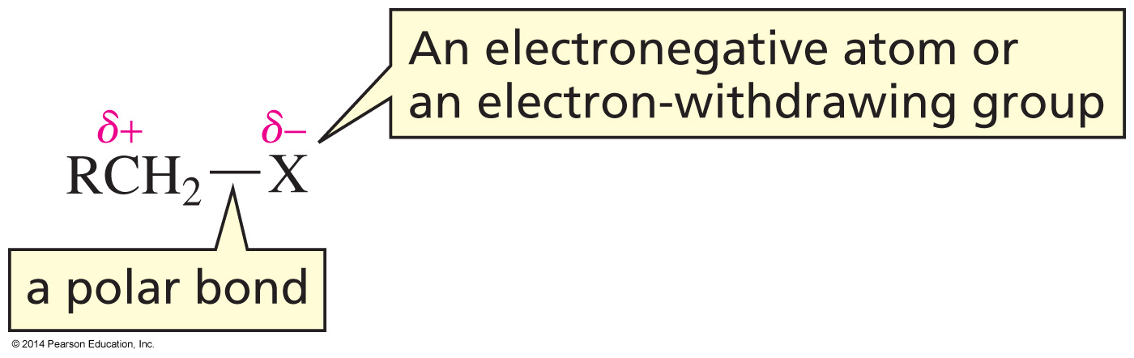
The Compounds in Group III
are Electrophiles
All the compounds in Group III have an electron withdrawing atom or group that is attached to an sp³ carbon.

Slide 4
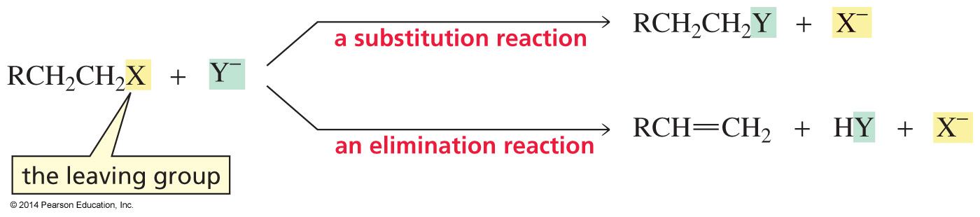
Because Group III Compounds are
Electrophiles, they react with Nucleophiles
Substitution reaction—the electronegative group is replaced by another group.
Elimination reaction—the electronegative group is eliminated along with a hydrogen.

Slide 5
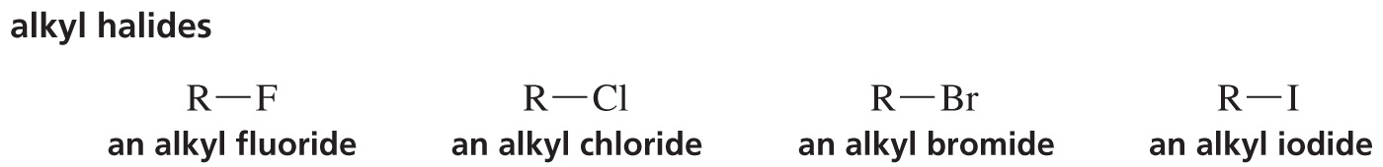
Alkyl Halides
This chapter discusses the substitution reactions of alkyl halides.
Alkyl halides have good leaving groups.

Slide 6
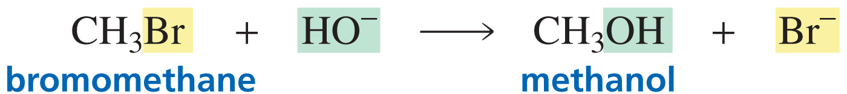
The S_{N}2 Reaction
The substitution reaction is more precisely called a nucleophilic substitution reaction because the atom replacing the halogen is a nucleophile.

Slide 7
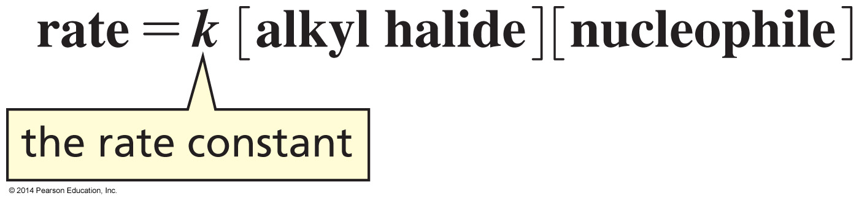
What is the Mechanism
of the Reaction?
The kinetics of a reaction—the factors that affect the rate of the reaction—can help determine the mechanism.
an S_{N}2 reaction

Slide 8
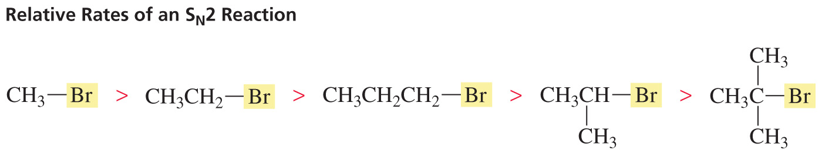
Relative Rates of an S_{N}2 Reaction

Slide 9
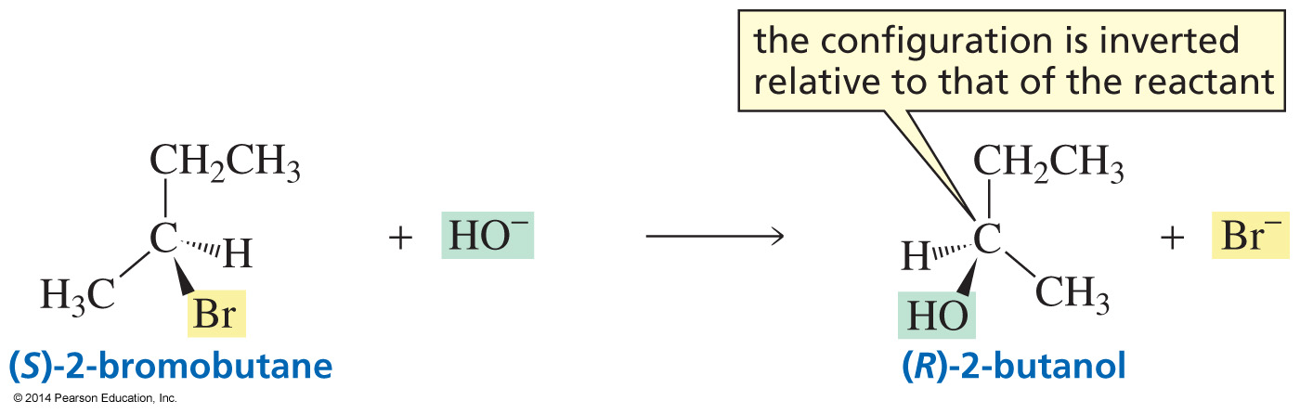
Inverted Configuration
If the halogen is bonded to an asymmetric center, the product will have the inverted configuration.

Slide 10
Summary of the Experimental Evidence
for the Mechanism of an S_{N}2 Reaction
The rate of the reaction is dependent on the concentration of both the alkyl halide and the nucleophile.
The relative rate of the reaction is:
primary alkyl halide > secondary alkyl halide > tertiary alkyl halide.
The configuration of the product is inverted compared to the configuration of the reacting chiral alkyl halide.

Slide 11
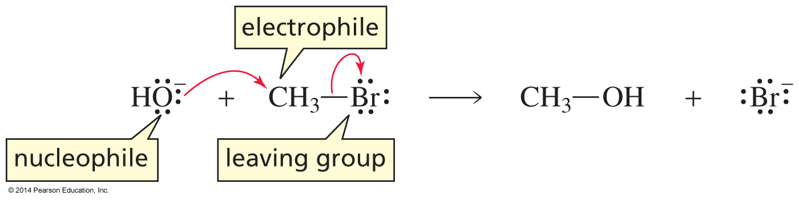
Mechanism for the S_{N}2 Reaction
of an Alkyl Halide

Slide 12
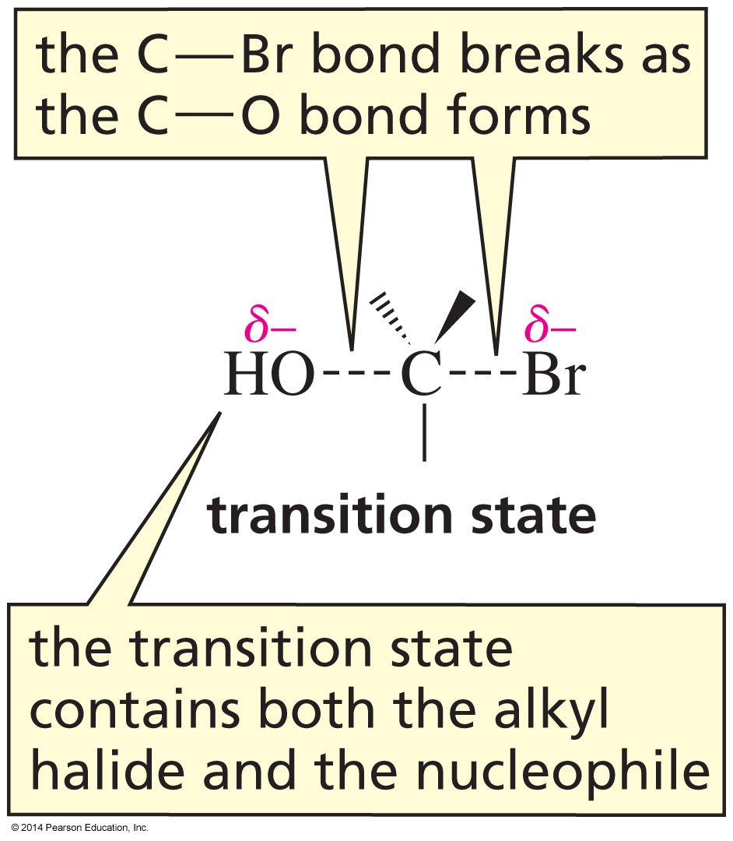
Why Bimolecular?

Slide 13
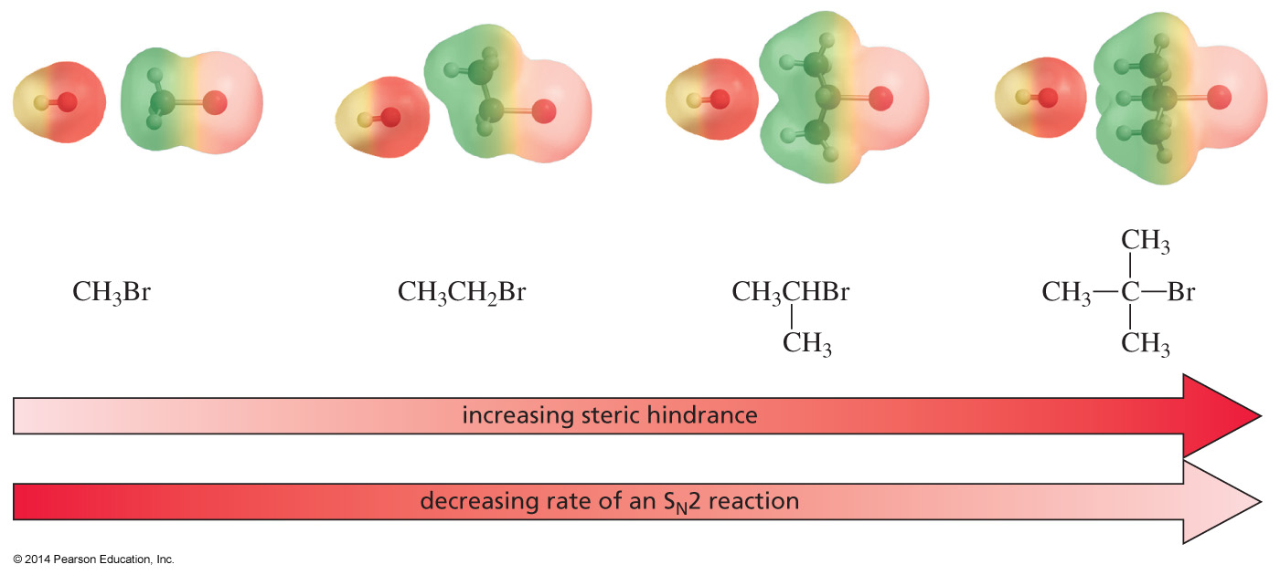
Why do Methyl Halides react the fastest
and Tertiary the Slowest?
steric hindrance

Slide 14
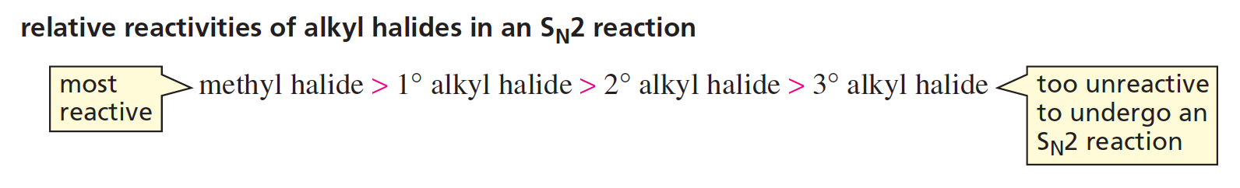
Why do Methyl Halides react the fastest
and Tertiary the slowest?
The relative lack of steric hindrance causes methyl halides and primary alkyl halides to be the most reactive alkyl halides in S_{N}2 reactions.
Tertiary alkyl halides cannot undergo S_{N}2 reactions.

Slide 15
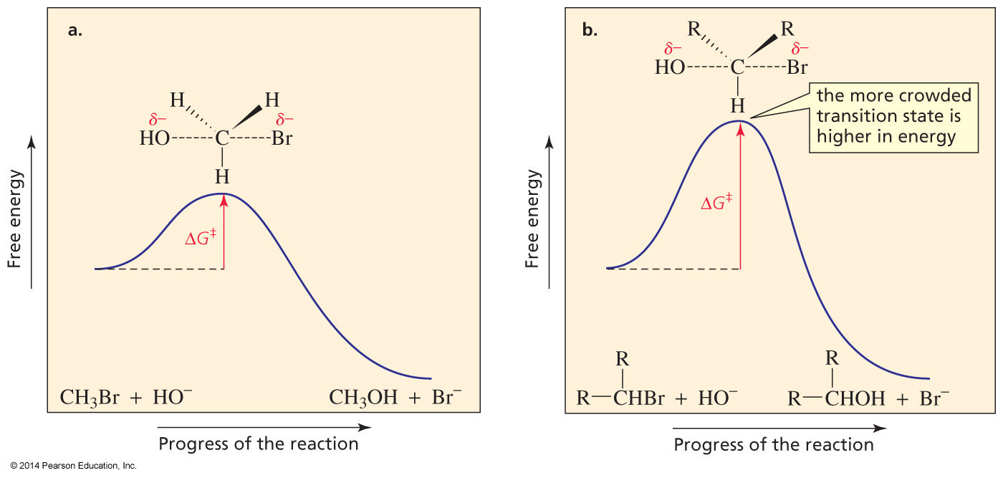
Why Steric Hindrance
decreases the rate

Slide 16
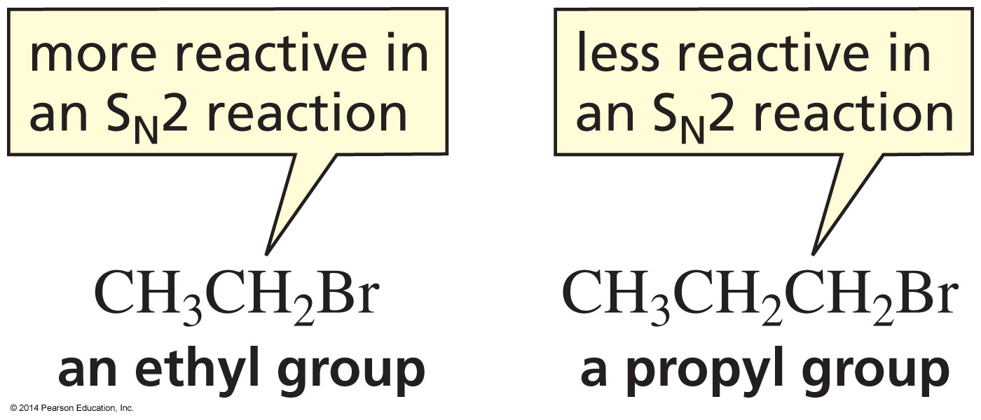
Both are Primary Alkyl Halides
but they react at different rates

Slide 17
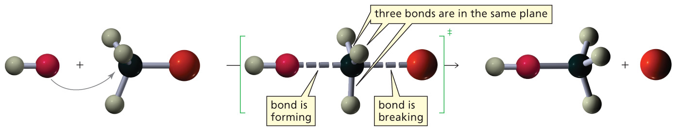
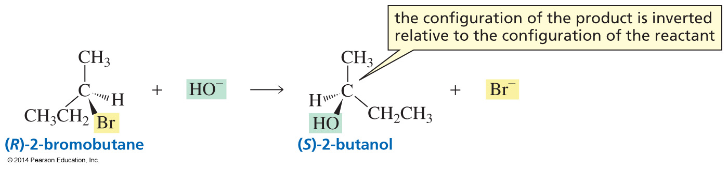
Why the configuration of the
Product is inverted

Slide 18
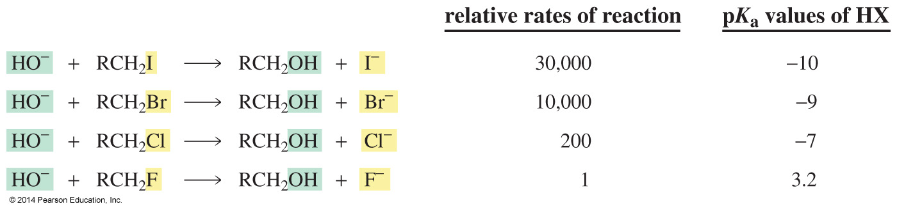
The rate of an S_{N}2 Reaction
is affected by the Leaving Group

Slide 19
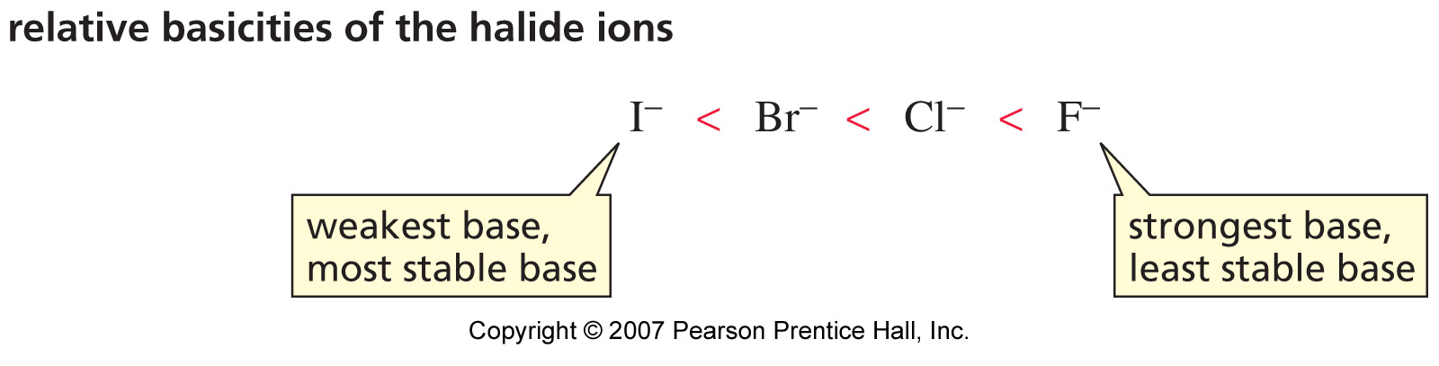
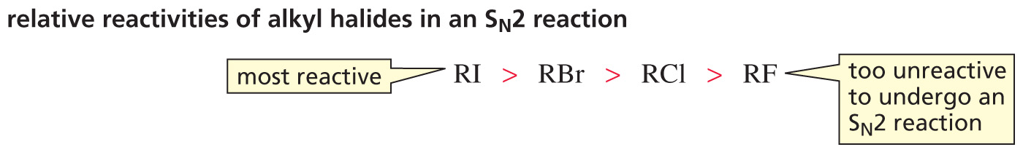
The Weakest Base is the best Leaving Group

Slide 20
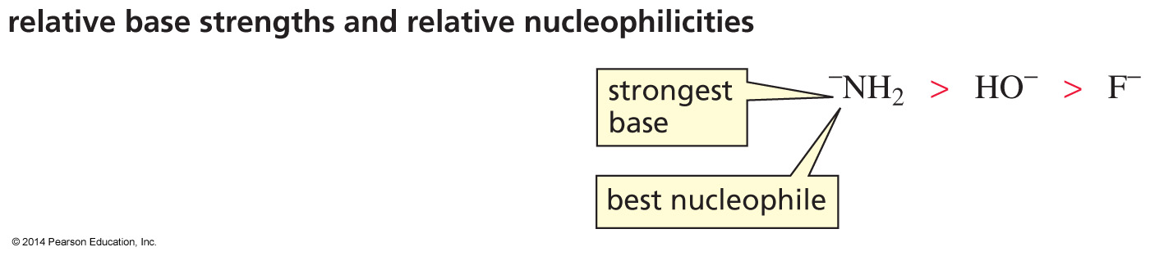
Base Strength and
Nucleophile Strength
If atoms are in the same row, the strongest base is the best nucleophile.

Slide 21
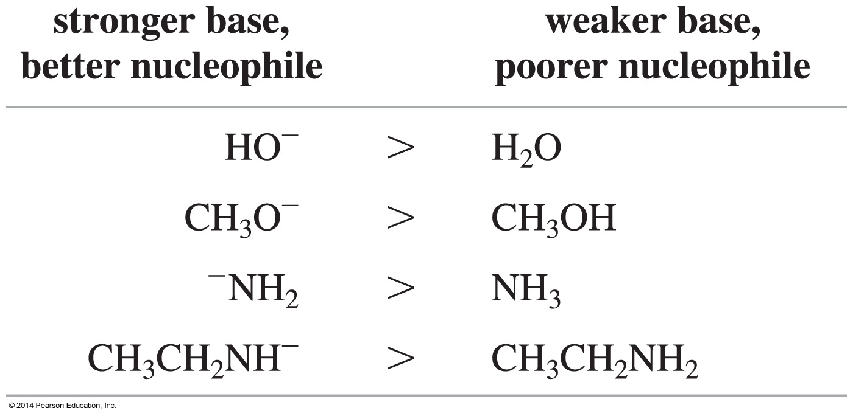
Base Strength and
Nucleophile Strength
A negatively charged atom is a stronger base and a better nucleophile than the same atom that is neutral.

Slide 22
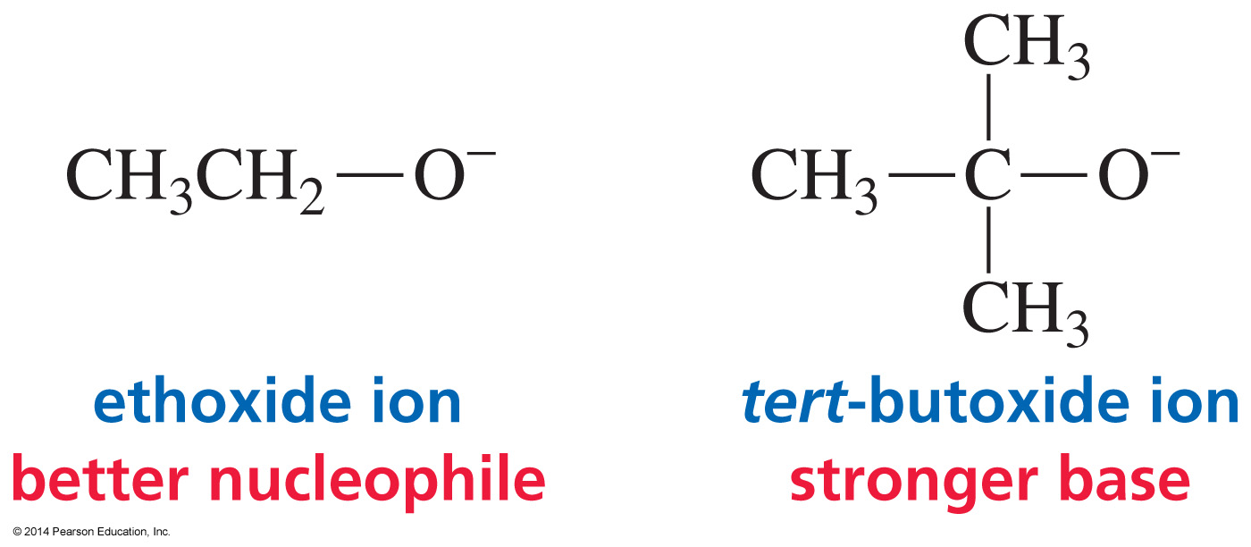
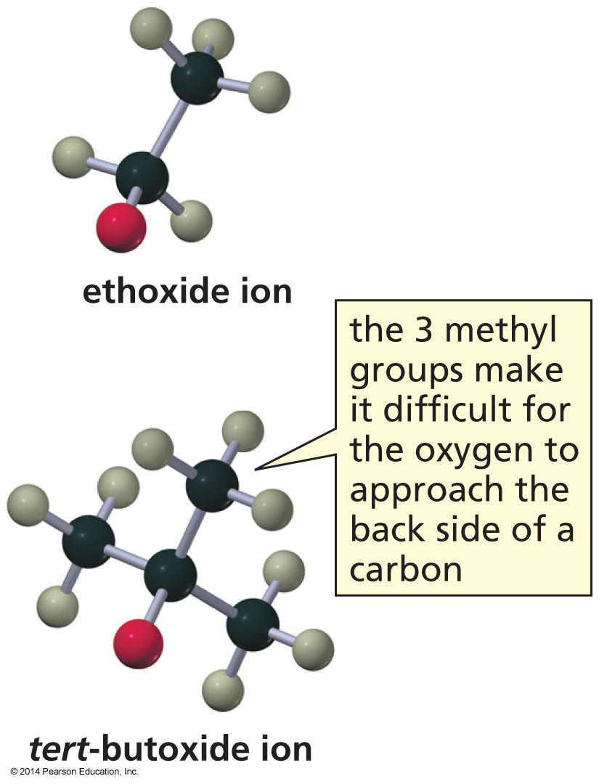
Steric Hindrance Decreases
Nucleophilicity
Even though the tert-butoxide ion is a stronger base, it is a poorer nucleophile because nucleophilic attack is more sterically hindered than proton removal.

Slide 23
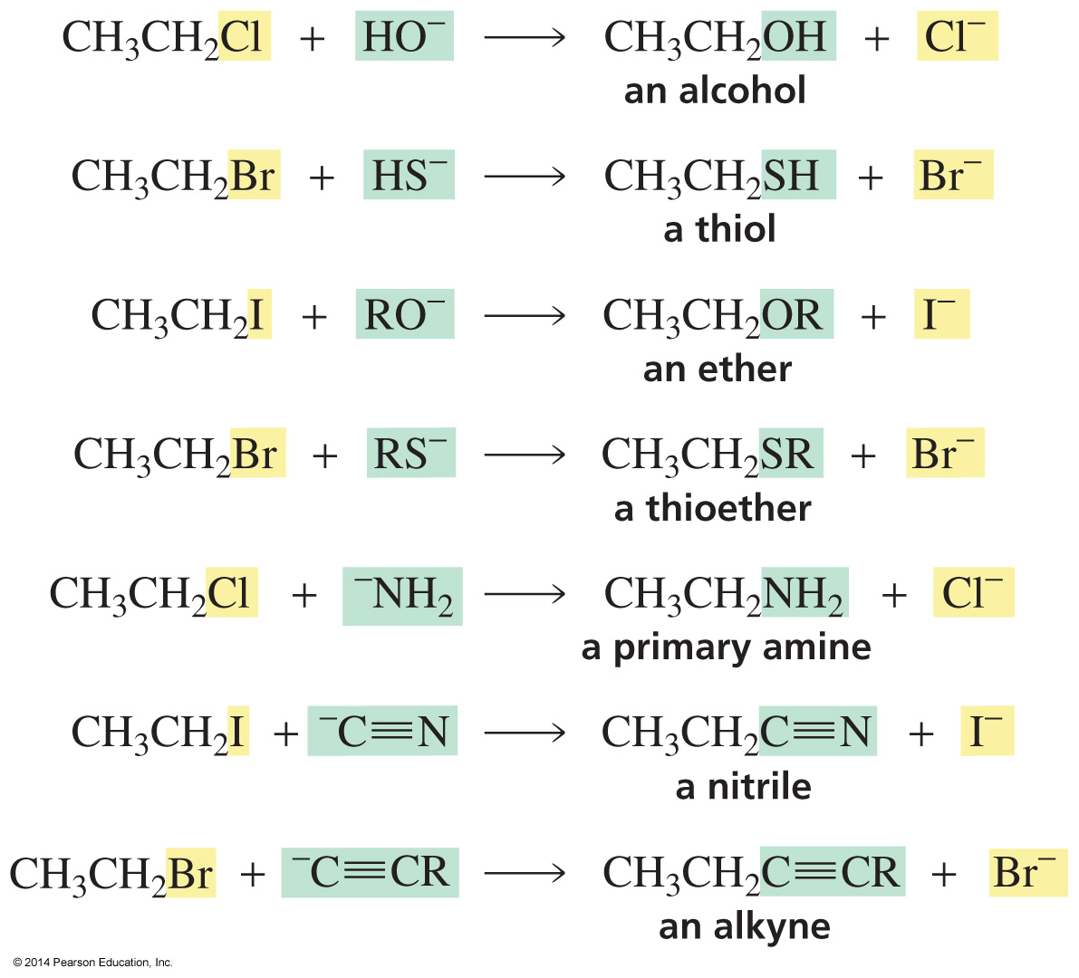
S_{N}2 Reactions can be used to make
a variety of Compounds
The reactions are irreversible because a strong base displaces a weak base.

Slide 24
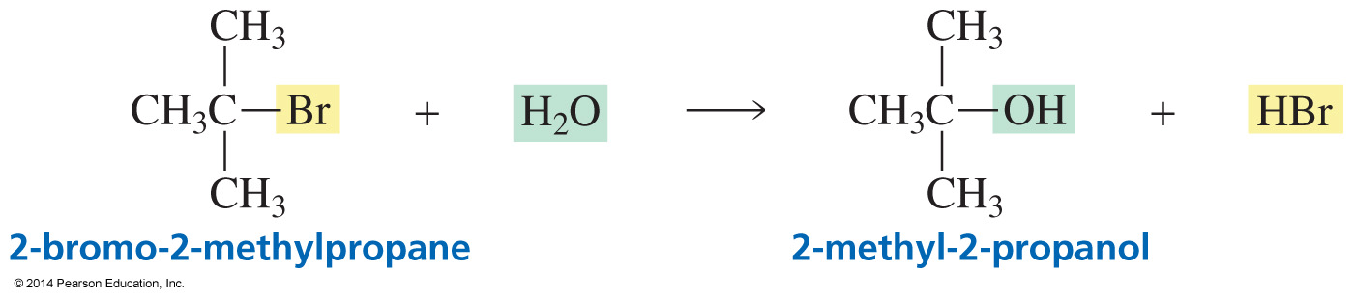
The S_{N}1 Reaction
A tertiary alkyl halide and a poor nucleophile
The reaction is surprisingly fast, so it must be taking place by a different mechanism.
Most S_{N}1 reactions are solvolysis reactions: the solvent is the nucleophile.

Slide 25

The rate of an S_{N}1 Reaction depends only on the Alkyl Halide Concentration

Slide 26
Summary of the Experimental Evidence
for the Mechanism of an S_{N}1 Reaction
The rate of the reaction depends only on the concentration of the alkyl halide.
Tertiary alkyl halides react the fastest.
If the halogen is attached to an asymmetric center the product will be a pair of enantiomers.

Slide 27
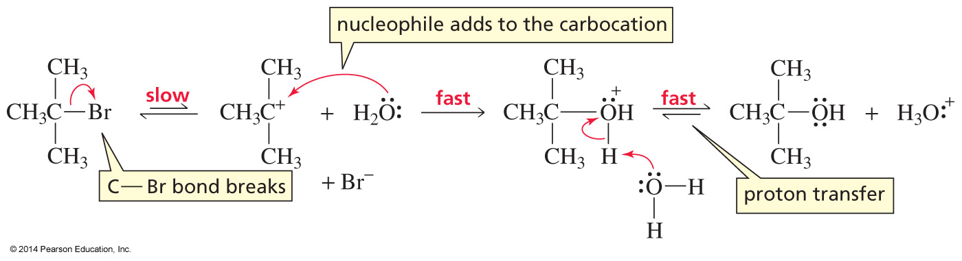
The Mechanism
The leaving group departs before the nucleophile approaches.

Slide 28
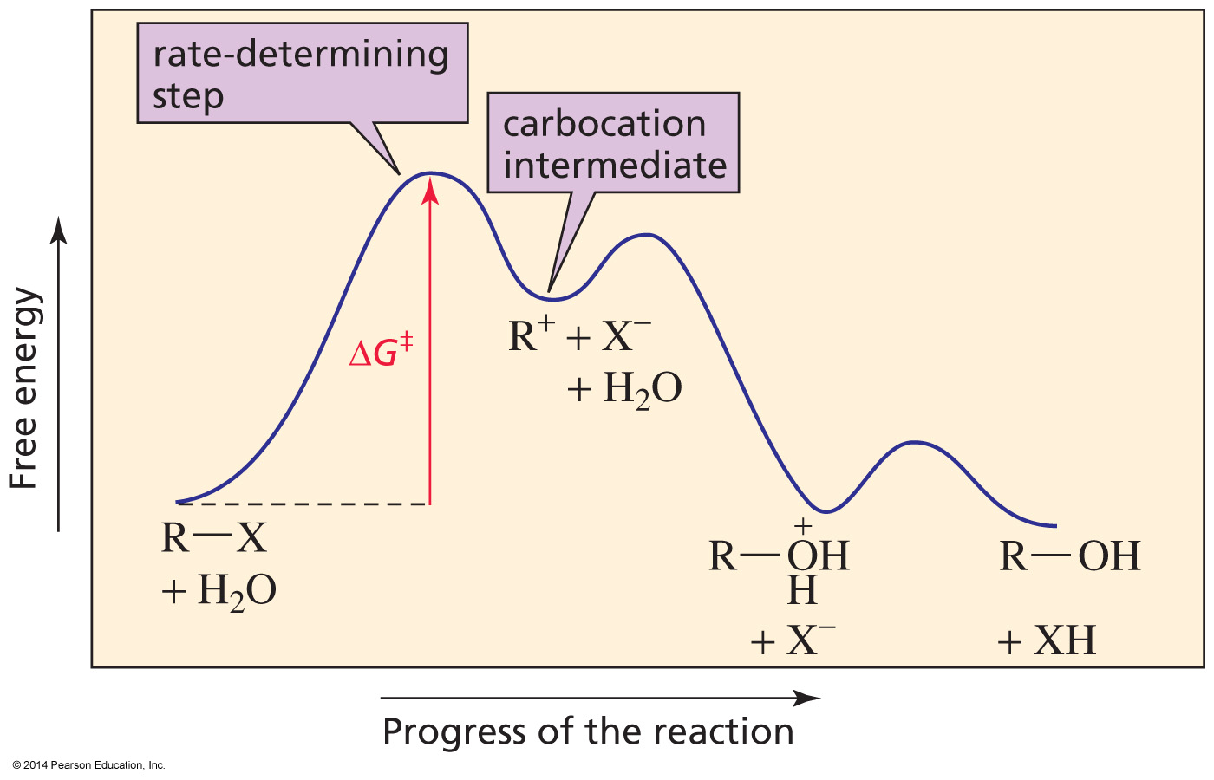
The Slow Step is
Formation of the Carbocation
Tertiary alkyl halides react the fastest; they form the most stable carbocation's.
Secondary and primary alkyl halides do not undergo S_{N}1 reactions.

Slide 29
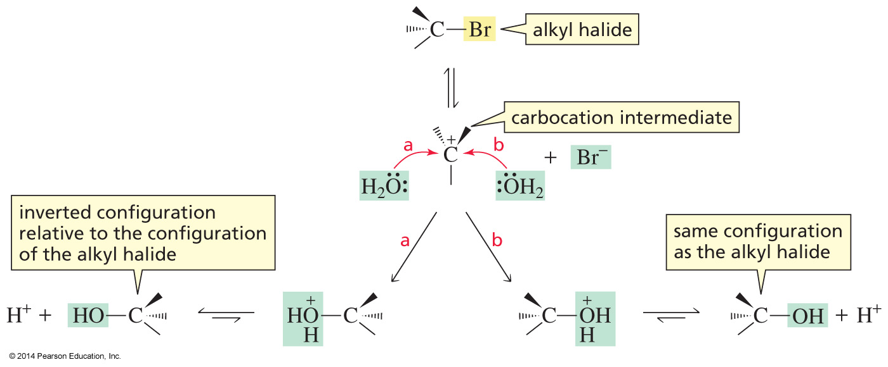
The Product is a Pair of Enantiomers

Slide 30
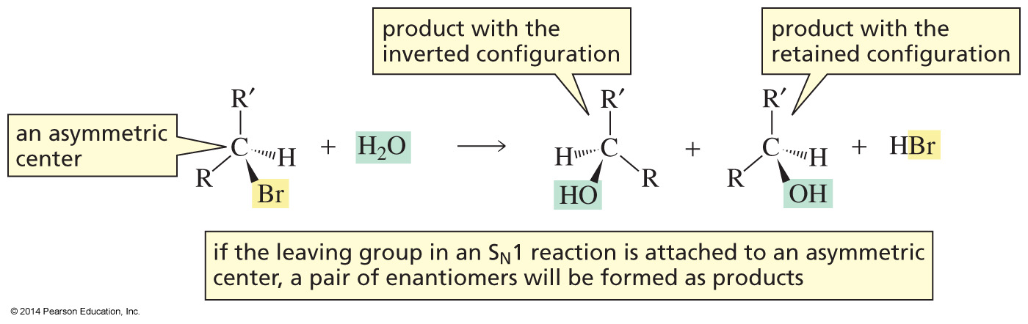
The Product is a Pair of Enantiomers
If the halogen is bonded to an asymmetric center, the product will be a pair of enantiomers.

Slide 31
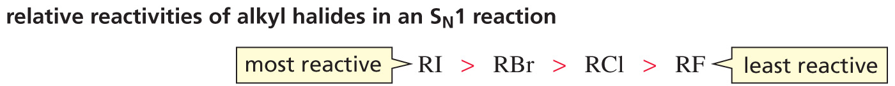
The Leaving Group in
an S_{N}1 Reaction

Slide 32
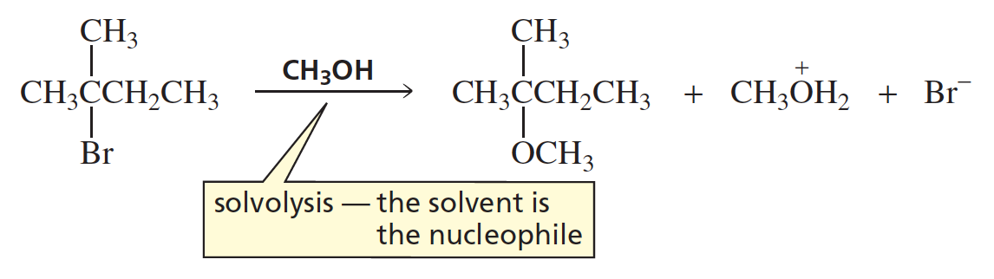
The Nucleophile in
an S_{N}1 Reaction
Most S_{N}1 reactions are solvolysis reactions; the nucleophile is the solvent.

Slide 33
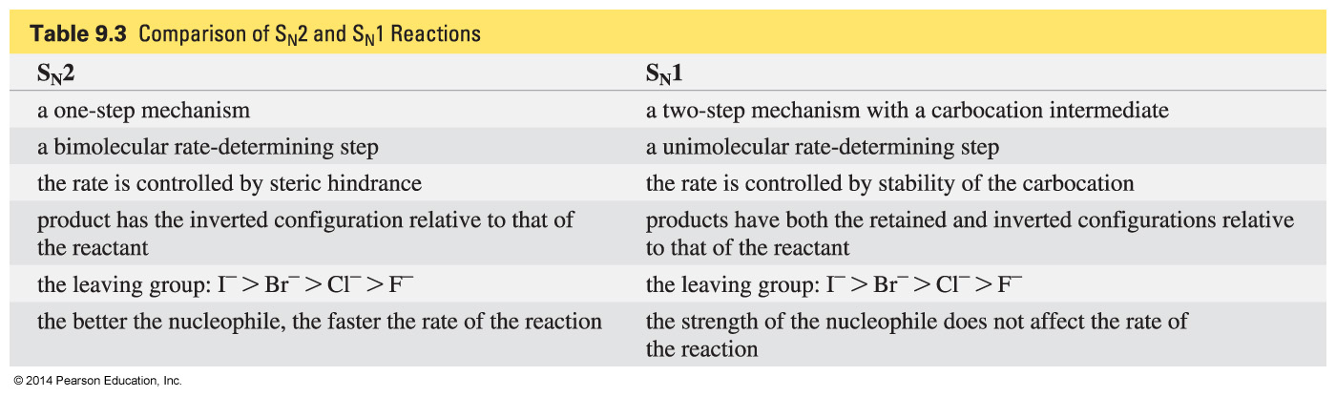
Comparing S_{N}2 and S_{N}1 Reaction

Slide 34
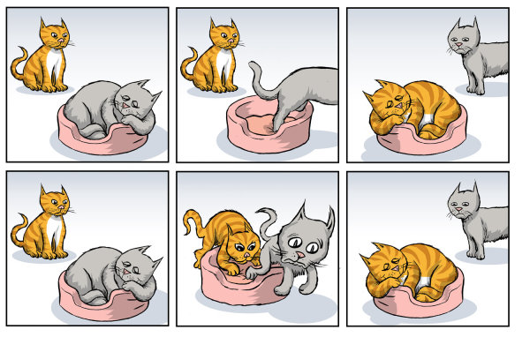
S_{N}1
S_{N}2

Slide 35
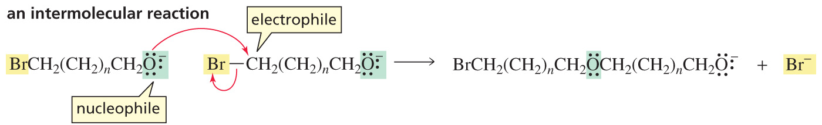
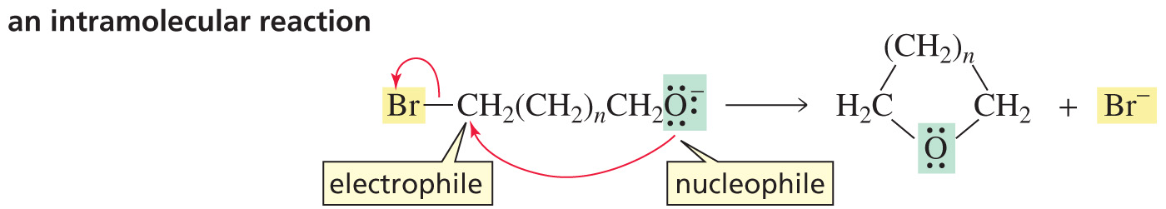
Intermolecular versus Intramolecular
S_{N}2 Reactions

Slide 36
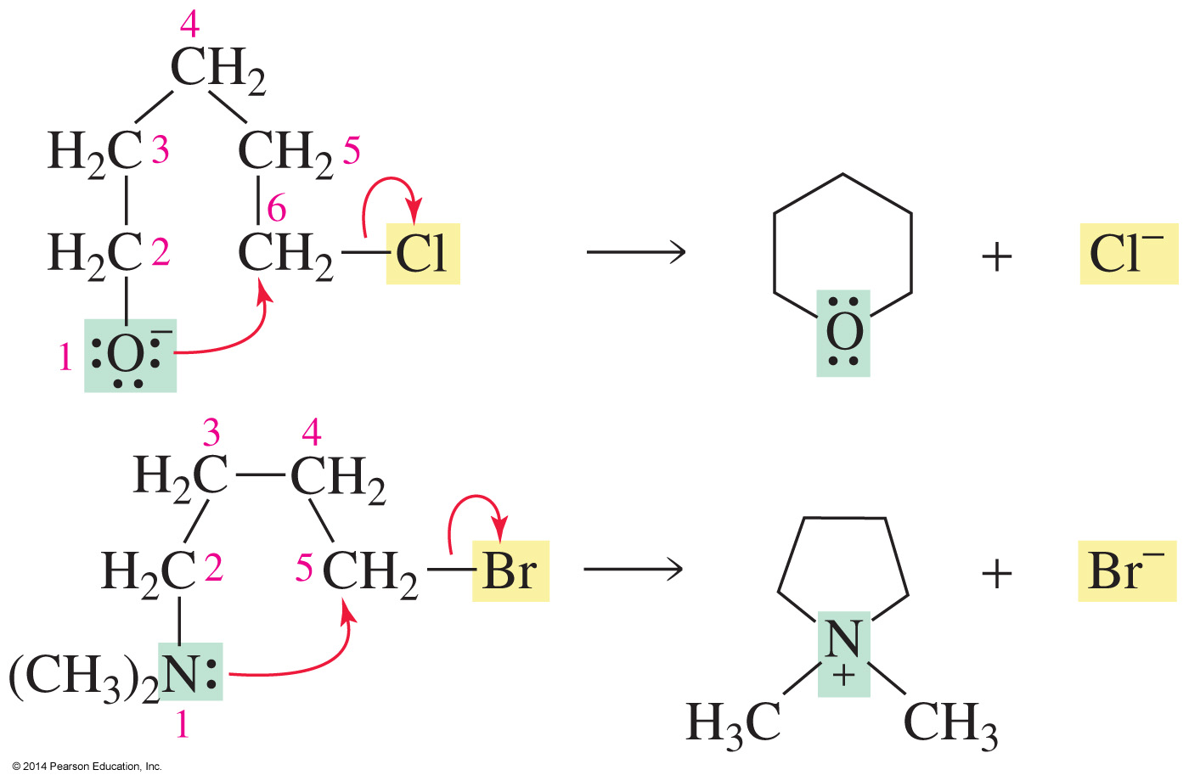
The Intramolecular Reaction is favored when a Five- or Six-Membered Ring can be formed

Slide 37
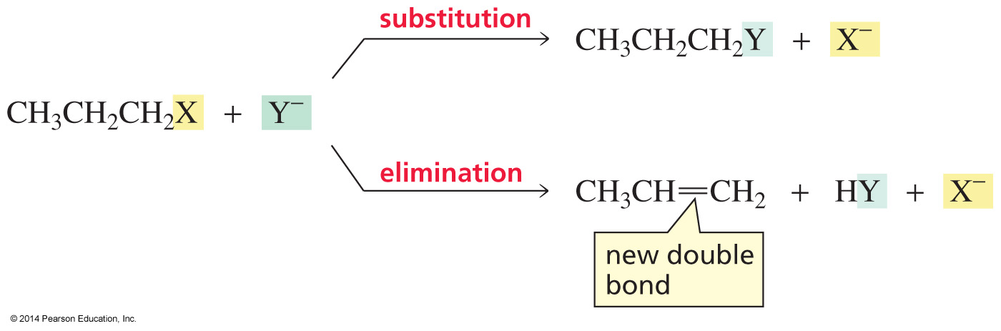
Alkyl Halides undergo
Substitution and Elimination Reactions
In an elimination reaction:
a halogen is removed from one carbon and
a hydrogen is removed from an adjacent carbon.
a double bond is formed between the two carbons
from which the atoms were removed.

Slide 38
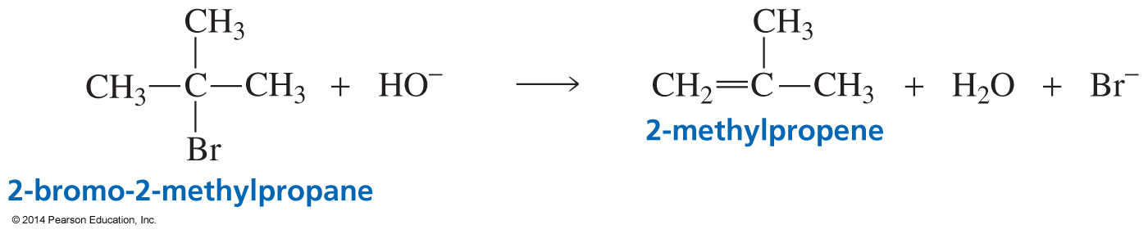
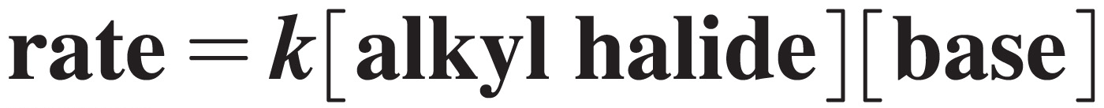
An E2 Reaction

Slide 39
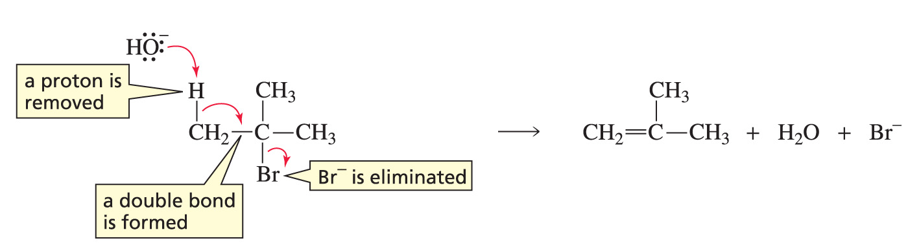
Mechanism for an E2 Reaction

Slide 40
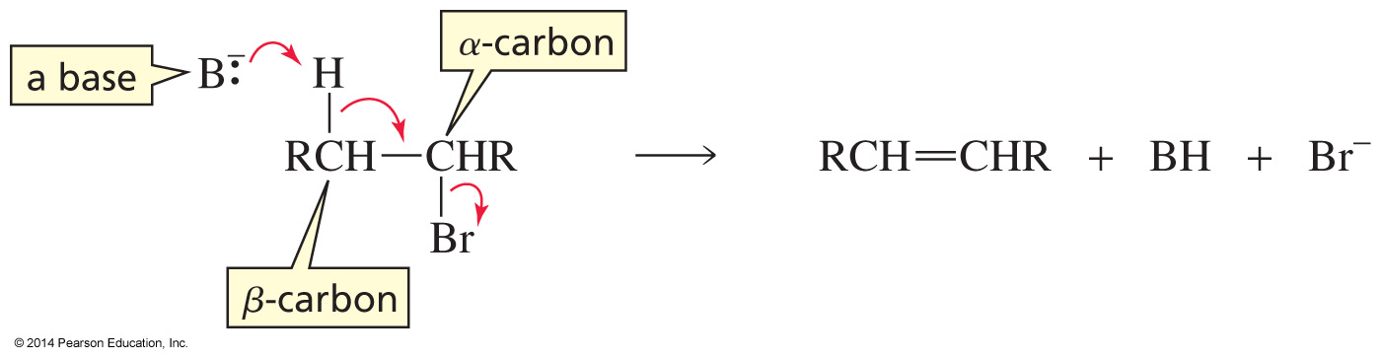
The Halogen comes off the Alpha Carbon;
the Hydrogen comes off the Beta Carbon
dehydrohalogenation

Slide 41
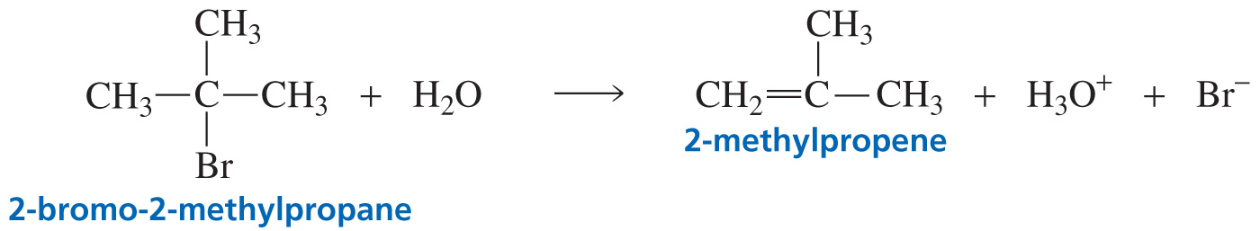

An E1 Reaction

Slide 42
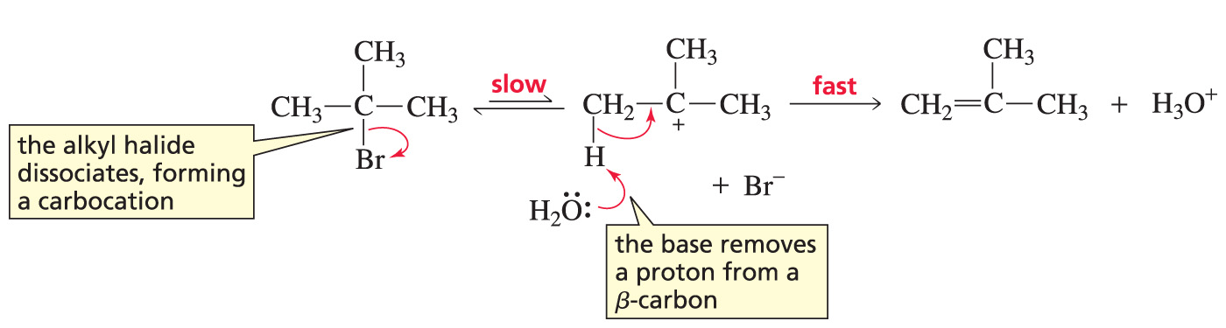
The Mechanism for an E1 Reaction

Slide 43
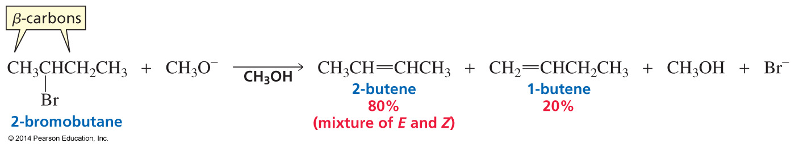
An E2 Reaction is Regioselective
The major product is the most stable alkene.
The most stable alkene is (generally) obtained by removing a hydrogen from the beta carbon that is bonded to the fewest hydrogens.

Slide 44
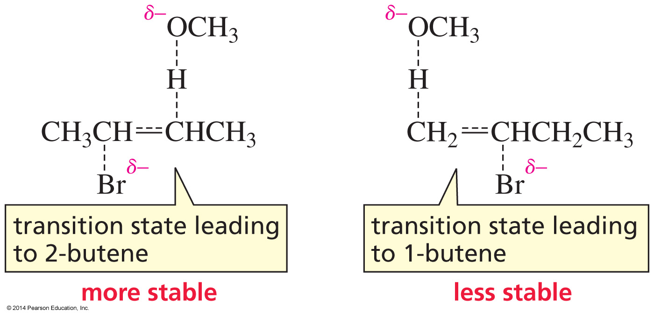
Alkene-Like Transition State

Slide 45
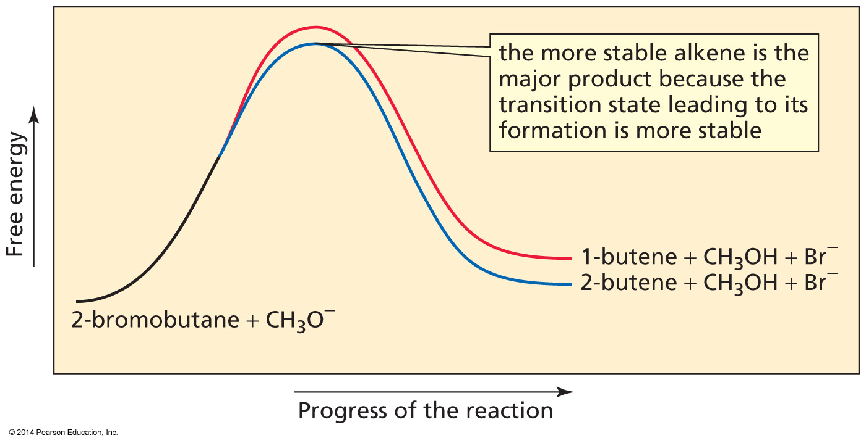
The more stable Alkene
has the more stable Transition State

Slide 46
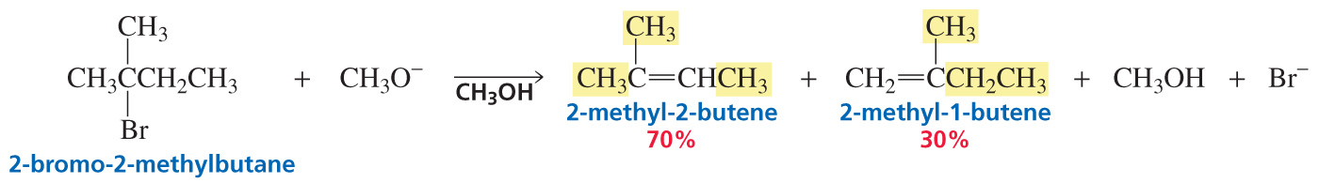
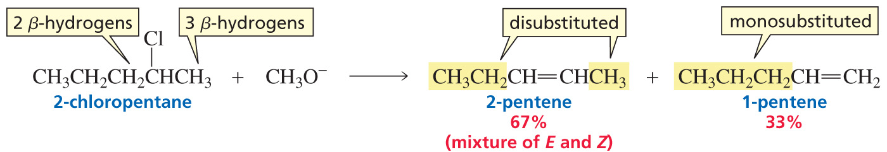
More Regioselective E2 Reactions

Slide 47
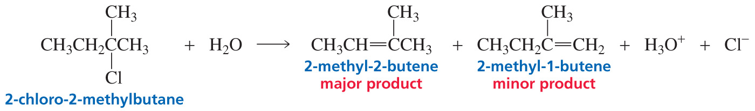
An E1 Reaction is Regioselective
The major product is the more stable alkene.
The most stable alkene is obtained by removing a hydrogen from the beta carbon that is bonded to the fewest hydrogens.

Slide 48

The more stable Alkene is the major product

Slide 49


Both E2 and E1 Reactions
are Regioselective

Slide 50



E2 and E1 Reactions
are Stereoselective

Slide 51

E2 and E1 Reactions
are Stereoselective

Slide 52

E2 and E1 Reactions
are Stereoselective

Slide 53

Relative Reactivities of Alkyl Halides
in an E2 Reaction

Slide 54

Does a Tertiary Alkyl Halide undergo
S_{N}2/E2 or S_{N}1/E1 Reactions?

Slide 55

Competition between
Substitution and Elimination

Slide 56

Under S_{N}2/E2 conditions, a Primary Alkyl Halide forms primarily a Substitution Product

Slide 57

Under S_{N}2/E2 conditions, a Secondary Alkyl Halide forms Substitution and Elimination Products
Substitution is favored by a weak base.
Elimination is favored by a strong base.

Slide 58

Under S_{N}2/E2 conditions, a Tertiary Alkyl Halide
forms only an Elimination Product

Slide 59

Under S_{N}1/E1 conditions, a Tertiary Alkyl Halide
forms Substitution and Elimination Products

Slide 60

Tertiary (S_{N}1/E1): Substitution is Favored
Tertiary (S_{N}2/E2): Only Elimination

Slide 61

Summary of the products obtained from Substitution and Elimination Reactions

Slide 62

Solvation
Polar solvents stabilize charged species.

Slide 63

If a reactant is charged, increasing the polarity of the solvent decreases the Rate

Slide 64

If the reactants are neutral, increasing the polarity of the solvent increases the Rate

Slide 65

How a solvent affects the Rate of a Reaction that does not have a Charged Reactant
If a reactant is not charged:
the charge on the transition state will be greater than the charge on the reactants.
Increasing the polarity of the solvent will increase the rate of the reaction.

Slide 66


How a solvent affects the Rate of an Reaction that has a Charged Reactant
If a reactant is charged:
the charge on the reactants will be greater than the charge on the transition state.
Increasing the polarity of the solvent will decrease the rate of the reaction.

Slide 67


DMF and DMSO
These solvents can solvate cations (+) better than they can solvate anions (–).

Slide 68

William Ether Synthesis:
an S_{N}2 Reaction

Slide 69
Forming an Alkoxide Ion

Slide 70

Synthesizing Butyl Propyl Ether

Slide 71


Synthesizing tert-Butyl Ethyl Ether
The less hindered group should be provided by the alkyl halide.

