Slide 1

NUTD 231: FUNDAMENTALS OF HUMAN NUTRITION

Slide 2
What is Nutrition ?

Slide 3
“Nutrition is the intake of food, considered
in relation to the body’s dietary needs. ”
World Health Organization - WHO

Slide 4
"The science of food, the nutrients and other substances therein, their action, interaction, and balance in relation to health and disease and the processes by which the organism ingests, digests, absorbs, transports, utilizes and excretes food substances.“
The Council on Food and Nutrition for the American Medical Association

Slide 5
Human Nutrition
Physiological and biochemical processes
Relationship to disease
  Excess/insufficiency of essential nutrients
Relationship between food and chronic disease
  Obesity, cancer, CVD’s
Behaviors around food (psychology, sociology, economy)
  Study of food habits

Slide 6
Two main questions in Nutrition
What are the essential nutrients ?
Can food be used to delay or prevent chronic disease?

Slide 7
What do we mean by
Essential Nutrients

Slide 8
A chemical substance that is required for growth, health and survival
The absence or inadequate intake of an essential nutrient from the diet leads to signs of deficiency syndrome, and ultimately death
The substance is not synthesized by the body or synthesized in insufficient amounts

Slide 9
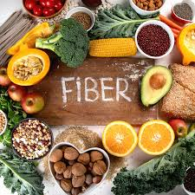
Dispensable:
  Foods that could be deleted from the diet without causing growth failure or specific signs of disease – nonessential
Conditionally Essential
  They are usually synthesized by the body in adequate amounts but may require exogenous supplementation during some circumstances
    Impaired absorption , increased anabolic requirements (e.g. pregnancy, and lactation), metabolic stress (e.g. trauma, burns, etc.)
Desirable for health
  e.g.: Fiber, probiotics

Slide 10
Discovery of Essential Nutrients
By the end of the nineteenth century
The essential amino acids in proteins had been mostly identified
Major inorganic nutrients (calcium, potassium, iodine, and iron)
Vitamins
How?
Experiments with animals
Biochemical experiments
Human trials
Observation in malnourished human

Slide 11
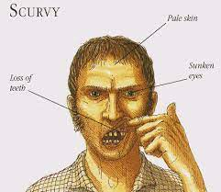
Vitamin C Discovery
scurvy was considered the major cause of disability and death among sailors
Scurvy symptoms:
swollen and bleeding gums, loose teeth, hemorrhaging under the skin, and slowed healing of wounds and death
Vitamin C was in short supply on most ships AND not part of the diet
In 1747, a physician James Lind conducted a trial of six different treatments for sailors with scurvy
“only oranges and lemons were effective in treating scurvy”

Slide 12
In 1907:
Two Norwegian biochemists experiment with guinea pigs and demonstrate that a scurvy-like condition can be produced in these animals when certain foods are restricted
In the 1920
A Hungarian professor isolated a substance from plants and animals that he called 'hexuronic acid’.
Four years later, a British chemist isolated vitamin C in his laboratory and concluded that it was the same as 'hexuronic acid
https://www.sciencelearn.org.nz/resources/1690-vitamin-c-history-timeline

Slide 13
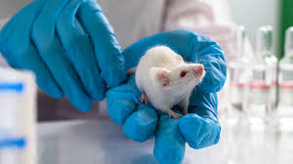
Animal Experimental models were determinantal in discovering essential nutrients
Using the right animal model
  Vitamin C is essential in humans and guinea pigs
  Rats can synthesize their own vitamin C from glucose

Slide 14
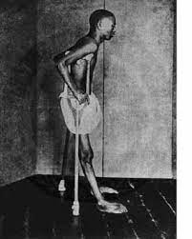
The discovery of thiamin/ Vitamin B1
Beriberi
Was common in South East Asia, not very common in Europe
Less common among poor villagers
Symptom: weight loss, weakness, paralysis of the legs, swelling of arms and legs, and impaired nerve function
Cause was unknown, scientist suspected bacteria

Slide 15
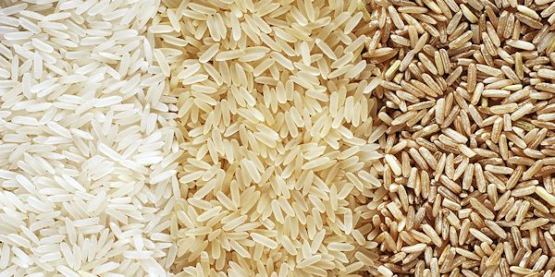
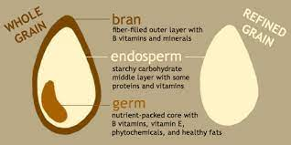
The discovery of thiamin/ Vitamin B1
To improve its flavor and shelf-life, rice was usually milled to remove the husks, bran and germ.
Polished rice was then sold to the wealthier people
In early 1800’s Experiments with chickens→ became ill on a diet of cooked polished rice but stayed well if they were fed cheap unhusked rice.
Human trials in Malaysia, and the Philippines showed that beri-beri could be prevented or cured with rice bran
1926, Thiamin was isolated in lab

Slide 16
Essential Nutrients
Water
Essential Vitamins
Essential Minerals
Essential Fatty Acids
Essential Amino Acids
Electrolytes

Slide 17
Diet and Chronic Disease
More complicated to study than diseases that result from nutritional deficiency diseases
Chronic diseases take years to develop and involve many causes/factors( environmental, dietary etc.)
Notes:
association between a food or nutrient and a disease comes from observing striking differences in incidence of that disease between countries (or groups within a country); these differences correlate with differences in intake of dietary components→ give rise to hypotheses (theories) about possible diet–disease links rather than proof of causation because many potential causative factors

Slide 18

Variation in disease incidence indicate relationship between nutrient consumption and disease
Blue Zones
Individuals over 100 years old, + people who had grown old without health problems like heart disease, obesity, cancer, or diabetes

Slide 19
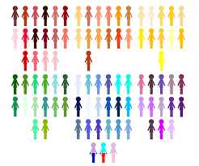
Human models are used to study relationship between diet and chronic disease
Epidemiological studies
Epidemiological studies, as a research category, are analytical studies of the determinants of health and illness in specific populations. Studies are designed to determine the relationship among exposure factors (which can be risk factors or protective factors) and outcomes.
Notes:
Animal experiments, because they are usually short term, are not as useful for investigating diet and chronic diseases

Slide 20
Epidemiological Studies
Cohort studies are longitudinal, observational studies that investigate risk factors and health outcomes.
no intervention, treatment, or exposure is administered to the participants.
correlation between a risk factor and disease rather than the cause.

Slide 21
Types of Epidemiological Studies
Prospective ( Cohort)
Starts with people free of disease
Assesses exposure at baseline (Information about dietary intake is collected)
Divide to subjects to exposed and unexposed
Follow up to see if disease develops
Both the groups should equally susceptible to disease
Be careful of confounders
Provide strong evidence of association but not causation

Slide 22
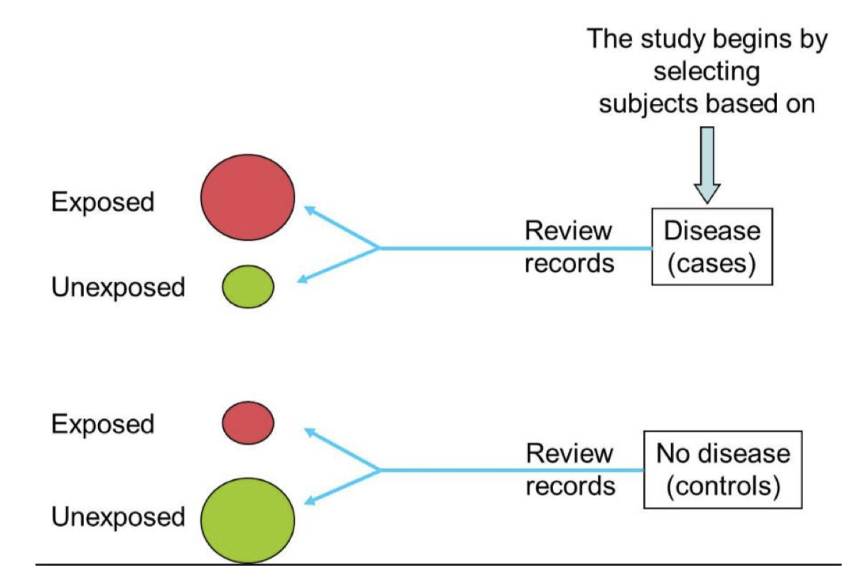
Types of Epidemiological Studies
Example
People with bowel cancer are compared to an equal number of people free of disease
Case-control studies
Weaknesses?
Disease development effects dietary habits
Disease group may suffer from other conditions that effect their dietary intake
Recall bias
Report bias
Notes:
involves identifying patients who have the outcome of interest (cases) and matching them with individuals who have similar characteristics, but do not have the outcome of interest (controls). Characteristics, such as previous exposure to a factor (i.e., the hypothesized causal or contributing factors), are then compared between cases and controls.

Slide 23
Problems with prospective studies?

Slide 24
Follow up may take a long time
Expensive
Dietary intake at one point may not represent actual intake of subjects
Loss of follow up/ no response

Slide 25
Example
5000 men and women in Ramallah are recruited into a study to understand heart disease development. Every two years, biomedical and behavioral data are collected from them. Health outcomes are tracked including cholesterol, blood pressure and smoking rates.
What type of epidemiological study ?

Slide 26
Example 2
Study Goal: Explore link between colon cancer and red meat consumption
Controls: 351 women
45 yrs. of age or younger
Hospitalized w/other conditions
Cases: 351 women
45 yrs. or younger
Hospitalized w/colon cancer
Women were asked about red meat consumption and frequency
Results:
* Red meat consumers were more likely to develop colon cancer

Slide 27
Randomized Control Prevention Trials
A study design that randomly assigns participants into an experimental group or a control group.
Experimental group receive either a supplement or a food/ nutrient
Control group receive a placebo
Disease (and death) outcomes in the two groups are compare

Slide 28
Advantages and Disadvantages of RCT
Advantages
Can prove causality
Prove benefit of adding/removing a food group
Disadvantages
Expensive
The sample sizes may be small
Long-term trials present challenges with maintaining contact with participants.
They depend on participant compliance.

Slide 29
Meta-analysis studies combines the results of multiple scientific studies, usually randomized control trials
Example: Understanding the role of diet in development of coronary heart disease emerged from analyzing meta-analyses of prospective studies or clinical trials

Slide 30
Observational studies provide an associations between dietary factors and chronic diseases.
For an association to be regarded as convincing
Evidence from experimental studies in humans or animals
A biological gradient or dose– response between the degree or level of exposure to the dietary factor and the disease risk
(the greater the exposure to the food or nutrient, the greater the risk).

Slide 31

Measuring food and drink intake
Dietary assessment
Information about food intake is subjective and depends on memory
Recall bias: When asked to record what they eat people may alter their diet.
Diet diversity: people are not consistent with what they eat, so taking a diet recall may not reflect an accurate profile of their dietary habits

Slide 32
Food composition tables
food tables that include a list of foods and provide information about each food such as calories , the major essential nutrients, and other important food components (e.g. dietary fiber) for each food measured by chemical analysis.

Slide 33
Dietary reference values
In 1941, the Food and Nutrition Board first proposed the Recommended Dietary Allowance (RDA) for the U.S. population “to serve as a goal for good nutrition
“The average daily dietary intake level that is sufficient to meet the nutrient requirement of nearly all (97 to 98 percent) healthy individuals in a group”
Purpose: to prevent malnutrition
Dietary reference intakes. (1998). doi:10.17226/6432

Slide 34
Dietary Reference Intakes (DRIs)
New Recommendations
Dietary Reference Intakes (DRIs)-The general term for a set of reference values used to plan and assess nutrient intakes of healthy people
Newer recommendations
Purpose: to prevent chronic disease
Dietary reference intakes. (1998). doi:10.17226/6432

Slide 35
Estimated Average Requirement (EAR): the average daily nutrient intake level estimated to meet the requirement of half the healthy individuals in a particular life stage and gender group
Adequate Intake (AI): a recommended average daily nutrient intake level based on observed or experimentally determined approximations or estimates of nutrient intake by a group (or groups) of apparently healthy people that are assumed to be adequate—used when an RDA cannot be determined
Upper Limit (UL): This is the highest level of daily nutrient intake that is unlikely to pose risk of adverse health effects to almost all individuals in the population
Dietary reference intakes. (1998). doi:10.17226/6432

Slide 36
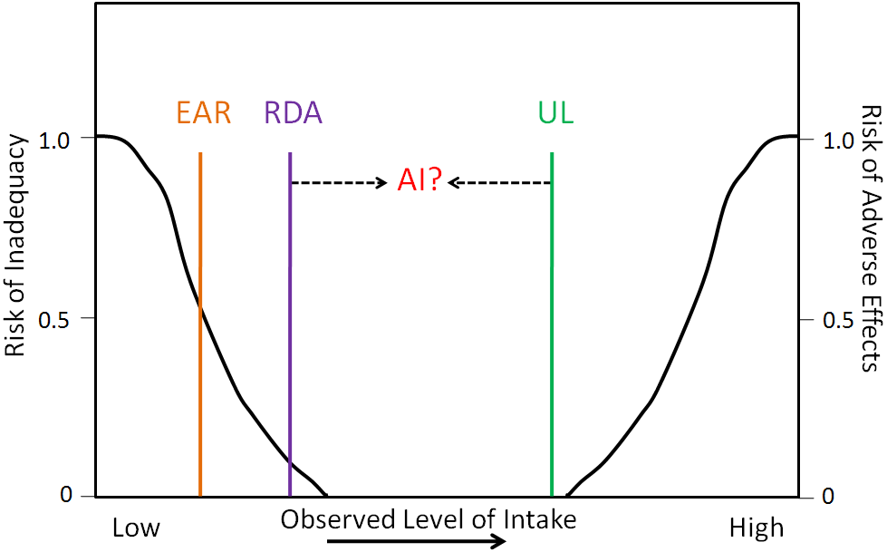
https://www.youtube.com/watch?v=UPsymcEobDk
https://courses.lumenlearning.com/suny-nutrition/chapter/8-4-dietary-reference-intakes-dris/
Notes:
The need of a nutrient by a population of people is normally distributed ( a bell shaped

Slide 37
Biomarkers: Biochemical Tests
An individual may be eating less than the recommended intake of nutrient yet they show no symptoms of deficiency. Why ?
  The nutrient may be underreported by the individual or the body has sufficient stores
Individuals can suffer deficiency of certain nutrient despite an acceptable intake. Why ?
  unusually high requirement,
  increased losses from disease

Slide 38
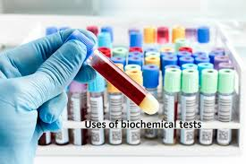
Biochemical Tests
Biochemical tests using blood or urine help estimate the amount of the nutrient functioning inside the body

