Slide 1

Timers
Shadi Daana

Slide 2
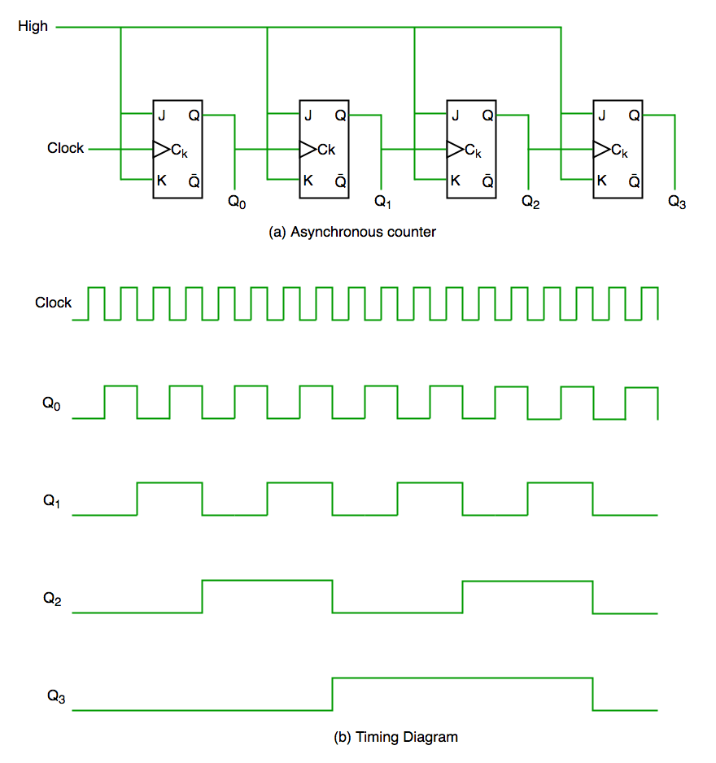
Counter in Digital Logic
A Counter is a device that records the number of times a particular event or process has occurred, often in relationship to a clock signal
The counters can be designed using flip flops

Slide 3
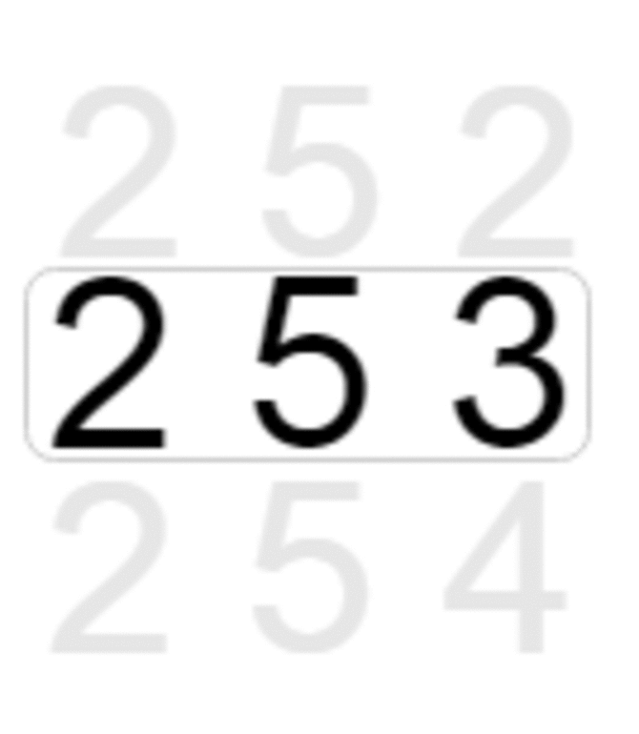
Timer Basics
A timer (sometimes referred to as a counter) is a special piece of hardware inside many microcontrollers
A timer is like a digital stopwatch inside a microcontroller. It helps the microcontroller keep track of time or count events.
Imagine it as a counter that goes up or down.
For example, an 8-bit timer will count from 0 to 255.
Most timers will “roll over” once they reach their max value and an overflow occurs
The maximum value is programmable, and it is called auto-reload value or period

Slide 4
Timer Basics
A timer can be used to measure time intervals, generate precise timing events, and control the execution of specific tasks.
Timers are crucial in various applications, including controlling external devices, generating PWM signals, and managing real-time tasks

Slide 5
Timer Resolution
Timer resolution is defined by the bit width, which is specified in bits such as 8-bit, 16-bit, or 32-bit.
A timer with an N-bit counter can count from 0 to 2^{N} - 1.
For example, a 16-bit timer will count from 0 to 65535
The auto reload value must be less than 65535

Slide 6
Timer Prescaler
A timer will tick (increment by one) each time it receives a clock pulse
The counting speed depends on the input clock frequency
Most microcontroller timers have a prescaler, which divides the input clock frequency to the timer.
This allows you to adjust the timer's resolution and control the timer's counting speed

Slide 7
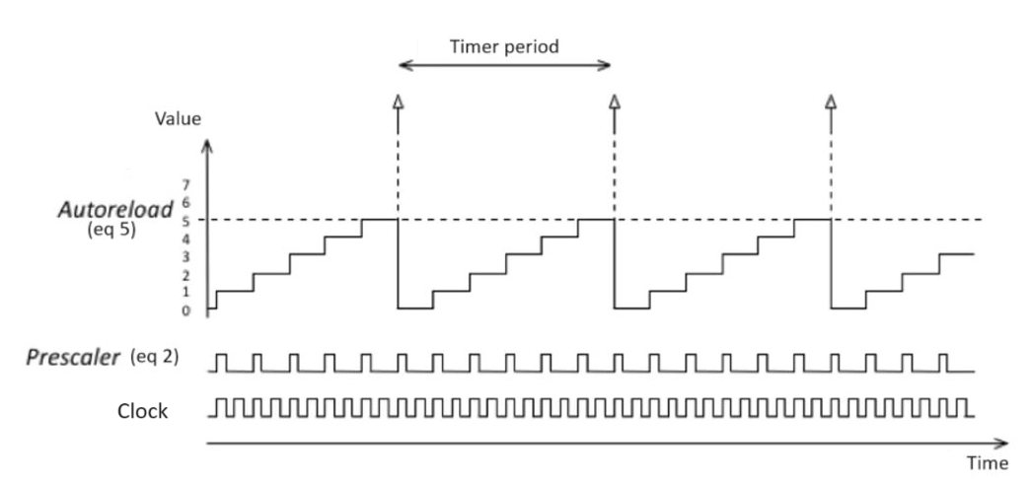
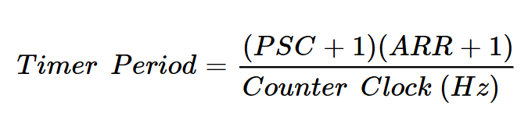
Timer Working Principle

Slide 8
Counting Directions
Upcounting : the counter counts from 0 to the auto-reload value (content of the TIMx_ARR register), then restarts from 0 and generates a counter overflow event
Downcounting : In this mode, the counter counts from the auto-reload value down to 0, then restarts from the auto-reload value and generates a counter underflow event
Center-aligned mode (up/down counting): the counter counts from 0 to the auto-reload value, generates a counter overflow event, then counts from the auto-reload value down to 0 and generates a counter underflow event. Then it restarts counting from 0

Slide 9
Timer Modes
A hardware timer runs in the background independently.
They are activated from the program, and they can be configured to operate in different modes:
Basic timer: Generate precise timing Interrupts or counting the occurring of events
Output compare (OC): control a pin state when a timer reaches a certain value
Pulse width modulation (PWM) generation: the timer repeatedly counts from 0 to a specific value and back, creating a pulse with a variable width
Input capture (IC): measure the time between events on a pin

Slide 10
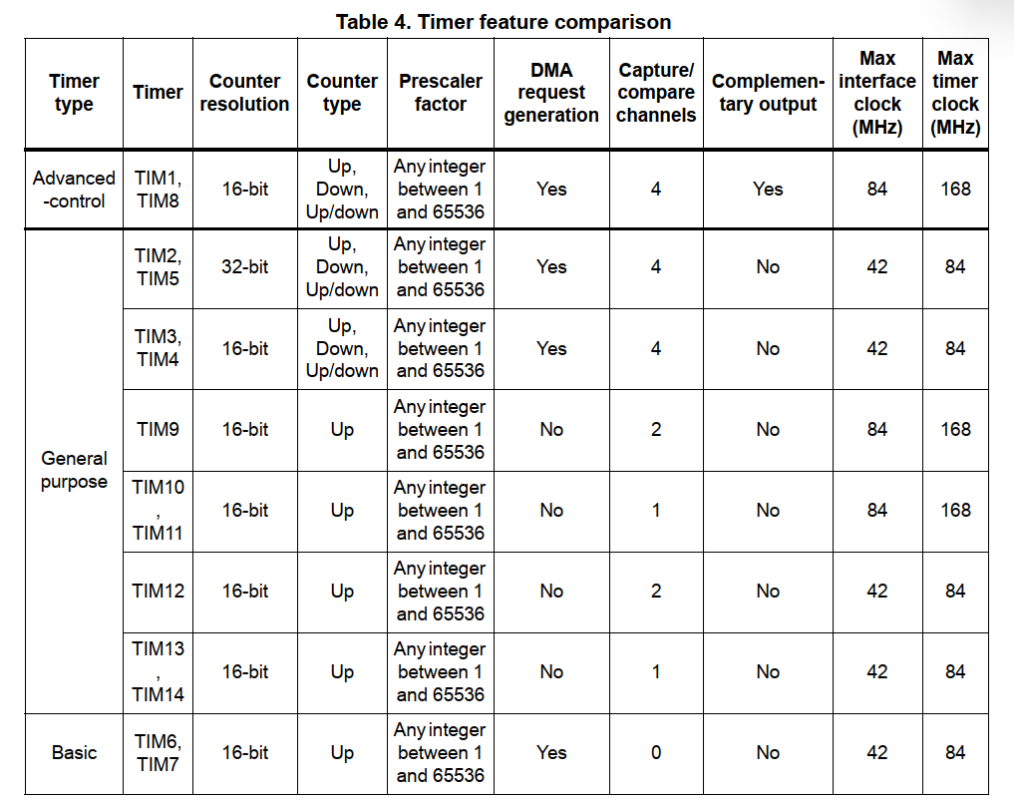
STM32F4 timers
If you look at the datasheet for your microcontroller, you will often find different sections talking about the various timers available.
STM32F4 has different timers (sometimes up to 17 timers)

Slide 11
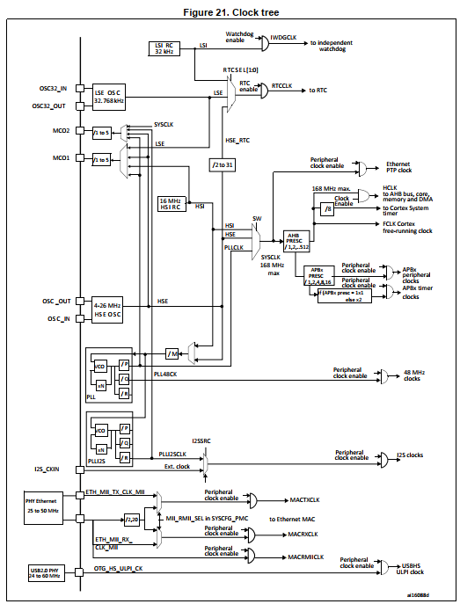
STM32F4 Clock Tree
Some timers are connected to APB1 and some to APB2

Slide 12
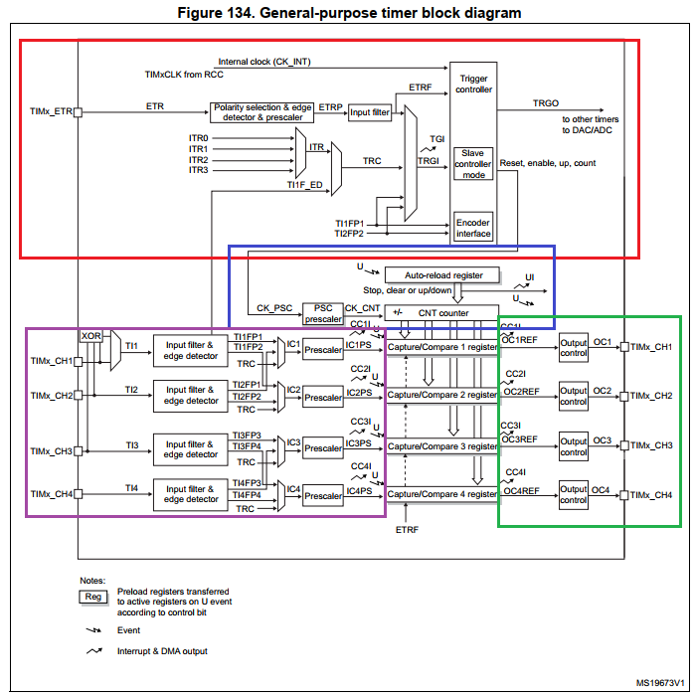
STM32F4 general-purpose timers
Trigger and clock unit
Time-base unit
Input capture
Output compare

Slide 13
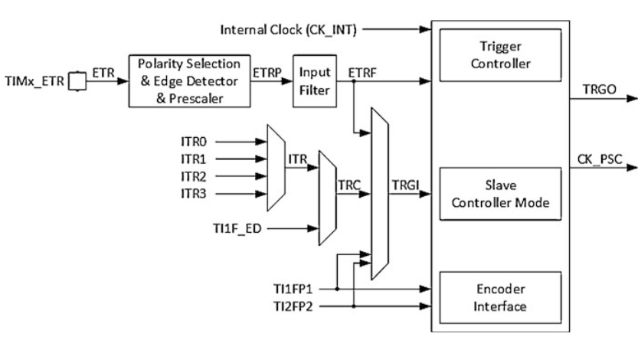
Trigger and Clock Controller Block
The trigger and clock controller block in the base timer is used to start/stop, reset, or update the timer counter using one of the trigger inputs.
The trigger source can be the internal clock signal CK_INT, external clock signal ETR, timer signals TI1FP1 or TI2FP2, or internal trigger signals ITR0-3.
The internal clock, CK_INT, is actually the PCLKx signal obtained from the STM32F4 microcontroller clock tree (APB1 or APB2 clock).
The external clock, ETR, is the signal obtained from the pin TIMx_ETR

Slide 14
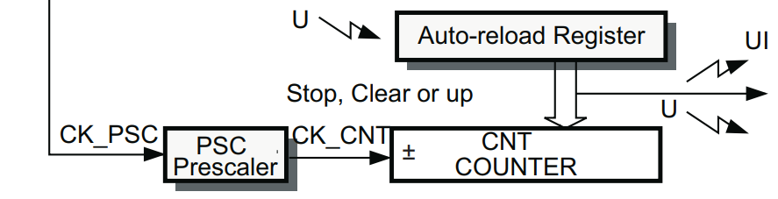
Time Base Unit
The time-base unit contains:
the counting engine, which manages the incrementing or decrementing of the counter.
the auto-reload register (ARR); which defines the maximum count value.
The prescaler (PSC), which divides the input clock frequency to adjust the speed of the counter.

Slide 15
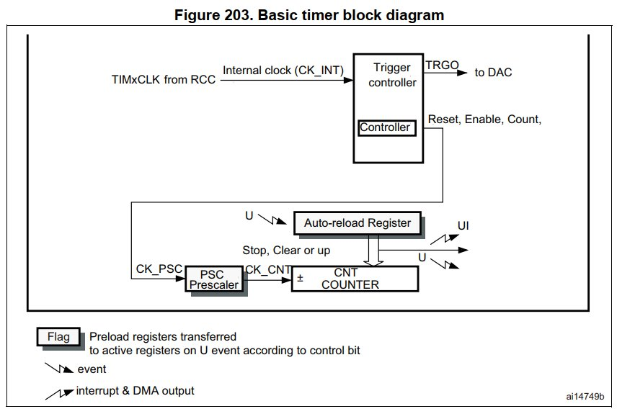
STM32F4 Basic Timer Mode
The basic timer consists of trigger and control clock unit besides timer-base unit
In this mode, it generates Interrupt whenever an overflow occurs

Slide 16
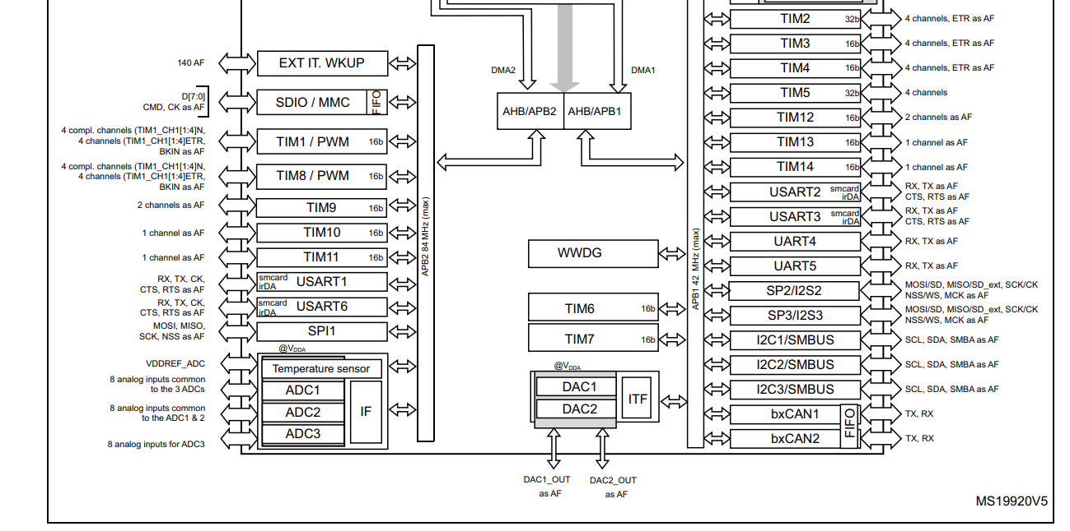
Example: Toggle an LED Using Basic Timer Every 50 ms Using TIM2
Open STM32CubeIDE and create a new STM32 project for your STM32F4 microcontroller.
From datasheet, TIM2 is connected to APB1 bus

Slide 17
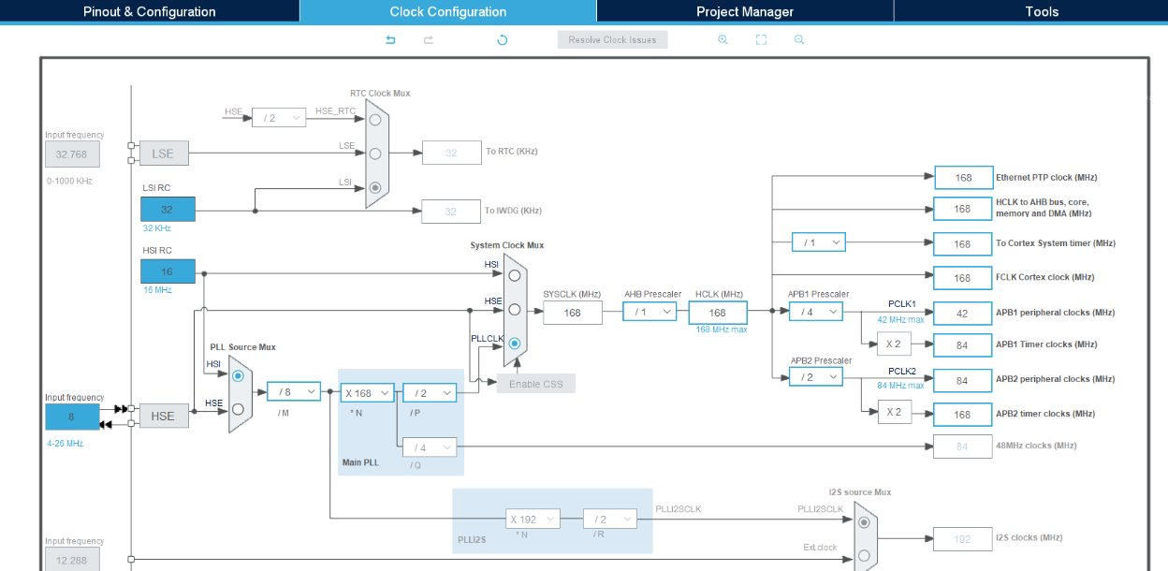
Example: Toggle an LED Using Basic Timer Every 50 ms Using TIM2
Set frequencies for the system clock (SYSCLK), (APB) clocks, and AHB bus (for example: Select HSI as a clock source to PLL, and set APB2 clock to 84 MHz)

Slide 18
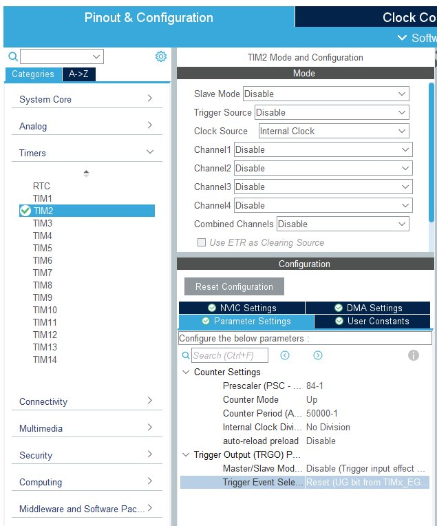
Example: Toggle an LED Using Basic Timer Every 50 ms Using TIM2
Configure the TIM2 timer to use the internal clock source and set the appropriate prescaler (PSC) and ARR values
Select counting direction

Slide 19
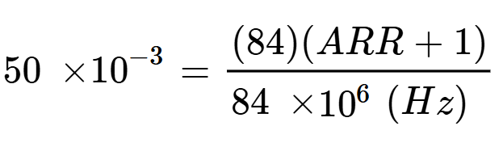
Example: Toggle an LED Using Basic Timer Every 50 ms Using TIM2
PSC and ARR values can be found based on the following formula
The timer period = 50 ms
Counter clock = 84 MHz
Assume PSC +1 = 84
Then, ARR = 50,000 –1

Slide 20
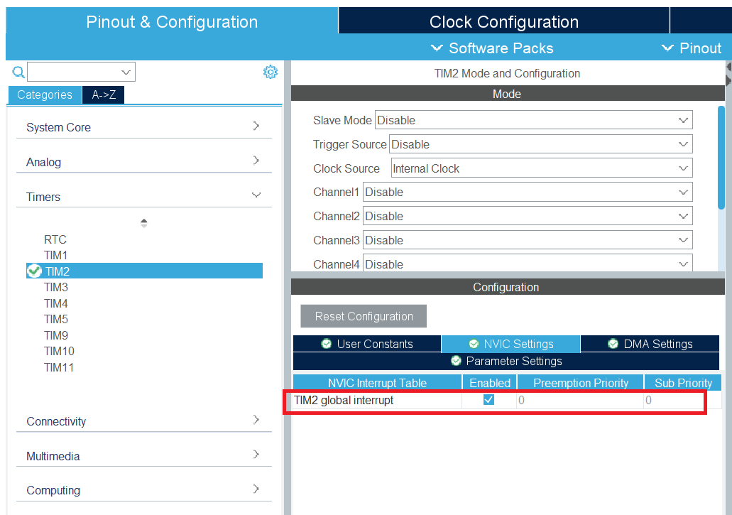
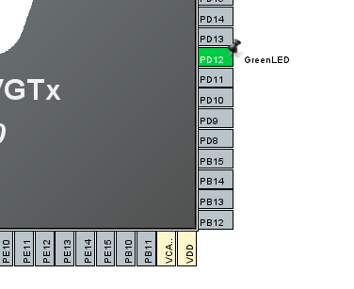
Example: Toggle an LED Using Basic Timer Every 50 ms Using TIM2
Enable TIM2 interrupt signal from NVIC setting tab
Configure PD12 as digital output pin as in GPIO lecture
Generate the code

Slide 21
Example: Toggle an LED Using Basic Timer Every 50 ms Using TIM2
void HAL_TIM_PeriodElapsedCallback(TIM_HandleTypeDef *htim){
if (htim->Instance == TIM2) {
HAL_GPIO_TogglePin(GreenLED_GPIO_Port, GreenLED_Pin);
}
}
Override HAL_TIM_PeriodElapsedCallback function.
This function will be called automatically whenever the counter overflow occurs (when the counter reaches 5000 counts)
This function will toggle the LED every 50 ms.
You need to start the timer in the main function using the following HAL API:
HAL_TIM_Base_Start_IT(&htim2);
int main(void)
{
….
HAL_TIM_Base_Start_IT(&htim2);
….
while (1)
{
}
}

Slide 22
Output compare
In output compare mode, a timer module controls an output waveform or indicates when a period of time has elapsed.
The output compare block, the counter is responsible for managing the pins without direct involvement of the CPU.
How does output compare mode work?
The timer has output channels (pins) associated with it
Each channel has its dedicated output compare register (OCR).
When a match detected between the value inside the OCR and the counter, the output compare function drives the corresponding output pin high, low, toggle its state, or stay unchanged based on the configurations.

Slide 23
STM32F4 general-purpose timers
In output compare mode, the timer has output channels (pins) associated with it
It also has its dedicated output compare register (OCR)

Slide 24
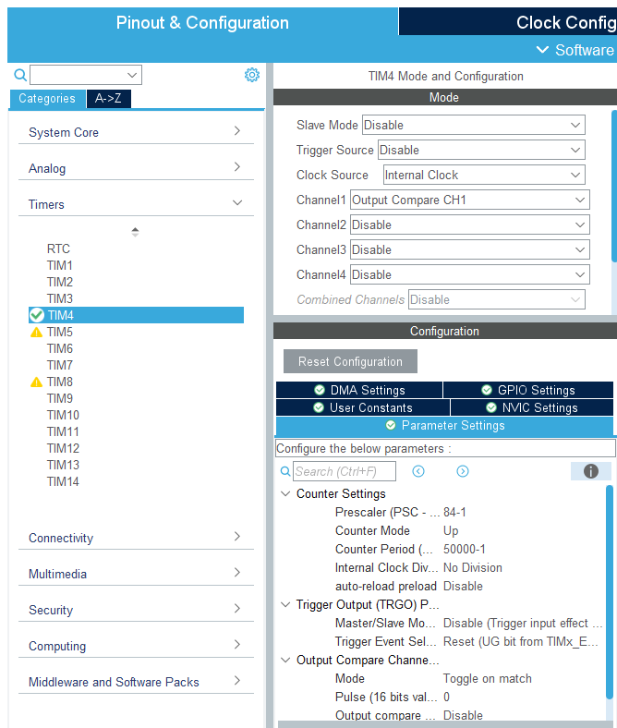
Toggle an LED Every 50 ms Using Output Compare Mode
In this example, we will demonstrate how we can control a pin via timer using output compare mode
The green LED connected to PD12 is associated to TIM4 channel 1
Create a new STM32 project for your STM32F4 microcontroller.
Set frequencies for the system clock as in the previous example
Activate the TIM4 internal clock and set Channel 1 to Output Compare mode.
Enter the PSC and ARR values based on the calculation in the previous example
select "Toggle on Match" from the drop-down menu, to allow the generation of a square wave signal.

Slide 25
Example: Toggle an LED Using Basic Timer Every 50 ms Using TIM2
You just need to start the timer in OC mode in the main function using the following HAL API:
HAL_TIM_OC_Start
int main(void)
{
….
HAL_TIM_OC_Start(&htim4, TIM_CHANNEL_1);
….
while (1)
{
}
}

Slide 26
Pulse width modulation (PWM)
Pulse Width Modulation (PWM) is a method used to create a continuous digital signal that alternates between high and low states, where the signal's pulse width is modulated while maintaining a constant frequency.
In PWM, the term "pulse width" refers to the duration of time during which the signal is in a high (ON) state within each period of the signal
The ratio of the pulse width to the total period is known as the duty cycle
By adjusting the duty cycle, PWM can effectively control the average power delivered to a load.
Embedded systems commonly employ this technique for tasks such as motor speed control, LED dimming, and other applications

Slide 27
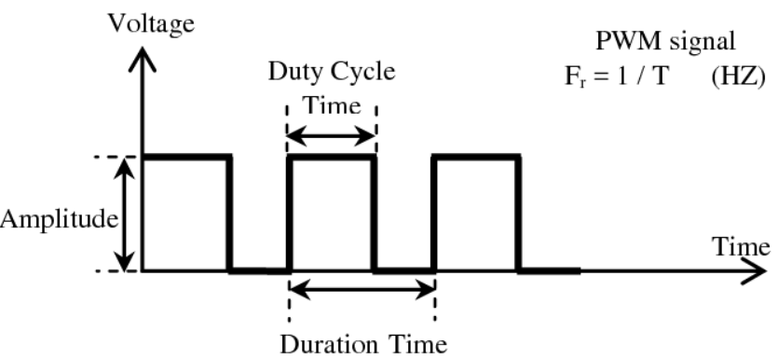
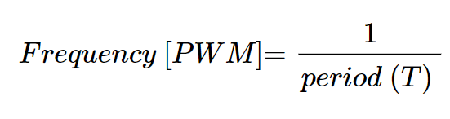
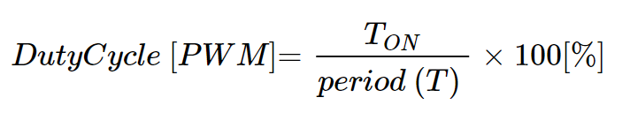
Pulse width modulation (PWM)
PWM frequency (f) is the number of cycles per unit of time (measured in Hertz).
PWM signals typically have a fixed frequency, and the duty cycle is adjusted to convey information
The duty cycle is usually expressed as a percentage and represents the ratio of the time the signal is high to the total time of one cycle
The duty cycle is defined as

Slide 28
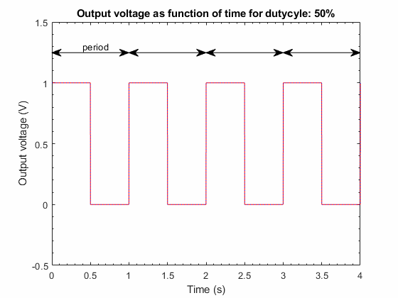
Pulse width modulation (PWM)

Slide 29
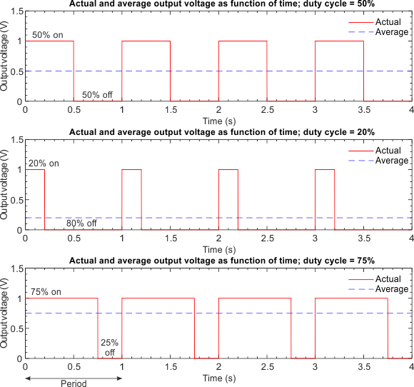

Pulse width modulation (PWM)
The average voltage of a PWM signal is a measure of the signal's effective voltage over a given period
It is determined by the duty cycle, representing the proportion of time the signal spends in the high state
The average output voltage is the duty cycle times the supply voltage

Slide 30
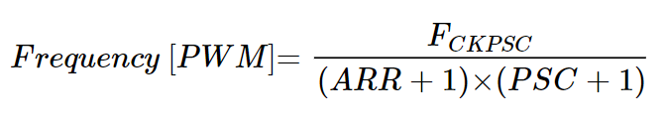
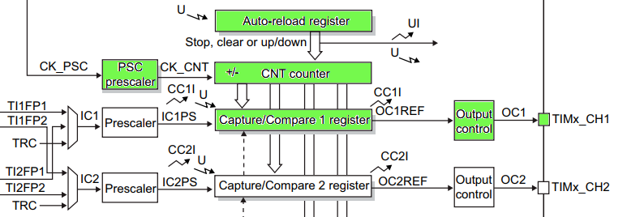

Pulse width modulation (PWM)
Pulse width modulation mode allows for generating a signal with a frequency determined by the value of the TIMx_ARR register and a duty cycle determined by the value of the TIMx_CCRx register.

Slide 31
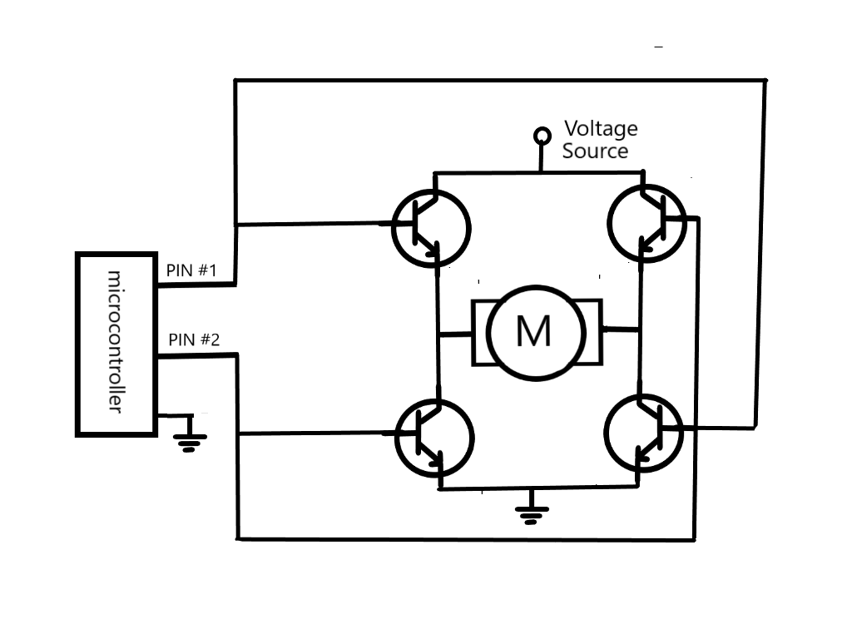
Motor Control Using PWM
The PWM from the microcontroller does not have enough power to drive the motor, therefore it needs an interfacing circuit to drive the motor from an external power source.

Slide 32
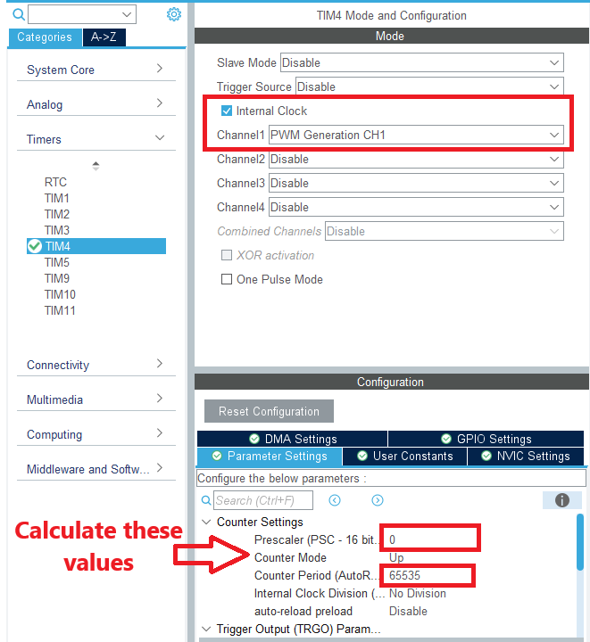
Example: LED dimming using PWM mode
In this example, we need to control the brightness of an LED using 20 KHz PWM signal
Set Create a new STM32 project for your STM32F4 microcontroller and select frequencies for the system clock as in the previous example
Activate the TIM4 internal clock and set Channel 1 to PWM mode.
Enter the PSC and ARR values for 20 KHz output signal.

Slide 33
LED dimming using PWM mode
You just need to start the timer in PWM mode in the main function using the following HAL API:
HAL_TIM_PWM_Start
You can assign value to capture compare register (CCR) using the following pointer access
TIM4->CCR1
CCR value should be < ARR value
int main(void)
{
….
HAL_TIM_PWM_Start(&htim4, TIM_CHANNEL_1);
….
while (1)
{
TIM4->CCR1=1000;
}
}

Slide 34
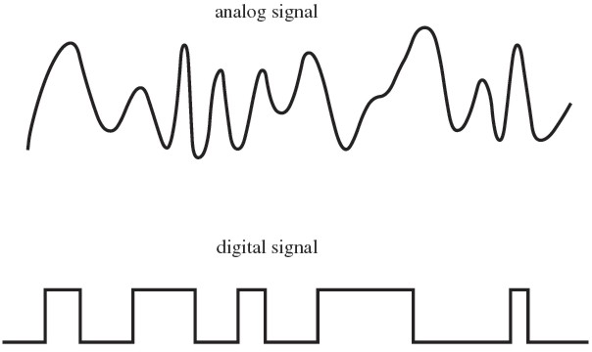
Input capture
Capture the timestamp of the occurrence of an event
Event is represented by a rising or falling edge in a digital signal

Slide 35
Input capture block
The input capture block in the base timer is used to copy the value inside the counter register to the capture/compare register when the selected input signal transition is detected
This transition can be low to high (rising edge), high to low (falling edge), or both (rising and falling edges)
The input signal should be connected to the related timer channel (pin)
We can measure:
a period of a signal by using the capture mode with rising or falling edges
the pulse duration of a signal by using capture mode with both edges
or duration of an operation (e.g., time between pressing and releasing a button) using different capture modes

Slide 36
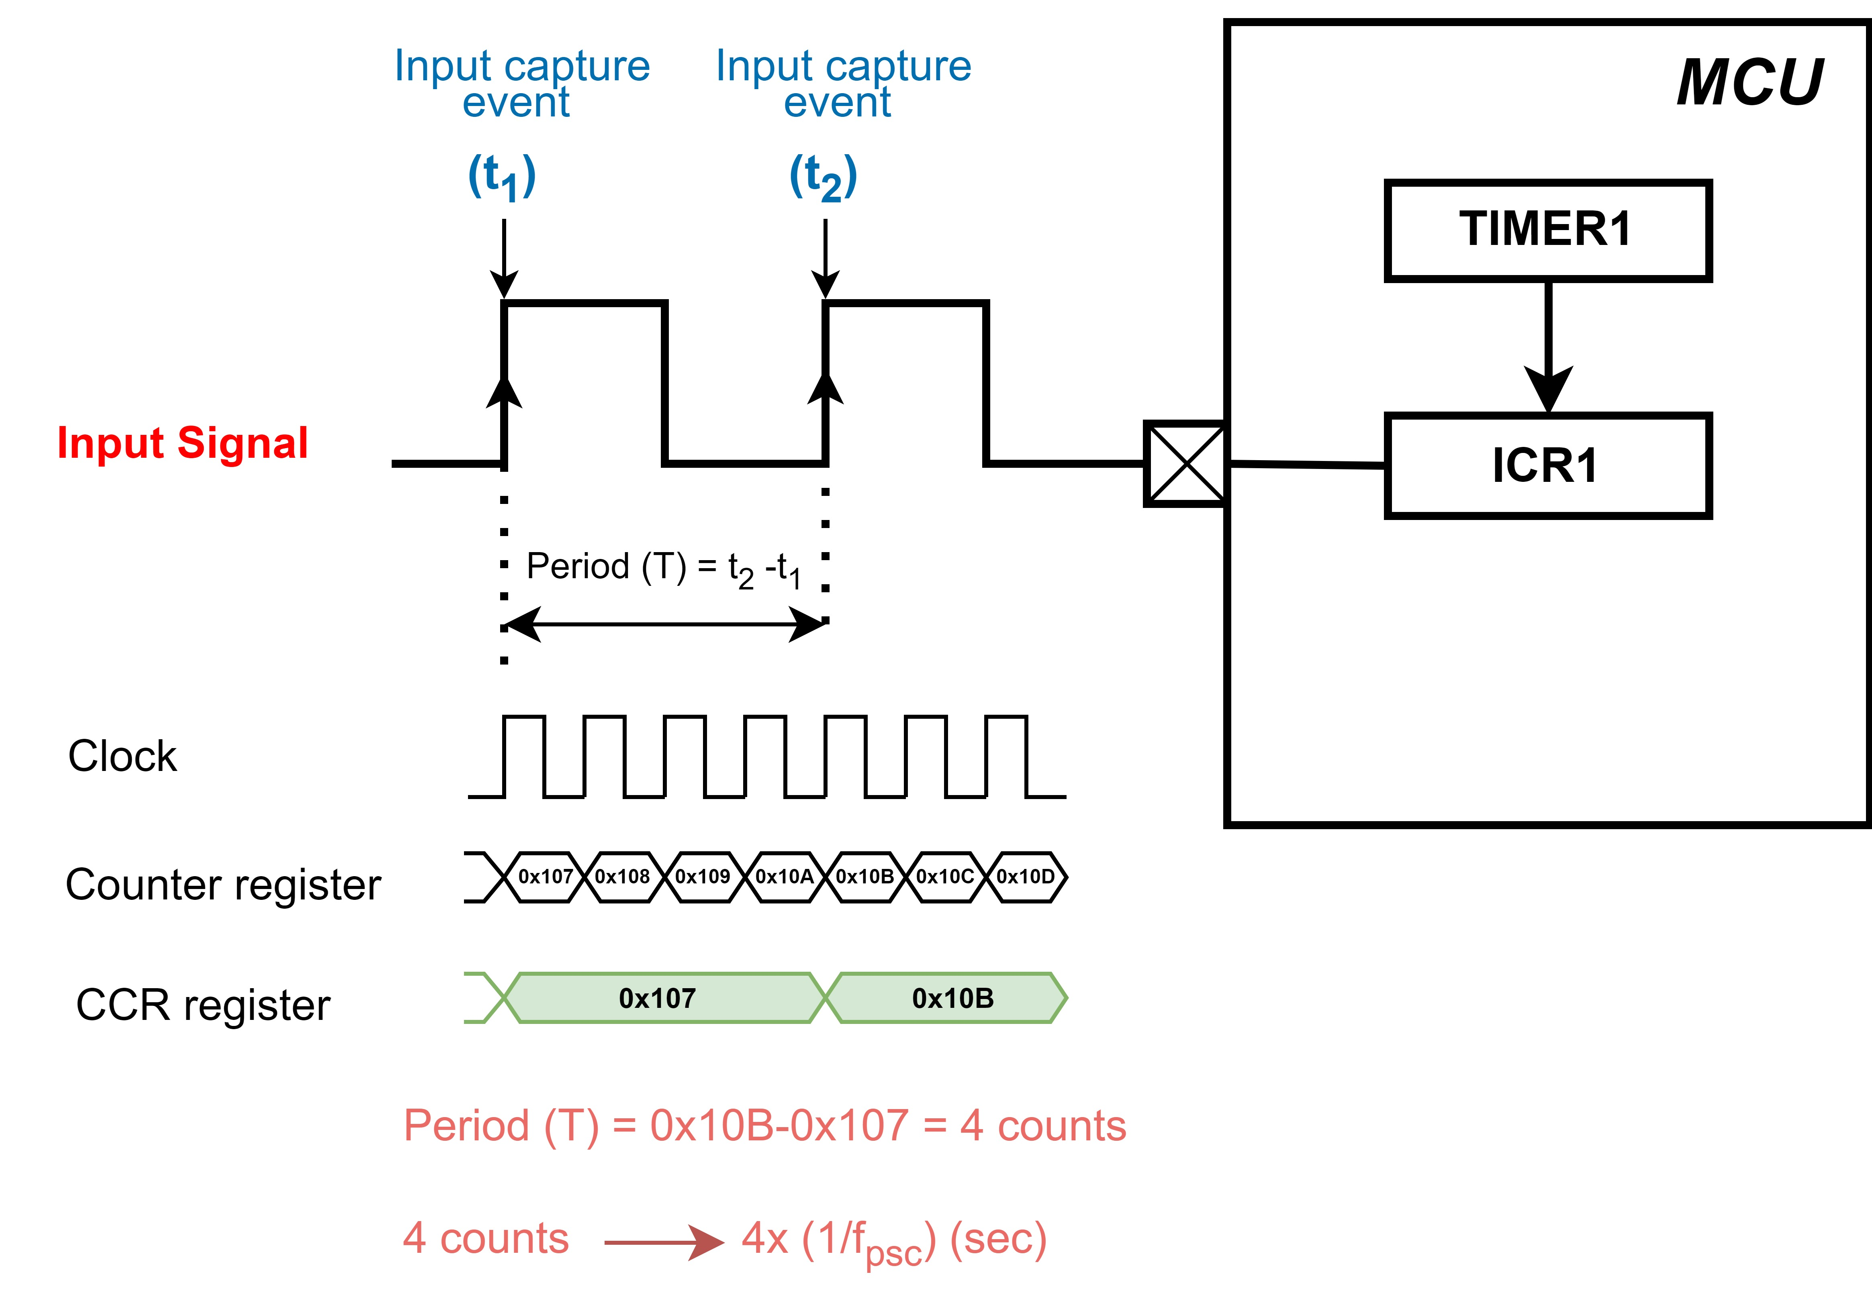
Input capture block

Slide 37
Example: Measuring Frequency of an input signal

Slide 38
Questions?

