Slide 1
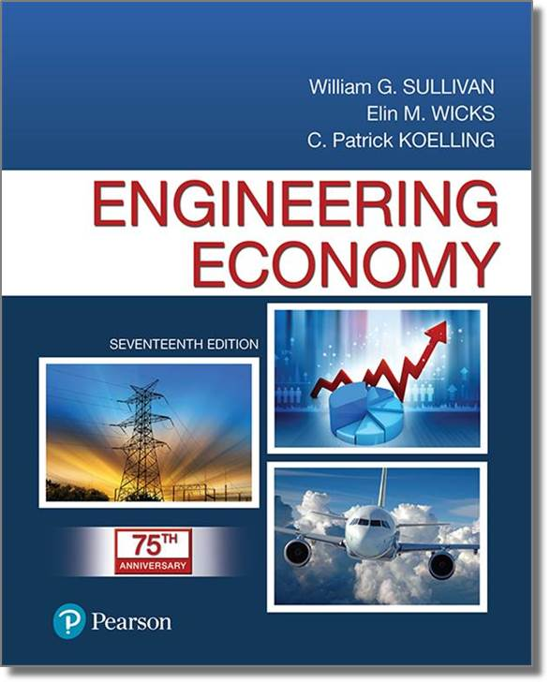
Engineering Economy
Seventeenth Edition
Chapter 01
Introduction to Engineering Economy
Copyright © 2019, 2016, 2013 Pearson Education, Inc. All Rights Reserved

Slide 2
The purpose of this book is to develop and illustrate the principles and methodology required to answer the basic economic question of any design: Do its benefits exceed its costs?
Engineering economy involves the systematic evaluation of the economic merits of proposed solutions to engineering.
Solutions to engineering problems must:
• promote the well-being and survival of an organization,
• embody creative and innovative technology and ideas,
• permit identification and scrutiny of their estimated outcomes, and
• translate profitability to the “bottom line” through a valid and acceptable measure of merit.

Slide 3

Engineering economic analysis can play a role in many types of situations: Examples
• Choosing the best design for a high- efficiency gas furnace.
• Selecting the most suitable robot for a welding operation on an automotive assembly line.
• Making a recommendation about whether jet airplanes for an overnight delivery service should be purchased or leased.
• Determining the optimal staffing plan for a computer help desk.

Slide 4
There are seven fundamental principles of engineering economy.
• Develop the alternatives
• Focus on the differences
• Use a consistent viewpoint
• Use a common unit of measure
• Consider all relevant criteria
• Make uncertainty explicit
• Revisit your decisions

Slide 5
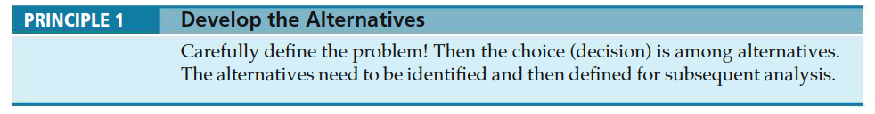
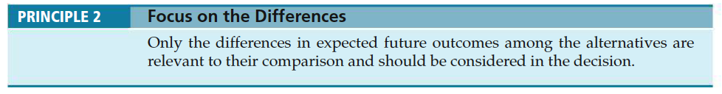
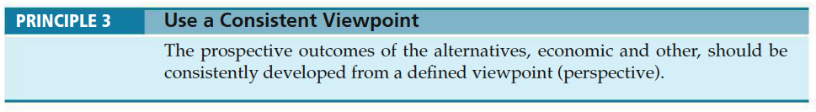
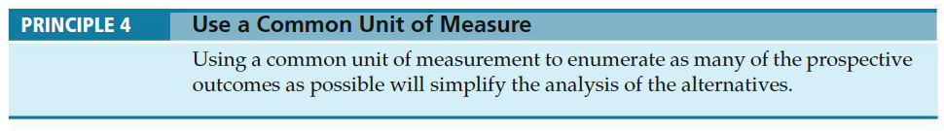

Slide 6
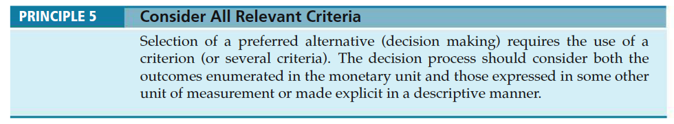
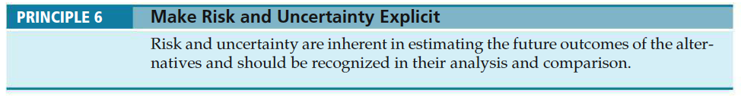
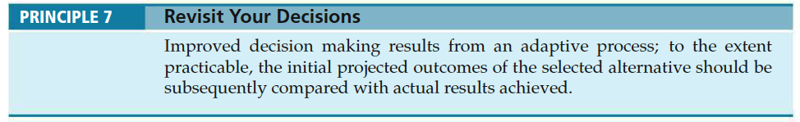

Slide 7


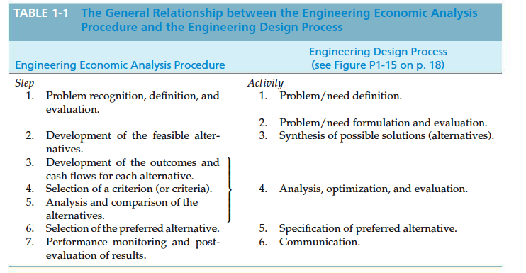

Slide 8
Engineering economic analysis procedure
• Problem definition
• Development of alternatives
• Development of prospective outcomes
• Selection of a decision criterion
• Analysis and comparison of alternatives.
• Selection of the preferred alternative.
• Performance monitoring and post evaluation of results.

Slide 9
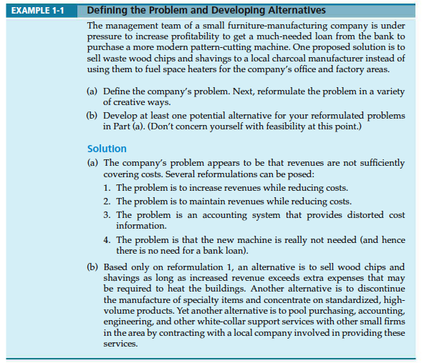

Slide 10
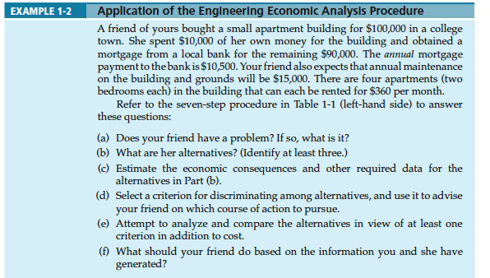

Slide 11
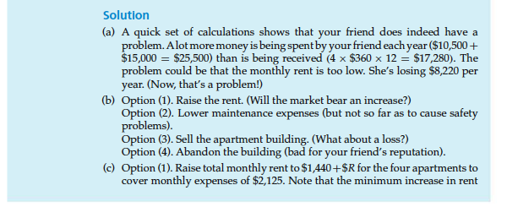

Slide 12
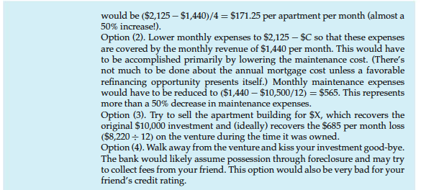

Slide 13
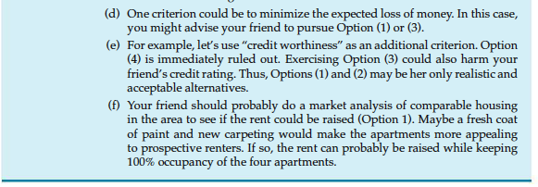

Slide 14
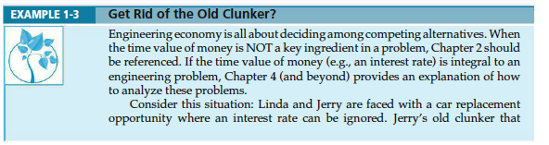

Slide 15
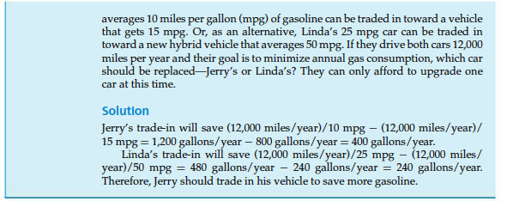

Slide 16
Electronic spreadsheets are a powerful addition to the analysis arsenal.
• Most engineering economy problems can be formulated and solved using a spreadsheet.
• Large problems can be quickly solved.
• Proper formulation allows key parameters to be changed.
• Graphical output is easily generated.

Slide 17
