Slide 1
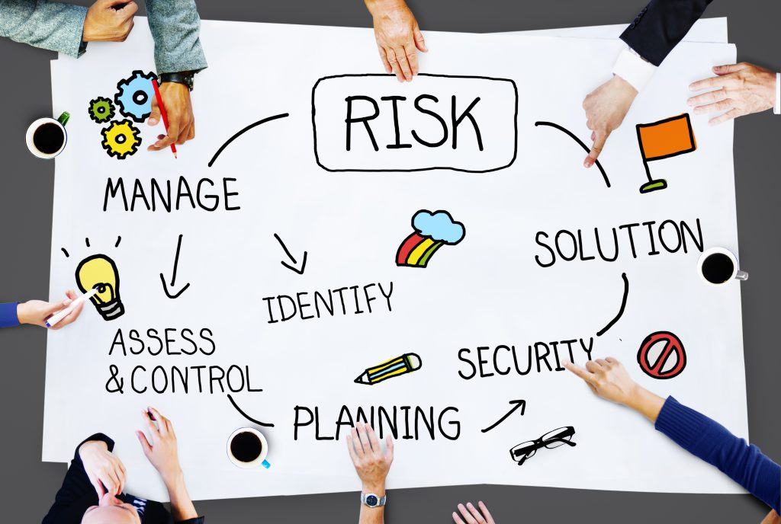
Chapter 4
Risk Management
ACCT 337: Internal Audit & Risk Management

Slide 2
Events and Uncertainty
An entity’s strategy and business objectives may be affected by potential events (positive or negative).
Event: An occurrence or set of occurrences.
A lack of complete predictability of an event occurring (or not) and its related impact creates uncertainty for an organization.
Uncertainty: The state of not knowing how or if potential events may manifest.

Slide 3

What is Risk? (1/5)
The English language word risk comes from the Italian word “risicare,” which means “to dare: a choice under uncertain conditions (rather than fate).”2 The key to this definition is the notion of uncertainty.
Committee of Sponsoring Organizations of the Treadway Commission (COSO) defined risk as “The possibility that events will occur and affect the achievement of a strategy and objectives.”
And the International Organization for Standardization (based in Switzerland and abbreviated ISO based on the French translation) very simply defines risk as the “effect of uncertainty on objectives.”

Slide 4
What is Risk? (2/5)
Risk begins with strategy formulation and setting of business objectives.
An organization is in business to achieve particular strategies and business objectives. Risks represent the barriers to successfully achieving those objectives as well as the opportunities that may help achieve those objectives.
Therefore, because each organization has somewhat different strategies and business objectives, they also will face different types of risks.
Risks may relate to preventing bad things from happening (risk mitigation), or failing to ensure good things happen (that is, exploiting or pursuing opportunities).
Most people focus on preventing bad outcomes—for example, a hazard that needs to be mitigated or eliminated. While many risks do, in fact, present threats to an organization, risks are also represented by the failure to pursue and achieve positive outcomes.

Slide 5
What is Risk? (3/5)
Risk refers to the possibility that events will occur and affect the achievement of a strategy and objectives.
It encompasses:
Negative Events: Events that cause harm, loss, or disruption.
Failure to Pursue Opportunities:
Opportunity is an action or potential action that creates or alters goals or approaches for creating, preserving, or realizing value. Failure to purse them may lead to missing chances for growth, efficiency, or other improvements.
Risk involves uncertainty, which COSO refers to as “The state of not knowing how potential events may or may not manifest.”

Slide 6
What is Risk? (4/5)
Negative Event Example:
Scenario: A factory faces machinery breakdowns during production.
What May Lead to This Risk:
Lack of regular maintenance.
Use of outdated equipment.
Untrained staff operating machinery.

Slide 7
What is Risk? (5/5)
2. Failure to Seize Opportunity Example:
Scenario: A municipality misses an opportunity to secure international funding for a renewable energy project.
What May Lead to This Risk:
Not enough resources (financial, human, or technical) to prepare a competitive grant proposal.
Limited expertise in drafting funding applications.
Lack of staff to manage communications with funding agencies.
Insufficient data to demonstrate the project’s feasibility and impact.

Slide 8
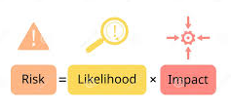
Likelihood vs. Impact
The difference between likelihood and impact in risk management lies in what each term assesses:
Likelihood:
Definition: Likelihood refers to the probability or chance that a particular risk event will occur.
Question it answers: "How likely is it that this risk will happen?"
Example: In a municipality, the likelihood of a data breach occurring might be considered high if there are frequent attempts to hack into municipal systems.
Impact:
Definition: Impact refers to the extent of the consequences or severity of effects if the risk event occurs.
Question it answers: "If this risk happens, how severe will the effects be on the organization?"
Example: The impact of a data breach in a municipality could be very high if it leads to exposure of sensitive information, financial losses, or loss of public trust.

Slide 9
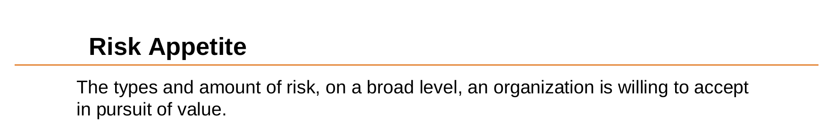

Risk Appetite vs. Risk Tolerance (1/3)
The difference between risk appetite and risk tolerance can be illustrated with a food example:
Risk Appetite: This represents the overall level or type of risk that someone is willing to take in pursuit of a goal. In food terms, it’s like saying, “I enjoy spicy food and am generally open to eating moderately spicy dishes because I like the flavor and thrill.”
Risk Tolerance: This is the acceptable level of variation from that appetite—the specific limits or thresholds that someone can handle. Continuing with the spicy food analogy, risk tolerance would be, “I’m comfortable with dishes that are moderately spicy, but if it gets too hot (like a ghost pepper level), that’s beyond my limit.”
So, in summary:
Risk Appetite is the broader, general willingness to take on risk (e.g., willingness to eat spicy food).
Risk Tolerance is the specific level at which the risk is still acceptable, and beyond which it becomes too much (e.g., a dish that is mildly to moderately spicy but not extremely hot).

Slide 10

Risk Appetite vs. Risk Tolerance (2/3)

Slide 11
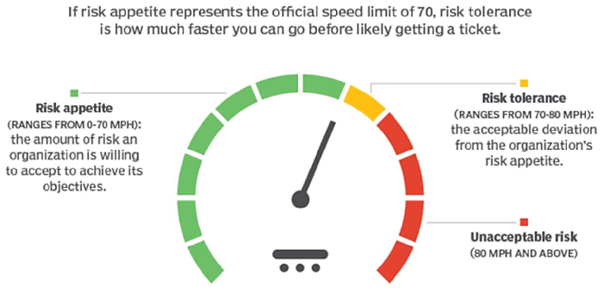
Risk Appetite vs. Risk Tolerance (3/3)

Slide 12
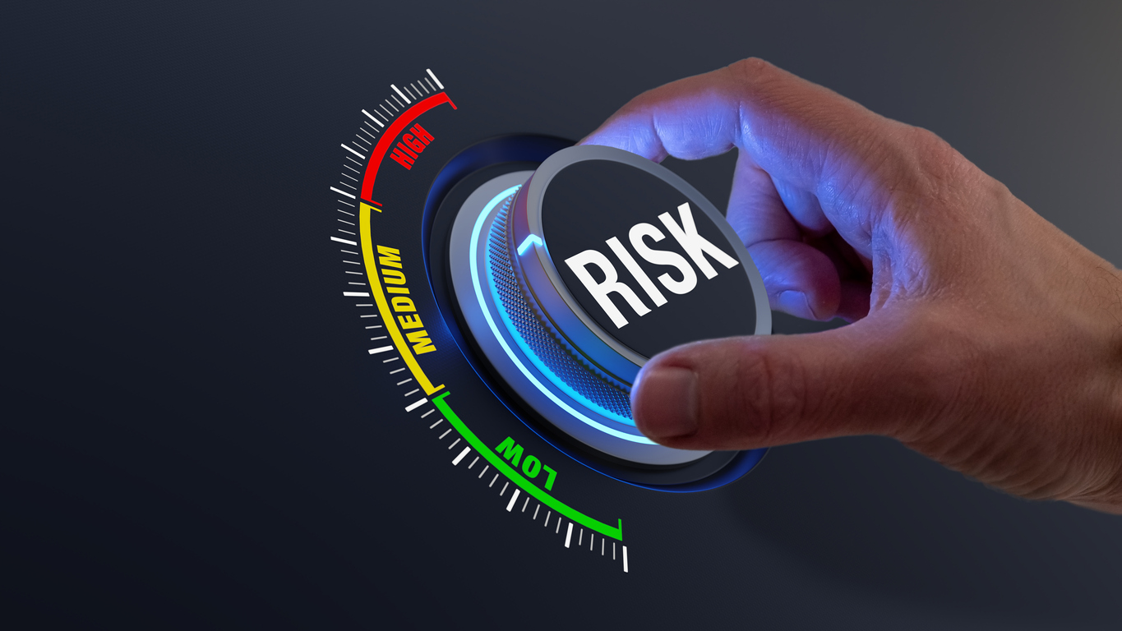
Risk Severity
Severity is a measurement of considerations such as:
Likelihood: The probability that a risk event will occur.
Impact: The extent of the consequences if the event happens.
Recovery Time: The time it takes to recover from the event.
Key Points:
Severity reflects the overall seriousness of a risk.
Helps organizations prioritize which risks require immediate action and which can be monitored or tolerated.
Typically classified as low, medium, high, or critical based on thresholds.

Slide 13
Understanding Risk- Example (1/4)
Example: Community Park Project
Scenario: A municipality is planning to build a community park to enhance public spaces and promote social activities.

Slide 14
Understanding Risk- Example (2/4)
Event: Unexpected heavy rains during construction.
Uncertainty: The exact timing, amount, and impact of the rain cannot be predicted.
Risk as a Negative Outcome:
The rain delays construction, increasing costs and public dissatisfaction.
Risk as Failure to Pursue Opportunity:
The municipality doesn’t apply for an environmental grant, missing a chance to fund eco-friendly park designs.

Slide 15
Understanding Risk- Example (3/4)
Risk Appetite: The municipality is willing to accept minor disruptions to the project timeline (e.g., delays of up to 2 weeks).
Risk Tolerance: The municipality cannot accept delays exceeding 4 weeks or cost overruns of more than $10,000, as this would breach contractual obligations and budget limits.
Difference: Appetite is about the general willingness to take risks (e.g., minor delays for better quality).Tolerance is the specific limit beyond which the risk becomes unacceptable (e.g., delays or costs causing financial/legal issues).

Slide 16
Understanding Risk- Example (4/4)
Likelihood: The probability of heavy rains occurring during construction is high (e.g., 70%).
Impact: The rain could severely disrupt timelines and escalate costs.
Severity: Combining likelihood (high) and impact (severe), this risk is classified as critical and requires immediate attention.

Slide 17
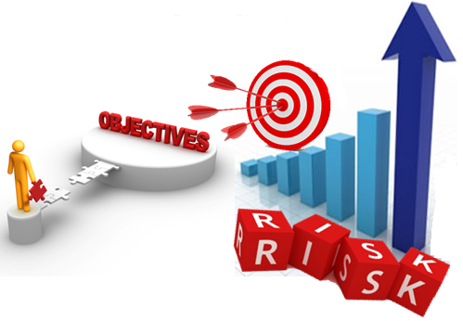
Why Should Organizations Understand Risks?
To ensure that objectives are achieved without disruption.
To minimize potential negative impacts on operations, finances, and reputation.
To identify and take advantage of opportunities for growth and improvement.
To comply with laws, regulations, and stakeholder expectations.

Slide 18
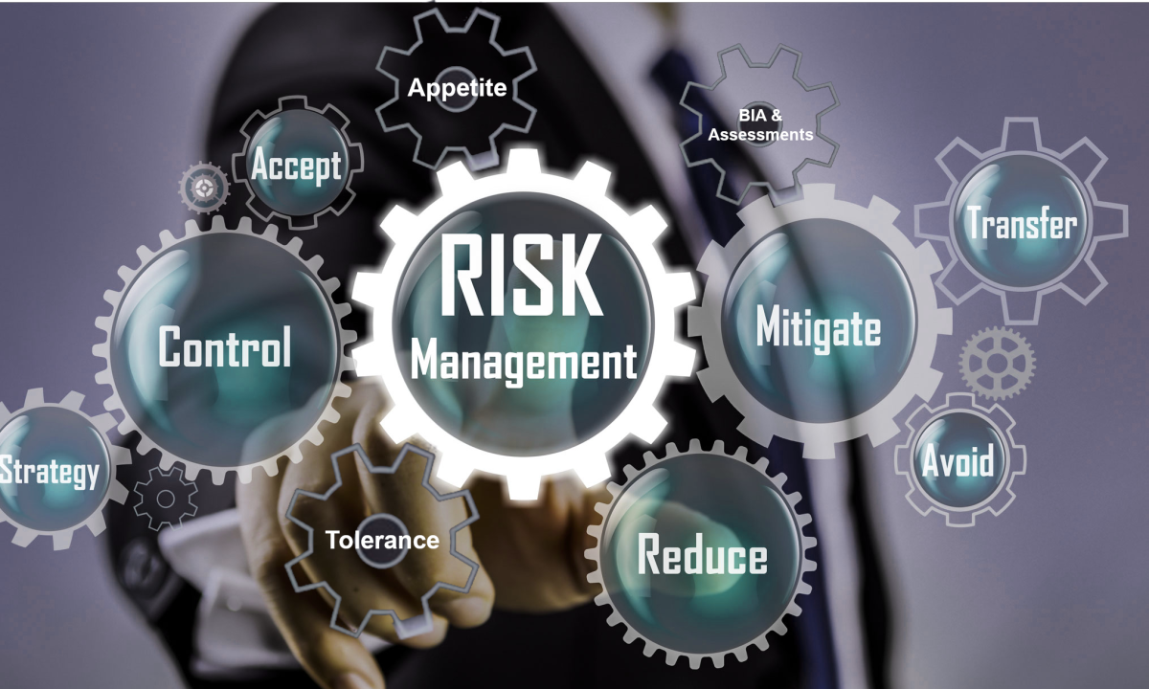
What Does the Organization Need to Do?
It needs to implement Risk Management.
What is Risk Management?
It’s the process of identifying, assessing, managing, and mitigating risks that could impact an organization's objectives and operations. It aims to reduce the likelihood and impact of adverse events while maximizing opportunities. Effective risk management helps organizations make informed decisions, protect resources, and achieve goals.
Ensures potential threats are minimized while opportunities are maximized.
Why is it Important?
To align risk exposure with the organization’s risk appetite and strategic goals.
To improve decision-making and resource allocation.

Slide 19
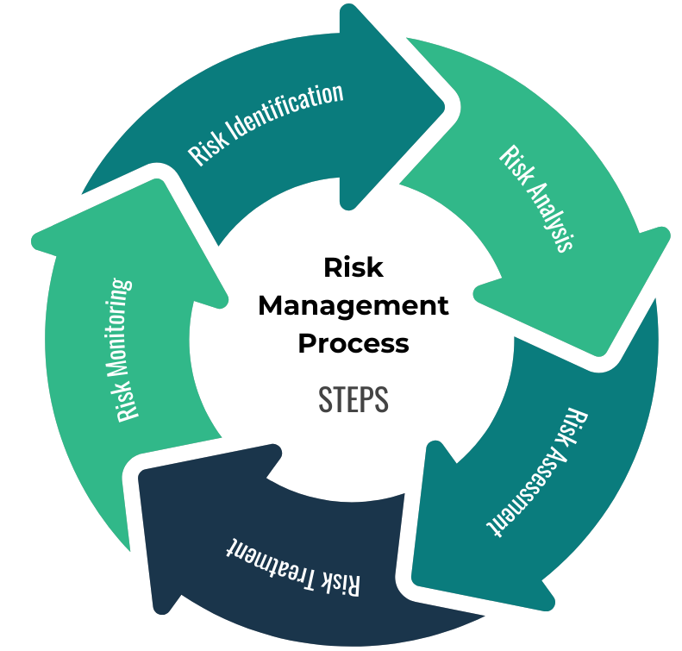
Step 1: Risk Identification
The process of identifying potential risks that could affect the achievement of objectives.
Risks are recognized and documented to prepare for further analysis.
Step 2: Risk Analysis
Analyzing the identified risks to understand their nature and possible causes.
Each risk is evaluated in terms of its likelihood and impact.
Step 3: Risk Assessment
Evaluating the identified risks to prioritize them based on their severity and potential impact.
Risks are ranked to determine which ones require immediate action.
Step 4: Risk Treatment (Risk Response)
Developing strategies to mitigate, transfer, accept, or avoid risks
Specific actions are planned and implemented to reduce or control the risks.
Step 5: Risk Monitoring & Reporting
Continuously monitoring risks and the effectiveness of mitigation strategies.
Risk mitigation actions are tracked, and new risks are identified.

Slide 20
Understanding Risk Management- Example (1/7)
Example: The municipality has decided to engage the community in a neighborhood cleanup event to improve public spaces and foster civic pride. While the initiative is a fantastic way to bring people together, it comes with its own set of challenges. What if it rains? What if there aren’t enough volunteers or supplies? Through effective risk management, the municipality can plan for these uncertainties, ensuring the event runs smoothly and meets its goals. By carefully identifying potential risks, preparing responses, and staying adaptable, the municipality can set the stage for a successful and impactful cleanup effort.
Required: As future risk managers, your task is to help the municipality ensure the success of this neighborhood cleanup event. For each step of the risk management process, you will:
Identify risks: Brainstorm potential challenges the event might face.
Assess risks: Determine how likely each risk is and how significant its impact could be.
Respond to risks: Propose practical and cost-effective solutions to handle or minimize each risk.
Monitor risks: Suggest ways to track and prepare for risks before the event.
Report risks: Reflect on what worked well and what could be improved after the event.

Slide 21
Understanding Risk Management- Example (2/7)
1. Risk Identification
What to Do: Think about what could go wrong with the event.
Example Risks:
Rain: It might rain, and the event could be canceled.
Fewer Volunteers: Not enough people might show up to help.
Not Enough Supplies: There may not be enough cleaning tools or bags.

Slide 22
Understanding Risk Management- Example (3/7)
2. Risk Analysis
What to Do: Figure out how likely each risk is to happen and how bad it could be.
Example:
Rain: Likely (50%), bad impact (it could stop the event).
Not Enough Volunteers: Unlikely (30%), medium impact (it could slow things down).
Not Enough Supplies: Unlikely (20%), high impact (the event can’t continue without supplies).

Slide 23
Understanding Risk Management- Example (4/7)
3. Risk Assessment
What to Do: Decide which risks are most important and need the most attention.
Example:
High Priority: Rain and running out of supplies—both could seriously impact the event.
Medium Priority: Not enough volunteers—though not likely, it could still cause a delay.

Slide 24
Understanding Risk Management- Example (5/7)
4. Risk Treatment
What to Do: Plan how to deal with each risk.
Example Plans:
Rain: Prepare raincoats and tents to keep everyone dry.
Not Enough Volunteers: Promote the event earlier to get more people involved.
Not Enough Supplies: Contact local businesses to get extra supplies or donations.

Slide 25
Understanding Risk Management- Example (6/7)
5. Risk Monitoring
What to Do: Keep an eye on how things are going and be ready to change the plan if needed.
Example Monitoring:
Weather: Check the weather forecast before the event.
Volunteers: Keep track of who signed up and ask for more if needed.
Supplies: Double-check how many supplies are available and get more if necessary.

Slide 26
Understanding Risk Management- Example (7/7)
6. Risk Reporting
What to Do: After the event, look back at how things went and report on the successes and challenges.
Example Reporting:
Talk about what worked well (like rain preparations) and what could be improved (like getting supplies earlier).
Share these results with everyone involved to help plan better next time.

Slide 27
Who Manages Risks in the Organization? (Aligned with COSO ERM)
1. Board of Directors (or Governing Body)
Sets the tone at the top.
Approves the organization’s risk appetite and oversees risk management processes.
Ensures alignment of risk management with strategic objectives.
Provides oversight and ensures accountability.
May establish a Risk Committee to focus on risk oversight and ensure the effectiveness of the organization’s risk management framework.

Slide 28
Who Manages Risks in the Organization? (Aligned with COSO ERM)
2. Senior Management
Designs and implements the risk management framework.
Integrates risk management into business strategies and decision-making.
Assigns responsibility for managing specific risks to risk owners.

Slide 29
Who Manages Risks in the Organization? (Aligned with COSO ERM)
3. Risk Owners
Individuals responsible for specific risks, often department heads and may be lower-level managers with direct oversight of activities.
They have day-to-day responsibility for ensuring that risk management activities effectively manage risks within the organization’s tolerance levels.
These individuals are responsible for identifying, measuring, managing, monitoring, and reporting on risks to the members of senior management to whom they report, typically the chief officers.
Examples of risk owners:
IT Manager for cybersecurity risks.
Procurement Officer for supply chain risks.
Facility Manager for safety risks.
Develop and implement risk responses for their assigned risks.

Slide 30
Who Manages Risks in the Organization? (Aligned with COSO ERM)
4. Risk Management Function (if applicable)
Develops and coordinates the organization’s risk management policies and procedures.
Monitors and reports on the risk environment and compliance with the framework.
5. All Employees
Play a role in identifying and reporting risks in their daily tasks.
Support a culture of risk awareness and accountability.

Slide 31
Internal Auditors’ Role in Risk Management
What Internal Auditors Do:
Provide independent assurance on the effectiveness of risk management processes.
Evaluate whether risks are identified, assessed, and managed appropriately.
Review the reliability of risk information and the organization’s ability to achieve its objectives.
Recommend improvements to enhance the risk management process.
What Internal Auditors Do NOT Do:
Internal auditors are not responsible for managing risks.
Managing risks is the responsibility of management and risk owners.
Their role is to provide assurance that risk management processes are working as intended and are aligned with the organization’s strategy.

Slide 32
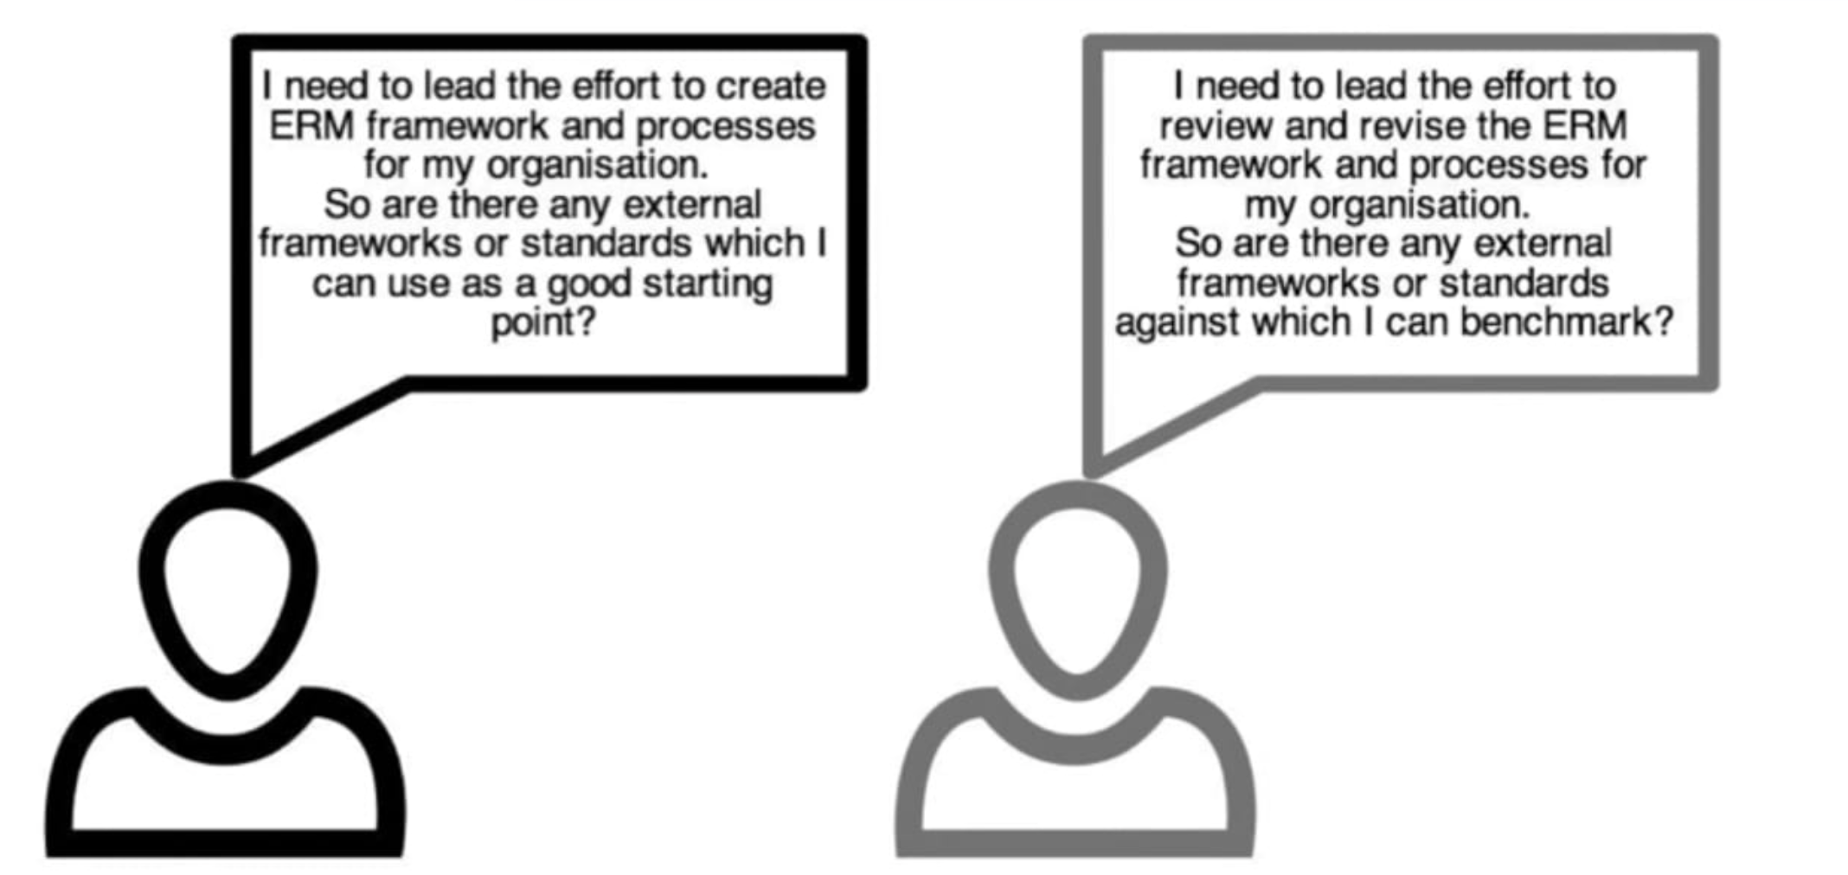
WHY CHOOSE A RISK MANAGEMENT FRAMEWORK?

Slide 33
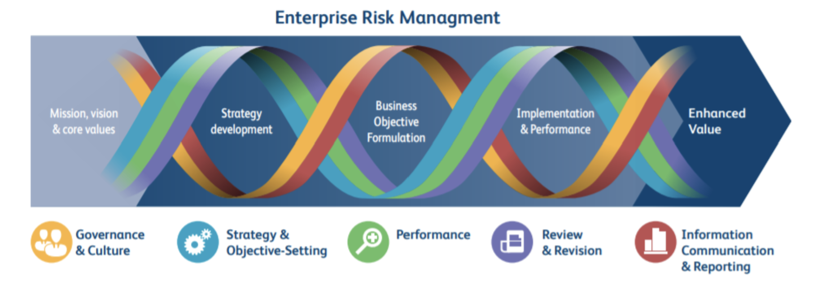
1^{st:} COSO ERM FRAMEWORK-2017

Slide 34
Introduction to COSO ERM
What is COSO ERM?
Developed by the Committee of Sponsoring Organizations (COSO).
Provides a structured and integrated framework for managing risks at an enterprise level.
It sets out a basic conceptual structure of ideas, which an organization can integrate into other practices occurring within the entity.
Why Use It?
Aligns risk management with strategy.
Helps organizations achieve objectives while addressing risks.
Who can use it?
Any organization as its principles apply at all levels of the organization and across all functions regardless of the size of the organization and industry.

Slide 35
Why apply the COSO ERM Framework?
Integrating enterprise risk management practices throughout an organization improves decision-making in governance, strategy, objective-setting, and day-to-day operations.
Risk affects an organization’s ability to achieve its strategy and business objectives.
Therefore, one challenge for management is determining the amount of risk the organization is prepared and able to accept. Effective enterprise risk management helps boards and management to optimize out comes with the goal of enhancing capabilities to create, preserve, and ultimately realize value.

Slide 36
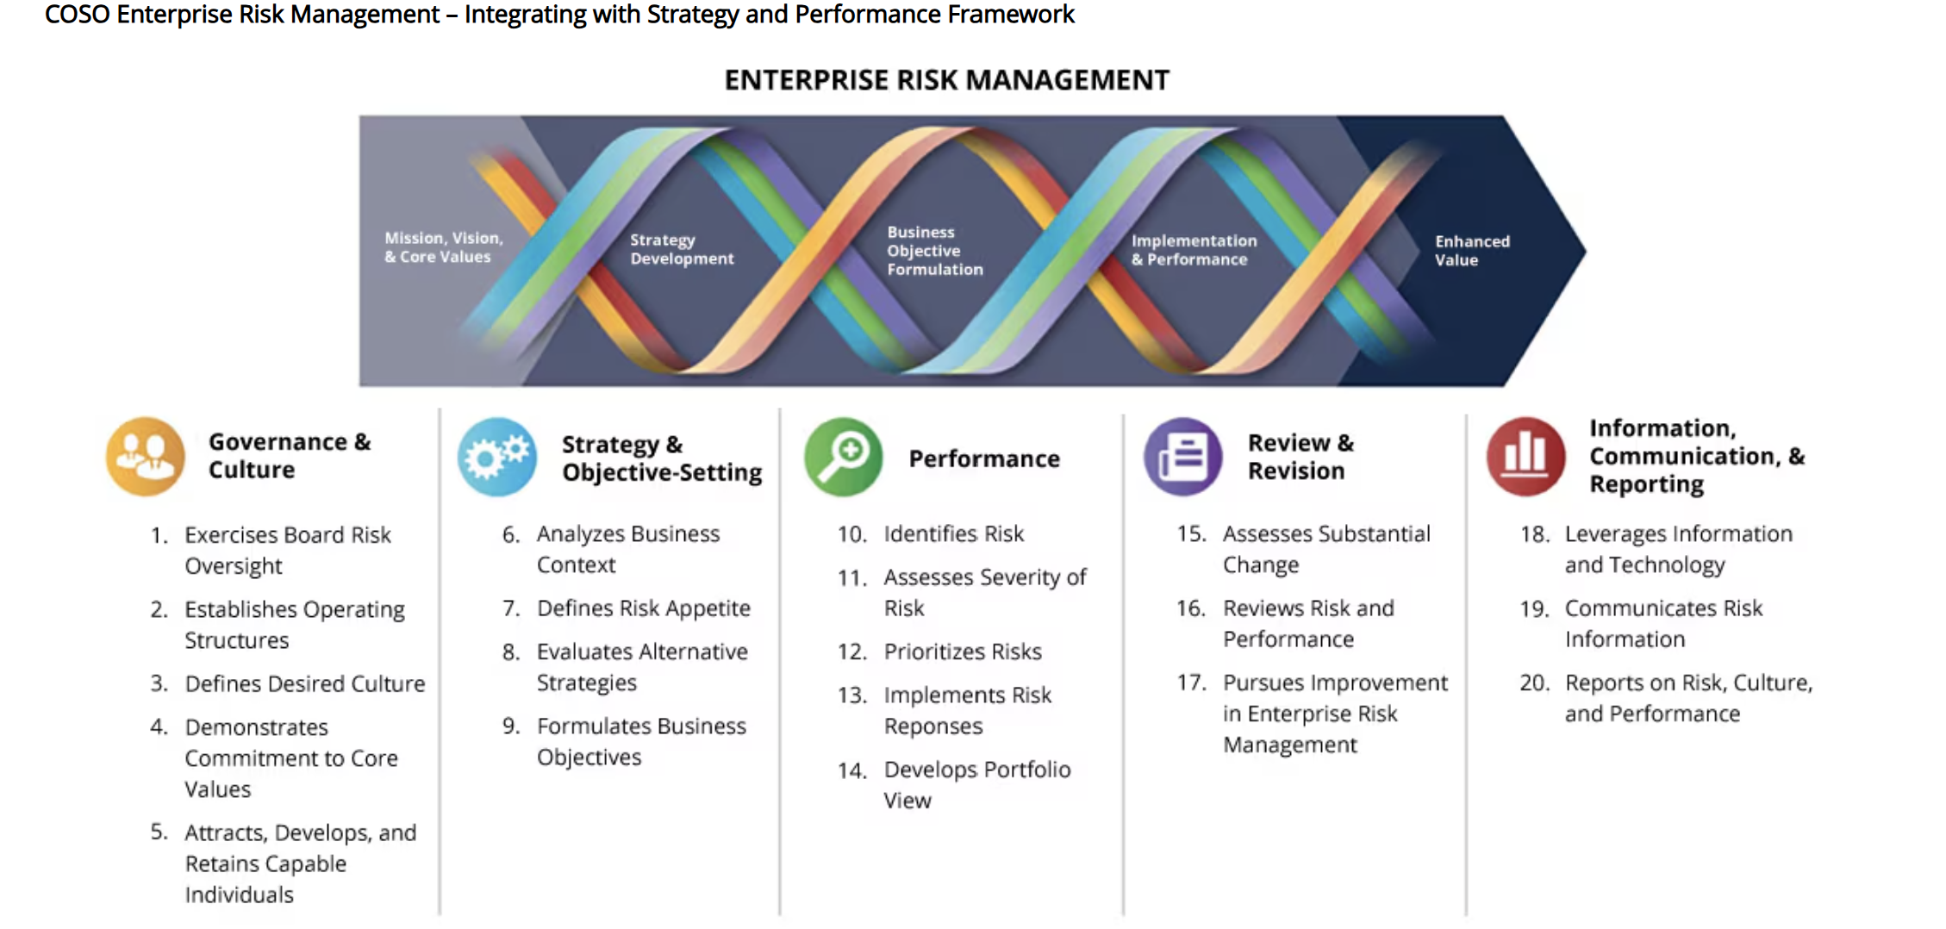

Slide 37
The COSO ERM Framework (Overview)
First introduced in 2004 and updated in 2017 to incorporate performance and strategy.
Focuses on integrating risk management into all organizational processes.
Key Concept: Risk is not just something to be avoided—it can also drive value creation.

Slide 38
The 5 Components of COSO ERM Framework
COSO’s ERM Framework includes five components or categories with 20 principles spread throughout each component. Those components are:
1- Governance and Culture:
Forms the basis of the other components by providing counsel on board oversight responsibilities, operating structures, leadership’s tone, and attracting, developing, and retaining the right individuals.
Sets the tone at the top and defines the organization’s risk culture.
Key Elements:
Leadership’s role in governance.
Embedding ethical values and risk awareness.
Establishing accountability for managing risks.
2- Strategy & Objective-Setting :
Focuses on strategic planning and how the organization can understand the effect of internal and external factors on risk. This section provides guidance on analyzing business context, defining risk appetite, and formulating objectives.
Aligns risk appetite with strategic goals and establishes clear objectives.
Key Elements:
1. Risk appetite definition.
Integrating risk into strategic planning.
Ensuring objectives are specific, measurable, and achievable.

Slide 39
The 5 Components of COSO ERM Framework
Performance:
After an organization develops its strategy, it then moves on to identify and assess risks that could affect its ability to achieve these goals.
Develops portfolio view of risk.
The organization engages in risk identification and assessment, and determines how to prioritize and respond to risks.
After all, an organization is only as good as its performance, which is bigger than just risk management.
Key Elements:
Risk identification and analysis.
Prioritization based on likelihood and impact.
Risk responses: Avoid, accept, mitigate, share.

Slide 40
The 5 Components of COSO ERM Framework
Review and Revision :
At some point after risks have been prioritized and a course of action been chosen, the organization moves into the review and revision phase where it assesses any changes that have taken place.
This is also the opportunity to understand how the ERM process in the organization can be improved upon and how to adapt to change.
Key Elements:
Assessing risk performance.
Addressing emerging risks.
Adjusting processes and strategies.

Slide 41
The 5 Components of COSO ERM Framework
Information, Communication, and Reporting :
The last component of the COSO ERM guidance involves sharing information from internal and external sources throughout the organization.
Systems are used to capture, process, manage, and report on the organization’s risk, culture, and performance.
Ensures accurate, timely, and transparent communication about risks.
Leverages technology to communicate risks
Key Elements:
Sharing information internally and externally.
Using reports to support decision-making.
Promoting an open flow of risk information.
ERM uses an iterative process. Just because an organization has issued risk reports doesn’t mean the work is finished. With information about risk treatments and processes in hand, a review and refinement of governance, strategy, and risk management processes can and should take place.

Slide 42
Benefits of the COSO ERM Framework
Aligns risk management with organizational strategy.
Enhances decision-making and resource allocation.
Provides a proactive approach to identifying and managing risks.
Helps organizations respond to changes in the external environment.
Builds confidence among stakeholders and ensures compliance.

Slide 43
Key Takeaways
Risk management is essential for achieving objectives.
The COSO ERM Framework integrates risk into decision-making processes.
Organizations should align risk management with strategy, monitor risks, and adjust as needed.
Proactively managing risks enhances performance and resilience.

Slide 44
Applying the COSO ERM Framework: University Graduation Ceremony Example
Scenario: A university in Palestine is planning its annual graduation ceremony to honor its students. The event will take place on campus, involve speeches, awards, and family celebrations, and be attended by local officials and guests. However, risks like unexpected weather, logistical issues, and safety concerns must be managed to ensure a smooth and memorable event.

Slide 45
Applying the COSO ERM Framework: University Graduation Ceremony Example
1. Governance and Culture
Definition: Governance ensures accountability for risks, and culture sets the tone for teamwork and responsibility.
Application in the Graduation Ceremony:
Leadership: The university president forms an Event Planning Committee composed of representatives from administration, faculty, and students.
Roles and Responsibilities:
Logistics team: Manages seating, stage setup, and guest services.
Safety team: Develops evacuation plans and coordinates with local civil defense for emergencies.
Communication team: Oversees invitations, social media announcements, and graduate notifications.
Promoting Collaboration: The committee emphasizes teamwork, professionalism, and respect for cultural traditions, ensuring inclusivity in all preparations.

Slide 46
Applying the COSO ERM Framework: University Graduation Ceremony Example
2. Strategy and Objective-Setting
Definition: Align the event’s goals with the university’s mission and define risk appetite.
Application in the Graduation Ceremony:
Goals:
Celebrate 300 graduates with a meaningful and organized ceremony.
Ensure the safety of all attendees, including graduates, families, and guests.
Enhance the university’s reputation as a leading educational institution.
Risk Appetite:
The university accepts minor logistical challenges, like short delays in the schedule.
The university has zero tolerance for safety issues, such as overcrowding or emergency response delays.

Slide 47
Applying the COSO ERM Framework: University Graduation Ceremony Example
3. Performance
Definition: Identify, assess, and respond to risks that could affect the event.
Application in the Graduation Ceremony:
Risk Identification:
Weather disruptions: Rain or high winds could impact outdoor plans.
Overcrowding: High attendance may lead to seating shortages or safety risks.
Technical failures: Microphone issues, power cuts, or projector malfunctions.
Low turnout: Families unable to attend due to transportation issues.
Risk Assessment:
Weather disruptions: Likelihood: Medium; Impact: High.
Overcrowding: Likelihood: High; Impact: High.
Technical failures: Likelihood: Medium; Impact: Medium.
Low turnout: Likelihood: Low; Impact: Medium.
Risk Responses:
Weather:
Secure a backup indoor venue on campus.
Rent tents for key outdoor areas if required.
Overcrowding:
Issue attendance tickets for each graduate’s family to limit the number of guests.
Assign ushers to guide attendees and manage seating.
Technical failures:
Test all equipment a day before the event.
Arrange backup generators and technical support on standby.
Low turnout:
Provide transportation options for families from remote areas in coordination with local bus services.
Send reminders through SMS and social media.

Slide 48
Applying the COSO ERM Framework: University Graduation Ceremony Example
4. Review and Revision
Definition: Monitor progress and adjust plans as new information arises.
Application in the Graduation Ceremony:
Hold weekly meetings with the Event Planning Committee to review progress (e.g., RSVP numbers, equipment checks).
Adjust based on updated information:
If weather forecasts predict rain, move the ceremony indoors and inform attendees.
If overcrowding concerns grow, assign additional ushers or open overflow areas with screens.

Slide 49
Applying the COSO ERM Framework: University Graduation Ceremony Example
5. Information, Communication, and Reporting
Definition: Clear communication ensures all stakeholders are informed, and reporting evaluates success and areas for improvement.
Application in the Graduation Ceremony:
Communication:
Send detailed invitations with RSVP instructions to graduates and their families.
Use social media, email, and bulletin boards to share event updates.
On the day of the event, assign volunteers to guide attendees and answer questions.
Reporting:
After the ceremony, prepare a report that includes:
Attendance numbers.
Feedback from graduates, families, and staff.
Successes (e.g., smooth seating arrangement).
Lessons learned (e.g., need for earlier equipment testing).

Slide 50
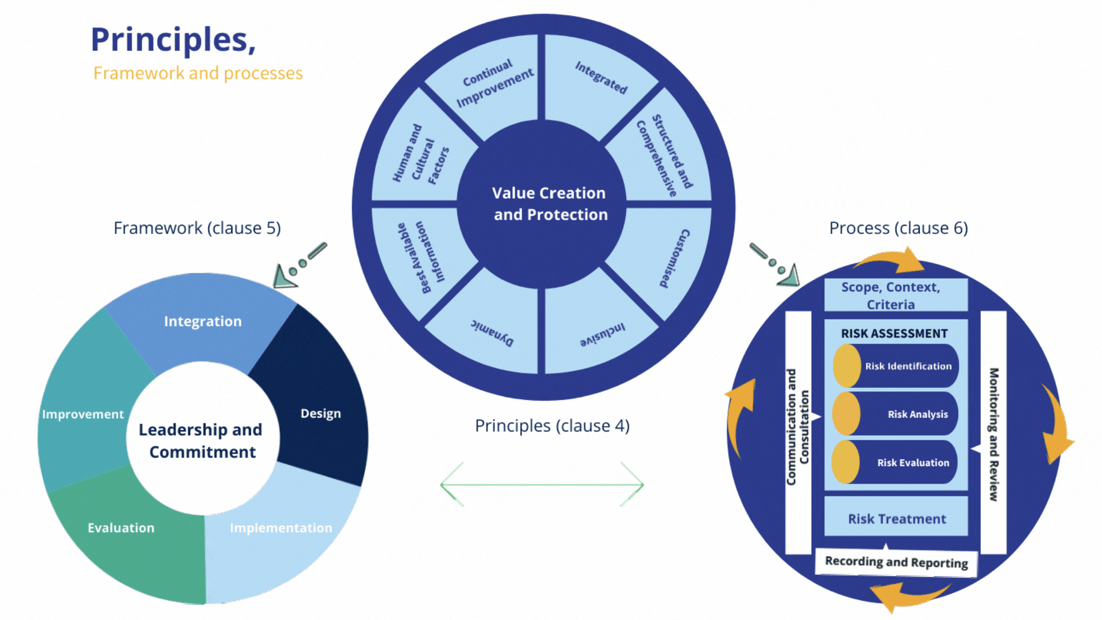
1^{st:} ISO 31000 RISK MANAGEMENT FRAMEWORK-2018

Slide 51
Introduction to ISO 31000-2018 Risk Management
ISO 31000 is an international standard for risk management that provides guidelines and principles for identifying, assessing, managing, and monitoring risks.
It is applicable to any organization, regardless of size, industry, or sector.
The standard helps organizations integrate risk management into their processes and decision-making to enhance resilience and achieve objectives.
Published by the International Organization for Standardization (ISO).
Provides a framework and process for risk management.
Aims to improve decision-making, minimize losses, and ensure business continuity.

Slide 52
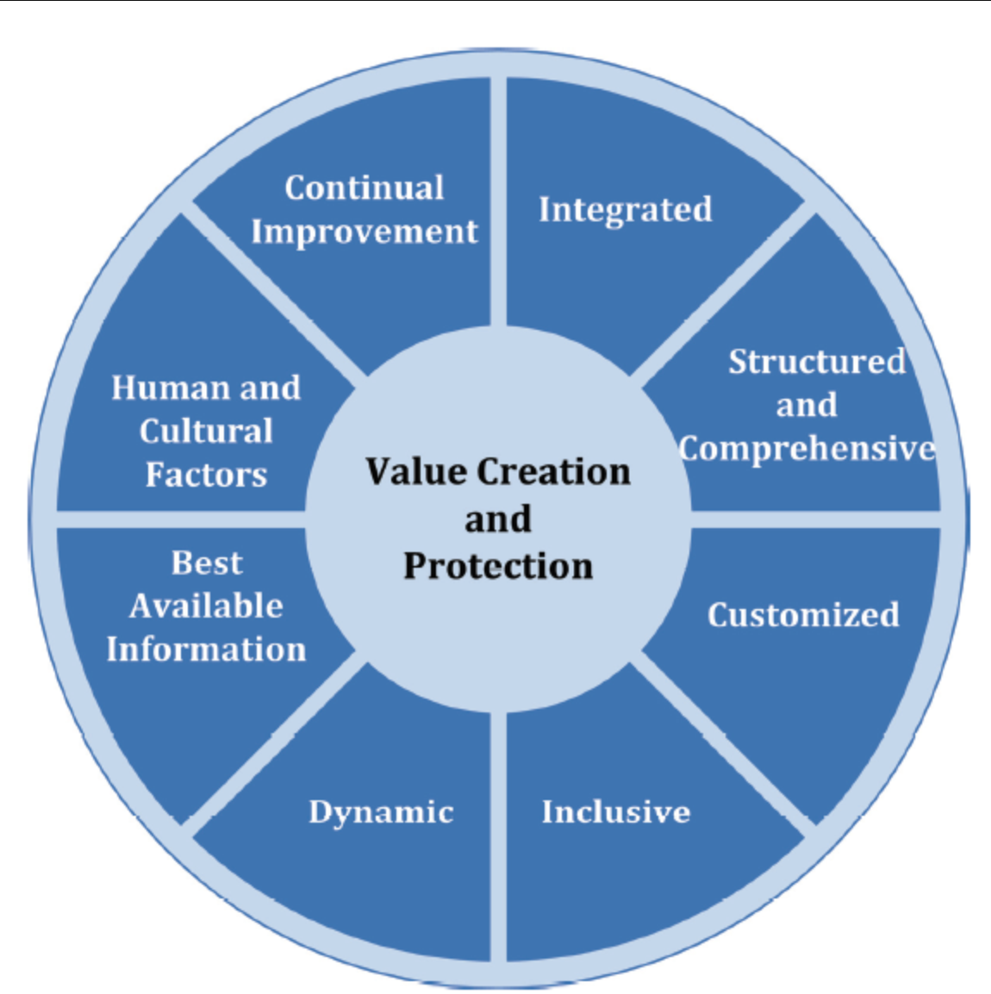
Core Principles of ISO 31000
ISO 31000 is based on 8 core principles that guide the risk management process:
Integrated: Risk management is an integral part of the organization’s governance structure.
Structured and Comprehensive: It provides a consistent approach across all organizational levels and processes.
Customized: The risk management process should be tailored to the organization’s needs, culture, and objectives.
Inclusive: It involves relevant stakeholders in the decision-making process.
Dynamic: Risk management should be proactive and responsive to internal and external changes.
Best Available Information: Decisions should be based on the best available information, recognizing uncertainty.
Human and Cultural Factors: It acknowledges the importance of human behavior and organizational culture in managing risks.
Continuous Improvement: The process should be evaluated and improved over time to adapt to changing conditions.

Slide 53
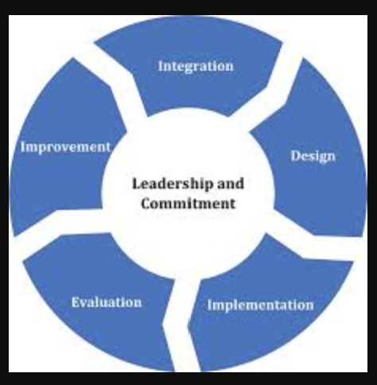
ISO 31000 Risk Management Framework
The ISO 31000 framework provides a structured approach to managing risks. It consists of three main elements: Leadership and Commitment, Risk Management Process, and Improvement.
Leadership and Commitment:
Risk management must be supported and championed by top management to be effective.
It should align with the organization’s strategic objectives and governance framework.
Risk Management Process:
Risk Identification: Identify risks that might affect the achievement of objectives.
Risk Assessment: Assess the likelihood and consequences of each risk.
Risk Treatment: Develop strategies to minimize or mitigate the risks.
Monitoring and Review: Continuously monitor risks and the effectiveness of treatments.
Communication and Consultation: Regularly communicate risks and the status of mitigation efforts with stakeholders.
Improvement:
Encourage learning from risk management outcomes to enhance future processes.
Use feedback to refine and improve the risk management framework.

Slide 54
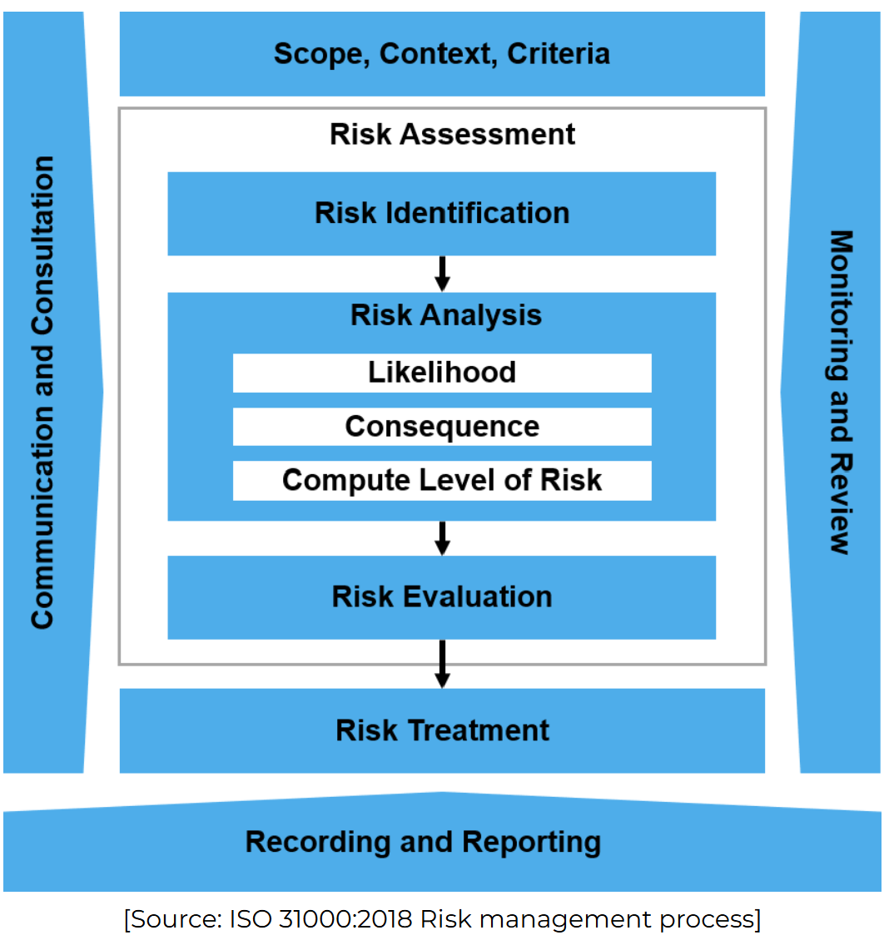
ISO 31000 Risk Management Process
The risk management process in ISO 31000 is a systematic series of steps designed to identify, assess, and manage risks, ensuring that organizations can make informed decisions.
7 Steps:
Step 1: Scope, Context, and Criteria – Understand the environment and set the risk tolerance.
Step 2: Risk Identification – Identify risks that may impact objectives.
Step 3: Risk Assessment – Analyze and evaluate risks.
Step 4: Risk Treatment – Develop and implement risk responses.
Step 5: Monitoring and Review – Regularly monitor and adjust as needed.
Step 6: Communication and Consultation – Keep stakeholders informed.
Step 7: Recording and Reporting – Document and report the process and outcomes

Slide 55
Step 1: Scope, Context, and Criteria
Define the scope of the risk management process, understand the internal and external context, and set risk criteria.
The scope ensures that all areas of the organization are covered, the context provides understanding of the environment, and the criteria establish thresholds for acceptable risk.
Example:
Scope: Managing safety and logistics for the graduation event.
Context: External context includes public health regulations; internal context includes the university's safety policies.
Criteria: Risks that cause a major disruption (e.g., severe weather) are unacceptable, while minor delays can be tolerated.

Slide 56
Step 2: Risk Identification
Identify the risks that could affect the organization’s objectives, both from internal and external sources.
Example:
Weather: Risk of rain disrupting the outdoor event.
Volunteer Shortage: Insufficient volunteers to manage the crowd and logistics.
Technical Failure: Sound or lighting equipment malfunction during the ceremony.

Slide 57
Step 3: Risk Assessment (Analysis and Evaluation)
Risk Analysis: Assess the likelihood and impact of each identified risk.
Risk Evaluation: Compare the risks against the established criteria to decide whether the risks are acceptable or require mitigation.
Example:
Weather (Rain): Likelihood (High – 70%), Impact (High – could disrupt the event entirely).
Volunteer Shortage: Likelihood (Medium – 50%), Impact (Medium – event could experience delays).
Technical Failure: Likelihood (Low – 20%), Impact (High – critical disruption to the ceremony).

Slide 58
Step 4: Risk Treatment
Develop and implement strategies to treat the risks. This can include:
Avoidance: Eliminate the risk.
Reduction: Reduce the likelihood or impact.
Transfer: Shift the risk to a third party (e.g., insurance).
Acceptance: Accept the risk if it’s within tolerance limits.
Example:
Weather: Reduce the risk by booking an indoor venue or preparing tents as a backup.
Volunteer Shortage: Increase volunteer numbers by recruiting more volunteers through social media.
Technical Failure: Reduce the risk by testing equipment a day before the event and having backup equipment ready.

Slide 59
Step 5: Monitoring and Review
Continuously monitor the risks and the effectiveness of the risk treatment measures. Regularly review and adapt the process to changing conditions.
Example:
Weather: Monitor the weather forecast daily and adjust plans if needed (e.g., move event indoors).
Volunteers: Track volunteer participation and ensure there is a backup plan in case of absences.
Technical Setup: Monitor the equipment setup and test again just before the event starts.

Slide 60
Step 6: Communication and Consultation
Ensure that communication happens throughout the risk management process. Stakeholders should be consulted and kept informed about risks and decisions.
Example:
Event Updates: Keep attendees and volunteers informed about potential changes, such as a venue switch due to weather, via social media and email.
Stakeholder Engagement: Regular updates to university staff about risk mitigation measures.

Slide 61
Step 7:Recording and Reporting
Document and report on the risk management process, actions taken, and outcomes. Ensure transparency and accountability.
Example:
After the event, prepare a risk management report that includes:
The identified risks.
How they were mitigated.
What worked and what could be improved for future events.

Slide 62
Benefits of ISO 31000
ISO 31000 helps organizations proactively manage risks, leading to better decision-making and improved resilience.
Key Benefits:
Improved Decision-Making: Risk-informed decisions lead to more consistent and reliable outcomes.
Enhanced Risk Awareness: Encourages a risk-conscious culture throughout the organization.
Increased Resilience: By identifying and managing risks, organizations are better prepared for unexpected challenges.
Better Resource Allocation: Focus resources on high-priority risks and opportunities.
Regulatory Compliance: Helps organizations meet legal and regulatory requirements related to risk management.
Competitive Advantage: By managing risks effectively, organizations can improve their strategic positioning.

Slide 63
ISO 31000 and Organizational Integration
ISO 31000 encourages the integration of risk management into all levels and processes of the organization.
Risk management is not a standalone function but should be integrated into strategic planning, decision-making, and day-to-day operations.
It applies to every department, from operations to finance to human resources, ensuring that risks are considered across all business areas.
Risk management aligns with the organization’s governance structure, ensuring that risks are managed in accordance with the organization’s overall objectives and strategies.

