Slide 1
Organic Chemistry, Fourth Edition
Janice Gorzynski Smith
University of Hawai’i
Chapter 13
Lecture Outline
Prepared by Layne A. Morsch
The University of Illinois - Springfield
Copyright © 2014 The McGraw-Hill Companies, Inc. Permission required for reproduction or display.
‹#›

Slide 2
Overview of Mass Spectrometry
Mass spectrometry is a technique used for measuring the molecular weight and determining the molecular formula of an organic compound.
In a mass spectrometer, a molecule is vaporized and ionized by bombardment with a beam of high-energy electrons.
The energy of the electrons is ~ 1600 kcal (or 70 eV).
Since it takes ~ 100 kcal of energy to cleave a typical σ bond, 1600 kcal is an enormous amount of energy to come into contact with a molecule.
The electron beam ionizes the molecule by causing it to eject an electron.
‹#›

Slide 3
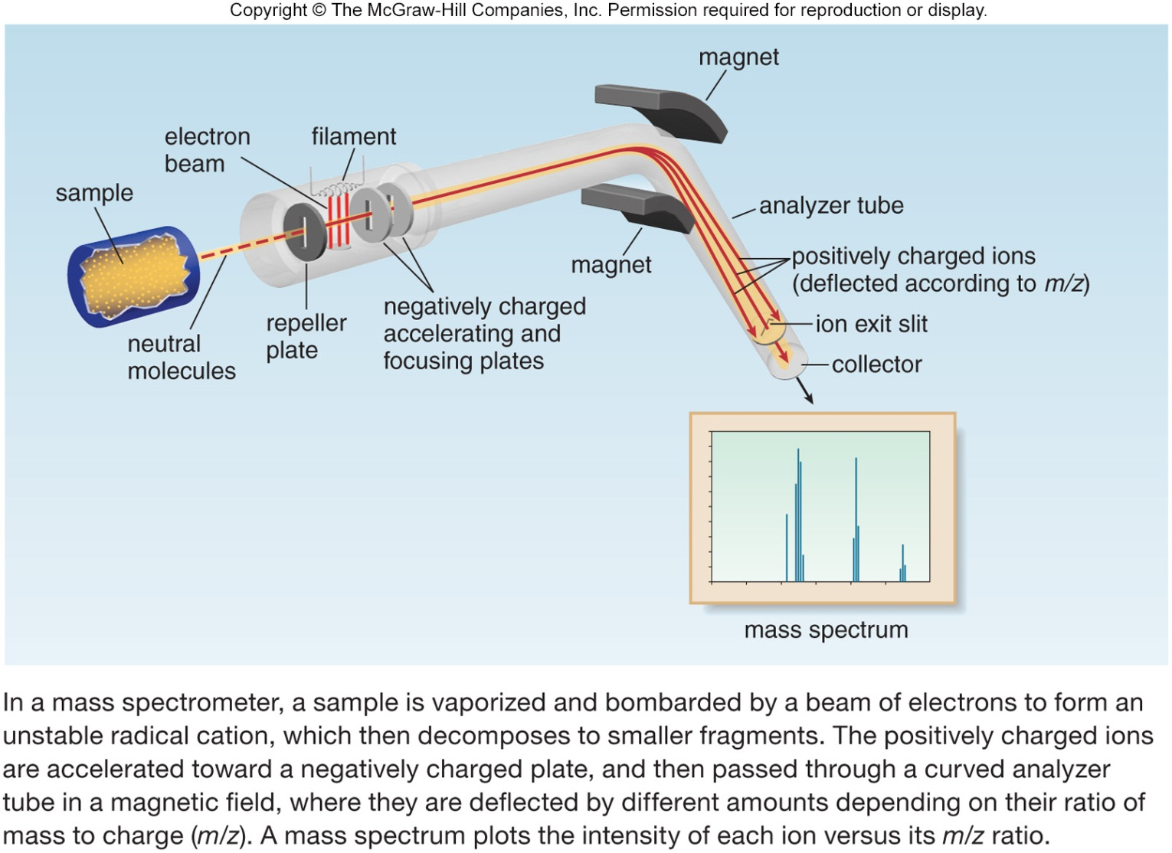
Schematic of a Mass Spectrometer
Figure 13.1
‹#›

Slide 4
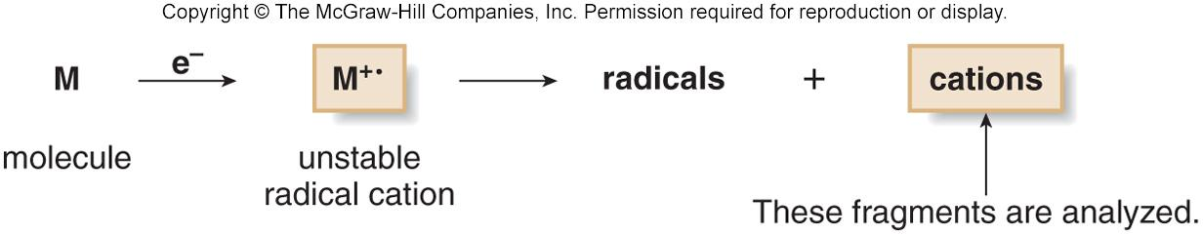
Function of a Mass Spectrometer
When the electron beam ionizes the molecule, the species that is formed is called a radical cation, and symbolized as M^{+•}.
The radical cation M^{+•} is called the molecular ion or parent ion.
The mass of M^{+•} represents the molecular weight of M.
Because M ^{+•} is unstable, it decomposes to form fragments of radicals and cations that have a lower molecular weight than M^{+•}.
‹#›

Slide 5
Function of a Mass Spectrometer
The mass spectrometer analyzes the masses of cations.
A mass spectrum is a plot of the amount of each cation (its relative abundance) versus its mass-to-charge ratio (m/z, where m is mass, and z is charge).
Since z is almost always +1, m/z actually measures the mass (m) of the individual ions.
‹#›

Slide 6
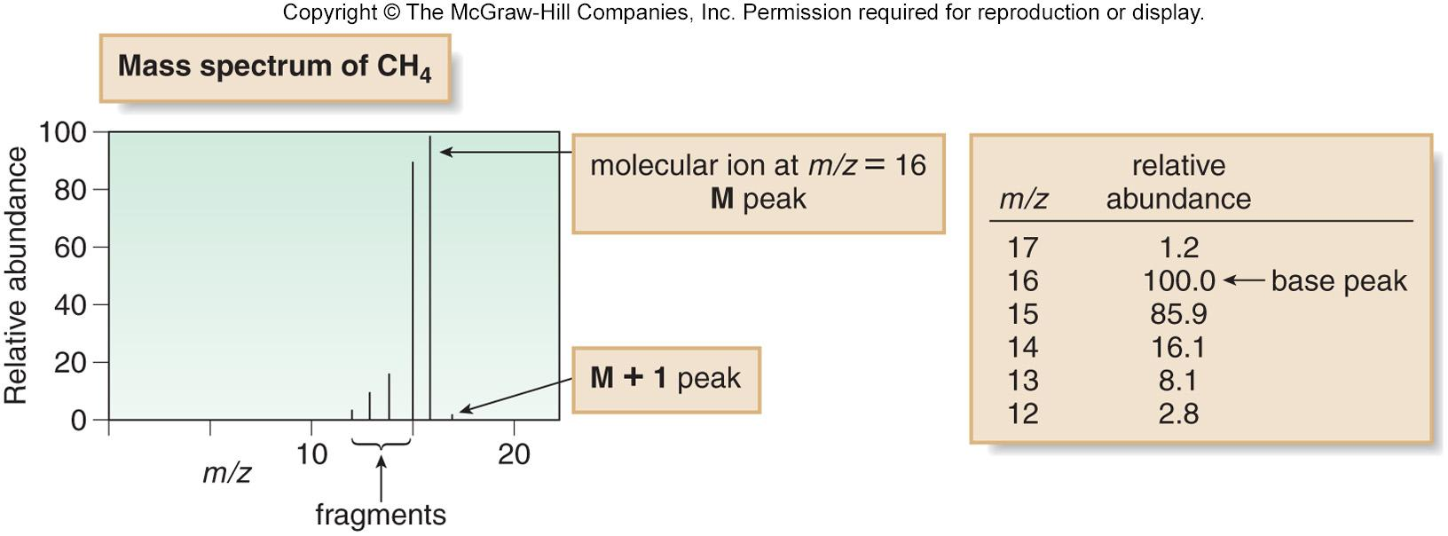
Understanding Mass Spectra
The tallest peak in the mass spectrum is called the base peak.
For methane the base peak is also the M peak (molecular ion), although this is not always the case.
Though most C atoms have an atomic mass of 12, 1.1% have a mass of 13.
Thus, ¹³CH₄ is responsible for the peak at m/z = 17. This is called the M + 1 peak.
‹#›

Slide 7
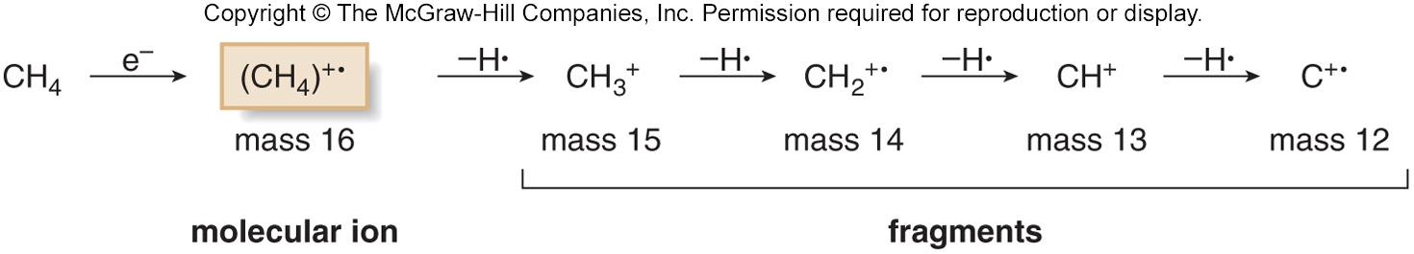
Peaks in a Mass Spectrum
The mass spectrum of CH₄ consists of more peaks than just the M peak.
Since the molecular ion is unstable, it fragments into other cations and radical cations containing one, two, three, or four fewer hydrogen atoms than methane itself.
Thus, the peaks at m/z 15, 14, 13, and 12 are due to these lower molecular weight fragments.
‹#›

Slide 8
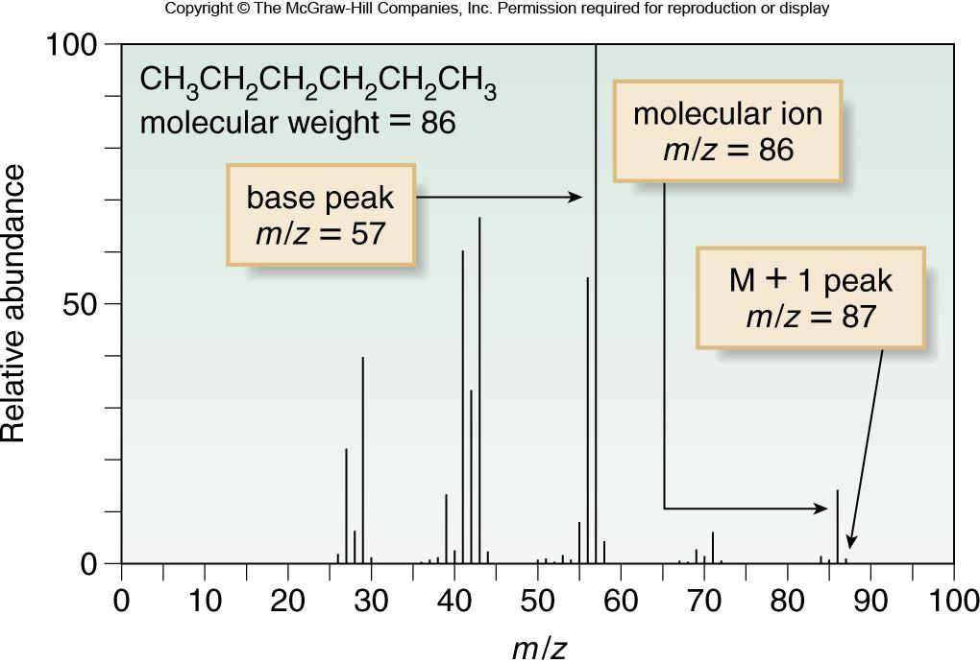
Mass Spectrum of Hexane
The molecular ion for hexane is at m/z = 86.
A small M + 1 peak occurs at m/z = 87.
The base peak occurs at m/z = 57 (C₄H₉⁺).
Major fragment peaks also occur at 43 (C₃H₇⁺) and 29 (C₂H₅⁺).
Figure 13.2
‹#›

Slide 9
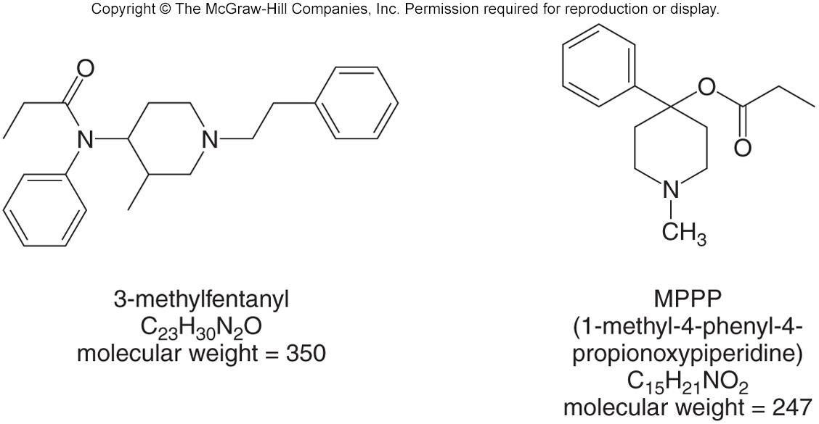
The Nitrogen Rule
Hydrocarbons, as well as compounds that contain only C, H, and O atoms, always have a molecular ion with an even mass.
An odd molecular ion generally indicates that a compound contains nitrogen.
This effect is called the nitrogen rule: A compound with an odd molecular ion contains an odd number of N atoms.
A compound that contains an even number of N atoms gives an even molecular ion.
Two “street” drugs that mimic the effect of heroin illustrate this principle.
‹#›

Slide 10
Alkyl Halides and the M + 2 Peak
Most elements have one major isotope.
Chlorine has two common isotopes, ³⁵Cl and ³⁷Cl, which occur naturally in a 3:1 ratio.
    Thus, there are two peaks in a 3:1 ratio for the molecular ion of an alkyl chloride.
    The larger peak, the M peak, corresponds to the compound containing the ³⁵Cl. The smaller peak, the M + 2 peak, corresponds to the compound containing ³⁷Cl.
    When the molecular ion consists of two peaks (M and M + 2) in a 3:1 ratio, a Cl atom is present.
Br has two common isotopes, ⁷⁹Br and ⁸¹Br, in a ratio of ~ 1:1.
  When the molecular ion consists of two peaks (M and M + 2) in a 1:1 ratio, a Br atom is present.
‹#›

Slide 11
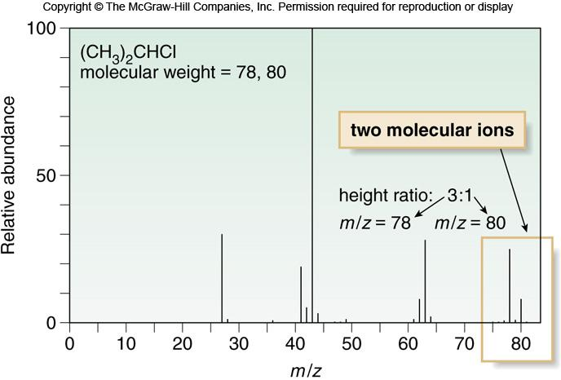
Mass Spectrum of 2-Chloropropane
Figure 13.3
‹#›

Slide 12
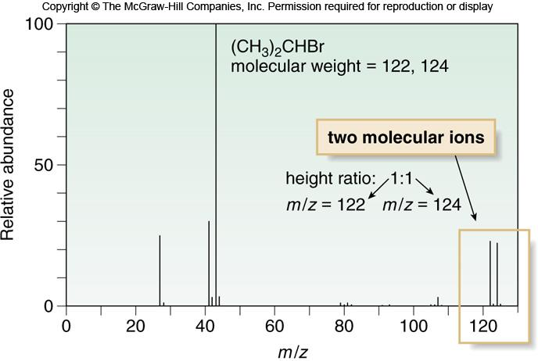
Mass Spectrum of 2-Bromopropane
Figure 13.4
‹#›

Slide 13
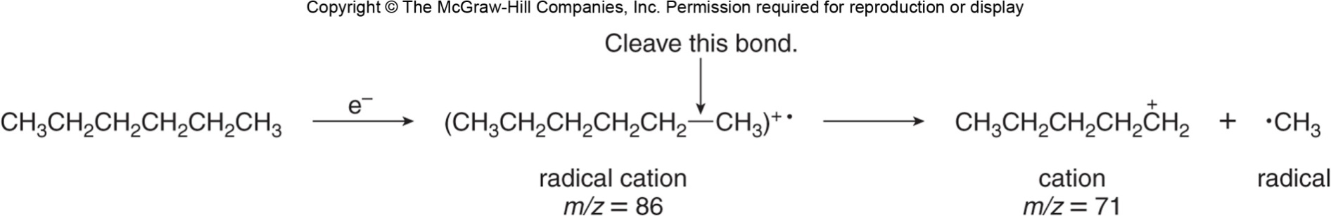
General Features of Fragmentation
While many chemists use a mass spectrum to determine only a compound’s molecular weight and molecular formula, additional useful structural information can be obtained from fragmentation patterns.
Particular functional groups exhibit common fragmentation patterns.
Loss of a CH₃ group always forms a fragment with a mass 15 units less than the molecular ion.
‹#›

Slide 14
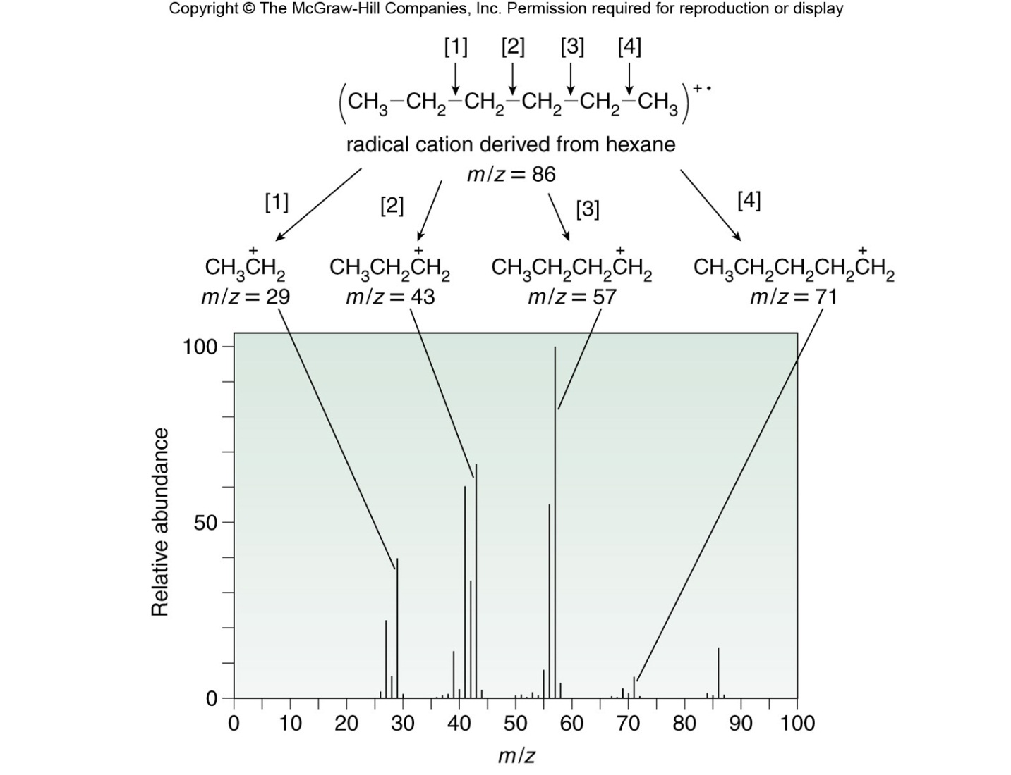
Fragmentation Patterns in Hexane
Consider Hexane again:
Cleavage of C − C bonds forms lower molecular weight fragments that correspond to lines in the mass spectrum.
Figure 13.5
‹#›

Slide 15
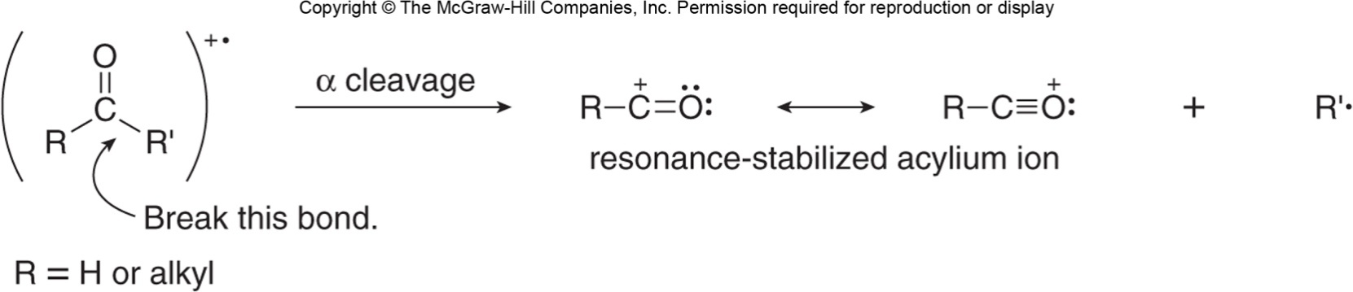
Fragmentation Patterns of Carbonyls
Aldehydes and ketones often undergo α cleavage, breaking the bond between the carbonyl carbon and an adjacent carbon.
Cleavage yields a neutral radical and a resonance stabilized acylium ion.
‹#›

Slide 16
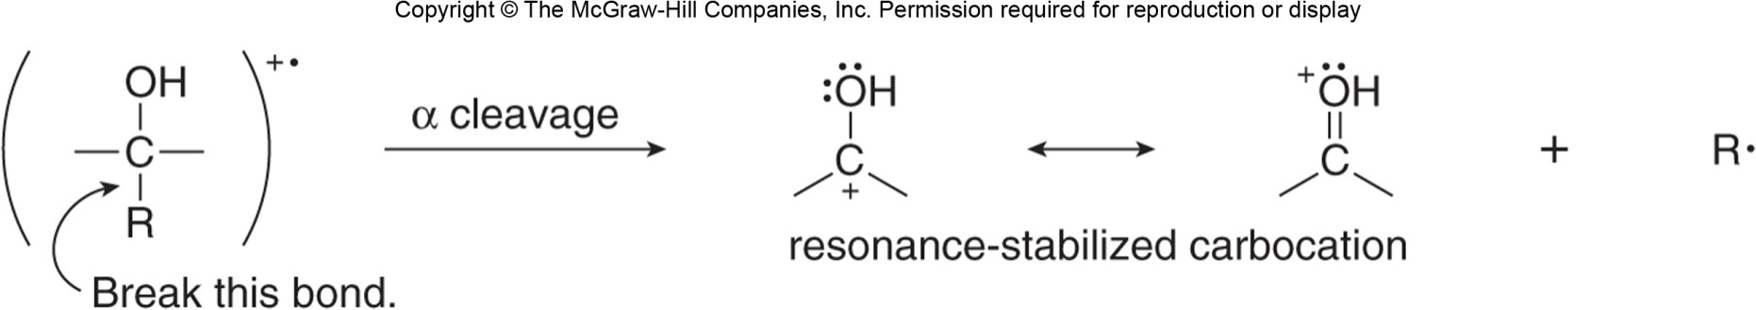
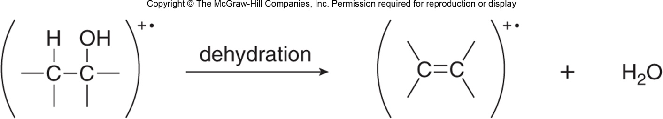
Fragmentation Patterns of Alcohols
Alcohols undergo a cleavage between an alkyl group and the carbon bearing the OH group.
Alcohols can also undergo dehydration forming water and a radical cation.
‹#›

Slide 17
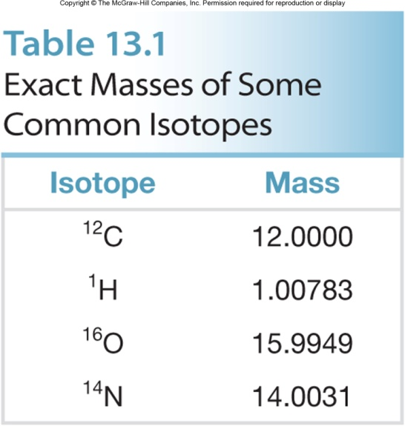
High Resolution Mass Spectrometers
Low resolution mass spectrometers report m/z values to the nearest whole number.
High resolution mass spectrometers measure m/z ratios to four (or more) decimal places.
  This is valuable because except for ¹²C whose mass is defined as 12.0000, the masses of all other nuclei are very close—but not exactly—whole numbers.
  Using the mass values of common nuclei, it is possible to determine the single molecular formula that gives rise to a molecular ion.
‹#›

Slide 18
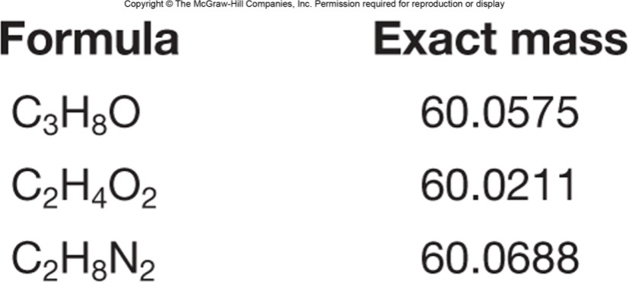
Exact Mass in High-Res Mass Spectra
A molecule having a molecular ion at m/z = 60 using a low-resolution mass spectrometer could have any one of the following molecular formulas.
A high-resolution mass spectrometer would differentiate between these to give only one possible formula.
‹#›

Slide 19
Gas Chromatography—Mass Spectrometry
Mass spectrometry can be combined with gas chromatography into a single instrument used to analyze mixtures of compounds.
A gas chromatograph (GC) consists of a thin capillary column containing a viscous high-boiling liquid, all housed in an oven.
When the sample is injected into the GC, it is vaporized and swept by an inert gas through the column.
The components travel through the column at different rates, often separated by boiling point, with lower boiling compounds exiting the column before higher boiling compounds.
‹#›

Slide 20
Gas Chromatography—Mass Spectrometry
Each component then enters the mass spectrometer where it is ionized to form a molecular ion and lower molecular weight fragments.
The GC-MS records a gas chromatogram of the mixture, and yields a plot of the amount of each component versus its retention time (the time required to travel through the column).
Mass spectra of each peak are stored and can be analyzed.
‹#›

Slide 21
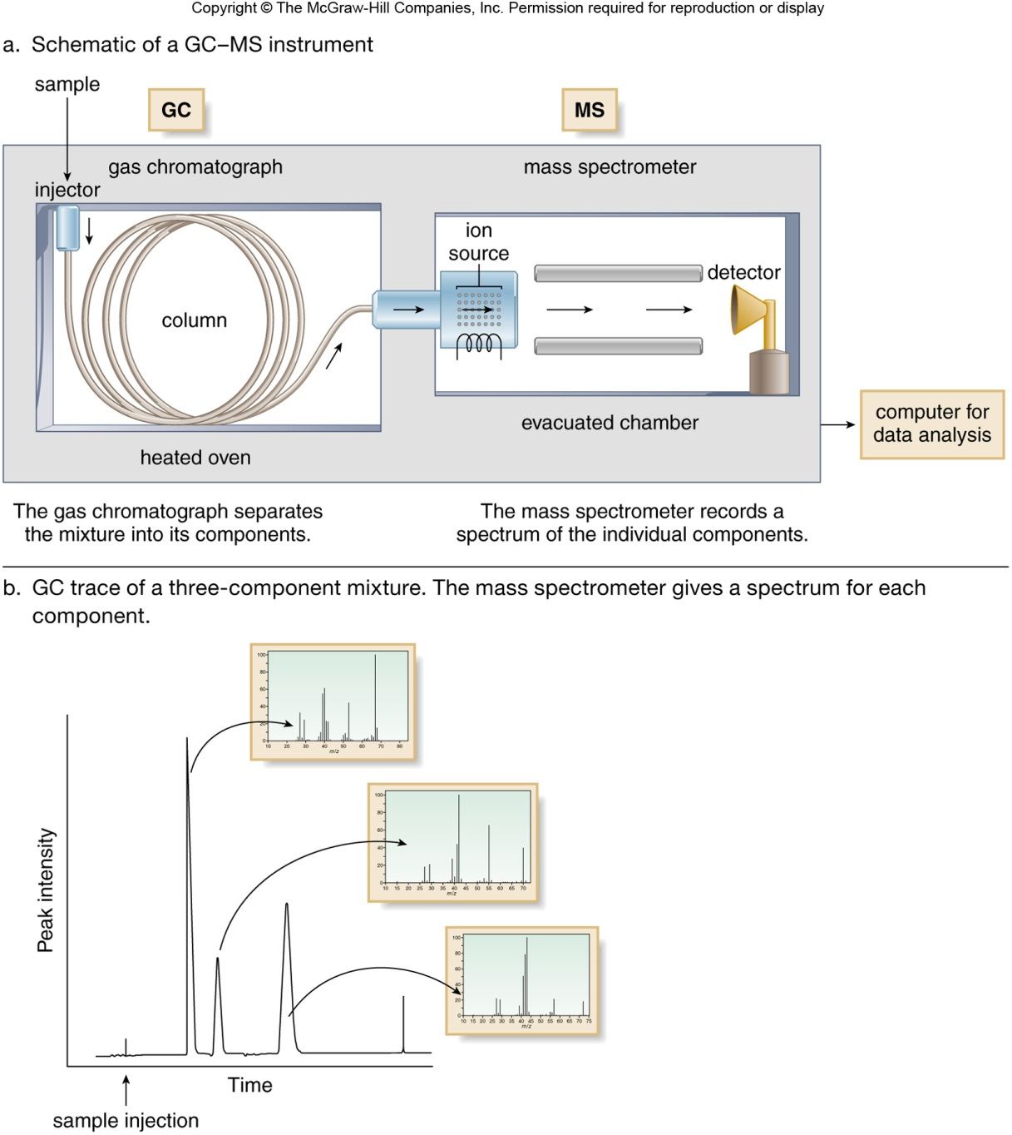
Function of GC-MS
Figure 13.6
‹#›

Slide 22
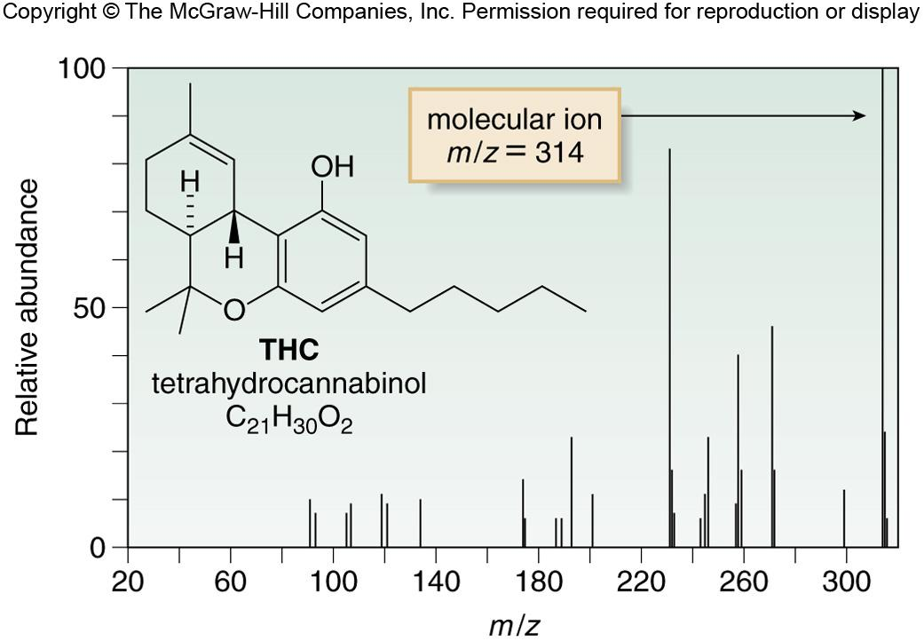
Analysis Using GC-MS
To analyze a urine sample for tetrahydrocannabinol (THC), the principal psychoactive component of marijuana, the organic compounds are extracted from urine, purified, concentrated, and injected into the GC-MS.
THC appears as a GC peak, whose mass spectrum gives a molecular ion at 314, its molecular weight.
Figure 13.7
‹#›

Slide 23
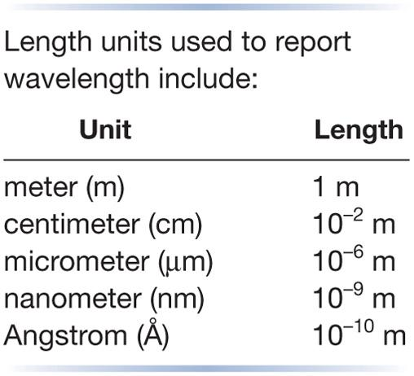
Electromagnetic Radiation
Electromagnetic radiation is radiant energy having dual properties of both waves and particles.
Particles of electromagnetic radiation are called photons, and each has a discrete amount of energy called a quantum.
Electromagnetic radiation can be characterized by its wavelength and frequency.
Wavelength (λ) is the distance from one point on a wave to the same point on an adjacent wave.
Frequency (ν) is the number of waves passing per unit time. It is reported in cycles per second (s⁻¹), which is also called hertz (Hz).
‹#›

Slide 24
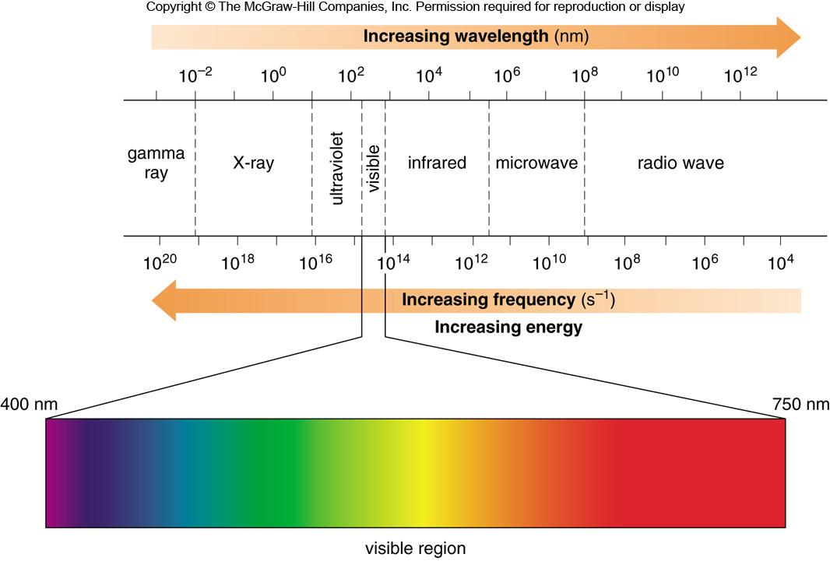
Electromagnetic Spectrum
The electromagnetic spectrum is arbitrarily divided into different regions, ranging from gamma rays to radio waves.
Visible light occupies only a small region of the electromagnetic spectrum.
Figure 13.8
‹#›

Slide 25
Properties of Electromagnetic Radiation
All electromagnetic radiation travels at the constant speed of light (c), 3.0 x 10⁸ m/s.
  The energy (E) of a photon is directly proportional to its frequency (i.e., E increases as ν increases).
    E = hν ; h = Planck’s constant (1.58 x 10⁻³⁴ cal•s)
  Since energy and wavelength are inversely proportional, E decreases as λ increases.
    E = hν = hc/λ
‹#›

Slide 26
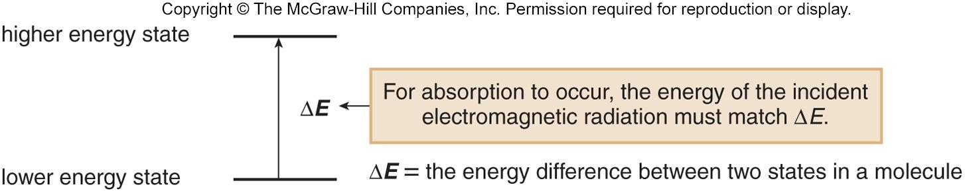
Absorption of Electromagnetic Radiation
When electromagnetic radiation strikes a molecule, some wavelengths, but not all, are absorbed.
For absorption to occur, the energy of the photon must match the difference between two energy states in the molecule (ground state to excited state).
The larger the energy difference between two states, the higher the energy of radiation needed for absorption.
Higher energy light (UV-visible) causes electronic excitation.
Lower energy radiation (infrared) causes vibrational excitation.
‹#›

Slide 27
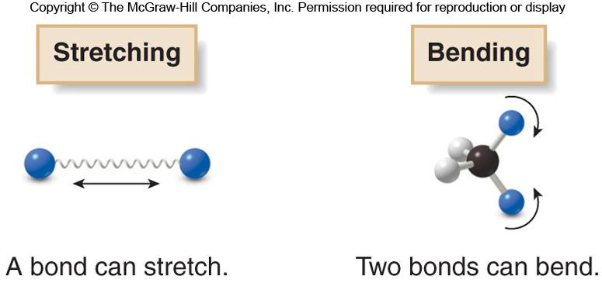
Absorption of IR Light
Absorption of IR light causes changes in the vibrational motions of a molecule.
The different vibrational modes available to a molecule include stretching and bending modes.
The vibrational modes of a molecule are quantized, so they occur only at specific frequencies which correspond to the frequency of IR light.
‹#›

Slide 28
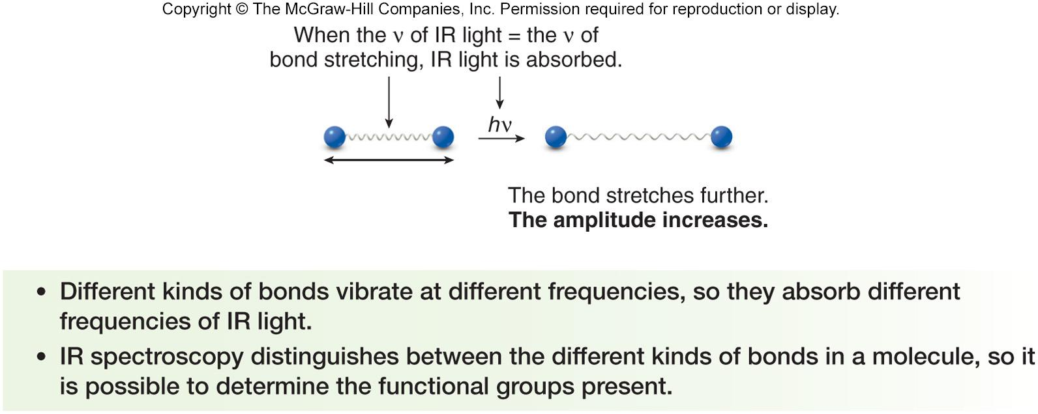
Bond Stretching and Bending
When the frequency of IR light matches the frequency of a particular vibrational mode, the IR light is absorbed, causing the amplitude of the particular bond stretch or bond bend to increase.
‹#›

Slide 29
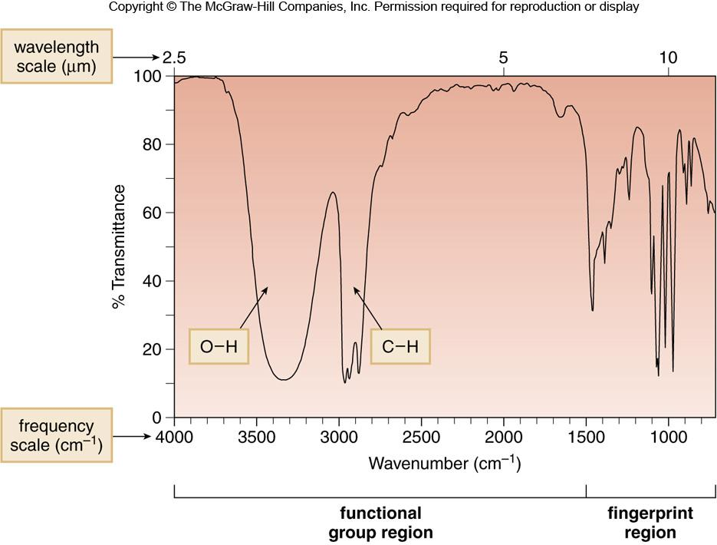
Characteristics of an IR Spectrum
In an IR spectrometer, light passes through a sample.
Frequencies that match the vibrational frequencies are absorbed, and the remaining light is transmitted to a detector.
An IR spectrum is a plot of the amount of transmitted light versus its wavenumber.
Most bonds in organic molecules absorb in the region of 4000 cm⁻¹ to 400 cm⁻¹.
‹#›

Slide 30
Characteristics of an IR Spectrum
The x-axis is reported in frequencies using a unit called wavenumbers (ν).
Wavenumbers are inversely proportional to wavelength and reported in reciprocal centimeters (cm^{–1}).
The y-axis is % transmittance: 100% transmittance means
that all the light shone on a sample is transmitted and none
is absorbed.
0% transmittance means that none of the light shone on the sample is transmitted and all is absorbed.
Each peak corresponds to a particular kind of bond, and
each bond type (such as O − H and C − H) occurs at a characteristic frequency.
Infrared (IR) spectroscopy is used to identify what bonds and what functional groups are in a compound.
‹#›

Slide 31
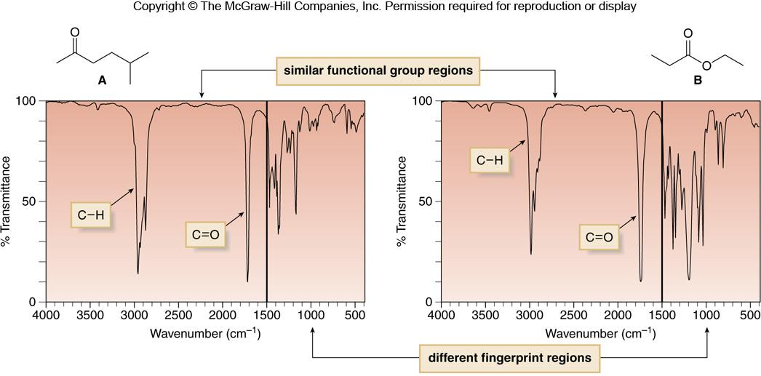
Regions of an IR Spectrum
The IR spectrum is divided into two regions: the functional group region (at ≥ 1500 cm⁻¹), and the fingerprint region
(at < 1500 cm⁻¹).
Figure 13.9
‹#›

Slide 32
Bonds and IR Absorption
Where a particular bond absorbs in the IR depends on bond strength and atom mass.
  Stronger bonds (i.e., triple > double > single) vibrate at a higher frequency, so they absorb at higher wavenumbers.
  Bonds with lighter atoms vibrate at higher frequency, so they absorb at higher wavenumbers.
‹#›

Slide 33
Bonds and IR Absorption
Bonds can be thought of as springs with weights on each end (behavior governed by Hooke’s Law).
  The strength of the spring is analogous to the bond strength, and the mass of the weights is analogous to atomic mass.
  For two springs with the same weight on each end, the stronger spring vibrates at a higher frequency.
  For two springs of the same strength; springs with lighter weights vibrate at a higher frequency than those with heavier weights.
‹#›

Slide 34
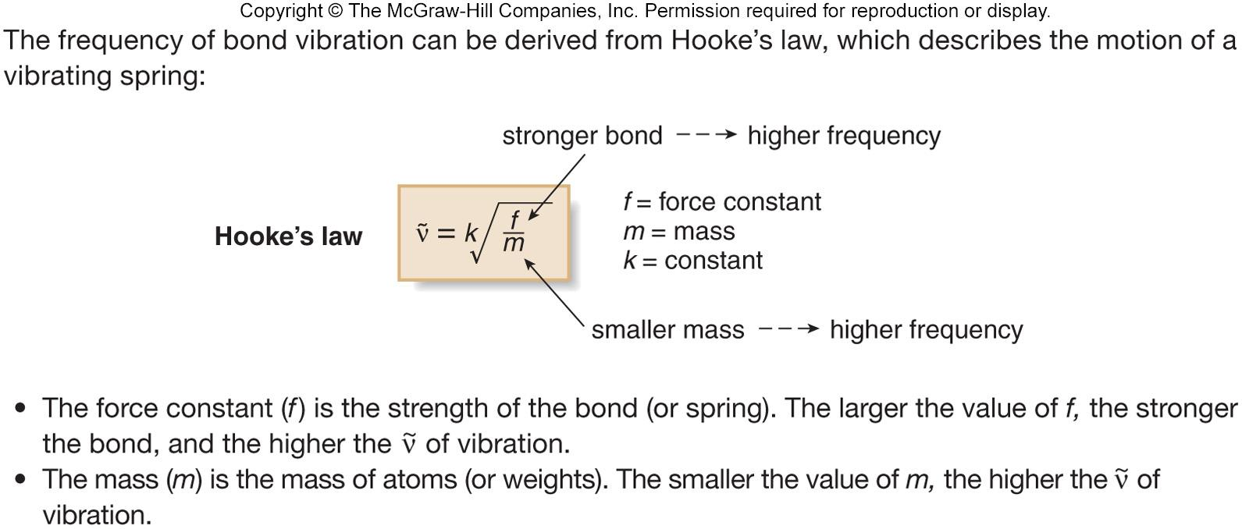
Hooke’s Law
Hooke’s Law describes the relationship of frequency to mass and bond length.
Figure 13.10
‹#›

Slide 35
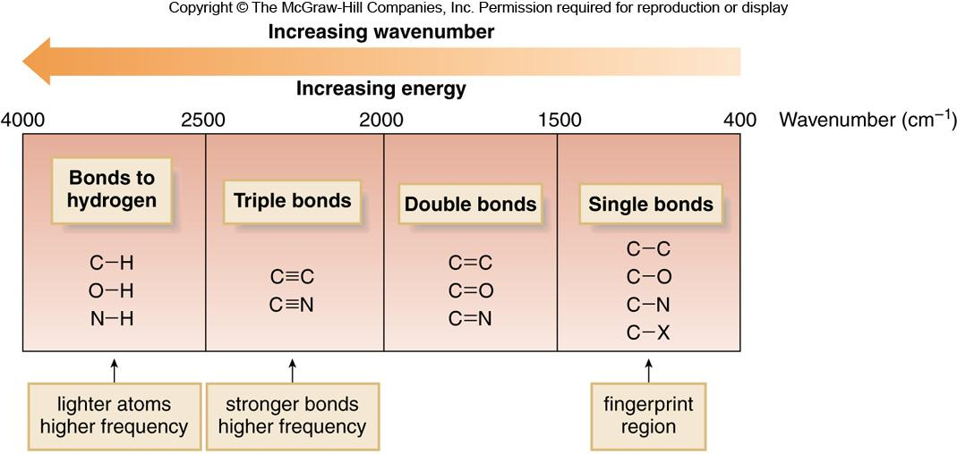
Four Regions of an IR Spectrum
Bonds absorb in four predictable regions of an IR spectrum.
Figure 13.11
‹#›

Slide 36
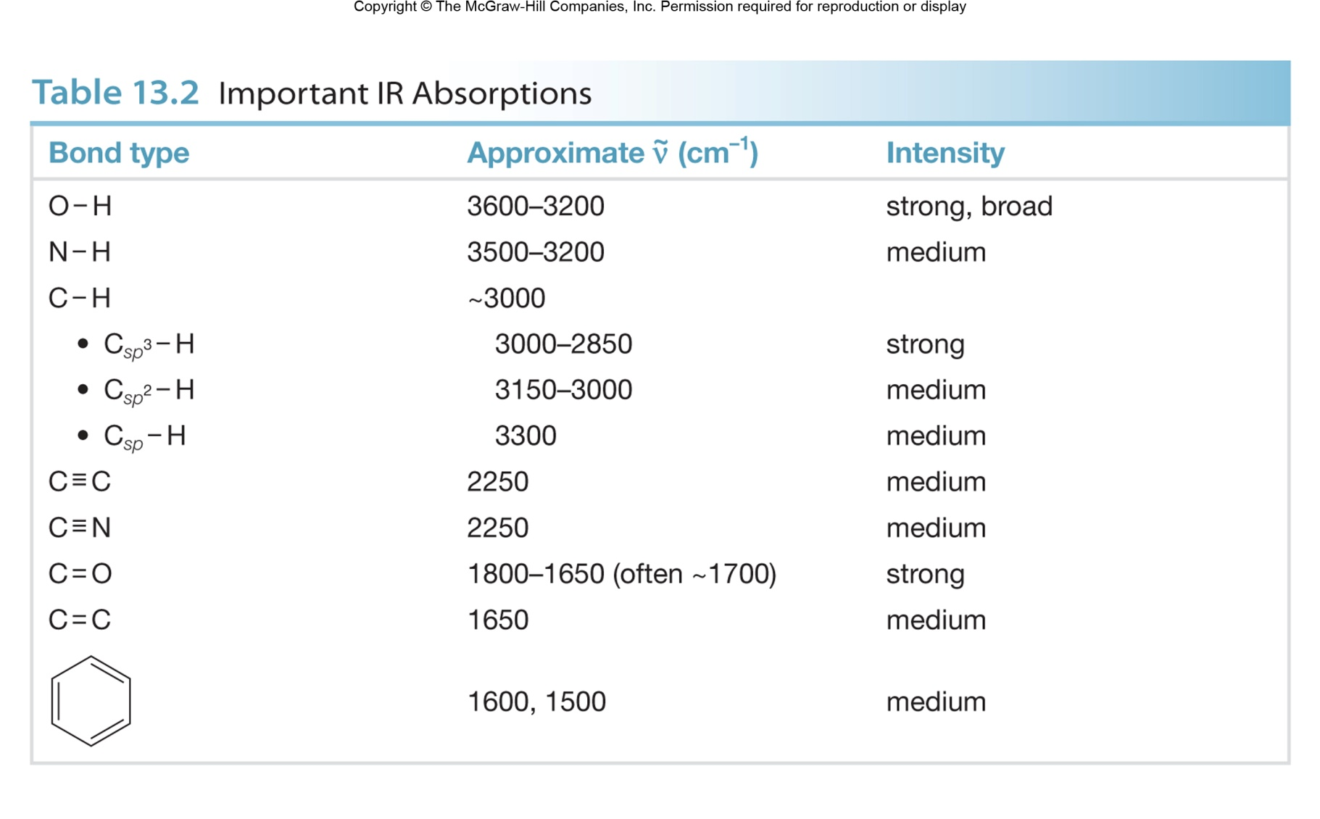
‹#›

Slide 37
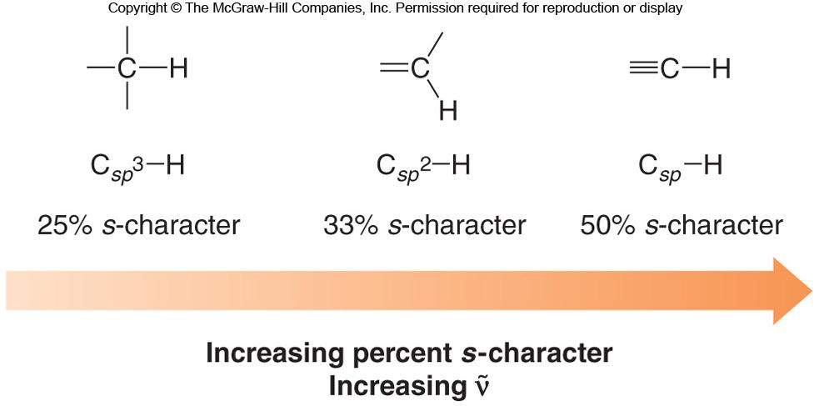
Bond Strength and % s-Character
Even subtle differences that affect bond strength affect the frequency of an IR absorption.
The higher the percent s-character, the stronger the bond and the higher the wavenumber of absorption.
‹#›

Slide 38
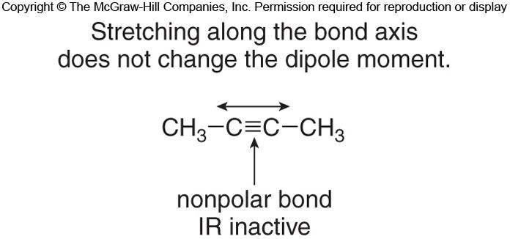
Symmetry and IR Absorption
For a bond to absorb in the IR, there must be a change in dipole moment during the vibration.
Symmetrical nonpolar bonds do not absorb in the IR. This type of vibration is said to be IR inactive.
‹#›

Slide 39
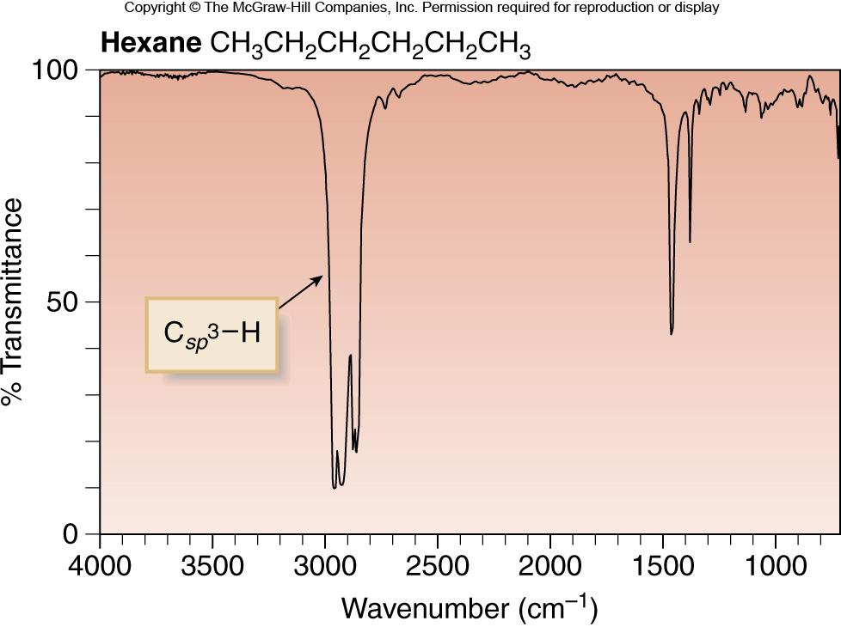
IR Absorptions in Hydrocarbons
Hexane has only C−C single bonds and sp³ hybridized
C atoms.
Therefore, it has only one major absorption at 3000-2850 cm⁻¹.
‹#›

Slide 40
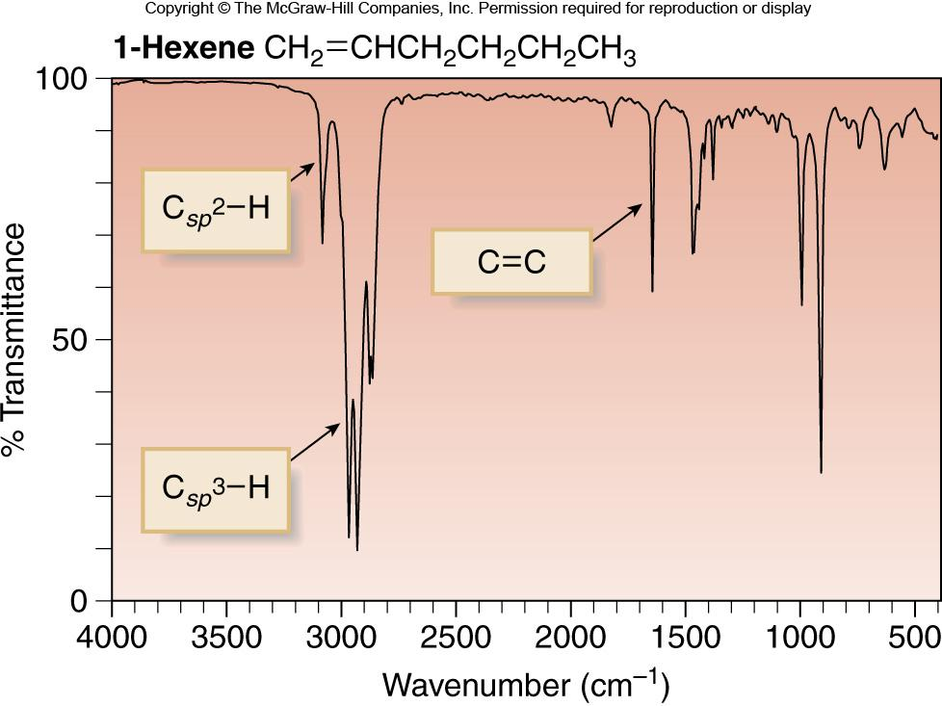
IR Spectrum of 1-Hexene
1-Hexene has a C=C and C_{sp2}−H, in addition to sp³ hybridized C atoms.
Therefore, there are three major absorptions: C_{sp2}−H
at 3150−3000 cm⁻¹; C_{sp3}−H at 3000−2850 cm⁻¹; C=C at
1650 cm⁻¹.
‹#›

Slide 41
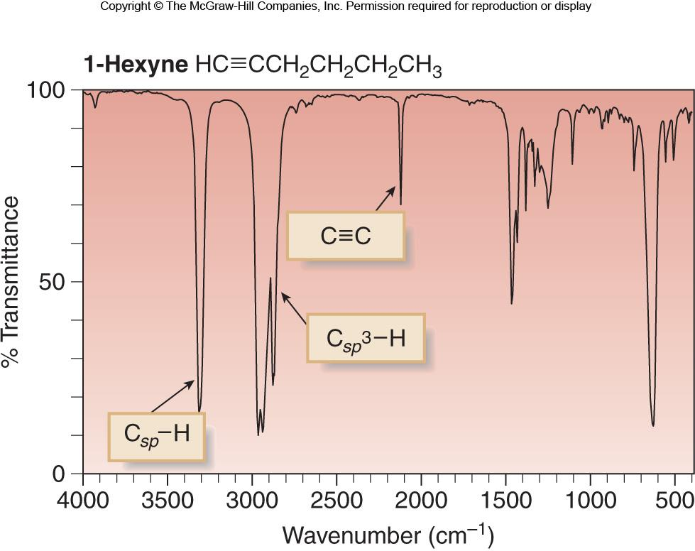
IR Spectrum of 1-Hexyne
1-Hexyne has a C≡C and C_{sp}−H, in addition to sp³ hybridized C atoms.
Therefore, there are three major absorptions: C_{sp}−H at
3300 cm⁻¹; C_{sp3}−H at 3000−2850 cm⁻¹; C≡C at 2250 cm⁻¹.
‹#›

Slide 42
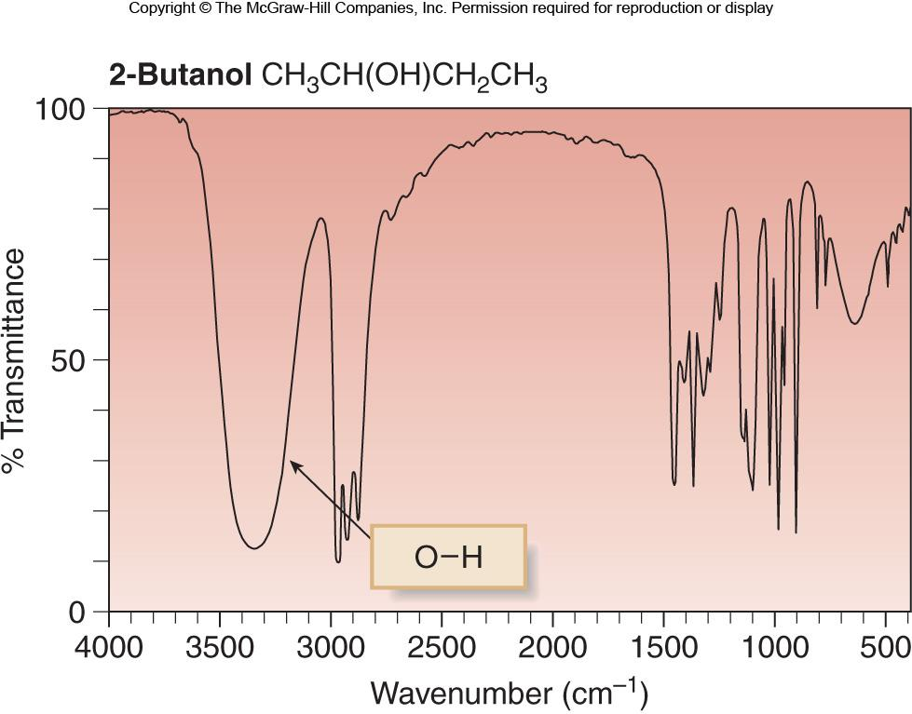
IR Spectrum of 2-Butanol
The OH group of the alcohol shows a strong absorption at 3600-3200 cm⁻¹.
The peak at ~ 3000 cm⁻¹ is due to sp³ hybridized C−H bonds.
‹#›

Slide 43
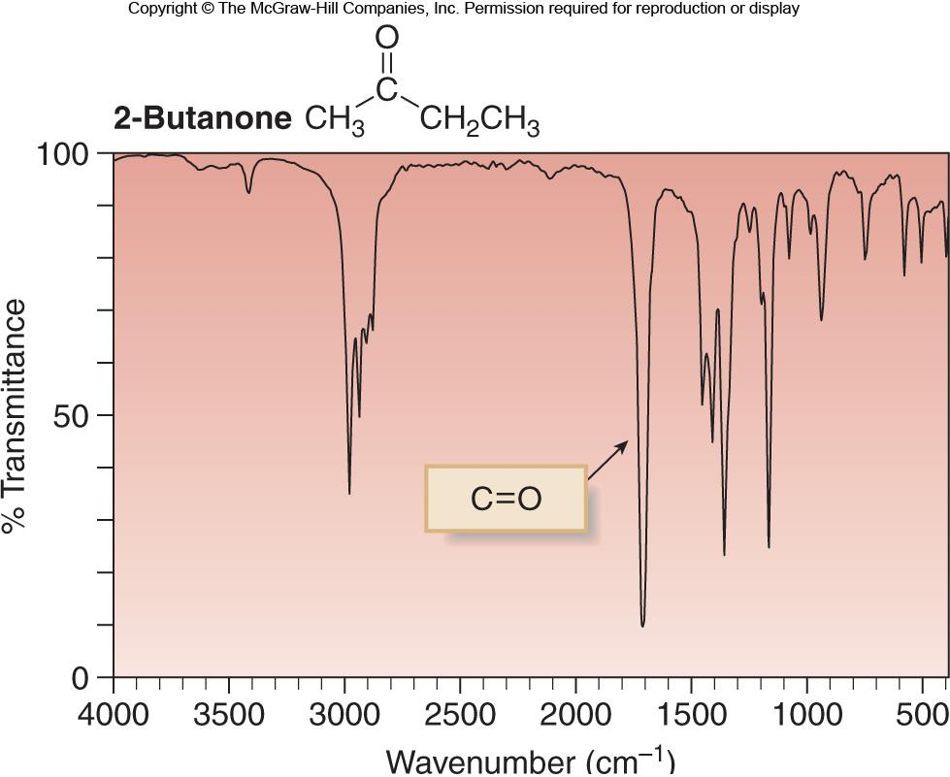
IR Spectrum of 2-Butanone
The C=O group in the ketone shows a strong absorption at ~ 1700 cm⁻¹.
The peak at ~ 3000 cm⁻¹ is due to sp³ hybridized C−H bonds.
‹#›

Slide 44
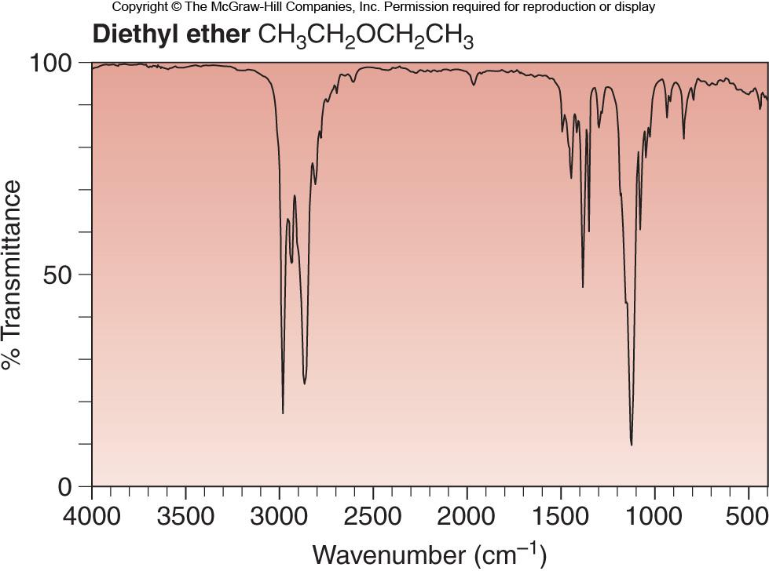
IR Spectrum of Diethyl Ether
The ether has neither an OH or a C=O, so its only absorption above 1500 cm⁻¹ occurs at ~ 3000 cm⁻¹, due to sp³ hybridized C−H bonds.
‹#›

Slide 45
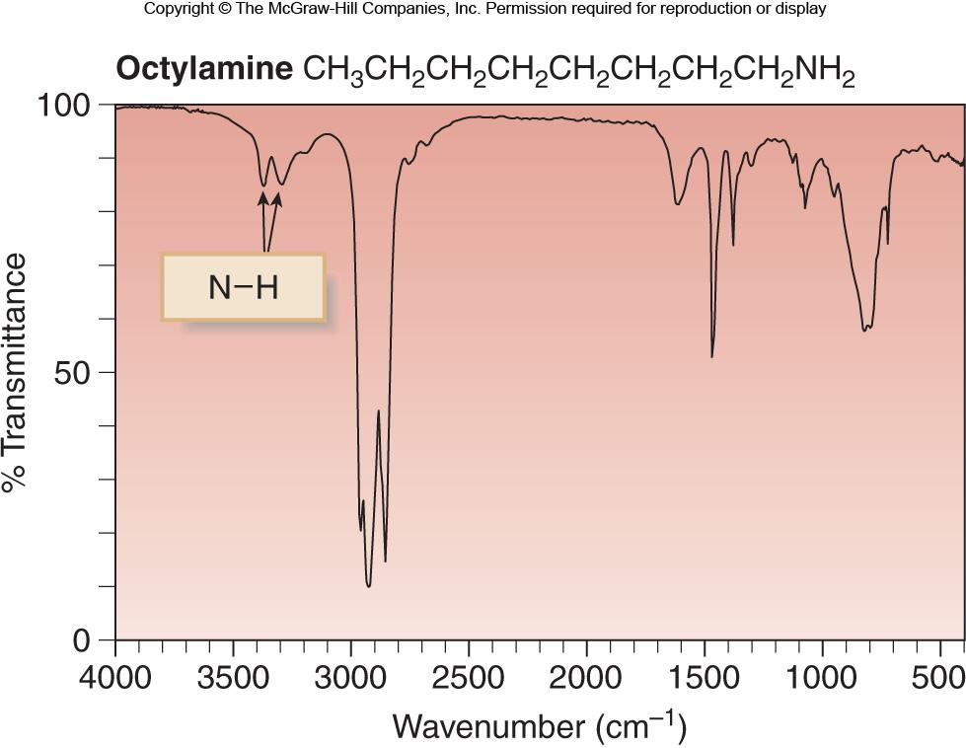
IR Spectrum of Octylamine
The N−H bonds in the amine give rise to two weak absorptions at 3300 and 3400 cm⁻¹.
‹#›

Slide 46
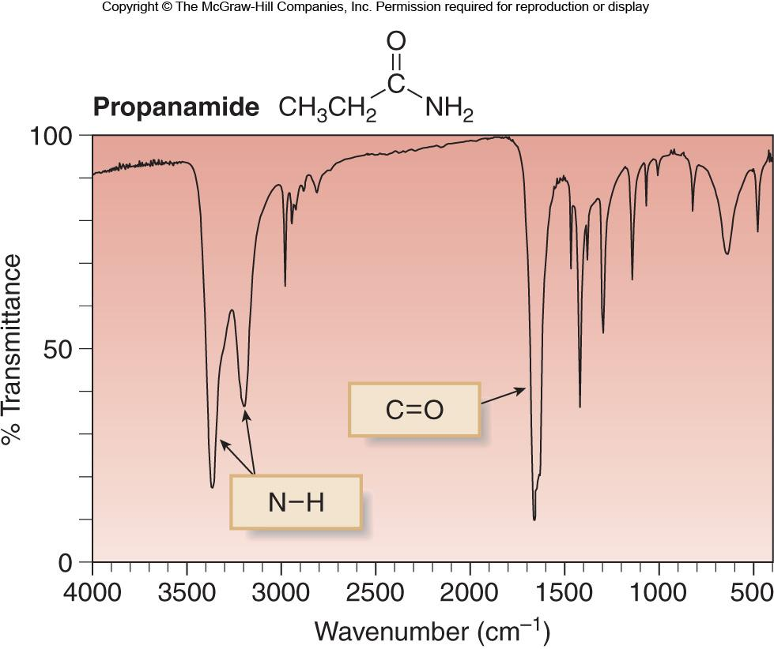
IR Spectrum of Propanamide
The amide exhibits absorptions above 1500 cm⁻¹ for both its N−H and C=O groups: N−H (two peaks) at 3200 and 3400 cm⁻¹; C=O at 1660 cm⁻¹.
‹#›

Slide 47
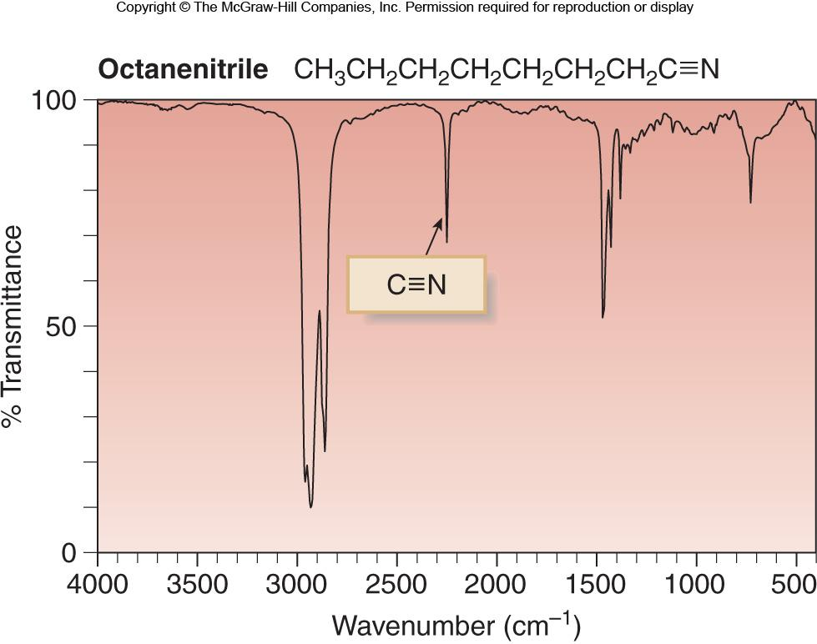
IR Spectrum of Octanenitrile
The C≡N of the nitrile absorbs in the triple bond region at ~ 2250 cm⁻¹.
‹#›

Slide 48
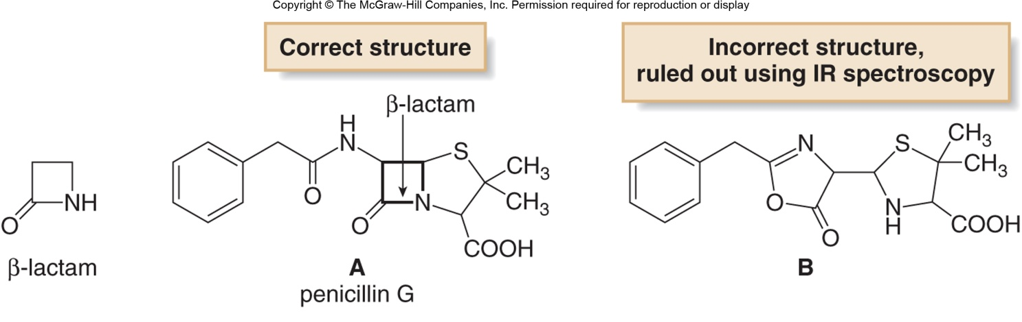
IR and Structure Determination
In the 1940’s, IR spectroscopy played a key role in elucidating the structure of penicillin G.
β-Lactams are 4 membered rings containing an amide.
  The carbonyl on β-Lactams absorbs at ~1760 cm-1, which is much higher than seen in most amides.
  Since penicillin G had an IR absorption at this frequency, it helped to rule out an incorrect structure and support the correct structure.
‹#›

Slide 49
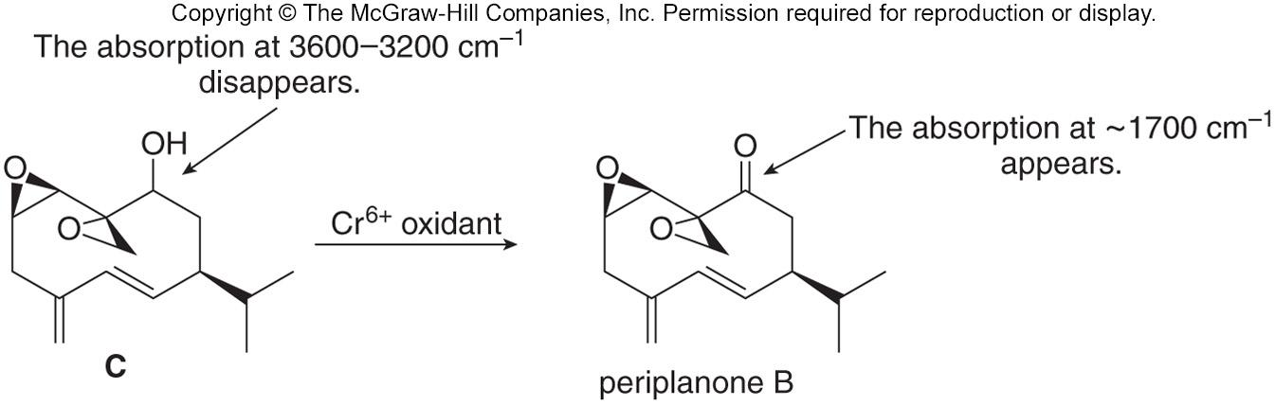
IR and Structure Determination
IR spectroscopy is often used to determine the outcome of a chemical reaction.
For example, oxidation of the hydroxy group in compound C to form the carbonyl group in periplanone B is accompanied by the disappearance of the OH absorption, and the appearance of a carbonyl absorption in the IR spectrum of the product.
‹#›

Slide 50
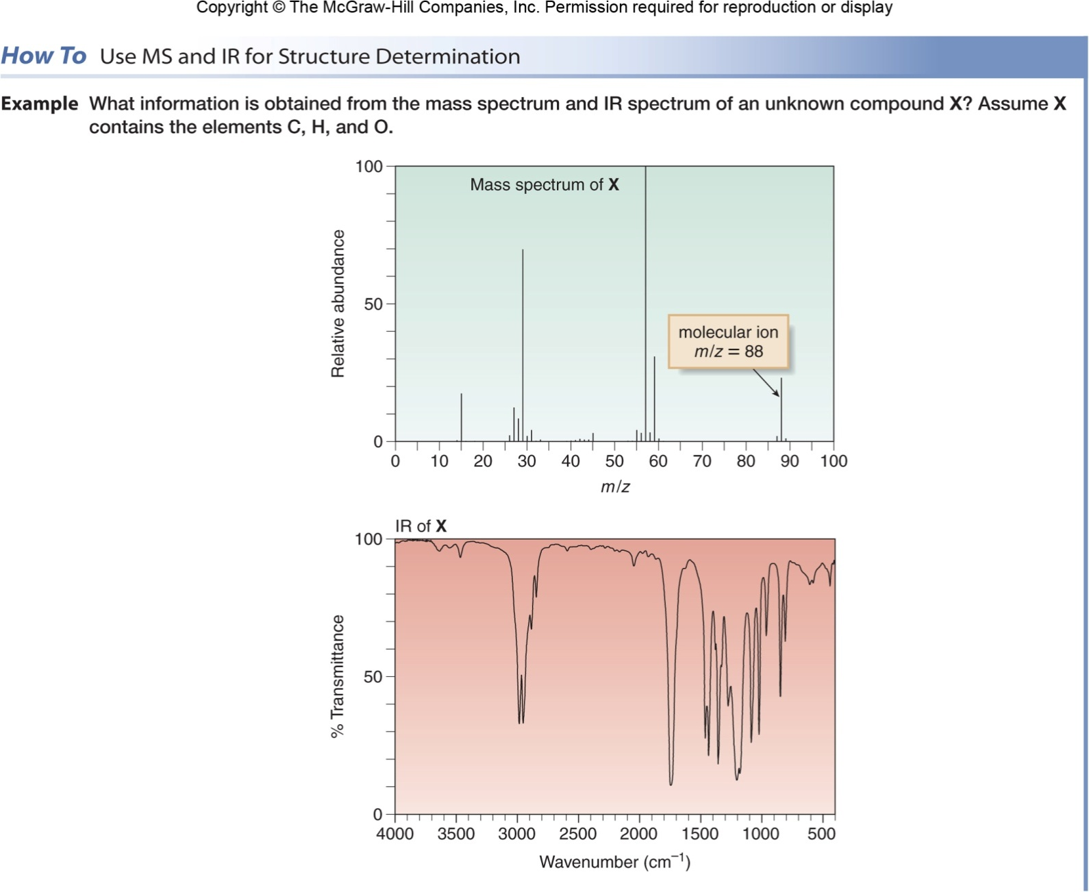
Using MS and IR for Structure Determination
‹#›

Slide 51
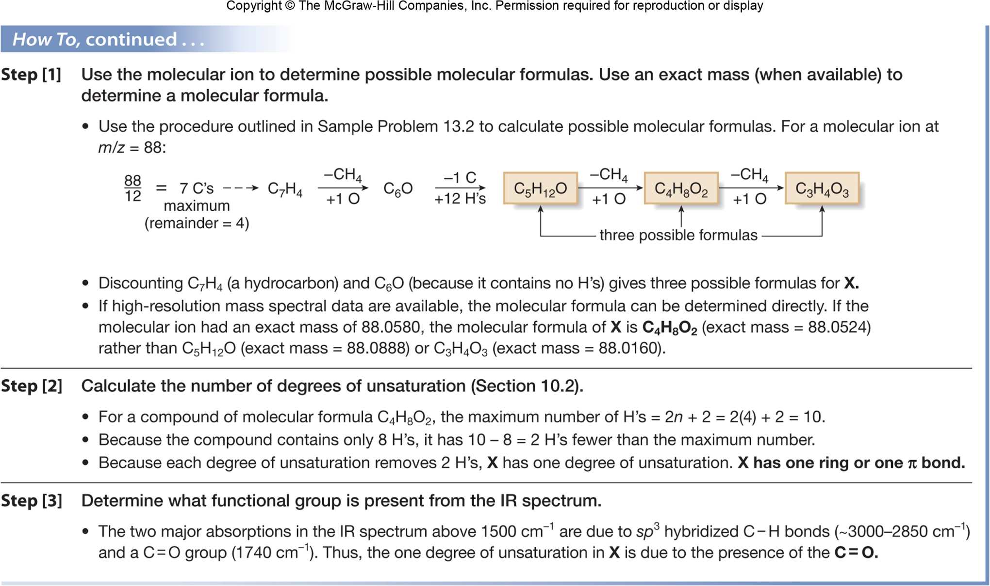
Using MS and IR for Structure Determination
‹#›

