Slide 1
Econometrics
Ch2.
Basic Ideas of Linear Regression- The Two-Variable Model

Slide 2
Introduction to Regression Analysis
Regression is probably the single most important tool at the econometrician’s disposal.
Meaning of Regression?
It is concerned with describing and evaluating the relationship between a given variable (usually called the dependent variable) and one or more other variables (usually known as the independent variable(s)).

Slide 3
A HYPOTHETICAL EXAMPLE
Regression analysis is largely concerned with estimating and/or predicting the (population) mean value of the dependent variable on the basis of the known or fixed values of the explanatory variable(s).
Look at table 2.1 which refers to a total population of 60 families and their weekly income (X) and weekly consumption expenditure (Y). The 60 families are divided into 10 income groups.
There is considerable variation in weekly consumption expenditure in each income group. But the general picture that one gets is that, despite the variability of weekly consumption expenditure within each income bracket, on the average, weekly consumption expenditure increases as income increases.

Slide 4
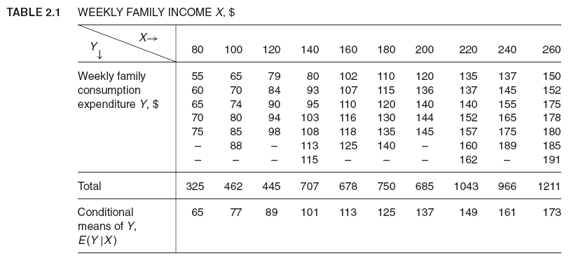

Slide 5
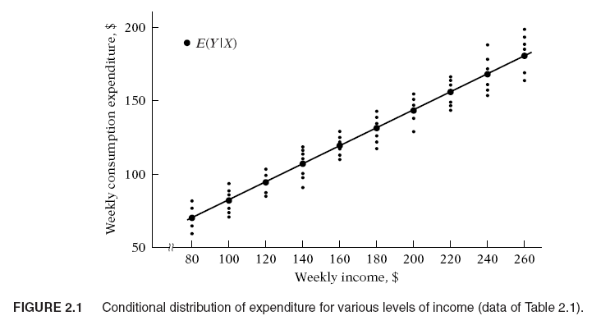

Slide 6
A HYPOTHETICAL EXAMPLE
The dark circled points in Figure 2.1 show the conditional mean values of Y against the various X values. If we join these conditional mean values, we obtain what is known as the population regression line (PRL), or more generally, the population regression curve. More simply, it is the regression of Y on X. The adjective “population” comes from the fact that we are dealing in this example with the entire population of 60 families. Of course, in reality a population may have many families.

Slide 7
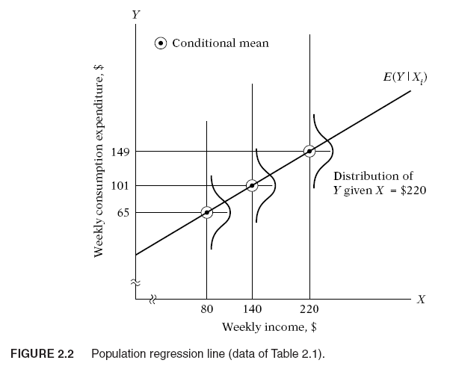

Slide 8
POPULATION REGRESSION FUNCTION (PRF)
From the preceding discussion and Figures. 2.1 and 2.2, it is clear that each conditional mean E(Y | X_{i}) is a function of X_{i}. Symbolically,
E(Y | X_{i}) = f (X_{i}) (2.2.1)
Equation (2.2.1) is known as the conditional expectation function (CEF) or population regression function (PRF) or population regression (PR) for short.
The functional form of the PRF is an empirical question. For example, we may assume that the PRF E(Y | X_{i}) is a linear function of X_{i}, say, of the type
E(Y | X_{i}) = β₁ + β₂X_{i} (2.2.2)

Slide 9
STOCHASTIC SPECIFICATION OF PRF
We can express the deviation of an individual Y_{i} around its expected value as follows:
u_{i} = Y_{i} − E(Y | X_{i})
or
Y_{i} = E(Y | X_{i}) + u_{i} (2.4.1)
Technically, u_{i} is known as the stochastic disturbance or stochastic error term.
How do we interpret (2.4.1)? The expenditure of an individual family, given its income level, can be expressed as the sum of two components:
(1) E(Y | X_{i}), the mean consumption of all families with the same level of income. This component is known as the systematic, or deterministic, component,
(2) u_{i}, which is the random, or nonsystematic, component.

Slide 10
THE SAMPLE REGRESSION FUNCTION (SRF)
The data of Table 2.1 represent the population, not a sample. In most practical situations what we have is a sample of Y values corresponding to some fixed X’s.
Pretend that the population of Table 2.1 was not known to us and the only information we had was a randomly selected sample of Y values for the fixed X’s as given in Table 2.4. each Y (given X_{i}) in Table 2.4 is chosen randomly from similar Y’s corresponding to the same X_{i} from the population of Table 2.1.
Can we estimate the PRF from the sample data? We may not be able to estimate the PRF “accurately” because of sampling fluctuations. To see this, suppose we draw another random sample from the population of Table 2.1, as presented in Table 2.5. Plotting the data of Tables 2.4 and 2.5, we obtain the scatter gram given in Figure 2.4. In the scattergram two sample regression lines are drawn so as

Slide 11
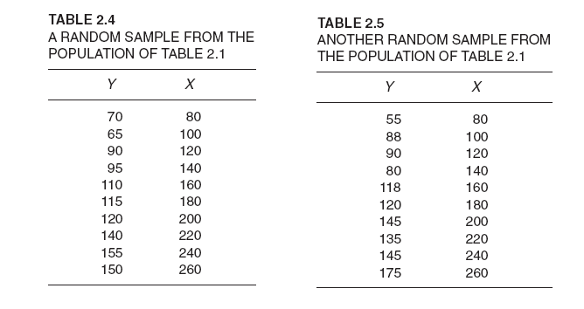

Slide 12
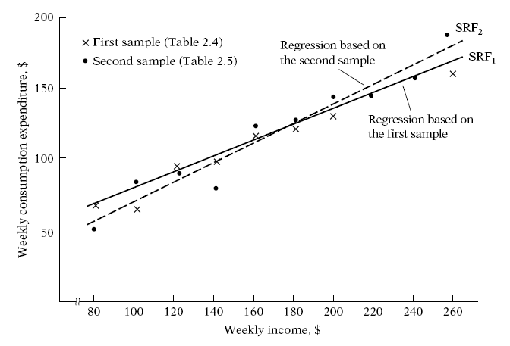

Slide 13
THE SAMPLE REGRESSION FUNCTION (SRF)
Which of the two regression lines represents the “true” population regression line? There is no way we can be absolutely sure that either of the regression lines shown in Figure 2.4 represents the true population regression line (or curve). Supposedly they represent the population regression line, but because of sampling fluctuations they are at best an approximation of the true PR. In general, we would get N different SRFs for N different samples, and these SRFs are not likely to be the same.

Slide 14
THE SAMPLE REGRESSION FUNCTION (SRF)
We can develop the concept of the sample regression function (SRF) to represent the sample regression line. The sample counterpart of (2.2.2) may be written as
Yˆ_{i} = βˆ₁ + βˆ₂X_{i} (2.6.1)
where Yˆ is read as “Y-hat’’ or “Y-cap’’
Yˆ_{i} = estimator of E(Y | X_{i})
βˆ₁ = estimator of β₁
βˆ₂ = estimator of β₂
Note that an estimator, also known as a (sample) statistic, is simply a rule or formula or method that tells how to estimate the population parameter from the information provided by the sample at hand.

Slide 15
THE SAMPLE REGRESSION FUNCTION (SRF)
Now just as we expressed the PRF in two equivalent forms, (2.2.2) and (2.4.2), we can express the SRF (2.6.1) in its stochastic form as follows:
Y_{i} = βˆ₁ + βˆ₂X_{i} +uˆ_{i} (2.6.2)
ˆu_{i} denotes the (sample) residual term. Conceptually ˆu_{i} is analogous to u_{i} and can be regarded as an estimate of u_{i}. It is introduced in the SRF for the same reasons as u_{i} was introduced in the PRF.
To sum up, then, we find our primary objective in regression analysis is to estimate the PRF
Y_{i} = β₁ + β₂X_{i} + u_{i} (2.4.2)
on the basis of the SRF
Y_{i} = βˆ₁ + βˆ₂X_{i} +uˆ_{i} (2.6.2)
because more often than not our analysis is based upon a single sample from some population. But because of sampling fluctuations our estimate of

Slide 16
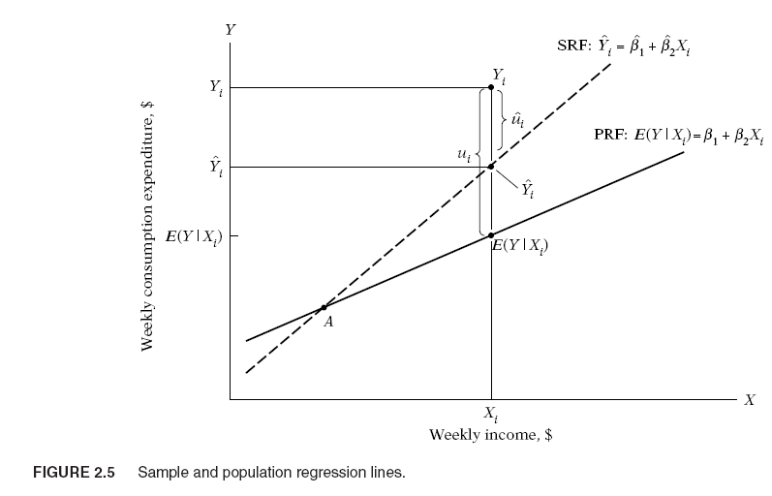

Slide 17
THE SAMPLE REGRESSION FUNCTION (SRF)
the PRF based on the SRF is at best an approximate one. This approximation is shown diagrammatically in Figure 2.5. For X = X_{i}, we have one (sample) observation Y = Y_{i}. In terms of the SRF, the observed Y_{i} can be expressed as:
Y_{i} = Yˆ_{i} +uˆ_{i} (2.6.3)
and in terms of the PRF, it can be expressed as
Y_{i} = E(Y | X_{i}) + u_{i} (2.6.4)
Now obviously in Figure 2.5 Yˆ_{i} overestimates the true E(Y | X_{i}) for the X_{i} shown therein. By the same token, for any X_{i} to the left of the point A, the SRF will underestimate the true PRF.

Slide 18
THE SAMPLE REGRESSION FUNCTION (SRF)
The critical question now is: Granted that the SRF is but an approximation of the PRF, can we devise a rule or a method that will make this approximation as “close” as possible? In other words, how should the SRF be constructed so that βˆ₁ is as “close” as possible to the true β₁ and βˆ₂ is as “close” as possible to the true β₂ even though we will never know the true β₁ and β₂?

Slide 19
Simple Linear Regression Model
Dependent Variable
Population Slope Coefficient
Population Y intercept
Independent Variable
Random Error term
Y_{i} = β₀ + β₁X_{i} + ε_{i}
Linear component
Random Error component

Slide 20
Some Terminology
We typically refer to y as the:
Dependent Variable, or
Left-Hand Side Variable, or
Explained Variable, or
Regressand

Slide 21
What Error Term Captures
Omitted variables
Measurement error in the dependent variable
Randomness of human behavior: People don't act exactly the same way even in the same circumstances

Slide 22
Linearity
Linearity can be in the variables or in the parameters.
Linearity in the variables
Conditional expectation of Y is a linear function of X -
The regression is a straight line
Slope is constant
Can't have a function with squares, square root, or interactive terms- these have a varying slope.

Slide 23
Linearity
We are concerned with linearity in the parameters
The parameters are raised to the first power only.
It may or may not be linear in the variables.

Slide 24
The Mathematical Interpretation: The Meaning of the Regression Parameters
B₀ = the intercept
the point where the line crosses the Y- axis.
(the value of the dependent variable when all of the independent variables = 0)
B₁ = the sloe
the increase in the dependent variable per unit change in the independent variable (also known as the 'rise over the run')

Slide 25
Example
observation (i) | number of ice cream cones sold (Y) | cost of icecream cones (X)
1 | 84 | $2.50
2 | 89 | $3.00
3 | 92 | $3.25
4 | 96 | $2.25
5 | 98 | $1.75
6 | 102 | $2.75
7 | 113 | $2.00
8 | 114 | $1.50
9 | 122 | $1.25
10 | 127 | $1.00

Slide 26
Accompanying Scatter plot

Slide 27
Accompanying Scatter plot with Regression Equation

Slide 28
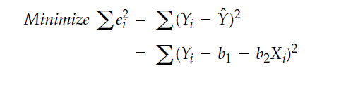
How to estimate the parameters: Ordinary Least Squares Method-OLS
b₀ and b₁ are obtained by finding the values of b₀ and b₁ that minimize the sum of the squared differences

Slide 29
Why squared error?
Because:
(1) the sum of the errors expressed as deviations would be zero as it is with standard deviations, and
(2) some feel that big errors should be more influential than small errors.
Therefore, we wish to find the values of b1 and b2 that produce the smallest sum of squared errors.

Slide 30
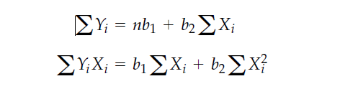
Least Squares Method-OLS
If one uses calculus to solve the minimization problem for the two parameters you obtain the following first order conditions, which are the same as we obtained before, multiplied by n

Slide 31
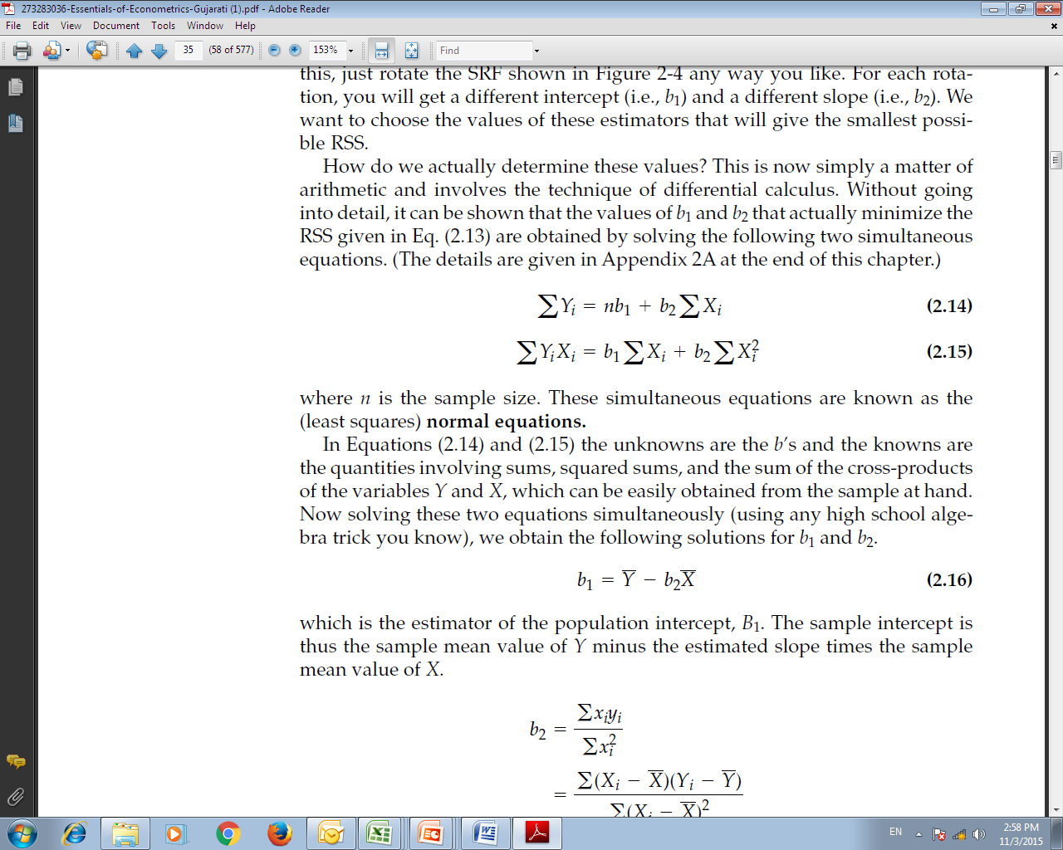
Deriving OLS Estimates
Given the definition of a sample mean, and properties of summation, we can rewrite the first condition as follows:

Slide 32
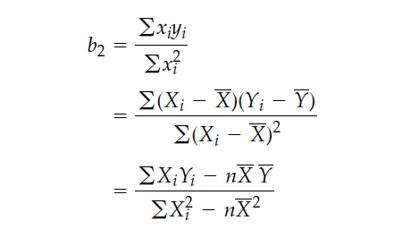
Deriving OLS Estimates
So the OLS estimated slope is

