Slide 1
Chapter Eighteen
Creating Competitive Advantage

Slide 2
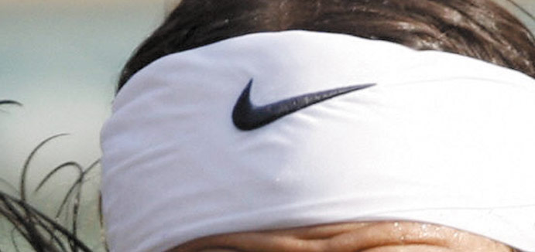
Creating Competitive Advantage
Topic Outline
Competitor Analysis
Competitive Strategies
Balancing Customer and Competitor Orientations

Slide 3
Today’s Companies
Competitive advantages require delivering more value and satisfaction to target consumers than competitors do
Competitive marketing strategies are how companies analyze their competitors and develop value-based strategies for profitable customer relationships

Slide 4
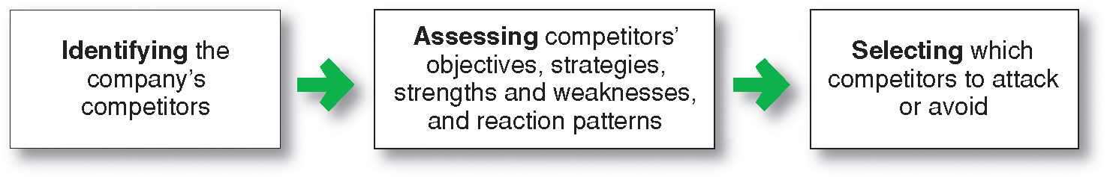
Competitor Analysis
Competitor analysis is the process of identifying, assessing, and selecting key competitors

Slide 5
Competitor Analysis
Identifying Competitors
Competitors can include:
All firms making the same product or class of products
All firms making products that supply the same service
All firms competing for the same consumer dollars

Slide 6
Competitor Analysis
Assessing Competitors
Notes:
Note to Instructor
A strategic group is a group of firms in an industry following the same or a similar strategy in a given target market. For example, in the major appliance industry, General Electric, and Whirlpool belong to the same strategic group. Each produces a full line of medium-price appliances supported by good service. In contrast, Sub-Zero and Viking belong to a different strategic group. They produce a narrower line of higher-quality appliances, offer a higher level of service, and charge a premium price.

Slide 7
Competitor Analysis
Assessing Competitors

Slide 8
Competitor Analysis
Selecting Competitors to Attack and Avoid
Customer value analysis determines the benefits that target customers’ value and how customers rate the relative value of various competitors’ offers
Identification of major attributes that customers value and the importance of these values
Assessment of the company’s and competitors’ performance on the valued attributes
Notes:
Note to Instructor

Slide 9
Competitor Analysis
Selecting Competitors to Attack and Avoid
Strong or weak competitors
Close or distant competitors
Good or bad competitors
Notes:
Note to Instructor
Weak versus Strong Competitors
Most companies prefer to compete against weak competitors. This requires fewer resources and less time. But in the process, the firm may gain little. You could argue that the firm also should compete with strong competitors in order to sharpen its abilities. Moreover, even strong competitors have some weaknesses, and succeeding against them often provides greater returns
Close versus Distant Competitors
Most companies will compete with close competitors—those that resemble them most—rather than distant competitors. Thus, Nike competes more against Adidas than against Timberland or Keen. And Target competes against Wal-Mart rather than Neiman Marcus or Nordstrom. At the same time, the company may want to avoid trying to “destroy” a close competitor.
Good versus Bad Competitors
Good competitors play by the rules of the industry. Bad competitors, in contrast, break the rules. They try to buy share rather than earn it, take large risks, and play by their own rules.

Slide 10

Competitor Analysis
Selecting Competitors to Attack and Avoid
Finding uncontested market spaces
Notes:
Note to Instructor
This is called “blue ocean” strategy where there are no direct competitors.

Slide 11
Competitor Analysis
Designing a Competitive Intelligence System
Identifies competitive information and the best sources of this information
Continually collects information
Checks information for validity and reliability
Interprets information
Organizes information
Sends key information to relevant decision makers
Responds to inquiries about competitors

Slide 12
Competitive Strategies
Approaches to Marketing Strategy
Entrepreneurial marketing involves visualizing an opportunity and constructing and implementing flexible strategies
Formulated marketing involves developing formal marketing strategies and following them closely
Intrepreneurial marketing involves the attempt to reestablish an internal entrepreneurial spirit and refresh marketing strategies and approaches

Slide 13
Competitive Strategies
Basic Competitive Strategies
Michael Porter’s four basic
competitive positioning strategies

Slide 14
Competitive Strategies
Basic Competitive Strategies
Overall cost leadership strategy:
a company achieves the lowest production and distribution costs and allows it to lower its prices and gain market share
Notes:
Note to Instructor

Slide 15
Competitive Strategies
Basic Competitive Strategies
Differentiation strategy is when a company concentrates on creating a highly differentiated product line and marketing program so it comes across as an industry class leader
Focus strategy is when a company focuses its effort on serving few market segments well rather than going after the whole market

Slide 16
Competitive Strategies
Basic Competitive Strategies
A company that pursued a clear strategy would achieve superior performance
Companies without a clear strategy, “middle of the road”, would not succeed
No clear strategy is

Slide 17
Competitive Strategies
Basic Competitive Strategies
Michael Treacy and Fred Wiersema suggest companies can gain leadership positions by delivering superior value to their customers in three strategies or “value disciplines:”
Operational excellence
Customer intimacy
Product leadership
Notes:
Note to Instructor
Treacy and Wiersema found that leading companies focus on and excel at a single value discipline, while meeting industry standards on the other two. Such companies design their entire value delivery network to single-mindedly support the chosen discipline.

Slide 18
Competitive Strategies
Basic Competitive Strategies
Operational excellence refers to a company providing value by leading its industry in price and convenience by reducing costs and creating a lean and efficient value delivery system

Slide 19
Competitive Strategies
Basic Competitive Strategies
Customer intimacy refers to a company providing superior value by segmenting markets and tailoring products or services to match the needs of the targeted customers
Notes:
Note to Instructor

Slide 20
Competitive Strategies
Basic Competitive Strategies
Product leadership refers to a company providing superior value by offering a continuous stream of leading-edge products or services. Product leaders are open to new ideas and solutions and bring them quickly to the market.

Slide 21
Competitive Strategies
Competitive Positions
Notes:
Note to Instructor
Forty percent of the market is in the hands of the market leader, the firm with the largest market share. Another 30 percent is in the hands of market challengers, runner‑up firms that are fighting hard to increase their market share. Another 20 percent is in the hands of market followers, other runner-up firms that want to hold their share without rocking the boat. The remaining 10 percent is in the hands of market nichers, firms that serve small segments not being pursued by other firms.

Slide 22
Competitive Strategies
Competitive Positions
Market leader is the firm with the largest market share and leads the market price changes, product innovations, distribution coverage, and promotion spending
Market challengers are firms fighting to increase market share

Slide 23
Competitive Strategies
Competitive Positions
Market followers are firms that want to hold onto their market share
Market nichers are firms that serve small market segments not being pursued by other firms

Slide 24
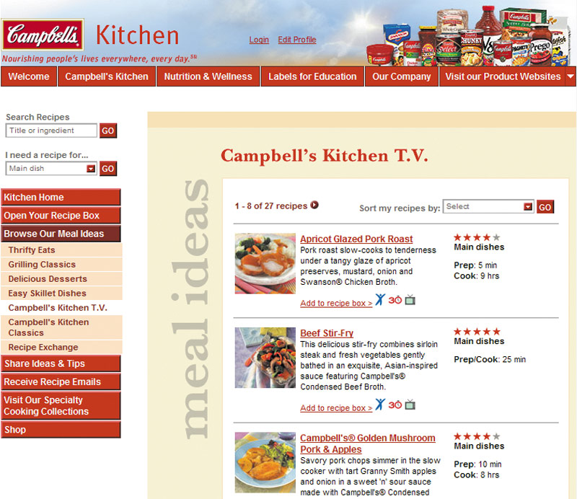
Competitive Strategies
Market Leader Strategies
Expand total demand
Protect their current market
Expand market share
Notes:
Note to Instructor
A leader’s life is not easy. It must maintain a constant watch. Other firms keep challenging its strengths or trying to take advantage of its weaknesses. The market leader can easily miss a turn in the market and plunge into second or third place. A product innovation may come along and hurt the leader. The leader might grow arrogant or complacent and misjudge the competition. Or the leader might look old-fashioned against new and peppier rivals.

Slide 25
Competitive Strategies
Market Leader Strategies
Expanding Total Demand
Expand total demand by developing:
New users
New uses
More usage of its products
Notes:
Note to Instructor

Slide 26
Competitive Strategies
Market Leader Strategies
Protecting Market Share
Protect current market by:
Fixing or preventing weaknesses that provide opportunities to competitors
Maintain consistent prices that provide value
Keep strong customer relationships
Continuous innovation

Slide 27
Competitive Strategies
Market Leader Strategies
Expanding Market Share
Expand market share by:
Increasing profitability with increasing market share in served markets
Producing high-quality products
Creating good service experiences
Building close relationships

Slide 28

Competitive Strategies
Market Challenger Strategies
Challenge the leader with an aggressive bid for more market share
Second mover advantage challenger observes what has made the leader successful and improves on it
Notes:
Note to Instructor
The text gives an excellent example of a market challenger:
Virgin Drinks took on the leaders head-on, launching its own cola, advertising heavily, and trying to get into all the same retail outlets that stocked the leading brands. At Virgin Cola’s launch, Virgin CEO Richard Branson even drove a tank through a wall of rivals’ cans in New York’s Times Square to symbolize the war he wished to wage on the big, established rivals. However, Coke’s and Pepsi’s viselike grip on U.S. shelf space proved impossible for Virgin Drinks to break. Although Virgin Drinks is still around, it has never gained more than a 1 percent share of the U.S. cola market.
Red Bull, by contrast, tackled the leaders indirectly. It entered the U.S. soft drinks market with a niche product: a carbonated energy drink retailing at about twice what you would pay for a Coke or Pepsi. It started by selling Red Bull through unconventional outlets not dominated by the market leaders, such as bars and nightclubs, where twenty-something's gulped down the caffeine-rich drink so they can dance all night. After gaining a loyal following, Red Bull used the pull of high margins to elbow its way into the corner store, where it now sits in refrigerated bins within arm’s length of Coke and Pepsi. In the United States, where Red Bull enjoys a 65 percent share of the energy drink market, its sales are growing at about 35 percent a year.

Slide 29
Competitive Strategies
Market Follower Strategies
Play along with competitors and not rock the boat
Copy or improve on leader’s products and programs with less investment
Brings distinctive advantages
Must keep costs and prices low or quality and services high

Slide 30

Competitive Strategies
Market Nicher Strategies
Ideal market niche is big enough to be profitable with high growth potential and has little interest from competitors
Key to market niching is specialization
Market
Customer
Product
Marketing mix
Notes:
Note to Instructor
This link refers to the example in the text for R.A.B. Food Group. The text mentions its Kosher line but it is interesting to see some of their smaller lines including Guiltless Gourmet.

Slide 31
Balancing Customer and Competitor Orientations
Companies need to continuously adapt strategies to changes in the competitive environment
  Competitor-centered company
  Customer-centered company
  Market-centered company

Slide 32
Balancing Customer and Competitor Orientations
Competitor-centered company spends most of its time tracking competitor’s moves and market shares and trying to find ways to counter them
Advantage is that the company is a fighter
Disadvantage is that the company is reactive

Slide 33

Balancing Customer and Competitor Orientations
Customer-centered company spends most of its time focusing on customer developments in designing strategies
Provides a better position than competitor-centered company to identify opportunities and build customer relationships
Notes:
Note to Instructor
In slideshow view, click on movie icon to launch UMPQUA Bank video snippet. See accompanying DVD for full video segment.

Slide 34
Balancing Customer and Competitor Orientations
Market-centered company spends most of its time focusing on both competitor and customer developments in designing strategies

Slide 35
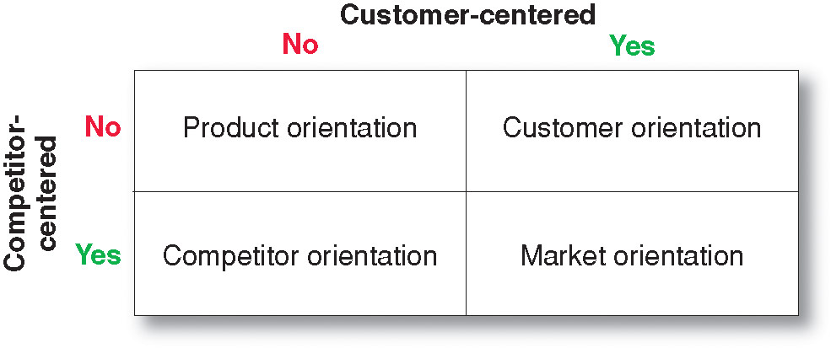
Balancing Customer and Competitor Orientations

Slide 36

All rights reserved. No part of this publication may be reproduced, stored in a retrieval system, or transmitted, in any form or by any means, electronic, mechanical, photocopying, recording, or otherwise, without the prior written permission of the publisher. Printed in the United States of America.
Copyright © 2012 Pearson Education, Inc.
Publishing as Prentice Hall

