Slide 1

Chapter 6
Liquidity of Short-Term Assets; Related
Debt-Paying Ability

Slide 2

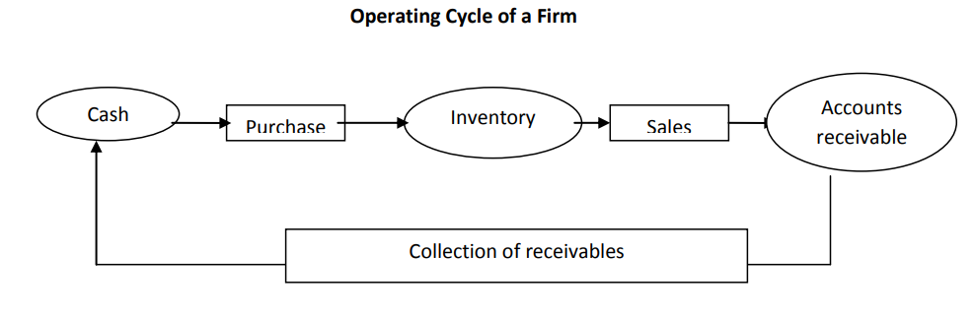
Operating Cycle
The time period between the acquisition of goods and the final cash realization from sales

Slide 3
Working Capital
Current Assets
– Current Liabilities
= Working Capital
2021 2020
$195,700 $193,000
The increase in net working capital is a favorable sign
Equal to current assets less current liabilities.
Current assets are those assets that are expected to be converted into cash or used up within 1 year.
Current liabilities are those liabilities that must be paid within 1 year; they are paid out of current assets.
Working capital is a safety cushion to creditors. A large balance is required when the entity has difficulty borrowing on short notice

Slide 4
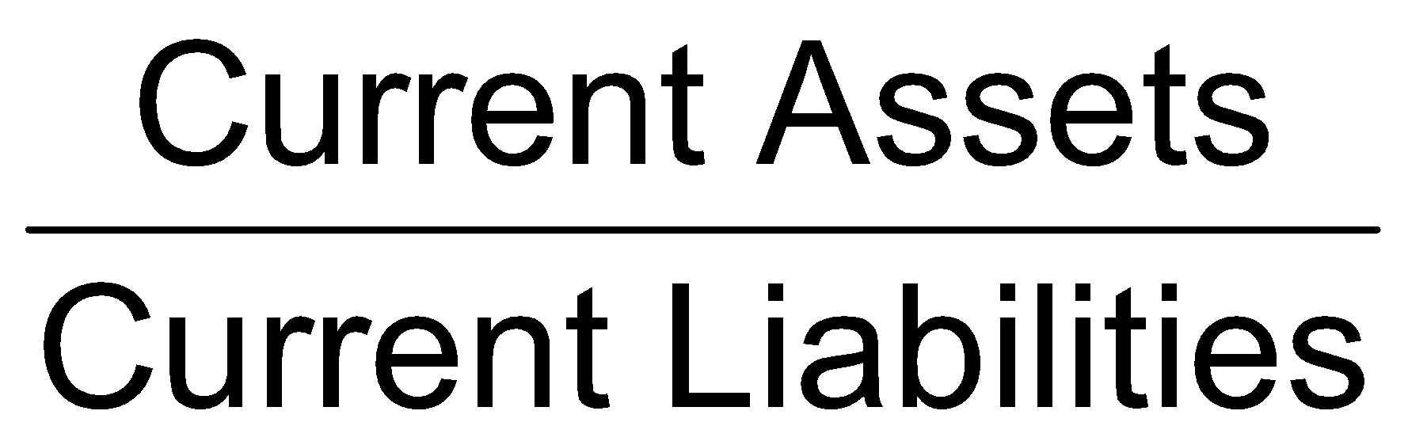
Current Ratio
The current ratio expresses the relative relationship between current assets and current liabilities. Determines short-term debt-paying ability
2021 2020
Current ratio 2.79 2.75
The 2021 ratio is interpreted to mean that there is $2.79 of current assets for each dollar for each dollar of current liabilities.
This represents an improvement over 2020.
A rule of thumb suggests that a 2:1 ratio is ordinarily satisfactory, but this is by no means a necessarily reliable relationship.
Consideration must also be given to industry practices, the firm’s operating cycle, and the mix of current assets.
A very low current ratio would ordinarily cause for concern since cash flow problems appear imminent.
An excessively high current ratio could suggest that the firm is not managing its current assets properly.

Slide 5
Current Ratio
Determines short-term debt-paying ability
Focus is on the relationship between current assets and current liabilities
  Inter-firm comparison is possible and meaningful
Traditional benchmark: 2.00
  Decreased current ratio indicates lower liquidity
  Industry averages provide contextual benchmark
Considerations
  Quality of inventory and receivables
  Inventory cost flow assumptions

Slide 6


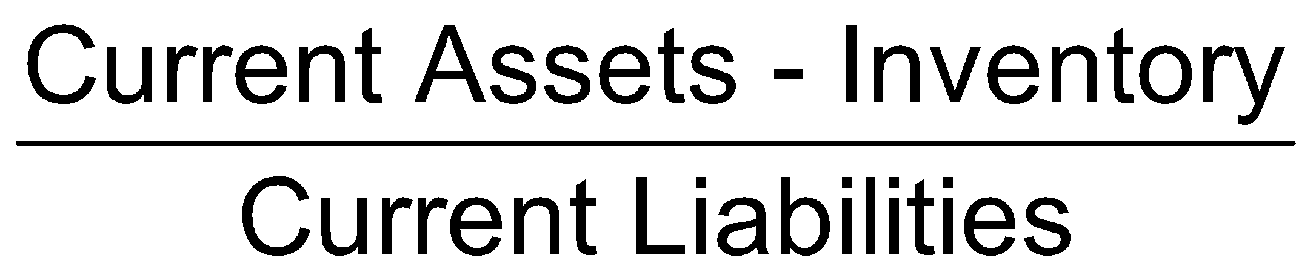
Acid-Test (Quick) Ratios
2021 2020
1.65 1.62
For each $1 of current liabilities in 2021, there is $1.65 of quick assets available to pay the obligations. There has been an improvement in the quick ratio.

Slide 7
Acid-Test (Quick) Ratio
Measures the immediate liquidity of the firm
Relates the most liquid assets to current liabilities
  Exclude inventory
  More conservative variation: Also exclude other current assets that do not represent current cash flow
Traditional benchmark: 1.00
  Industry averages provide contextual benchmark

Slide 8
Acid-Test (Quick) Ratio
Short-Term Creditors: A significant decline in the quick ratio indicates deterioration in the company’s liquidity, which could indicate the company’s inability to satisfy its maturing debt immediately.
Financial Management: A lower quick ratio may mean that the company will have greater difficulty borrowing short-term funds. A very low ratio may indicate that the company will be unable to meet its short-term debt payments.

Slide 9

Cash Ratio
2021 2020 Trend
0.45 0.44 Imoroving
Extremely conservative
  Unrealistic for a firm to have sufficient cash and securities to cover all its current liabilities
Appropriate context
  Firms with naturally slow-moving inventory and receivables
  Firms in financial distress as it assumes the worst case assumption ( the business ceases to exist and only the cash on hand is available to meet credit obligations).

Slide 10
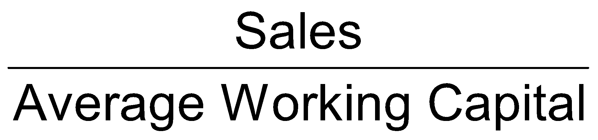
Sales to Working Capital
2021 2020
4.53 4.76
Measures the turnover of working capital per year
Compare with
  Historical data
  Industry competitors
  Industry averages
Assessment
  Low: potentially unprofitable use of working capital
  High: potential undercapitalization

Slide 11
Activity Ratios
Activity (asset utilization, turnover) ratios are used to determine how quickly various accounts are converted into sales or cash.
Overall liquidity ratios generally do not give an adequate picture of a company’s real liquidity, due to differences in the kinds of current assets and liabilities the company holds. Thus, it is necessary to evaluate the activity or liquidity of specific current accounts.
Various ratios exist to measure the activity of receivables, inventory, and total assets.

Slide 12
Receivables Issues
Accounts receivable ratios comprise the:
  accounts receivable turnover
  Accounts receivable turnover in days (average collection period)

Slide 13

Accounts Receivable Turnover
Indicates the liquidity of receivables
Determining average gross receivables
  End of year and beginning of year base points for average mask seasonal fluctuations
  Internal analysis: use monthly or weekly amounts
  External analysis: use quarterly data

Slide 14
Accounts Receivable Turnover
Typically collected in 30 days
Valuation
  Impairments
    Uncollectibility
    Allowed discounts
    Allowances given
    Returns

Slide 15
Accounts Receivable Turnover
The accounts receivable turnover gives the number of times accounts receivable is collected during the year.
Average accounts receivable is typically found by adding the beginning and ending accounts receivable and dividing by 2.
Note: When a balance sheet amount is related to an income statement amount in computing a ratio, the balance sheet amount should be converted to an average for the year.
The reason is that the income statement amounts represent activity over a period. Thus, the balance sheet figure should be adjusted to reflect assets available for use throughout the period.

Slide 16
Accounts Receivable Turnover
2021 2020 Trend
6.75 7.09 deteriorating
Accounts receivable turnover =
In general, the higher the accounts receivable turnover, the better since the company is collecting quickly from customers and these funds can then be invested. However, an excessively high ratio may indicate that the company’s credit policy is too stringent, with the
Note: If the beginning of the period balance is not available, the end of the period accounts receivable would be used in the denominator of the formula.

Slide 17
Accounts Receivable Turnover in Days
OR
Average collection period
Average collection period = average gross receivables / (Net sales / 365)
OR
Average collection period = 365days / Accounts receivable turnover
Also called Average collection period
Should reflect firm’s credit and collection policies
The average collection period (the accounts receivable turnover in days) is the number of days it takes to collect on receivables

Slide 18
Accounts Receivable Turnover in Days
OR
Average collection period
2021 2020 Trend
54.11 51.5 deteriorating
This means that it takes almost 54 days for a sale to be converted into cash in 2021. In 2020, the average collection period was 52 days . A deterioration is noted for this company.

Slide 19
Inventory Issues
Held for sale in the normal course of business
Used in the production of goods
Trading business
  Wholesale to retail
  Retail to end consumer
  Single inventory (merchandise) account
Manufacturer has three distinct inventories
  Raw materials inventory
  Work in process inventory
  Finished goods inventory

Slide 20
Inventory Records
Perpetual
  A continuous record of
    Physical quantities is maintained
    Inventory and cost of goods sold, updated as sales and purchases take place
  Records are verified through physical inventory
Periodic
  Periodic physical inventories to determine quantity
  Attach costs to ending inventory based on selected cost flow assumption(s)

Slide 21
Inventory Cost
Specific identification
  Tracking of specific cost normally impractical
  Exceptions: large and/or expensive items
Cost flow assumptions
  FIFO (first-in, first-out)
  LIFO (last-in, first-out)
  Average

Slide 22
FIFO Cost Flow Assumption
First inventory acquired is the first sold
Cost of goods sold is oldest costs
  Current costs are not matched against revenue
  Inflates profit
Ending inventory reflects latest costs
  Approximates replacement cost
  Slow turnover can distort the approximation of replacement cost by ending inventory value

Slide 23
LIFO Cost Flow Assumption
Cost of most recently-acquired goods are matched against sales revenue
  Profit is reflective of replacement cost
Ending inventory contains oldest costs
  Inventory valuation can be based on costs that are years or decades old

Slide 24
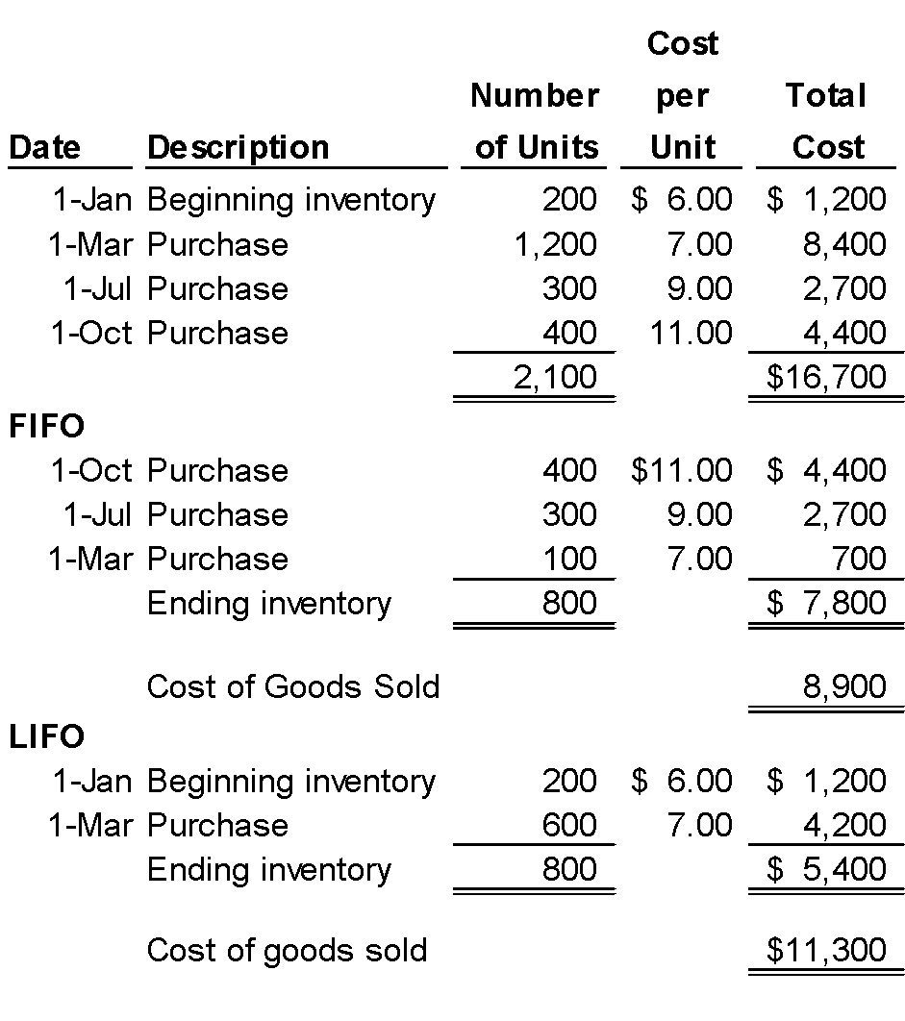
Cost Flow Assumption Example
2,100 units available for sale.
800 units of ending inventory are valued at the most recent costs.
800 units of ending inventory are valued at the oldest costs.

Slide 25
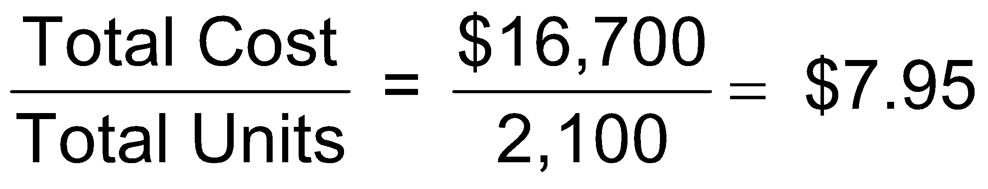
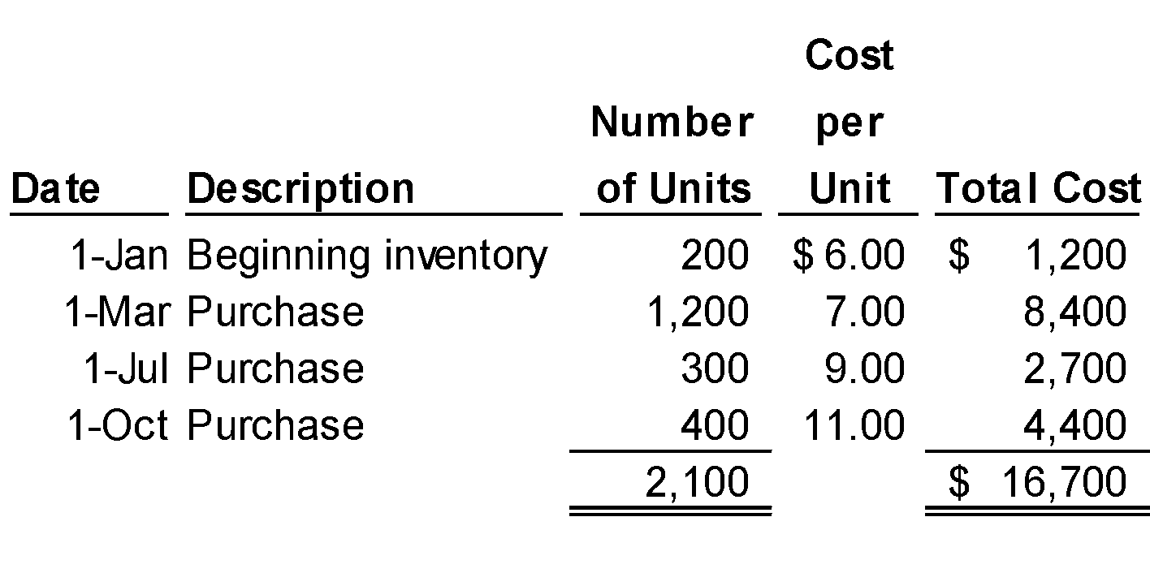
Cost Flow Assumption Example
Average Cost
2,100 units available for sale.
800 units of ending inventory are valued at average unit cost.
Ending inventory (800 × $7.95) = $6,360
Cost of goods sold ($16,700 – $6,360) = $10,340

Slide 26
Impact on Financial Statements
LIFO profit generally lower than FIFO profit
LIFO profit reflects current costs of sales
LIFO reserve
  Measures the spread between LIFO and FIFO inventory value
  Discloses the approximate FIFO inventory value
FIFO inventory is closer to replacement value of the asset

Slide 27
Inventory: Lower-of-Cost-or-Market
Cost flow assumptions use historical data
If “utility” (market) is below cost, inventory must be written down to reflect the diminished value
Definitions of market
  Replacement cost
  Net realizable value

Slide 28
INVENTORY RATIOS
The inventory turnover ratio establishes the relationship between the volume of goods sold and inventory.
The inventory turnover for businesses in different industries and within industries can vary widely.
A grocery store may have an average turnover of 20, for all items. A furniture store would normally have a much smaller turnover.
  Inventory turnover in times per year
  Inventory turnover in days

Slide 29
Inventory Turnover
Inventory turnover = Cost of goods sold / Average inventory
2021 2020 Trend
6.02 6.08 deteriorating
Note: Inter-company comparisons of inventory turnover do not provide valid comparisons when the companies are using different inventory methods, e.g., FIFO and LIFO, since the cost of goods sold and inventory under LIFO during periods of rising prices will be higher and lower, respectively, than under FIFO. These effects are summarized below:

Slide 30
Inventory turnover in days
Inventory turnover in days = Average Inventory/ (Cost of Goods Sold/365)
OR
365 / Inventory turnover
2021 2020 Trend
66.67 60.03 deteriorating

Slide 31
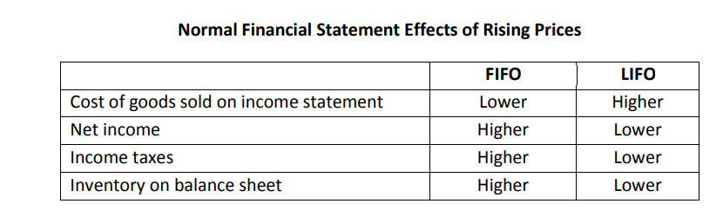
Inventory Turnover

Slide 32
Inventory Turnover
Generally, a high inventory turnover indicates that the firm
is operating effectively as far as inventory is concerned (purchasing, receiving, storing, selling),
investment in inventory is reduced,
the operating cycle involving converting inventory to cash is shortened, and
less opportunity for the inventory to become obsolete exists. An excessively high inventory turnover may suggest that the company is not keeping sufficient inventory on hand to meet sales requirements resulting in stock-outs and unhappy customers.
A low value for the inventory turnover ratio suggests an excessive amount of inventory on hand, slow sales, high carrying costs for the inventory, and weak cash inflow prospects.
A low turnover could increase the company’s exposure to future financing problems

Slide 33
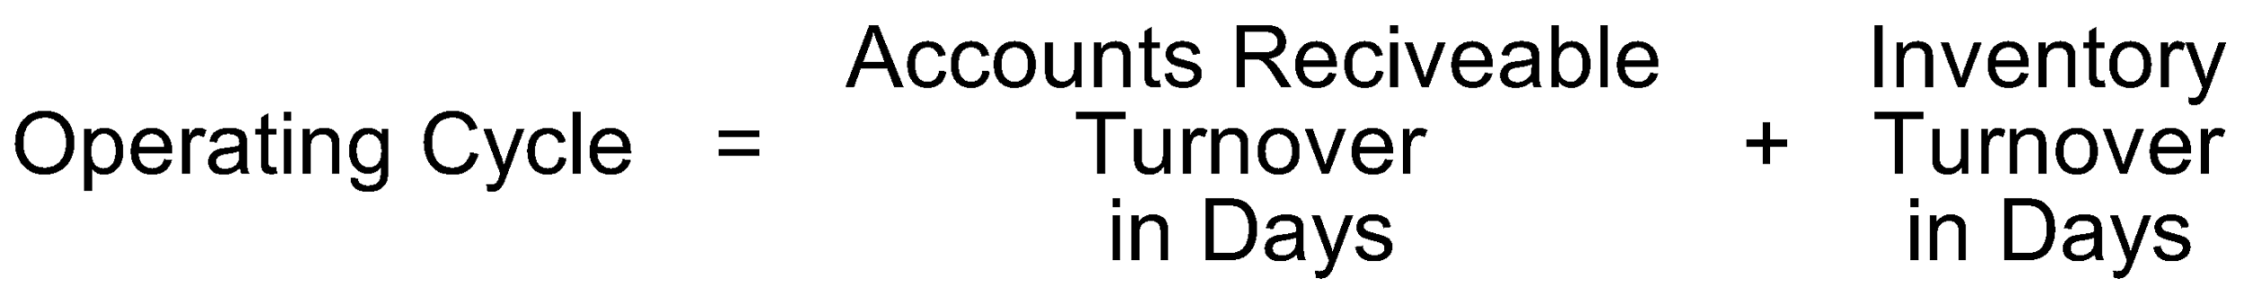
Current Assets: Operating Cycle
The time period between acquisition of goods and the final cash realization from sales
Subject to potential understatement from understatement of turnover measures
  Use of LIFO
  Use of a natural business year
  Averages are computed on beginning-of-year and end-of-year data

