Slide 1
Software Engineering
Comp 433
Lecturer: Dr. Samer Zein
E-mail: szain@birzeit.edu
Linkedin: https://www.linkedin.com/in/samer-m-zain-phd/

Slide 2

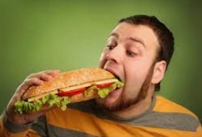
No phones and No Eating in Class

Slide 3
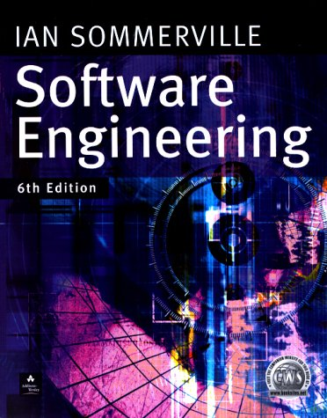


Recommended Course Textbooks
Bruegge and Dutoit, Object-Oriented Software Engineering Using UML, Patterns, and Java, Prentice Hall 3rd Edition
Sommerville I. (2010)
Software Engineering 9th Edition, Addison-Wesley, Harlow, Essex,UK (6th ,7th,or 8th would suffice)
Stevens P. with Pooley, R. (2005)
Using UML: Software Engineering with Objects and Components,
2nd Ed., Addison-Wesley, Harlow, Essex, UK
Jeffrey A. Hoffer, Joey F. George, Joseph S. Valacich. (2005)
Modern System Analysis and Design 4th - 6th Edition,
Prentice Hall.
Roger Pressman (2014), Software Engineering: A Practitioner's Approach 6-8th Edition, McGraw-Hill.

Slide 4

Value of software
We can’t run the modern world without software.
  National infrastructure
  Electric products.
  Industrial manufacturing
  Goods distribution.
  Education, Banks
  Organizations
  Mobile apps, the new player!
However, building and maintaining software is hard and getting harder

Slide 5
Complexity:
Software development is Complex!
Abstract and intangible.
Important to distinguish “small” systems (one developer, one user, experimental use only) from “Complex” systems (multiple developers, multiple users, products)
Experience with “small” systems is misleading
  One person techniques do not scale up
Analogy with bridge building:
  Over a stream = easy, one person job
  Over a River … ? (the techniques do not scale)

Slide 6
Different Approaches!
It is pointless to look for universal notations, methods, or techniques for software engineering because different types of software require different approaches.
All of these applications need software engineering; they do not all need the same software engineering techniques.
Very
Different
MIS
Controller for scientific Instrument
Gaming

Slide 7
Industry and Software Engineering
Increasing demands: Systems have to be built and delivered more quickly; larger, even more complex systems are required
Low expectations: It is relatively easy to write computer programs without using software engineering methods and techniques.
  Many companies have drifted into software development as their products and services have evolved.
  They do not use software engineering methods in their everyday work.
  Consequently, their software is often more expensive and less reliable than it should be.

Slide 8
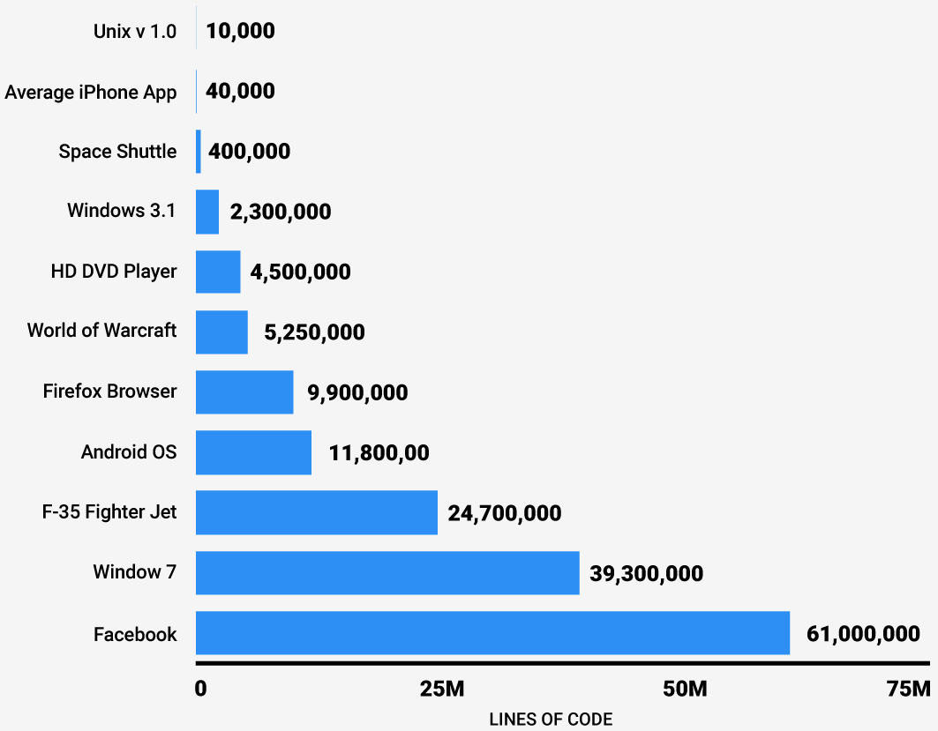
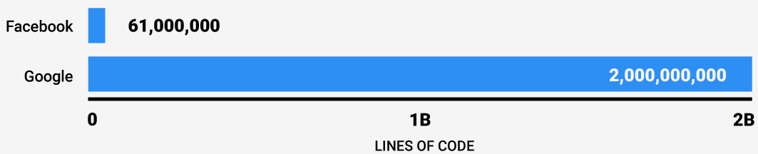
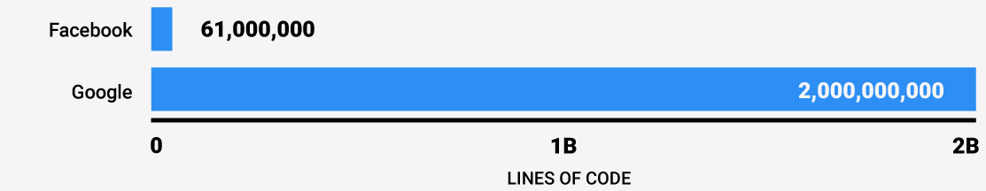
Why Software Engineering ?
Complexity
increases as
Size
increases!

Slide 9
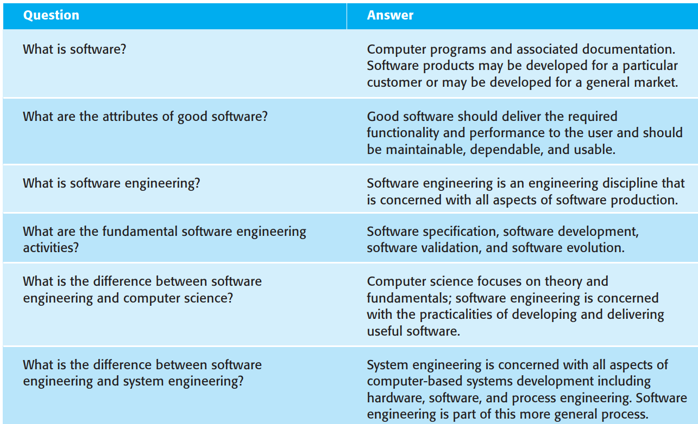

Slide 10
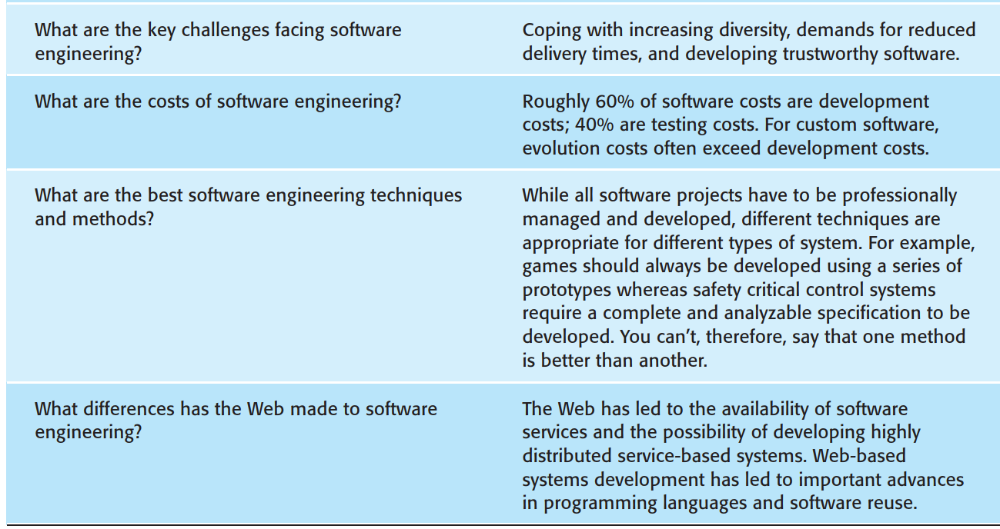

Slide 11
What is the difference between software engineering and computer science?
Computer Science
Software Engineering
is concerned with
theory
fundamentals
Algorithms, date structures, complexity theory, numerical methods
the practicalities of developing and
delivering useful software
SE deals with practical problems in
complex software products
Computer science theories are currently insufficient to act as a complete underpinning for software engineering, BUT it is a foundation for practical aspects of software engineering

Slide 12
Different than regular engineers?
Yes, normal engineers for buildings and bridges for example, have faced similar examples, risks, solutions.
But we are not so lucky
So what is the problem, really?
  Complexity
  Change

Slide 13
SE history
SE introduced first in 1968 – conference about “software crisis” when the introduction of third generation computer hardware led to more complex software systems than before
Early approaches based on informal methodologies led to
  Delays in software delivery
  Higher costs than initially estimated
  Unreliable, difficult to maintain software
Need for new methods and techniques to manage the production of complex software.

Slide 14
Professional Software Development
The vast majority of software development is a professional activity:
  Special team of developers.
  For specific business purpose.
  Formal and systematic (Process).
  Software will be maintained and changed throughout its life
Software Engineering supports professional SW development, not amateur development.
Two types of Software:
  Generic products: MS Office
  Customized Products: Ramallah Library System, Jawwal حسابي

Slide 15
Attributes of a Good Software
Good software:
  deliver the required functionality
  Acceptable performance to the user
  and should be maintainable,
  dependable,
  and usable
Therefore, a banking system must be secure,
An interactive game must be responsive,
a medical software system must be reliable, and so on

Slide 16
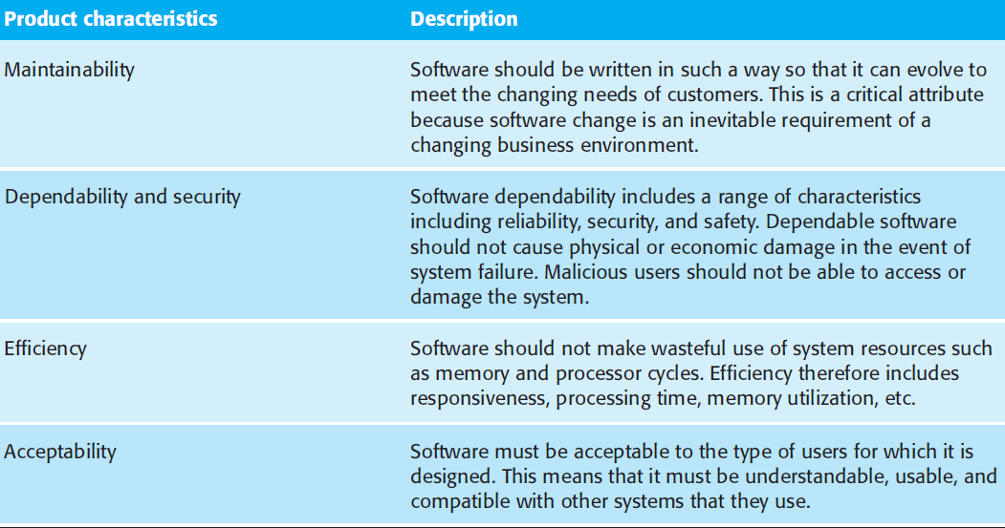
Attributes of a Good Software 2

Slide 17
Software myths (For Discussion)
Management myths
  Standards and procedures for building software exist
  Add more programmers if behind schedule
Customer myths
  A general description of objectives enough to start coding
  Requirements may change as software is flexible
Practitioner myths
  Task accomplished when the program works
  “Working program” the only project deliverable

Slide 18
Software failures
Therac-25 (1985-1987): six people overexposed during treatments for cancer
Taurus (1993): the planned automatic transaction settlement system for London Stock Exchange cancelled after five years of development
Ariane 5 (1996): rocket exploded soon after its launch due error conversion (16 floating point into 16-bit integer)
The Mars Climate Orbiter assumed to be lost by NASA officials (1999): different measurement systems (Imperial and metric)

Slide 19
More Software failures
Passport System delays cause backlog (1999, UK)
Ferry Company left thousands of lorries stranded for 12 hours (back up also failed, 1999, UK)
Inland Revenue (IR) ‘losing tax records’ (2000, UK)
=> IR spokesman said ‘All major IT initiatives have some kind of teething problems ....’
=> Guardian (20 July 2000) ‘At the centre of the crisis are two computer systems .... Files appear to have gone missing somewhere between the two’
General Motors Ford Cars (2016, USA + Worldwide): A “software bug” that may cause human safety, 4.5M cars recalled.

Slide 20
Even More Software failures
In 1995 annual US spending on software projects reached 250 billion dollars
This involved some 175,000 projects
Of this spend:
  Overspend cost 59 billion dollars
  Cancelled projects cost 81 billion dollars
  Causes of Software Failures?

Slide 21
Causes:
Cost of delayed error detection

Slide 22
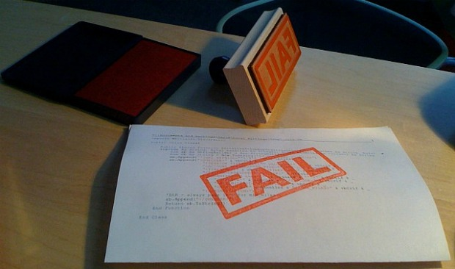
Why software projects fail?
Inaccurate understanding of customer needs
Inability to deal with changing requirements
Modules that do not fit together
Software that are hard to maintain/extend
Poor Quality
Testing….normally should cost 40%
Unacceptable performance
Technology change and team-member change over time in long period projects

Slide 23
So what is a successful software project?
Good software should:
  Deliver the required functionality
  Efficient: does not waste voluble resources, response time
  Usable
  Dependable: reliable, secure, and safe.
  Maintainable
  Within budget and time

Slide 24
Software Development Process
A systematic approach for software development.
It is a sequence of activities that leads to the production of software.
Requirements
Engineering
Design & development
Validation
Evolution

Slide 25
Software Development Process..2
Different types of systems need different development processes.
E-commerce and MIS systems → Incremental
While real time (critical) system for an aircraft must be completely specified in details before design & implementation

Slide 26
Different Types of Software → Different Types of Approaches
Different types of software:
  Stand-Alone: Office products
  Interactive transaction based: Ritaj
  Embedded systems: car software systems
  Entertainment: games
  Data collection: Mars rovers

Slide 27
Software Engineering fundamentals that Apply to all Types of Software
Clear
Development
Process
Performance
Clear Requirements
Dependability
Reusability

Slide 28
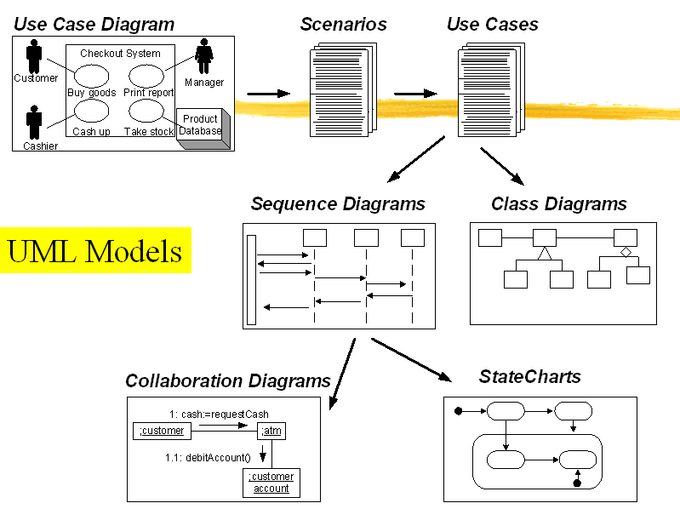

Slide 29
Requirements
Requirements specify a set of features that the system must have.
A functional requirement is a specification of a function that the system must support,
Nonfunctional requirement: is a constraint on the operation of the system that is not related directly to a function of the system.

Slide 30
Example
The user must be able to purchase tickets
The user must be able to access traffic information
The system must be provided feedback in less than one second
The colors used in the interface should be consistent with the company LOGO
System should be easy to use since users could be of different ages

Slide 31
Other nonfunctional requirements may include:
  using specific hardware platform for the system,
  security requirements,
  how the system should deal with failures and faults,
  and how to provide backward compatibility with an old system that the client is unwilling to retire.

Slide 32
Generic Technical Terms:
Notation: a graphical or textual set of rules for representing a model (UML)
Method: a repeatable technique that specifies the steps involved in solving a specific problem (Sorting Algorithm)
Methodology: a collection of methods for solving a specific set of problems.

Slide 33
What is CASE ?
(Computer-Aided Software Engineering)
Software systems which are intended to provide automated support for software process activities, such as requirements analysis, system modelling, debugging and testing
Upper-CASE
  Tools to support the early process activities of requirements and design
Lower-CASE
  Tools to support later activities such as programming, debugging and testing

Slide 34
What are the key challenges facing software engineering?
Software engineering in the 22st century faces three key challenges:
Legacy systems
  Old, valuable systems must be maintained and updated
Increasing Diversity and Heterogeneity
  Systems are distributed and include
  a mix of different hardware and software
Dependability and Delivery
  Having trustworthy software with faster
  delivery of software (time-to-market)

