Slide 1
Nutrition Care and Assessment
Textbook Understanding Normal and Clinical Nutrition chapter 17
NTP chapter 2

Slide 2
Malnutrition
Malnutrition is common among hospitalized patients
Malnutrition worsens patients outcome and lengthens stay in hospital. Patients must be screened to ensure optimal nutrition status
Medical nutrition therapy involves nutrition assessment and appropriate nutrition interventions reduces morbidity
Nutrition support improves health outcomes and lowers costs

Slide 3


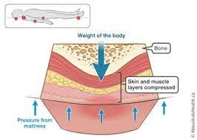
DOES ILLNESS AFFECT NUTRITION STATUS
Reduced food intake
No appetite, nausea, vomiting
Malabsorption of nutrients
GI discomfort
Altered nutrient metabolism and excretion
Pressure sores, muscle wasting, increased protein needs , metabolic stress
https://www.aboutkidshealth.ca/Article?contentid=772&language=English
Notes:
Pressure ulcers are injuries to the skin and underlying tissue, primarily caused by prolonged pressure on the skin. usually affects people confined to bed or who sit in a chair or wheelchair for long periods of time.

Slide 4
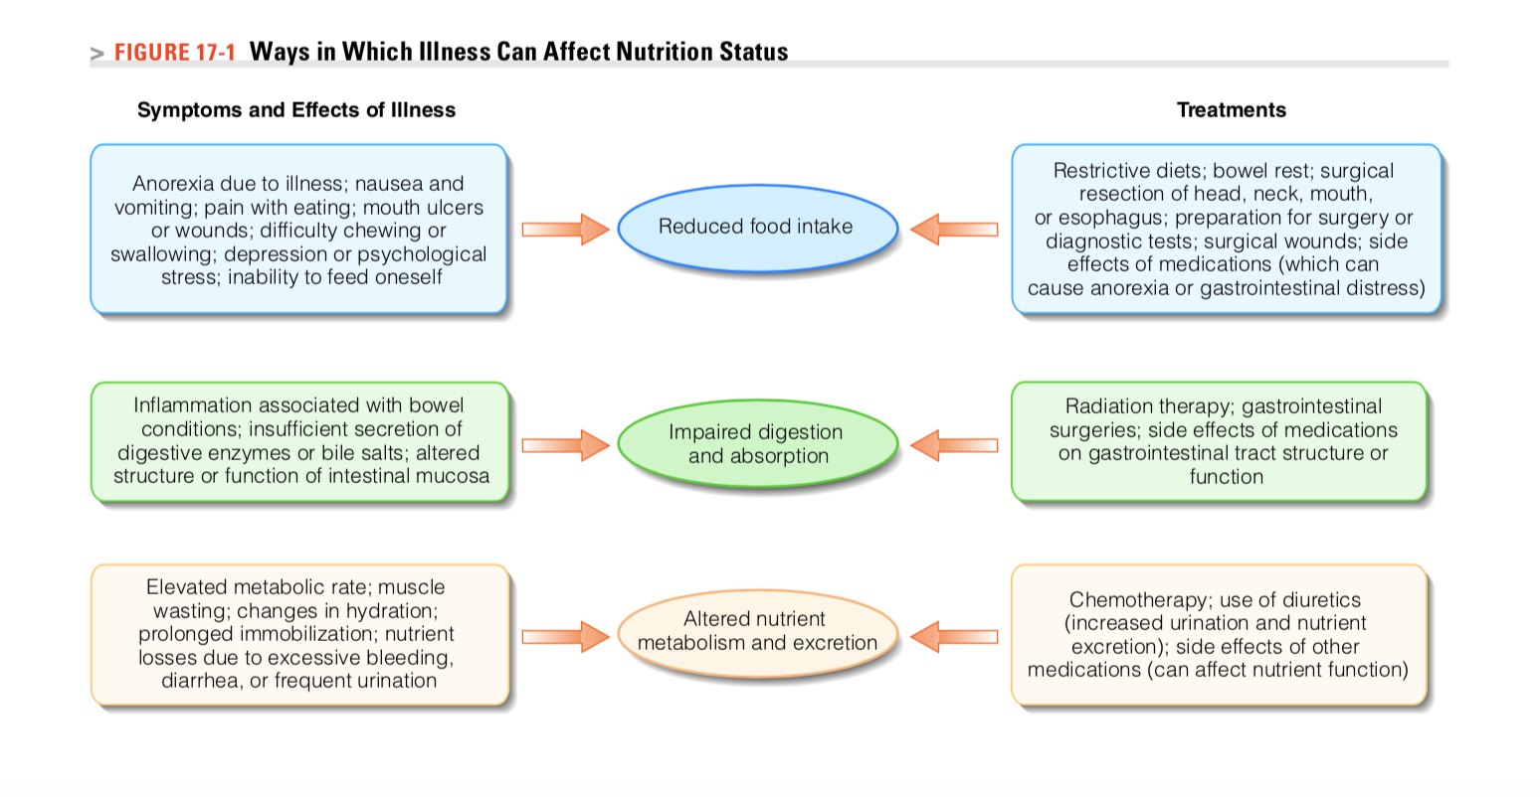

Slide 5
Acute illness requires short term/ temporary and can be tailored to accommodate an individual’s preferences and lifestyle.
In chronic illness: e.g. diabetes treatment requires lifelong changes in diet and lifestyle that some people may find difficult to adhere to
A registered dietitian is a food and nutrition expert who is qualified to provide medical nutrition therapy
Provides nutrition assessment
Nutrition diagnosis
Develops nutrition plan, and implement it
Follow up to evaluate the efficacy of the nutrition plan
Order diets and develop menus
Provide dietary counseling and nutrition education services
A Registered dietitian works closely with physicians and nurses

Slide 6
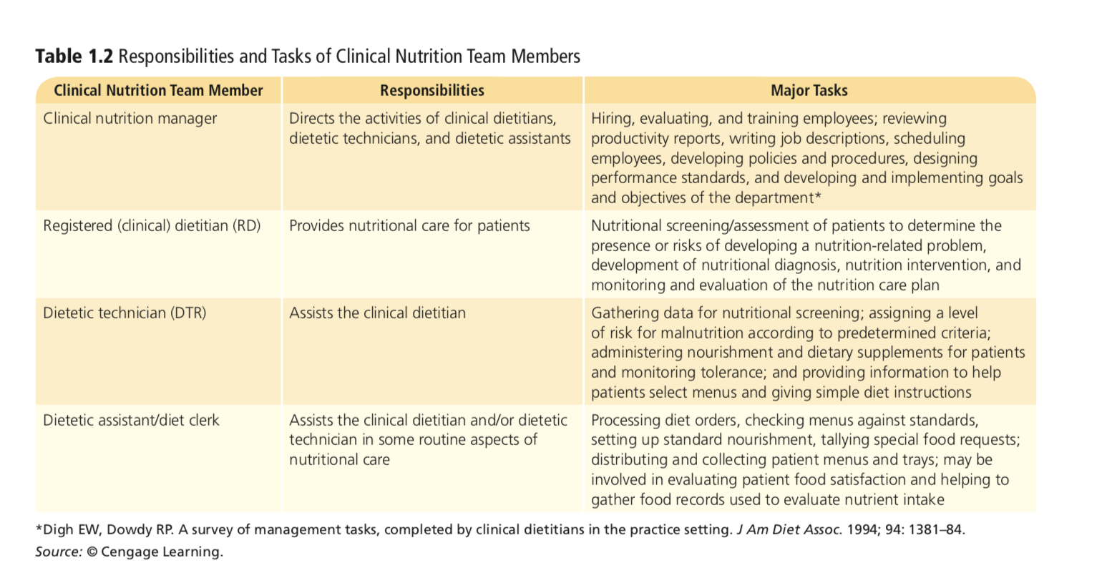

Slide 7
Nutrition screening
Nutrition screening is conducted within 24 hours of a patient’s admission to a hospital or other extended-care facility
Conducted to detect malnutrition
A nutrition screening involves collecting health-related data that can indicate the presence of protein-energy malnutrition (PEM) or other nutrition problems
The screening should be sensitive enough to identify patients who require nutrition care but simple enough to be completed within 10 to 15 minutes.

Slide 8
Nutrition screening
Nutrition screening includes the
Admitting diagnosis, of the patient
Physical measurements
Laboratory test results obtained during the admission process
relevant symptoms, and information about diet and health status provided by the patient or caregiver

Slide 9
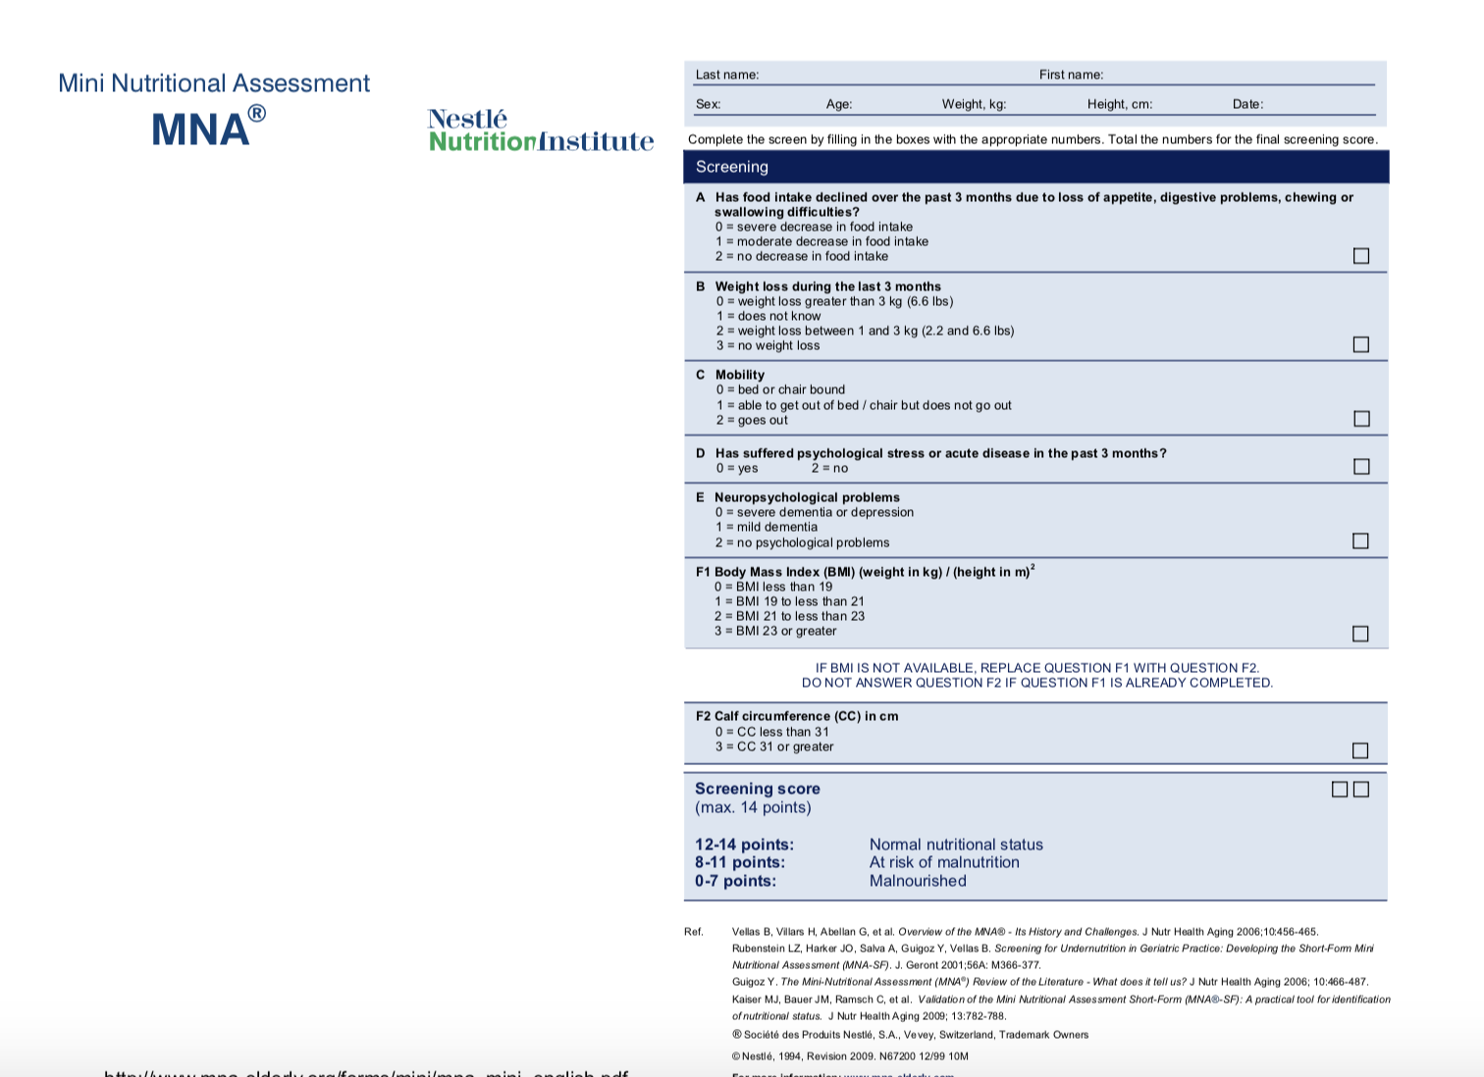
SCREENING TOOLS
The Mini Nutritional Assessment was developed to detect the risk of malnutrition in adults over 65 years of age

Slide 10
Examples
60 year old male living in Ramallah
172 cm
85 kg CHOL 235 mg/dl Fasting Blood glucose 170 mg/dl
Following a high protein diet Waist circumference 45 inches
Has health insurance
75 year old female
155 cm-
40 kg
weight loss of 5 kg in 4 months
All lab work within normal limits
BP 160/95
Medical prescription for diuretic and a beta blocker for Hypertension
Suffered from stroke; walks with assistance
Lives alone

Slide 11
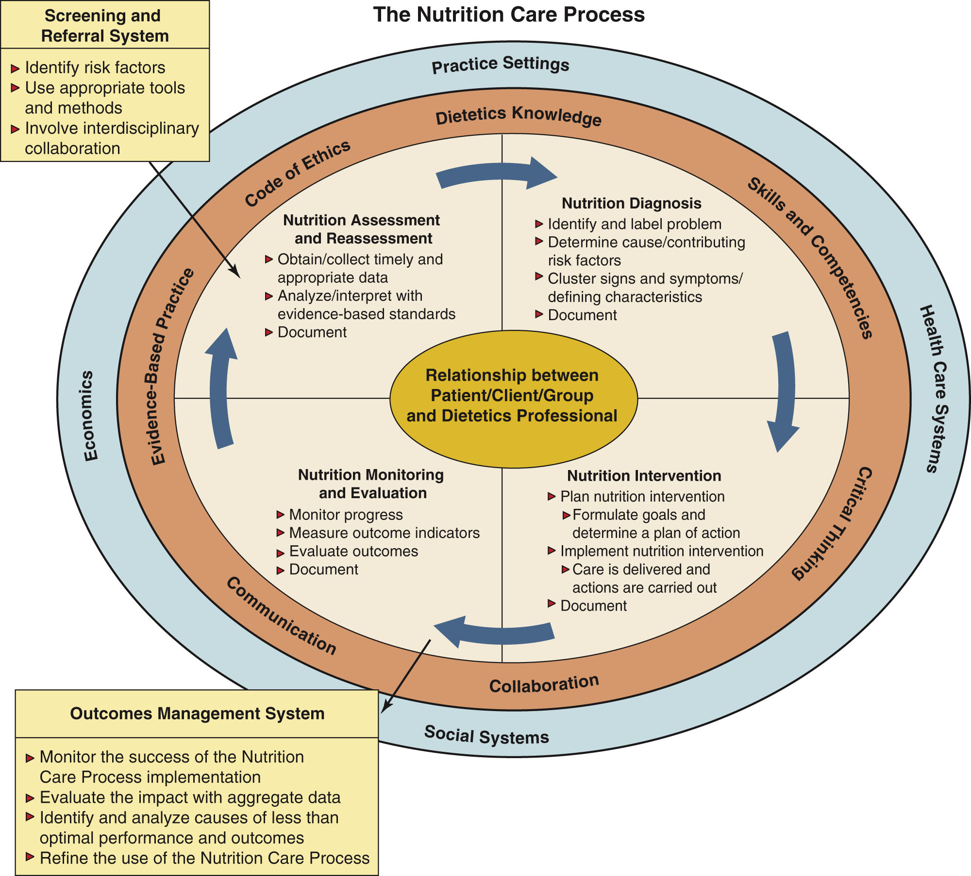
Nutrition care process

Slide 12
Nutrition care process
Central goal: Relationship between the client and the registered dietitian
What effect this relationship
The client’s previous experiences and readiness for change as well
Ability of the dietetics practitioner to establish trust,
Empathy
Demonstrate Effective communication
The central core focuses on individualized care and positive relationship

Slide 13
Outer layers effecting the nutrition care process
Environmental factors
Practice settings
Health care systems
Social systems,
Economics—
The environment can impact how much the client/ patient will receive and benefit from the interventions of nutrition care
As a dietitian, need to assess these factors and be able to evaluate the degree to which they may either be positive or negative influences on the outcomes of care.

Slide 14
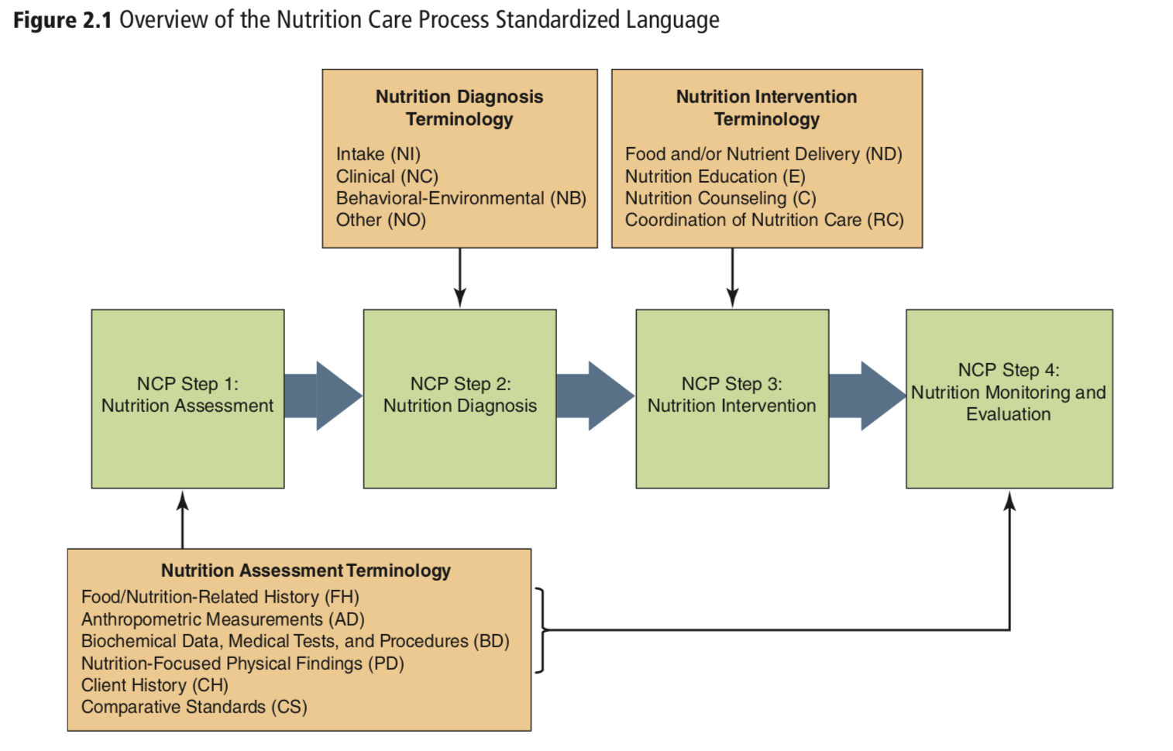
Notes:
Intake-related diagnoses are those related to the inadequate or excessive ingestion of nutrients, energy, fluid, alcohol, dietary supplements, and food ingredients
Clinical diagnoses are nutritional problems related to specific medical or physical conditions, such as impairments in physiological or mechanical functioning that cause feeding problems, alterations in nutrient metabolism, and body weight problems
Behavioral-environmental diagnoses include problems related to the patient’s knowledge, attitudes, beliefs, or behaviors; physical abilities; access to food; and food safety.

Slide 15
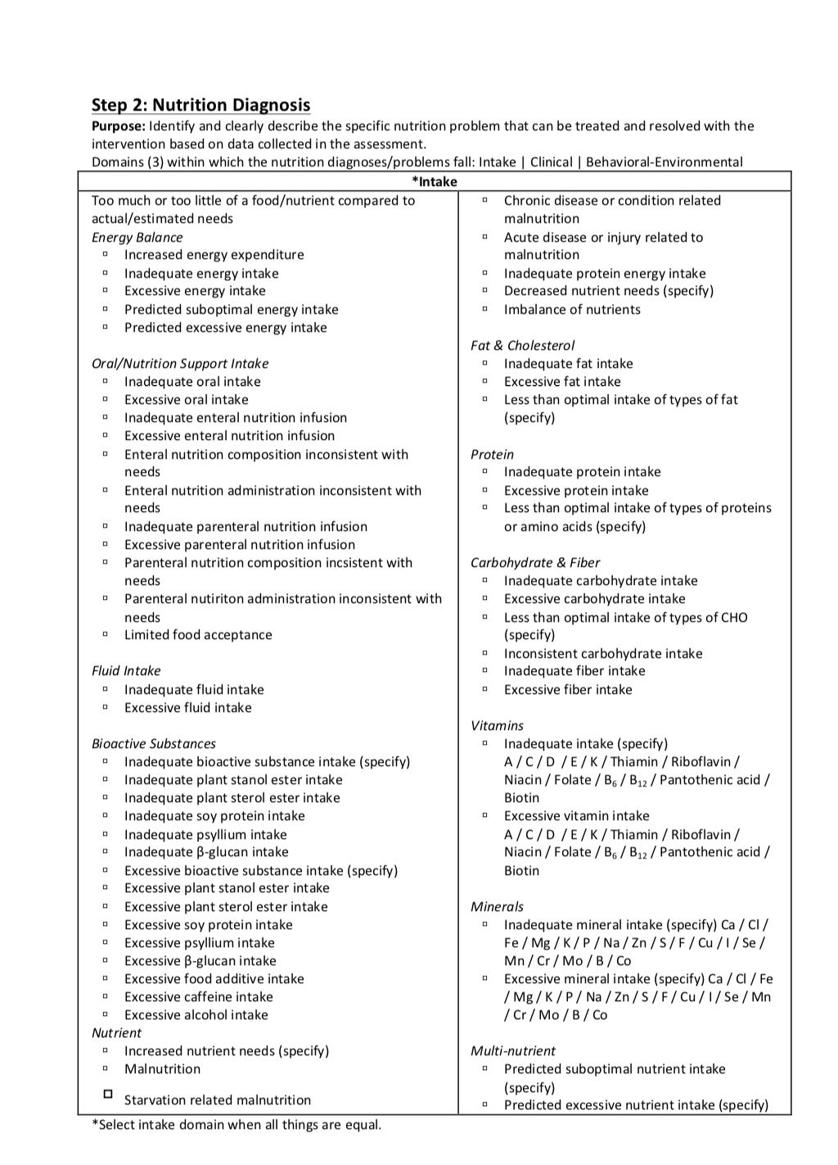

Slide 16
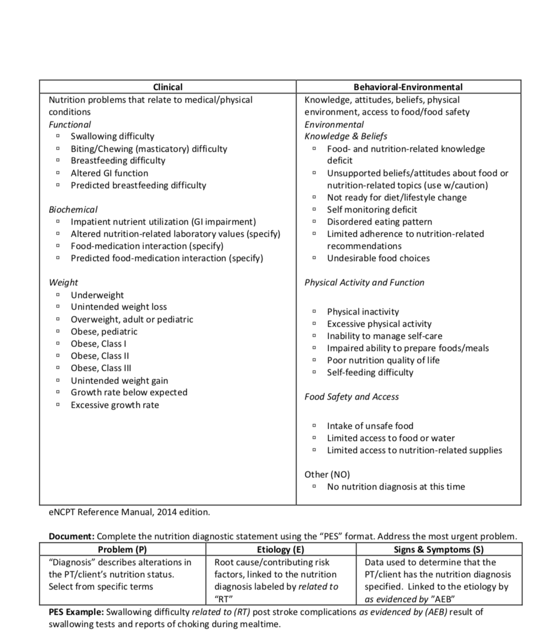

Slide 17
Step 1: Nutrition Assessment
Gathering information that will help you determine the patient’s health and nutrition status
Involves initial data collection AND continual reassessment and analysis of a client’s needs and condition.
This info will help you make the nutrition diagnosis
What are the nutritional problem present and what data do you have to support the severity of this problem
Accordingly what are the desired outcome and goals and how can you monitor the sustainability of these goals
E.g. if the nutrition problem is “undesirable food choices” what data do you have to support this claim?
Patient drinks 4 cups of Cola each day
What is the desired outcome/goals
Can you track progress

Slide 18
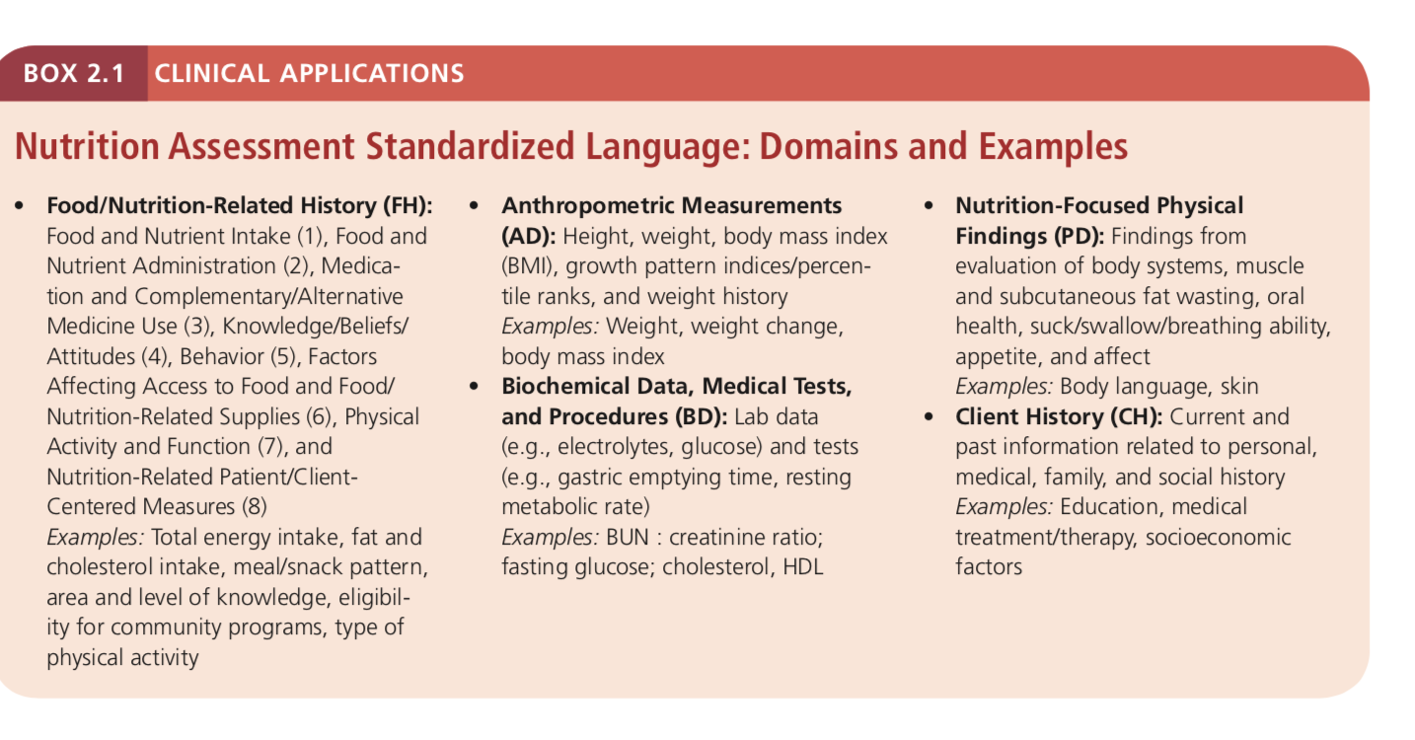
Nutrition Assessment What kind of data is gathered

Slide 19
Anthropometric- Determine if patient is underweight/overweight, had unintended weight loss or gain, or over- weight/obesity
Information gathered in an interview that reveals a person’s knowledge and beliefs about health and nutrition
Client history Historical information provides valuable clues about the patient’s nutrition status and nutrient requirements; it also reveals personal preferences that need consideration when developing a nutrition care plan

Slide 20
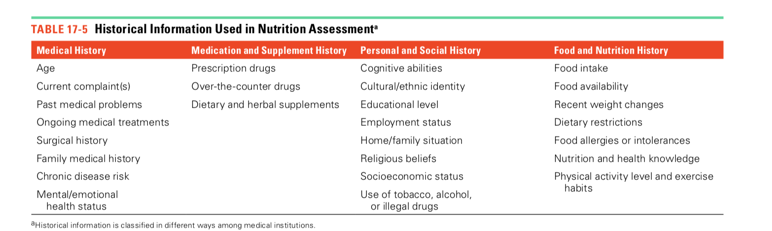
Client history Info

Slide 21
Client history
Medical History The medical history describes the patient’s current and ongoing medical issues to evaluate possible drug-nutrient interaction
family medical info can reveal genetic susceptibilities to disease
Medication and Supplement History
Personal and Social History: cultural and religious beliefs, economic factors, ability to cook one’s food, psychological factors, living situation. Use of alcohol, drugs , or tobacco
Food and Nutrition History: Diet history
Details about a person’s dietary practices
information about food intake, lifestyle habits
Physical activity and exercise patterns
Factors that affect food choices, such as food allergies or beliefs about nutrition and health
24-hour dietary recall
survey about usual food choices (food frequency questionnaire)

Slide 22
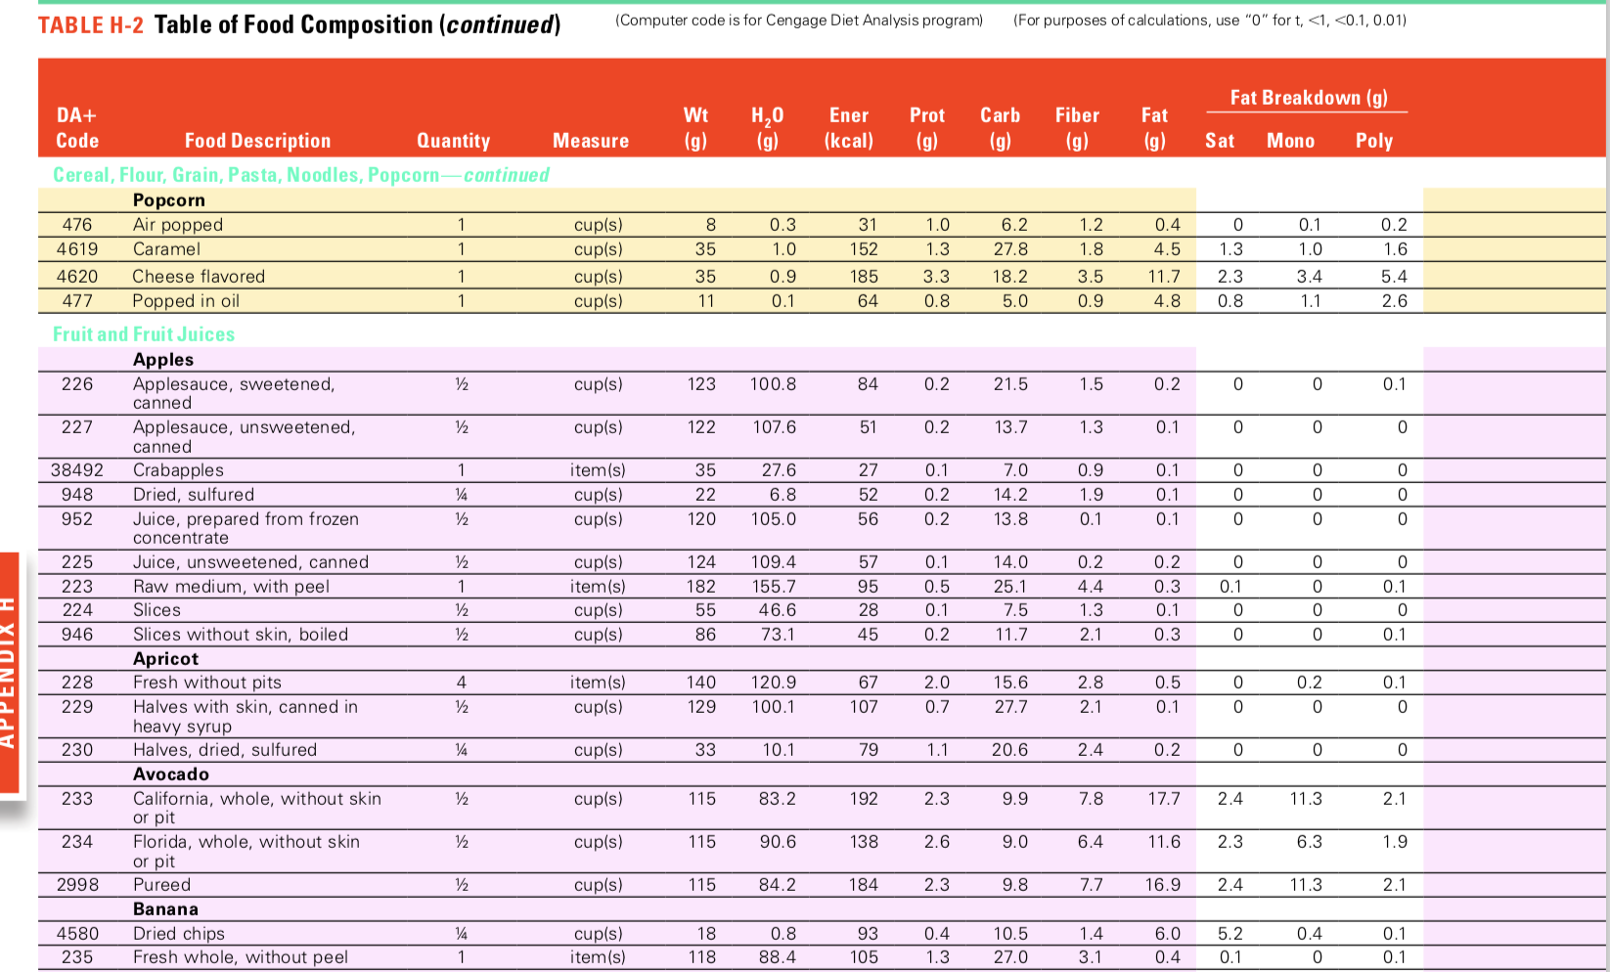
Food intake
Obtaining accurate food intake data is challenging ?
After food intake data are collected, nutrient intakes can be estimated using dietary analysis software or a table of food composition nutrient intake levels can be compared with RDA and AI values./ compare to dietary guidelines
Notes:
individual’s memory and honesty and the assessor’s skill and training

Slide 23
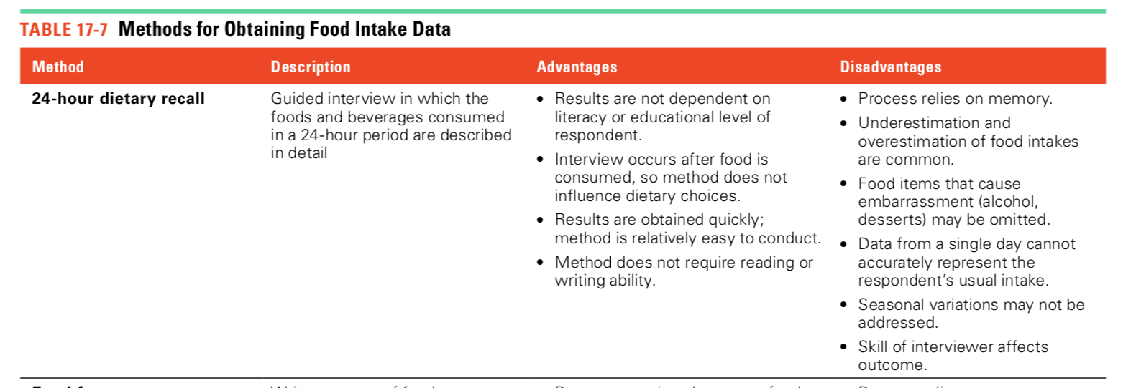
methods

Slide 24
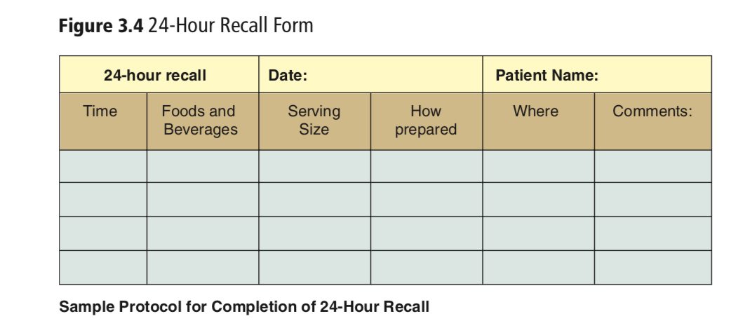
https://www.youtube.com/watch?v=j7yvNbm94XQ

Slide 25
methods
Disadvantages
Relies on memory
Includes common foods only
Serving sizes are often difficult for respondents to evaluate without assistance
Calculated nutrient intakes may not be accurate.
The instrument may not child-appropriate foods or quantities that are realistic for those eating larger amounts, such as athletes.
Food frequency Questionnaires
Foods are organized into groups, and the client identifies how often and in what quantities he or she consumes a specific food or food group
Can qualitative only: w/o portion sizes or
Semi semiquantitative ( including portion sizes)
Advantages:
Examines long-term food intake, so day-to-day and seasonal variability should not affect results.
Questionnaire is completed after food is consumed, so method does not influence food choices.
Method is inexpensive to administer.

Slide 26
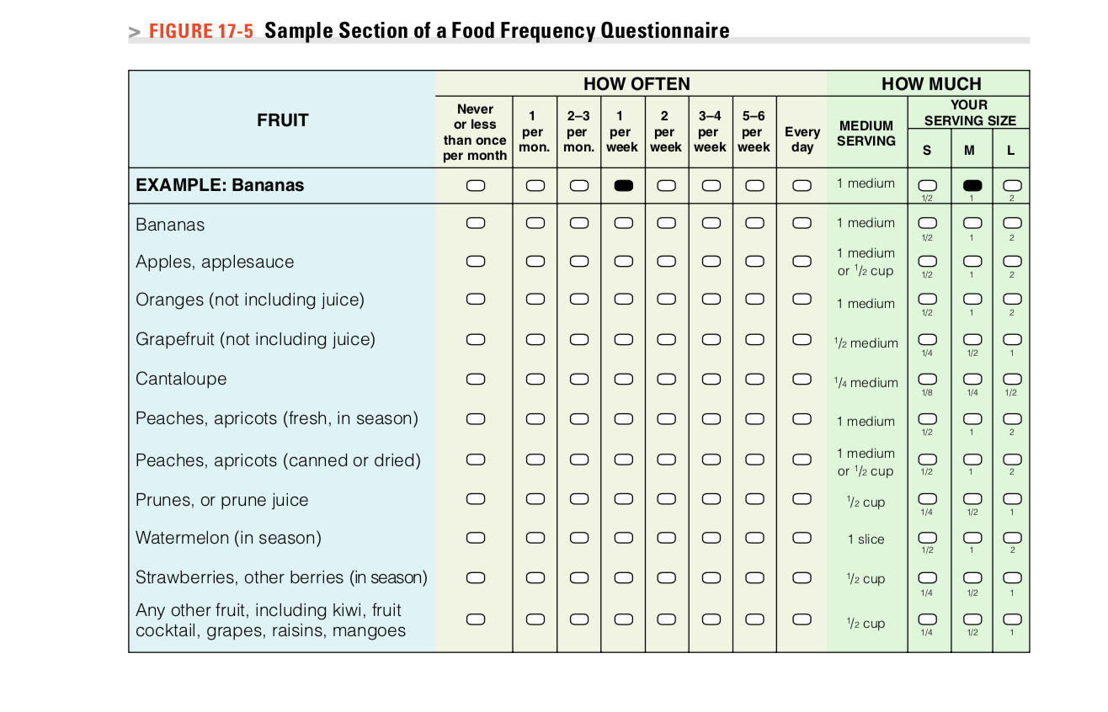

Slide 27
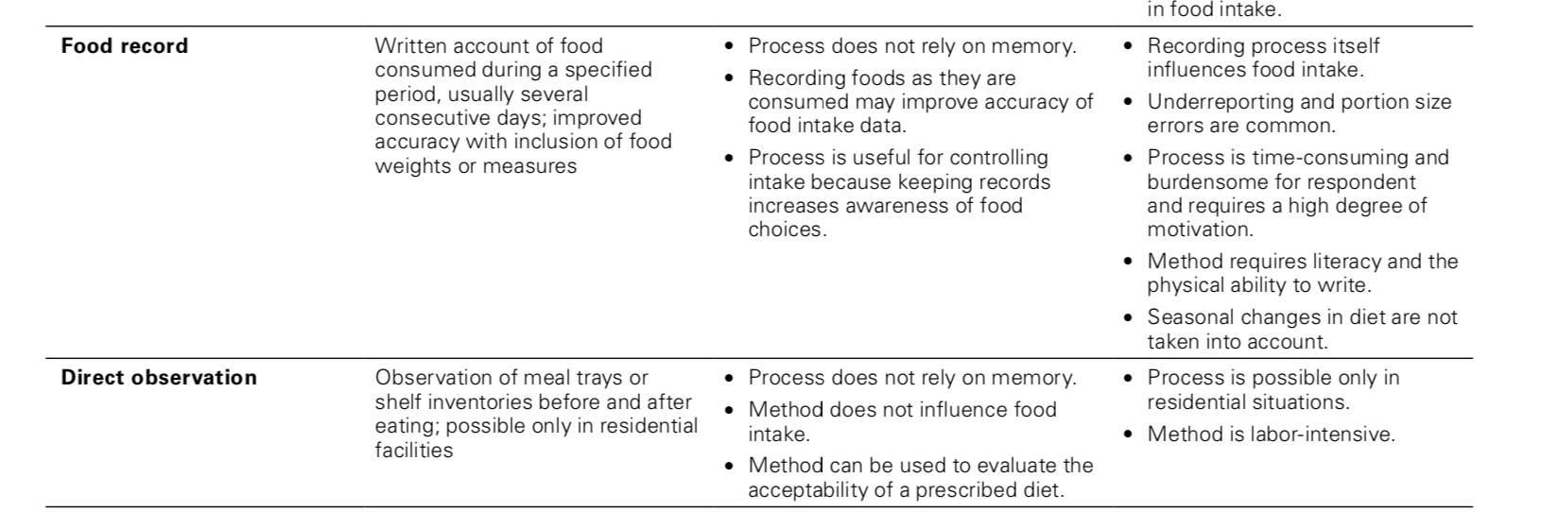
methods
Advantages
Disadvantages
Notes:
Direct observation: To perform a calorie count, the clinician records the dietary items that a patient is given at meals and subtracts the amounts remaining after meals are completed; this procedure allows an estimate of the caloric content of foods and beverages that are actually consumed.

Slide 28
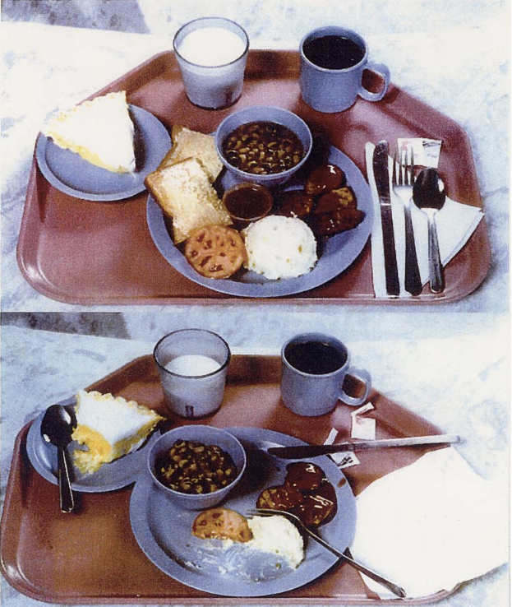

Slide 29
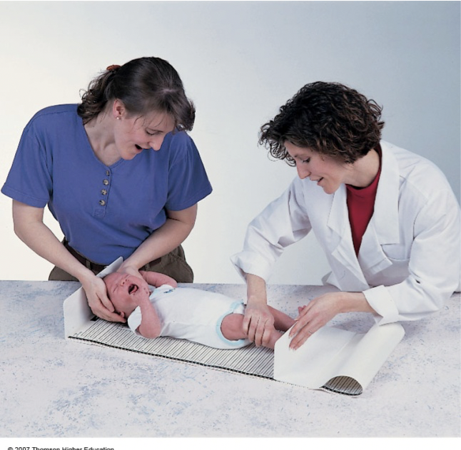
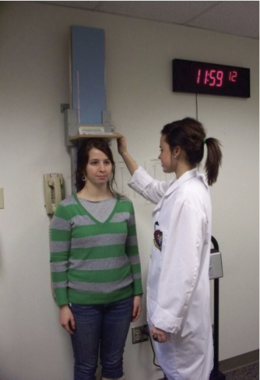
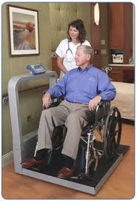
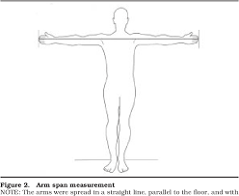
Anthropometric & Body Composition Measures
Measure of body size, weight and proportions
Height/Length
Poor growth in children can be a sign of malnutrition
Length is measured in infants and children younger than 24 months of age, and height is usually measured in older children and adults.
Adults who are bedridden or unable to stand, height can be estimated from equations that include either the knee height or the full arm span
Arm span
Wheelchair and bed scales are sometimes used for nonambulatory patients

Slide 30
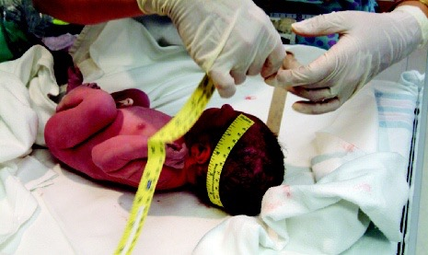
Assessment in Infants and Children
Head Circumference
A head circumference measurement helps to assess brain growth and malnutrition in children up to 3 years of age
Weight and height for infants and children are evaluated using growth charts (allows comparison of an infant or child to a reference population)
Height for age
Weight for age
Weight for height (independent of age and can be used to evaluate acute malnutrition or obesity)
Growth charts also include BMI ( Used for children above 2 years of age and adolescents)
Circumferences of Waist and Limbs
Notes:
Although individual growth patterns vary, a child’s growth will generally stay at about the same percentile throughout childhood; a sharp drop in a previously steady growth pattern suggests malnutrition
Growth patterns that fall be- low the 5th percentile may also be cause for concern
In BMI growth charts the 5th and 85th percentiles are used as cutoffs to identify children who may be malnourished or overweight,

Slide 31
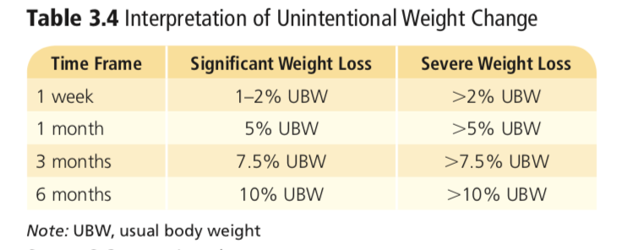
Anthropometric Assessment in Adults
To evaluate the nutritional risks associated with illness, clinicians monitor both the total reduction in weight and the rate of weight loss over time.
an unintended weight loss of more than 2 percent within one week or more than 5 percent within 1 month suggests the development of malnutrition.

Slide 32
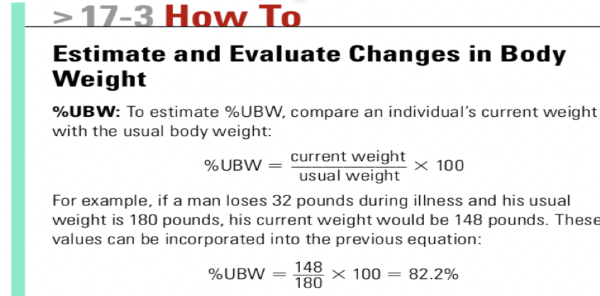
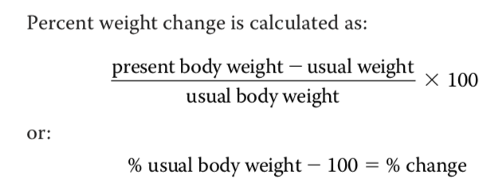
Weight data are often expressed as a percentage of usual body weight (%UBW)
Usual Body Weight
% Weight Change
Notes:
% weight change= 17.7%

Slide 33
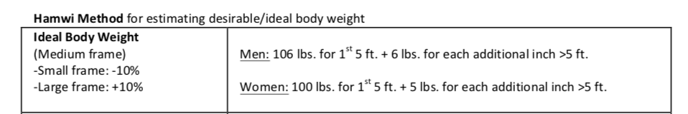
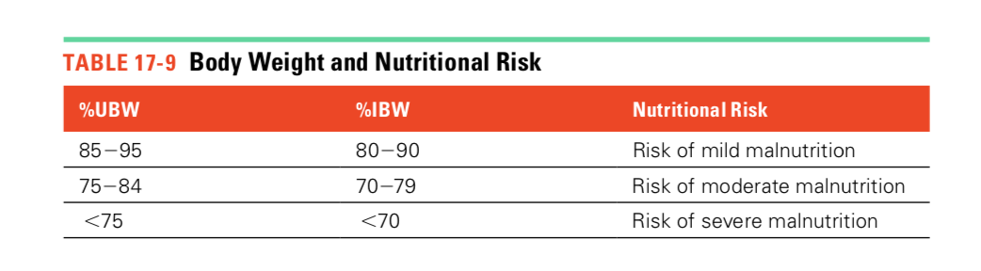
Anthropometric Assessment in Adults
Ideal body weight( IBW) Is also used to evaluate nutrition risk and a way to monitor weight change
To estimate %IBW, compare an individual’s current weight with a reasonable (ideal) weight from a BMI table or other appropriate reference OR using the Hamwi equation

Slide 34
LIMITATIONS
Weight changes must be evaluated carefully
unintentional weight loss can indicate malnutrition, weight gain may result from fluid retention rather than recovery of muscle tissue or over- nutrition.
Fluid retention often accompanies worsening disease in patients
can mask the weight loss associated with PEM.
%UBW is better in evaluating weight changes in obese, overweight and underweight patients

Slide 35
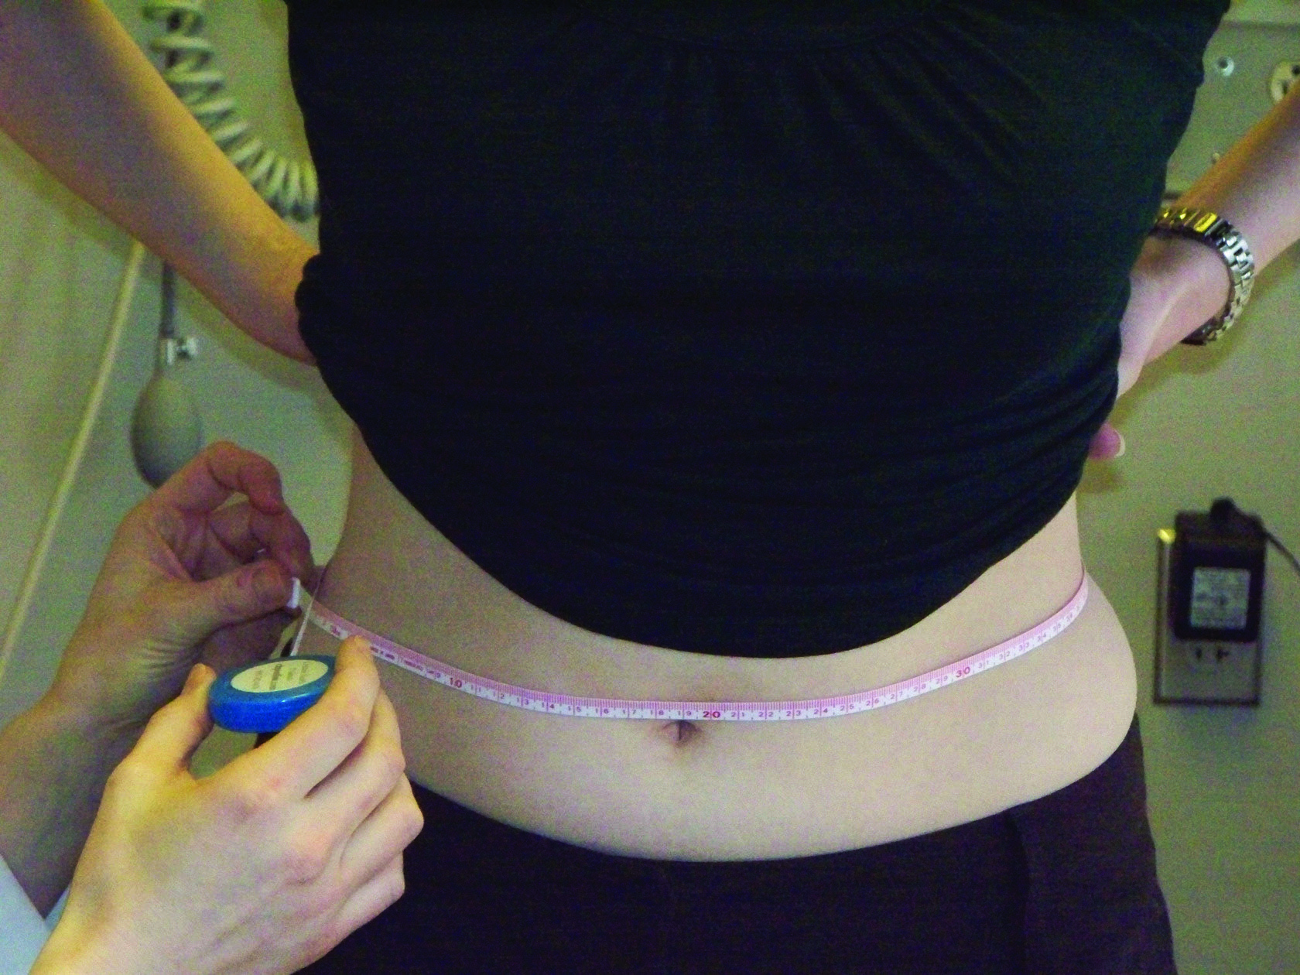
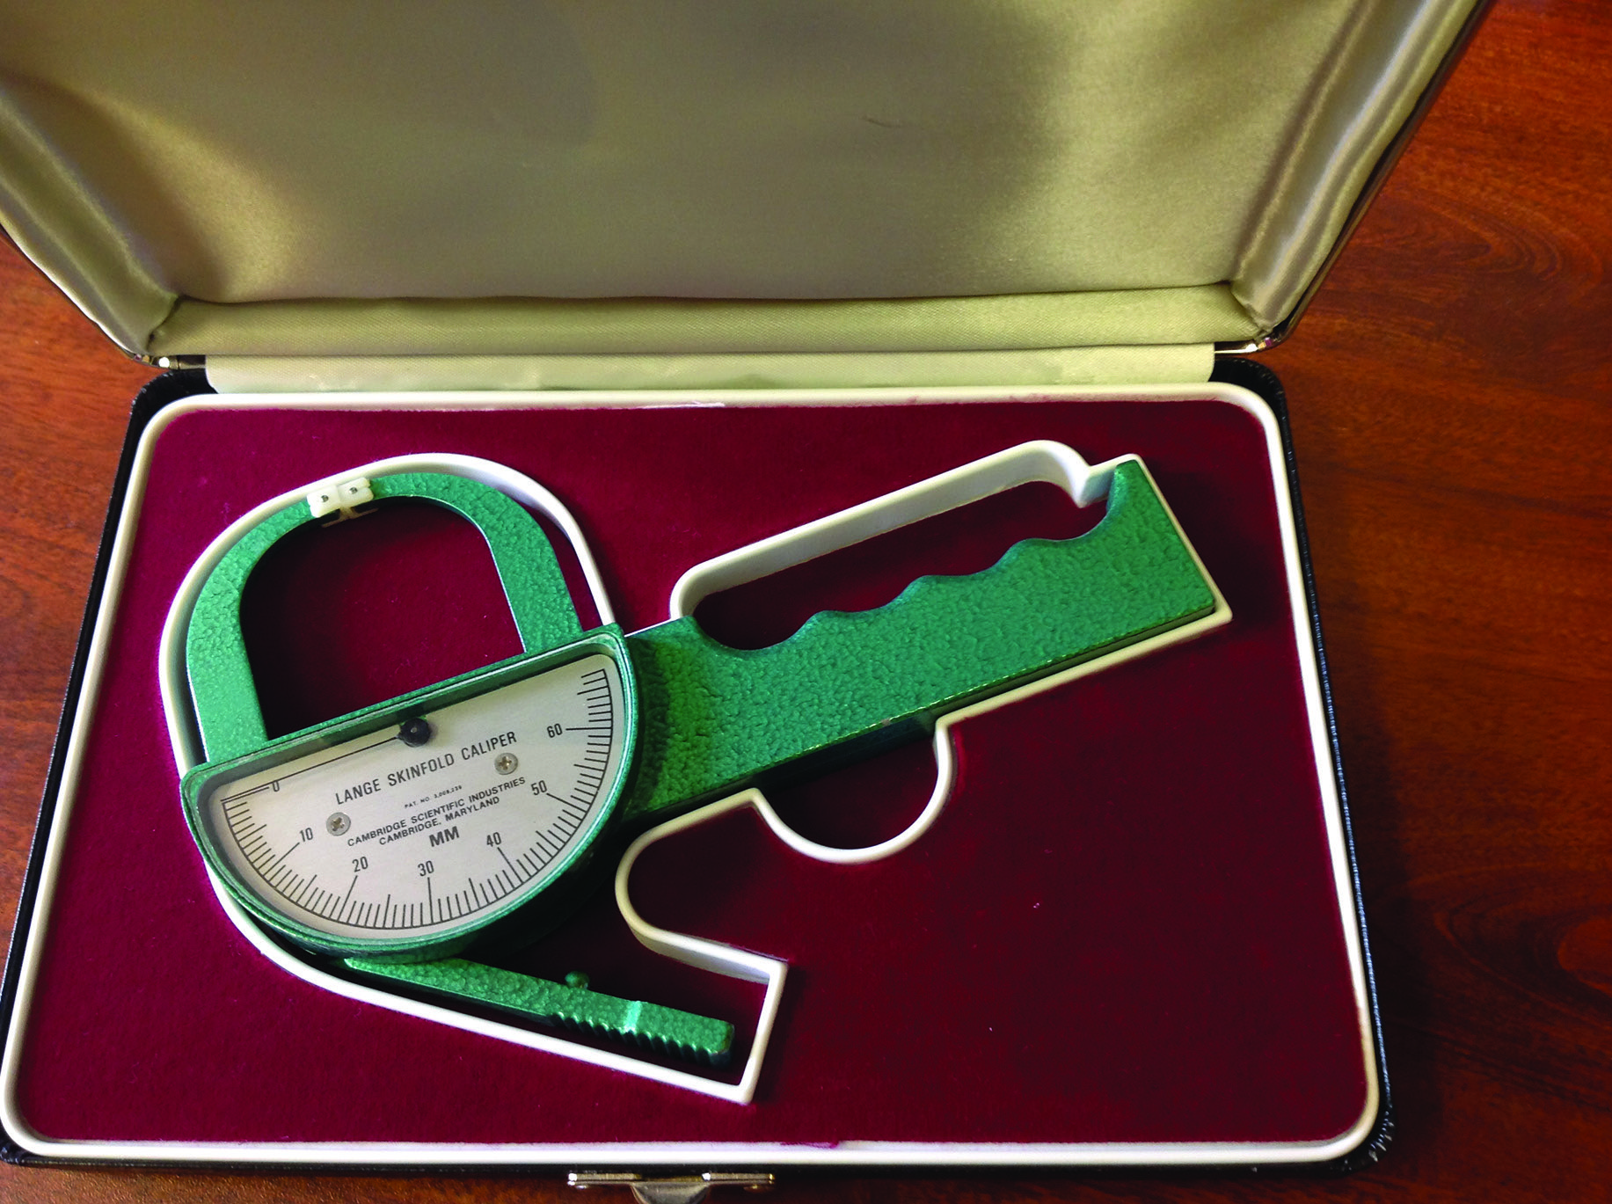
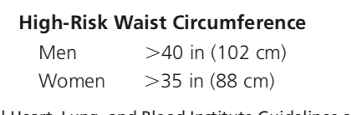
Anthropometric Assessment in Adults
Clinicians may include skinfold and limb circumference measurements in a nutrition assessment to help them identify changes in body composition
Waist circumference

Slide 36
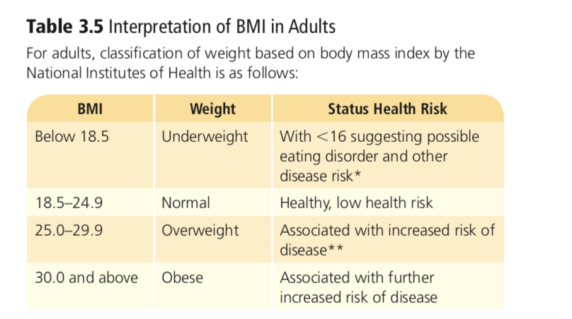

Slide 37
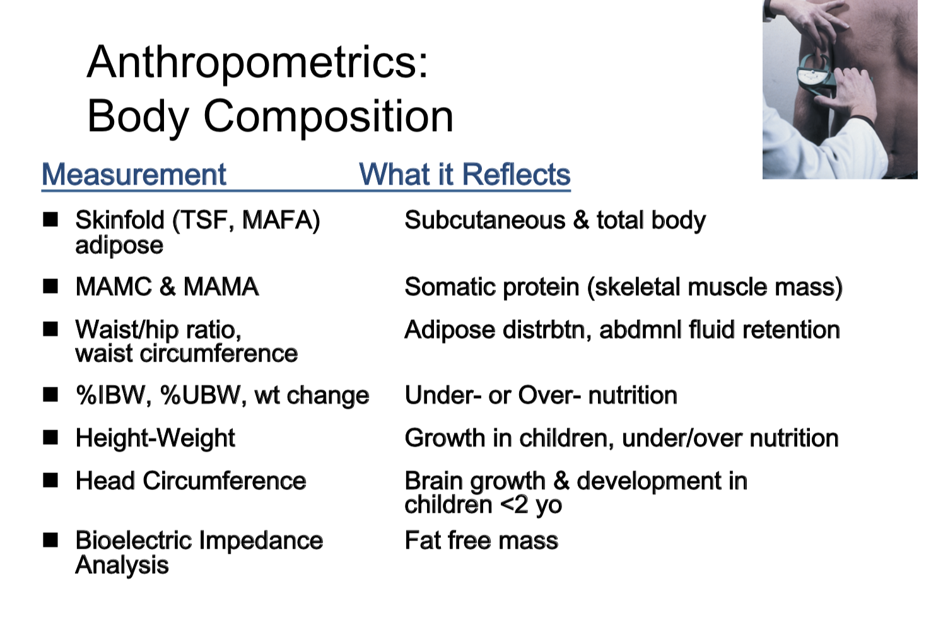
Anthropometric SUMMARY

Slide 38
Biochemical
Analyses of blood and urine samples, which contain proteins, nutrients, and metabolites
Interpreting laboratory values can be challenging and not always very accurate of the patients nutritional status
For example: Fluid imbalances may alter values: fluid retention dilutes sub- stances and therefore lowers lab values, whereas dehydration can cause an increase in lab values
Certain biomarkers like serum proteins may be elevated if the patients is suffering from inflammation, infection or if patient is pregnant
Together with other assessment data, laboratory test results help provide a clearer assessment of the patient

Slide 39
Biochemical Visceral (non-skeletal) proteins
Serum protein levels can aid in the assessment of protein-energy status
Acute-phase proteins are defined as “those whose plasma concentration increases (positive acute-phase proteins) or decreases (negative acute-phase proteins) by at least 25%” during inflammation, illness, and/or metabolic stress
Albumin: most abundant serum protein ( has a slow rate of degradation do In people with chronic PEM, albumin levels remain normal for a long period despite significant protein depletion and increases slowly as patient is recovering from malnutrition) – NOT A SENITIVE TEST FOR MALNUTRITION
Transferrin: Transferrin is an iron-transport protein, and its blood concentrations respond to iron status, PEM, and various illnesses (Transferrin levels INCREASE as iron status worsens and DECREASES as iron status improves)
Notes:
serum proteins are synthesized in the liver, blood levels of these proteins can reflect liver function. Metabolic stress alters serum proteins because the liver responds by increasing its synthesis of some proteins and reducing the synthesis of others.

Slide 40
Biochemical
Serum Proteins
Transthyretin and Retinol-Binding Protein: decrease rapidly during PEM Respond quickly to improved protein intakes.
More sensitive tests ( short term change in protein status)
C-Reactive Protein(CRP): Rise rapidly in response to inflammation or infection
with critical illness, heart disease, and certain cancers. Sometimes used as a biomarker for malnutrition
Higher CRP levels are associated with increased nutritional risk during stress, illness, and trauma.

Slide 41
Somatic protein – skeletal muscle
Creatinine: Creatine is the by product of creatinine phosphate which is stored in muscle
Creatinine is not stored in muscle but is cleared and excreted by the kidney. Daily urine output of creatinine can be correlated with total muscle mass.
Nitrogen Balance
Measuring nitrogen balance assesses overall protein status
nitrogen excretion = nitrogen intake (Healthy individual)
Notes:
In order to measure nitrogen balance, the dietary intake of protein for a 24-hour period is estimated while a 24-hour urine collection is gathered to measure total excretion of nitrogen.

Slide 42
Biochemical Assessment ~ Hematological
Biochemical Assessment ~ Hematological
Hematologic Assessment
Hemoglobin (Hgb)
Hematocrit (Hct)
Mean Corpuscular Volume (MCV)
Mean Corpuscular Hemoglobin (MCH)
Mean Corpuscular Hemoglobin Concentra*on (MCHC)
Ferritin
Transferrin Saturation
Serum Folate
Serum B12
White blood cell (WBC) count

Slide 43
Biochemical tests
Vitamin/Mineral Assessment – Not routinely done
Other labs of significance –
Lipid status
Electrolytes
Serum Glucose
Enzymes

Slide 44
Physical Examination
Physical signs of malnutrition
Signs of malnutrition tend to appear most often in parts of the body where cell replacement occurs at a rapid rate, such as the hair, skin, and digestive tract (including the mouth and tongue)

Slide 45
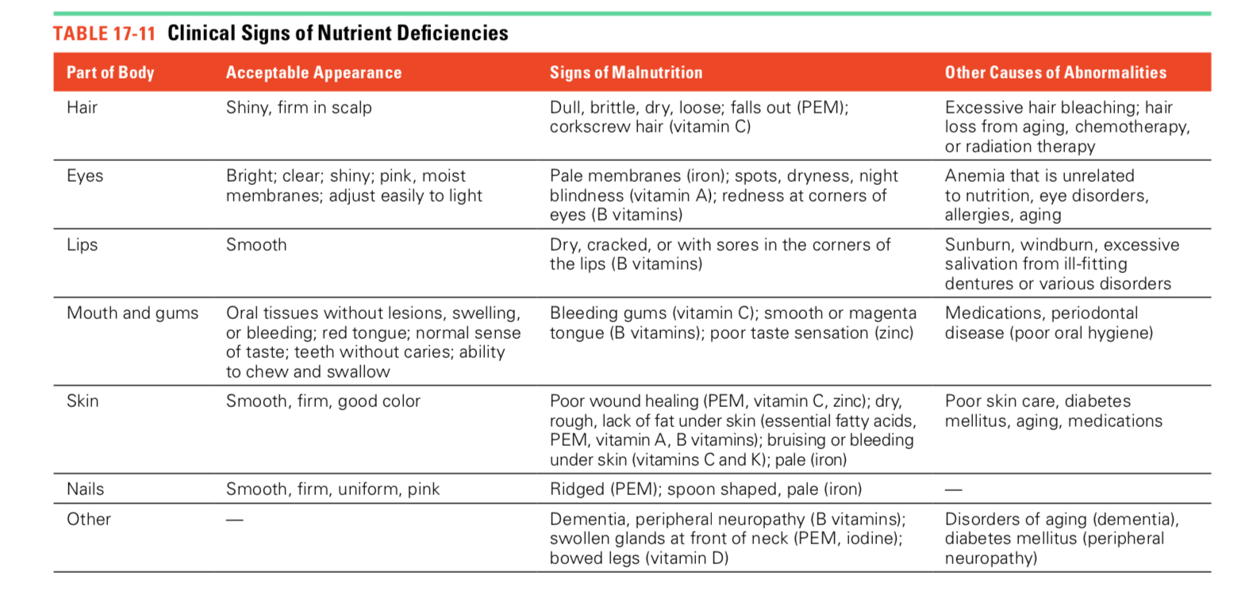

Slide 46
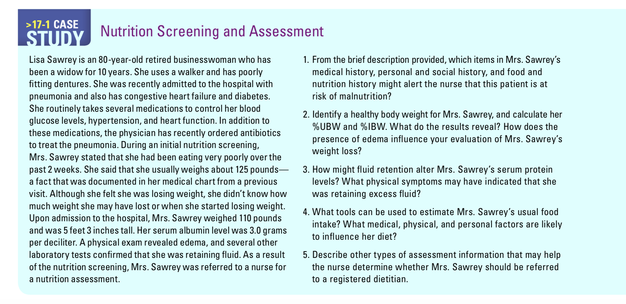

Slide 47
Patient history ( medical and family)
Diet history
CW
UBW
Ht
BMI
Meds
Physical
Labs
Calculate % IBW and %UBW and % % Weight Change and classify
According to the BMI chart in your book, the IBW for Lisa is 124 pounds

