Slide 1
Exp #4
SQLite Database
SLIDES BY: Tarek Zidan and Mohamad Balawi

Slide 2
Note
Before proceeding with this experiment, please ensure that you have the code prepared for experiment 2 as this experiment builds upon it.
Our goal
To store customer records in SQLite Database instead of using ArrayList.

Slide 3
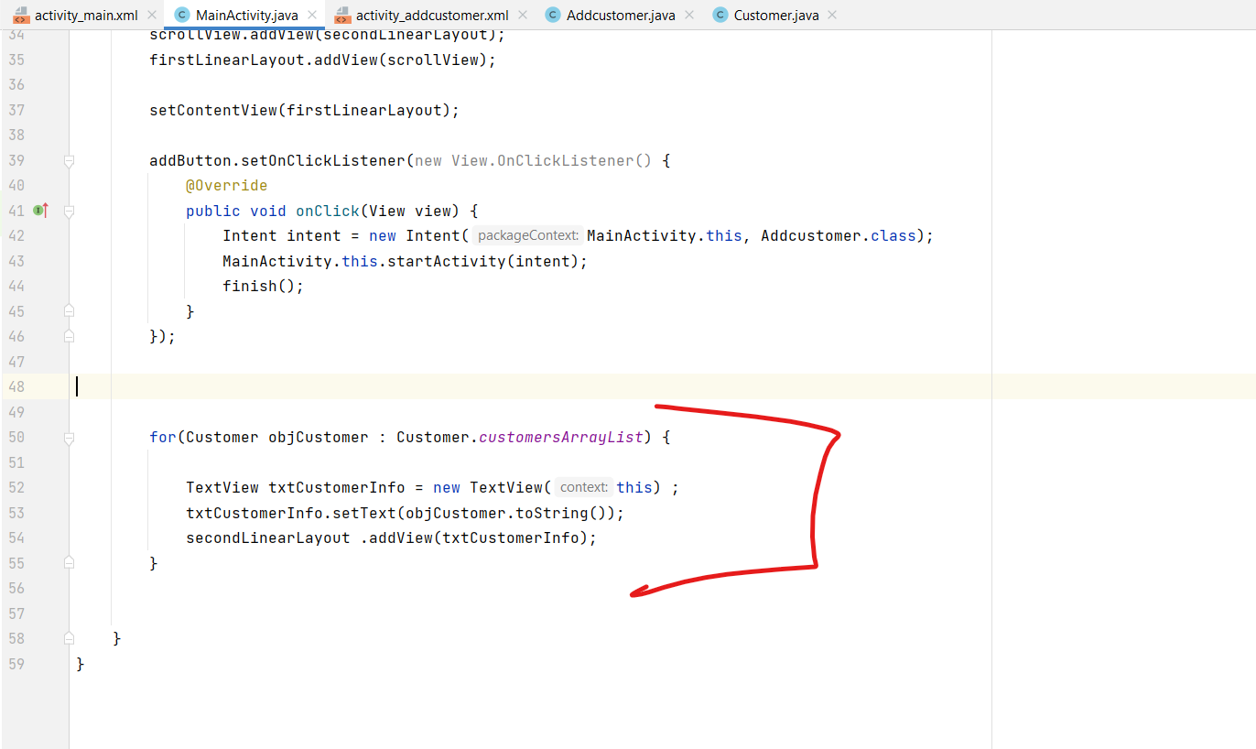
Things that we don’t need from exp2: MainActivity

Slide 4
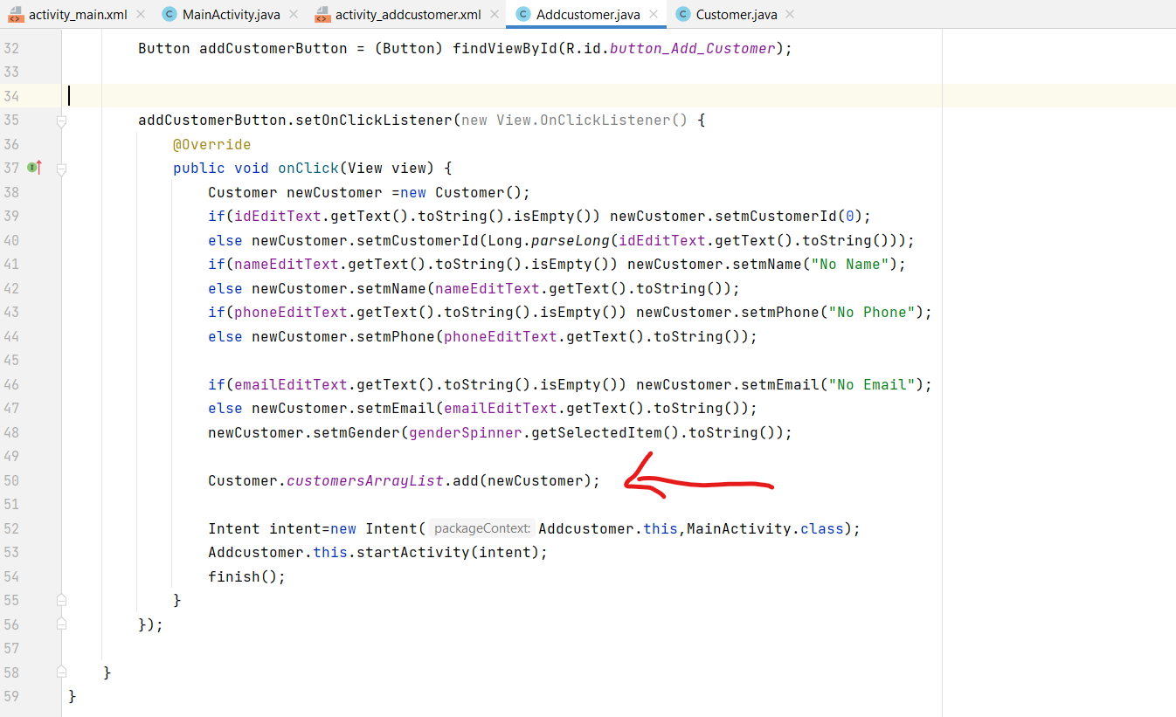
Things that we don’t need from exp2: AddCustomerActivity

Slide 5
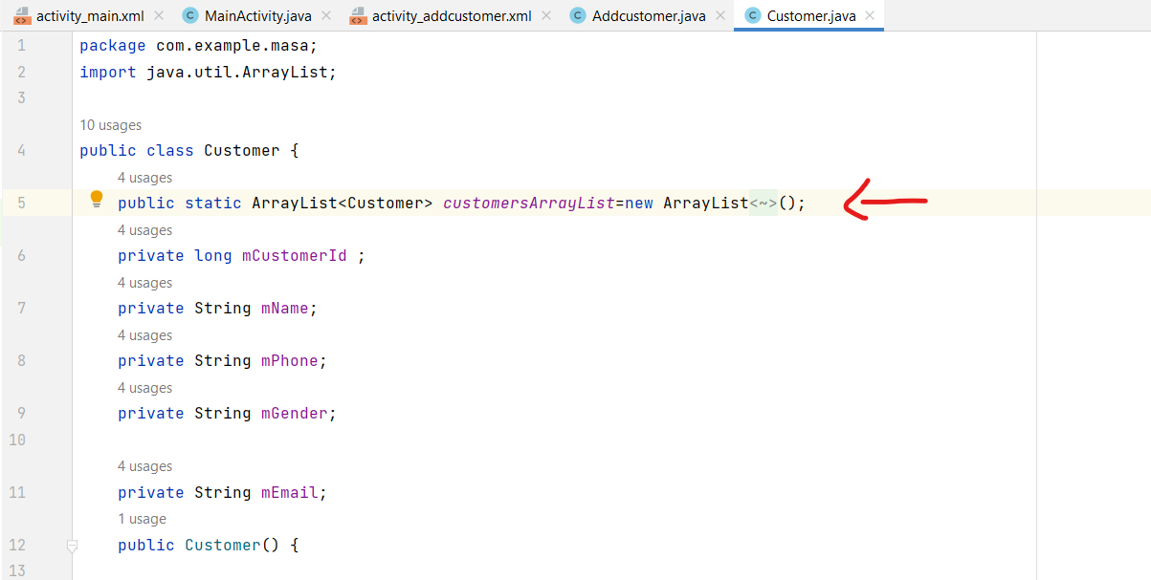
Things that we don’t need from exp2: Customer

Slide 6
Why do we need a Database?
Why can’t we just use an ArrayList to store customers, like we did in Experiment 2?
Permanent storage.
Complex queries.
Universal language (SQL).

Slide 7
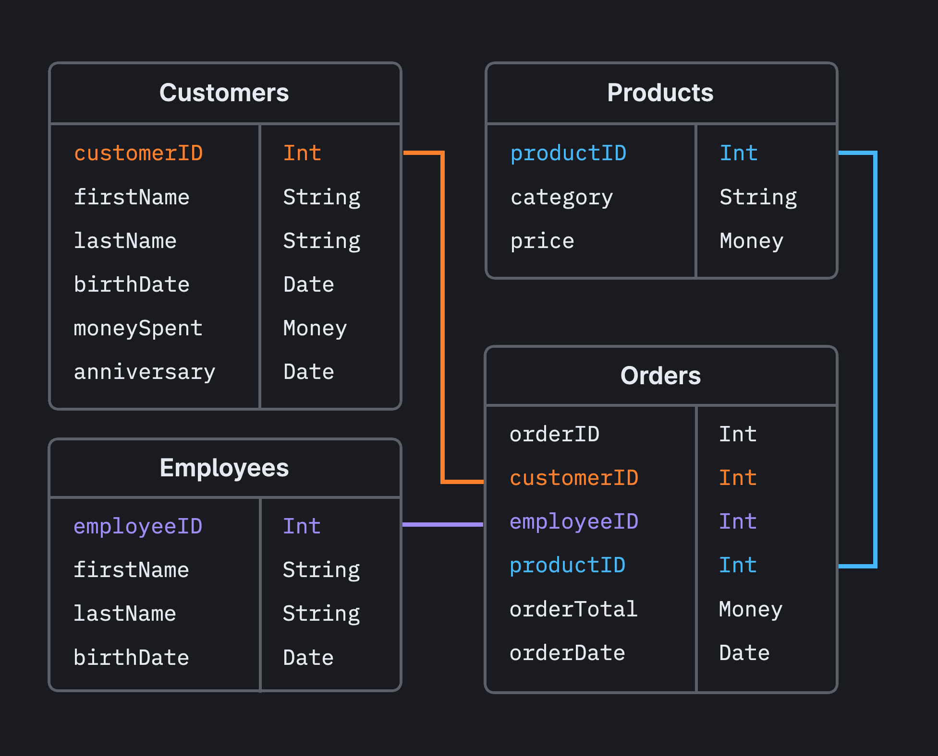
Schema
A formal declaration of how the database is organized, including tables, fields, relationships, and constraints. It serves as a blueprint for organizing and representing data in a database system.

Slide 8
SQL helper
Once you have defined how your database looks, you should implement methods that
1- create
2- maintain the database and tables
Android stores your database in your app's private folder. Your data is secure, because by default this area is not accessible to other apps or the user

Slide 9
How to access the Database: SQLiteOpenHelper class
The SQLiteOpenHelper class contains a useful set of APIs for managing your database. When you use this class to obtain references to your database, the system performs the potentially long-running operations of creating and updating the database only when needed and not during app startup.
All you need to do is call
1- getWritableDatabase(): Write on a database
2- getReadableDatabase(): Read from a database

Slide 10
Write on a database: ‘insert()’
1- pass a ‘ContentValues object’ to the insert().
2- The first argument for insert() is simply the table name.
3- The second argument tells the framework what to do if the ContentValues is empty.
The insert() method returns the ID for the newly created row, or it will return -1 if failed.

Slide 11
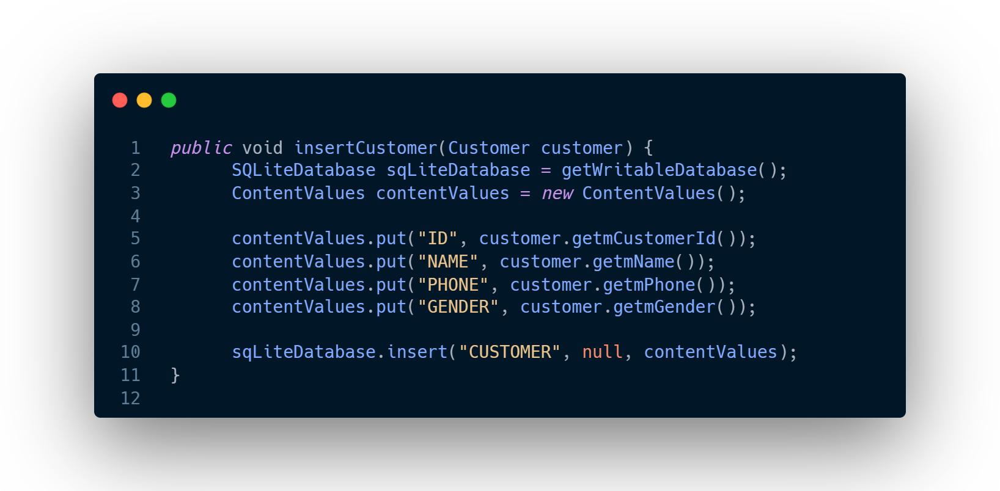
Inserting into SQLite table

Slide 12
Read from a database: ‘query()’
To read from a database use the query() method, passing it your selection criteria and desired columns. The method combines elements of insert() and update(), except the column list defines the data you want to fetch (the "projection"), rather than the data to insert.
The results of the query are returned to you in a Cursor object.

Slide 13
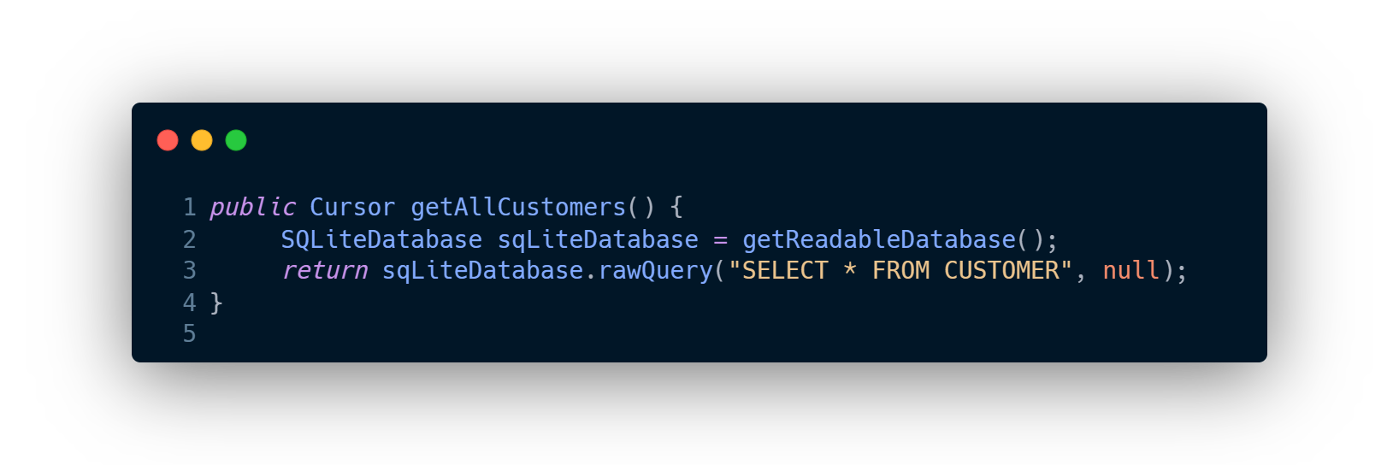
Querying SQLite
Notice how it returns a Cursor object and not a list of customers.

Slide 14
Cursor object
The cursor object points to the table returned by the query, it has the ability to move between the different rows of the table and get values for the different columns in the current row.
ID | Name | Phone | Gender
1 | Amal | 05962335 | Female
2 | Basel | 05687673 | Male
3 | Hani | 05689726 | Male
4 | Sara | 05785231 | Female

Slide 15
Query example
SQLiteDatabase sqLiteDatabase = getReadableDatabase();
Cursor cursor = sqLiteDatabase.rawQuery("SELECT * FROM CUSTOMER", null);
1
0
ID | Name | Phone | Gender
1 | Amal | 05962335 | Female
2 | Basel | 05687673 | Male
3 | Hani | 05689726 | Male
4 | Sara | 05785231 | Female
2
3
cursor.getInt(0)
“Basel”
cursor.moveToPosition(1)
cursor.moveToNext()
cursor.move(1)
cursor.moveToLast()
cursor.moveToFirst()
cursor.getString(1)
cursor.getColumnIndex(“Gender”)

Slide 16
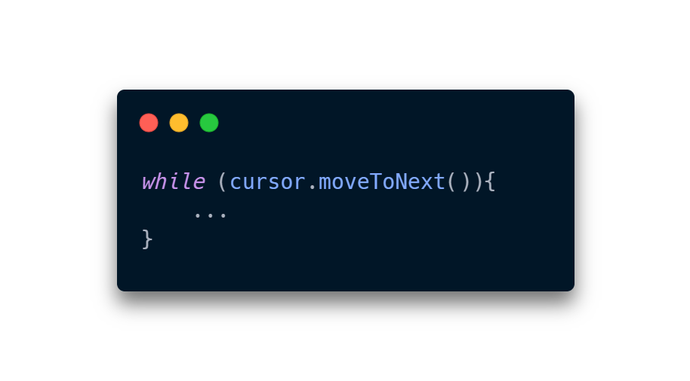
Cursor looping
We can easily loop through cursor results:

Slide 17
Activity life cycle
Activity gets initialized but is not yet visible.
Activity is visible but not necessarily in focus.
Activity is in the foreground and focused.
Activity is partially covered by another.
Activity is not visible (app minimized or switched to another app).
Executed when the activity is no longer needed, such as when exiting the app.

Slide 18
Methods that must be defined in the activity:
onCreate():
You must implement this callback, which fires when the system first creates the activity. On activity creation, the activity enters the Created state.
onResume():
When the activity enters the Resumed state, it comes to the foreground, and then the system invokes the onResume() callback. This is the state in which the app interacts with the user.

Slide 19
Cursor object
Move between rows
Get row values (columns)
moveToFirst()
moveToLast()
moveToNext()
moveToPrevious()
move(int offset): Relative to the current position. positive means forward, negative means backward.
moveToPosition(int position): Moves the cursor to an absolute position in the result set.
You need to use the correct type function with the column index to get the value.
getInt(int columnIndex)
getString(int columnIndex)
getDouble(int columnIndex)
If you don’t know the order of the columns you can get column index by using:
getColumnIndex(String columnName)

Slide 20
Add Customer Activity

Slide 21
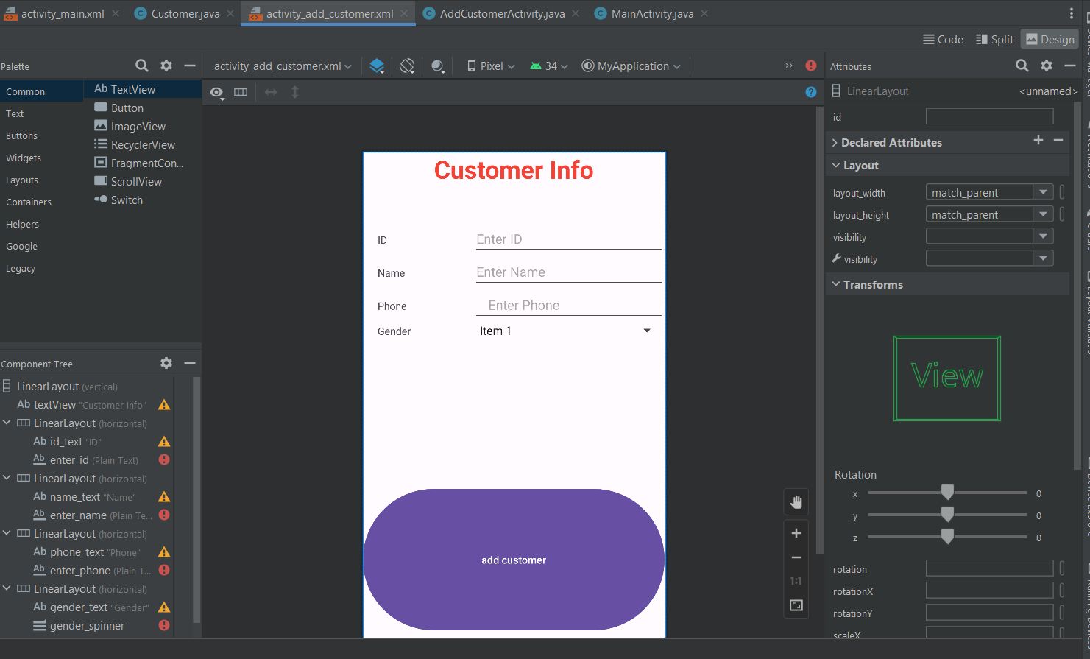

Slide 22
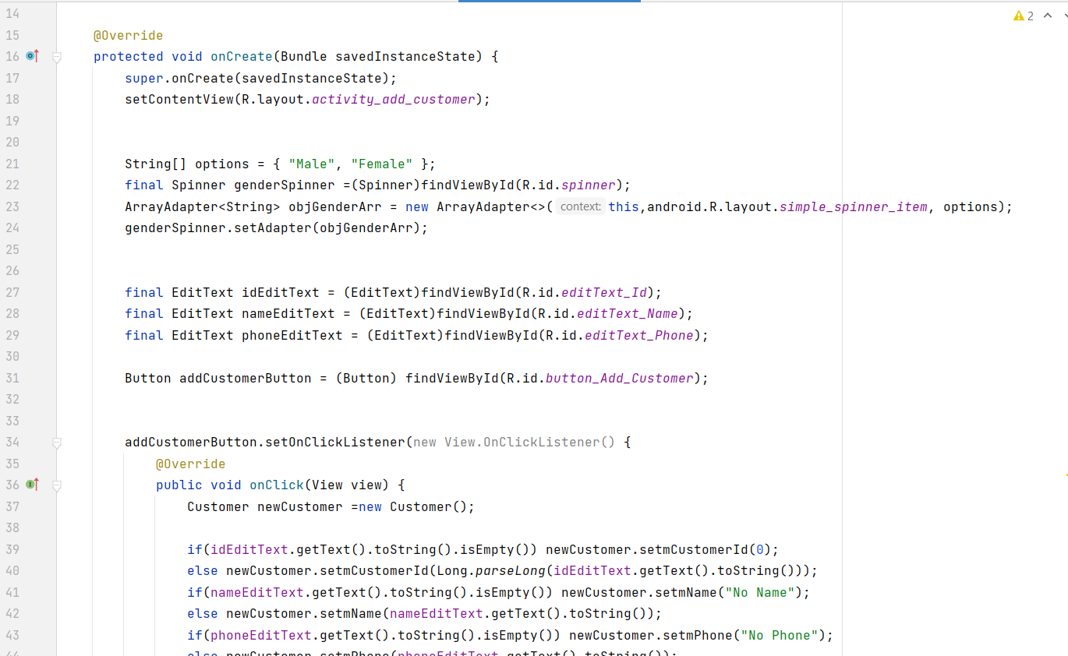

Slide 23
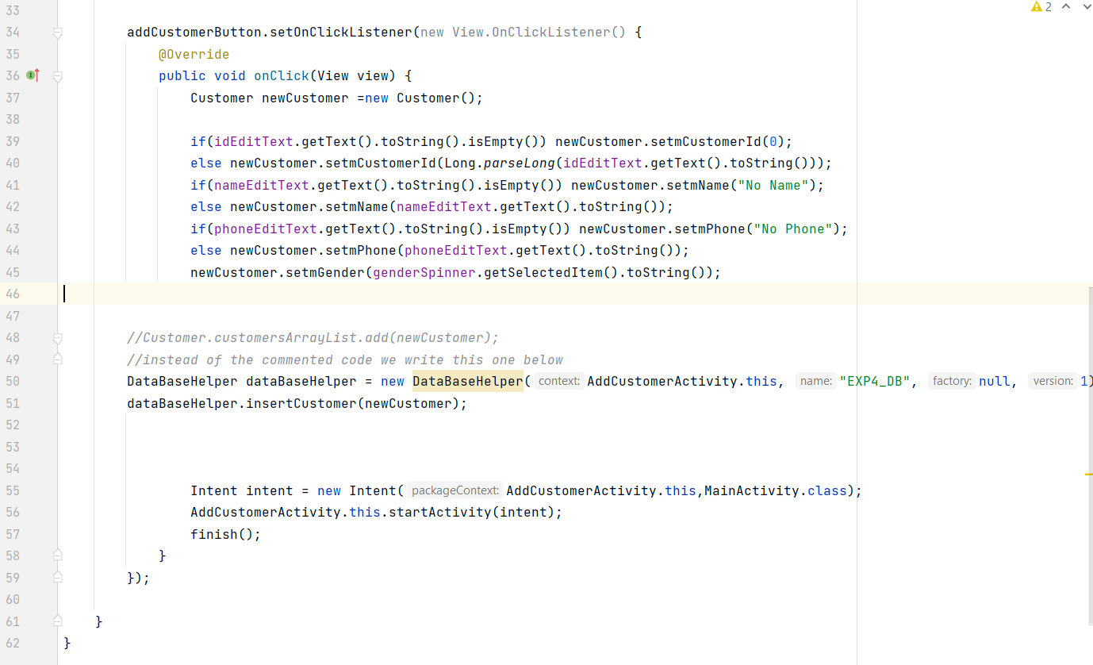

Slide 24
Main Activity

Slide 25
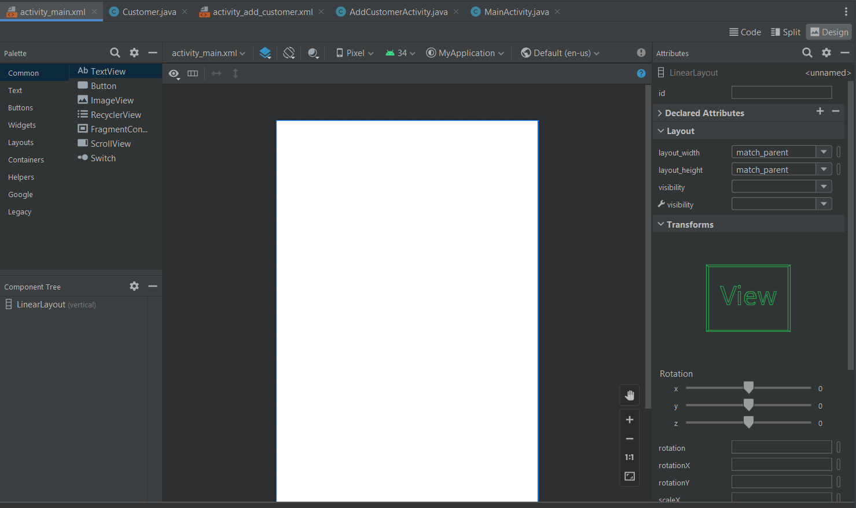

Slide 26
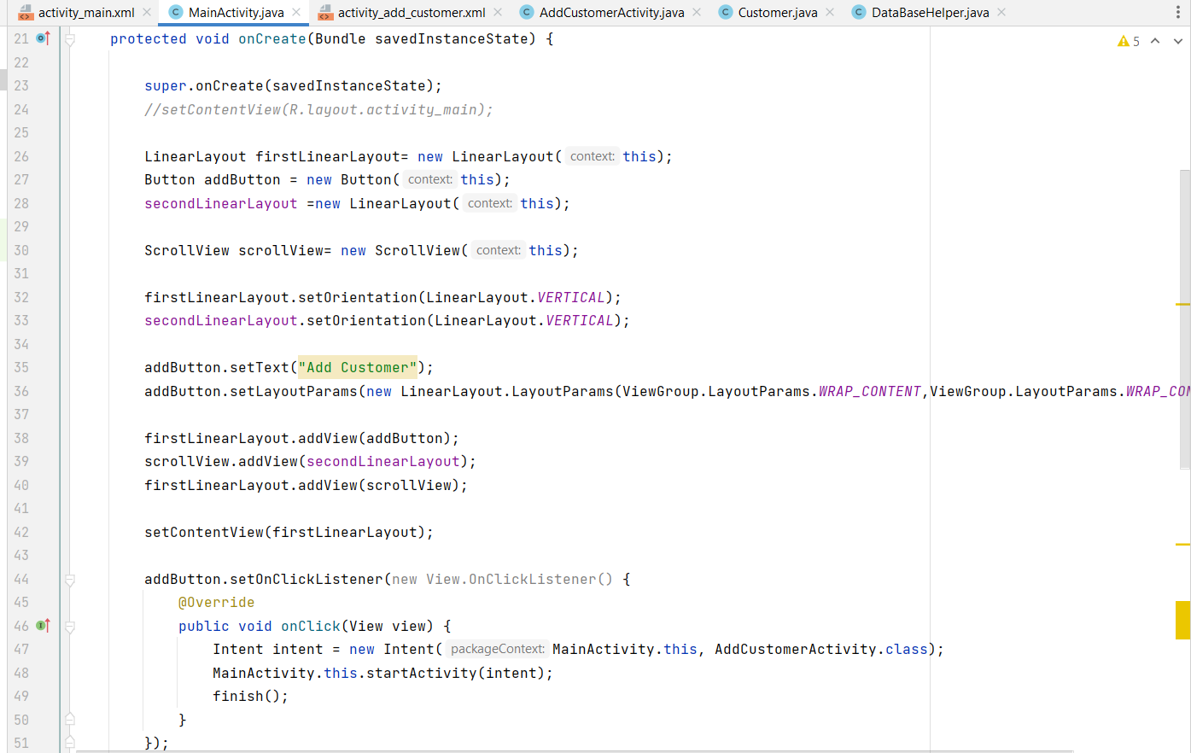

Slide 27
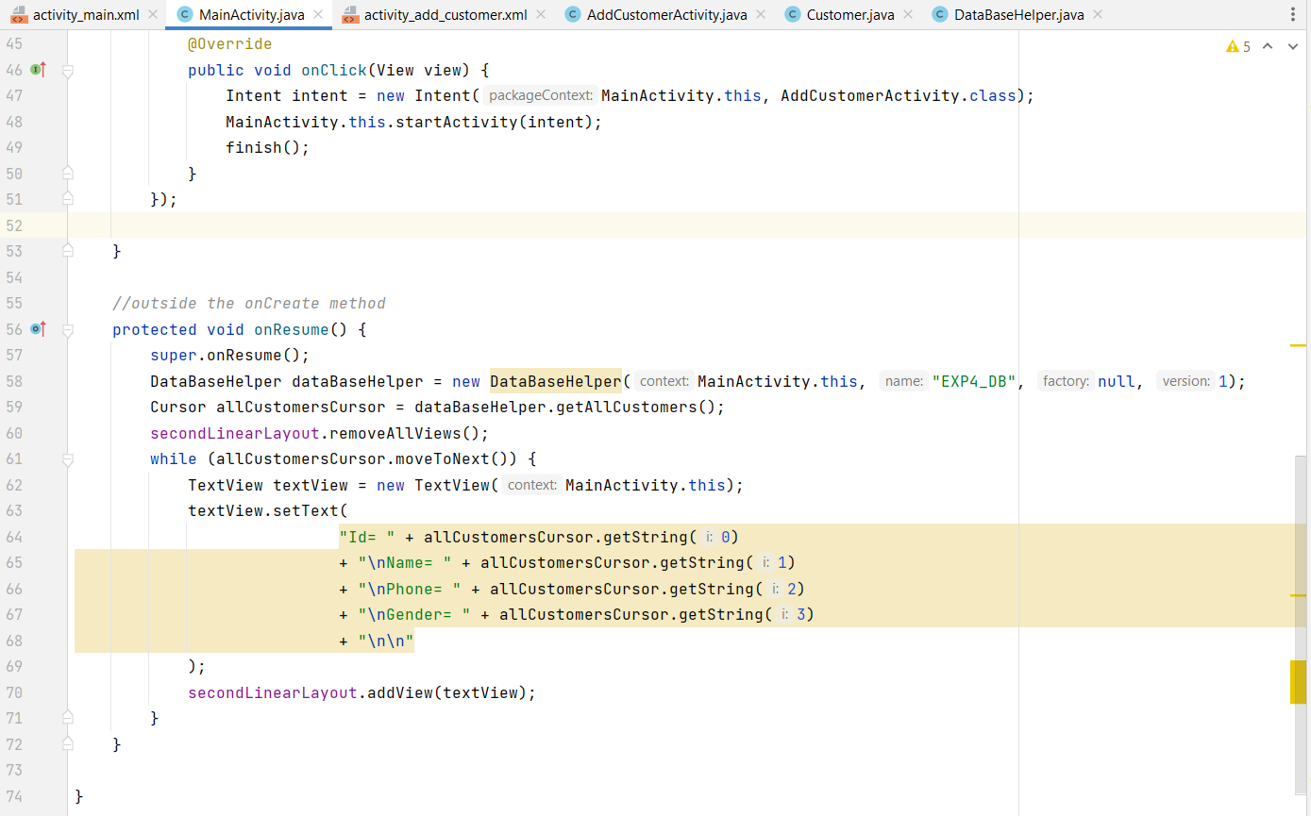

Slide 28
Customer (easy)

Slide 29
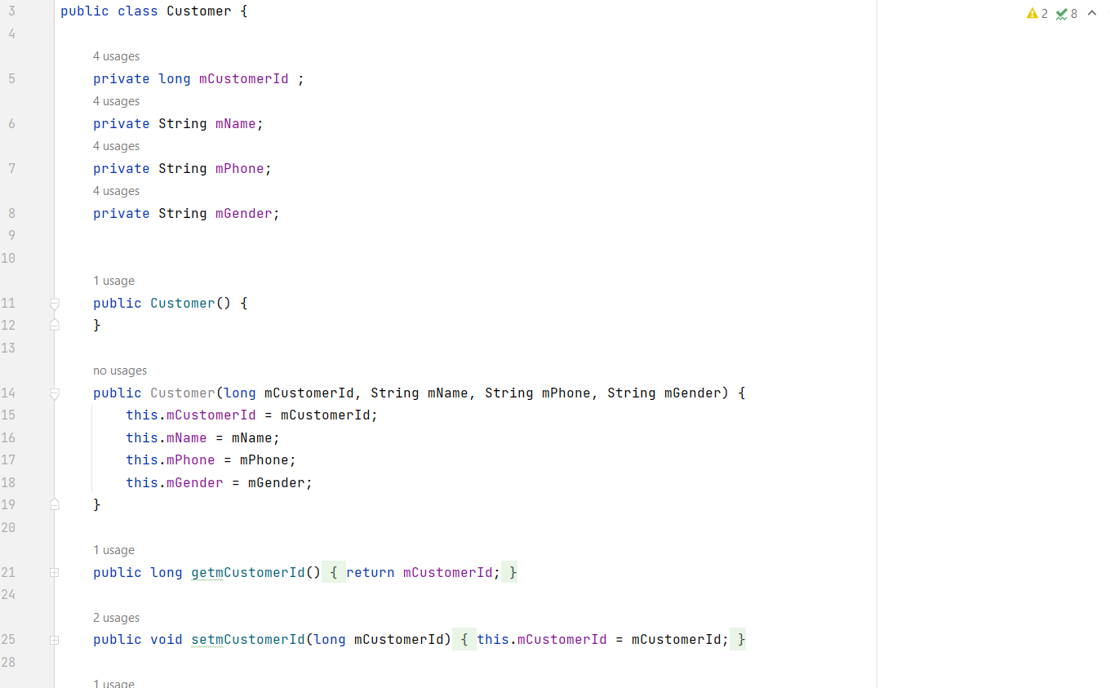

Slide 30
DatBaseHelper

Slide 31
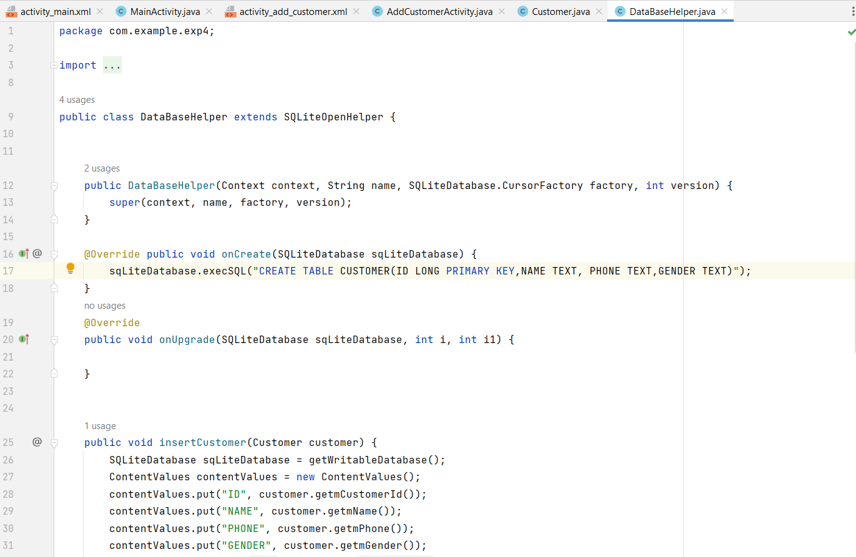

Slide 32
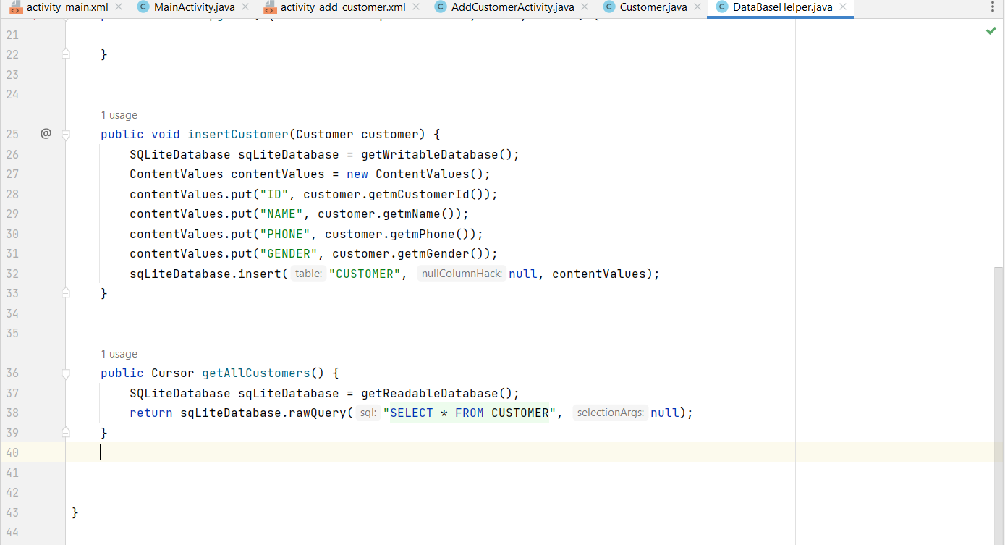

Slide 33
Note:
If you want to add a new feature to the database:
1- The order of the features matters.
2- You must delete the entire application from the virtual device to drop the database before running an application with a different database so that the schema gets updated.

