Slide 1
Preschool
Building Literacy on Language

Slide 2
Decontextualized Language
Contextualized Language: use for the immediate context, or the here and now, relies on the background knowledge a speaker and a listener share, and on gestures, intonation, and immediately present situational cues.
De-contexualized language: does not contain context cues and does not assume a speaker and a listener share background knowledge or context.
the ability to use decontextualized language is fundamental to academic success because nearly all the learning that occurs in schools focuses on event sand concepts beyond the classroom walls.

Slide 3
theory of mind
First, diverse desires. second, diverse beliefs. third, false belief. Fourth, knowledge access. Fifth, hidden emotion. sixth, understanding sarcasm—a nonliteral type of language in which the meaning of a speaker’s words is the opposite of the literal interpretation.
children’s knowledge of sentential complements are structures that represent a person’s speech or mental state, facilitates TOM development. These contain a main clause with a verb of communication (e.g., to say; to exclaim) or a mental state verb (e.g., to think; to believe), and an embedded clause that may or may not be true.
conversations and social interactions contribute to social-cognitive advances, including theory of mind development.

Slide 4
emergent Literacy
emergent Literacy: the earliest period of learning about reading and writing that depend heavily on the oral language skills (well-developed phonological systems, well-developed vocabularies) for comprehending language and using language expressively.
For example, children need not only well-developed phonological systems before they can make sense of grapheme-to-phoneme (letter-to-sound) correspondences, but also well-developed vocabularies so derive meaning from text. For this reason, pre-schoolers are said to “build literacy on language.”
Preschooler viewing language as an object of attention (metalinguistic ability)
three important achievements in emergent literacy for preschoolers are:

Slide 5
alphabet knowledge
Do children know all letters in preschool years ? no
Factors in letter acquisition:
1. Own-name advantage By age 5 years, children are often familiar with the letters that make up their names.
2. Letter-name pronunciation effect: children learn alphabet letters with the name of the letter in its pronunciation earlier than letters for which this is not the case (e.g., letter B is pronounced /bi/, but letter X is pronounced /εks/).
3. Letter-order hypothesis: children learn letters occurring earlier in the alphabet string (e.g., A, B, C) before letters occurring later in the alphabet string (e.g., X, Y, Z).
4. Consonant-order hypothesis: children learn letters for which corresponding consonantal phonemes are learned early in development (e.g., B, M) before letters for which corresponding consonantal phonemes are learned later (e.g., J, V).

Slide 6
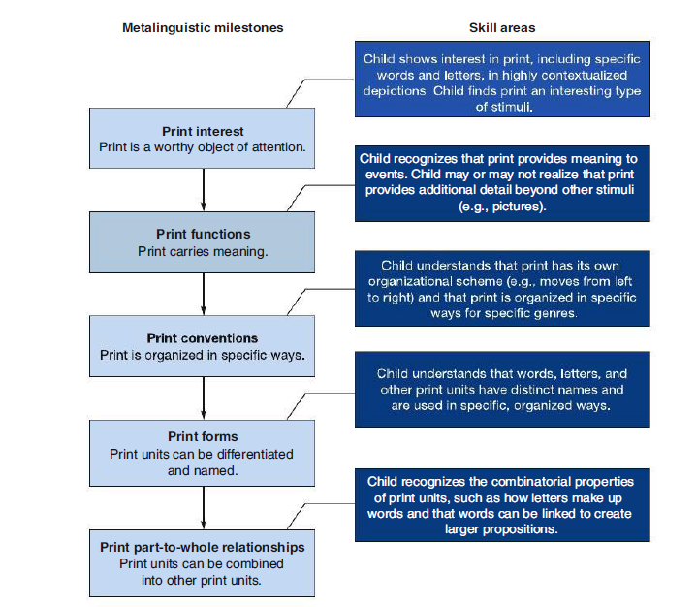

print awareness
some research indicates preschoolers do not, on their own, focus on print; they seem to need prompting from adults to pay attention to print.

Slide 7
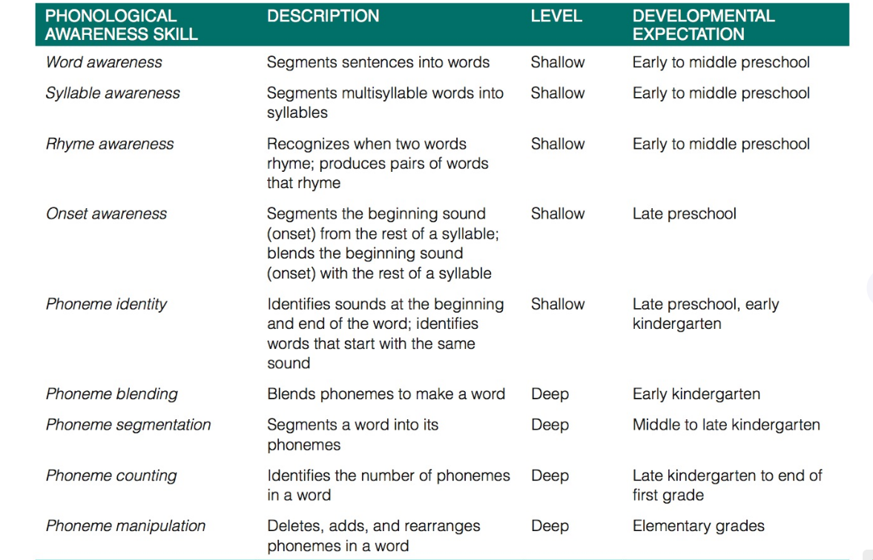
phonological awareness

Slide 8
What majOr achIevements In LanGuaGe FOrm, cOntent, anD use characterIZe the PreschOOL PerIOD?

Slide 9
Language Form
Achievements in speech Production
grammatical and Derivational morphology
sentence Forms

Slide 10
Achievements in speech Production
4 and 5-year-old children generally show only minimal difficulties with a few of the later-developing phonemes, including /r/ , /l/,/s/,/tʃ/,/ʃ/, /z/,/θ/and /ð/, also may exhibit persistent difficulties of earlier-acquired phonemes when they appear in complex multisyllabic words or in words with consonant clusters.
The phonological processes continue to diminish. two patterns that may persist past the fifth birthday are Liquid gliding and stopping
receptive phonology continues to develop during the preschool years, which becomes important to children’s early reading development. alphabetic principle, or the relationship between letters or combinations of letters (graphemes) and sounds (phonemes).
environmental and biological factors can affect children’s development of adequate phonological representations. For instance, children who receive little linguistic stimulation, and those who have ongoing middle ear infections are at risk for having delays in the development of phonological representations

Slide 11
grammatical and Derivational morphology
Derivational morphology: is similar to grammatical morphology in that it modifies the structure of words. however, derivational morphemes are the prefixes, suffixes and infixes we add to a word to change its meaning and sometimes it’s part of speech.
six factors contribute to the order in which children acquire morphemes:
1. Frequent occurrence in utterance-final position (suffixes first)
2. Syllabicity: learn morphemes that constitute their own syllables (ing) earlier than morphemes that contain only a single sound (s).
3. Single relation between morpheme and meaning: (morpheme the functions only as a definite article) (-s denotes present tense, third person, and plural number).
4. Consistency in use: ☹(possessive nouns always end in ’s) more easily than morphemes that vary in their use (e.g., past tense verbs sometimes end in -ed but at other times take an irregular form).
5. Allomorphic variation: children learn morphemes that have a consistent pronunciation (e.g., -ing) before they learn morphemes that have allomorphic variation (e.g., the plural morpheme has three variations: /s/, /z/, and /Iz/).
6. Clear semantic function: children first learn morphemes that have a clear meaning (e.g., plural morpheme) before they learn morphemes with less clear meaning (e.g., third-person singular morpheme such as “he runs”)

Slide 12
grammatical and Derivational morphology
the most significant area of morpheme development in the preschool period is verb morphology. One way English speakers inflect verbs is with tense (e.g., past, present, future) to provide information about time.
When the verb to be or any of its derivatives (am, is, are, was, were) is the main verb in a sentence as in I am Doug it is called a copula. When the verb to be or one of its derivatives is a helping verb in a sentence as in I am hugging Doug it is called an auxiliary. the to be copula and auxiliary forms can be made into contractions (I’m bouncing the ball) or left in their uncontracted forms (I am bouncing the ball).
Preschoolers master the verb to be in its copula and auxiliary forms, representing a major syntactic achievement of these years.

Slide 13
sentence Form
Preschoolers move from simple to more elaborate sentence patterns:
1. Subject–verb–object–adverb: “Daddy’s hitting the hammer outside.”
2. Subject–verb–complement–adverb: “Daddy is hungry now.”
3. Subject–auxiliary–verb–adverb: “Daddy is eating fastly.
children also begin to embed multiple phrases and clauses into their utterances to create complex and compound sentences and use coordinating conjunctions (e.g., and, or, but) and subordinating conjunctions (e.g., then, when, because) to connect clauses.

Slide 14
Language content
Fast mapping
Knowledge of semantics and syntax
shared storybook reading
relational terms

Slide 15
Fast mapping
Many researchers view word learning as a gradual process in which word representations progressively develop from immature, incomplete representations to mature, accurate, and precise representations.
recall that children are able to acquire a general representation of a new word with as little as a single exposure through fast mapping (carey, 1978). after fast mapping occurs, children engage in slow mapping, during which they gradually refine representations with time and multiple exposures to the word in varying contexts

Slide 16
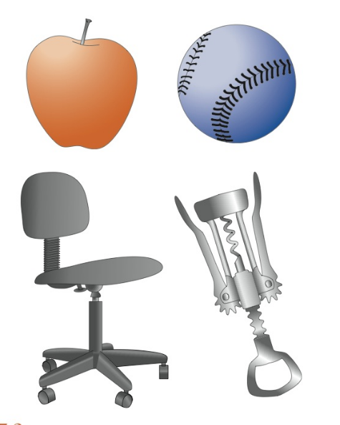
Fast mapping
Dale (1965) described vocabulary knowledge development as a four-stage process: Stage 1 no knowledge of a word “I never saw it before.”
Stage 2 emergent knowledge “I’ve heard of it but don’t know what it means.”
Stage 3 contextual knowledge “I recognize it in context it has something to do with”
Stage 4 Full knowledge “I know it”
Preschoolers, like toddlers, use the principle of novel name–nameless category (n3c) to match novel labels to nameless objects and can then fast map novel words through this process.

Slide 17
Knowledge of semantics and syntax
preschool children continue to overextend object names basis on function of other objects not perceptual features.
Preschool-age children using the animacy of objects to infer the meaning of new words. Preschoolers select animate objects as referents for novel proper names and inanimate objects as referents for common nouns For example, if given the choice of a novel inanimate object and a novel animate object, preschoolers will select the inanimate object when you tell them “Find the dax” and will select the animate object when you tell them “Find Dax.”
another way preschoolers infer the meanings of new words is by recruiting syntactic cues that signal the form class (e.g., noun, verb, adjective) of a novel word.
distinguish between Generic vs Specific sentences.

Slide 18
shared storybook reading
Variations in reading interactions with young children are related to children’s receptive and expressive vocabulary abilities.
research results indicate children can learn new words through incidental exposure to words during storybook-reading sessions in which the meanings of target words are not discussed .
preschoolers better comprehend stories when adults read them with an expressive style (using variation in pitch, tone, volume, pace, and pausing) than with a less expressive style

Slide 19
relational terms
Deictic Terms words use and interrupt depend on the location of a speaker and listener within a particular setting. Children master proximal deictic terms such as “this and here” more easily than they master distal deictic terms such as “that and there”.
Interrogatives answering and asking questions. they understand and use question words with more concrete applications, such as what, where, who, whose, and which before other abstract applications, such as when, how, and why.
Temporal Terms temporal terms describe the order of events (before, after), the duration of events (since, until), and the concurrence of events (while, during).
Opposites
Locational Prepositions under, next to, behind, in back of, and in front of
Kinship Terms mommy, sister, and friend to refer to specific individuals

Slide 20
Language use: Discourse funcTIONS
Interpretive functions make clear the whole of a person’s experience (e.g., “I was pretty scared after watching that movie.”).
Logical functions express logical relations between ideas (e.g., “Let’s put our boots on so our feet don’t get wet.”).
Participatory functions express wishes, feelings, attitudes, and judgments (e.g., “I don’t like this game. Let’s play a different one.”).
Organizing functions manage discourse (e.g., “First we added the flour, and next we added the eggs.”).

Slide 21
Language use: Conversational skills
Preschoolers begin to improve their conversational skills as they learn how to take turns in a conversation, particularly when they select the discussion topic .
They still have some difficulty realizing when communication breakdowns occur and giving listeners the appropriate amount of feedback to facilitate understanding.
trying to avoid being unclear and ambiguous and be brief and orderly.

Slide 22
narrative skills
a narrative is a child’s spoken or written description of a real or fictional event from the past, the present, or the future.
Preschool children’s narratives serve as a showcase for multiple language achievements. How? including those in syntax, morphology, semantics, phonology, and pragmatics. children must use syntax to arrange words and ideas, verb morphology to signal the time of events, vocabulary to represent events and persons precisely, phonology to pronounce words clearly and with proper intonation, and pragmatics to share an appropriate amount of information with the listener
to produce a narrative, the child introduces a topic and organizes the information pertaining to the topic in such a way that the listener can assume a relatively passive role, providing only minimal support to the speaker.
Two important types of narratives are the personal narrative, in which an individual shares a factual event, and the fictional narrative, in which an individual shares an imaginary event.
A causal sequence unfolds following a cause-and-effect chain of events. A temporal sequence unfolds with time (e.g., “First, we rode our bikes around the lake. next, we fed the ducks”).

Slide 23
Narrative skills
Although narrative skills begin to develop as early as age 2 years, most children cannot construct true narratives with a problem and a resolution (or high point) until around age 4 years.
Children’s early narratives may include only a minimal description of the participants, time, and location relevant to the event and may contain only a series of events.
ethnographic research is a qualitative research method that involves gathering data about different societies and cultures with the aim of describing the nature of the populations interest.

