Slide 1
Acute care and drugs of emergency

Slide 2
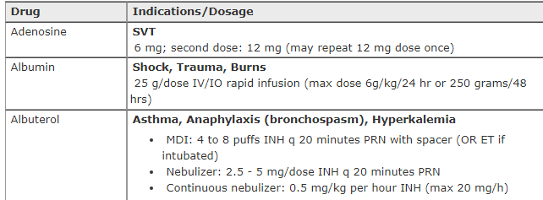
The most frequent drug medications used in emergency and acute care are:

Slide 3
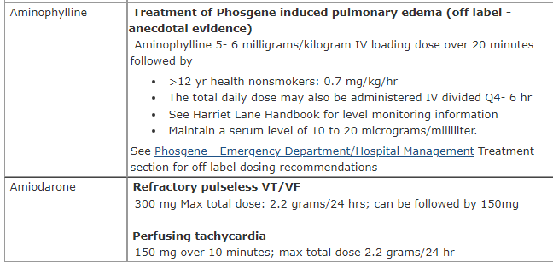

Slide 4
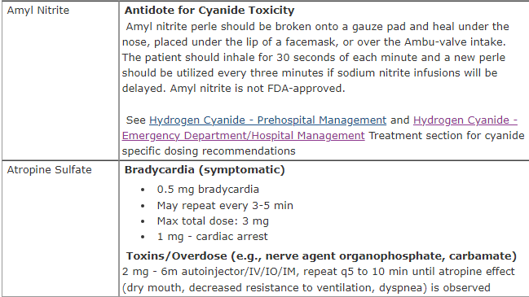

Slide 5


Slide 6
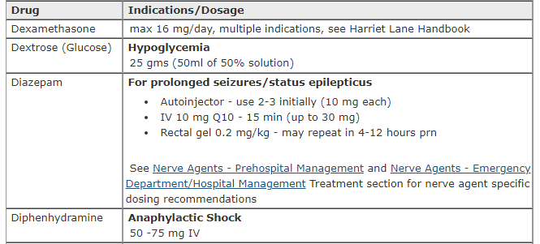

Slide 7


Slide 8
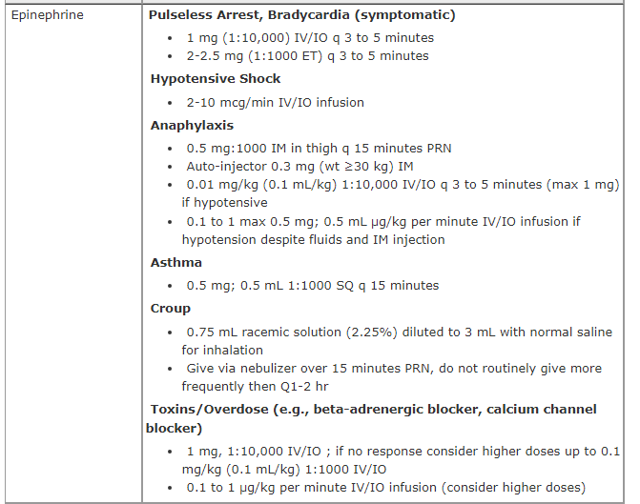

Slide 9

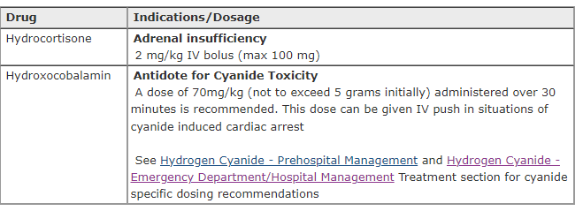

Slide 10



Slide 11
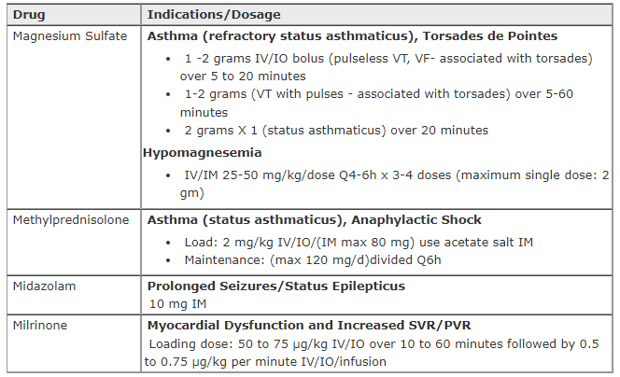

Slide 12
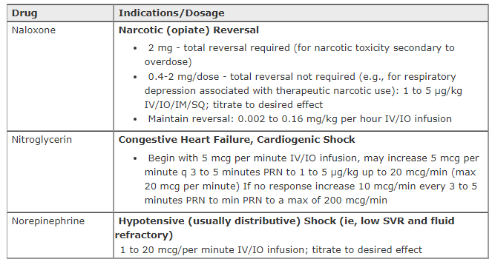

Slide 13



Slide 14
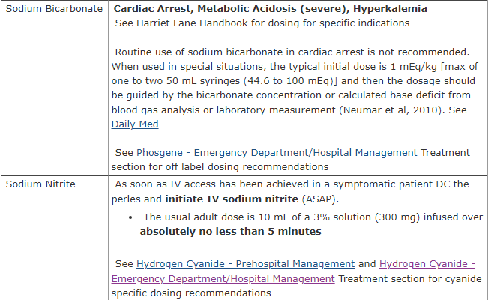

Slide 15
Reference
https://chemm.hhs.gov/adultmedications.htm

