Slide 1
Introduction to Apache Cassandra
A Comprehensive Guide to Cassandra Database

Slide 2
Introduction &Overview of Cassandra
Social media platforms have become essential for communication, sharing experiences, and building communities.
The architecture and data management strategies of a social media application designed to handle millions of users and their interactions seamlessly.
For this purpose we need a high performance platform that meets the demands of modern users by employing a distributed architecture and effective data management strategies.

Slide 3
Apache Cassandra
Apache Cassandra is a highly scalable, distributed NoSQL database designed to handle large amounts of data across many commodity servers, providing high availability with no single point of failure.
Developed by Facebook; now an Apache project
Key use cases: Social media, IoT, e commerce, real time analytics

Slide 4
Key Features of Cassandra
Decentralized Architecture
Scalability
High Availability
Fault Tolerance
Tunable Consistency
Flexible Schema
Optimized Write and Read Performance

Slide 5
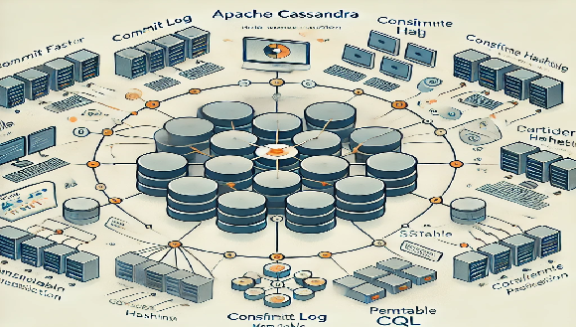
Apache Cassandra's Architecture.
Here is an illustration of It highlights the key components like the peer-to-peer model, consistent hashing, data replication, and storage elements like Commit Log, Memtable, and SSTable.

Slide 6
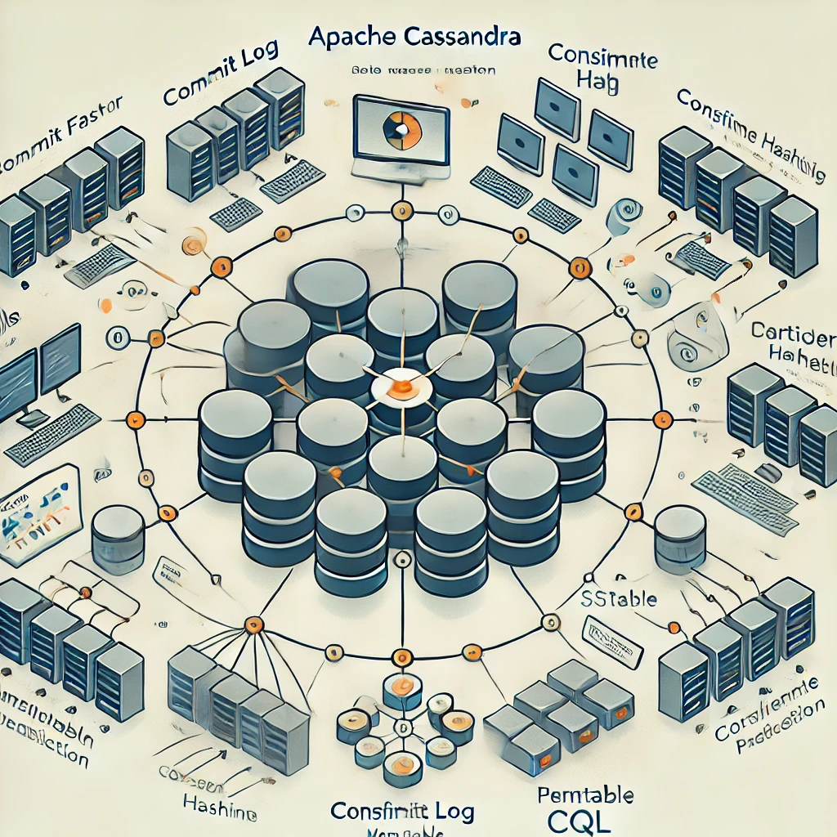

Key Points (1)
1. Cassandra Components : The image labels various Cassandra components, including:
- Commit Log: Used for durability and crash recovery.
- Memtable: An in-memory data structure for fast writes.
- SSTable: Disk-based data files for persistent storage.
- Compaction: The process of merging and optimizing SSTables.
- Consistent Hashing: The mechanism for distributing data across nodes.

Slide 7
Key Points (2)
2. Cassandra Cluster : A cluster of multiple Cassandra nodes (represented as servers) connected in a ring structure, emphasizing the peer-to-peer model used by Cassandra.
3. Data Distribution : The image highlights the use of consistent hashing for data distribution across the Cassandra cluster. Arrows are used to illustrate how data is distributed and replicated across the nodes.
4. Replication and Availability : The image suggests that Cassandra's distributed architecture and replication strategies ensure high availability and fault tolerance, as the data is replicated across multiple nodes.
5. Performance Optimizations : The image mentions features like Pernitable CQL (Cassandra Query Language) and Hashing, which contribute to the overall performance and efficiency of the Cassandra database system.

Slide 8
Core Concepts
Data Model: Tables, Rows, Partitions
Partition Key
Replication Factor
Consistency Levels (ONE, QUORUM, ALL, etc.)
Cassandra Query Language (CQL)

Slide 9
Cassandra vs. Other Databases
Cassandra vs. RDBMS
No fixed schema, no JOINs, optimized for scale
Cassandra vs. MongoDB
Distributed by default; stronger focus on availability

Slide 10
Advantages and Challenges
Advantages:
Scalability, fault tolerance, flexibility
Challenges:
Learning curve, eventual consistency trade offs

Slide 11
Practical Use Cases
Examples from companies: Netflix, Spotify, eBay
Applications: User activity tracking, sensor data storage, recommendation systems

Slide 12
Case Study: A Social Media Application Using Cassandra
This case study illustrates how a social media application can leverage Apache Cassandra's strengths to create a scalable, high-performance platform that meets the demands of modern users. By employing a distributed architecture and effective data management strategies, the application is well-equipped to handle the complexities of social interactions in a digital environment.
It explores the architecture and data management strategies of a social media application designed to handle millions of users and their interactions seamlessly.

Slide 13
Case Study Key Highlight
1. Purpose and Functionality :
- The application allows users to create profiles, post content, connect with friends, and engage with a community through likes and comments. It aims to provide a user-friendly experience while ensuring high availability and responsiveness.

Slide 14
Case Study Key Highlight
2. Why Cassandra? :
- Scalability : As user numbers grow, the application can easily scale horizontally by adding more nodes to the Cassandra cluster without downtime.
- High Availability : With its distributed nature and data replication capabilities, Cassandra ensures that user data is always accessible, even in the event of node failures.
- Performance : Cassandra's ability to handle large volumes of write and read operations makes it ideal for real-time applications like social media.

Slide 15
Case Study Key Highlight
3. Core Features :
- User registration and authentication.
- Creation and management of user profiles.
- Posting and sharing of multimedia content.
- Real-time news feed displaying updates from friends.
- Notification system for user interactions (likes, comments, etc.).
- Search functionality to discover other users and content.
4. Data Management :
- The application employs a well-structured data model using Cassandra's tables, optimized for quick access and efficient storage. Key tables include user profiles, posts, friends lists, and notifications.
- Data is partitioned based on user IDs and replicated across multiple nodes to enhance fault tolerance and improve read performance.

Slide 16
Case Study Key Highlight
5. Architecture Overview :
- The application architecture consists of a frontend built with modern web frameworks, a backend that handles business logic, and a robust Cassandra database for data storage. A load balancer ensures even distribution of incoming requests, enhancing overall system performance.
6. Security Measures :
- The application implements security best practices, including data encryption, secure authentication mechanisms, and role-based access controls, ensuring user data is protected.

