Slide 2
Lecture 15
NUTD343
Dr Emilia Rappocciolo

Slide 3
Food Preservation methods
Traditional
Drying
Smoking
Salting
New
Pasteurization (by heat)
Canning (commercial sterilization by heat)
Refrigeration
Freezing
Chemical preservatives
Food irradiation

Slide 4

irradiation
International Symbol of Irradiated food
Food irradiation: processing of food products by ionizing radiation to control foodborne pathogens, reduce microbial load and insect infestation, inhibit the germination of root crops, and extend the durable life of perishable produce

Slide 5
Control by Irradiation
Over 60 countries have approved the use of irradiation for about 50 different types of food
list of irradiated products:
Spices
Herbs
Seasonings
Fresh or dried fruits and vegetables
Seafood
Meat and meat products
Poultry
Egg products

Slide 6
Control by irradiation
Food preservation by irradiation:
X-Ray, beta-rays , gamma rays were tested
Beta rays (e⁻) cannot penetrate inside the food – useless
X-Rays, penetrate but can’t be focused – useless

Slide 7
Control by irradiation
Gamma rays (photons)
Have high penetration power
Effective, economical
Cobalt 60, ⁶⁰CO, is the best source of gamma-Rays
⁶⁰CO, produces radioactive isotope that is used in nuclear medicine
When its activity becomes low and can no longer be used in medicine, it is used to irradiate food
Food irradiated with ⁶⁰CO do not become radioactive, but inhibit the growth microorganisms

Slide 8
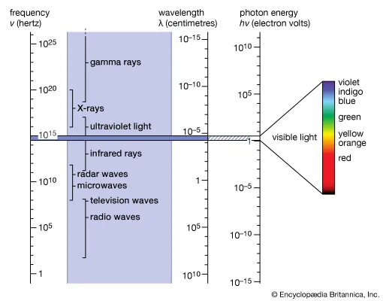
Gamma rays

Slide 9
Use of irradiation in food
Initially, the process affected the flavor qualities of the foods; these problems were overcome by reducing exposure time and lowering product temperature
It was thought that irradiation of food would give storage stability for indefinite periods of time
Safety:
Studies showed that irradiated foods did not cause any toxic effect or genetic defects
Irradiation is the only food preservation method that has been studied for safety for a long time (> 50 years) before recommendation

Slide 10
Use of irradiation in food
WHO expert committee:
reviewed more than 200 well-designed studies conducted worldwide
Recommended - irradiation of food up to a certain dose level (10 kGy)
This level is currently approved for use in meat, fish, vegetables, fruits, and grains
Many countries sell irradiated foods – vegetables, fruits, grains
Consumer resistance has been high
Due to lack of information/understanding that irradiated foods are not radioactive
There is no controversy among experts that food irradiation is an economical and effective food preservation method

Slide 11
Objectives
Irradiated has destructive power of ionization on microorganisms in food
Depending on the method used, it can completely or partially destroy molds, yeasts, bacterial cells, spores, viruses
Irradiation can destroy worms, insects, and larvae in food
It prevents sprouting of some foods, such as potatoes and onions.
Irradiation cannot destroy toxins or undesirable enzymes in a food – (not heat treatment)

Slide 12
Objectives
Irradiation is a cold sterilization process - temperature of food does not increase during irradiation
Foods don't show the damaging effects of heat on food quality
Irradiation can cause oxidation of lipids and denaturation of food proteins when used at higher doses

Slide 13
Mechanism of action
ɤ-rays produce high energy - absorbed by molecules/atoms in food/organism, cause removal of e⁻ and produce neg-pos ion pairs
This energization and ionization can damage microorganisms
Direct effect of ionizing radiation on microorganisms:
Remove electrons from the DNA and cause damage
Ionize water molecules inside cells to form free radicals (hydrogen and hydroxyl )-highly reactive, cause oxidation-reduction and breakdown C-C bonds of molecules including DNA
OH-radical can break single/double-strands in DNA, change bases
These damages inhibit replication of DNA - death
Indirectly: ionizing radiation damage the membrane and other structures, causing sub-lethal injury - radiation resistant organisms
Some organisms can repair DNA strand damage and bases

Slide 14
Ionizing radiation
Microbial death by ionizing radiation depend on:
the dose (strength and exposure time)
microbial species,
Environmental factors
the D value (minutes to reduce cell viability by 1 log of a species in a population at a given exposure) can be determined to decide the time necessary to reduce the population to a desirable level
UV- radiation
When microorganisms are exposed to UV radiation (260 nm), the energy is absorbed by the nucleotide bases in DNA to form dimers (thymine dimers) and cause breaks in the DNA strand

Slide 15
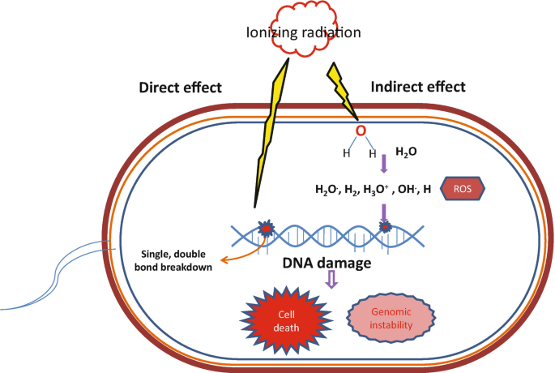
Hussain, M. S. (2022). Response of foodborne pathogens to irradiation. In Stress Responses of Foodborne Pathogens (pp. 347-366). Cham: Springer International Publishing.

Slide 16
Factors affecting radiation
Influencing Factors
ɤ -rays have effective and economical use in food preservation
^{6O}Co is used in food irradiation because
Available and economic
has a half-life of 5.3 years
continuously emits gamma-rays, can be lost when it is not used
The antimicrobial efficiency of ionizing radiation
increases as the dose is increased
decreases in the absence of oxygen (reduced oxidizing reactions)
Decreases at low Aw (reduced free-radical formation with less water)
Reduced by freezing because of reduced availability of reactive water molecules

Slide 17
Factors affecting radiation
Nature of Foods
gamma-Rays have a penetration capability of ~ 40 cm
can penetrate through paper, plastic, and cans
foods can be exposed to gamma-radiation in packages, cans, baskets, and bags
Frozen, dry, or ana-erobically packaged foods need higher doses of treatment
Other conditions:
high hydrostatic pressure, high temperature, and low pH enhance the antimicrobial effect of radiation in food
Food compositions (thickness and particle size) also determine the efficiency of irradiation in reducing microbial numbers

Slide 18
Nature of microorganisms
Size variations
Larger organisms are more susceptible to ionizing (and UV) radiation
molds > sensitive than yeasts > sensitive than bacterial cells > more sensitive than viruses
Gram-negative more sensitive than Gram-positive bacteria
rods are more sensitive than cocci
Bacterial species and strains vary in their sensitivity to irradiation:
Some strains are radiation resistant – they can repair the cellular damages (breaks of DNA and base damage)
Radiation resistant strains that are important in foods:
Salmonella, E. coli, Enterococcus, S. aureus
Spores are quite resistant to irradiation

Slide 19
Methods
Unit dose of irradiation is the Gray (Gy)
1 Gy: the quantity of ionizing radiation emitted when 1 kg of food absorbs the energy of 1 joule
According to the international health and safety authorities:
foods irradiated up to 10,000 Gy (10 kGy)- recommended dose is safe
Sensitivity of microorganisms to irradiation dose is a function of size and water content
Low dose: <1 kGy- control insects in fruits/vegetables, and parasites in meat/fish
Medium dose: 1-10 kGy, control foodborne pathogens and to extend safety and stability of refrigerated foods (molds, yeasts, bacterial cell)
High dose: > 10 KGy, destroy bacterial spores; not used in foods (not safe), only in spices.
CIostridium botulinum spores : 30-60 kGy, viruses 10-200 kGy

Slide 20
Terminology
Radurization
intended to destroy spoilage bacteria in high-pH, high Aw foods
Mild treatment (< 1 kGy)
products should be packaged and chilled to prevent growth of pathogens (mesophiles). may not be effective against psychrotrophs
Radicidation
to destroy vegetative food borne pathogens
dose level used is 2.5-5.0 kGy
effective against pathogenic vegetative bacterial cells and molds but not spores of pathogens
some radiation-resistant pathogens can survive - Salmonella
products need to be stored at <4°C, to prevent germination of C. botulinum spores

Slide 21
Terminology
Radappertization
radiation of food at a high dose (30 kGy) to destroy C. botulinum spores
to get a safety in terms of number of spores, similar to that by 12D heat treatment
not recommended for use in food

Slide 22
Recommendations
In 37 countries including France; Belgium, the Netherlands
Approved the use of irradiated fresh fruits, vegetables, meat, and fish
In the United States
Irradiated foods - used by the army and the space program
Before 1985, irradiation was permitted for spices, wheat, wheat flour (to destroy insects), and potatoes (to prevent sprouting)
in 1985 irradiation approved (1kGy) for pork - against Trichinella
in 1986 – fresh fruits and vegetables to destroy insects and larvae
in 1992 - Poultry and poultry parts (to destroy Salmonella)

Slide 23
UV Radiation
Microorganisms are especially susceptible to UV light between 200 and 280 nm
It has low penetration power
used to inactivate microorganisms on the surface of foods (meat, fish, and bread)
in air and on walls, shelves, and equipment in the food handling and processing area
liquids, such as water and syrups, in thin layers can been treated with UV

