Slide 1

Chapter 12
Introduction to the Engagement Process
Internal Audit (ACCT 337)
Internal Audit & Risk Management
ACCT 337

Slide 2
LEARNING OBJECTIVES
Understand the types of engagements internal auditors perform.
Understand the key activities involved in planning and performing an assurance engagement and reporting the engagement outcomes.
Describe how the consulting engagement process differs from the assurance engagement process.

Slide 3
Types of Internal Audit Engagements
The 2 types of engagements internal auditors perform include:
  Assurance Services
  Consulting Services

Slide 4

Assurance Services
An objective examination of evidence for the purpose of providing an independent assessment on governance, risk management, and control processes for the organization.
Examples (can be financial, performance, compliance, system security, due diligence):
  Assess the design adequacy and operating effectiveness of business process controls.
  Assess the design adequacy and operating effectiveness of information technology (IT) controls.
  Directly assess business process performance.

Slide 5

Consulting Services
Advisory and related client service activities, the nature and scope of which are agreed with the client, are intended to add value and improve an organization’s governance, risk management, and control processes without the internal auditor assuming management responsibility.
Examples (may include counsel, advice, facilitation, and training):
  Provide advice to process owners about how they can streamline their processes to gain operational efficiencies.
  Facilitate process owners’ assessments of the risks threatening their processes.
  Conduct in-house training about fundamental governance, risk management, and control concepts.

Slide 6

Overview of the Assurance Engagement Process
The three phases of the assurance engagement process:
  Planning (slides 8-18)
  Performing (slides 19-24)
  Communicating (slides 25-32)

Slide 7
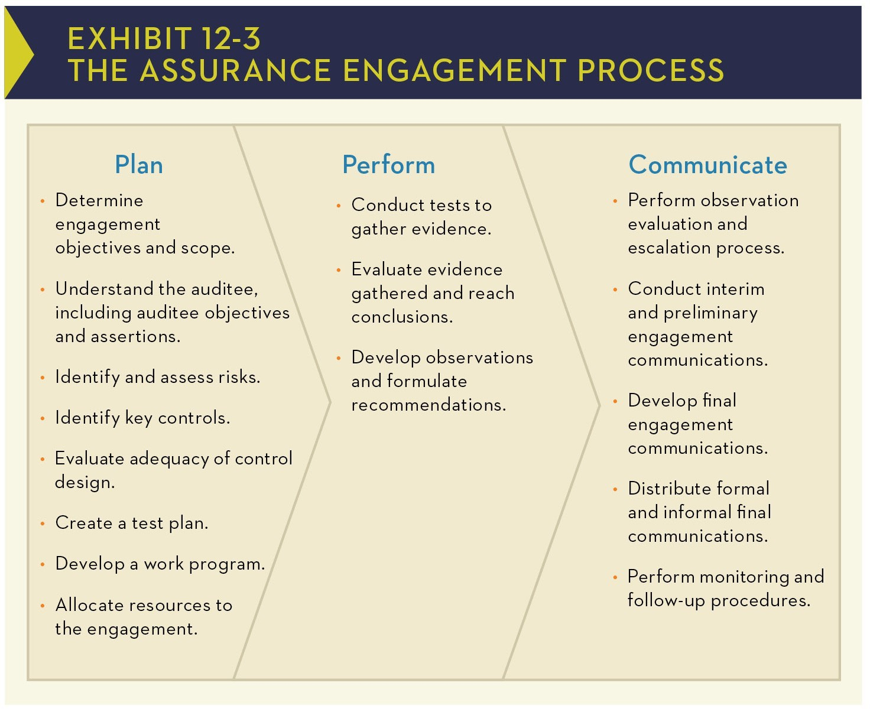
There are no hard lines between planning, performing, and communicating.
Where engagement planning ends and performance begins is debatable.
In fact, planning typically continues throughout the engagement because adjustments need to be made as new evidence is uncovered.

Slide 8
Overview of the Assurance Engagement Process- Planning
The 6 Ps: “Proper Prior Planning Prevents Poor Performance.”
Planning (8 steps):
Determine engagement objectives and scope.
Understand the auditee, including auditee objectives and assertions.
Identify and assess risks.
Identify key control activities.
Evaluate adequacy of control design.
Create a test plan.
Develop a work program.
Allocate resources to the engagement.

Slide 9
Overview of the Assurance Engagement Process- Planning (Step 1)
Step 1: Determine engagement objectives and scope.
  Objectives: What the engagement is intended to achieve?
  Scope: What the engagement will and will not cover?
  Important considerations:
    the type of business objective that is of audit interest (Strategic, financial, operational, reporting and/or compliance)
    the deliverables the internal audit team is expected to produce (Ex: the team might be expected to focus on communicating individual control observations that were identified during the engagement to the appropriate levels of management, or might be expected to express an overall opinion on the controls)
    the “boundaries” of the engagement (Ex: if the auditee is a business process or subprocess, where does the process or subprocess begin and where does it end? Which specific location(s) will the internal audit team visit and what portion(s) of each business unit will the engagement cover?)

Slide 10
Overview of the Assurance Engagement Process- Planning (Step 1)
Step 1: Determine engagement objectives and scope. (Example)
  Example: Imagine your internal audit team is conducting an audit of the procurement process in an organization.
  Objective: The objective defines what the audit aims to achieve.
  Example: "To assess whether the procurement process complies with the municipality’s procurement policies and applicable regulations."
  Scope: The scope defines the boundaries of the audit—what will and will not be included.
  Example: "The audit will cover procurement transactions from January to December 2024, focusing on purchase requisitions, approvals, and vendor selection for contracts above $10,000. It will exclude emergency purchases and procurement below $1,000."

Slide 11
Overview of the Assurance Engagement Process- Planning (Step 2)
Step 2: Understand the auditee, including auditee objectives and assertions.
  Auditee objectives: what the auditee is striving to achieve
  Auditee assertions: after-the-fact statements of what was achieved
  From the auditee’s perspective, clear and measurable objectives serve as meaningful targets of performance, and assertions reflect the level of performance achieved.
  From an internal auditor’s perspective, the auditee’s objectives and assertions provide a framework for defining the engagement objectives (what the internal auditor wants to achieve).

Slide 12
Overview of the Assurance Engagement Process- Planning (Step 2)
Step 2: Understand the auditee, including auditee objectives and assertions.
  Example: The organization’s service department has a written objective of responding to customers’ requests for service within 48 hours after the requests are received. Implicit in this objective is the assertion that the service department has implemented the controls necessary to provide reasonable assurance that the objective is achieved. The performance report posted in the service department lobby explicitly asserts that the department met this goal for 92 percent of the customer service requests received over the past three months

Slide 13
Overview of the Assurance Engagement Process- Planning (Step 3)
Step 3: Identify and assess risks.
  The internal audit team must identify and assess the business risks that threaten the achievement of the auditee’s objectives and, ultimately, the organization’s objectives.
  The internal audit team focuses its attention at this stage of the engagement on inherent risk, that is, the risk to the auditee in the absence of any direct or focused actions by management to alter its severity.
  Risk assessment involves gauging both the impact of the risk (if it should occur) and the likelihood of the risk occurring.
  Expressing risks in terms of causes and effects helps the internal auditor assess how big the potential problem is and how likely it is to occur.
  Take, for example, the following risk: Inefficient processing of vendor invoices for payment (the cause) may result in lost discounts, delays in payment, and vendor dissatisfaction (the effects).
  The internal audit team also must weigh the assessed risk levels against management’s risk tolerance thresholds and decide whether risks are being managed appropriately.

Slide 14
Overview of the Assurance Engagement Process- Planning (Step 4 & 5)
Step 4: Identify key control activities.
  Identify those controls that are most critical to reducing business key risks to acceptable levels and thus providing assurance that established objectives are achieved.
    Procurement Internal Audit Engagement Example:
    ✅ Key Control Identified:
    Approval Workflow – All purchase requests above $10,000 must be reviewed and approved by the procurement committee.
Step 5: Evaluate adequacy of control design.
  The internal audit team must then decide whether the identified key controls are designed adequately to reduce risks, both individually and collectively, to acceptable levels, assuming that the controls have been placed in operation and are operating as intended.
  Internal auditors need to recognize at this point that the relationship between risks and controls is not one-to-one—one control may help mitigate several risks, and multiple controls may be needed to mitigate one risk effectively.
    Procurement Internal Audit Engagement Example:
    ✅ If Well-Designed:
    ✔️ The approval process follows clear, documented policies with defined roles and responsibilities for approvers.
    ✔️ Approval is based on predefined criteria such as budget availability, necessity, and market price analysis.
    ✔️ Approvals are logged in an audit trail, ensuring accountability and transparency.
    ❌ If Poorly Designed:
    ✖️ No clear approval criteria, leading to inconsistent decision-making.
    ✖️ The procurement committee approves requests without reviewing supporting documents, increasing the risk of unauthorized spending.
    ✖️ Approvals are not properly documented, making it difficult to track accountability.

Slide 15
Overview of the Assurance Engagement Process- Planning (Step 6)
Step 6: Create a test plan.
  Creating a test plan involves determining the nature, timing, and extent of the procedures needed to gather the required audit evidence.
  Test plans may include direct tests of controls, tests of performance that provide indirect evidence regarding the operating effectiveness of controls, or both.
  A plan for testing controls already placed in operation should ensure that sufficient appropriate evidence is gathered and evaluated to determine whether adequately designed controls are operating effectively.

Slide 16
Overview of the Assurance Engagement Process- Planning (Step 7)
Step 7: Develop a work program.
  The work program is an extremely important planning device.
  A structured plan outlining the audit procedures required to meet the engagement objectives.
  Helps internal auditors to track their progress and sign off completed tasks.
  Enables engagement team supervisors to review the work that has been finished, monitor the work that remains to be done, and review results.
  Serves as a documented record of the work completed and documents who completed the work and when it was completed.

Slide 17
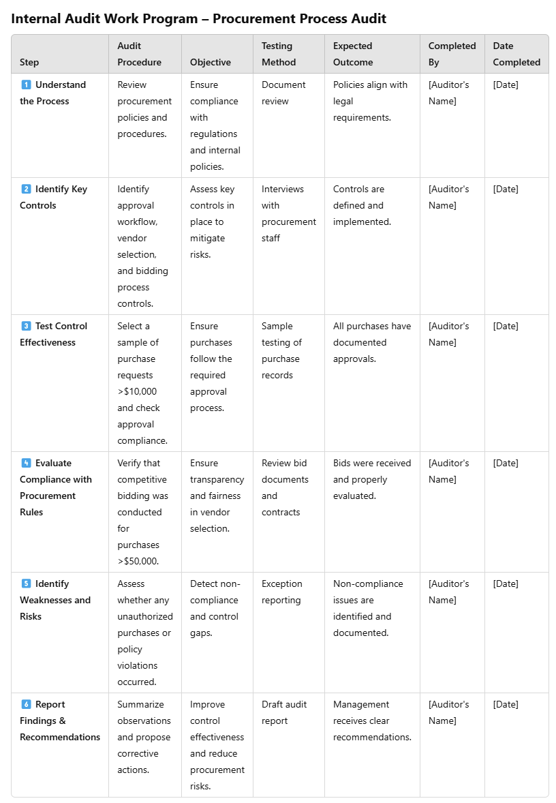
Overview of the Assurance Engagement Process- Planning (Step 7)
Step 7: Develop a work program.
Example: Internal Audit Work Program – Procurement Process Audit

Slide 18
Overview of the Assurance Engagement Process- Planning (Step 8)
Step 8: Allocate resources to the engagement.
  This involves determining the audit expertise needed, estimating the time it will take to complete the engagement, assigning appropriate internal auditors to the engagement, and scheduling the work so that it is completed timely.

Slide 19
Overview of the Assurance Engagement Process- Performing
Performing (3 steps):
Conduct tests to gather evidence.
Evaluate audit evidence gathered and reach conclusions.
Develop observations and formulate recommendations.

Slide 20
Overview of the Assurance Engagement Process- Performing (Step 1)
Step 1: Conduct tests to gather evidence.
Performing the engagement involves the application of specific audit procedures to gather evidence. Procedures include, for example, making inquiries, observing operations, inspecting documents, and analyzing the reasonableness of information.
A second important aspect of gathering evidence is documenting the procedures performed and the results of performing the procedures.

Slide 21
Overview of the Assurance Engagement Process- Performing (Step 2)
Step 2: Evaluate audit evidence gathered and reach conclusions.
Evaluating the audit evidence gathered to determine, for example, whether controls are designed adequately and operating effectively requires a significant degree of professional judgment. The internal audit team must ultimately reach logical conclusions (that is, make informed decisions)

Slide 22
Overview of the Assurance Engagement Process- Performing (Step 3)
Step 3: Develop observations and formulate recommendations.
Observations (also referred to as findings) are pertinent statements of fact that emerge when criteria (the correct state) are compared with the condition (the current state).
  Well-written audit observations contain the following elements:
    Criteria: Standards, measures, or expectations used in making an evaluation and/or verification of an observation (what should exist).
    Condition: Factual evidence is identified during the course of the engagement (what does exist).
    Cause: Underlying reason for the difference between the criteria and condition (why the difference exists).
    Effect: Risk or exposure encountered because the condition is not consistent with the criteria (the consequence of the difference).

Slide 23
Overview of the Assurance Engagement Process- Performing (Step 3)
Step 3: Develop observations and formulate recommendations.
Recommendations are:
  based on the internal auditor’s observations and conclusions.
  Also called proposed corrective actions or the fifth C in some frameworks.
  Documented within the audit observation or separately.
Purpose of Recommendations
  Close the gap between criteria (expected standard) and condition (actual state).
  Address root causes of the issue, not just symptoms.
  Provide long-term solutions rather than short-term fixes.
Effective Recommendations Should Be:
✅ Root-cause focused – Solve the actual problem, not just its effects.
✅ Sustainable – Offer lasting improvements.
✅ Economically feasible – Benefits outweigh the costs.
⚠️ Weak recommendations only treat symptoms, making them of little value!

Slide 24
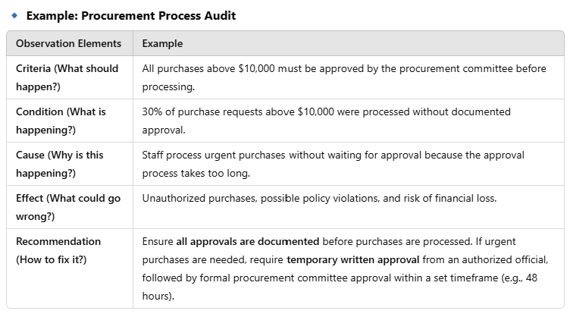
Overview of the Assurance Engagement Process- Performing (Step 3)
Step 3: Develop observations and formulate recommendations.

Slide 25
Overview of the Assurance Engagement Process- Communicating
Communication of engagement outcomes “must be accurate, objective, clear, concise, constructive, complete, and timely” (IIA Standard 2420: Quality of Communications).
Communicating (5 steps):
Perform observation evaluation and escalation process.
Conduct interim and preliminary engagement communications.
Develop final engagement communications.
Distribute formal and informal final communications.
Perform monitoring and follow-up procedures.

Slide 26
Overview of the Assurance Engagement Process- Communicating (Step 1)
Step 1: Perform observation evaluation and escalation process.
Once one or more observations are identified, the internal audit team must assess each observation using an evaluation and escalation process and determine the implications those observations have on the resulting communications for the area (process) under review.

Slide 27
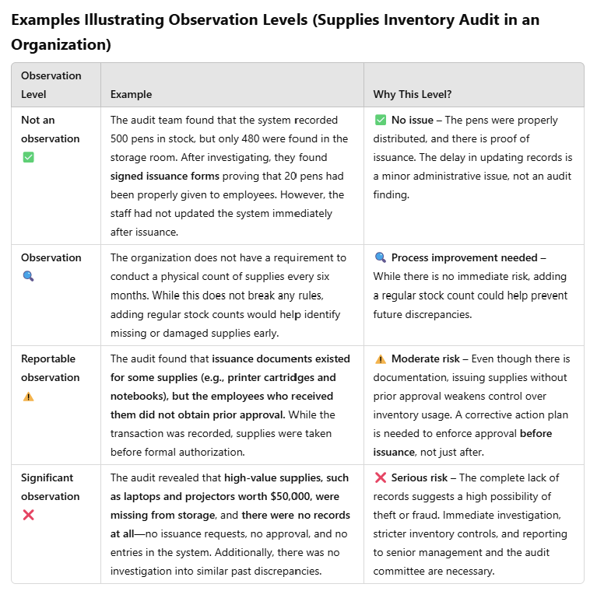
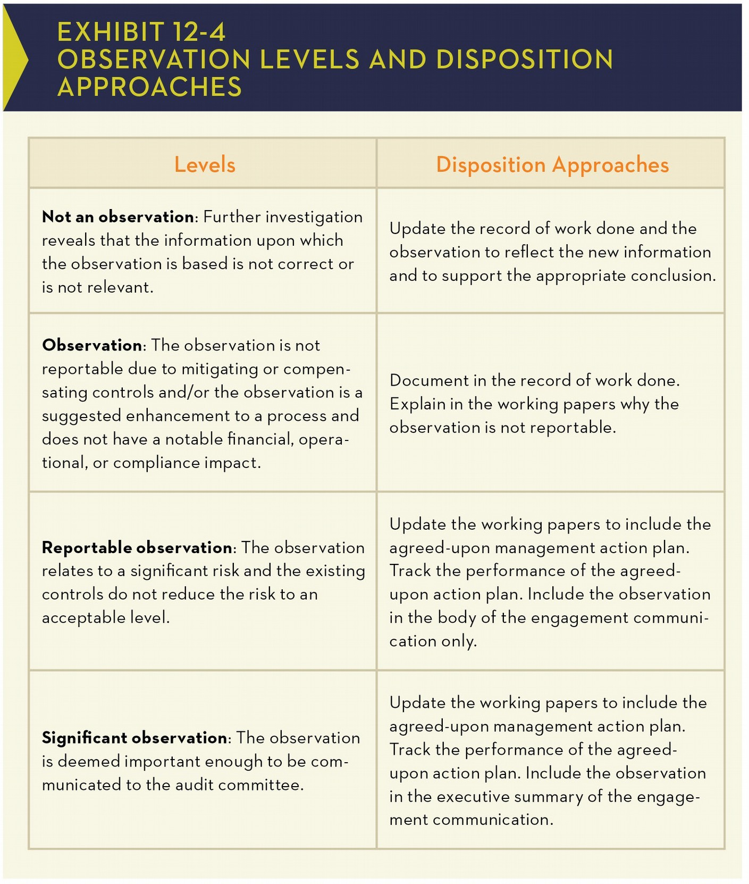
Overview of the Assurance Engagement Process- Communicating (Step 1)
Step 1: Perform observation evaluation and escalation process.

Slide 28
Overview of the Assurance Engagement Process- Communicating (Step 2)
Step 2: Conduct interim and preliminary engagement communications.
Internal audit communications occur throughout the engagement, not just at the end.
Matters often arise during internal audit engagements that warrant management’s immediate or short-term attention.
Timely communication of such matters allows management to address and resolve them sooner, sometimes before the engagement is completed.
  Example:
  Imagine an audit of the payroll process where you discover that some terminated employees are still receiving salaries. Instead of waiting for the final report, you communicate this to management immediately so they can stop the payments and investigate the issue.
Reviewing draft versions of the report with management provides assurance that they concur with what the internal auditors have said and what they have written in their report.
  Example:
  During an audit, the internal auditor finds several purchase orders missing approval records. Before reporting it as a compliance issue, they meet with management, who provides email approvals that weren’t uploaded to the system. This clarification prevents an inaccurate finding and instead highlights a documentation process gap.

Slide 29
Overview of the Assurance Engagement Process- Communicating (Step 3)
Step 3: Develop final engagement communications.
At this point, the internal audit team is ready to consolidate and synthesize all the evidence gathered during the engagement.
There is no single prescribed way for expressing overall engagement results. Options include:
  No assurance: Listing and prioritizing control observations but stopping short of reaching an overall conclusion or expressing any level of assurance regarding the effectiveness of the auditee’s controls.
  Negative Assurance: Reaching a conclusion known as negative assurance (also referred to as limited assurance). Internal auditors express negative assurance when they conclude that nothing has come to their attention that indicates that the auditee’s controls are designed inadequately or operating ineffectively.
  Positive Assurance: Reaching a conclusion known as positive assurance (also referred to as reasonable assurance). Internal auditors express positive assurance when they conclude that, in their opinion, the auditee’s controls are designed adequately and operating effectively.

Slide 30
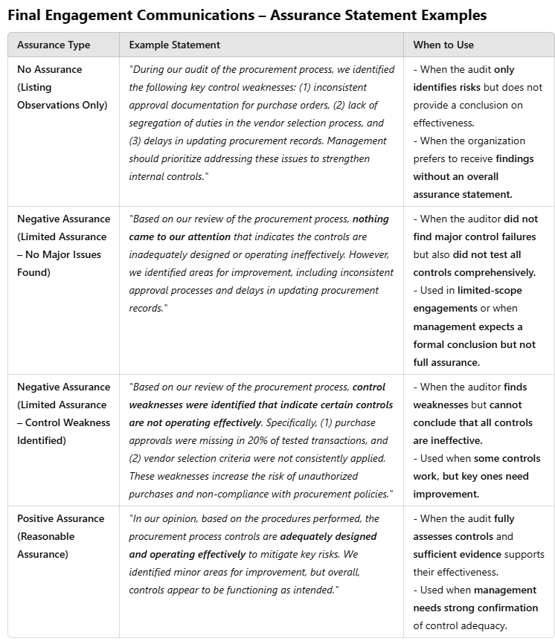
Overview of the Assurance Engagement Process- Communicating (Step 3)
Step 3: Develop final engagement communications. (Example)

Slide 31
Overview of the Assurance Engagement Process- Communicating (Step 4)
Step 4: Distribute formal and informal final communications.
According to the IIA’s Standards:
Communications must include the engagement’s objectives, scope, and results. (Standard 2410– Criteria for Communicating)
  Final communication of engagement results must include applicable conclusions, as well as applicable recommendation and/or action plans. Where appropriate, the internal auditors’ opinion should be provided. An opinion must take into account the expectations of senior management, the board, and other stakeholders and must be supported by sufficient, reliable, relevant, and useful information.(Standard 2410.A1)
  Internal auditors are encouraged to acknowledge satisfactory performance in engagement communications. .(Standard 2410.A2)
  When releasing engagement results to parties outside the organization, the communication must include limitations on distribution and use of the results.(Standard 2410.A3)
The chief audit executive must communicate results to the appropriate parties. (Standard 2440 – Disseminating Results)
  The chief audit executive is responsible for communicating the final results to parties who can ensure that the results are given due consideration. (Standard 2440.A1)
  If not otherwise mandated by legal, statutory, or regulatory requirements, prior to releasing results to parties outside the organization the chief audit executive must: (Standard 2440.A1)
    Assess the potential risk to the organization.
    Consult with senior management and/or legal counsel as appropriate.
    Control dissemination by restricting the use of the results

Slide 32
Overview of the Assurance Engagement Process- Communicating
Step 5: Perform monitoring and follow-up procedures.
The assurance engagement process does not end with reporting.
It is very important for the internal audit function to determine that corrective actions on engagement observations and recommendations were, in fact, taken by management and that the actions taken remedy the underlying conditions in a timely manner.
The internal audit charter should define the internal audit function’s responsibility for follow-up, and the CAE should determine the nature, timing, and extent of follow up procedures appropriate for a particular engagement.

Slide 33

Overview of the Consulting Engagement Process
Internal audit consulting engagements differ from assurance engagements in certain ways, including:
Whereas the nature and scope of an assurance engagement are determined by the internal audit function, the nature and scope of a consulting engagement are subject to agreement with the engagement client.
Consulting engagements are, accordingly, much more discretionary in nature than assurance engagements. As indicated in the Glossary to the Standards, consulting services include “counsel, advice, facilitation, and training.”

Slide 34
Overview of the Consulting Engagement Process
The consulting engagement process includes the same steps as the assurance engagement process.
However, the difference is that each step may not be necessary for every consulting engagement, and many of the steps may be conducted differently.
The three major phases of the engagement:
  Engagement planning
    “Internal auditors must develop and document a plan for each [consulting] engagement, including the engagement’s objectives, scope, timing, and resource allocations” (IIA Standard 2200: Engagement Planning).
  Performing the engagement
    “Internal auditors must identify, analyze, evaluate, and document sufficient information to achieve the [consulting] engagement’s objectives” (IIA Standard 2300: Performing the Engagement).
  Communicating results
    “Internal auditors must communicate the results [consulting] engagements” (IIA Standard 2400: Communicating Results).
    However, “communication of the progress and results of consulting engagements will vary in form and content depending upon the nature of the engagement and the needs of the [customer]” (Standard 2410.C1).

Slide 35
Overview of the Consulting Engagement Process-Phase 1: Planning
Phase 1: Engagement planning
📌 Assurance Engagement:
The auditor sets specific objectives based on risk assessments, compliance requirements, and internal controls.
The scope is independent of management's input, ensuring objectivity and alignment with audit standards.
Example: The audit team plans to assess the procurement process for compliance with policies and fraud risks.
📌 Consulting Engagement:
The scope and objectives are based on management's request (e.g., process improvements, efficiency recommendations).
The engagement is more flexible, allowing adjustments based on discussions with management.
Example: Management requests advice on streamlining procurement approval workflows to reduce delays.

Slide 36
Overview of the Consulting Engagement Process- Phase 2: Performing
Phase 2: Performing the engagement
📌 Assurance Engagement:
The auditor follows predefined procedures, such as testing controls, verifying compliance, and identifying risks.
The approach is formal and evidence-driven, requiring audit testing and documentation.
Example: Testing procurement transactions to verify whether approvals were obtained before issuing purchase orders.
📌 Consulting Engagement:
The internal auditor collaborates with management, offering expertise and recommendations without performing strict control testing.
More interactive and problem-solving oriented, focusing on identifying best practices.
Example: Interviewing procurement staff and recommending an automated approval workflow for efficiency.

Slide 37
Overview of the Consulting Engagement Process- Phase 3-Communicating
Phase 3: Communicating the engagement
📌 Assurance Engagement:
The final report contains formal conclusions, audit opinions, and recommendations that management is expected to implement.
The report may be shared with governance bodies (e.g., audit committee).
Example: The audit report concludes that procurement controls are weak and recommends implementing a stricter approval matrix.
📌 Consulting Engagement:
The final communication is more informal and advisory, focusing on helping management make improvements.
It may include meetings, presentations, or summary reports with tailored recommendations.
Example: Providing management with a report suggesting improvements in procurement approval efficiency and offering training on best practices.

Slide 38
End of Chapter

